Slide 1
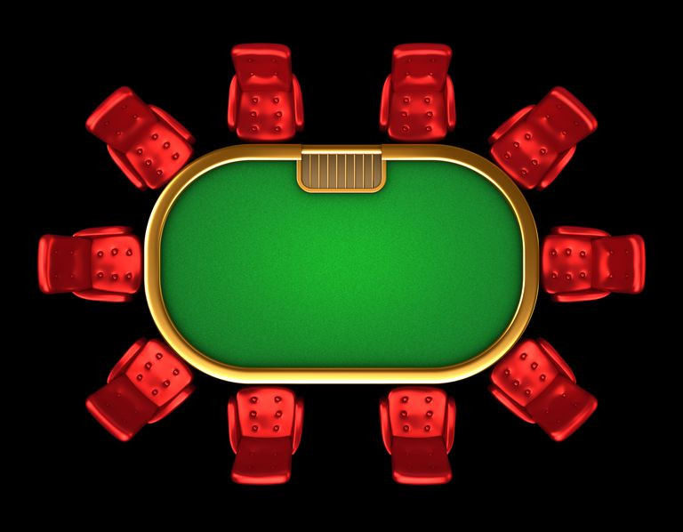
Riverboat Gambling

Slide 2
Texas hold’em

Slide 3
How to play
Choose a dealer
The buckskin knife is the ‘dealer token’
Give each player 2 cards
The next player is the small blind
They must pay half of the ante
The following player is the big blind
They must pay the ante

Slide 4
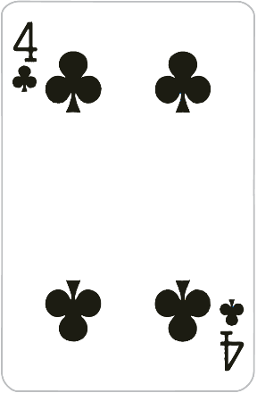
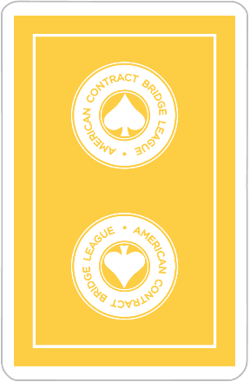
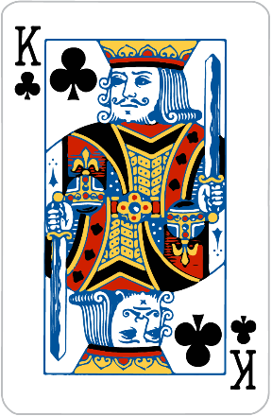
How to play
Everyone looks at their two secret cards.
(one round of betting)

Slide 5
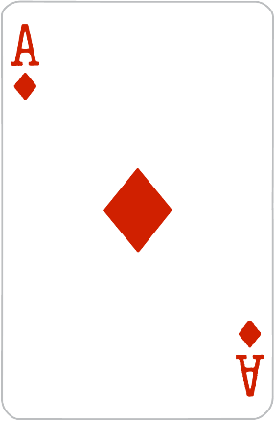
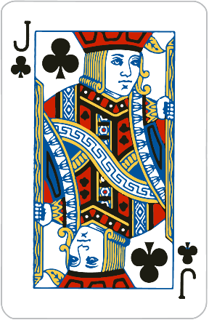
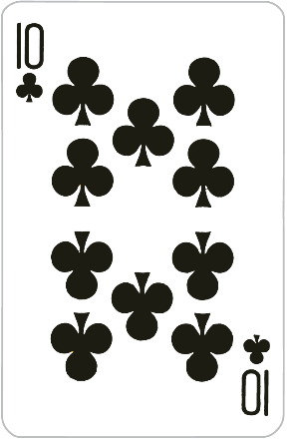
How to play
The dealer reveals three cards
(one round of betting)

Slide 6
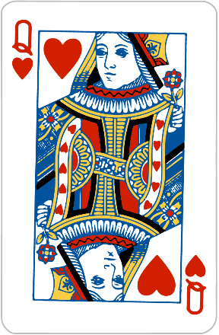
How to play
The dealer reveals 1 more card
(one round of betting)

Slide 7
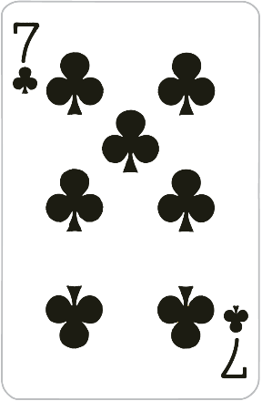
How to play
The dealer reveals the last card
(one round of betting)

Slide 8
How to play
Using a combination of your two cards and the five shared cards, determine what is your best hand.
Whoever was the last player to bet shows their hand
Any player that has a better hand shows their hand
Whoever has the best hand takes the chips from the center of the table.

Slide 9
Betting

Slide 10
Betting
Check = If there were no previous bets, you can pass your turn.
Call = match a previous bet
Raise = increase the total bet
Fold = Discard your hand without matching the bet.

Slide 11
Betting
You cannot raise your own bet
If another player raises it after you, then you can raise it again
Betting continues until all players have called or folded a bet.

Slide 12
CHIPS

Slide 13
Chips
White = $1
Red = $5
Green = $10
Blue = $25
Black = $50
Start with 5 white, 4 red, 3 green, 2 blue, and 1 black chip.

Slide 14
Riverboat Gambling
If you use a phrase from handout, you can take an extra White Chip.
Must be used correctly and in context.
The other players can dispute its use.

Slide 15
Gambling Phrases

Slide 16
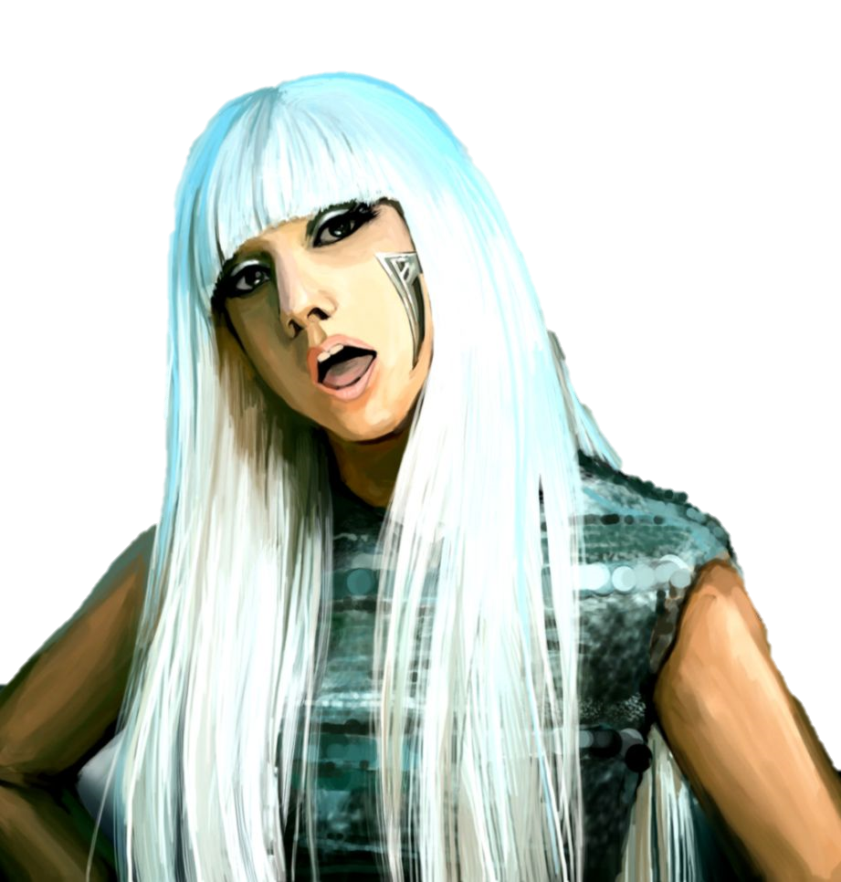
Poker face
Not showing emotion

Slide 17
I’ll call.
Same meaning.

Slide 18
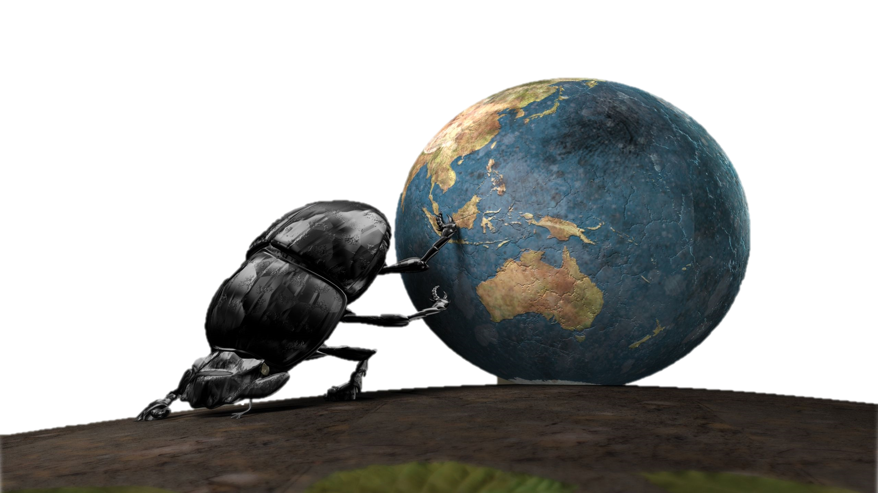
I’m all in.
I’m giving all of my effort.

Slide 19
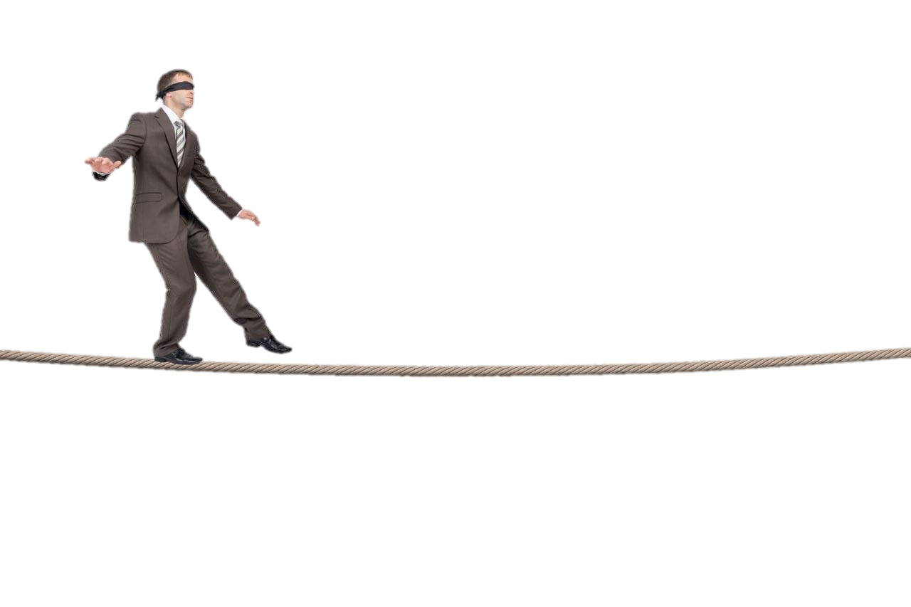
All the chips are down.
I’m risking everything

Slide 20
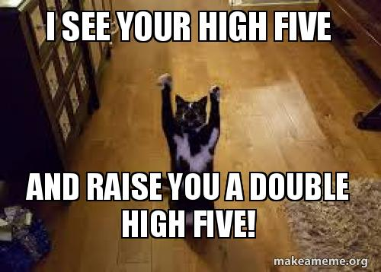
I see you and I raise you
Used when you don’t believe someone.

Slide 21
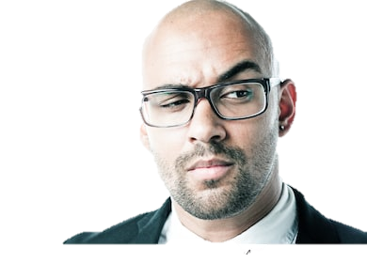
I’ll call your bluff.
You’re lying so I’ll make you prove it.

Slide 22
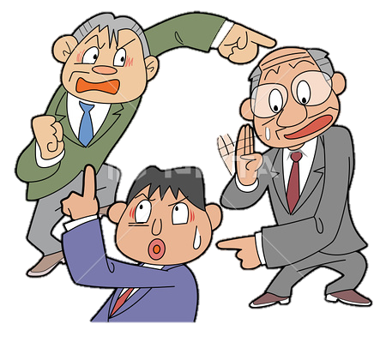
Pass the buck
Give responsibility to someone else.

Slide 23
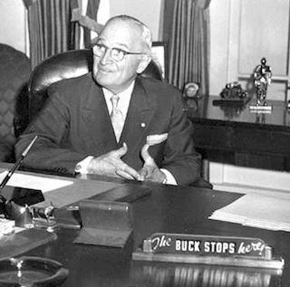
The buck stops here
Accepting responsibility

Slide 24
Square deal / Fair deal
It seems fair to me / President Truman

Slide 25
New deal
President Roosevelt

Slide 26
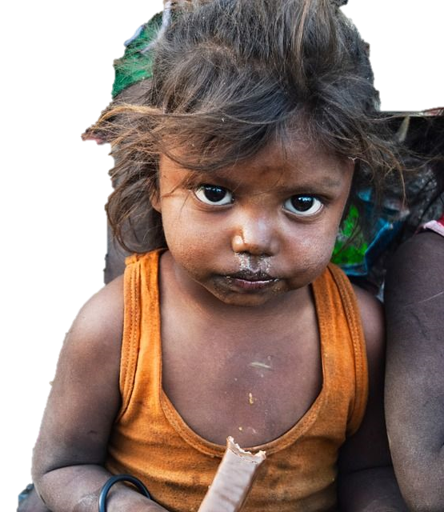
Raw deal
You are given a very bad situation

Slide 27
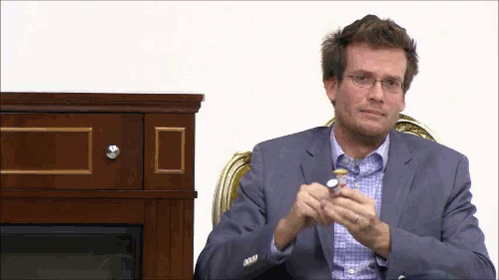
Big deal / No big deal
(sarcastic) VIP / it was easy for me

Slide 28
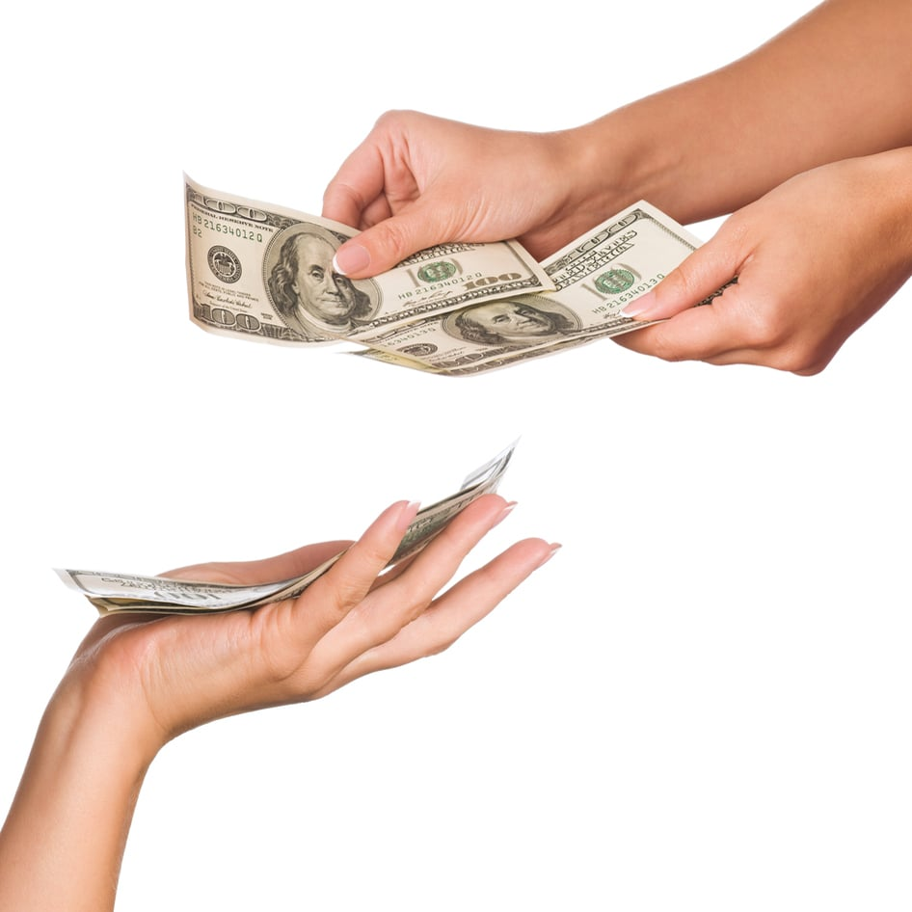
Ante up
Give me money

Slide 29
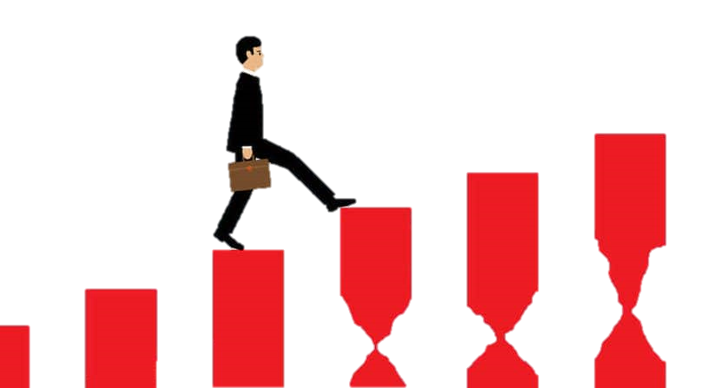
Up the ante
Increase the risk / reward

Slide 30
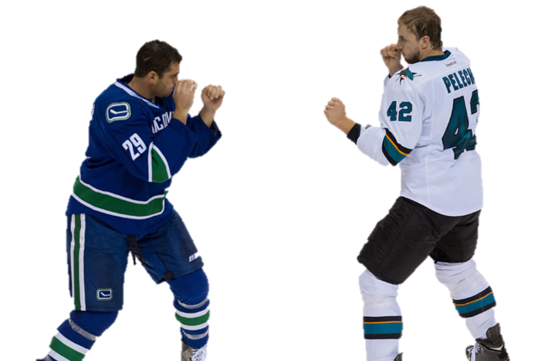
Put up or shut up!
Prove it or remain silent

Slide 31
You bet!
Affirmative!!

Slide 32
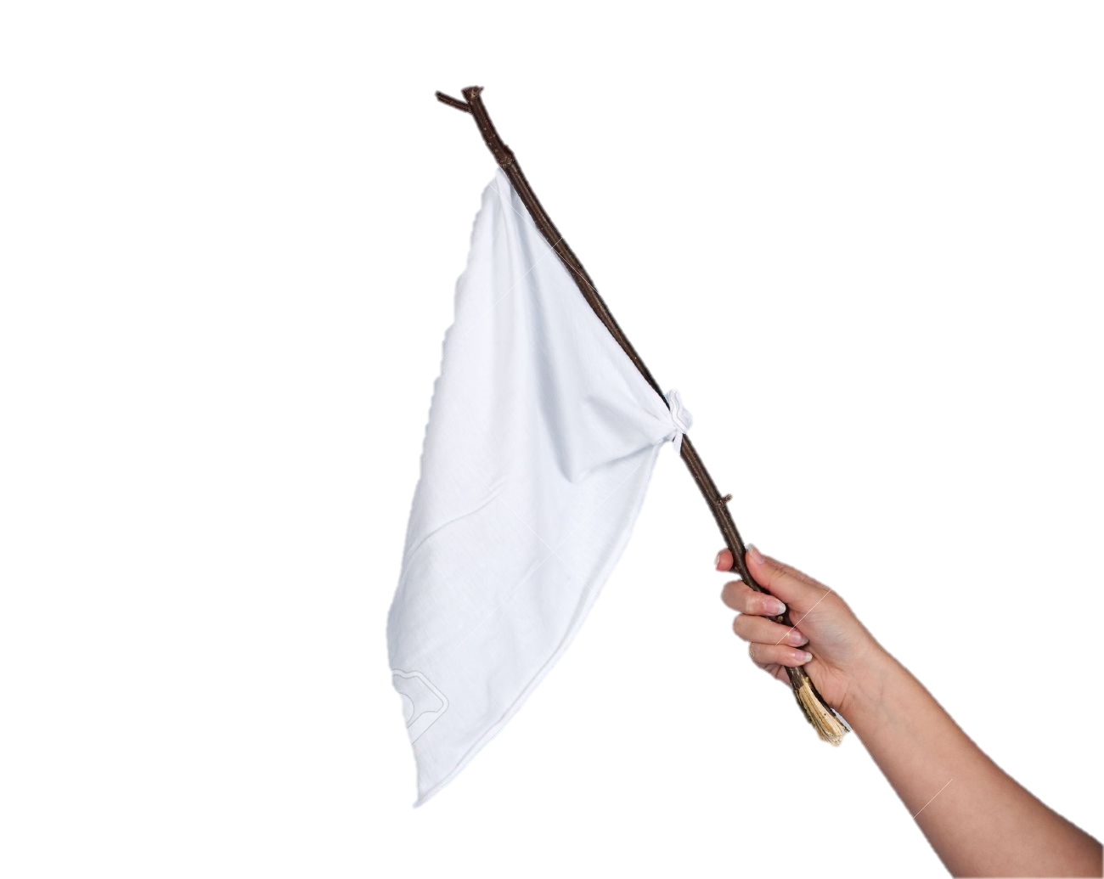
She’s throwing in her hand.
She gave up.

Slide 33
The cards are stacked against me.
It’s impossible and out of my control.

Slide 34
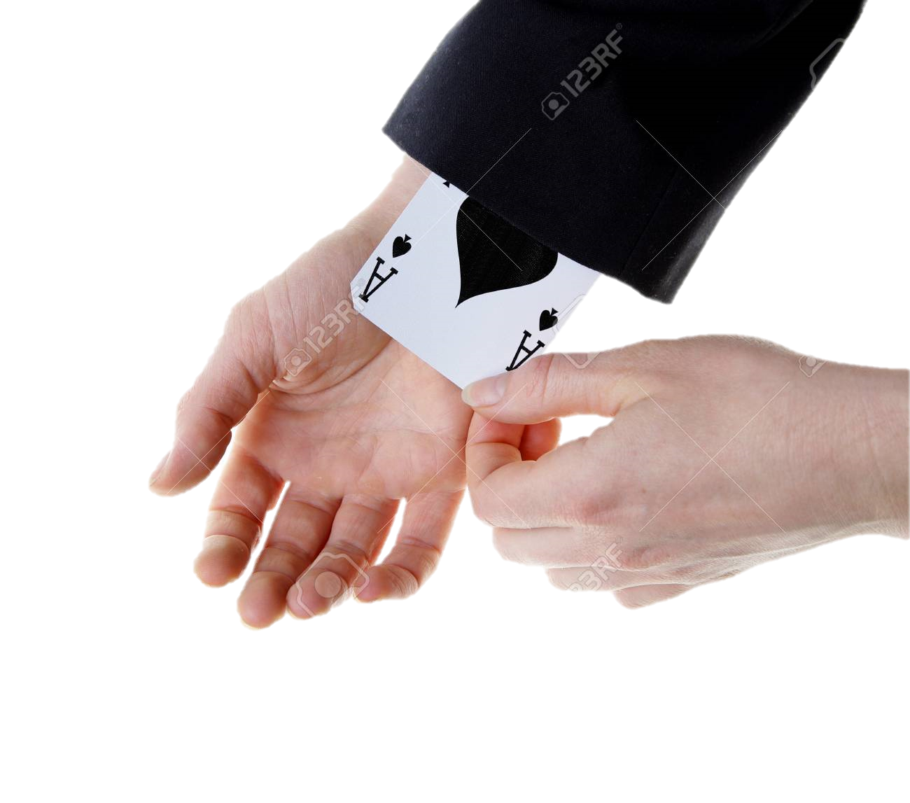
You have an ace up your sleeve.
You are very lucky (too lucky?)

Slide 35
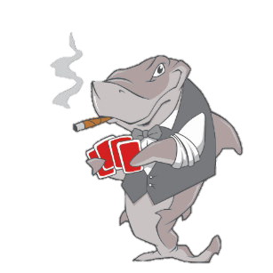
Card Sharp (Card Shark)
A professional (or cheater)

Slide 36
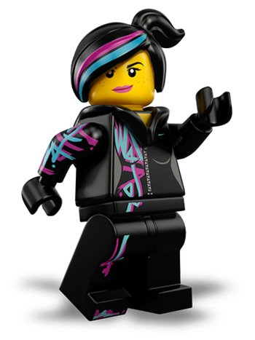
Wild Card
Unpredictable person

