Slide 1
Redneck Jokes
RED
NECK
jokes

Slide 2
Who are they?
Too poor to take the riverboat.
Work hard
Red from sun

Slide 3
Stereotypes
Poor
Stupid
Racist
Violent
Loud
Inbred
Uncivilized
Uneducated

Slide 4
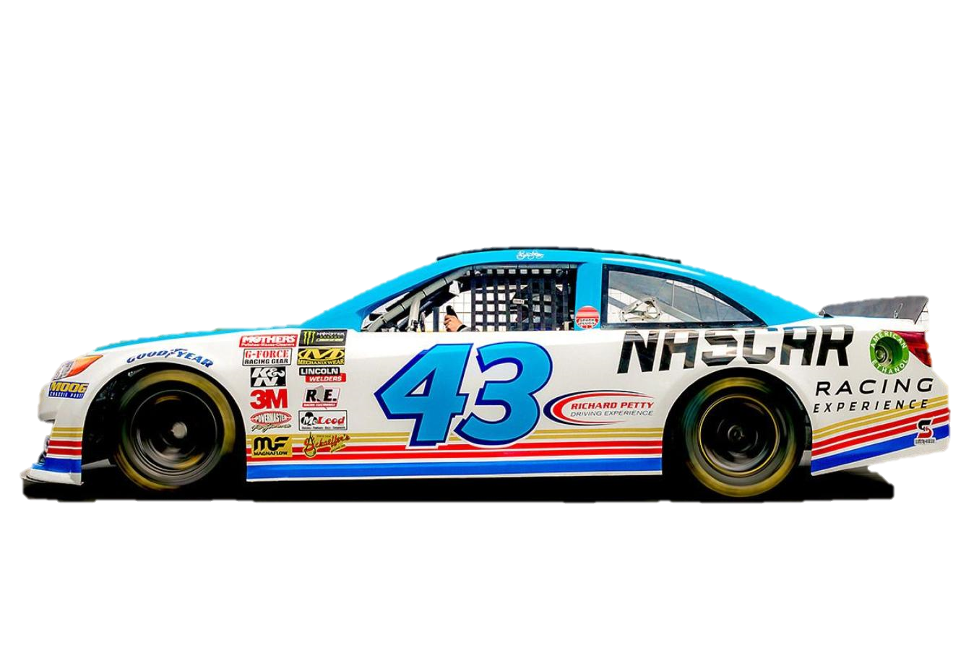
Stereotypes
They love:
Alcohol
Trucks
Country music
Tobacco
Unhealthy Food
NASCAR
America
God
Guns

Slide 5
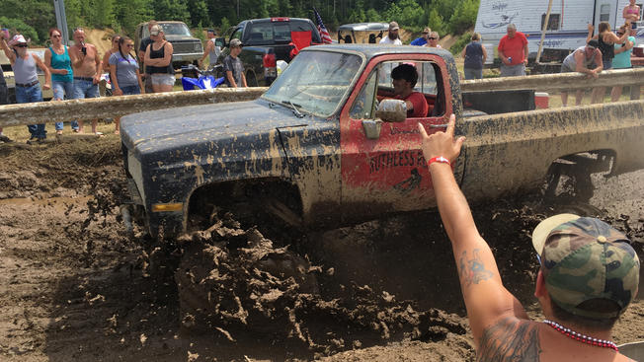

Slide 6
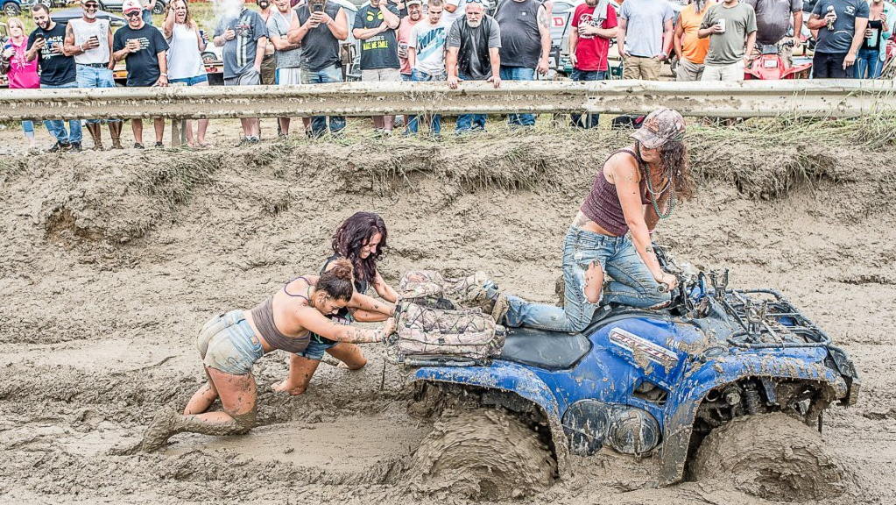

Slide 9
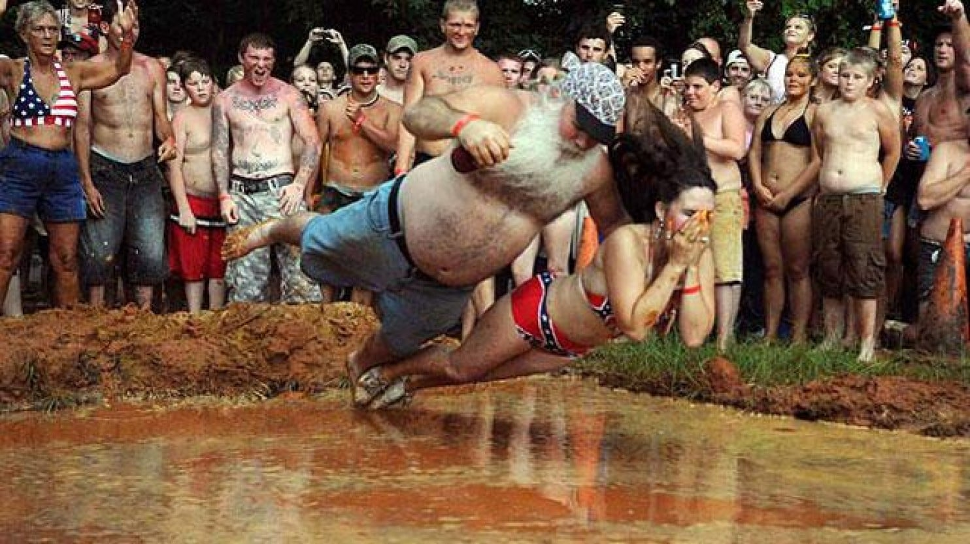

Slide 10
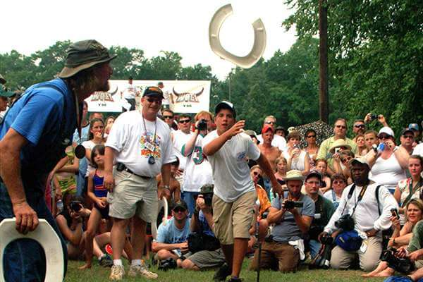

Slide 11
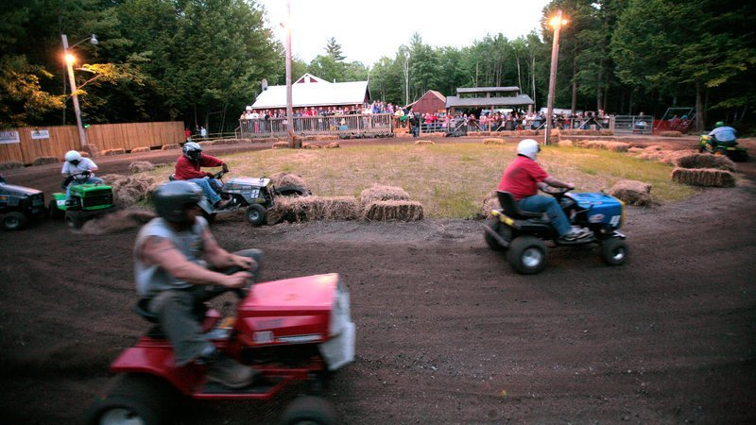

Slide 13
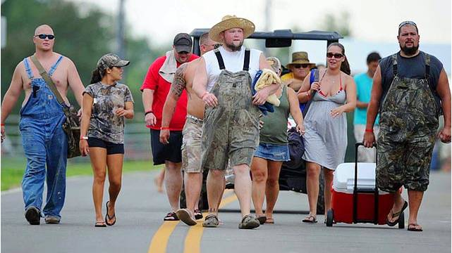

Slide 14
Redneck Jokes
RED
NECK
solutions

Slide 15
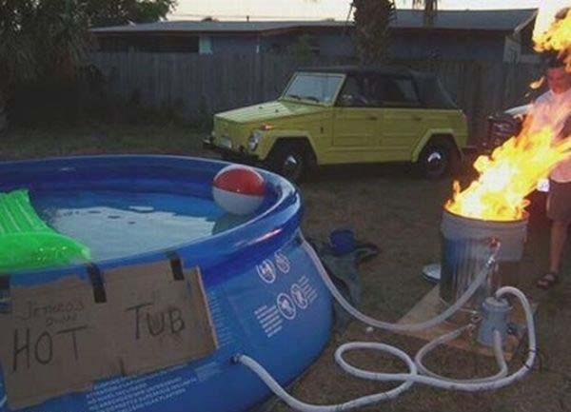
Redneck Solutions

Slide 16
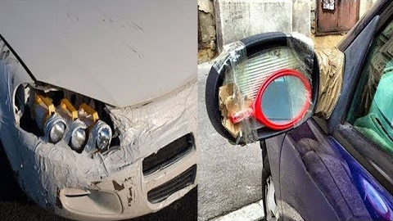
Redneck Solutions

Slide 17
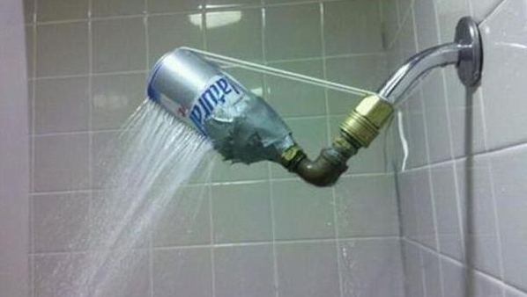
Redneck Solutions

Slide 18
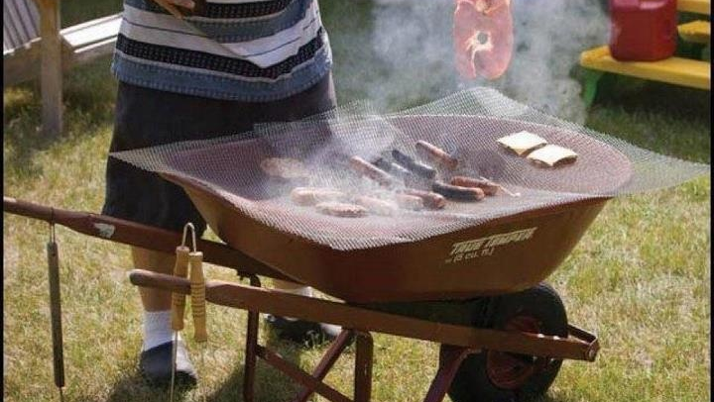
Redneck Solutions

Slide 19
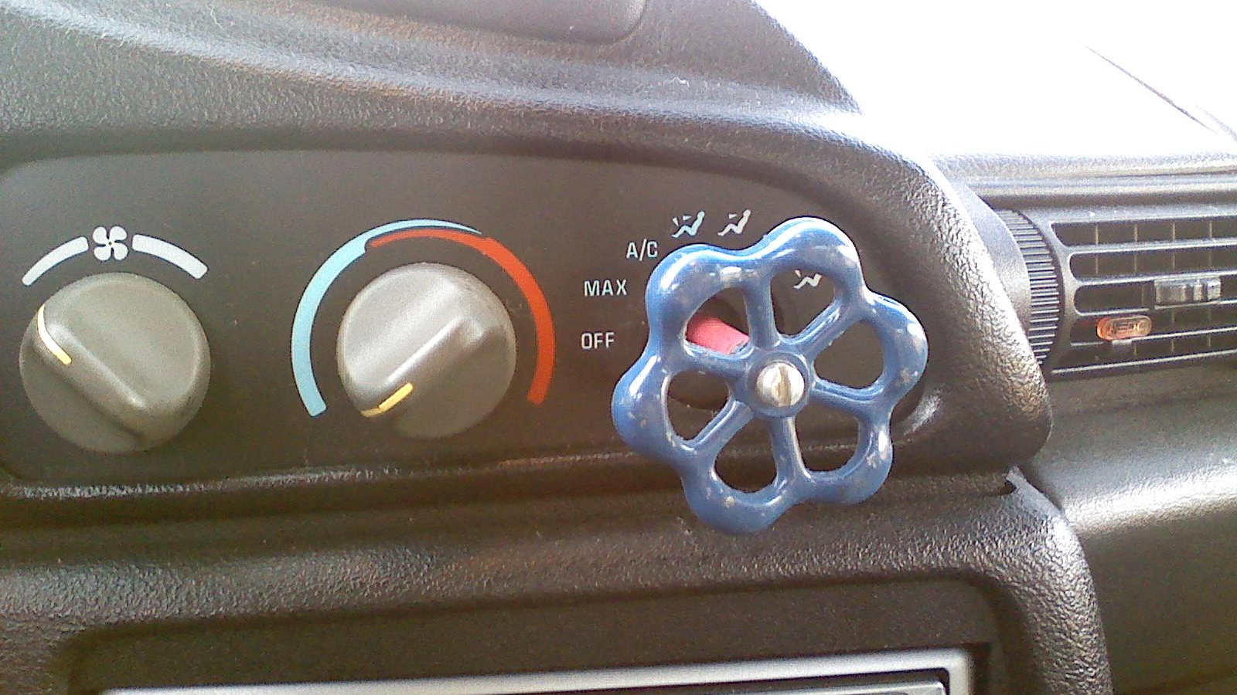
Redneck Solutions

Slide 20
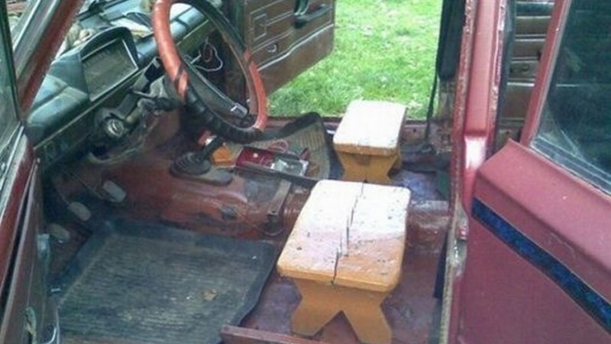
Redneck Solutions

Slide 21
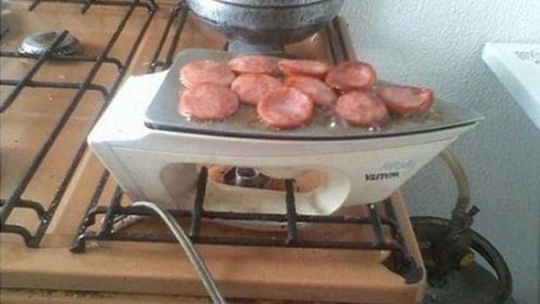
Redneck Solutions

Slide 22
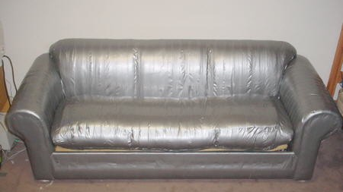
Redneck Solutions

Slide 23
Redneck Solutions

Slide 24
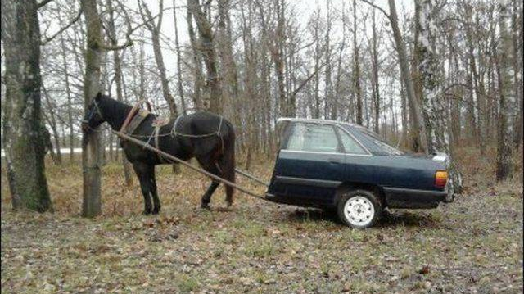
Redneck Solutions

Slide 25
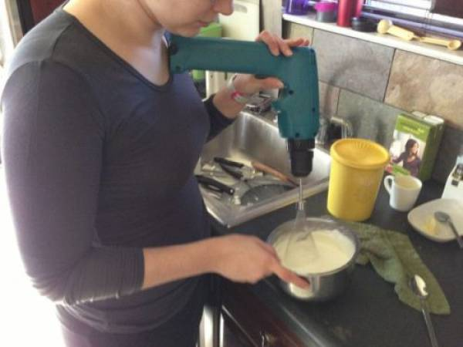
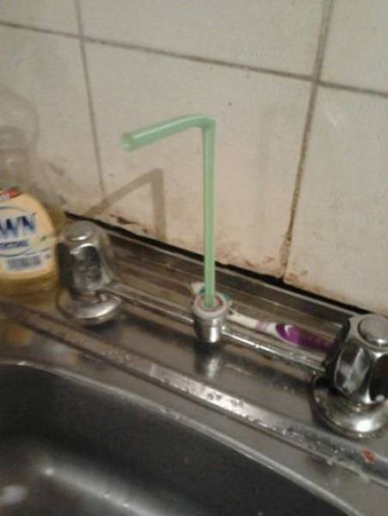
Redneck Solutions

Slide 26
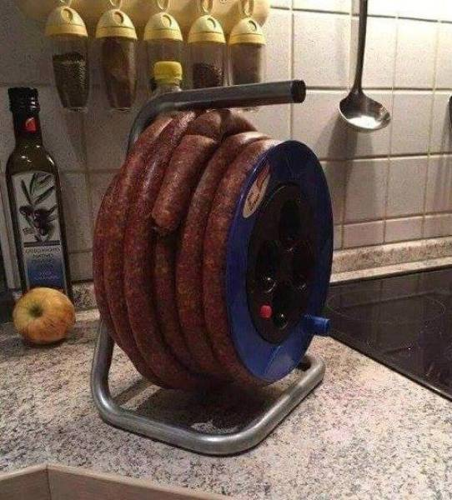
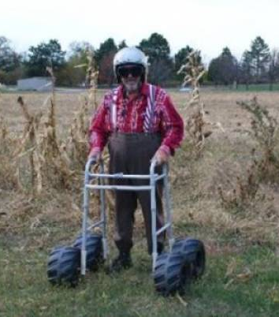
Redneck Solutions

Slide 27
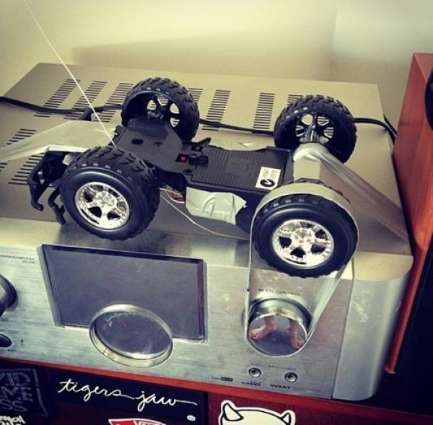
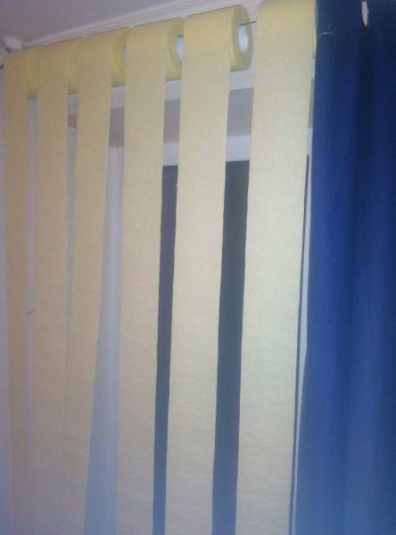
Redneck Solutions

Slide 28
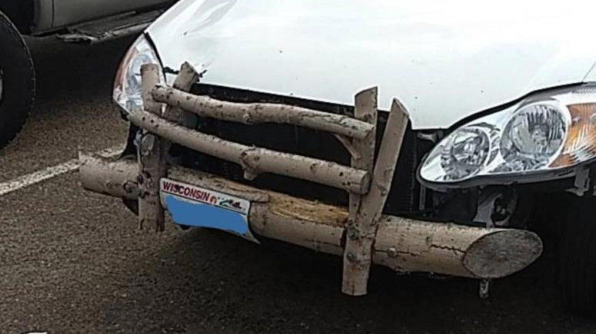
Redneck Solutions

Slide 29
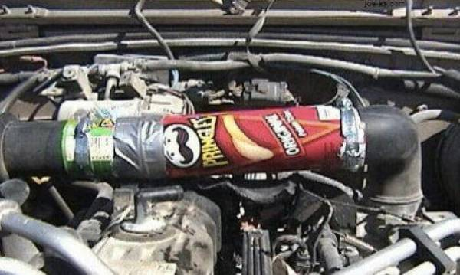
Redneck Solutions

Slide 30
Jeff Foxworthy

Slide 31
Taking back stereotypes
Part of the in-group
Take it to an extreme
True enough, but not personal

Slide 32
If you ever cut your grass and found a car…
you might be a redneck.

Slide 33
If your dad walks you to school because you are in the same grade…
you might be a redneck.

Slide 34
If birds are attracted to your beard…
you might be a redneck.

Slide 35
If you’ve been married twice but have the same in-laws…
you might be a redneck.

Slide 36
If you lost more than two teeth opening bottles of beer…
you might be a redneck.

Slide 37
If directions to your house include, “turn off the paved road”…
you might be a redneck.

Slide 38
If you ever hit a deer deliberately…
you might be a redneck.

Slide 39
If you ever stole toilet paper…
you might be a redneck.

Slide 40
If your brother-in-law is your uncle…
you might be a redneck.

Slide 41
If you own a fridge dedicated to kimchi…
you might be a Korean.

Slide 42
Create Your Own Joke
You might be a Korean
You might be a Canadian

Slide 43
Redneck Jokes
TROY
JOKES

Slide 44
If you bring ramen with you on vacation,
you might be a Korean

Slide 45
If you wear more makeup than your girlfriend,
you might be a Korean

Slide 46
If your boyfriend also has a handbag,
you might be a Korean

Slide 47
If your toilet paper is made by an electronics company
you might be a Korean

