Slide 1
to make a
HOW

Slide 3
Think & Write
A difficult situation

Slide 4
Characters

Slide 5
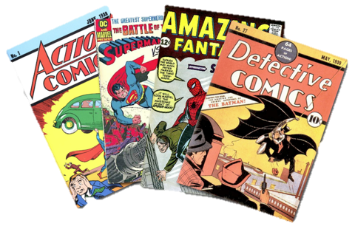
Characters

Slide 6
Think & Write
5-10 Character Names

Slide 7
Homer Simpson
Characters
Ironman

Slide 8
Think & Write
Good Qualities

Slide 9
kind
loyal
caring
Homer Simpson
Characters
Ironman
brave
stoic
intelligent

Slide 10
Think & Write
Flaws

Slide 11
kind
loyal
caring
Homer Simpson
narcissistic
Characters
selfish
lazy
stupid
Ironman
brave
alcoholic
stoic
intelligent

Slide 12
Character Flaws

Slide 13
Why do we like characters with flaws?
Resent Perfection
Relatable
Might Fail
Something to overcome
Human

Slide 14
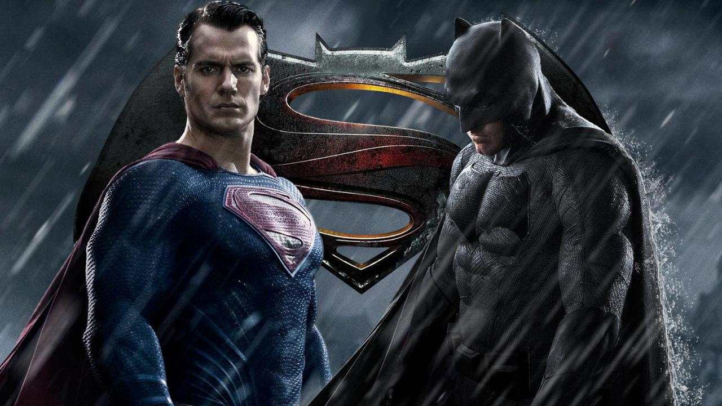

Slide 15
Examples?

Slide 16
Archetypes

Slide 17
Choose an Archetype
Strengths
Flaws
Motivation
Examples
https://nofilmschool.com/12-character-archetypes-for-your-screenplay

Slide 18
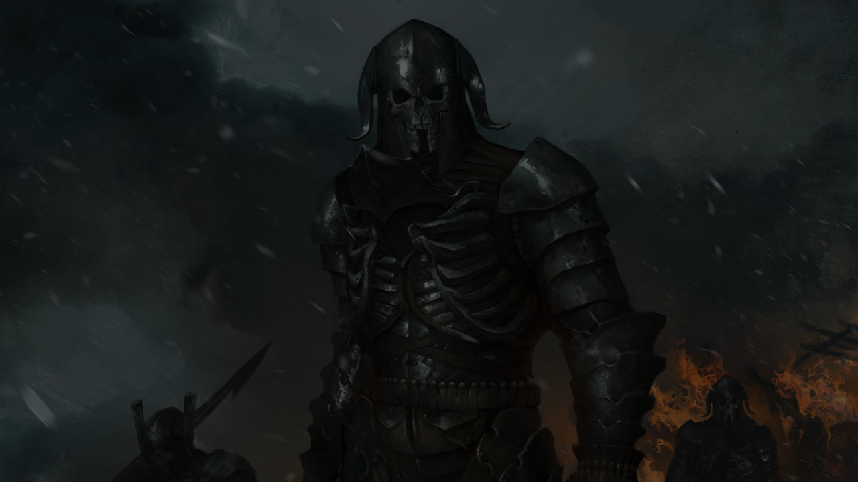
The Warrior
Better with a sword and a speech, the warrior is usually the person with the plan. A traditional hero in every sense of the word, they're there to rally the troops and take them into battle. Or to rob a casino. Or out of Egypt. Or across No Man's Land to save troops on the other side.

Slide 19
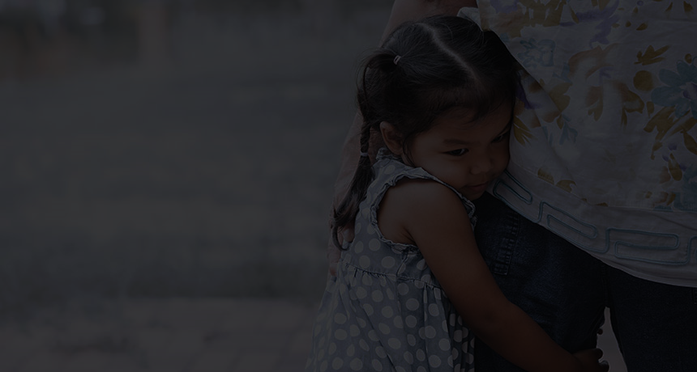
The Child
Ever think the world was one way and then get a dose of harsh reality? That's the story of the Child. They're young, naive, and need to learn the hard way.

Slide 20
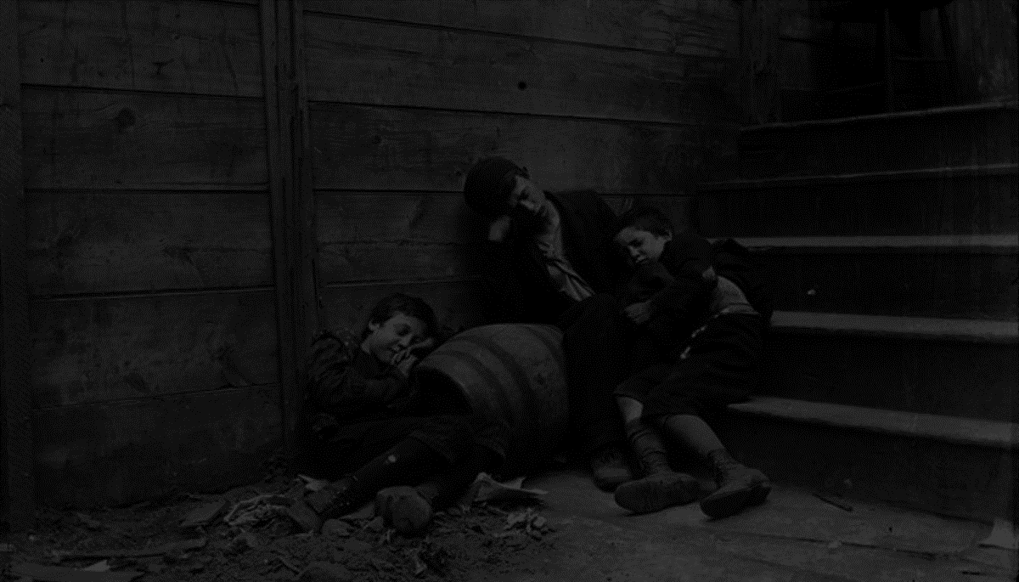
The Orphan
The orphan has no idea their worth until someone shows up and tells them. They're usually anointed as the savior or protagonist of the story. They live a normal life until their circumstances thrust them into the spotlight.

Slide 21
The Creator
What's it like to create something from nothing? This character needs to create something palpable or tangible in their world. They'll make any sacrifice necessary to achieve something grander than the world they have now.

Slide 22
The Caregiver
Selfless acts are rare in real life and even rarer in film and television. The caregiver character archetype lives their entire journey trying to help others at all costs. They care about friends, family, or all of the above more than anything else. You can rely on them.

Slide 23
The Mentor
We've said this before, it's hard to succeed in Hollywood without a mentor. The same goes for archetypes. Mentors or sages are wise teachers. They can have magic or logic or both.

Slide 24
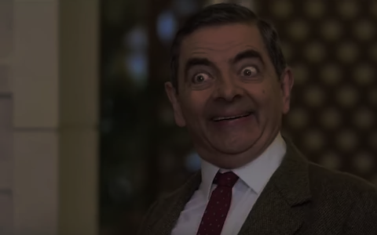
The Joker
This is the class clown or the stoner. The person just trying to get by in life and comic relief. They can be a cautionary tale or just there for the laughs.

Slide 25
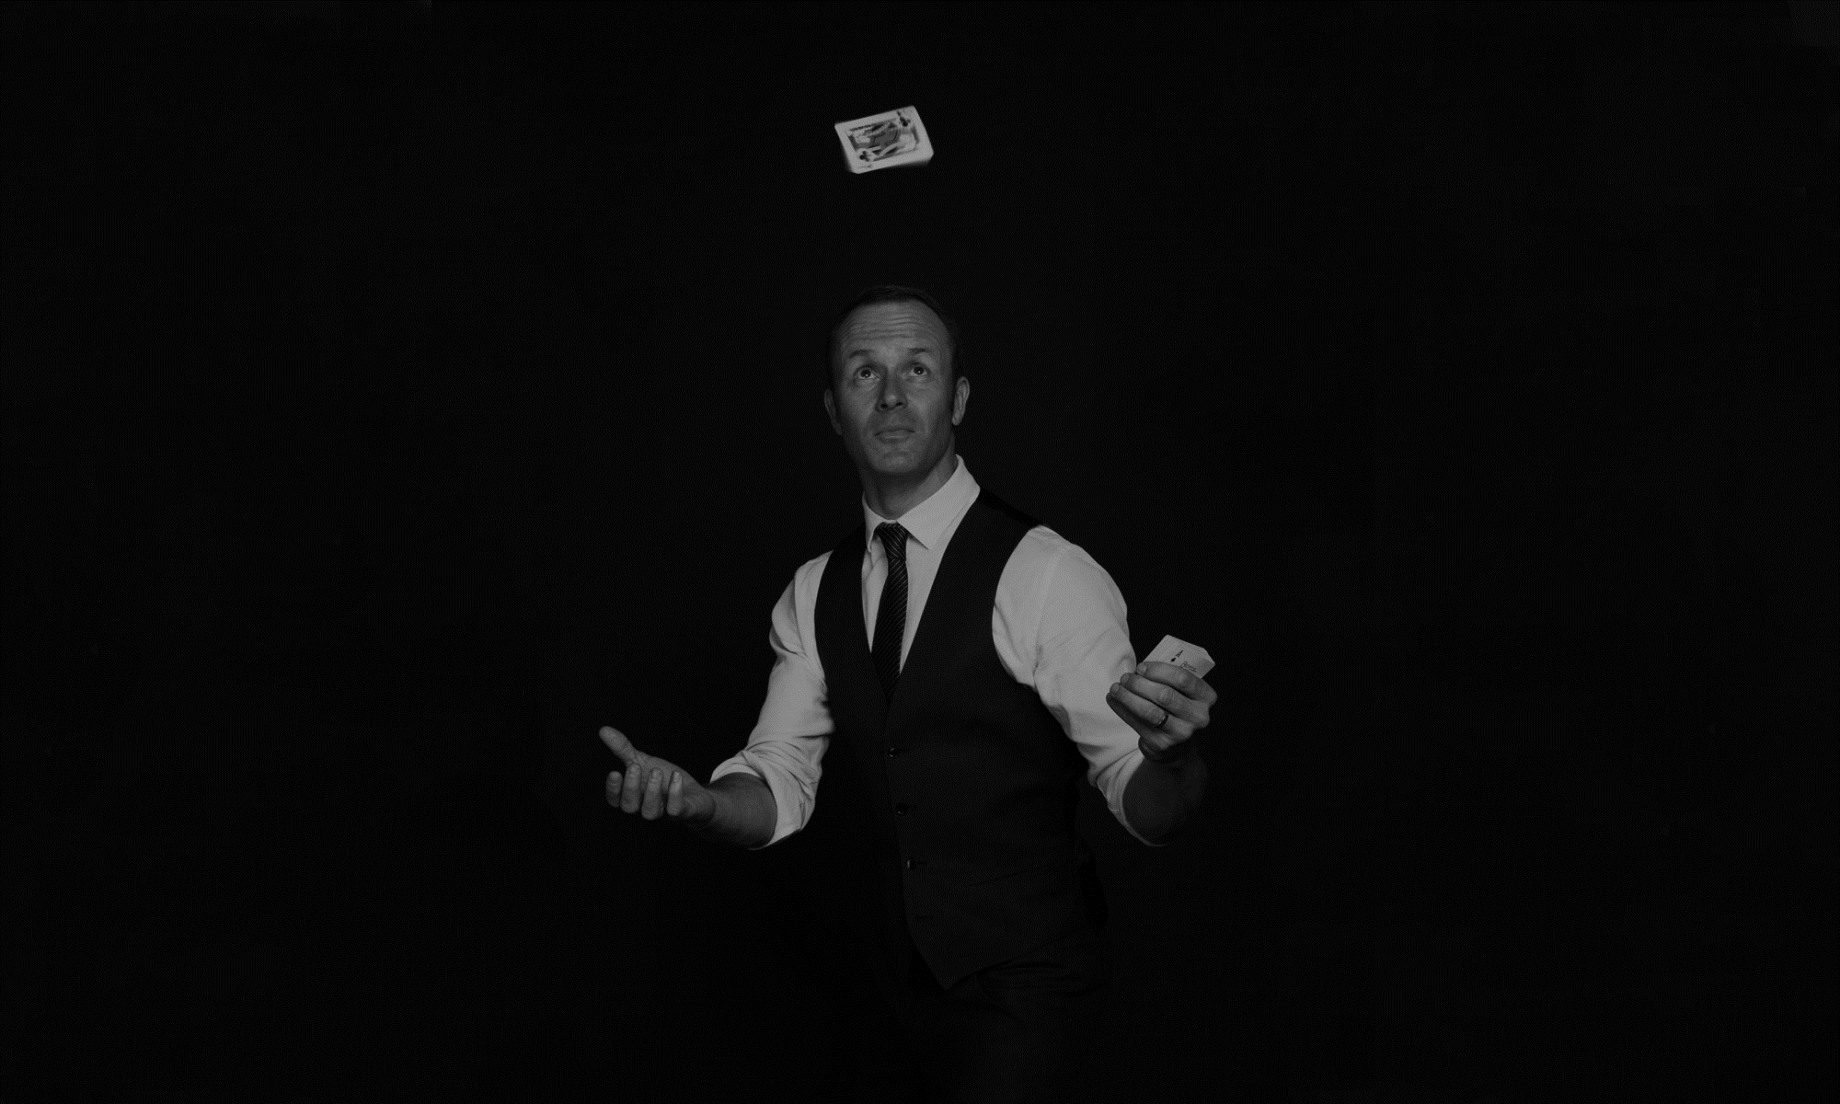
The Magician
The search for enlightenment can take some people a lifetime. The difference between this person and the mentor is that the Magician has an agenda they want everyone to follow.

Slide 26
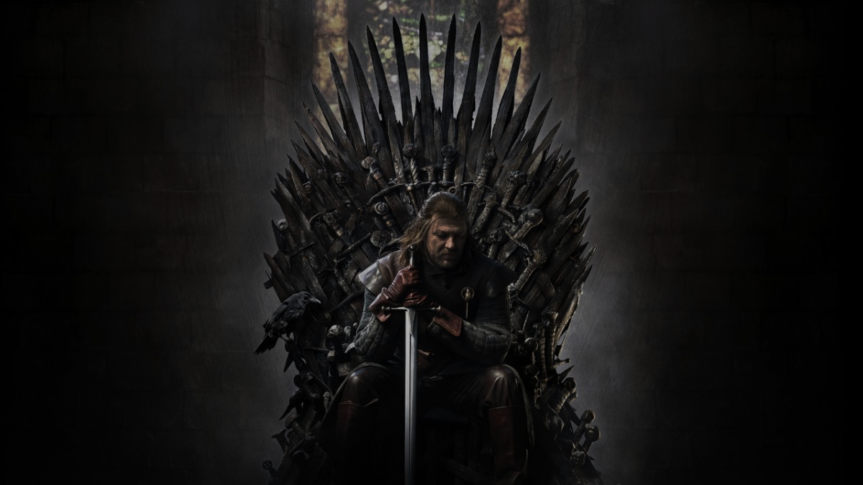
The Ruler
Take me to your leader. This king or queen runs the country or corporation. They're the person you follow and the one who gives the orders. Hopefully, they're good at it.

Slide 27
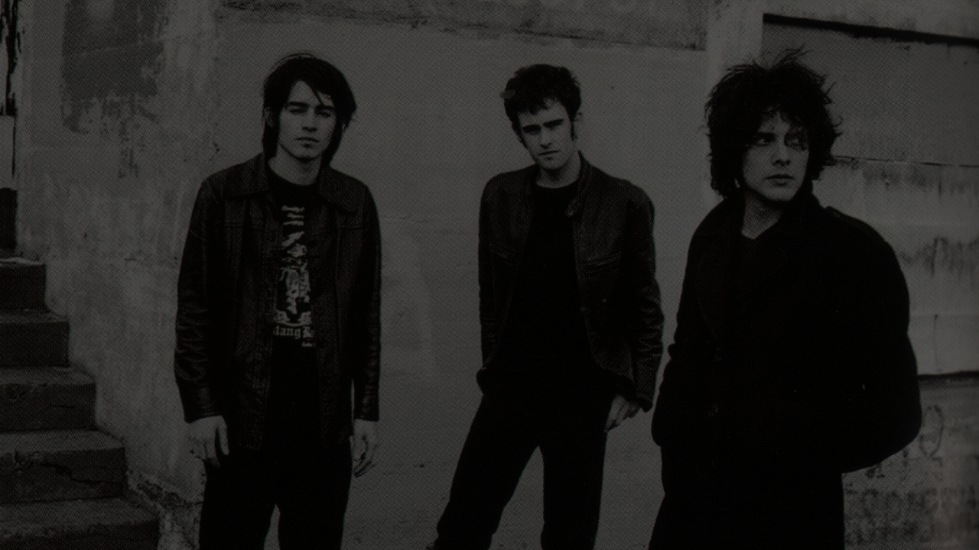
The Rebel
Life's not fair, and the rebel is sick of it. They won't settle for the average day, not when they think they deserve more. Rebels like people but that doesn't mean they're the first choice to lead. Still, people follow someone who wants to shake the world up.

Slide 28
The Lover
Love will keep us together and keep the Lover going. They lead with their heart, which they wear on their sleeve. They're selfless, and even though fully devoted to the one they adore, can sometimes neglect their own health and safety.

Slide 29
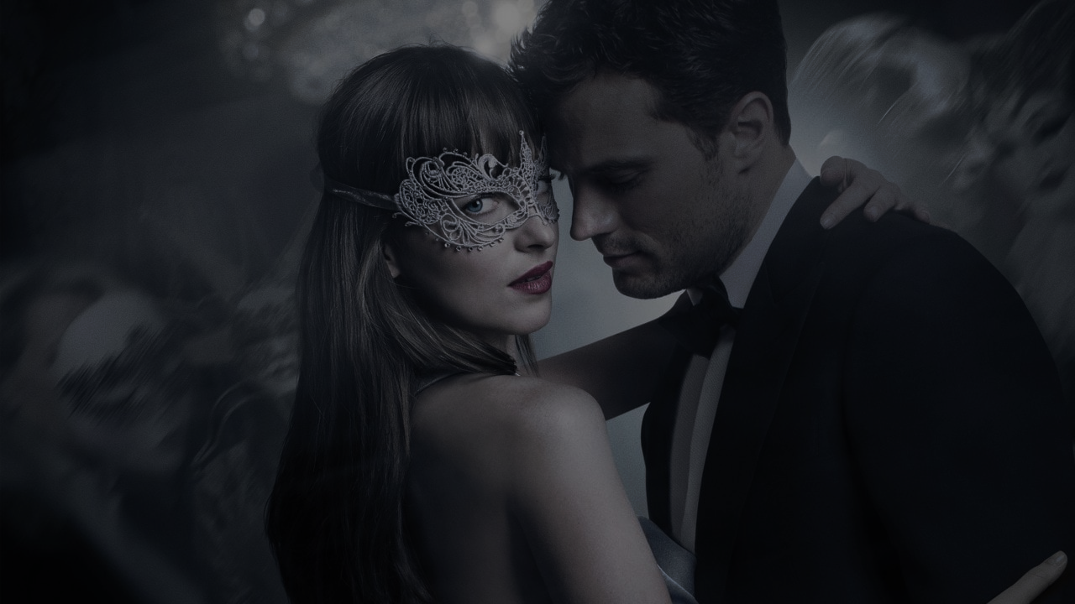
The Seducer
Some call them a femme fatale or homme fatale for a man. These are beautiful people using their looks and charm to take control of every situation. They're conniving and value only what they want. And nothing will stop them.

Slide 30
Design Your
Character

Slide 31
3 Characters per group:
Protagonist
Antagonist
Supporting Character

