Slide 1
CHARACTER INTRODUCTION

Slide 2
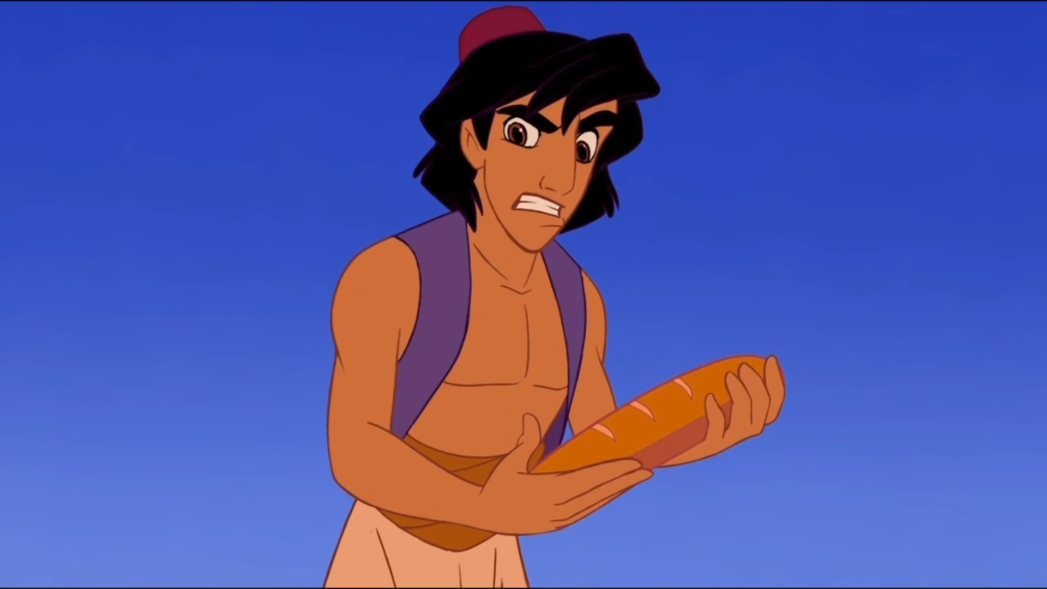
Aladdin (1992)
https://www.youtube.com/watch?v=5VdZewCFyfg&t=1s

Slide 3
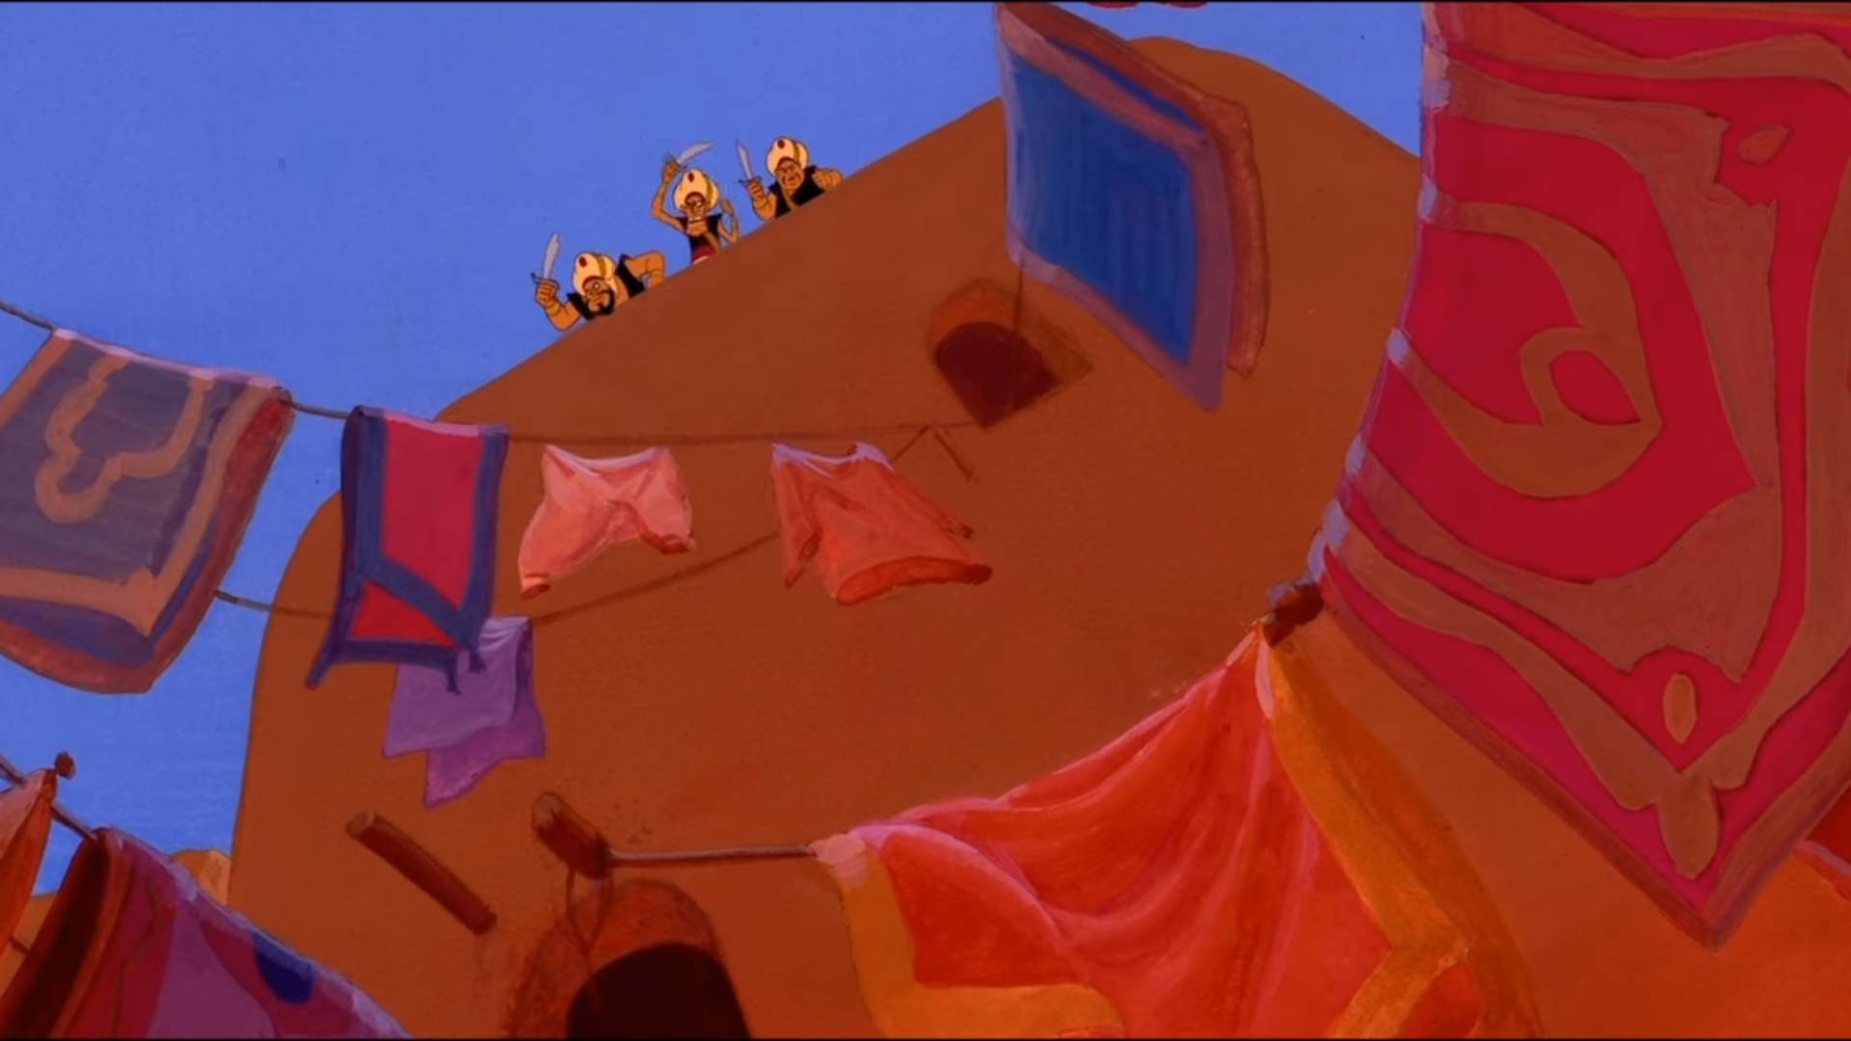

Slide 4
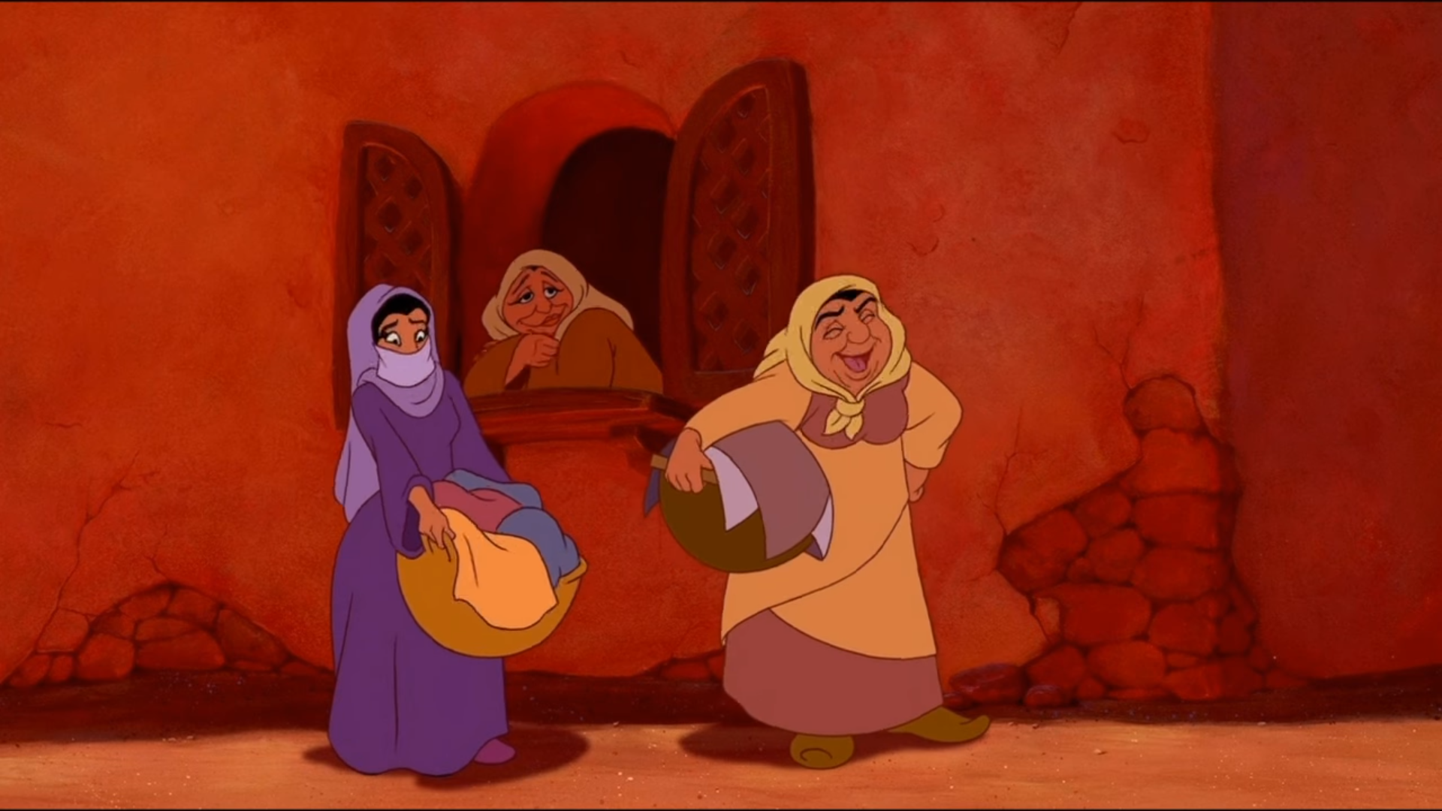

Slide 5
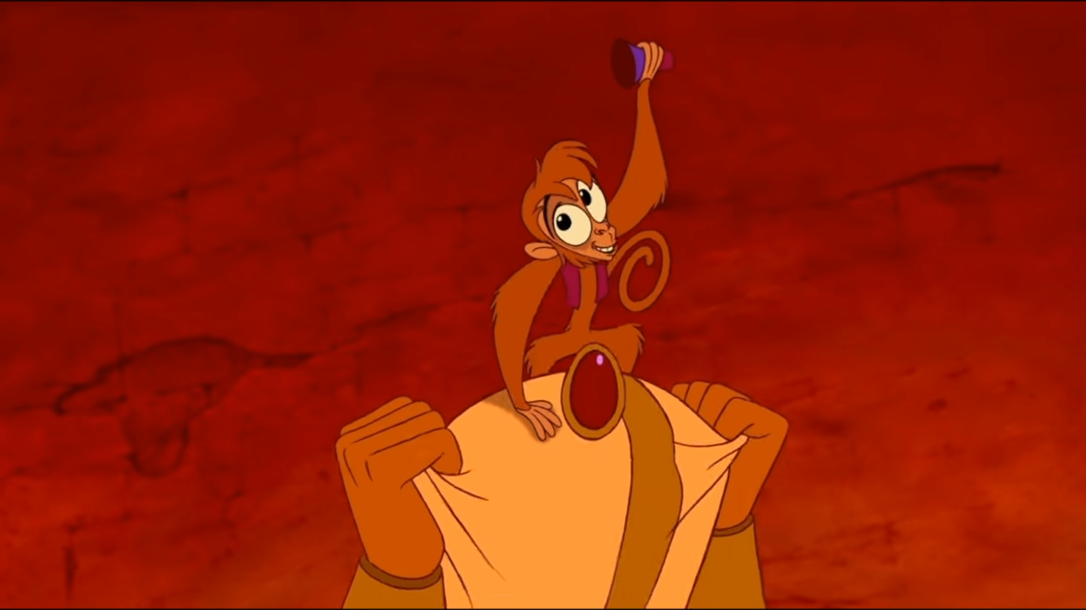

Slide 6
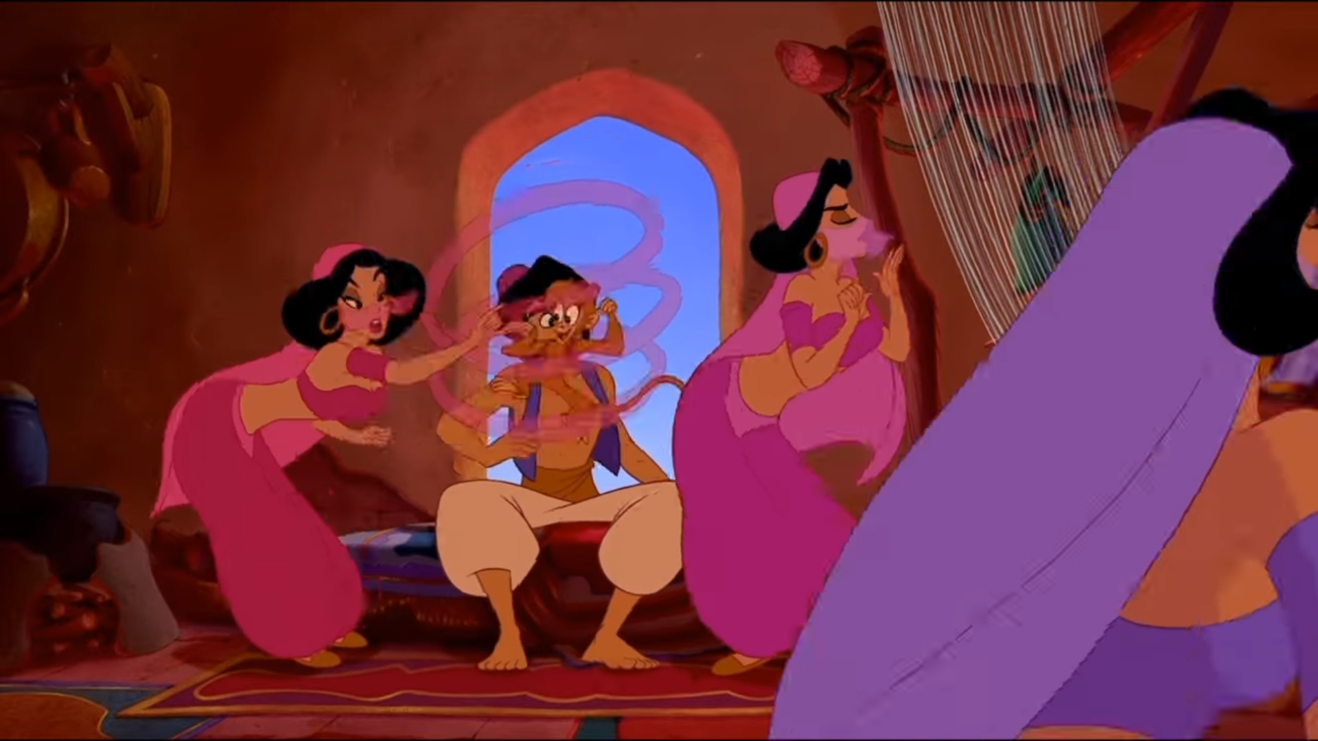

Slide 7
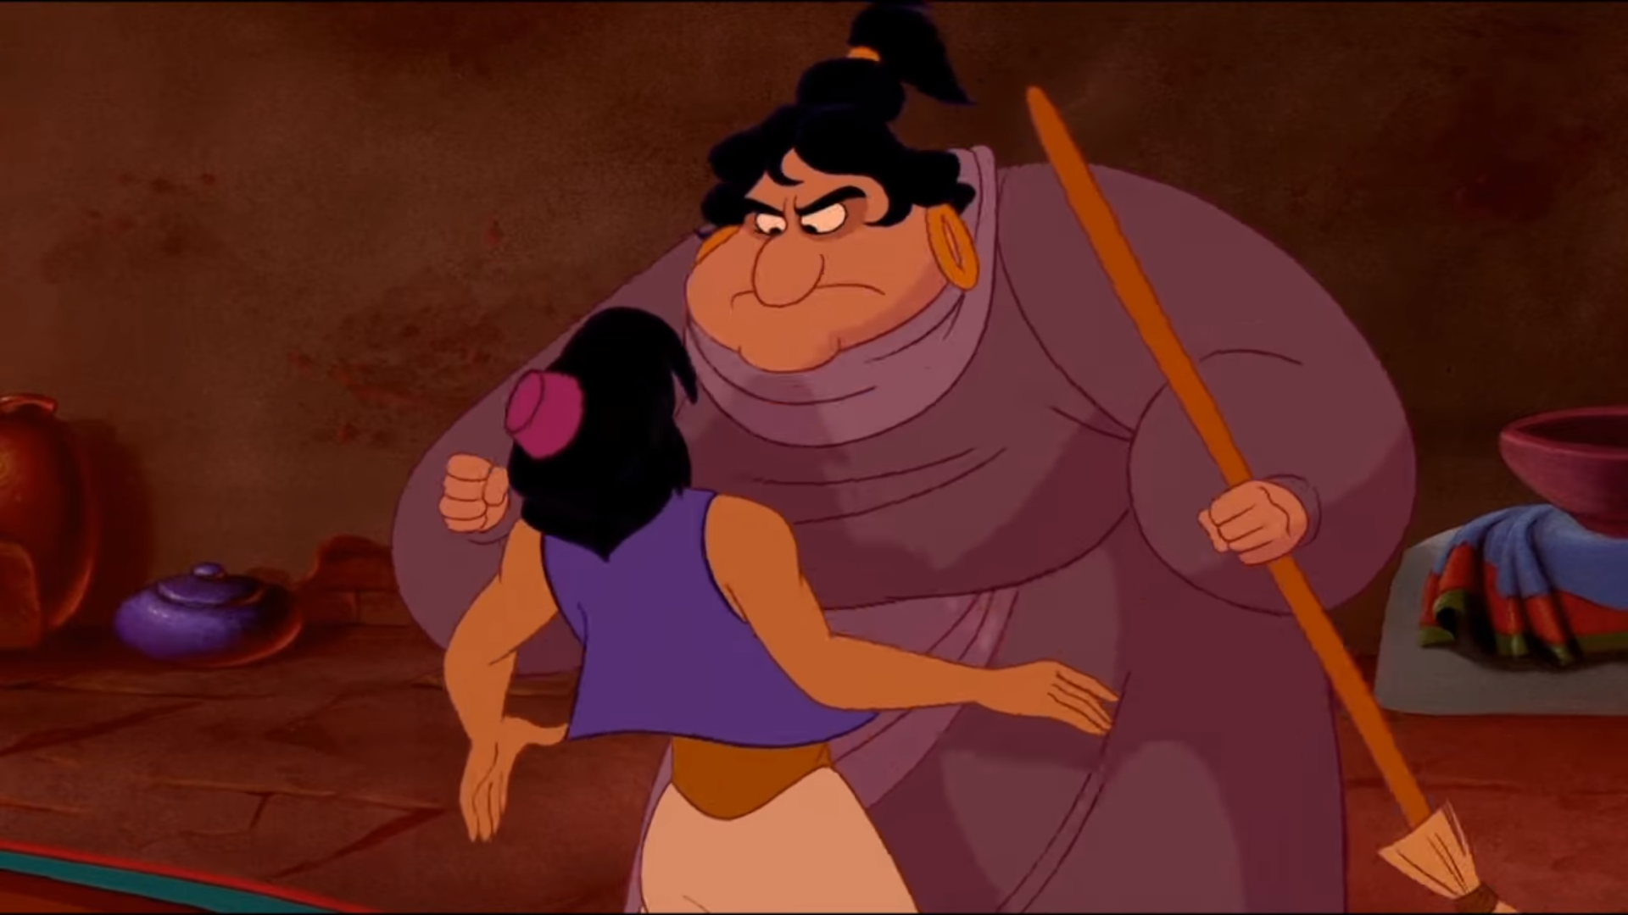
I blame parents, except hasn’t got them.

Slide 8
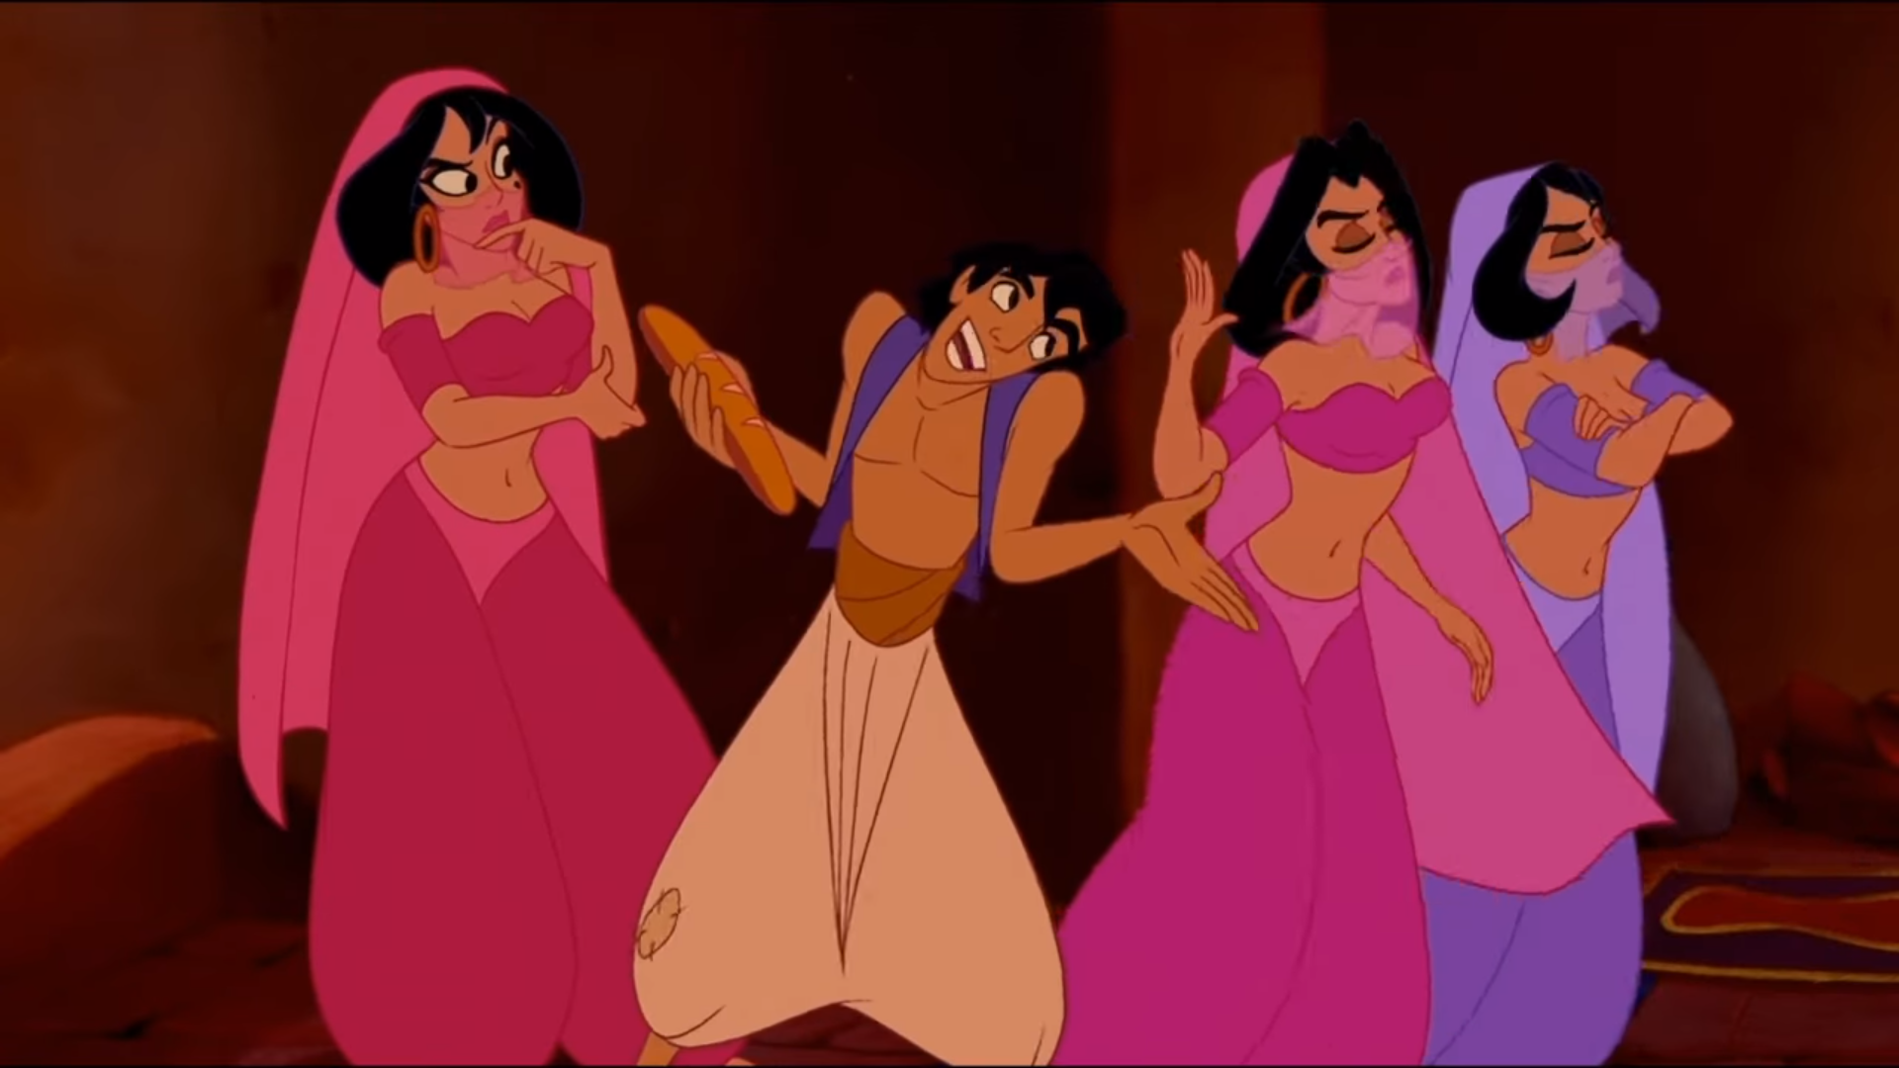
Gotta steal to eat,
gotta eat to live

Slide 9
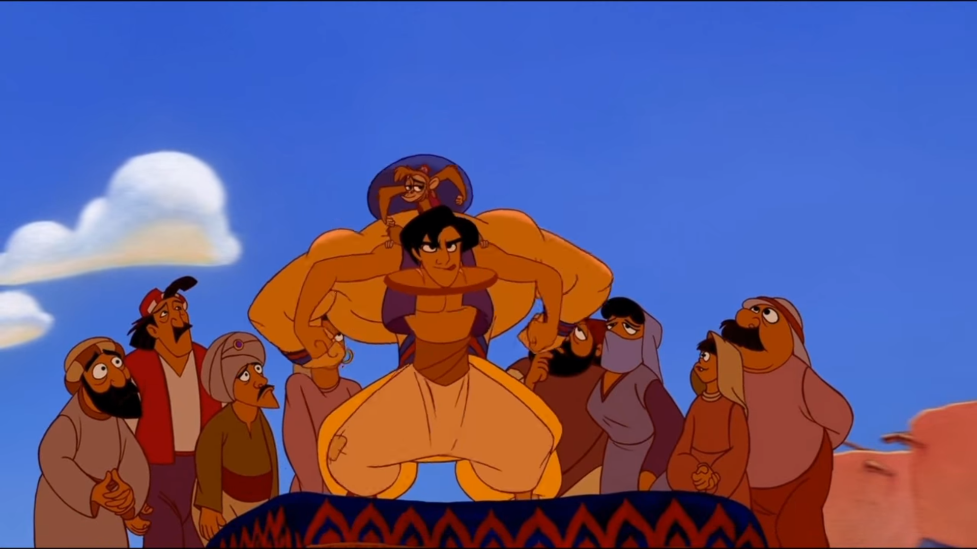

Slide 10
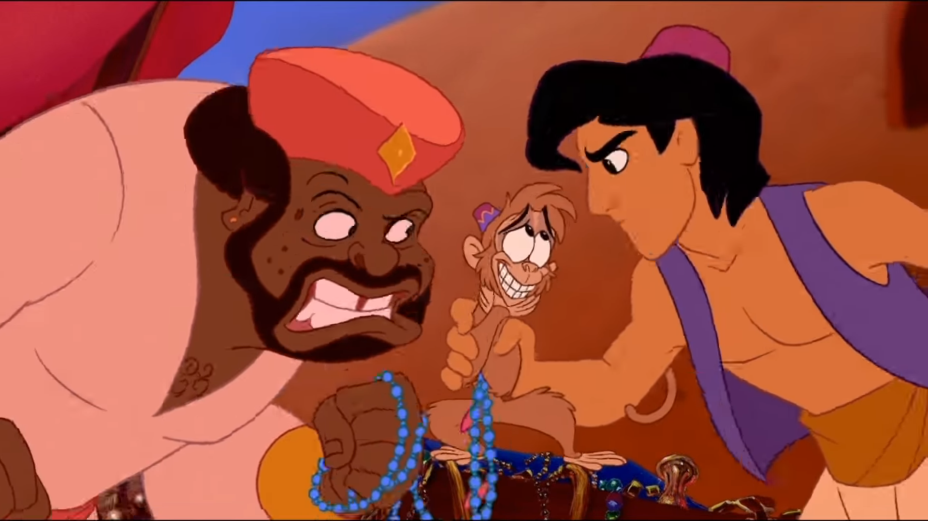

Slide 11
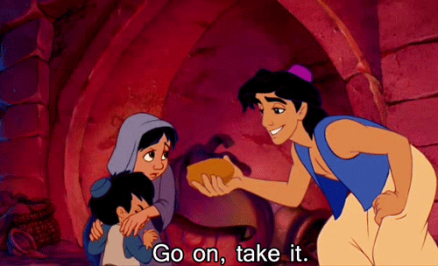

Slide 12
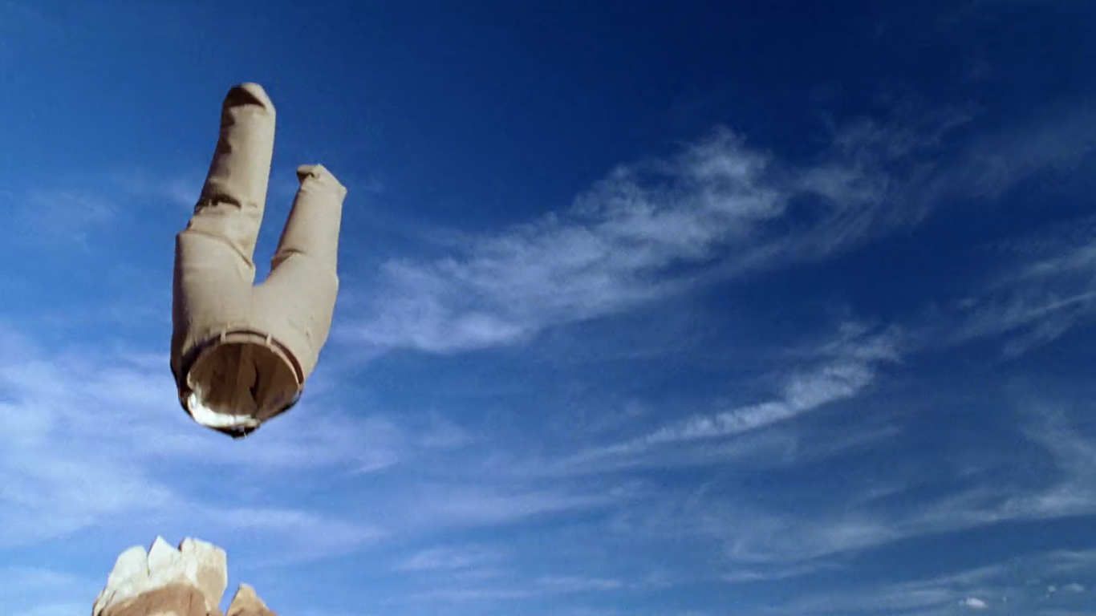
Breaking Bad (2008)
https://www.youtube.com/watch?v=O0804OxD5Ao

Slide 13
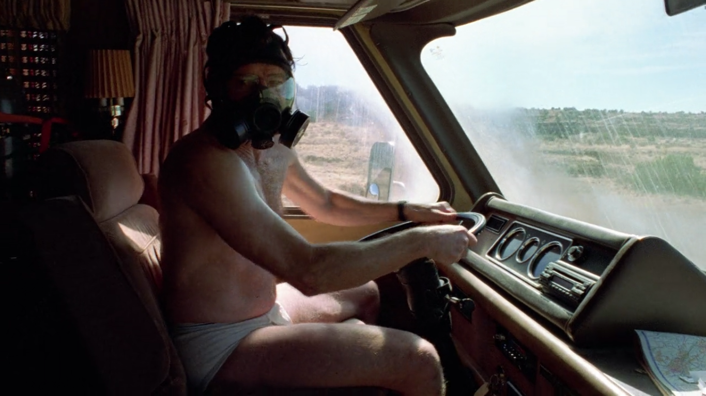

Slide 14
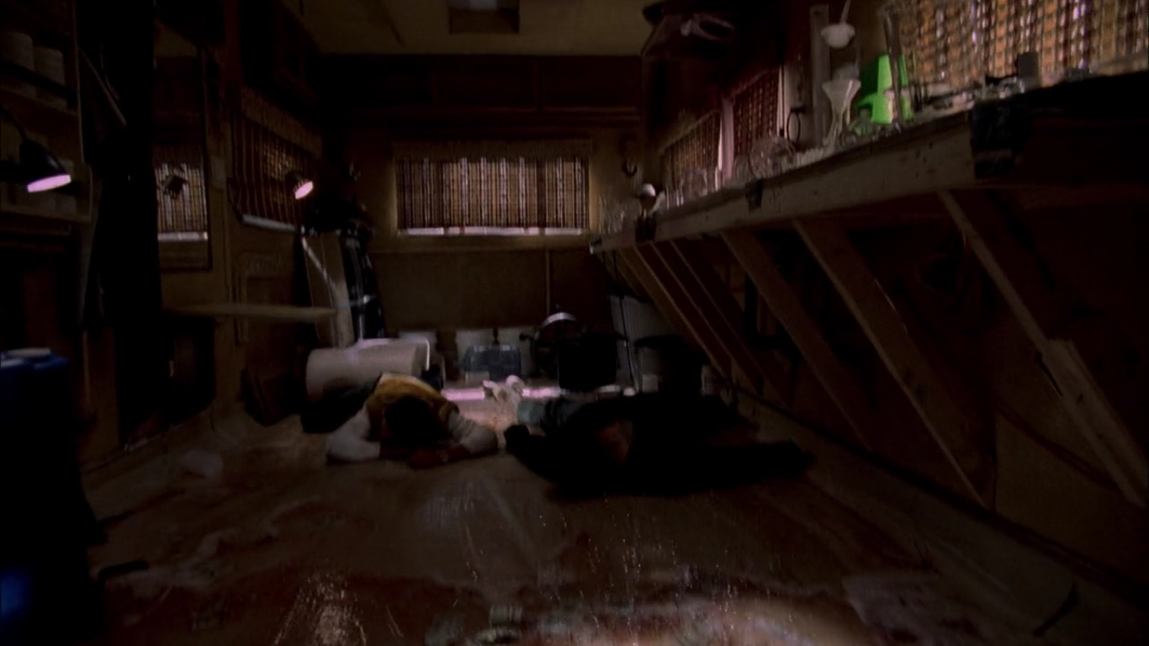

Slide 16
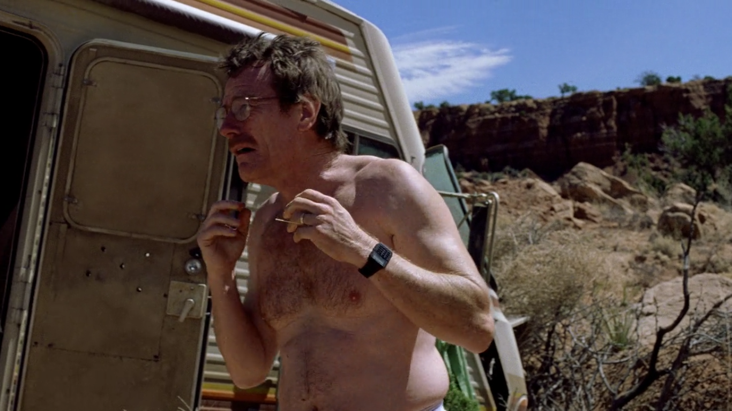

Slide 17
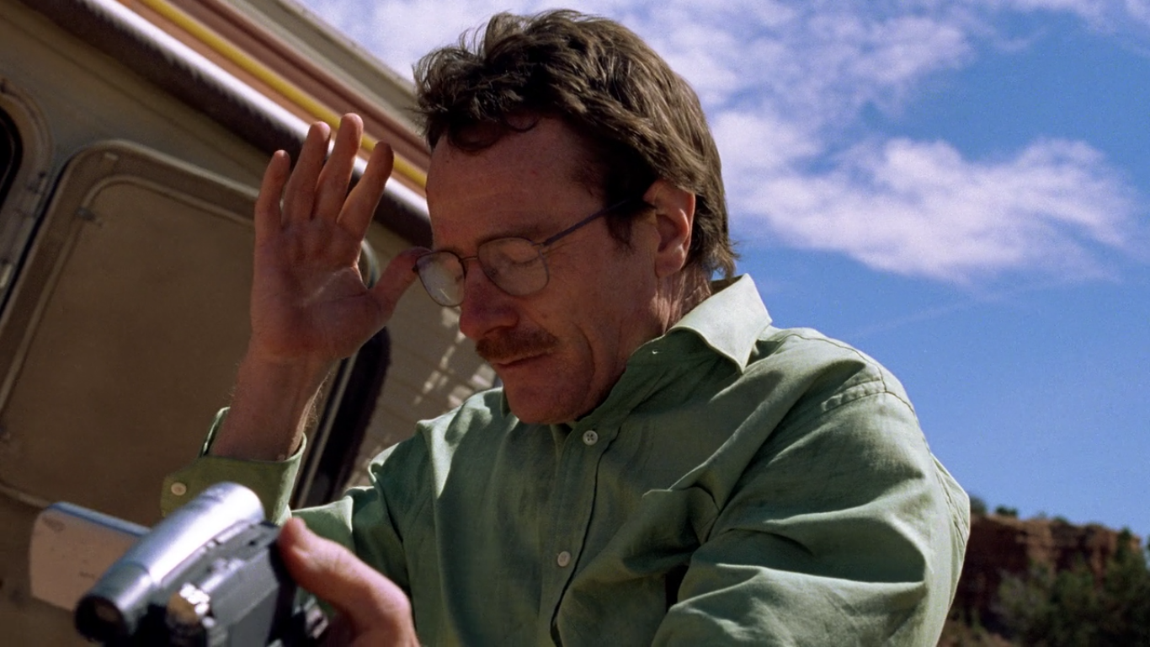

Slide 19
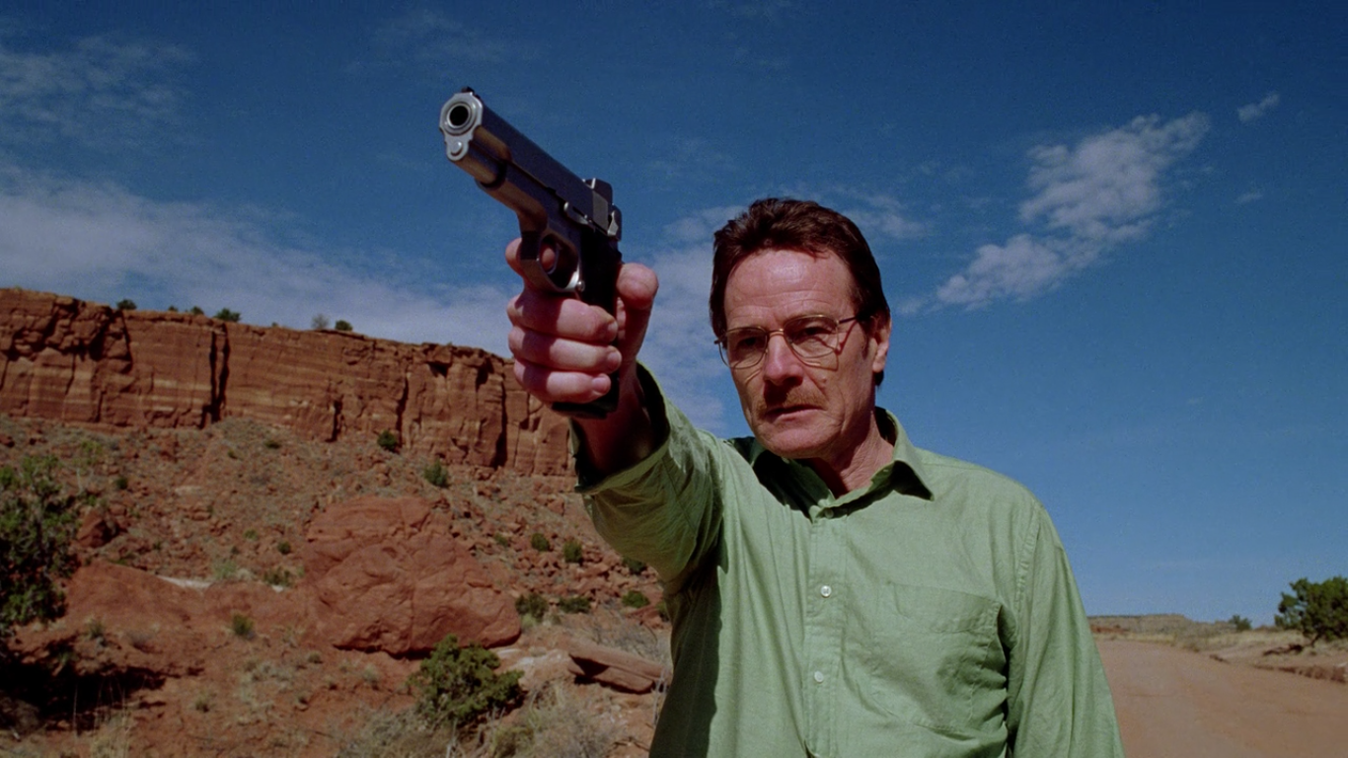

Slide 20
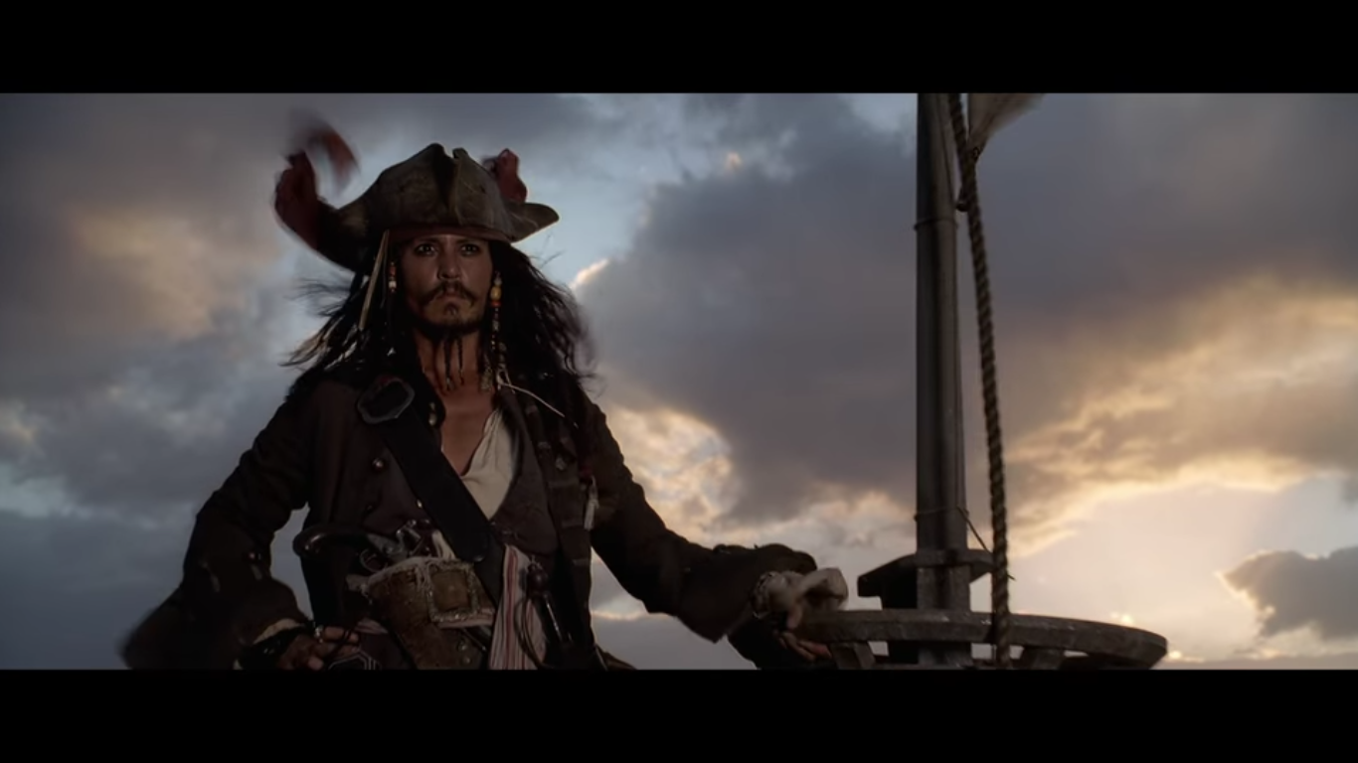
Pirates of the Caribbean (2008)
https://www.youtube.com/watch?v=dvdrCPr3gDQ

Slide 21
CHARACTER INTRODUCTION
Show, don’t tell.

Slide 22
She was very pretty.
As she walked in the room, she kept her eyes low. If she raised her head; she would see every man, single and married, staring at her. She was familiar with the feeling of so many eyes on her, but she was never comfortable with it…

Slide 23
He was the most courageous boy in his class.
As the squeaks started to get softer from inside the inferno, it was obvious to all that the class’ pet hamster was slowly dying. The students surrounding the burning school grew quiet. Everyone was stuck in place, unable to move. Some whispered, some just wished for the squeaking to stop.
A shout from one of the teachers broke the silence, “Harold! Get back here!” All of the students turned together to see young Harold pull his shirt over his mouth and disappear into the school.
The moments passed too slowly. The teachers looked at each other with an expression saying, “you go get him, I’m too afraid.” Then with a faint, but much closer squeak, Harold emerged from the fireball with Fluffy in his arms.

Slide 24
Suggestions
Common Ways to Introduce Characters

Slide 25
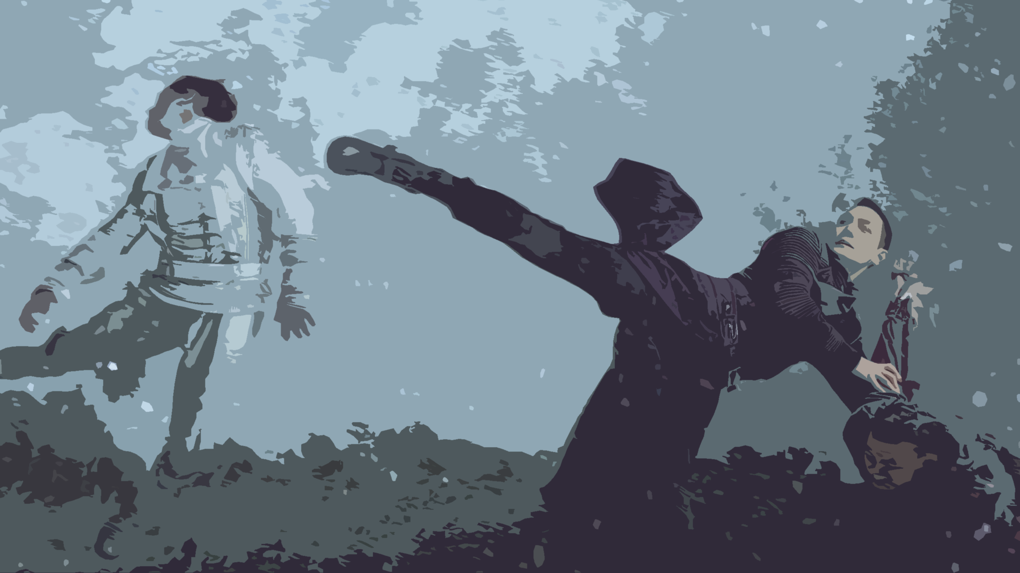
Action Scene
Adventure / Superhero / Sci-fi
Sets the tone
We learn what the character is capable of

Slide 26
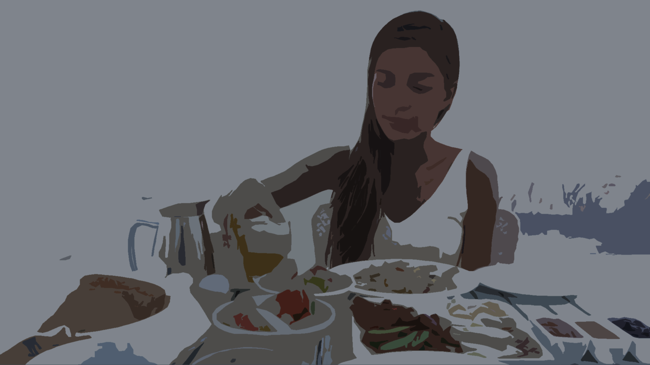
A Day in the Life
Drama, Relatable character, Fantasy
Character wakes up and does normal routine
Is it similar or different routine?
Can establish a new world

Slide 27
Gossip
Have others talking about the character
Reputation

Slide 28
Talking to a Mirror
Talking to their self
Internal struggles
A little boring

Slide 29
Ready for Change
The character is thinking about / doing something that is not ordinary.
Helps start the book
Immediate character development

Slide 30
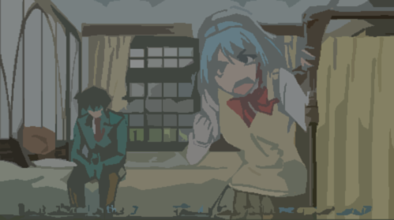
Direct Introduction
The character talks directly to the reader
See how the character sees their self
Not genuine or immersive

Slide 31
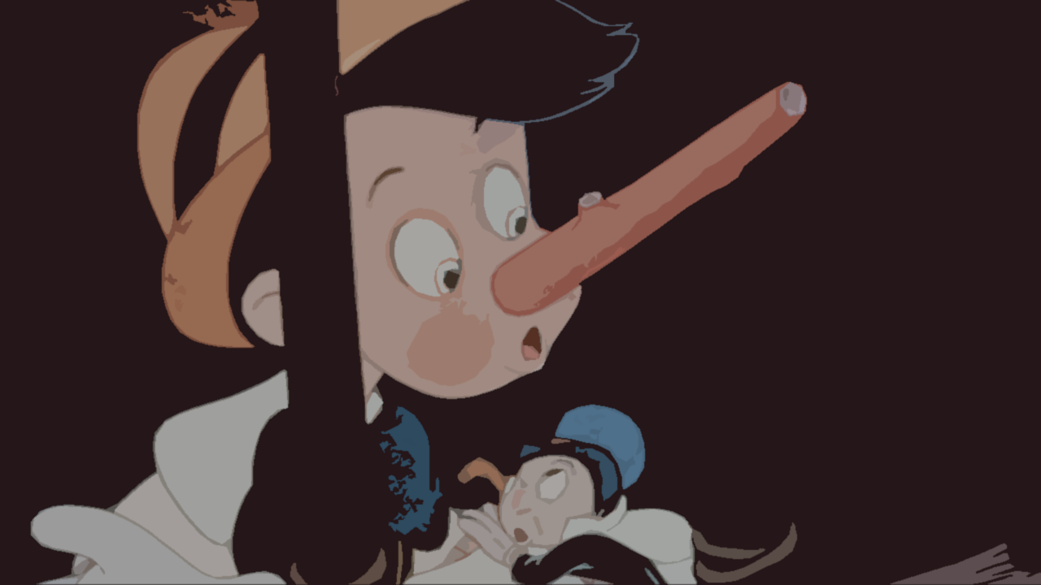
Memorable Physical Characteristic
What is most noticeable about your character?
What the other character notice first
Intriguing (make sure you explain)

Slide 32
Backstory
The character’s life until now

Slide 33
Action Scene A Day in the Life Gossip Talking to a Mirror Ready for Change Direct Introduction Backstory

