Slide 1
Character Arcs

Slide 2
Protagonist
During the story, the character should change:
Internal
External
The most important part of the character’s life.

Slide 3
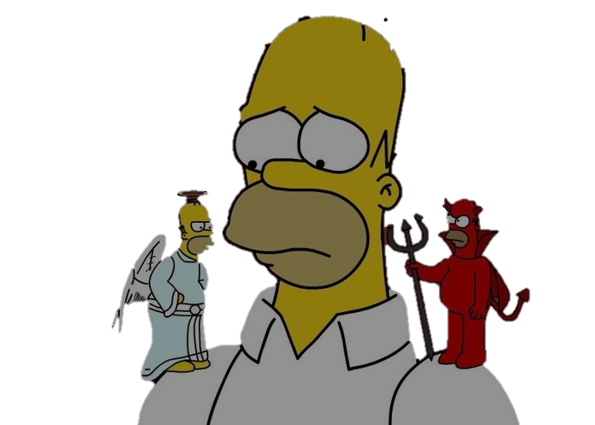
Internal Challenges
The lie that the character believes
Doubt
Fear
Flaw
Regret or Remorse

Slide 4
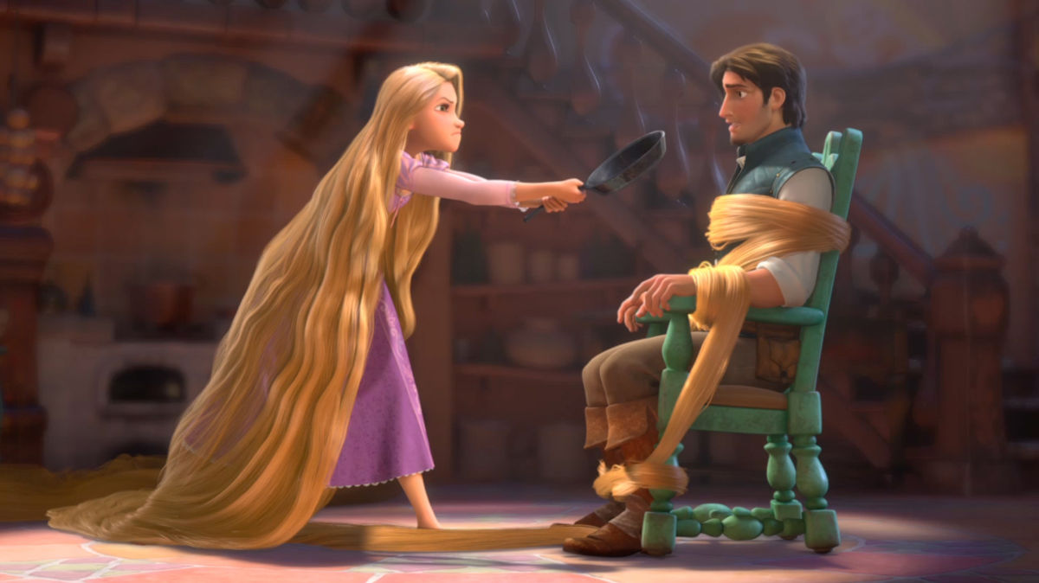
The outside world is evil.

Slide 5
She finds someone who cares about her.

Slide 6
Might is right.

Slide 7
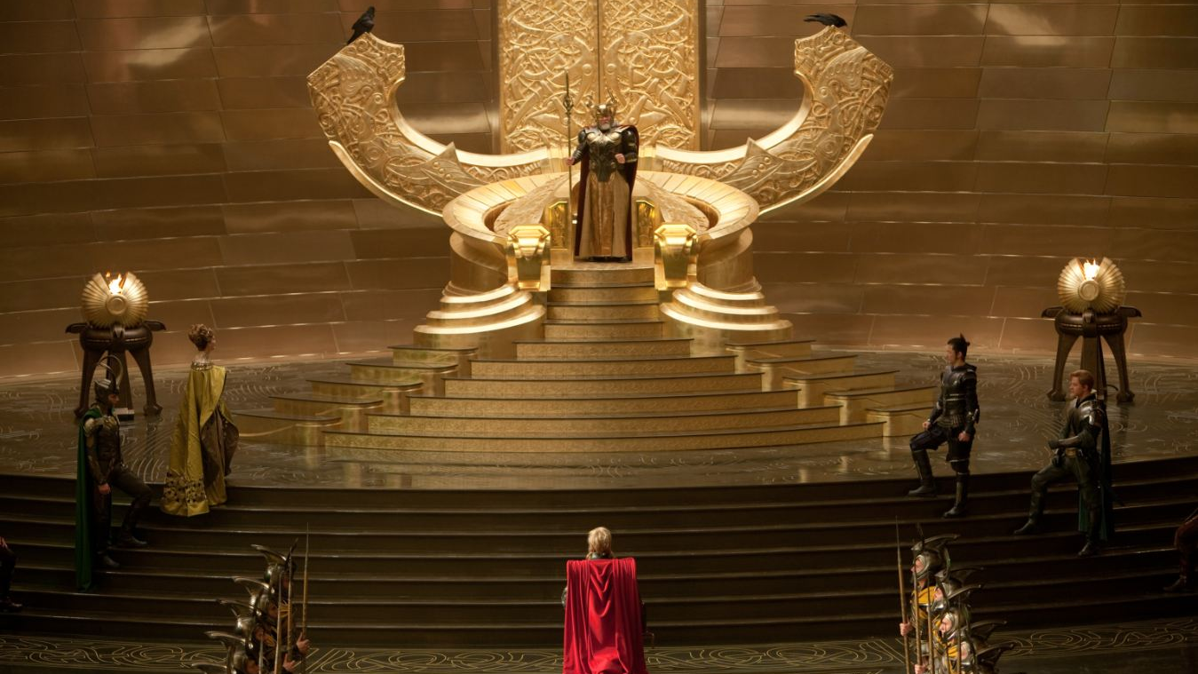
Thor realizes there is more to being king than strength

Slide 8
She is not worthy of love or family.

Slide 9
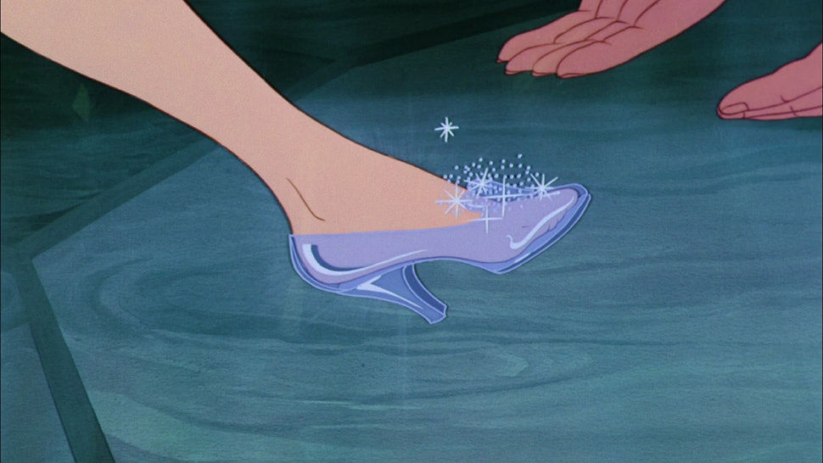
The prince finds her and she becomes a princess

Slide 10
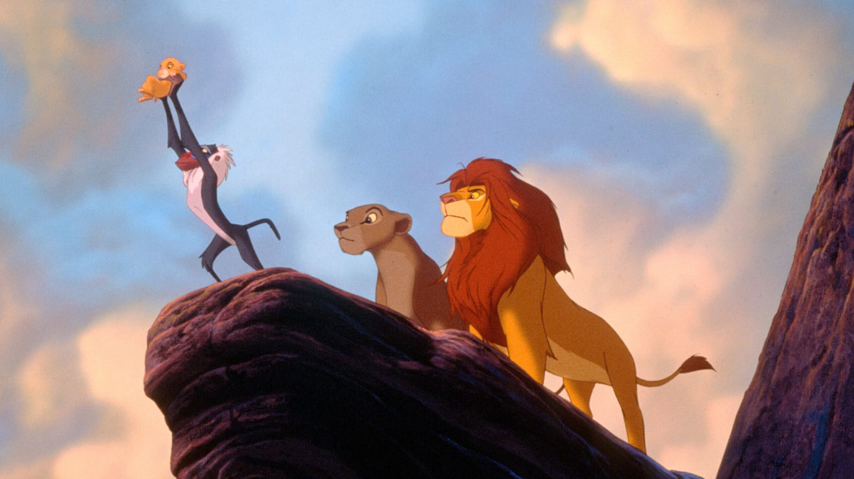
He killed his father.

Slide 11
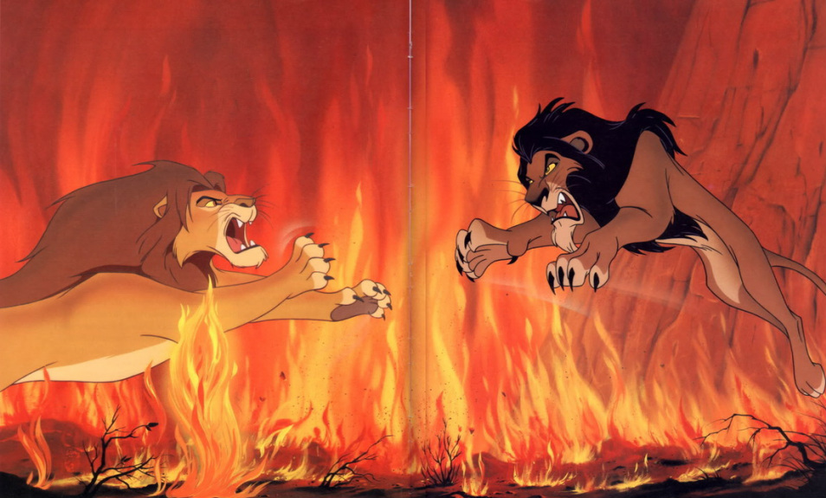
He defeats his Uncle Scar, who told him the lie.

Slide 12
Others will make him unhappy.

Slide 13
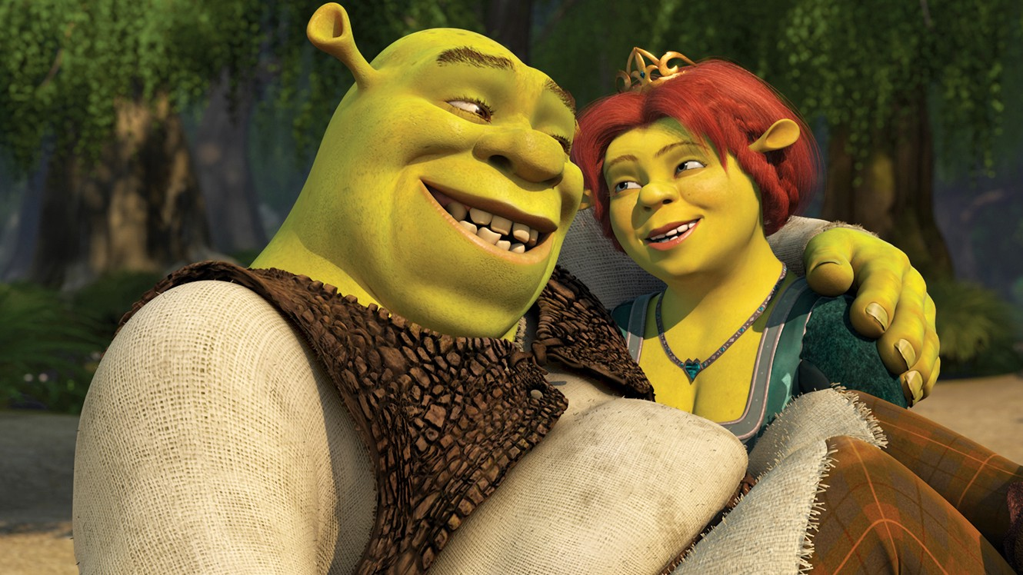
He realizes that he needs Donkey and the dragon to stop the marriage.

Slide 14
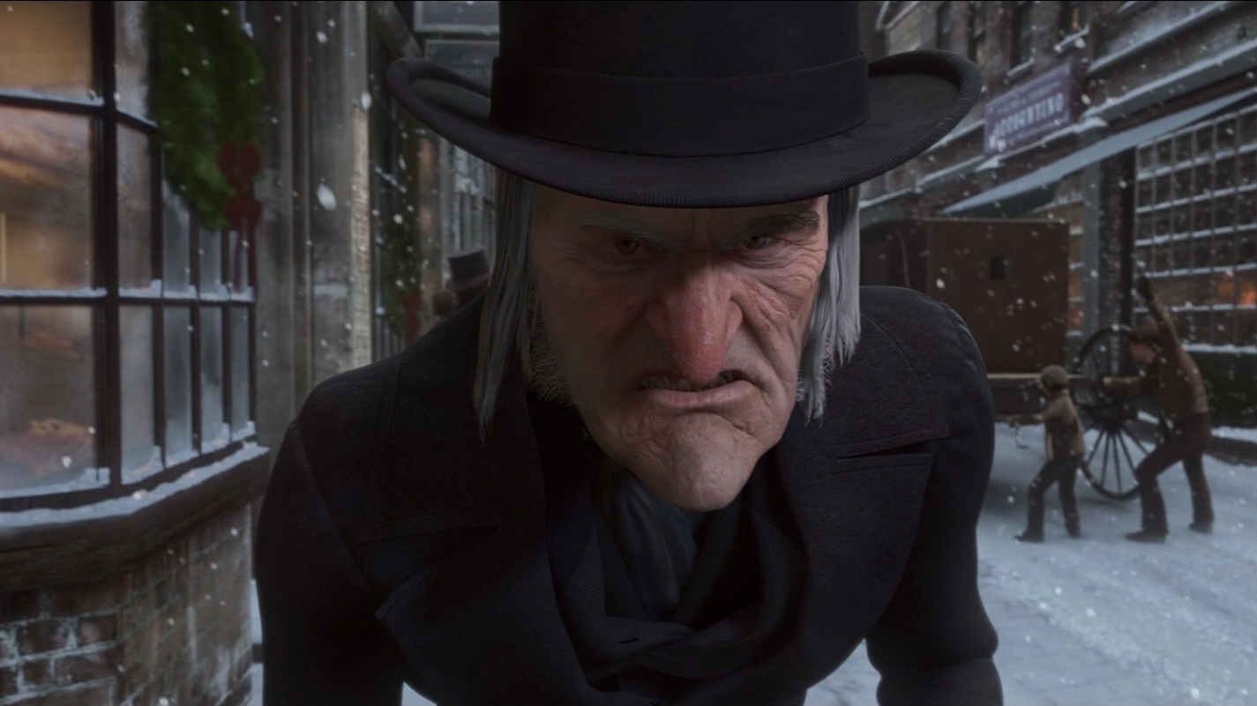
Money makes you important

Slide 15
He gives away his fortune and adopts Little Tim.

Slide 16
External Challenges
Conflict drives narrative
The internal change from external forces
Show how the character is changing

Slide 17
Character vs Society
Many different motivations to take action – survival, stability, human rights, happiness, freedom, justice, or morality.
Must overcome their LIE to succeed.

Slide 18
Character vs Nature
Main character needs to confront their LIE to survive.

Slide 19
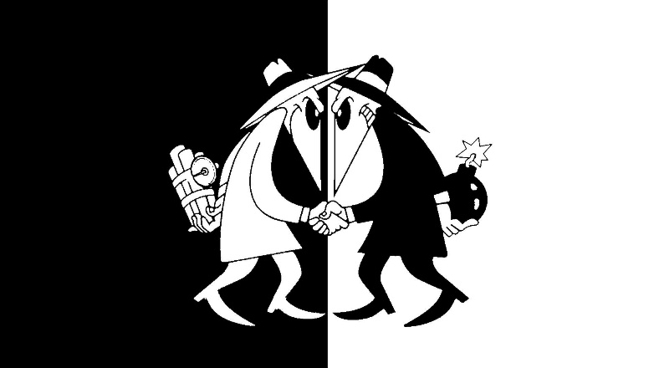
Character vs Character
Shows human imperfection, greed, or fragility.
Internal conflict shows technology’s affect on the human mind.

Slide 20
Character vs Technology
Human imperfection, greed, fragility
Internal conflict shows how technology affects society and the human mind.

Slide 21
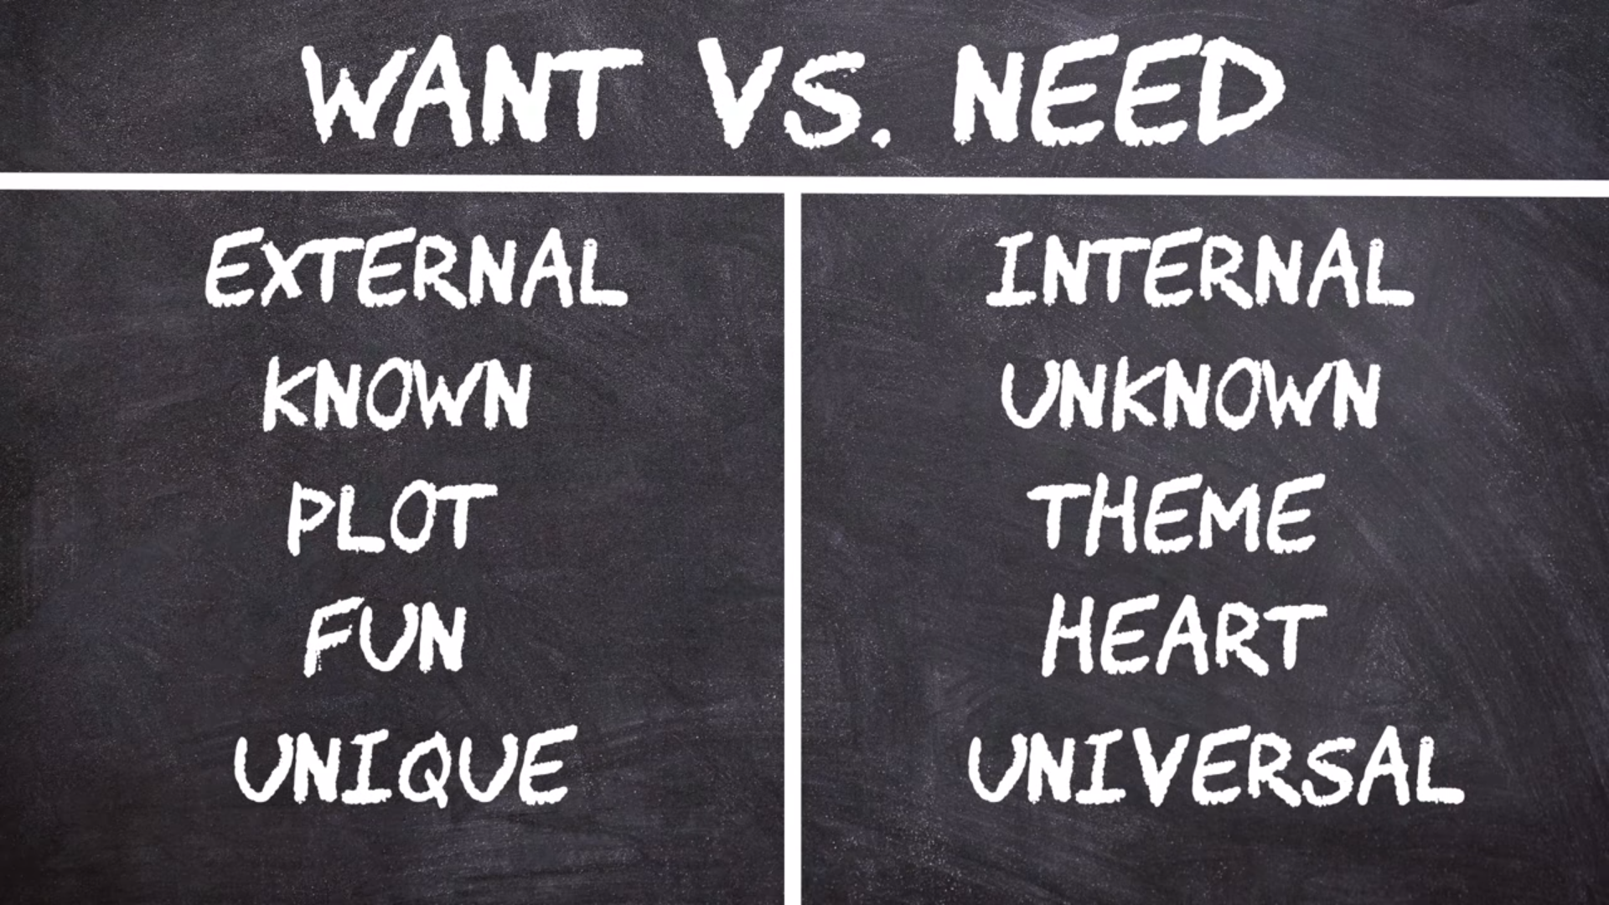

Slide 22
Character Arc
Character Introduction
No Action
Pressure to confront the lie
Forced to confront the lie
Overcome the lie

Slide 23
Steps to create a Character Arc
What is the ‘lie’
How will they overcome the lie? (climax)
What are some challenges that might prevent the truth (plot points)

