Slide 1
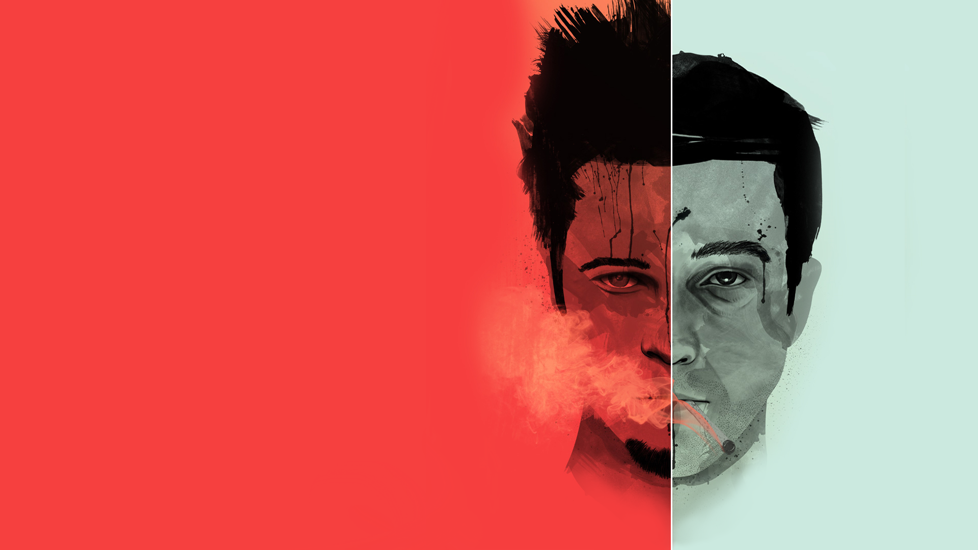
Plot Outline

Slide 3
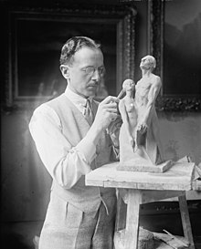
So far…
Character creation
Character introduction
Strengths / Flaws / Motivation
Character Arcs
The lie the character believes
How they will overcome the lie

Slide 4
Story Arc
Climax
ACT 1
ACT 2
ACT 3
Crisis
Falling Action
Rising Action
Routine
Resolution
Inciting
Incident
Beginning
End

Slide 5
Routine
What is normal for the character?
Show their starting characteristics
The lie the character believes

Slide 6
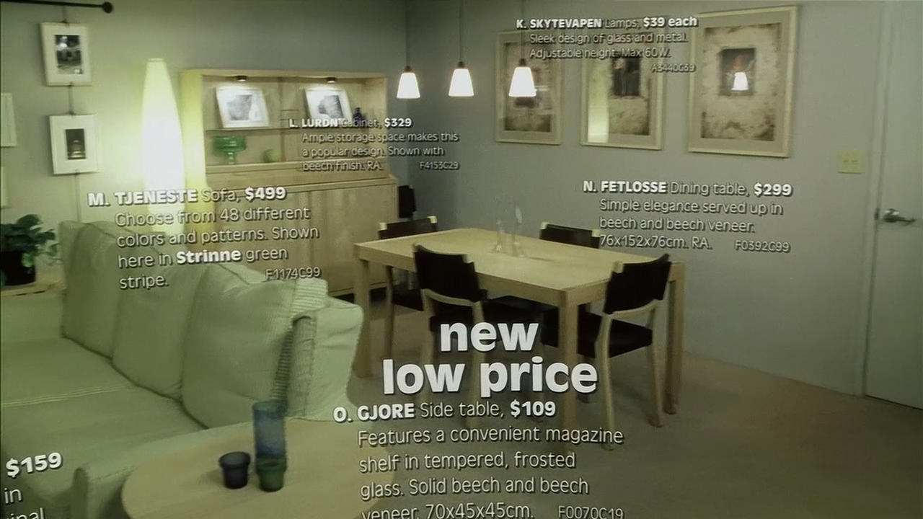

Slide 7
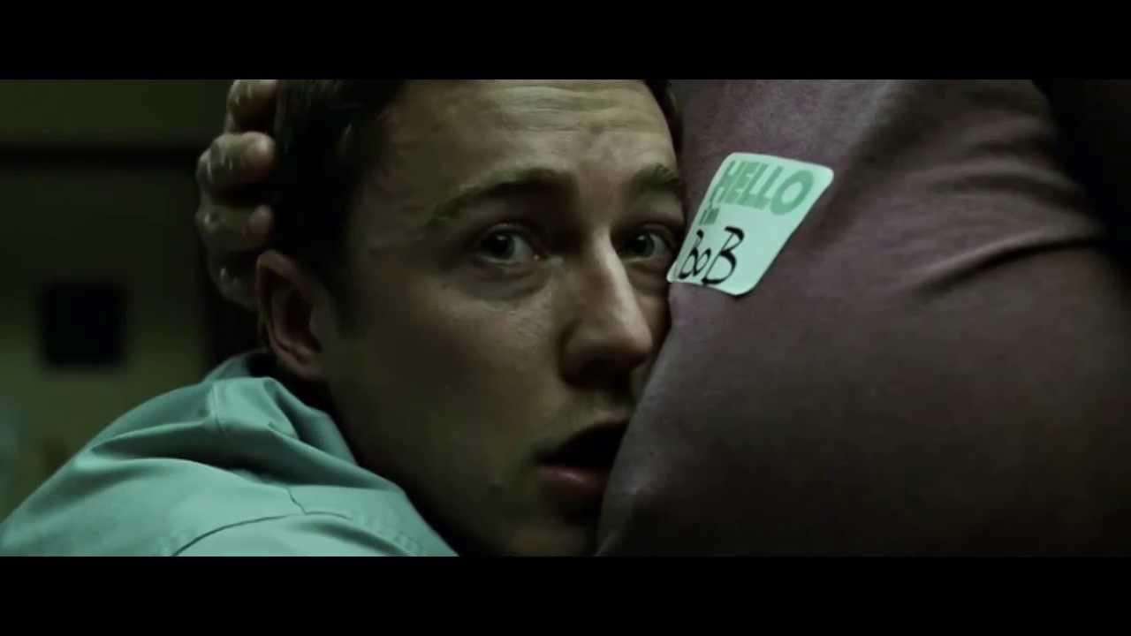

Slide 8
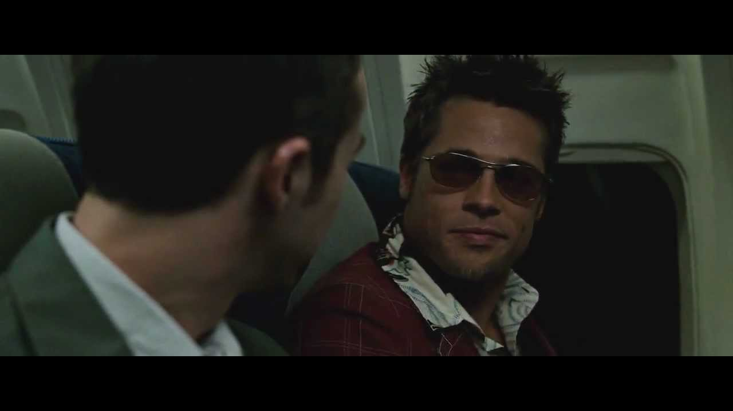

Slide 9
Story Arc
Climax
ACT 1
ACT 2
ACT 3
Crisis
Falling Action
Rising Action
Routine
Resolution
Inciting
Incident
Beginning
End

Slide 10
Climax
The character overcomes the lie.
What is their final obstacle:
To achieve their goal
To change their personality

Slide 11
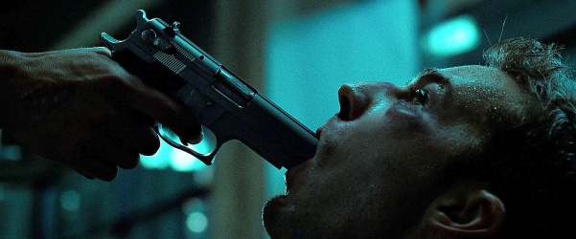

Slide 12
How do we go from: normal routine → climax

Slide 13
Story Arc
Climax
ACT 1
ACT 2
ACT 3
Crisis
Falling Action
Rising Action
Routine
Resolution
Inciting Incident
Beginning
End

Slide 14
Inciting incident
The thing that starts the journey
The first time the character faces their lie

Slide 15
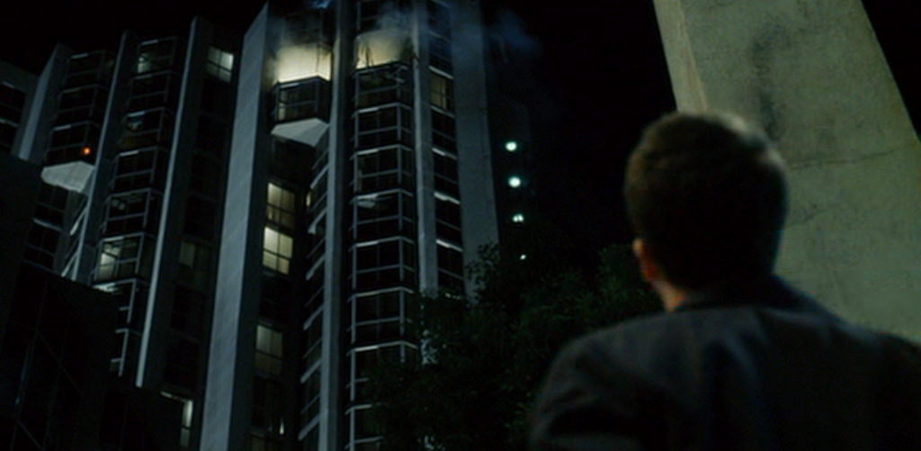

Slide 16
Story Arc
Climax
ACT 1
ACT 2
ACT 3
Crisis
Falling Action
Rising Action
Routine
Resolution
Inciting
Incident
Beginning
End

Slide 17
Rising Action
Many plot points
Each pushes the character a little more
Slowly realizing the lie

Slide 18
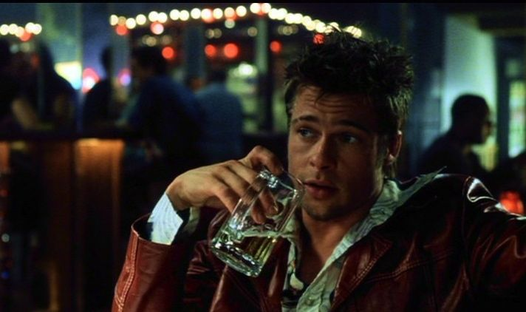

Slide 19
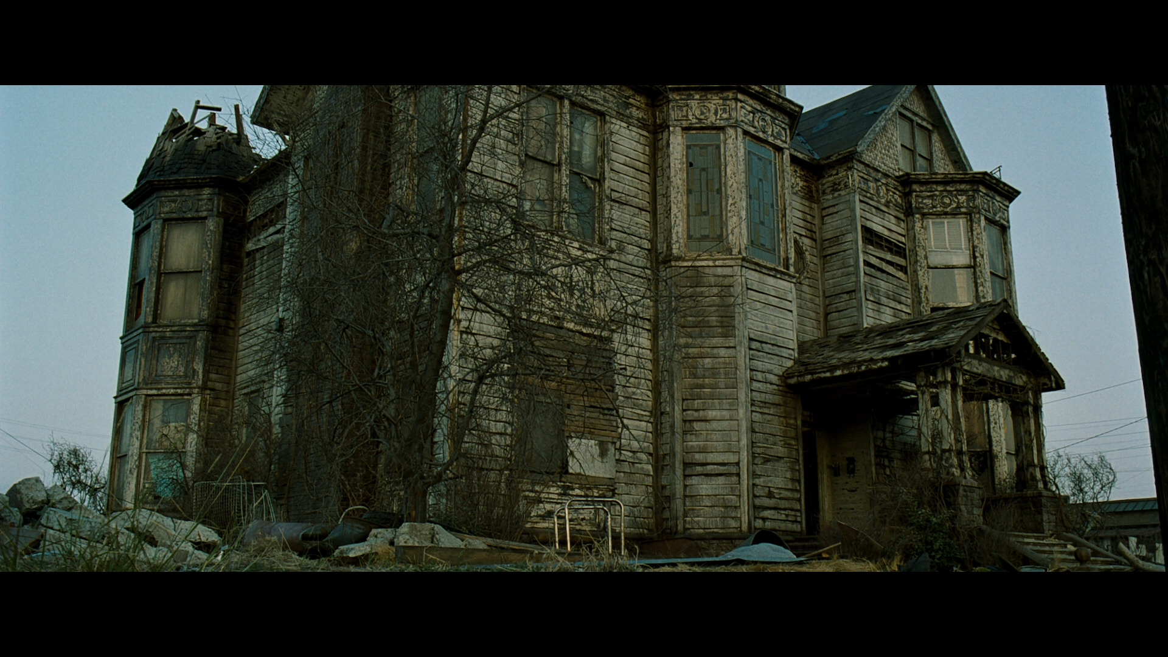

Slide 20
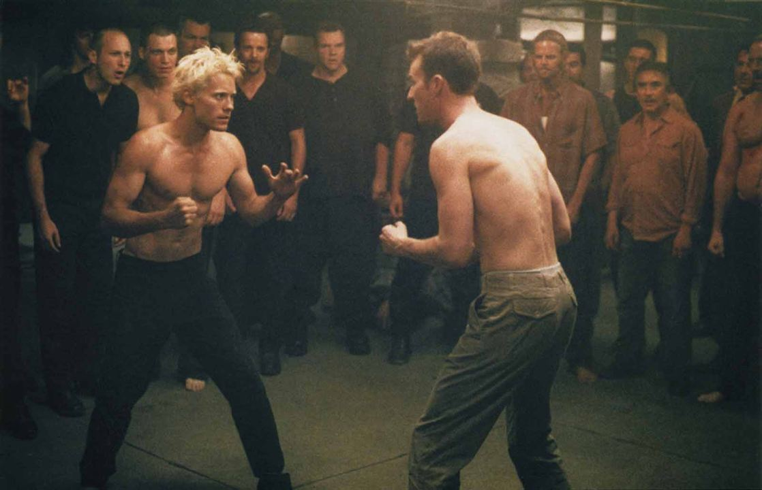

Slide 21
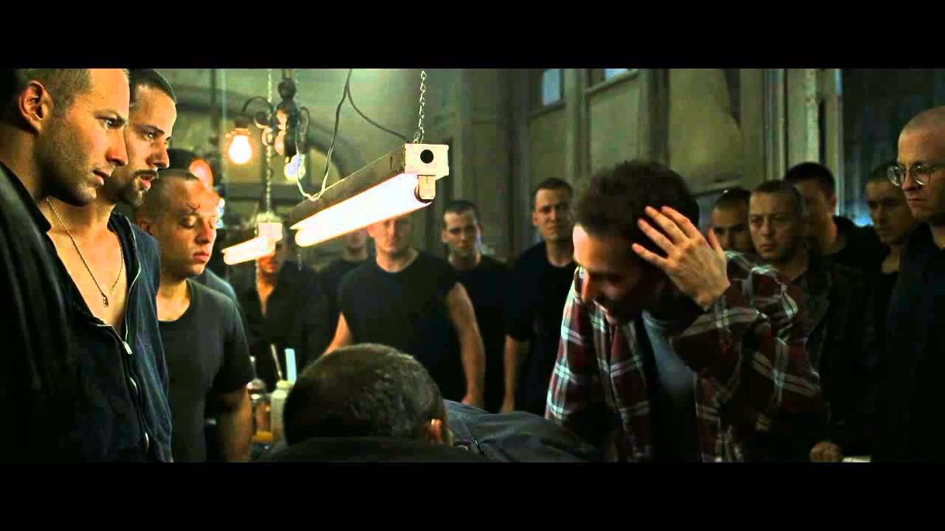

Slide 22
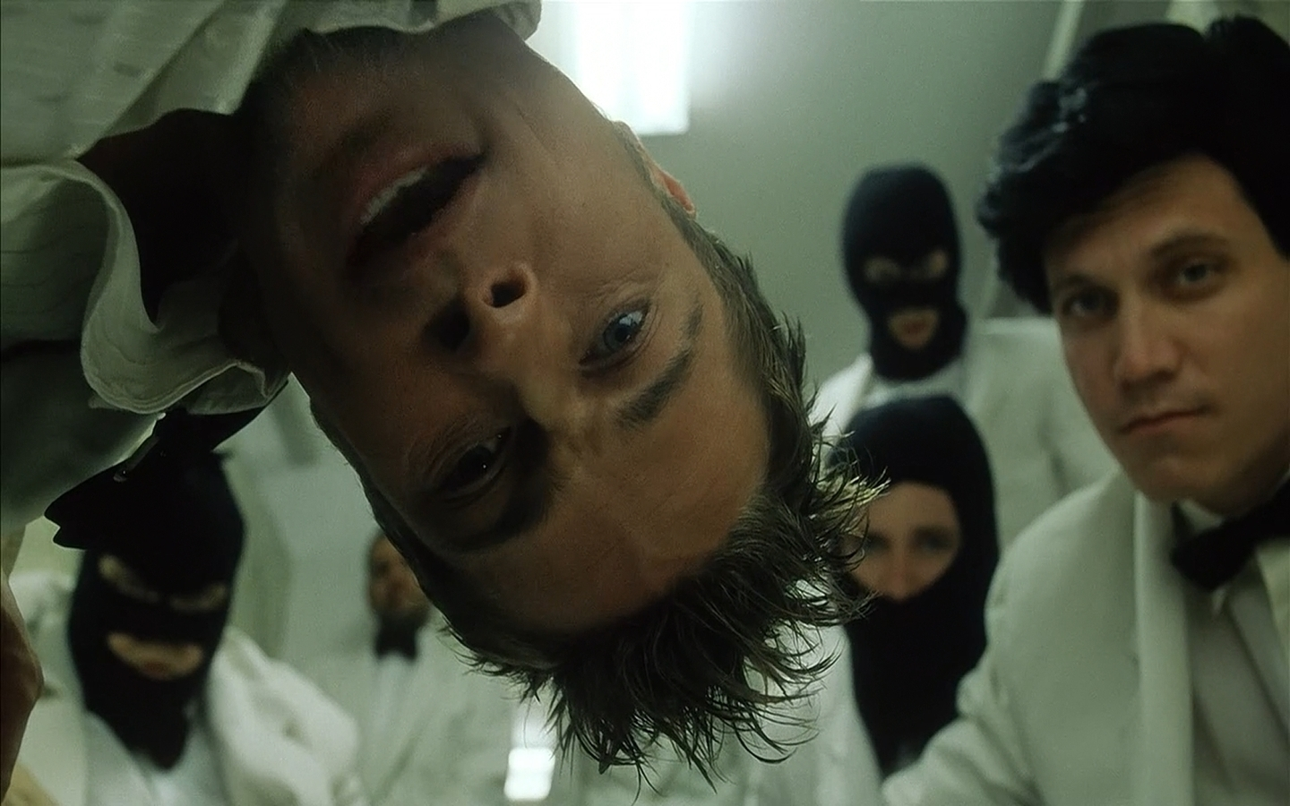

Slide 23
Story Arc
Climax
ACT 1
ACT 2
ACT 3
Crisis
Falling Action
Rising Action
Routine
Resolution
Inciting
Incident
Beginning
End

Slide 24
Crisis
The character must confront the lie
They can’t ignore the lie anymore

Slide 25
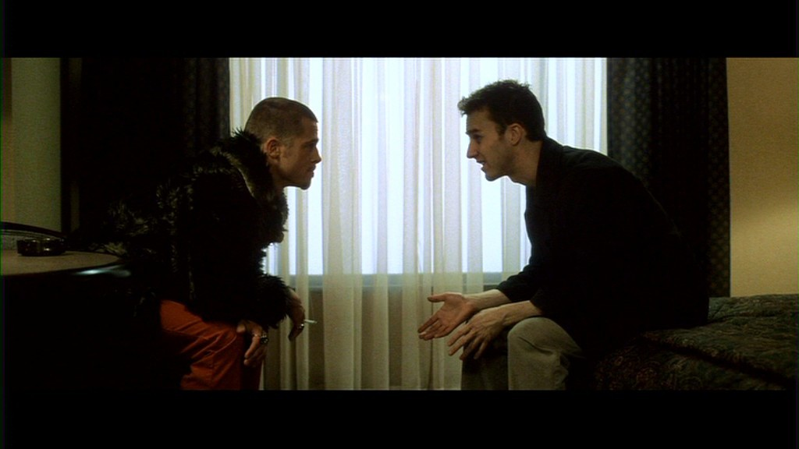

Slide 26
Story Arc
Climax
ACT 1
ACT 2
ACT 3
Crisis
Falling Action
Rising Action
Routine
Resolution
Inciting
Incident
Beginning
End

Slide 27
Falling Action
The consequences of overcoming the lie
Action dies down

Slide 28
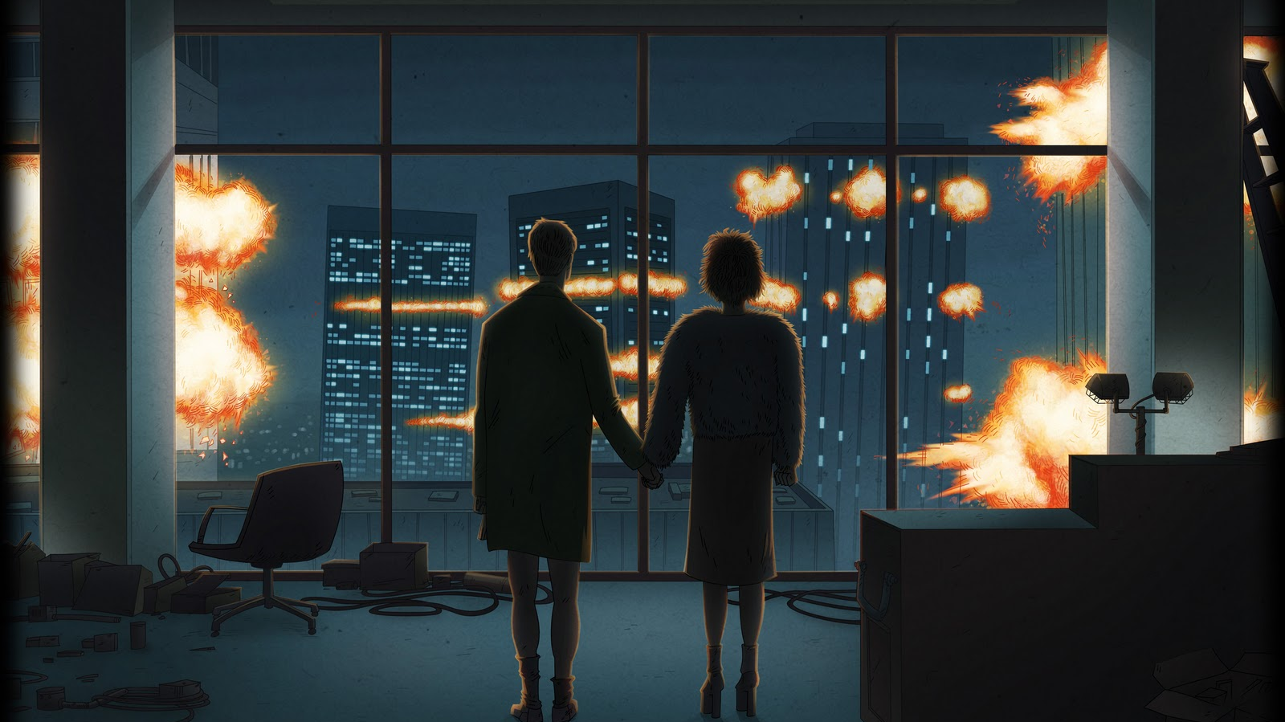

Slide 29
Story Arc
Climax
ACT 1
ACT 2
ACT 3
Crisis
Falling Action
Rising Action
Routine
Resolution
Inciting
Incident
Beginning
End

Slide 30
Resolution
The final outcome
Maybe a short explanation of what will happen

Slide 31
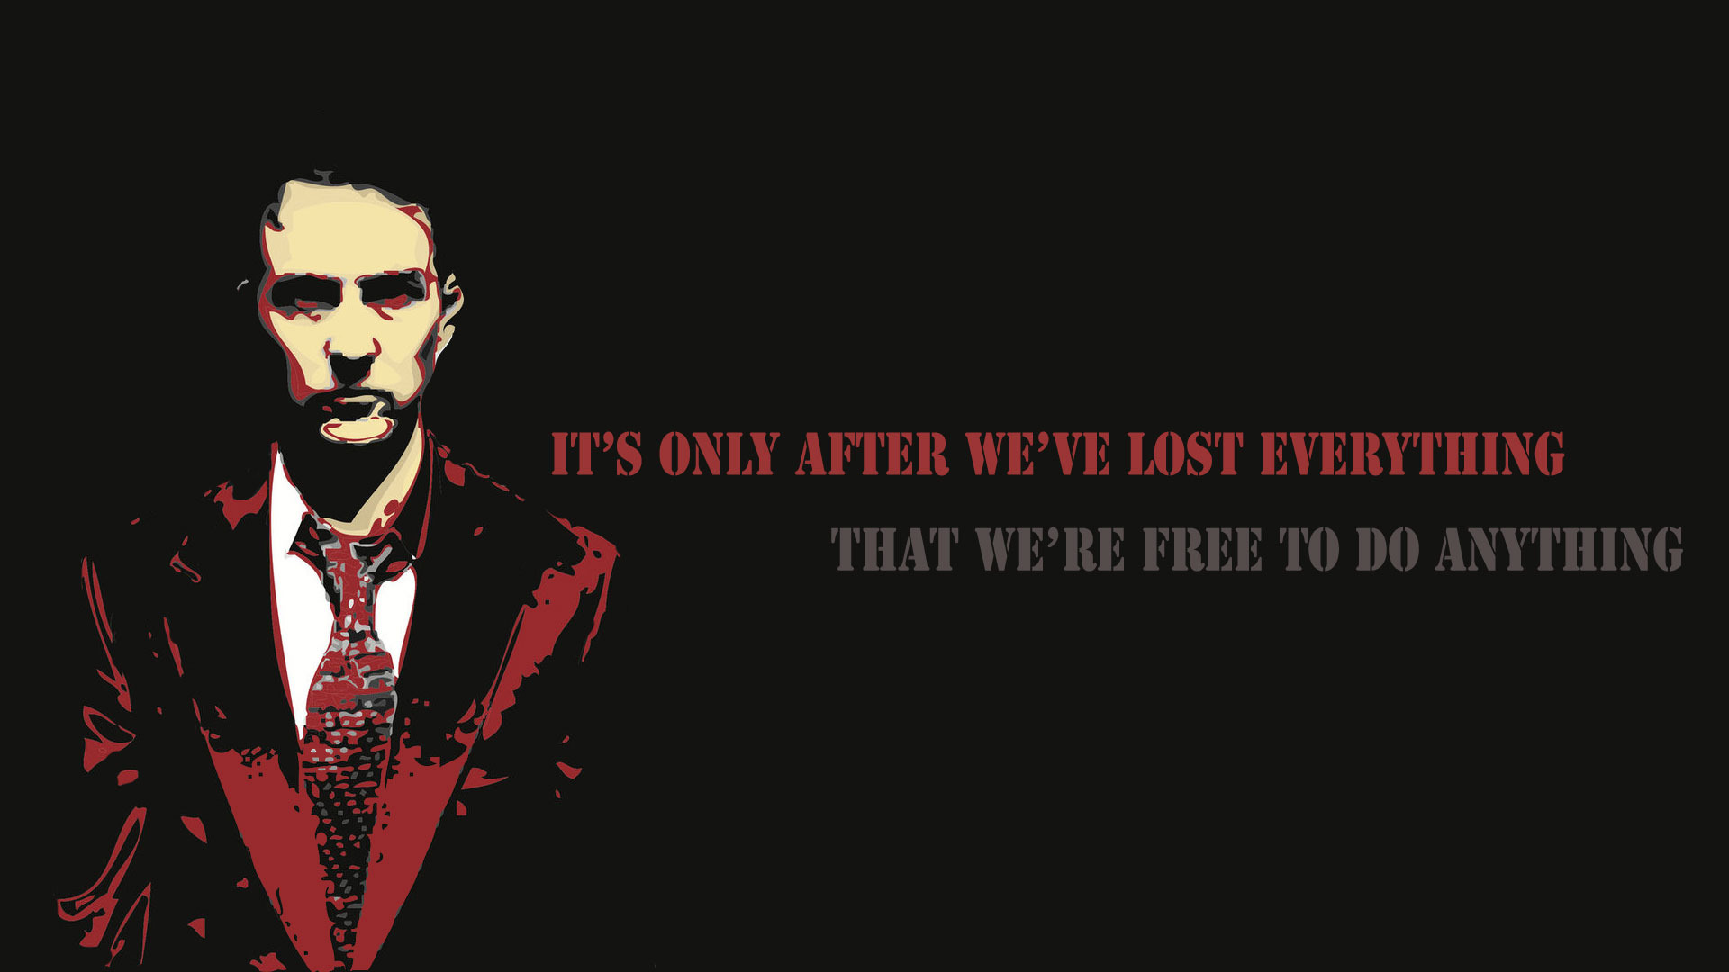

Slide 32
Show
Tell
So…
And then..

