Slide 1
FEED
BACK

Slide 2
I worked hard.
I doubt my ability.
It was difficult for me.

Slide 3
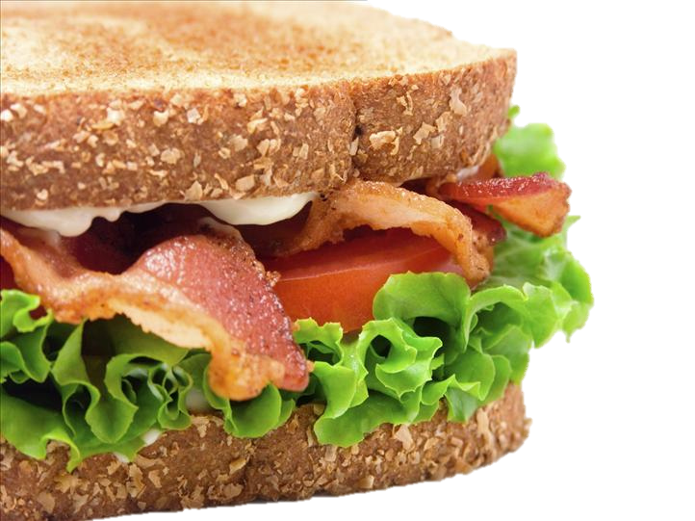
Compliment Sandwich
Compliment
Criticism
Compliment

Slide 4
compliment

Slide 5
Complimenting Work
Positive
Encouraging
Specific
happy
future behavior
meaningful

Slide 6
Complimenting a Person
Honest
Achievements
Point of pride
Not obvious
genuine
not physical
proud
personal

Slide 7
SNOW
BALL
compliments

Slide 8
Good Job
Very well written
The backstory for Fiona was quite thorough

Slide 9
Wow. Amazing.
I really like how Jake overcame his shyness
You did a better job than I expected.

Slide 10
You have a talent for writing
Keep up the good work
You followed the instructions

Slide 11
criticism

Slide 12
Criticism
Improvement
Not personal
“I think..”
Development
Less offensive

Slide 13
You should describe Sandra’s lie better.
I would like to know more about Sandra’s lie
You didn’t explain Sandra’s lie

Slide 14
I think the climax needs to be explained better.
I was disappointed in the climax of the story.
The climax was interesting.

Slide 15
Compliment Sandwich
Read a story.
Write your feedback.

