Slide 1
3.15.4.5 2.18.5.1.11.9.14.7

Slide 2
Code Breaking

Slide 3
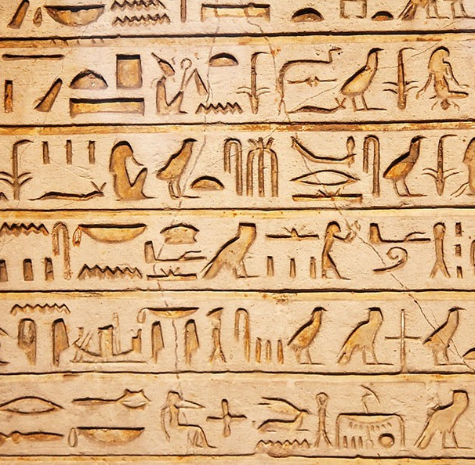
Writing as a Code
Pictograms
Ideograms
Logograms

Slide 4
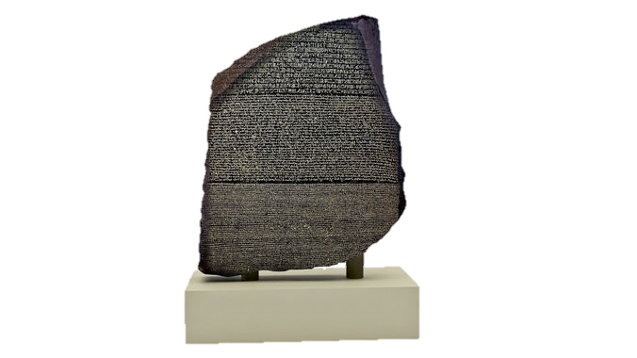
Writing as a Code
Rosetta Stone

Slide 5
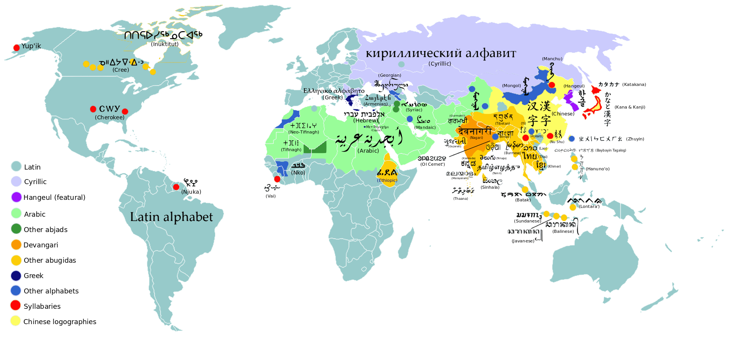
Writing as a Code
Phonograms

Slide 6
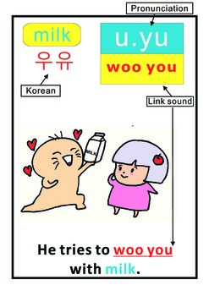
Writing as a Code
Phonograms

Slide 7
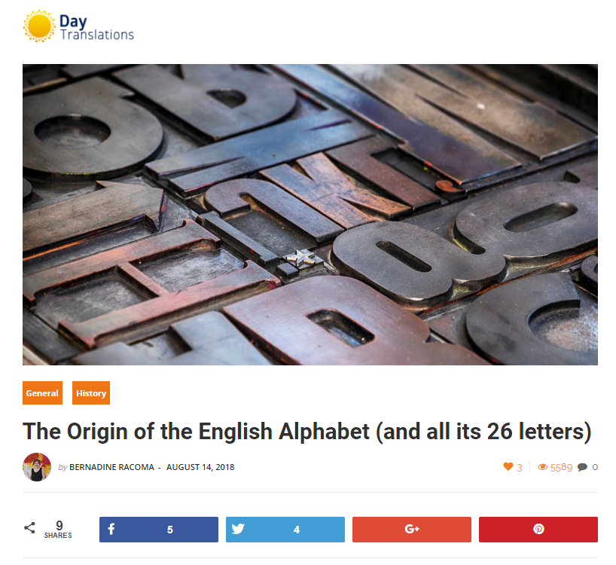
Writing as a Code
What is the English alphabet?
https://www.daytranslations.com/blog/2018/08/the-origin-of-the-english-alphabet-and-all-its-26-letters-12118/?fbclid=IwAR0vJmZN-siv6CHeAPz_ajlMv6B-I6jsOafduszEodX4cUhauC9CAxkQPqA

Slide 8
Cryptography

Slide 9
Substitution Cipher
Letters are replaced with other letters

Slide 10
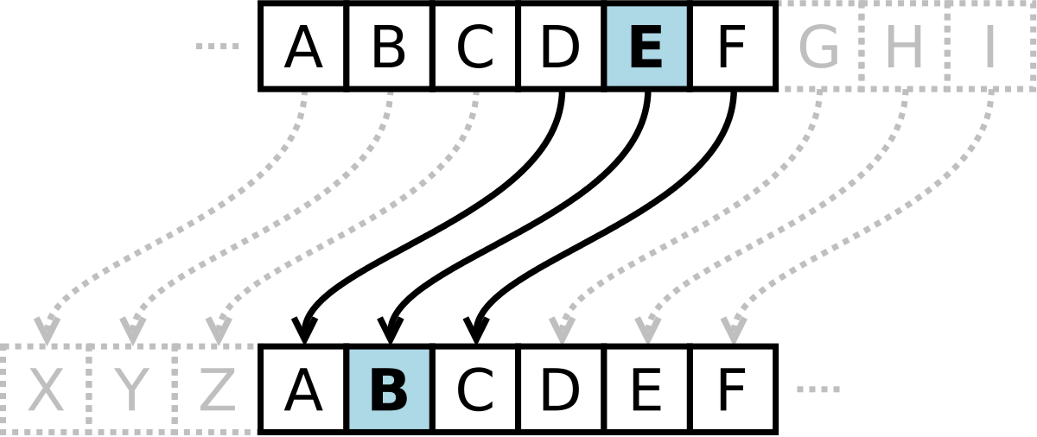
Substitution Cipher
Caesar Cipher

Slide 11
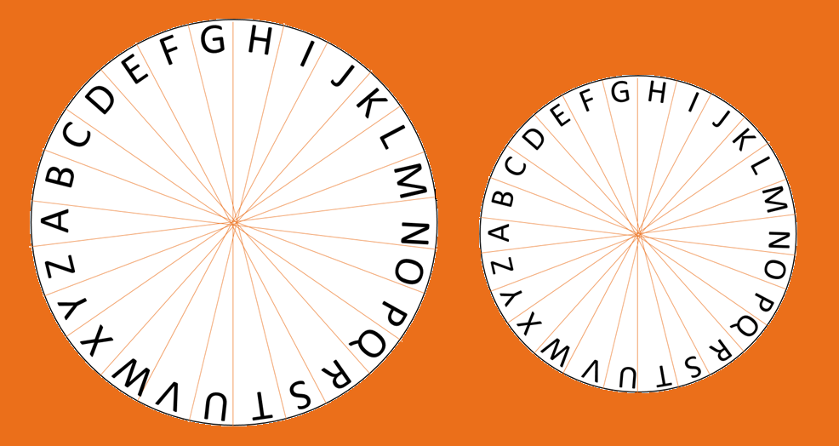
Cipher Wheel
Cut the printouts
Connect the Disks

Slide 12
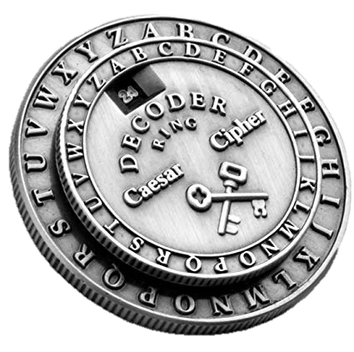
Caesar Cipher
+4 AHALDWJP
-8 KWMQTQ
-12 PAZMXP FDGYB
+7 UKXTDYTLM
ELEPHANT
COEILI
DONALD TRUMP
BREAKFAST

Slide 13
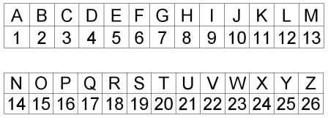
Substitution Cipher
Number Cipher

Slide 14
Substitution Cipher
Keyword Cipher

Slide 15
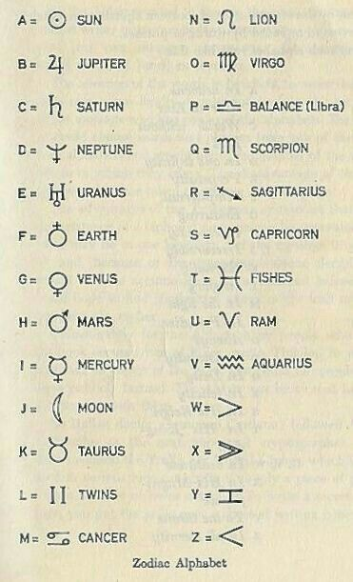
Substitution Cipher
Symbol Substitution

Slide 16
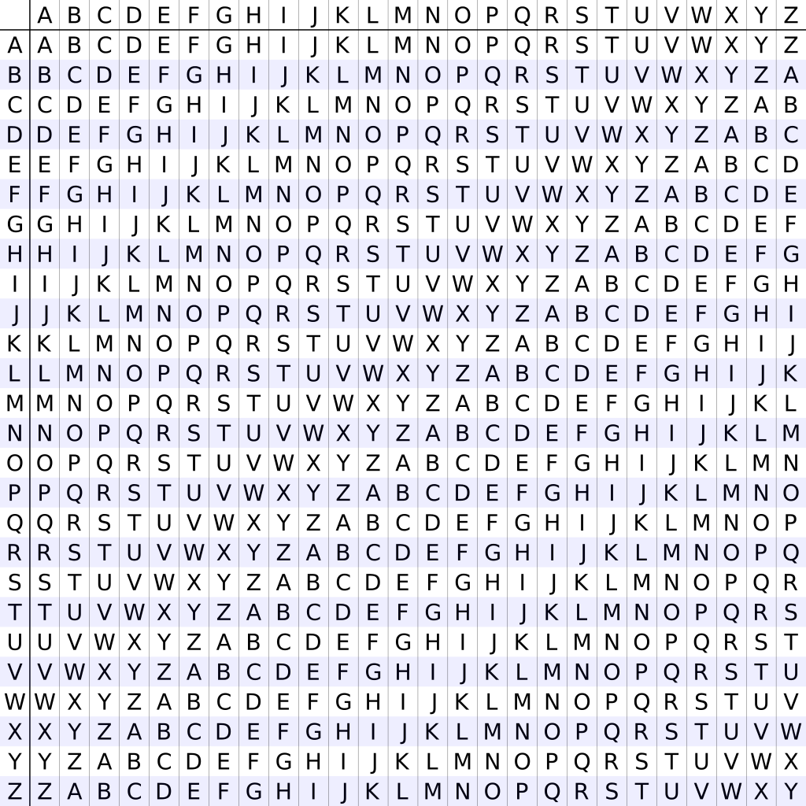
Substitution Code
Key Letter
Vigenère square
Cipher Letter
Output Code

Slide 17
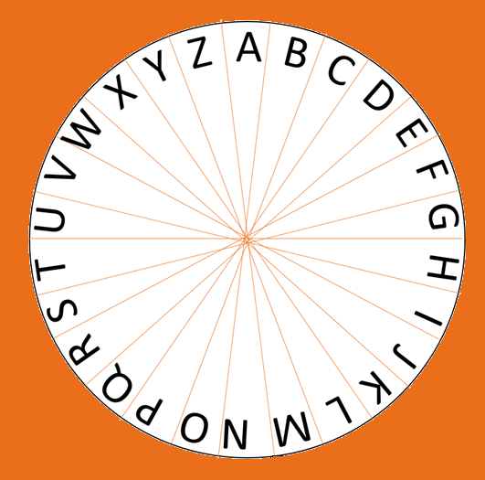
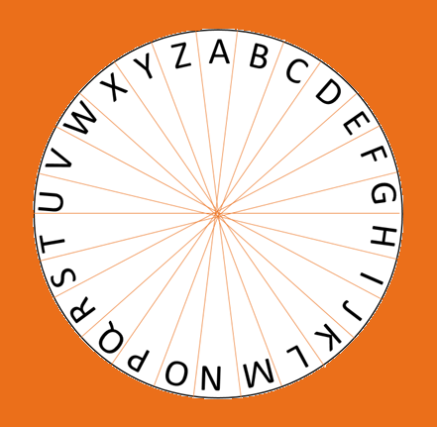
Substitution Code
Vigenère square
Using cipher disk
Key = TIM
Key String = TIMTIMTIMT…
Code = AMXIUQ

Slide 18
Vigenère Cipher
Key = CAT, Code = XIZGNXTE
Key = BACON, Code = HOQRWPB
Vigenere
Good Job

Slide 19
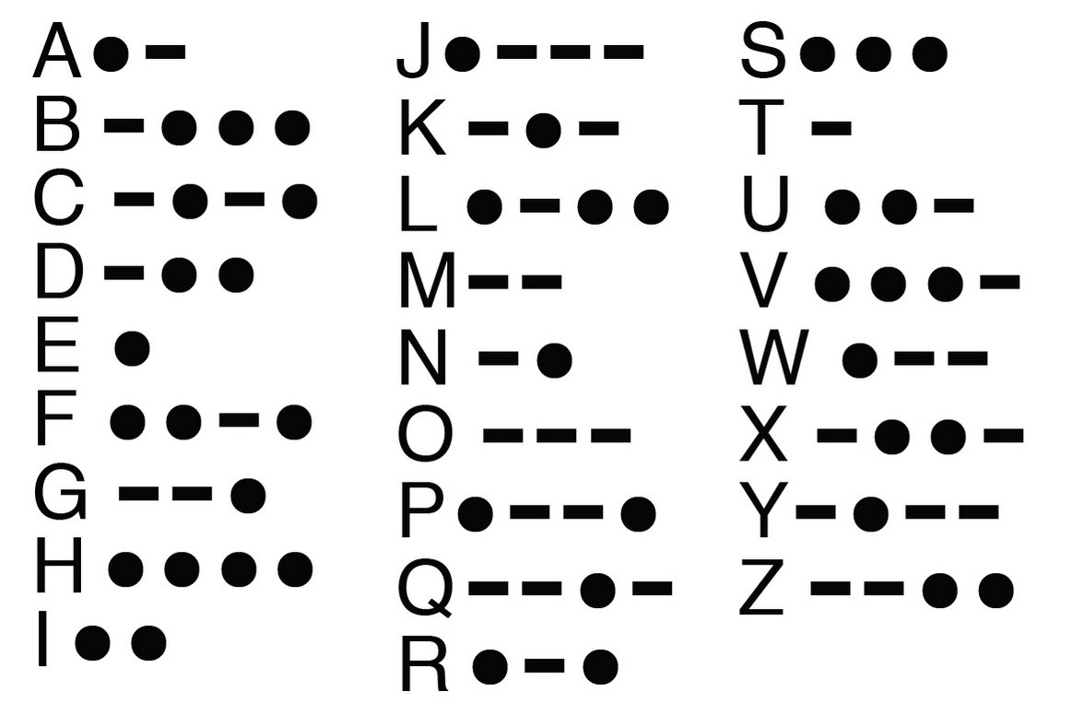
Substitution Cipher
Symbol Substitution

Slide 20
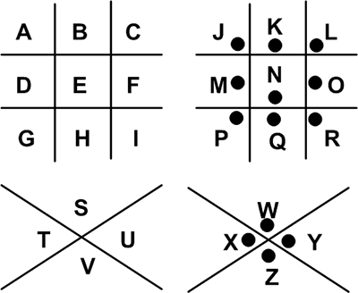
Substitution Cipher
Pigpen Cipher

Slide 21
Pigpen Cipher
CIPHER
ENGLISH
FIND THE UNICORN
Cipher
English
Find the Unicorn

Slide 22
Substitution Cipher
Letters are the same, position changes

Slide 23
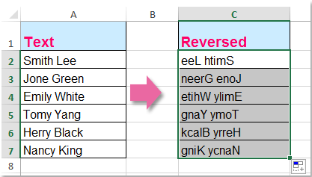
Transposition Cipher
Reverse Order

Slide 24
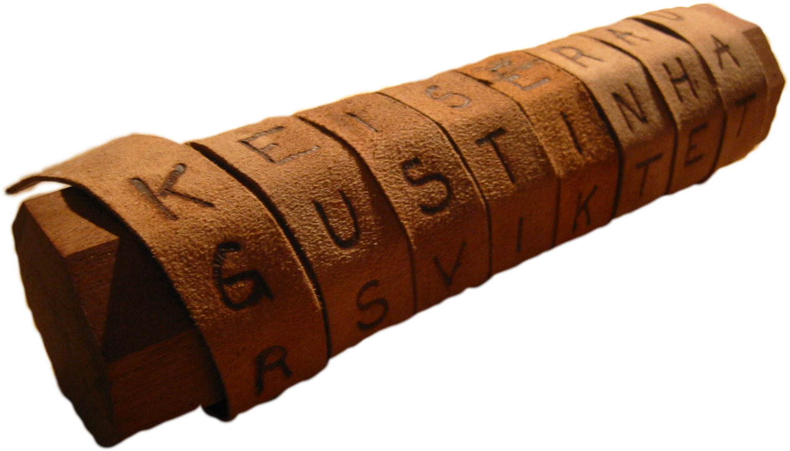
Transposition Cipher
Scytale

Slide 25
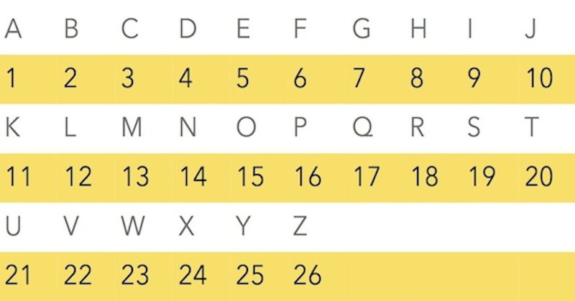
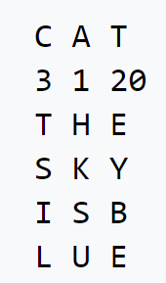
Transposition Cipher
Columnar Cipher
Key = cat
CAT = ACT
HKSUTSILEYBE

Slide 26
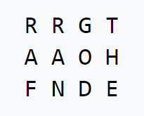
Transposition Cipher
Chinese Cipher
RRGT AAOH FNDE

Slide 27
Mexican Army Cipher Wheel

Slide 28
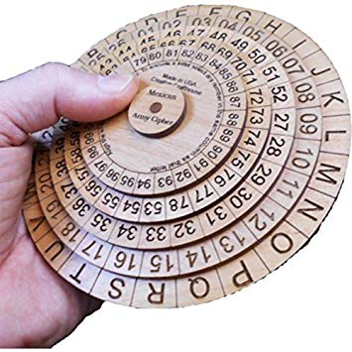
Mexican Army Cipher Wheel
Cut the disks
Connect the Disks

Slide 29
Mexican Army Cipher Wheel
Create a Code
Choose a ‘key’
Use any of the 4 numbers under each letter.

Slide 30
Pigpen Cipher
Key = A08526483
5722252296390140
9552239412 19876413
00644101405544
Toronto
Maple Leaf
Raptors

Slide 31
Classic Cryptology
All of these ciphers are easily broken these days.

Slide 32
Guess Who

Slide 33
Guess Who
There is a spy in the game.
Break the code to find the spies.

Slide 34
Guess Who
Spy #1
Spy #2
Spy #3
Spy#4
Megan
Joshua
David
Ashley

Slide 35
Code Breaker
You know this is in English, what do you know about English…
Common letters repeat (e t a o i n s r h l d c u m f p g w y b v k x j q z)
Vowels in each word
1 letter, 2 letter, 3 letter words.

Slide 36
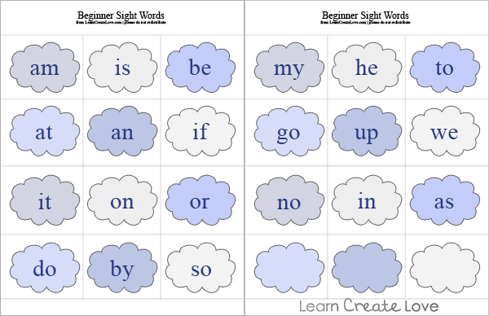
Hint
#1
Hint
#2
Hint
#3
Hint
#4
= H
= A
= N
= C
Can you decipher the message?
Hint
#5
Answer
Hello Earth. We come in peace. Let’s be friends.

