Slide 1
ᛁᛝᚸᛚᛁᚳ ᛫ ᚱᚢᚾᛋ᛫
English Runes

Slide 2
Anglo-Frisian Link

Slide 3
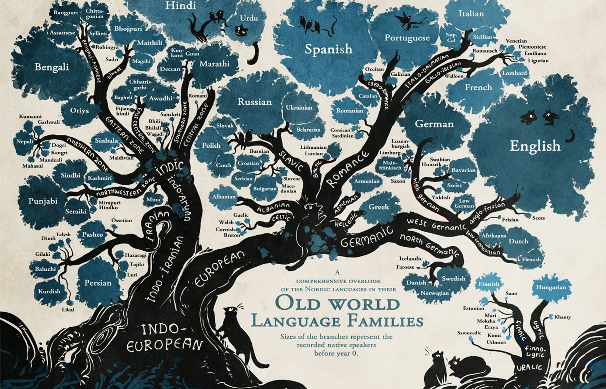
Anglo-Frisian Link
History

Slide 4
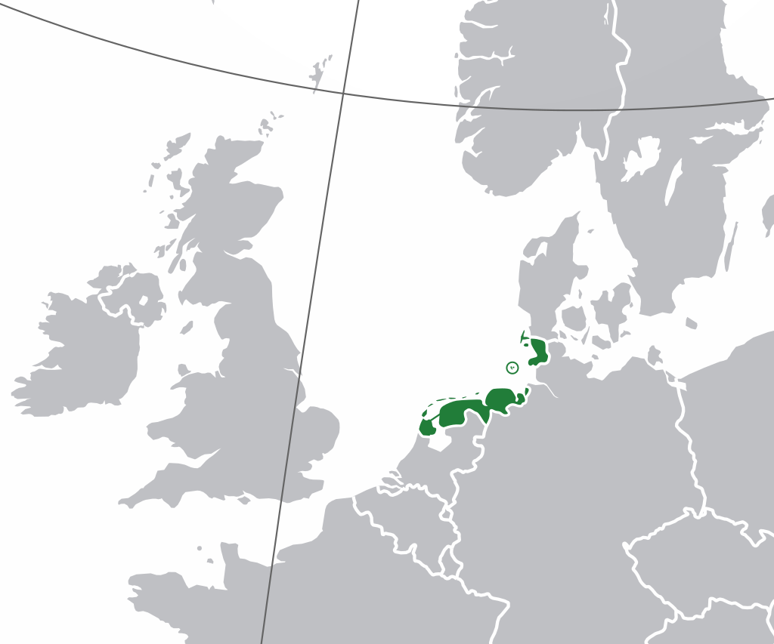
Anglo-Frisian Link
History

Slide 5
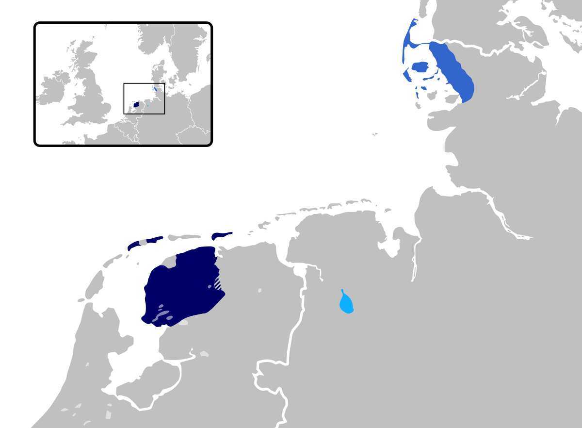
Anglo-Frisian Link
History

Slide 6
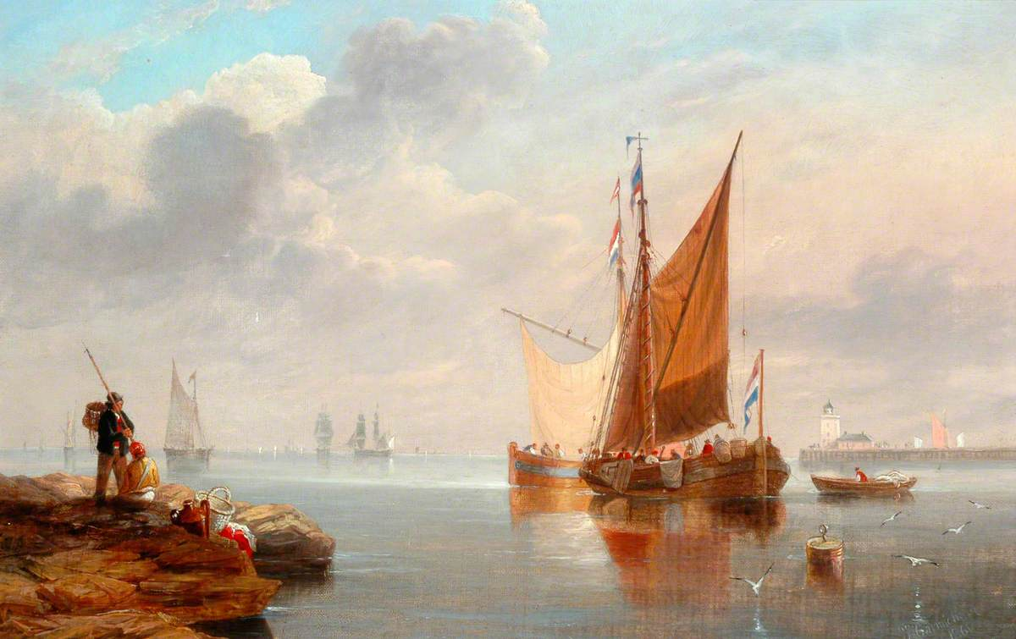
Anglo-Frisian Link
History

Slide 7
Anglo-Frisian Link
Grandmother
This is my “Beppe”
Video

Slide 8
Anglo-Frisian Link
What was the story about?
What words did you hear?
Video

Slide 9
What was the story about?
Anglo-Frisian Link
She and her sister came on a boat and arrived in Halifax in 1955.
They were on the ocean for 10 days.
Then they rode a train to here (Dunnville).
She is 84 years old.
At the end she said she was sitting at home with my parents
Video

Slide 10
What words did you hear?
Anglo-Frisian Link
Icke
Mi
Suster
Ymigrêre
Jier
Oseaan
Halifax
Komme
I
My
Sister
Immigrate
Year
Ocean
Halifax
Come
Video

Slide 11
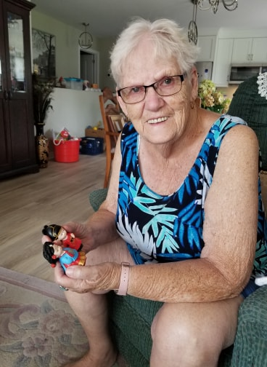
Anglo-Frisian Link
Video

Slide 12
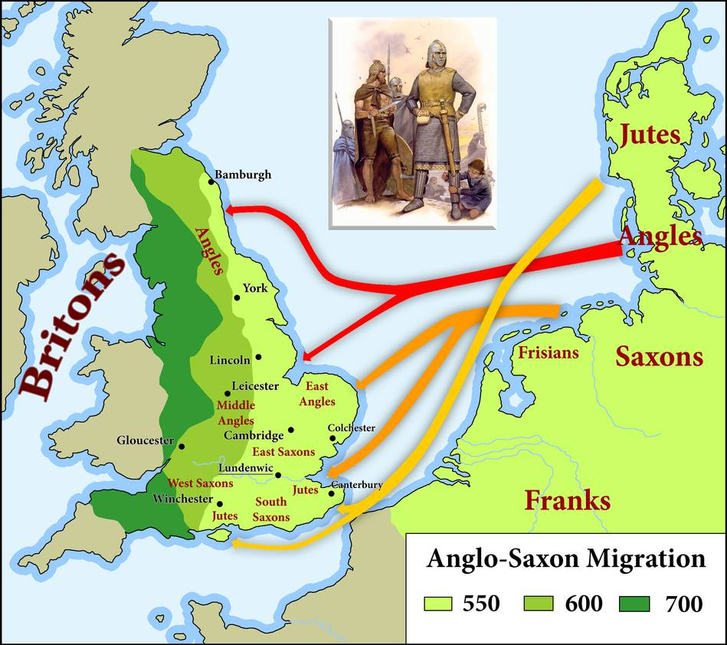
Anglo-Frisian Link
Language Legacy

Slide 13
Hert
Skiep
Wêr
See
Stoarm
Simmer
Sied
Twa
Trije
Fjouwer
Heart
Sheep
Where
Sea
Storm
Summer
Seed
Two
Three
Four
Anglo-Frisian Link
Language Legacy

Slide 14
Anglo-Frisian Link
Bread, butter and green cheese is good for English and good for Fris.
Brea, bûter en griene tsiis is goed Ingelsk en goed Frysk.
Language Legacy

Slide 15
Runes

Slide 16
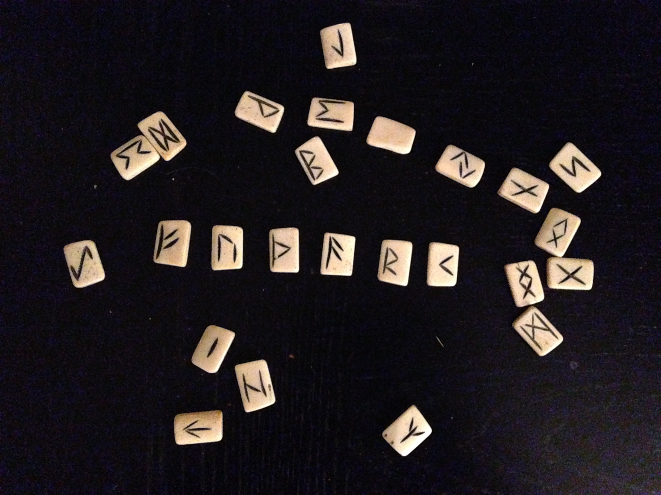
Early English
Futhorc Runes

Slide 17
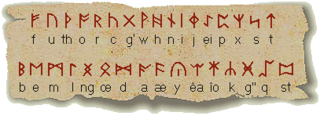
Early English
Futhorc Runes
7th century missionaries
Adds “th” and “w”

Slide 18
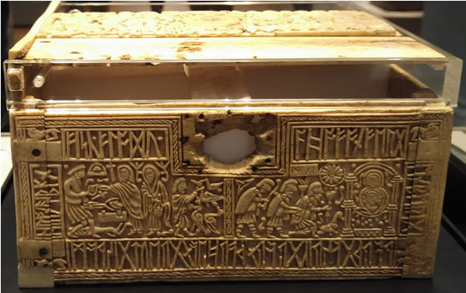
Early English
Futhorc Runes

Slide 19
Early English
Youth, son, daughter, in, on, into, and, the, numbers, drink, love and game
Anglo-Saxon

Slide 20
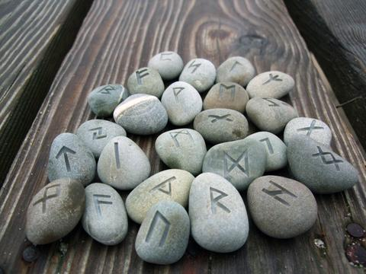
Make Your Own Rune
http://futhorc.com/futhorc/runic.php

Slide 21
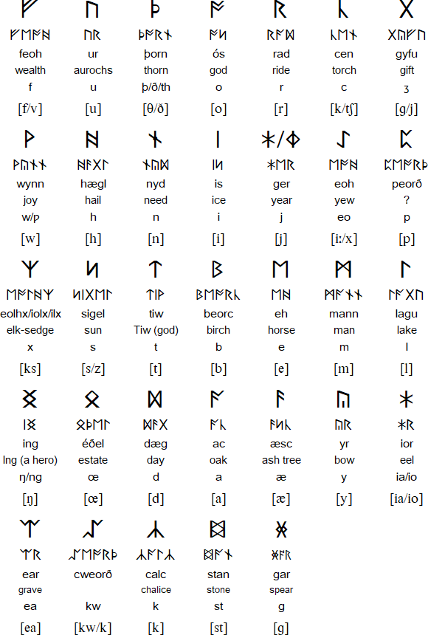

Slide 22
Guess the Time Period
Put the text in correct order

Slide 23
English Writing
Answers
https://www.youtube.com/watch?v=8fxy6ZaMOq8

Slide 24
English Writing
Robinson Crusoe
1719

Slide 25
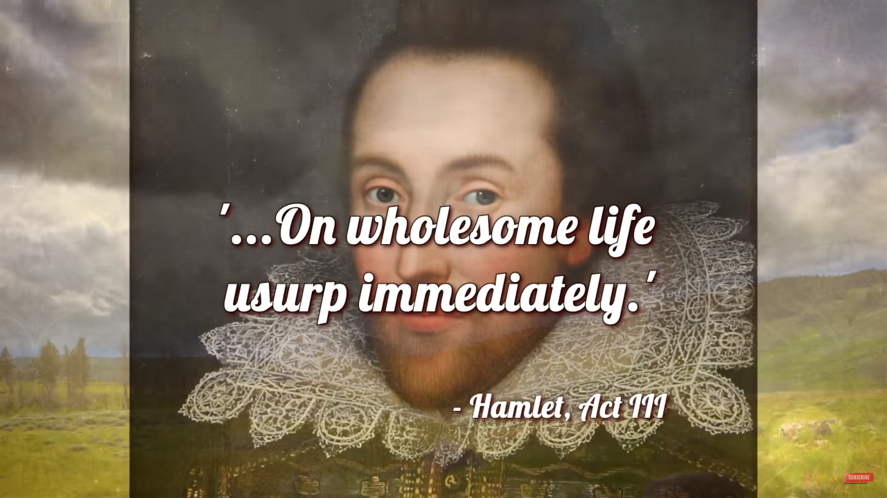
English Writing
Hamlet
1599

Slide 26
English Writing
Written in “Middle English”
1611

Slide 27
English Writing
The Canterbury Tales
1389

Slide 28
English Writing
Lord’s Prayer
Old English

Slide 29
English Writing
Beowulf
975 - 1010

Slide 30
English Writing
Beowulf
975 - 1010

