Slide 1
Beowulf
The Vikings
… and the Viking invasions

Slide 2
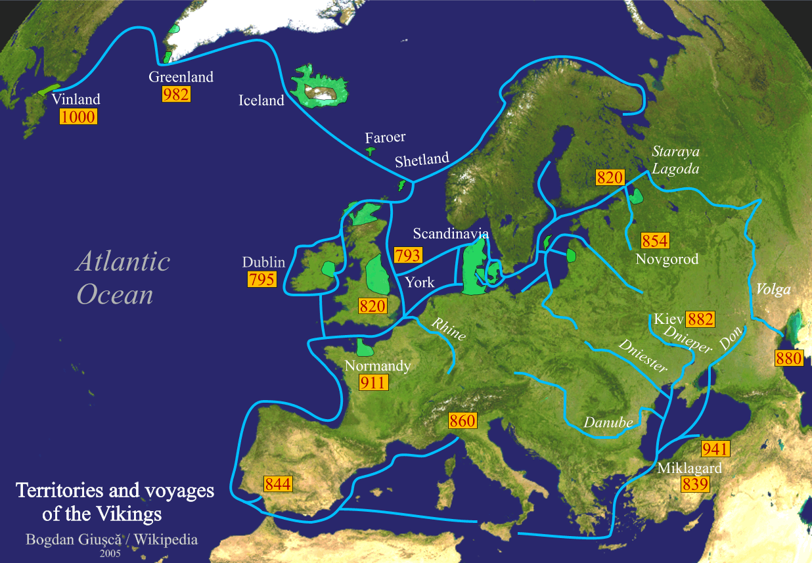
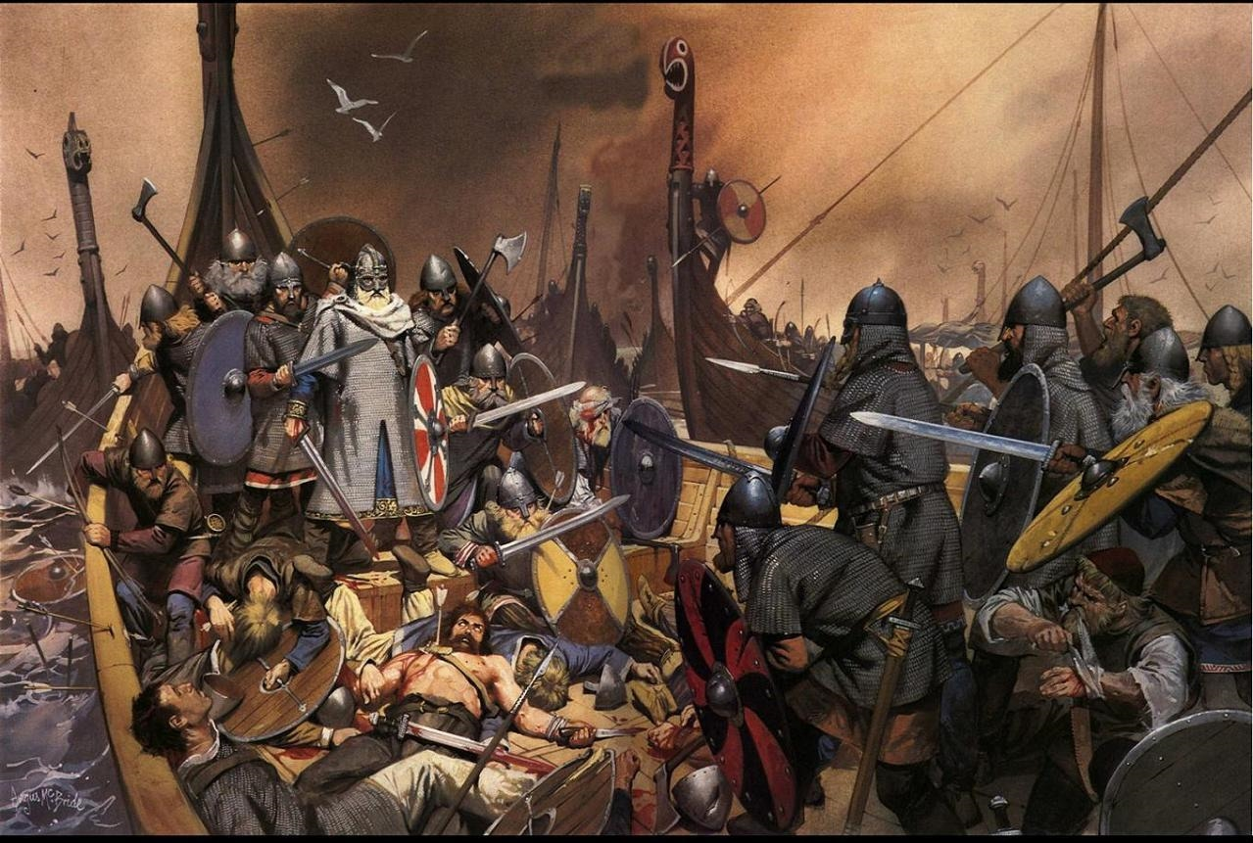
The Viking Age
793 – 1066 AD

Slide 3
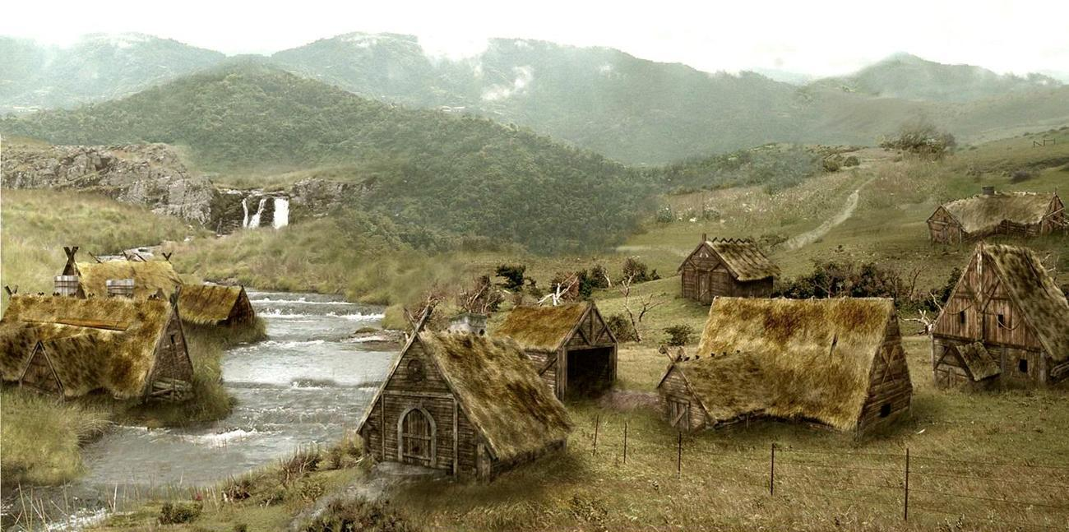
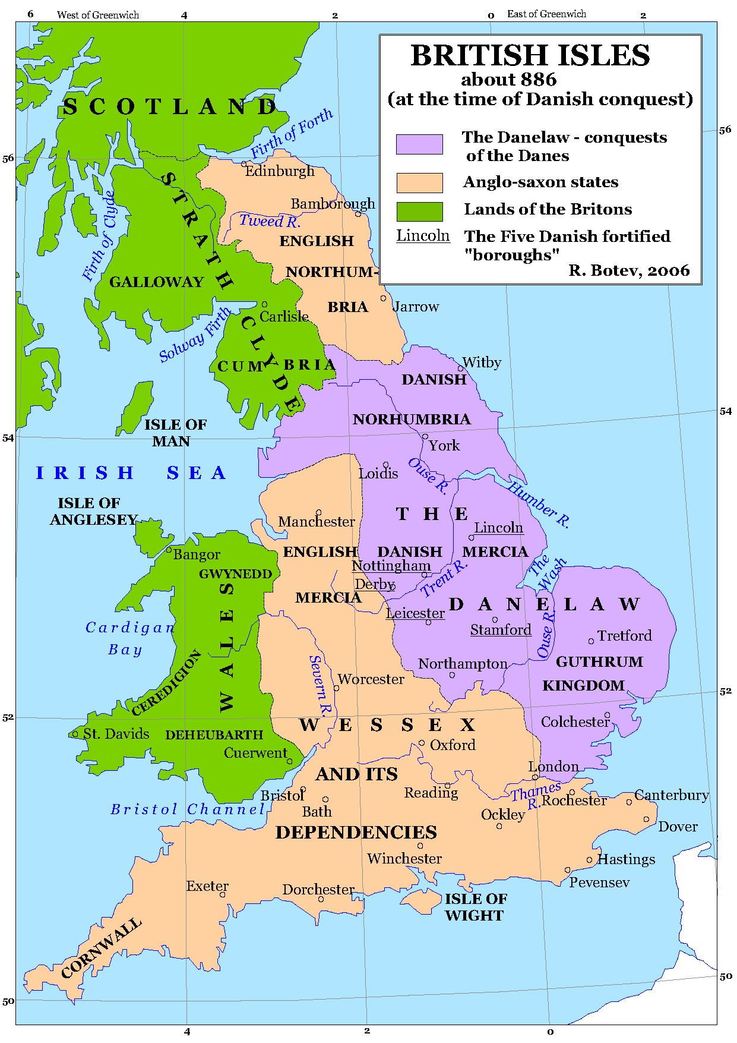
Danelaw
878 – 984 AD
Intermarrying
Settling
Exchange Language

Slide 4
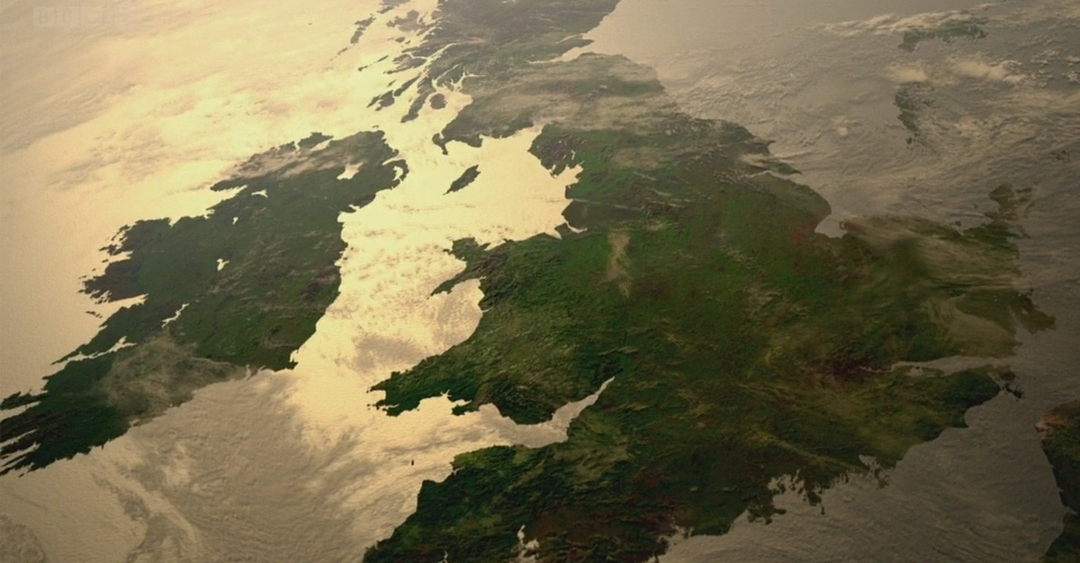
Old Norse Influence
Similar to Old English
Mutually intelligible
50% of Germanic words

Slide 5
https://www.youtube.com/watch?v=CDAU3TpunwM&fbclid=IwAR06FQSDin4QsvrKh-qv28nuu_57qv-M6VUULNc4kZvbJdyhkeH1n-PmEtg

Slide 6
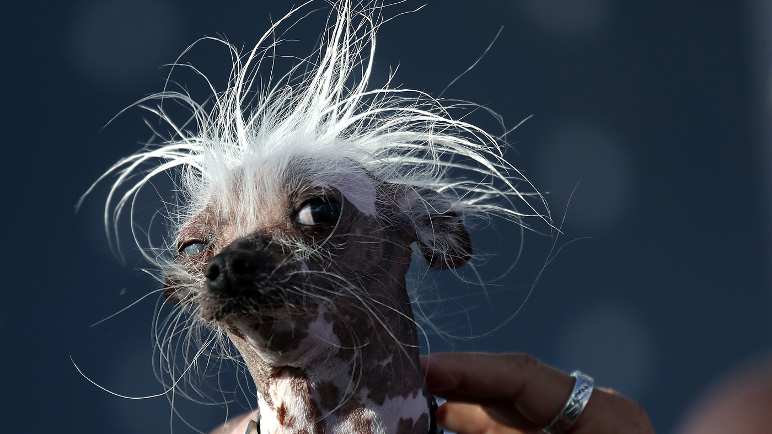
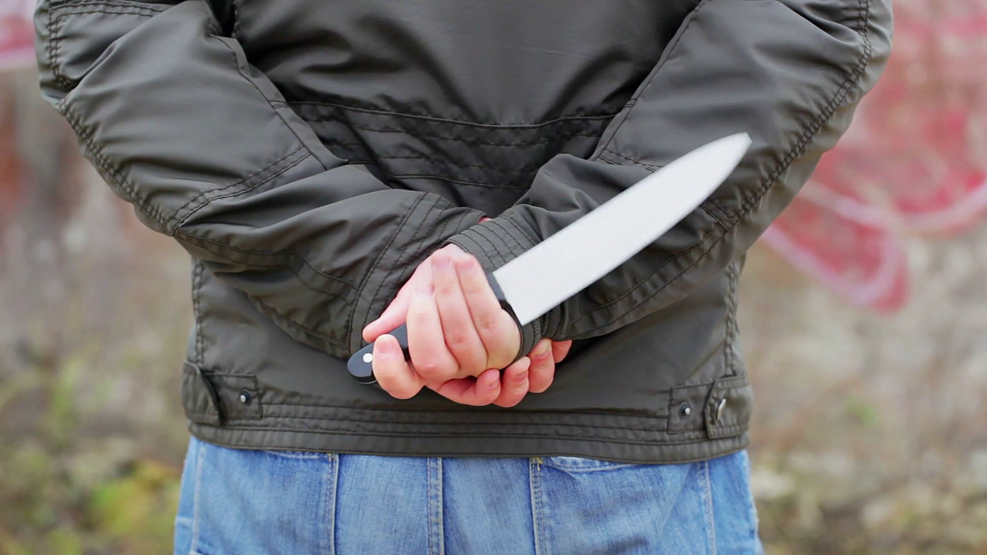
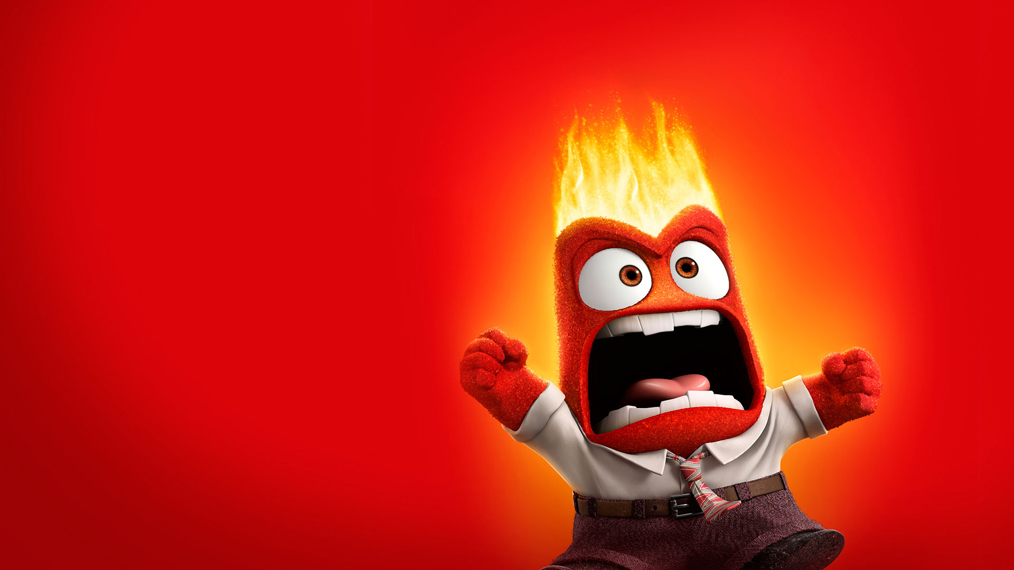
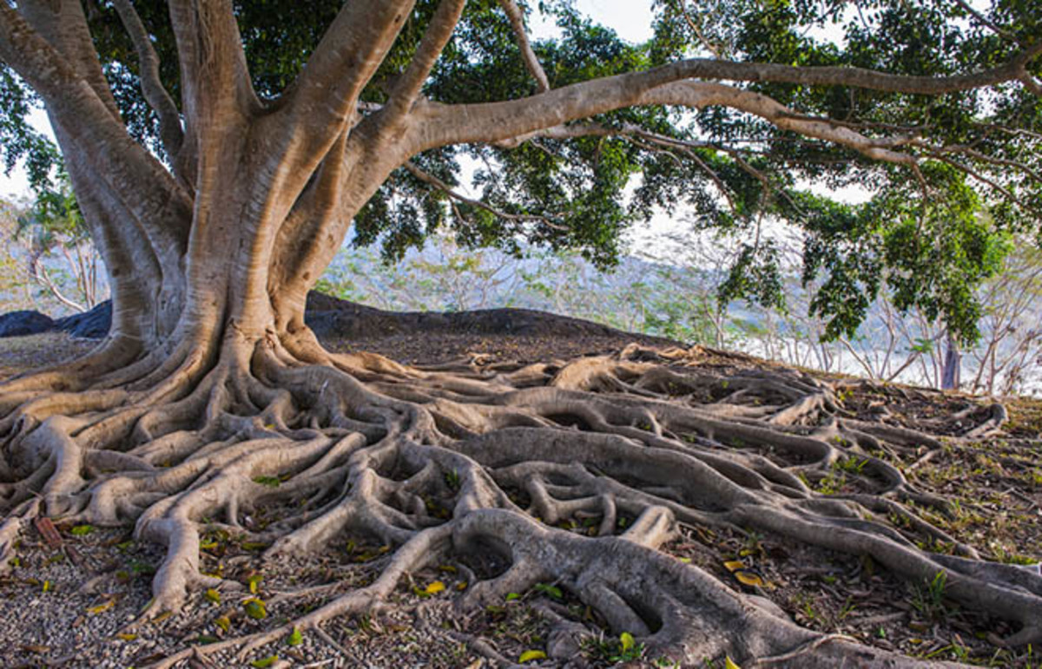
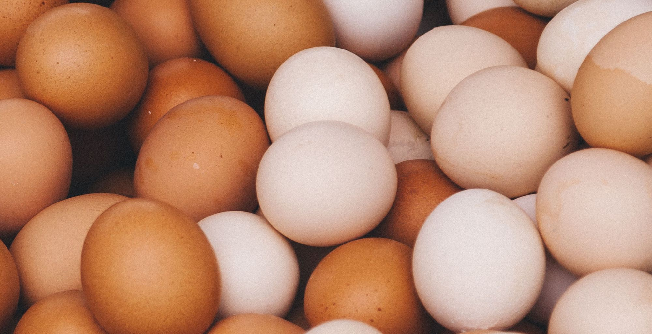
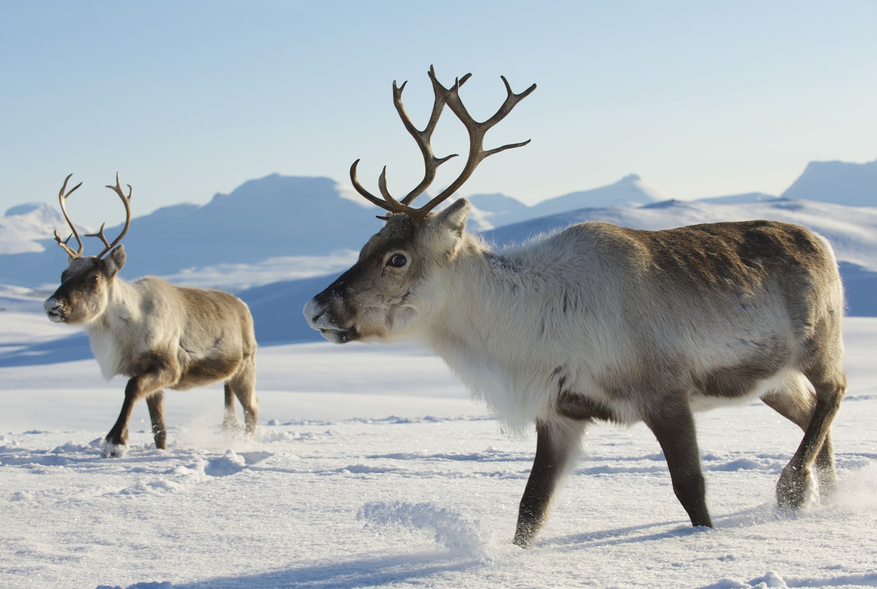
The Viking Age
Reindeer
die
take
Eggs
knife
ugly
Anger
Roots
Sky *
ill
Vocabulary
skin
leg

Slide 7
Old Norse Influence
Vocabulary
they, their, them
“are”
“sk” + “sh”

Slide 8
Old Norse Influence
Simplified Grammar
Synthetic to Analytic
Inflections to Word Order

Slide 9
Old Norse Influence
Subjective
Inflections
Possessive
Nominative
Genitive
Dative
Accusative
Object of words: to, for
Objective

Slide 10
Old Norse Influence
Inflections
https://oldenglishteaching.arts.gla.ac.uk/Units/3_Description_of_OE.html

Slide 11
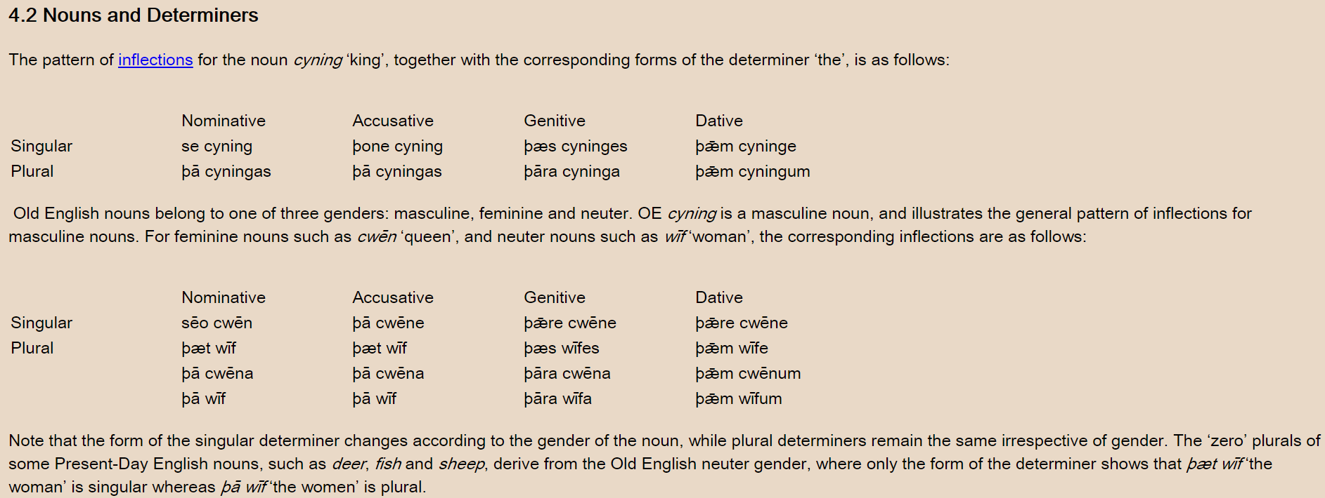
Old Norse Influence
Inflections
https://oldenglishteaching.arts.gla.ac.uk/Units/3_Description_of_OE.html

Slide 12
Old Norse Influence
Inflections
https://oldenglishteaching.arts.gla.ac.uk/Units/3_Description_of_OE.html

Slide 13
https://www.youtube.com/watch?v=CDAU3TpunwM&fbclid=IwAR06FQSDin4QsvrKh-qv28nuu_57qv-M6VUULNc4kZvbJdyhkeH1n-PmEtg

Slide 14
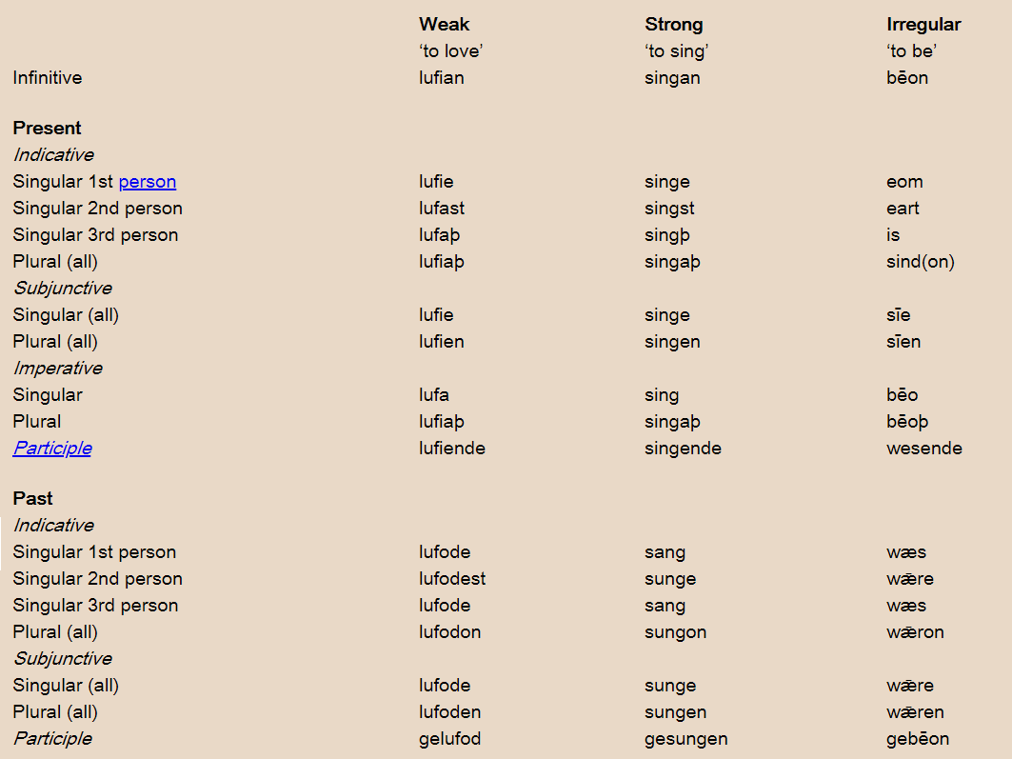
Old Norse Influence
Inflections
https://oldenglishteaching.arts.gla.ac.uk/Units/3_Description_of_OE.html

Slide 15
https://www.youtube.com/watch?v=CDAU3TpunwM&fbclid=IwAR06FQSDin4QsvrKh-qv28nuu_57qv-M6VUULNc4kZvbJdyhkeH1n-PmEtg

Slide 16
Old Norse Influence
Simplified Grammar
Plurals
-as
-a
-y_e
-an
-en
oxen, children, brethren

Slide 17
Old Norse Influence
Simplified Grammar
Auxiliary verbs added to compensate for the loss of inflections

Slide 18
Old Norse Influence
Simplified Grammar
Word order is similar to North Germanic syntax (Old Norse)

Slide 19
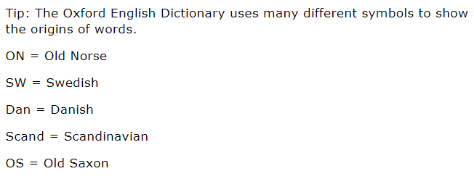
Can you find a word originating from Old Norse?

Slide 20
Beowulf
The Vikings
… and the Viking invasions

Slide 21
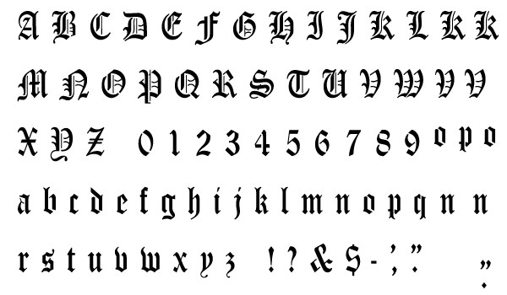
Beowulf
Old English

Slide 22
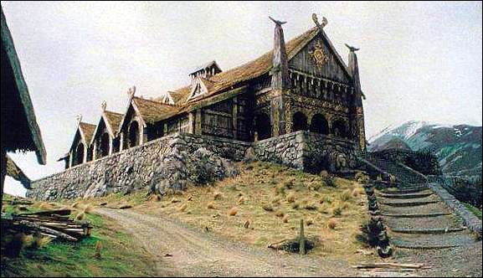
Beowulf
King Hrothgar builds a grand hall (Heorot)

Slide 23
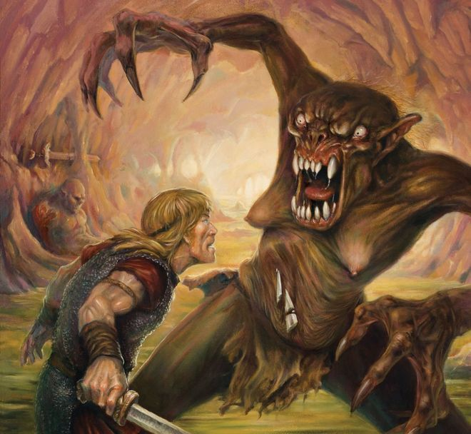
Beowulf
But there is a monster (Grendel) that keeps attacking and killing patrons.

Slide 24
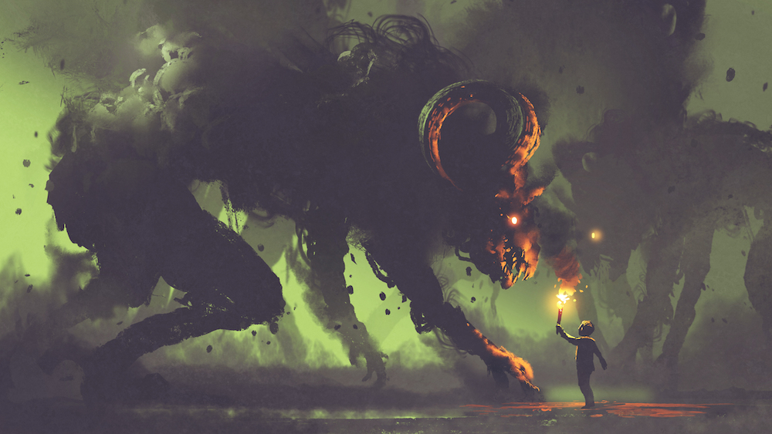
Beowulf
Beowulf comes to Denmark
He fights Grendel with no weapons

Slide 25
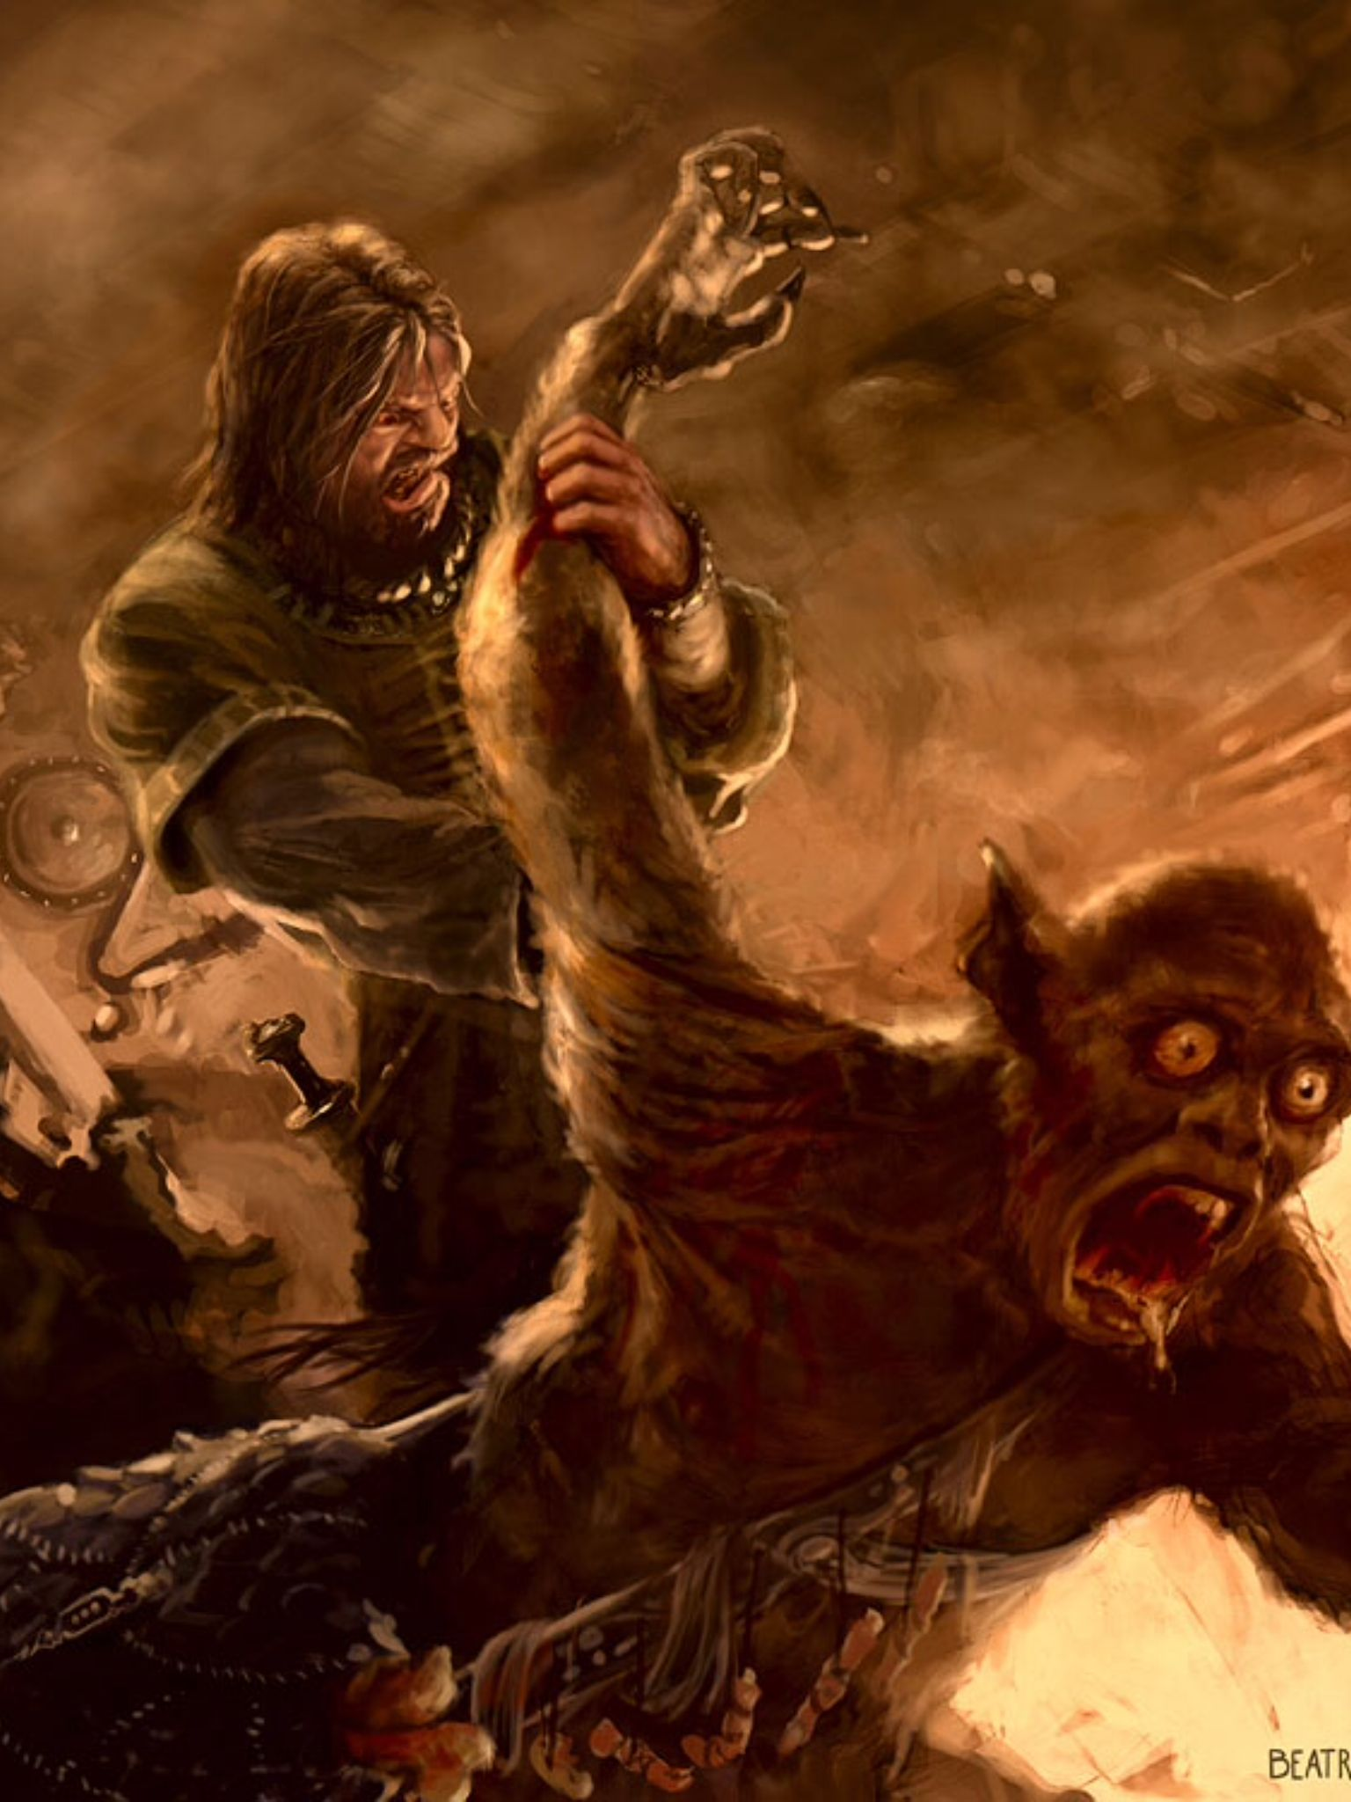
Beowulf
Beowulf defeats Grendel by ripping off his arm.

Slide 26
Beowulf
Grendel’s mother wants revenge
Beowulf goes to her underwater lair.

Slide 27
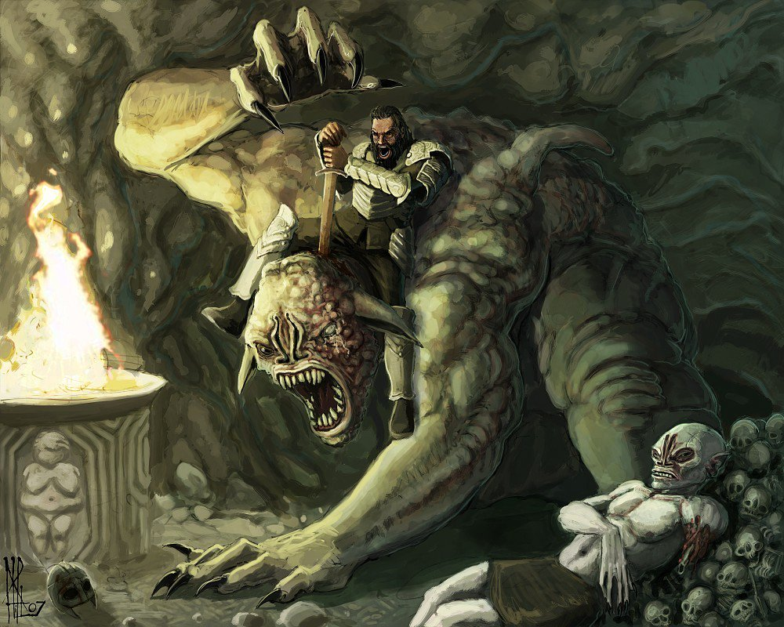
Beowulf
Beowulf cuts off Grendel’s mother’s head with a special sword.

Slide 28
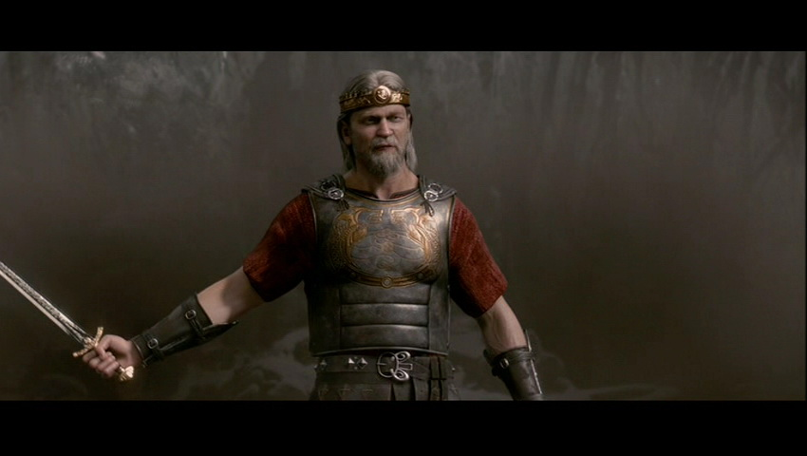
Beowulf
Beowulf eventually becomes king.

Slide 29
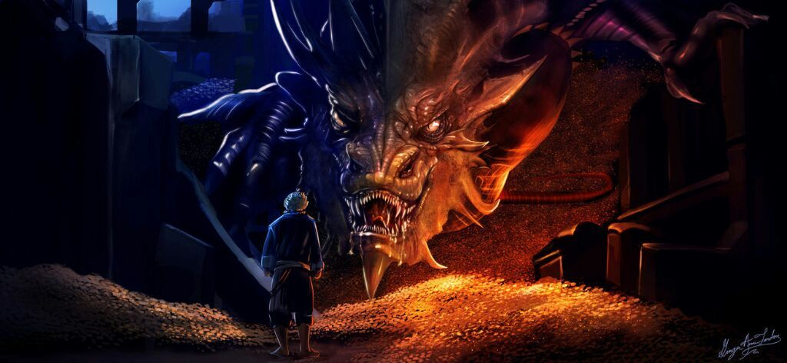
Beowulf
A slave escapes and steals gold from a dragon

Slide 30
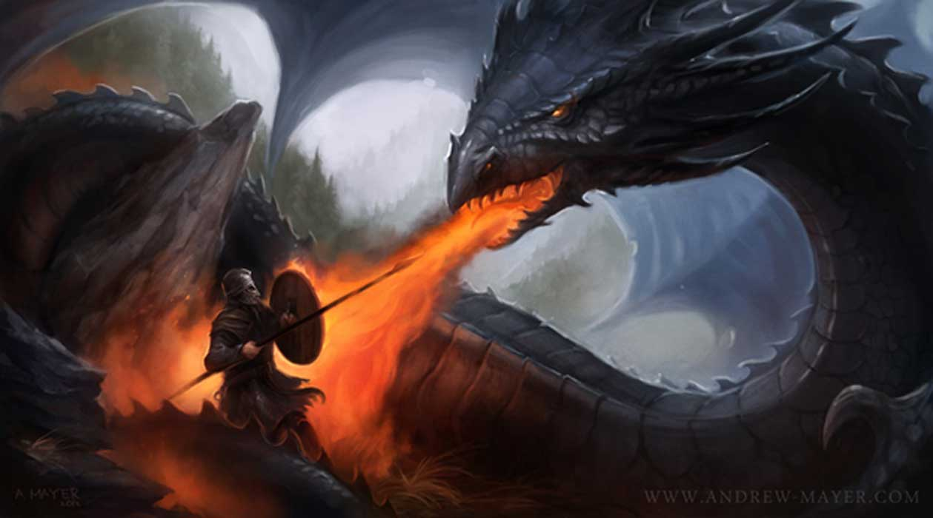
Beowulf
Beowulf (though old) kills the dragon but is wounded.

Slide 31
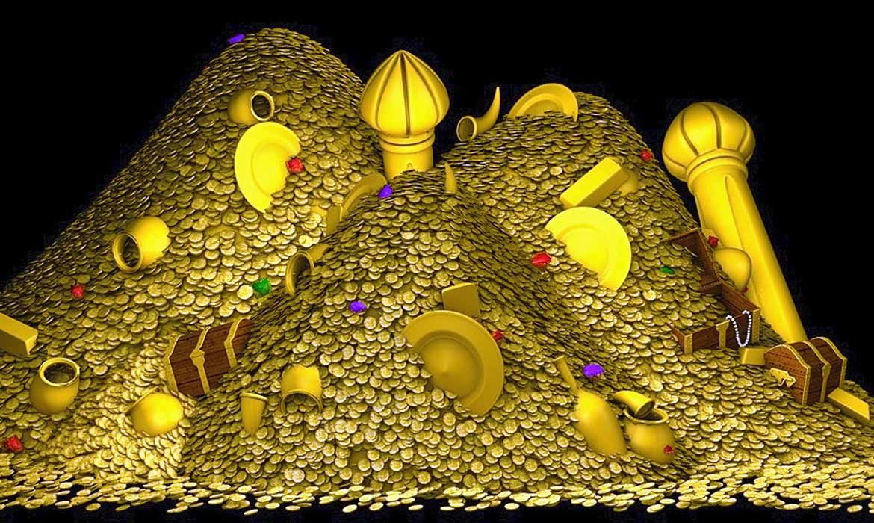
Beowulf
Before he dies, he asks to see the treasure of the dragon.

Slide 32
Beowulf
Kennings
Kennings are compound words that use figurative language to replace a common word.
Sky candle = sun
Game Link

Slide 33
Write Your Own Kenning
The Vikings
Secretly

Slide 34
Enigmages
The Vikings
Game
Game Link

Slide 35
Beowulf
Self Study
https://www.bl.uk/learning/langlit/changlang/activities/lang/timewords.html

Slide 36
Beowulf and Grendel's Mother
Lines 1357-1382
Hie dygel lond warigeað, wulfhleoþu, windige næssas, frecne fengelad, ðær fyrgenstream
under næssa genipu niþer gewiteð, flod under foldan. Nis þæt feor heonon milgemearces þæt se mere standeð; ofer þæm hongiað hrinde bearwas, wudu wyrtum fæst wæter oferhelmað.
land
wolf
windy
stream
under
flood under
that
miles
stand
over them hangs
wood
water

Slide 37
Beowulf and Grendel's Mother
Lines 1357-1382
þær mæg nihta gehwæm niðwundor seon, fyr on flode. No þæs frod leofað gumena bearna, þæt þone grund wite; ðeah þe hæðstapa hundum geswenced, heorot hornum trum, holtwudu sece,
feorran geflymed, ær he feorh seleð, aldor on ofre, ær he in wille hafelan hydan. Nis þæt heoru stow! þonon yðgeblond up astigeð won to wolcnum, þonne wind styreþ,
May (at) night
wonder
fire on flood
ground
hounds
horn
wood
will
hide
stow (place)
up
wind
stir

Slide 38
Beowulf and Grendel's Mother
Lines 1357-1382
lað gewidru, oðþæt lyft drysmaþ, roderas reotað. Nu is se ræd gelang eft æt þe anum. Eard git ne const, frecne stowe, ðær þu findan miht felasinnigne secg; sec gif þu dyrre.
Ic þe þa fæhðe feo leanige, eald gestreonum, swa ic ær dyde, wundnum golde, gyf þu on weg cymest."
now
yet
stow
Where you might find
Seek if you dare
old
did
old
if you away
come

