Slide 1
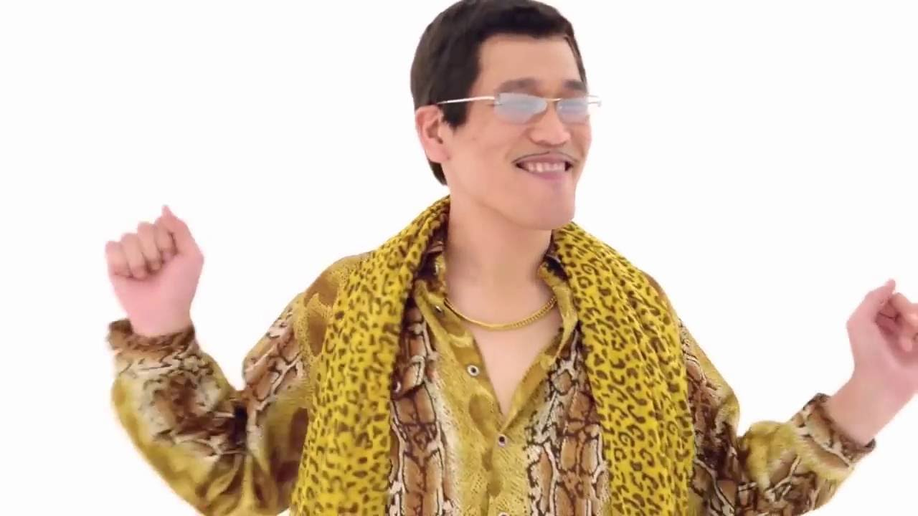
Enigmages

Slide 2
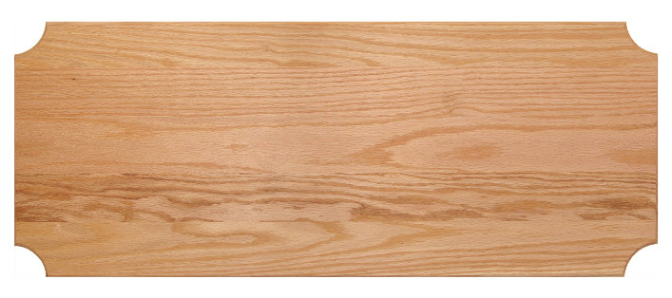
Enigmages
Two pictures (together) make a word.
Use the clue to make a word.
RAIN
BOW
/
1
point

Slide 3
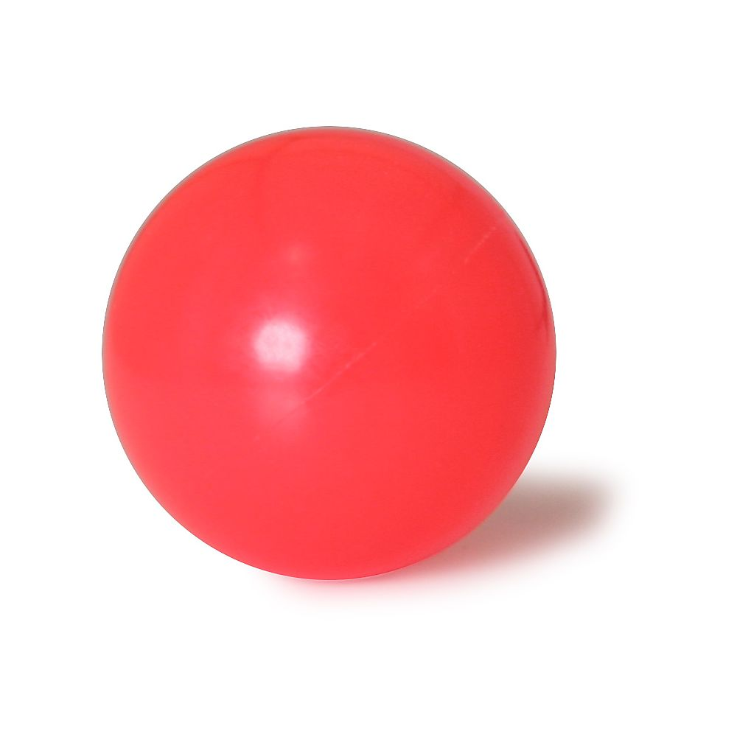
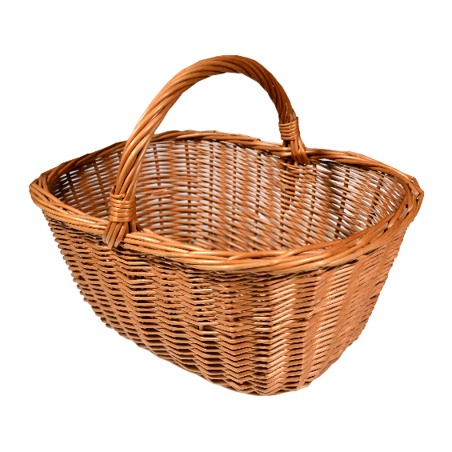
A sport
BASKET
BALL

Slide 4
Niagara
WATER
FALL

Slide 5
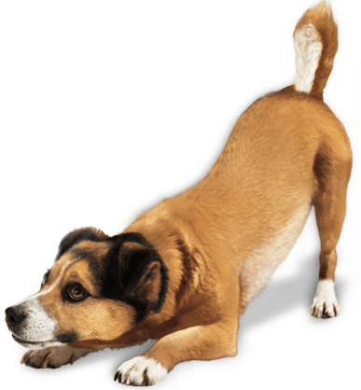
You can cook it on the barbeque
HOT
DOG

Slide 6
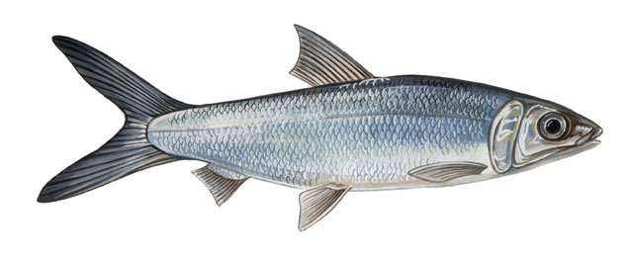
A pet
GOLD
FISH

Slide 7
You can play games or talk to people on it.
SMART
PHONE
i-
PHONE

Slide 8
I need to go to the dentist.
TOOTH
ACHE

Slide 9
A large plant
SUN
FLOWER

Slide 10
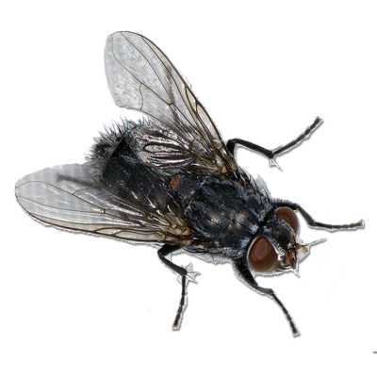
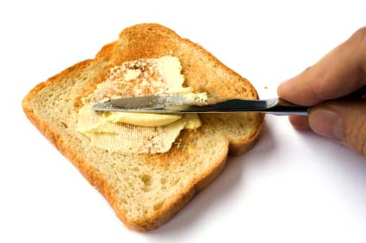
A beautiful insect.
BUTTER
FLY

Slide 11
A superhero
BAT
MAN

Slide 12
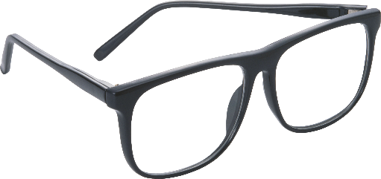
Wear it at the beach
SUN
GLASSES

Slide 13
May 30th
TO
DAY

Slide 14
Frozen song
SNOW
MAN

Slide 15
To make you beautiful.
LIP
STICK
EYE
LINER

Slide 16
The internet
ON
LINE

Slide 17
A dangerous job
FIRE
MAN
COW
BOY

Slide 18
A winter fight
SNOW
BALL

Slide 19
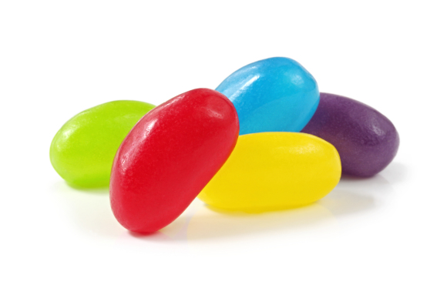
Sea animal with many legs.
JELLY
FISH

Slide 20
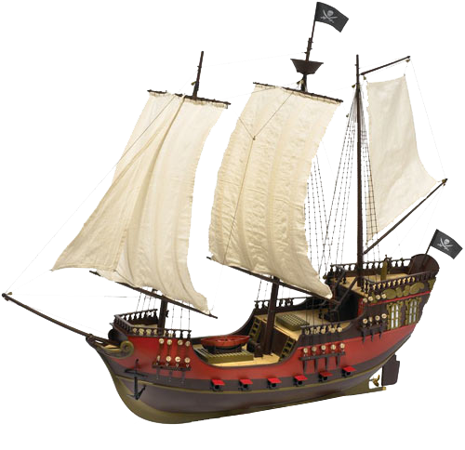
NASA
SPACE
SHIP

Slide 21
A body part
EYE
BALL

Slide 22
A large carnivorous insect
DRAGON
FLY

Slide 23
Take some medicine (Tylenol)
HEAD
ACHE

Slide 24
It lives on the ocean floor
STAR
FISH

Slide 25
An insect that has its own light
FIRE
FLY

