Slide 1
1066
The Norman Conquest

Slide 2
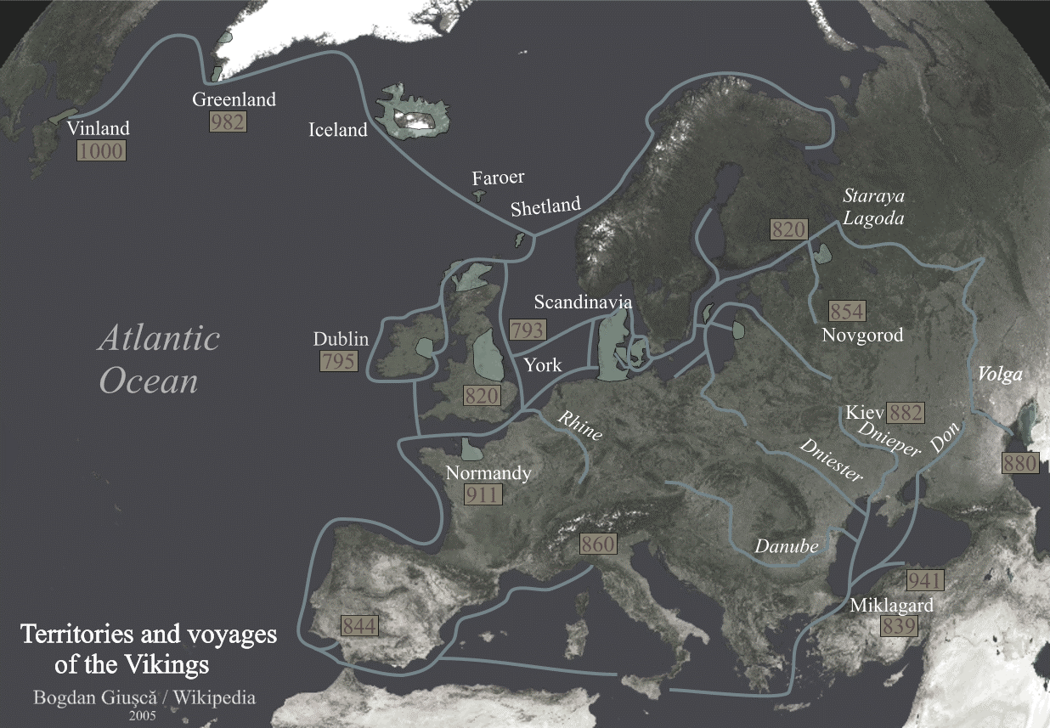
The Normans
911
Conquered “Normandy”
Rollo
Charles III

Slide 3
The Normans
1066
Conquered “England”
William the Conqueror
Battle of Hastings

Slide 4
The Normans
No more written English
French replaced English
Latin used for official documents
(and science papers)

Slide 5
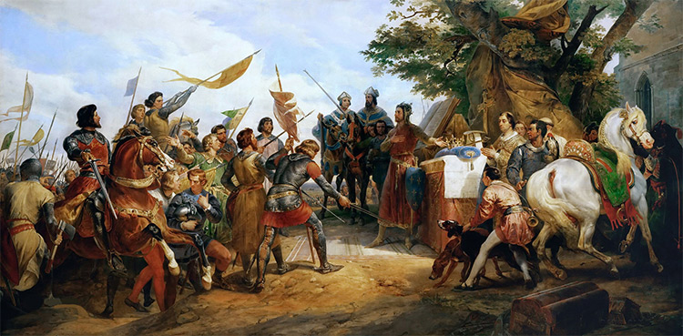
The Normans
1204
Cut off from Normandy
King Philip II
Henry III
Treaty of Paris (1259)

Slide 6
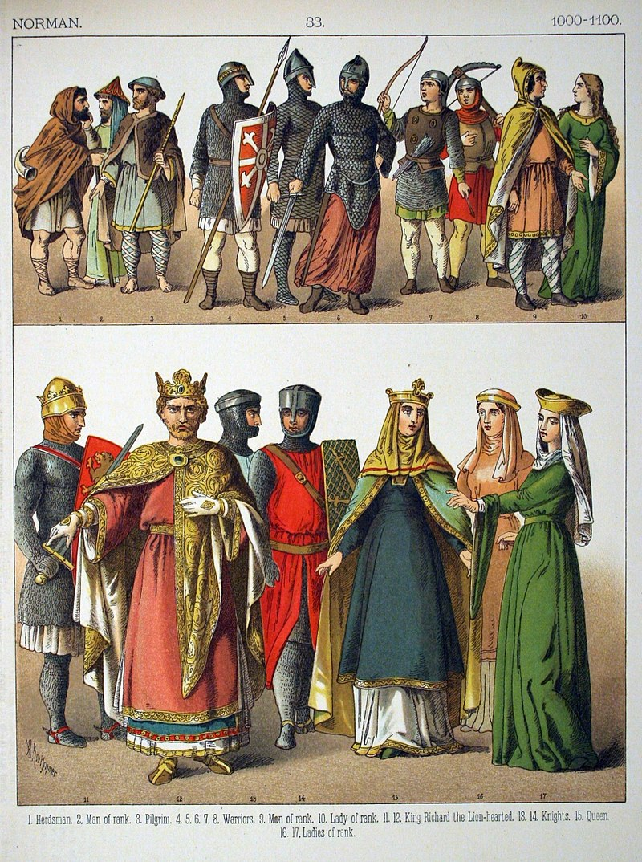
The Normans
Culture
Mixing

Slide 7
The Normans
Role Play
Interact using your assigned language.
Language implications?

Slide 8
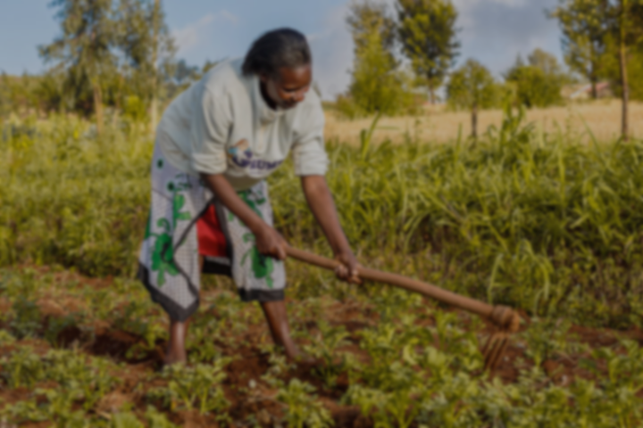
The Farmers
What languages could you speak?
How were the living conditions for you?
How did you feel about the nobility?

Slide 9
The Farmers
Farmers didn’t care about language changes.
They continued speaking English.
Developed regional dialects.

Slide 10
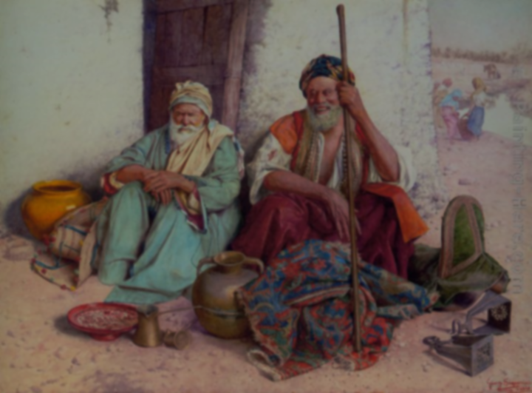
The Merchants
What languages could you speak?
What language did you use to speak to farmers? Lords?

Slide 11
The Merchants
Bilingual – English to Farmers
Bilingual – French to Nobility
They were important in the sharing (and development) of languages.

Slide 12
Food Words
Duboulets (twinlings)
Cow
Calf
Sheep
Chicken
Deer
Snail
Dove
Beef
Veal
Mutton
Poultry
Venison
Escargot
Pigeon
Notes:
https://en.wikipedia.org/wiki/List_of_English_words_with_dual_French_and_Anglo-Saxon_variations

Slide 13
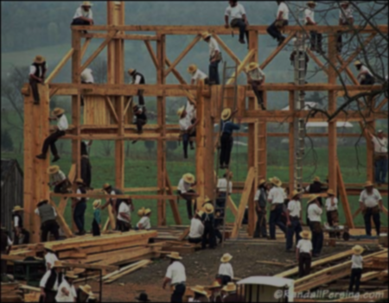
The Builders
What languages could you speak?
If you were living at that time, would you need to learn another language?

Slide 14
The Builders
The trades people were effected.
French terms were important.
English in daily lives.

Slide 15
Technical Trade Words
Duboulets (twinlings)
Sell
Buy
Trade
Bring
Lawyer
Hunt
Haven
Woodwork
Vend
Purchase
Commerce
Carry
Attorney
Chase
Port
Carpentry
Notes:
https://en.wikipedia.org/wiki/List_of_English_words_with_dual_French_and_Anglo-Saxon_variations

Slide 16
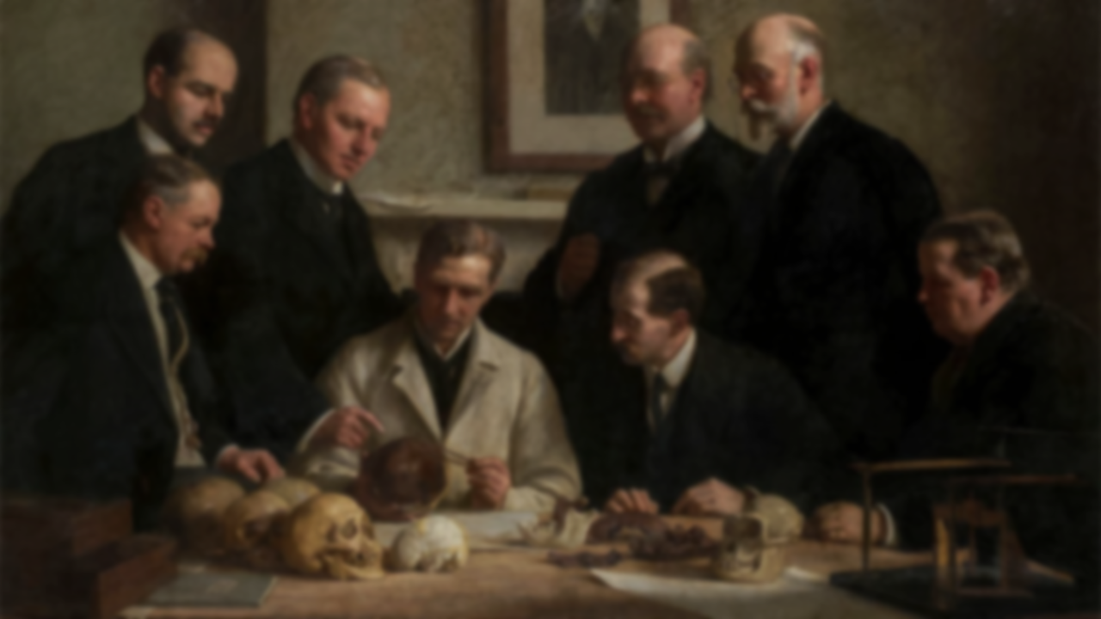
The Scientists
What languages did you need to know?
How would you improve the system?

Slide 17
The Scientists
Education (university) required Latin
Latin was a dying language.
Cambridge University required Latin until recently (1960).

Slide 18
Opticks (Newton 1704)
Duboulets (twinlings)
Knowledge
Ask
Answer
Sake
Sex
Smell (stench)
Hue
Blossom
Science
Enquire
Response (reply)
Reason (cause)
Gender
Odor
Color
Flower
Notes:
https://en.wikipedia.org/wiki/List_of_English_words_with_dual_French_and_Anglo-Saxon_variations

Slide 19
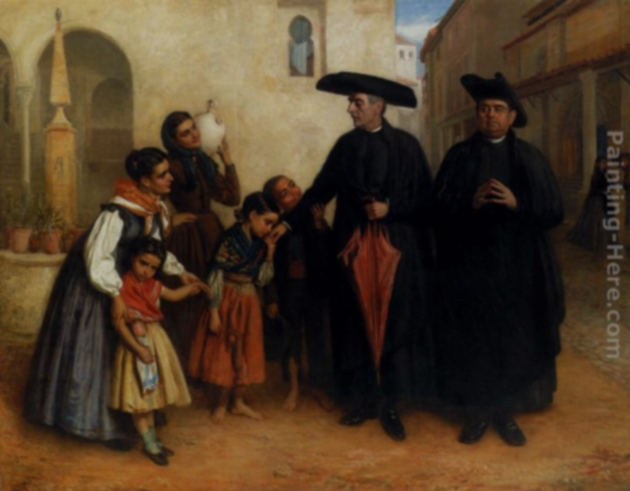
The Priests
What languages could you speak?
Are there any problems with the bible being written ONLY in Chinese?

Slide 20
The Priests
Main educators
Over time, they couldn’t read Latin
Could make up stories.

Slide 21
Wycliffe Bible (1380) Tinsdale Bible (1526) King James Bible (1611)
Duboulets (twinlings)
Belief
Wonder
Almighty
Awesome
Faith
Ponder
Omnipotent
Incredible
Notes:
https://en.wikipedia.org/wiki/List_of_English_words_with_dual_French_and_Anglo-Saxon_variations

Slide 22
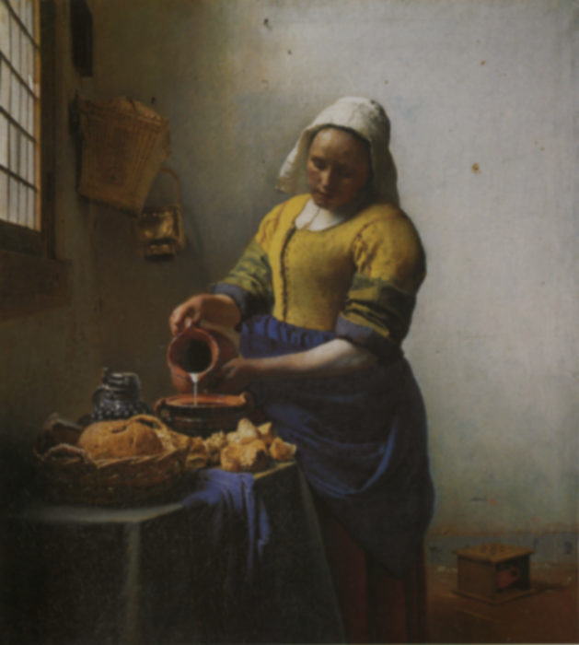
The Maids
What languages could you speak?
What languages would you have spoken to your clients?
How would this effect nobility?

Slide 23
The Maids
Taught English to the sons/daughters of nobility.
Made English acceptable to nobles.

Slide 24
Duboulets (twinlings)
Motherly
Fatherly
Sisterly
Brotherly
Lovely
Maternal
Paternal
Sororal
Fraternal
Beautiful
Notes:
https://en.wikipedia.org/wiki/List_of_English_words_with_dual_French_and_Anglo-Saxon_variations

Slide 25
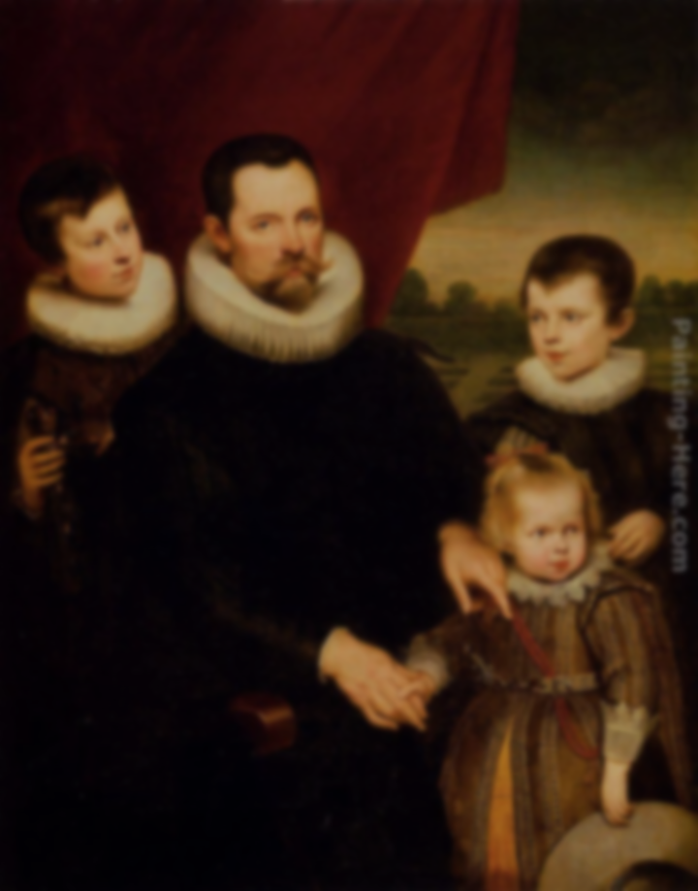
Noble Sons/Daughters
What languages could you speak?
How would you learn those languages?

Slide 26
Noble Sons/Daughters
Learned French from parents.
Learned English from maids.
When they got older, they used a hybrid language.

Slide 27
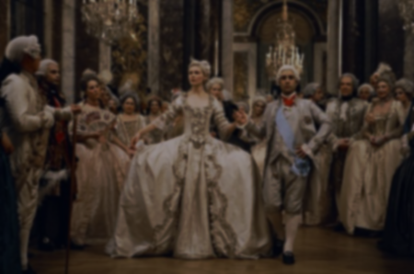
The Lords
What languages could you speak?
How was your relationship with the farmers?
How did you communicate with them?
How many jobs / responsibilities did you have?

Slide 28
The Lords
Originally they only spoke French
Over time they took on more English
Developed a separate identity from French Normans.

Slide 29
Duboulets (twinlings)
Lord
House
Worthy
Belongings
Athel
Liege
Mansion
Valuable
Property
Noble
Notes:
https://en.wikipedia.org/wiki/List_of_English_words_with_dual_French_and_Anglo-Saxon_variations

Slide 30
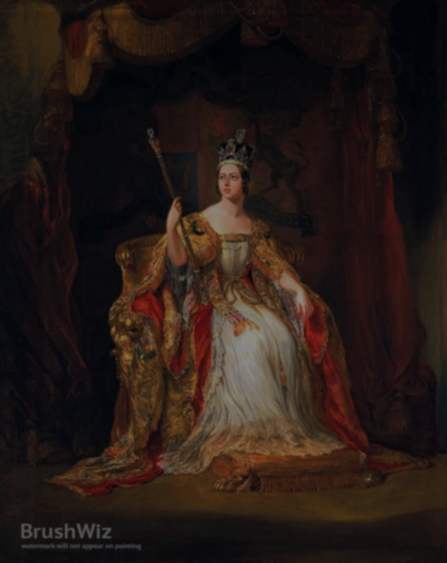
Queen Mercury
What languages could you speak?
How did you use your power?
How would you change for communicating?

Slide 31
Queen Mercury
They didn’t care about English.
The first English speaking crown was…
Henry IV (1399)
Pleading in English Act (1362)

Slide 32
Royal Words
Duboulets (twinlings)
Kingly
Kingship
Freedom
Fairness
Atheling/ drighten
Frith
Royal
Monarchy
Liberty
Justice
Prince
Peace
Notes:
https://en.wikipedia.org/wiki/List_of_English_words_with_dual_French_and_Anglo-Saxon_variations

Slide 33
Latin
French
Germanic Languages
Greek
Other Languages
Proper Names

