Slide 1
Queen Mercury
Tell everyone where to live
Lord Deacon gets half of the classroom
Lord May gets half of the classroom
The lords should give you gold and food.
You can only speak Korean.
You can write in Chinese
Lord May
You have a young daughter
The farmers will give you food. Feed employees and family.
Buy gold from the merchant to give to Queen Mercury.
Your maid will take care of your daughter.
You can’t speak English at all. You know some Chinese
You are fluent in Korean.
Lord Deacon
You have a young son
The farmers will give you food. Feed employees and family.
Buy gold from the merchant to give to Queen Mercury.
Your maid will take care of your daughter.
You only speak a little English
You are fluent in Korean.
Lord Deacon’s Maid
You work for Lord Deacon
You don’t speak Korean well.
You can speak English
You must raise Lord Deacon’s son.
A scientist tutors Lord Deacon's son.
Lord May’s Maid
You work for Lord May
You only speak a little Korean
You can speak English
You must raise Lord Deacon’s son.
Merchant
You can speak English well
You can speak some Korean
Sell the gold for as much food as possible

Slide 2
Builder
You can only speak English
You work to get food.
Priest
You can speak English
The bible is written in Chinese
Most people can’t understand Chinese
Tell everyone that the bible says they must give you food.
Merchant
You can speak Korean well
You can speak some English
Sell the gold for as much food as possible
Lord May’s Daughter
You are young
Your parents speak Korean
But the maid speaks English
Lord Deacon’s Son
You are young
Your parents speak Korean
But the maid speaks English
You want to learn how to be a scientist.
Scientist
You speak English and Korean
You must write in Chinese (but you can’t speak it)
You are tutoring Lord Deacon’s son.

Slide 3
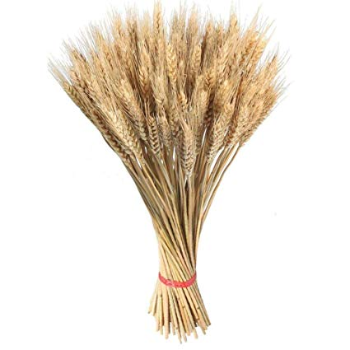
Farmer
You can only speak English
To make food, roll the dice and harvest that much food.
Give all of your food to your Lord
Get advice from the priest
Farmer
You can only speak English
To make food, roll the dice and harvest that much food.
Give all of your food to your Lord
Get advice from the priest
Farmer
You can only speak English
To make food, roll the dice and harvest that much food.
Give all of your food to your Lord
Get advice from the priest
Food
x3
Food
x3
Food
x3
Food
x3
Food
Food
Food
Food
Food
Food
Food
Food
Food
Food
Food
Food

Slide 4
Food
Food
Food
Food
Food
Food
Food
Food
Food
Food
Food
Food
Food
Food
Food
Food
Food
Food
Food
Food
Food
Food
Food
Food
Food
Food
Food
Food

Slide 5
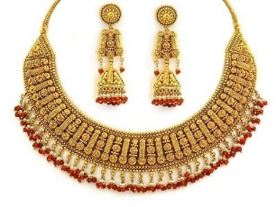
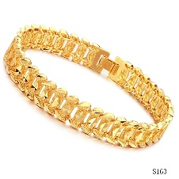
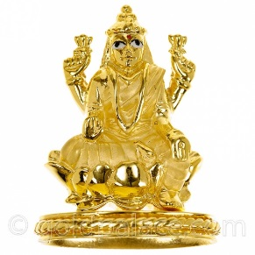
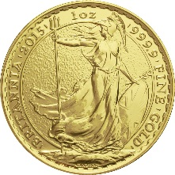
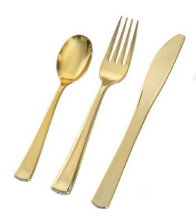
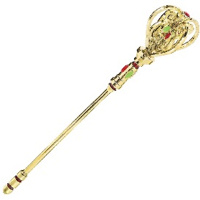
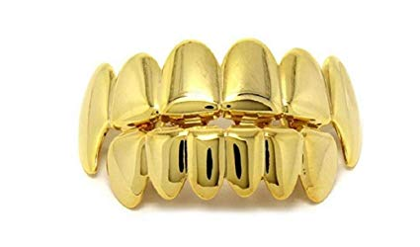
Gold
Gold
Gold
Gold
Gold
Gold
Gold
Gold
Gold
Gold
Gold
Gold
Food
x2
Food
x2
Food
x2
Food
x2
Food
x2
Food
x2
Food
x2
Food
x2
Food
x2
Food
x2
Food
x2
Food
x2

