Slide 1
Foot and Mouth Disease

Slide 2
Contagious Diseases
A disease that spreads easily and quickly.
Can you think of some?

Slide 3
Famous Examples:

Slide 4
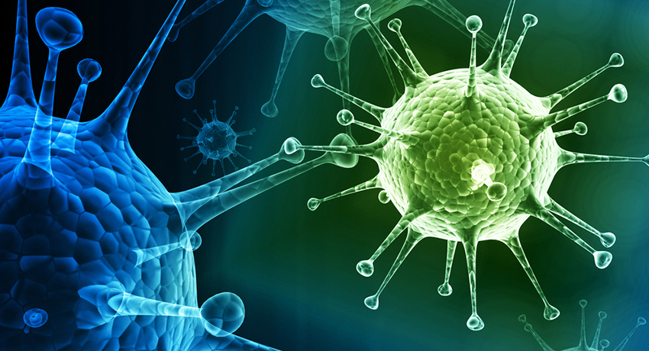
Flu

Slide 5
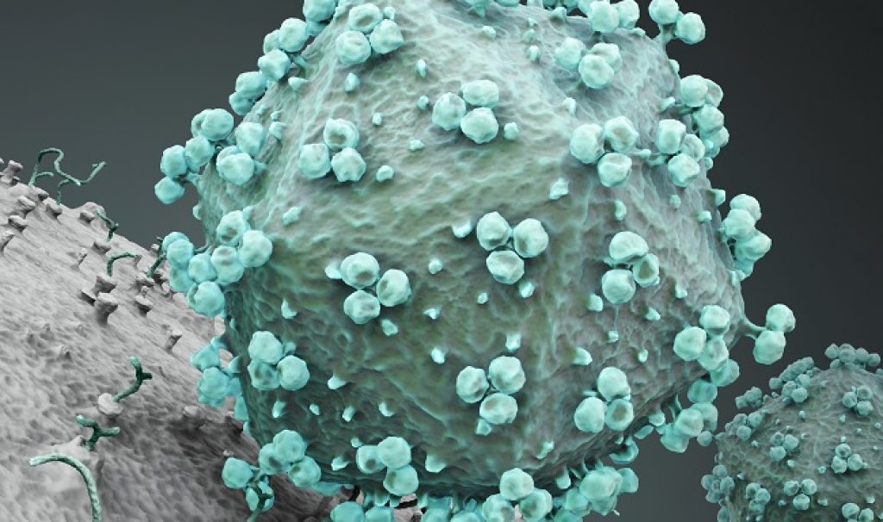
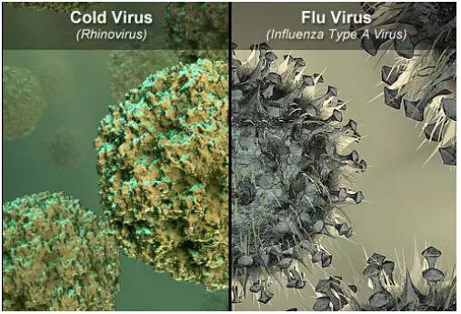
Common Cold

Slide 6
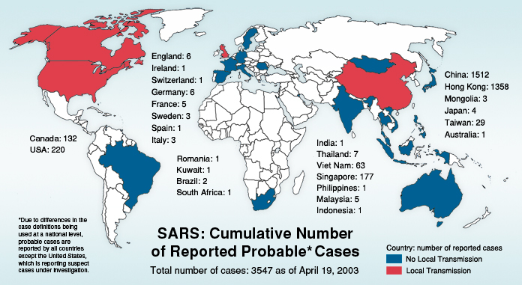

Slide 7
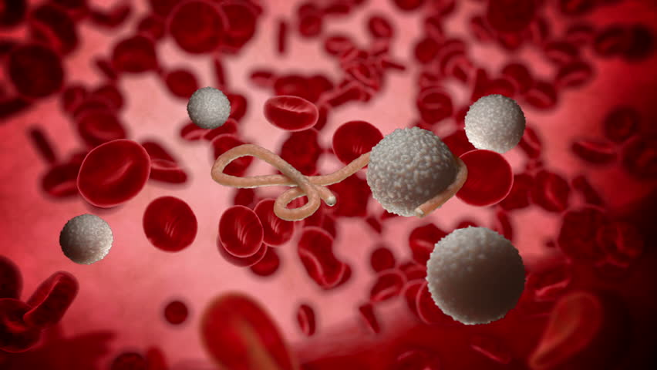
Ebola

Slide 8
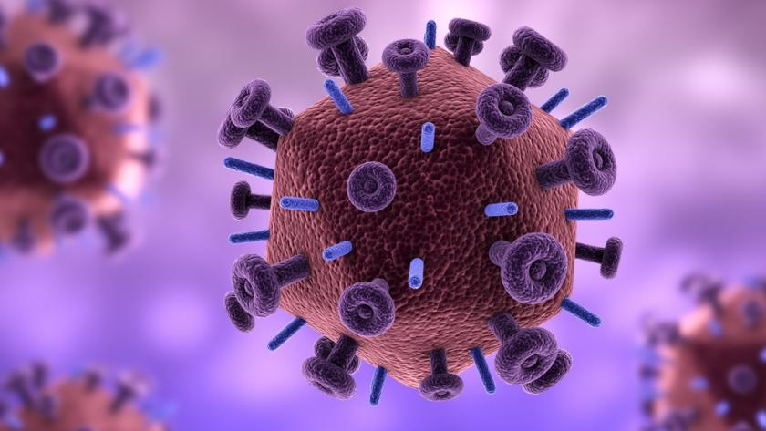
AIDS

Slide 9
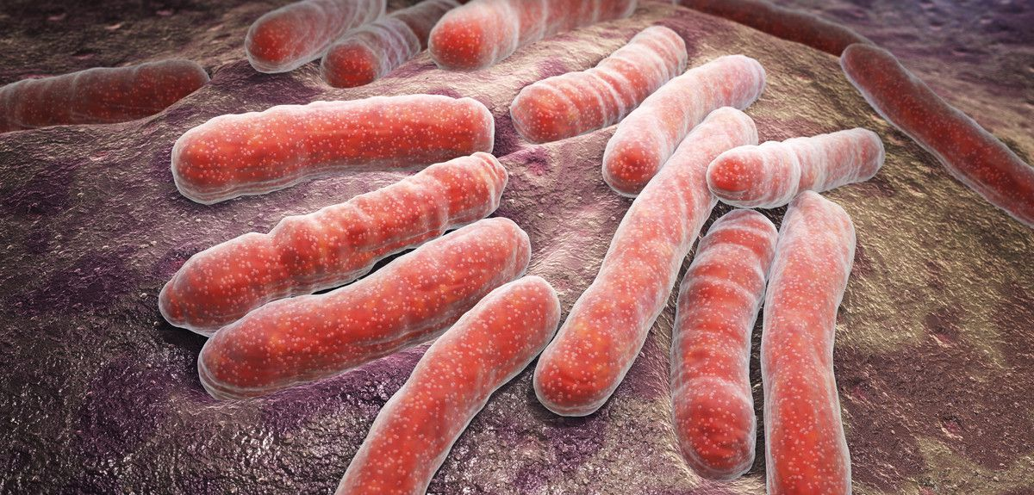
Tuberculosis

Slide 10
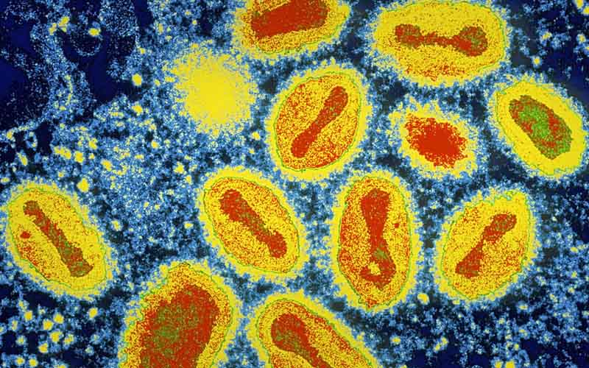
Smallpox

Slide 11
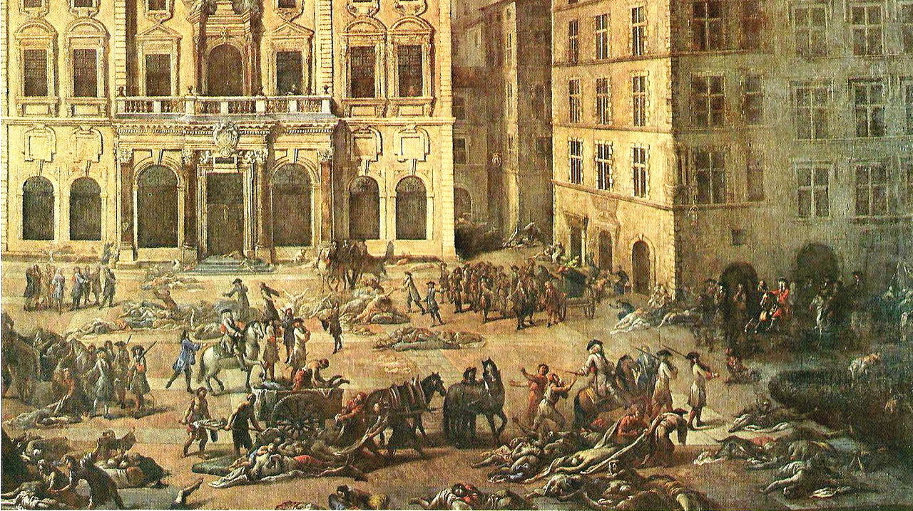
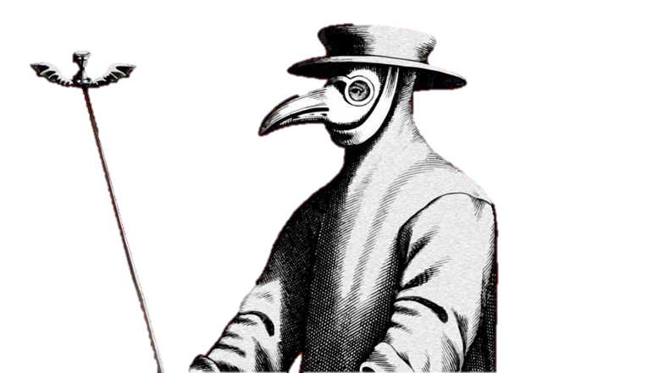
The Black Death
The Great Plague
The Plague
Bubonic Plague

Slide 12
The Black Death
From 1347 to 1351, this contagious disease killed 1/3 (up to 50%) of all Europeans.

Slide 13
How would the world change if 30% of the Korean population died in the next 4 years?

Slide 14
Contagious Diseases
What causes a disease?

Slide 15
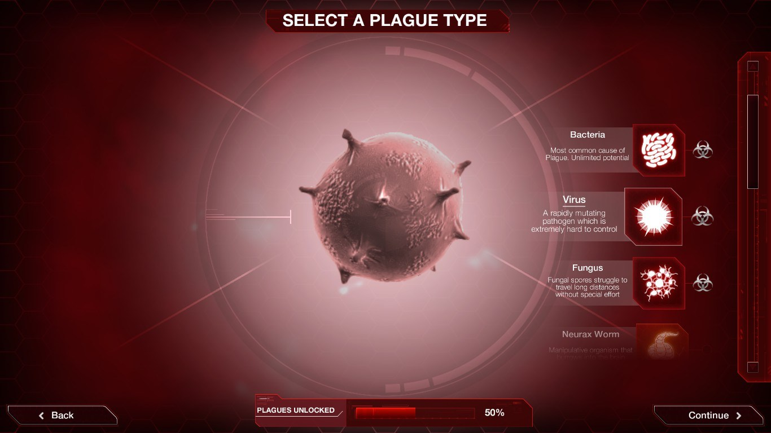
Virus

Slide 20
The Black Death
This bubonic plague was caused by a bacteria called, “Yersinia pestis”

Slide 21
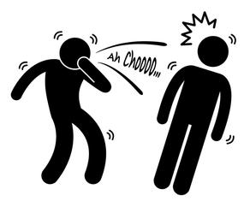
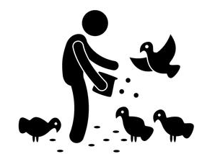
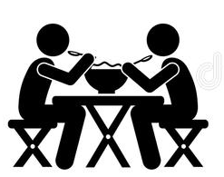
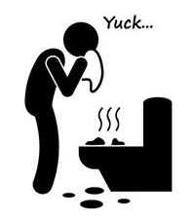
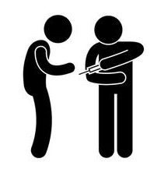
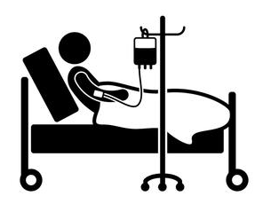
Contagious Diseases
How can a disease spread?
Exposure to other sick people
Sexual transmission
Touch
Animals
Sharing food
Poor sanitation
Sharing needles
Blood transfusion
Kissing

Slide 22
The Black Death
The disease was spread via fleas living on the backs of black rats.

Slide 23
Which areas were least affected?

Slide 24
How did the Black Death change English?

Slide 25
Study of how diseases spread

Slide 26
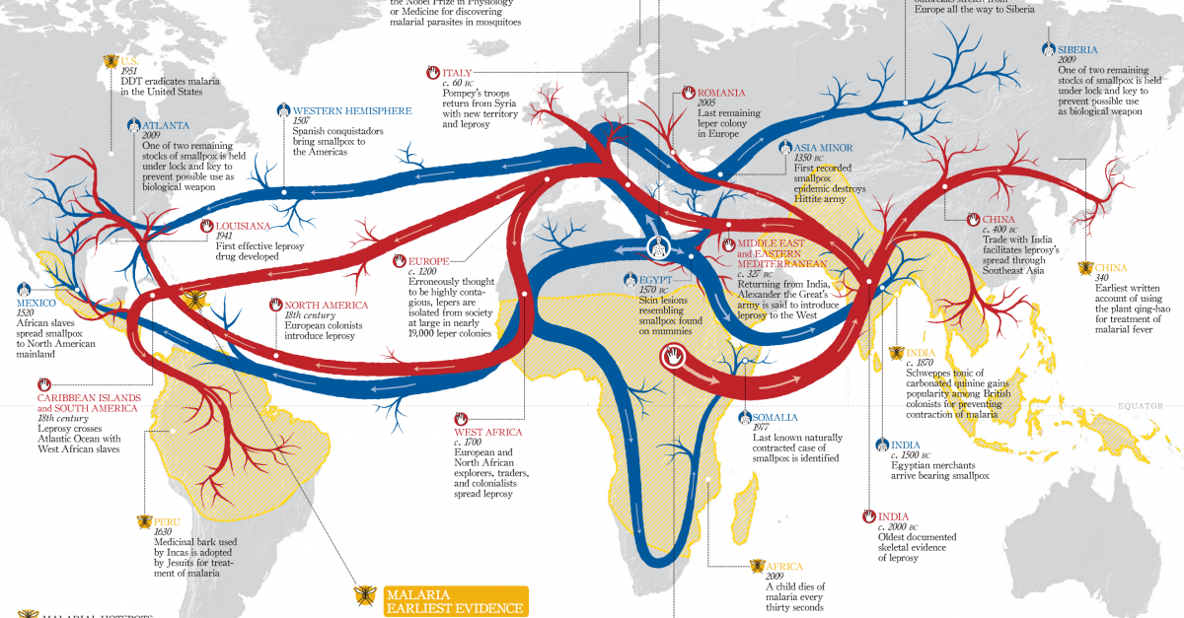
Epidemiology

Slide 27
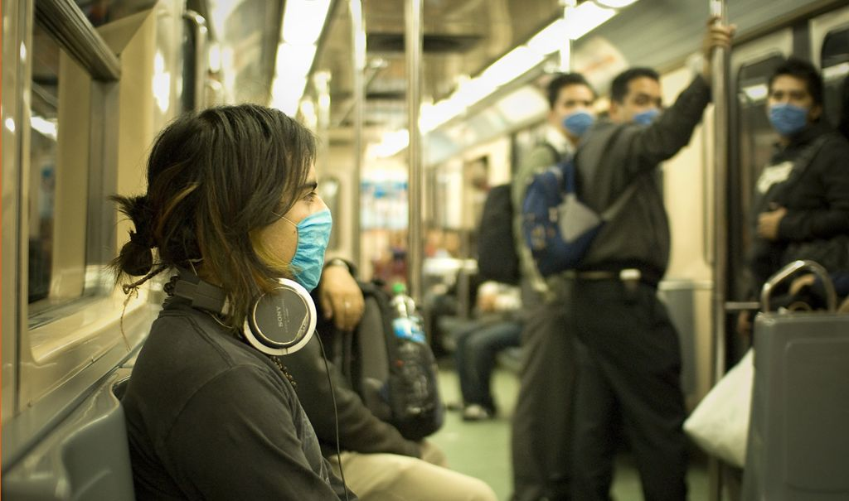
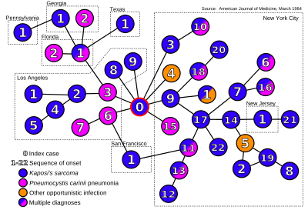
Patient 0

Slide 28
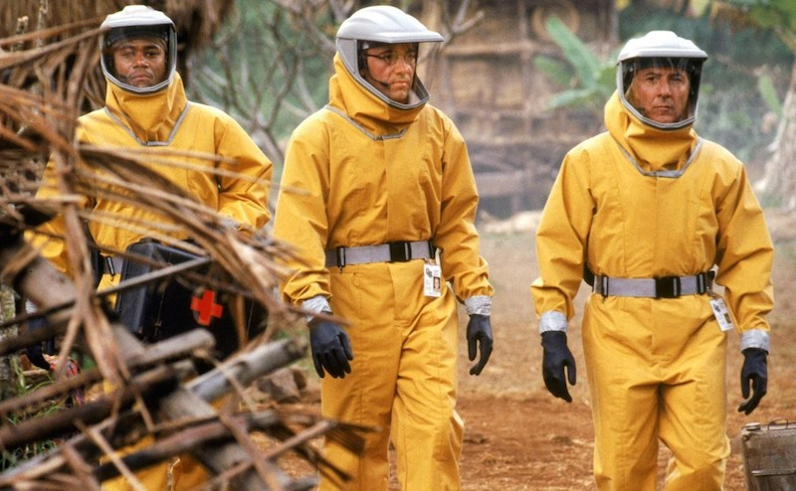
Outbreak

Slide 29
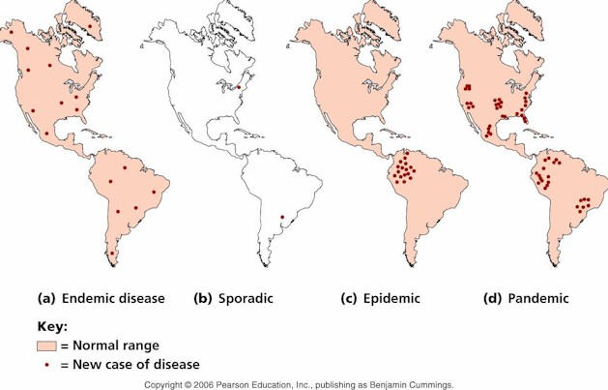
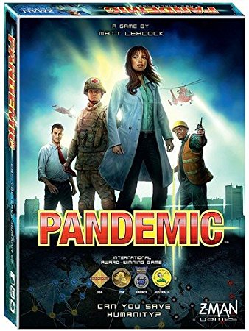

Slide 31
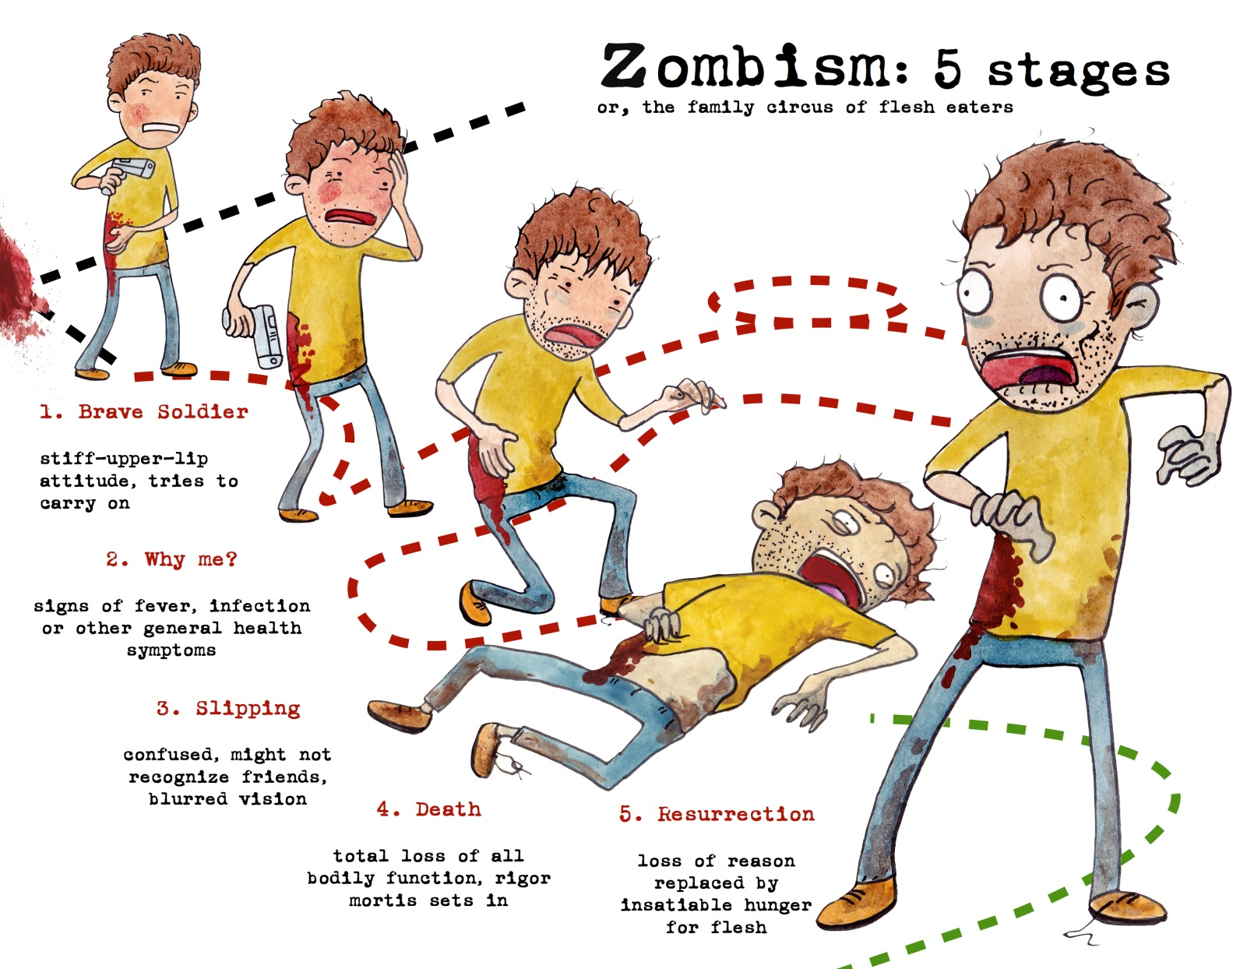

Slide 32
Zombie Rules (Your Turn)
You may take up to 3 actions:
Move (to a connecting province)
Treatment (remove a zombie magnet)

Slide 33
Zombie Rules (My Turn)
I’ll draw 3 location cards
Add a zombie
Spread the disease to adjacent provinces
If a disease is eliminated, the card is discarded
If I draw a “Zombies” card, I will shuffle the cards.

Slide 34
Win
All of the zombie are eliminated.

Slide 35
Lose
All of the zombies magnets are used.

Slide 36
Zombie Parasites
https://www.youtube.com/watch?v=AgCQStTSMuk

Slide 37
