Slide 1
Zombie Pandemic

Slide 2
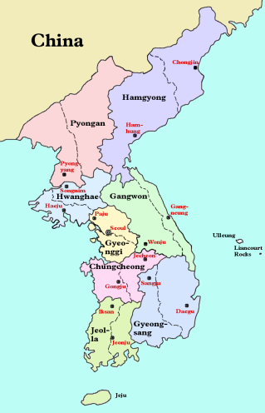
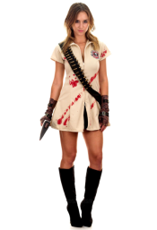
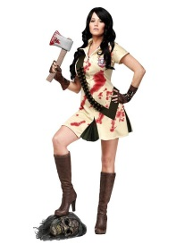
Components
Map projected on magnetic board.
3 character magnets
Colored magnets (20 of each color - RBG)
27 Province Cards (+3 zombie cards)
Jeolla-do
Gyeongsang-do
Jeju-do
Zombies

Slide 3
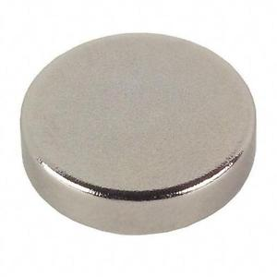
Types of Zombies

Slide 4
+1

Slide 5
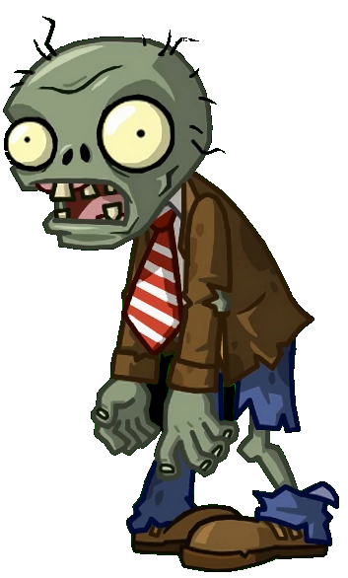
Set Up
Use the projector against a magnetic board to serve as the game board.
Draw cards until the first outbreak occurs (see “Draw Cards” slide)
Split the class into three groups, giving each group a character.
All groups start in Seoul (Gyeonggi Province)

Slide 6
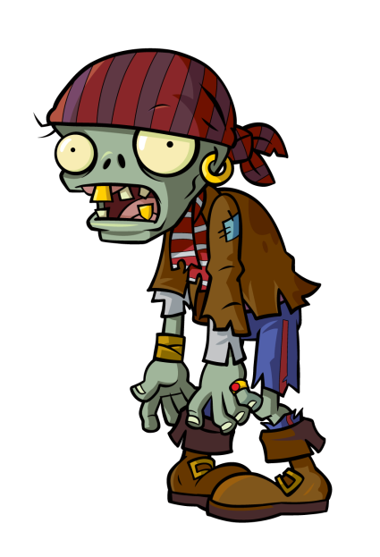
Rules
Each turn
Each player (group) may take 3 actions (see ‘action’ slide)
Draw 3 cards and place magnets (see ‘Draw a card’ slide)

Slide 7
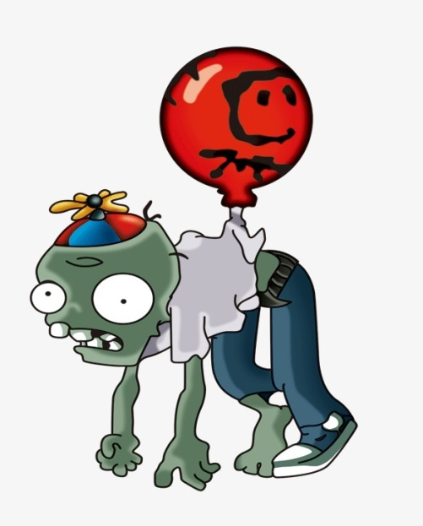
Draw a Card
Teacher will randomly select a card.
The cards are the provinces (or “zombie”).
We will add magnets to that province according to the province name and the color of the card.
If there are zombies (of the same color) there already, a magnet will be placed on each connecting province in addition to the drawn card.
Cards will be placed in a discard pile until a ‘zombie’ card is drawn. When the zombie card is drawn, shuffle all the cards again. Repeat until the end of the game.
Gyeongsang-do
Zombies

Slide 8
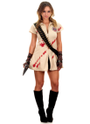
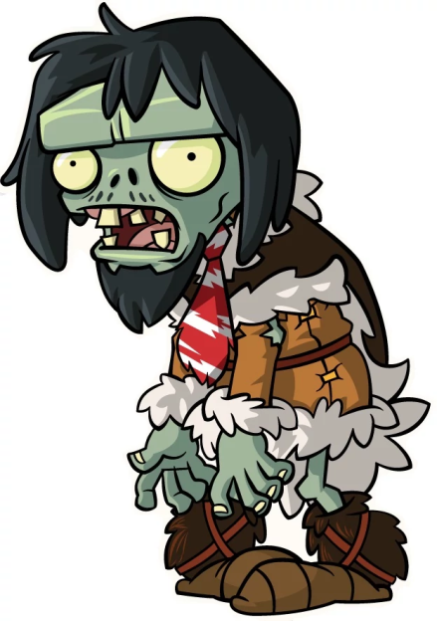
Actions
Move 1 space
You can move to Jeju from Jeolla-do but it costs an additional action
Also, the zombie virus can’t spread from Jeju.
Kill 1 zombie
EASY ~ any color
HARD ~ characters can only kill certain zombies

Slide 9
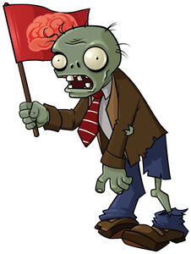
Eradicate Zombies
If you are able to eliminate all of a certain color, that color of magnet will no longer be placed on the board.
If you eradicate all zombie types, you win!! ☺
But if class finishes or no more magnets are available for a color, you lose. ☹

Slide 10
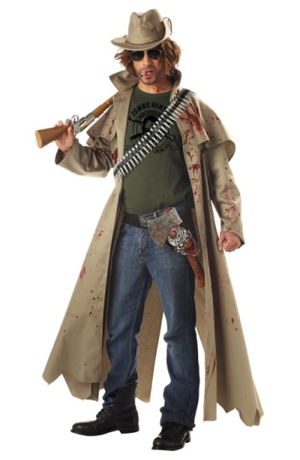
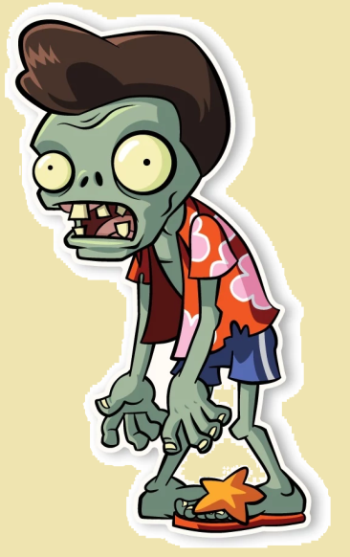
Choose a Game Mode
Easy = a player can kill any type of zombie
Hard = players may only kill zombies according to their cards (see below)
This player can only kill green and blue zombies.

Slide 11
WIN
LOSE
+1

Slide 12
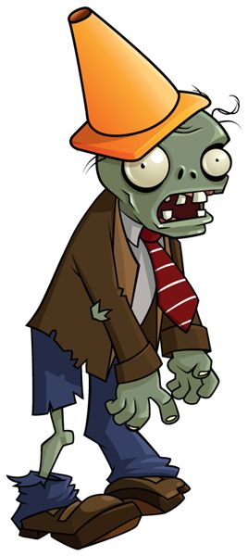
Alternate Rules
There may be up to 5 players at a time in the game.
However, during the “draw cards” phase, draw as many cards as there are players.

Slide 13
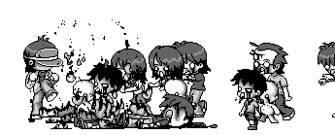

Slide 14
