Slide 1
Dictionary

Slide 2
B
T
C
P
O
M
B
Notes:
https://www.youtube.com/watch?v=Mfz3kFNVopk

Slide 3
S
N
U
B
P
H
O
E
M
M
E
Notes:
https://www.youtube.com/watch?v=Mfz3kFNVopk

Slide 4
W
H
O
R
S
E
Notes:
https://www.youtube.com/watch?v=Mfz3kFNVopk

Slide 5
D
R
L
A
U
G
H
T
E
Notes:
https://www.youtube.com/watch?v=Mfz3kFNVopk

Slide 6
M
U
S
T
A
C
H
E
Notes:
https://www.youtube.com/watch?v=Mfz3kFNVopk

Slide 7
B
H
E
A
R
D
Notes:
https://www.youtube.com/watch?v=Mfz3kFNVopk

Slide 8
G
D
N
O
Notes:
https://www.youtube.com/watch?v=Mfz3kFNVopk

Slide 9
Notes:
https://www.youtube.com/watch?v=7ucCJ_Vn58w

Slide 10
The Problem

Slide 11
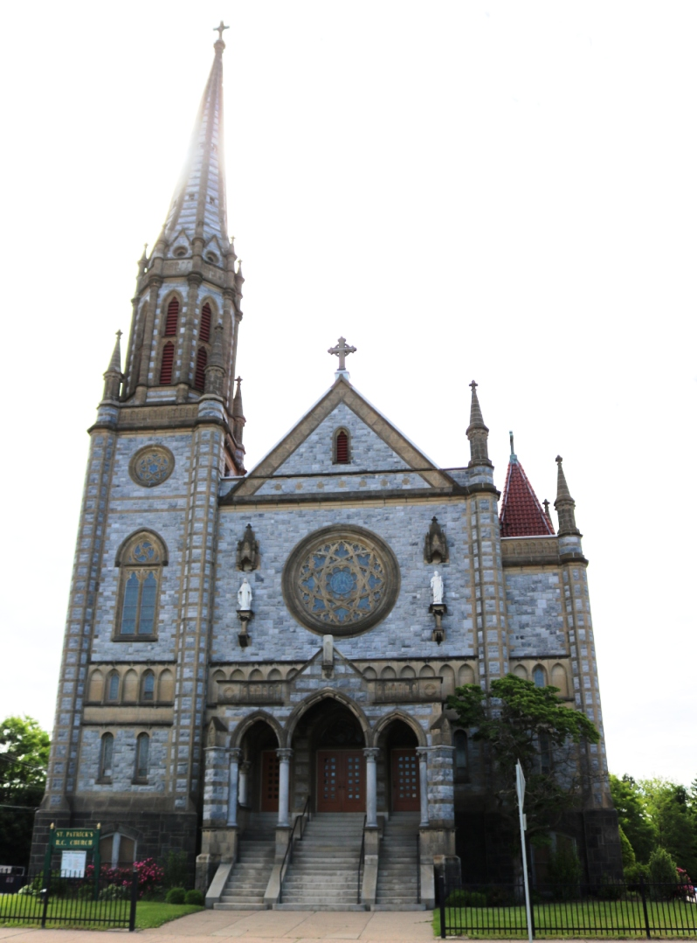
The Problem
There was no standardized spelling
Double letters and ending e’s seem to be arbitrarily used (dog/dogg/dogge).
Phonetic spellings
Complicated by Great Vowel Shift
Regional spellings
5 Major Dialects
The ending –ing was said as -and in the North, -end in the East Midlands, and -ind in the West Midlands.
The word church could be spelled 30 different ways: churche, cherche, chirch, chyrch, charge, chyche, schyrche, etc.

Slide 12
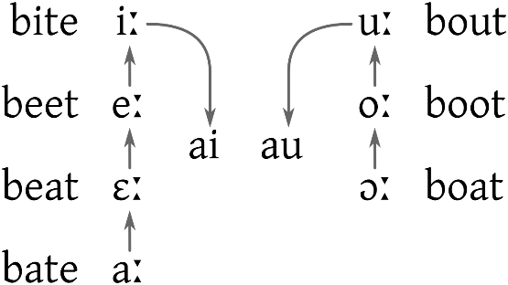
The Problem
The Great Vowel Shift
Stan -> Stone, rap -> rope, derk -> dark, herte -> heart
No longer phonetic
Kept original spelling
Voiceless fricatives
laugh, cough (f-sound)
Stopped pronouncing some consonants
B = dumb, comb
L = walk, talk
G/K = knee, gnaw
In 1569, the grammarian, John Cheke proposed removing all silent letters.

Slide 13
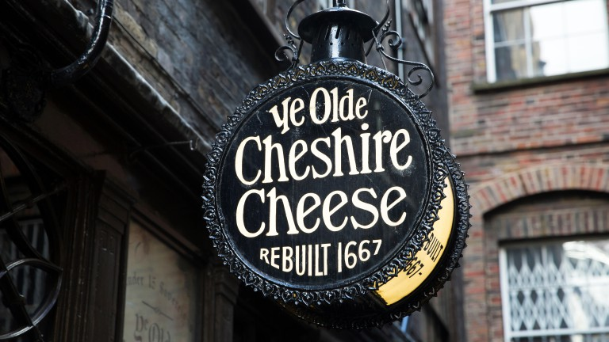
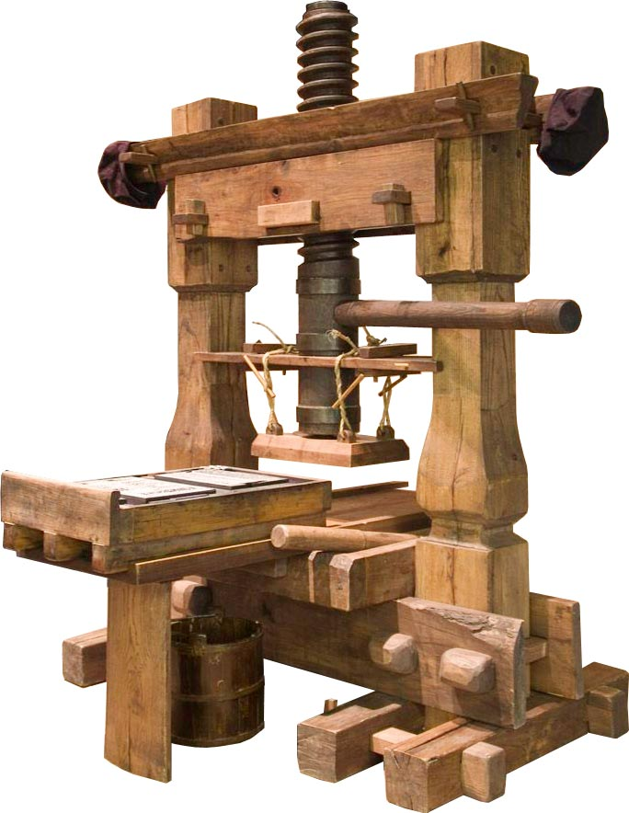
The Problem
1476 – William Claxton produces the first printing press in England
Runic based symbols like thorn (þ) were not found on the printing press. So, publishers began using y in its place.
Newspaper writers were designing the language
Legal Paperwork – Previously in Latin, now in English

Slide 14
Chancery

Slide 15
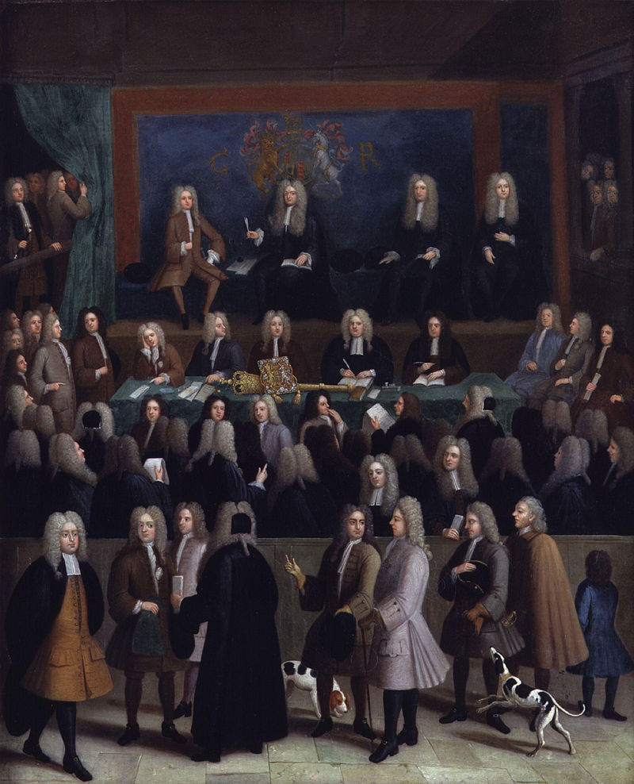
Chancery
Opened before Norman Invasion
A court, part of government = recorded (wrote down) laws
After 1430, they began writing in English
Since they made the laws, their English became the standard.
Respelled some words based on French

Slide 16
Chancery
They chose a “correct” spelling.
Lond → Land
Xal or schal → shall
Rithe → right
Hath → has
Doth→ does
Such, not, but, these, any, many, can, cannot, but, shall, should, could, ought, thorough, etc.

Slide 17
Early Dictionaries

Slide 18
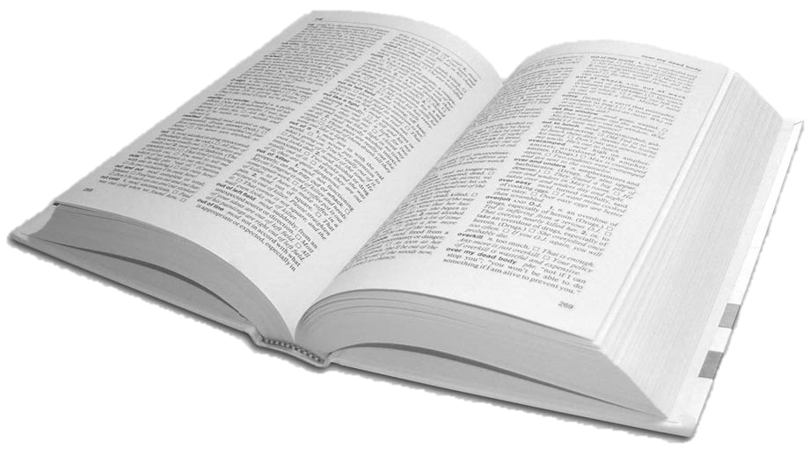
Early Dictionaries
Bilingual = Sumerian to Akkadian tablets (2300 BCE)
Monolingual = Chinese Dicitionary (200-300 BCE)
Arabic (700-1400 CE)
Spanish (1611)
Italian (1612)
French (1694)

Slide 19
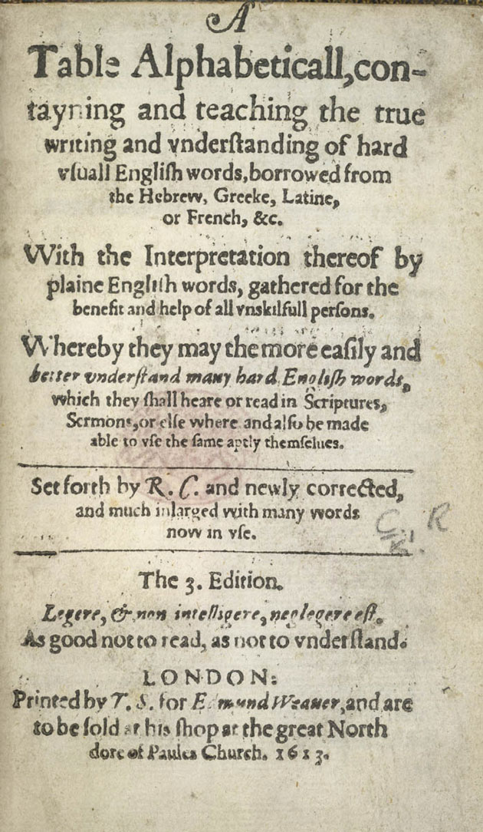
Table Alphabeticall
Robert Cawdrey (1604)
2,543 words
Definitions were mostly synonyms
Purpose = “for the benefit and helpe of Ladies, Gentlewomen, or other unskillful persons”
4th edition had 3,264 words
Popular, but not too useful.

Slide 20
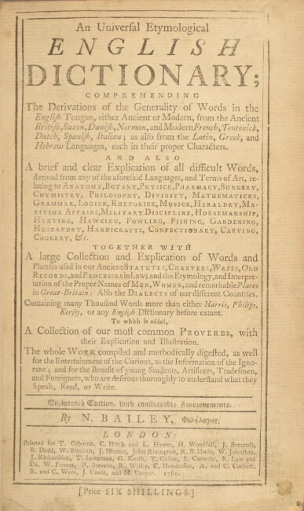
An Universall Etymological English Dictionary
Nathan Bailey(1721)
900 pages
Most popular dictionary in 18th century
Used common words rather than just difficult ones.

Slide 21
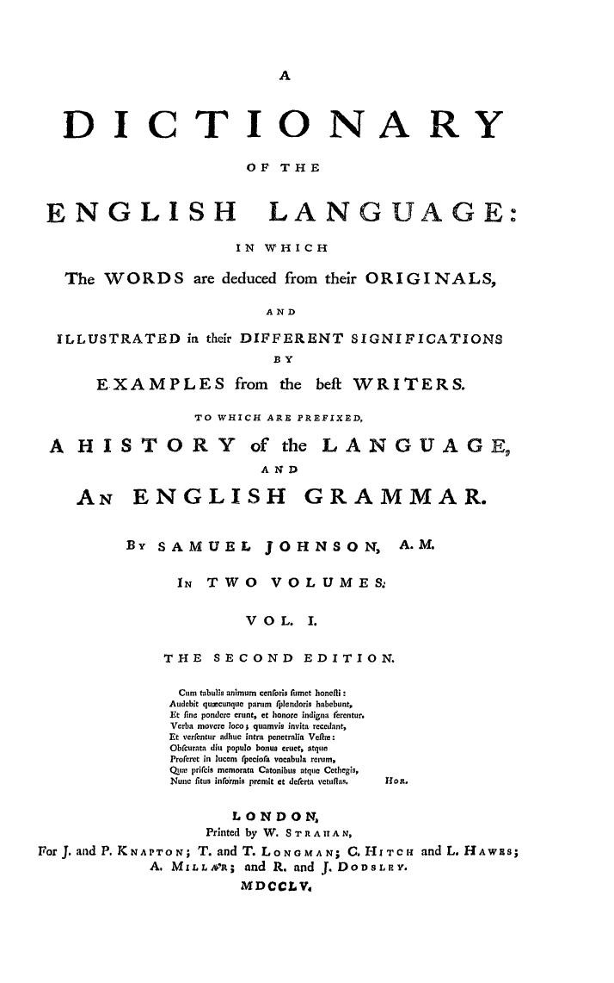
A Dictionary of the English Language
Samuel Johnson (1755)
40,000 words
Just 7 years to complete single-handedly
Omitted rude words, scientific words and words he did not understand.
Considered a really great achievement.

Slide 22
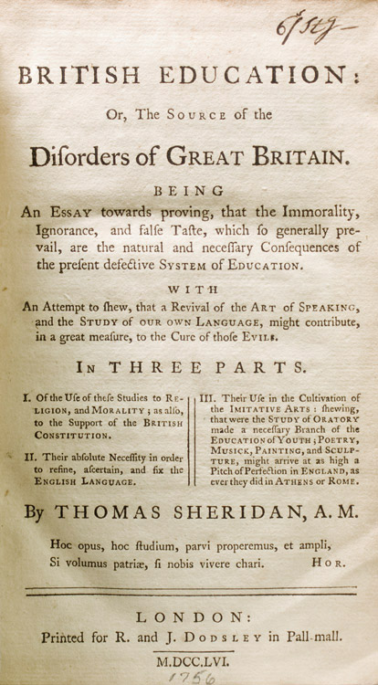
British Education
Thomas Sheridan (1756)
Actor
Hated the pronunciation of ‘lower’ English
So, he created a book to teach people how to speak and act like a “British” person
He toured the country giving seminars to the middle class to sound more dignified.

Slide 23
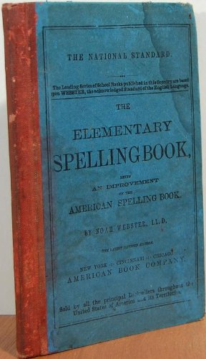
Blueback Speller
Noah Webster (1783-1785)
Speller (1783), Grammar (1784), Reader (1785)
Teacher
2nd Best selling book in American history
Changed English to give us American spellings.
Spelling Bees based on the Blueback Speller are popular in America.
His spellings were accepted and taught across America. Uniform dialects.

Slide 24
How many words in the Merriam-Webster dictionary?
~ 470,0000

Slide 25
Which language has the largest dictionary?
Korean –
> 1,000,000 entries
우리말샘 (Woori Mal Saem, 2017)

Slide 26
Dictionary Deciders

Slide 27
Traditionalists vs Reformers
Traditionalists
Wanted words derived from French to sound more Latin
Keep old spelling
Reformers
Wanted simple spelling
Follow spelling rules, closer to phonetic.

Slide 28
Inkhorn Controversy
A foreign borrowing into English that is unnecessary or pretentious
1550s to 1650s
(just as Middle English became Modern English)
Latinate words

Slide 29
Major Reformations
Many proposals over the years.
Dictionary Writers / Grammarians / Phonics Teachers
Noah Webster (American Spelling)
The Blueback Speller

Slide 30
Dictionary Deciders
Two Groups
Traditionalists (inkhorn)
Reformers
Discuss if you think we should add it to our dictionary
Vote
Pass = Into our dictionary
Fail = Not in our dictionary
At the end, reveal which words were traditional spelling and which were new spellings. The team with the most words, wins!

Slide 31
DOUBT
Finish

Slide 32
LOGIC
Finish

Slide 33
WAR
Finish

Slide 34
DEBT
Finish

Slide 35
SIN
Finish

Slide 36
SCISSORS
Finish

Slide 37
ISLAND
Finish

Slide 38
TOWN
Finish

Slide 39
TRUE
Finish

Slide 40
CHECK
Finish

Slide 41
ACHE
Finish

Slide 42
DEFENSE
Finish

Slide 43
FRIEND
Finish

Slide 44
BUILD
Finish

Slide 45
RHYME
Finish

Slide 46
COLOR
Finish

Slide 47
MUSIC
Finish

Slide 48
VISITOR
Finish

Slide 49
THEATER
Finish

Slide 50
NAUSEA
Finish

Slide 51
IMPEDE
Finish

Slide 52
CELEBRATE
Finish

Slide 53
ENCYCLOPEDIA
Finish

Slide 54
DELIGHT
Finish

Slide 55
FOCUS
Finish

Slide 56
DRAFT
Finish

Slide 57
Traditionalist Words
Reformer Words
Doubt (dout)
Debt (det)
Scissors (sissors)
Island (iland)
Ache (ake)
Friend (frend)
Build (bild)
Rhyme (rime)
Nausea (nausia)
Impede (impedire)
Celebrate (celebrare)
Encyclopedia (enkuklopaideía)
Focus
Logic (logique)
War (warre)
Sin (sinne)
Town (toune)
True (tru)
Check (cheque)
Defense (defence)
Color (colour)
Music (musick)
Visitor (visiter)
Theater (theatre)
Delight (delite)
Draft (draught)

