Slide 1
Artificial Intelligence

Slide 2
Artificial Intelligence (AI) is intelligence demonstrated by a machine.
https://www.youtube.com/watch?v=mJeNghZXtMo

Slide 3
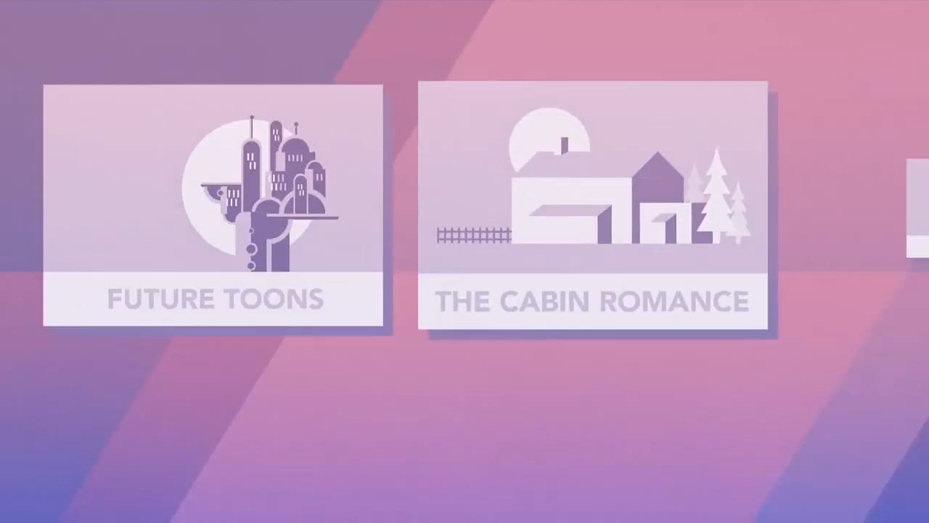
https://www.youtube.com/watch?v=mJeNghZXtMo

Slide 4
Can computers be truly intelligent?

Slide 5
Why are we developing
AI technology?

Slide 6
How can AI help us?

Slide 7
Where can we apply AI?

Slide 8
AI has improved from a list of codes into a learning algorithm.
Nowadays, computers are using past experiences to change their behavior in the future.

Slide 9
Can / Should we stop AI?

Slide 10
What changes might we experience as AI grows?

Slide 11
Over the past few years, the Korean government has been trying different methods of adding technology to the classroom.
https://www.youtube.com/watch?v=loFL5gT_m8I
https://www.youtube.com/watch?v=uZ73ZsBkcus

Slide 12
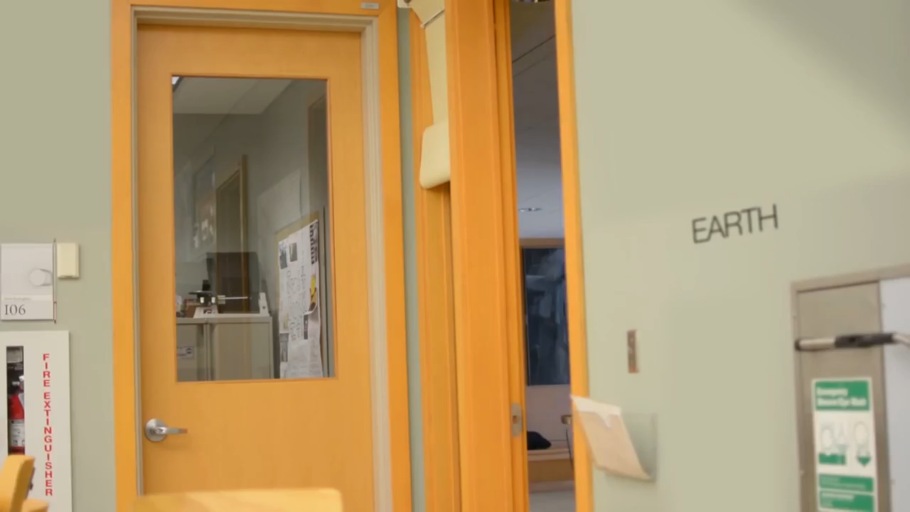

Slide 13
Can AI / technology be more effective than teachers?

Slide 14
Which jobs will be affected?
Check out this website:
https://willrobotstakemyjob.com/

Slide 15
Will AI be our last invention?

Slide 16
AI will inevitably eliminate a lot of jobs (especially manual labor). Since many jobs will disappear, some futurists say that we will need to adopt Universal Basic Income (UBI).
https://www.youtube.com/watch?v=OEkT14RBzDI

Slide 17
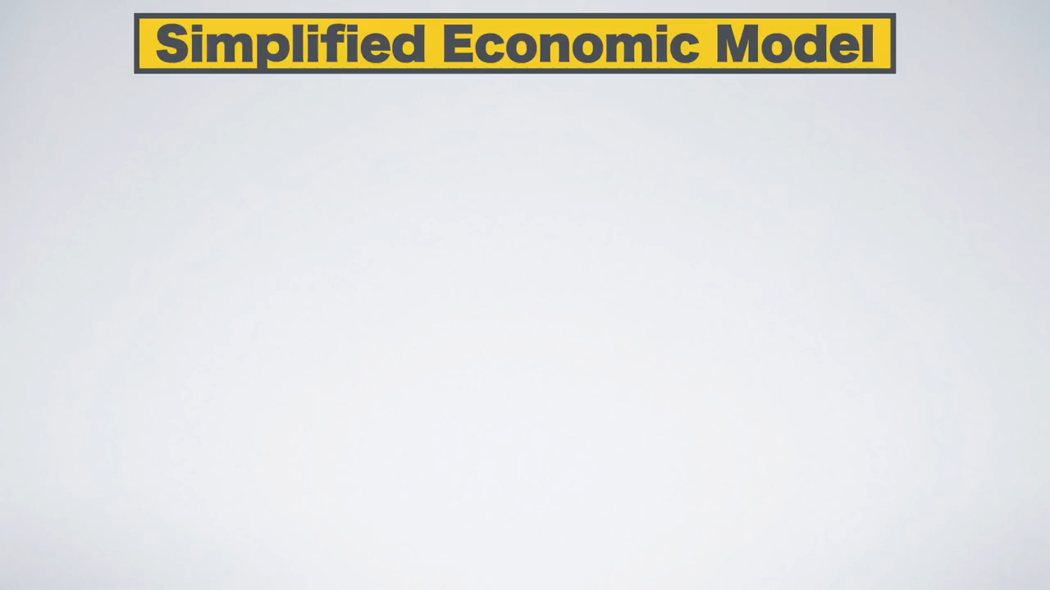

Slide 18
Will we need to adopt Universal Basic Income?

Slide 19
Will we need jobs in the future?

Slide 20
What would society be like?

Slide 21
What would you do with your free time?

Slide 22
Some scientists and engineers are worried about the power that AI might accrue. In this video, Elon Musk explains why he is worried.
https://www.youtube.com/watch?v=z3EQqjn-ELs&t=273s

Slide 23


Slide 24
Will AI take over?

Slide 25
What will AI Want?

Slide 26
What are some of the dangers of AI?

Slide 27
What would happen if AI decided that we are no longer needed?

Slide 28
Isaac Asimov, a sci-fi writer and professor suggested three basic laws for robots:
“A robot may not injure a human being or, through interaction, allow a human to come to harm.
“A robot must obey orders given it by human beings except where such orders would conflict with the first law.
“A robot must protect its own existence as long as such protection does not conflict with the first or second laws.”
https://www.youtube.com/watch?v=2z7a8MTYrDE

Slide 29
Are these laws reasonable?

Slide 30
What laws would you make?

Slide 31
Would AI follow the law?

Slide 32
The Turing Test is a way of testing how ‘human’ an AI is.
If an evaluator can’t tell that it is an AI, then the AI passes the test.
https://www.youtube.com/watch?v=bMH9Y0JoPRs

Slide 33
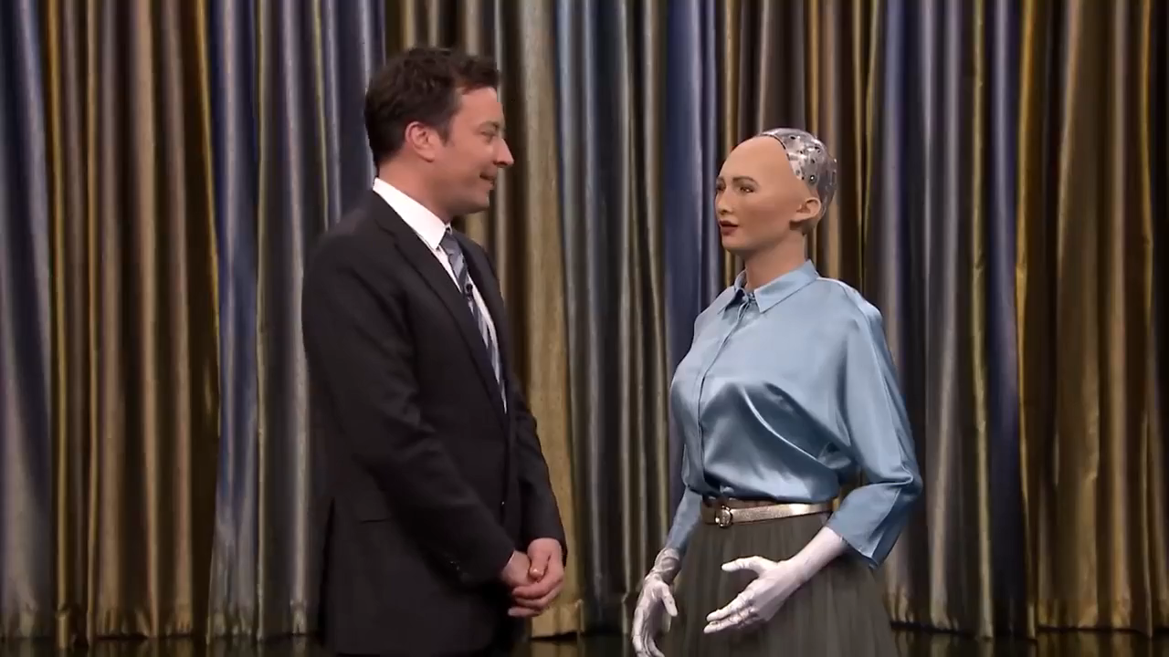

Slide 34
Can AI pass the Turing Test?

Slide 35
How can you tell the difference?

Slide 36
What ‘human’ qualities are difficult for computers?

Slide 37
Will computers develop consciousness?

Slide 38
One day it may be possible to reproduce your consciousness in a computer. This would not be you, but an exact copy of you. The real ‘you’ might die, but the digital copy would live on.
https://www.youtube.com/watch?v=Urk3xn7l3AM

Slide 39
Would you duplicate your intelligence to live forever online?

Slide 40
Would you talk to yourself?
What would you talk about?

Slide 41
Is it ethical to delete a digital consciousness?

Slide 42
Finally, a fun video:
https://www.youtube.com/watch?v=BDS3c4lwy_o

Slide 43
Answers with Joe:
https://www.youtube.com/watch?v=XLG98G4JBc0

