Slide 1
Essay Writing
Step by Step

Slide 2
Topic
Choosing a Topic

Slide 3
Topic
Choosing a Topic
Are there:
Constraints
Lists of topics
Open

Slide 4
Topic
Choosing a Topic
Does it interest you?
Do you want to learn more about it?

Slide 5
Topic
Narrowing the Topic
What part of the topic is interesting to you?
What part of that…
What part of that…

Slide 6
Topic
Narrowing the Topic
Narrow is easier

Slide 7
Topic
Advice
Brainstorm
You can change later
Ask instructor for help
Just start writing

Slide 8
Research
Research

Slide 9
Research
Research
If someone wanted to read your article, what would they want to know?

Slide 10
Brainstorm
Research
Brainstorm what you already know.
Gaps in information
Supporting evidence

Slide 11
Search
Research
Gather information
Both sides of the argument
Keep notes
Write down sources / URLs

Slide 12
Search
Research
Wikipedia
Google Scholar
Academic Journals
- Reliable?
- Follow Links

Slide 13
Thesis
Thesis Statement

Slide 14
Thesis Statement
Thesis
One or two sentences
Or narrow your topic

Slide 15
Thesis Statement
Thesis
Not an argument
Clear and concise

Slide 16
Outline
Outline

Slide 17
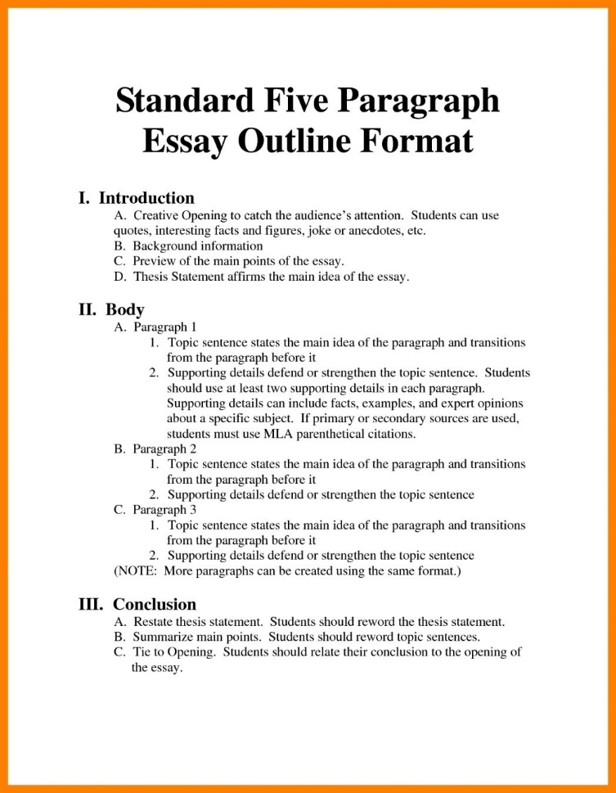
Essay Outline
Introduction
Body paragraphs
Conclusion
- Point form
Outline
Notes:
https://www.google.com/search?q=essay+format&rlz=1C2CAFC_enKR827KR827&source=lnms&tbm=isch&sa=X&ved=0ahUKEwid1OHeqdnjAhWbyIsBHec_AdIQ_AUIESgB&biw=1920&bih=969#imgrc=SXO-w1tjLCKB8M:

Slide 18
Introduction
Thesis statement
Main Idea #1
Supporting points
Proof
Proof
Main Idea #2
Supporting points
Proof
Proof
Main Idea #3
Supporting points
Proof
Proof
Conclusion
Detail
Outline

Slide 19
Research Again
Research

Slide 20
Re-Research
Now you know what you want to write
More specific information
3-4 pieces of evidence for each point.
Research

Slide 21
Essay Body
Body

Slide 22
Body Paragraph
Introductory Sentence
Point
Proof
Point
Proof
Conclusion Sentence
Body

Slide 23
Introductory Sentence
State what you will talk about
How it relates to the thesis statement
Body

Slide 24
Points / Proof
State how it relates to the topic of the paragraph
Add extra information to support your view (from research)
Body

Slide 25
Conclusion Sentence
Restate your introductory sentence
Add the points you made
Body

Slide 26
Introduction
Paragraph
Introduction

Slide 27
Introduction
Start with your thesis statement
Add 1 sentence for each of your body paragraphs
Say how you will prove it (arguments)
Introduction

Slide 28
Conclusion
Paragraph
Conclusion

Slide 29
Conclusion Sentence
Very similar to Introduction
Restate your strongest points
Last sentence should summarize all of your arguments
Conclusion

Slide 30
References
References

Slide 31
Referencing
Any information that you did not create
Specific details you used
Any information copied from another piece of work.
References

Slide 32
Referencing
Format – refer to textbook
Important information:
Title
Author
Year
References

Slide 33
Referencing
End notes
Footnotes
Bibliography
Oxford Royale Academy. (2014). How to Do Research for an Excellent Essay: the Complete Guide. [online] Available at: https://www.oxford-royale.co.uk/articles/essay-research-skills.html [Accessed May 10, 2019].
References

Slide 34
Introduction Paragraph
Thesis Statement
Introduce your arguments
Conclusion Statement

Slide 35
Body Paragraphs
State your arguments
Add your points
Support your points with proof (references)

Slide 36
Conclusion Paragraph
Restate your thesis statement
Restate your best arguments (no proof)
Summarize your essay

