Slide 1
Assessing
Students

Slide 2
Feedback vs Marking
Accuracy vs Fluency

Slide 3
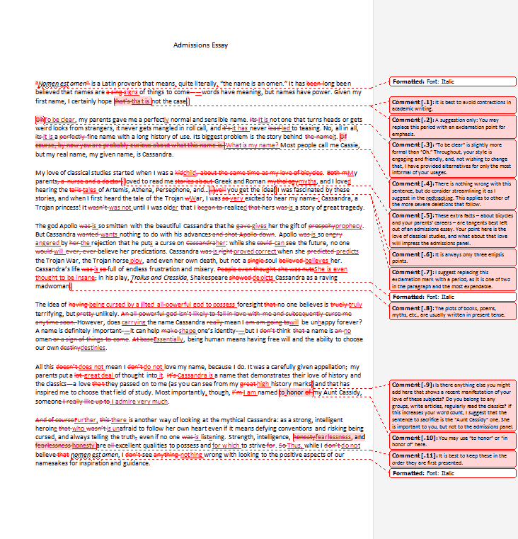
A lot of red discourages students.

Slide 4
Create
a
Rubric

Slide 5
Fluency
Accuracy
Did they complete the writing task?
Goals

Slide 6
Fluency
Well connected thoughts
Word choice
Fluidity
Development
Author’s voice (personality)
Ideas – is it memorable?
Details
Content – shows knowledge of the subject

Slide 7
Accuracy
Spelling
Grammar
Clear and well stated thesis
Word Count / Vocabulary
Punctuation
Meaningful words

Slide 8
Accomplishing Goals
Proper formatting
Reverenced well
Clearly defined relationships:
Thesis and arguments
Arguments and points
Points and proofs
Organization

Slide 9
 | 1 point | 2 Point | 3 Point | 4 Point
Metric | Criteria | Criteria | Criteria | Criteria
https://www.rcampus.com/rubricshowc.cfm?sp=yes&code=UAX785&

Slide 10
Assignment
There are many different energy sources (for example, sun, wind, oil, water, natural gas, coal, nuclear fission, etc.). Pick one such source and discuss its advantages and disadvantages. You might consider availability, safety, geographical location, etc.
Write a 5 paragraph essay on one of these topics
https://michiganassessment.org/wp-content/uploads/2014/11/MELAB-SampleEssays-Commentary-2013.pdf

Slide 11
Let’s make a rubric
 | 1 POINT | 2 POINTS | 3 POINTS | 4 POINTS
Metric 1 | Criteria | Criteria | Criteria | Criteria
Metric 2 | Criteria | Criteria | Criteria | Criteria
Metric 3 | Criteria | Criteria | Criteria | Criteria
Metric 4 | Criteria | Criteria | Criteria | Criteria
Metric 5 | Criteria | Criteria | Criteria | Criteria
https://www.rcampus.com/rubricshowc.cfm?sp=yes&code=UAX785&

