Slide 1
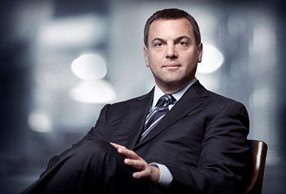
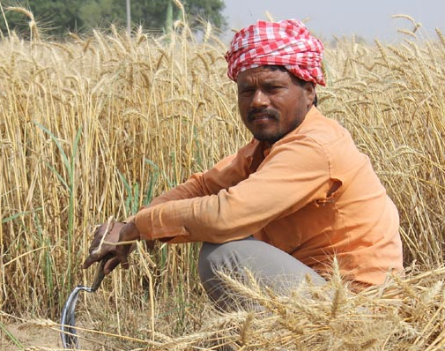
CEO
Buddhist Monk
Farmer
Gender: Male
Age: 41
Gender: Male
Age: 15
Gender: Male
Age: 45
Engineer
Teacher
Doctor
Gender: Female
Age: 39
Gender: Female
Age: 29
Gender: Female
Age: 62

Slide 2
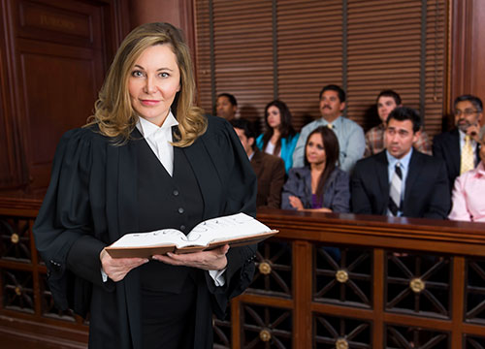
Construction
Worker
Chef
Scientist
Gender: Male
Age: 26
Gender: Male
Age: 37
Gender: Male
Age: 48
Lawyer
Police Officer
Politician
Gender: Female
Age: 44
Gender: Female
Age: 31
Gender: Female
Age: 24

Slide 3
Who?
Why?
Who?
Why?

