Slide 1
Abstract Expressionism

Slide 2
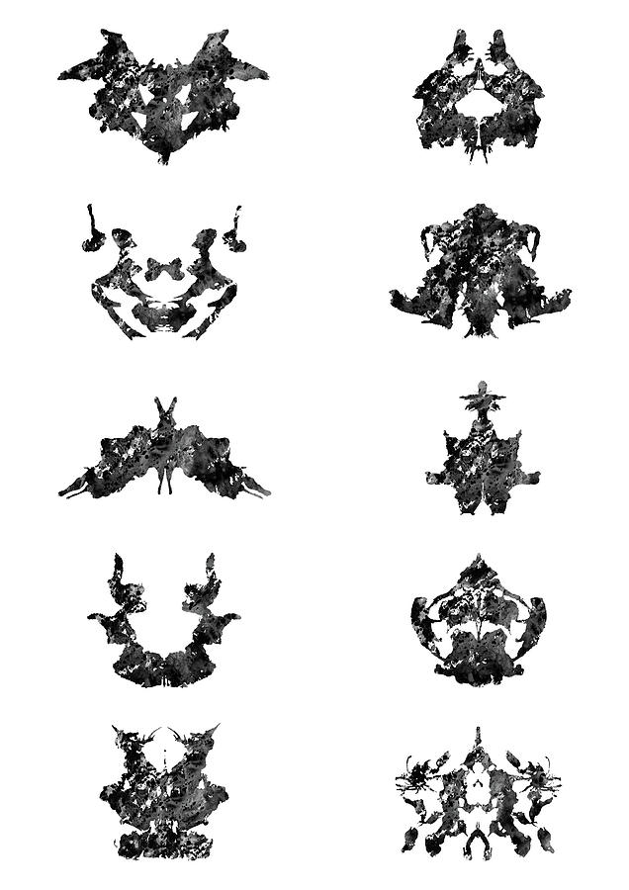
Inkblot (Rorschach) Test
https://www.youtube.com/watch?v=BKcrXGQkcAk

Slide 3
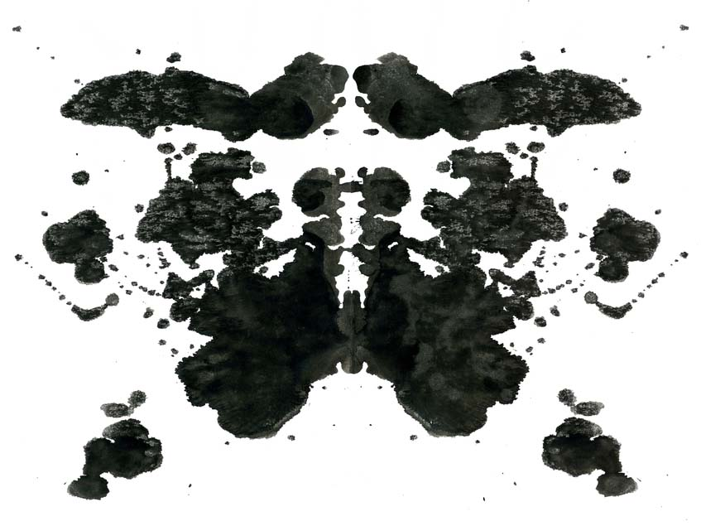

Slide 5
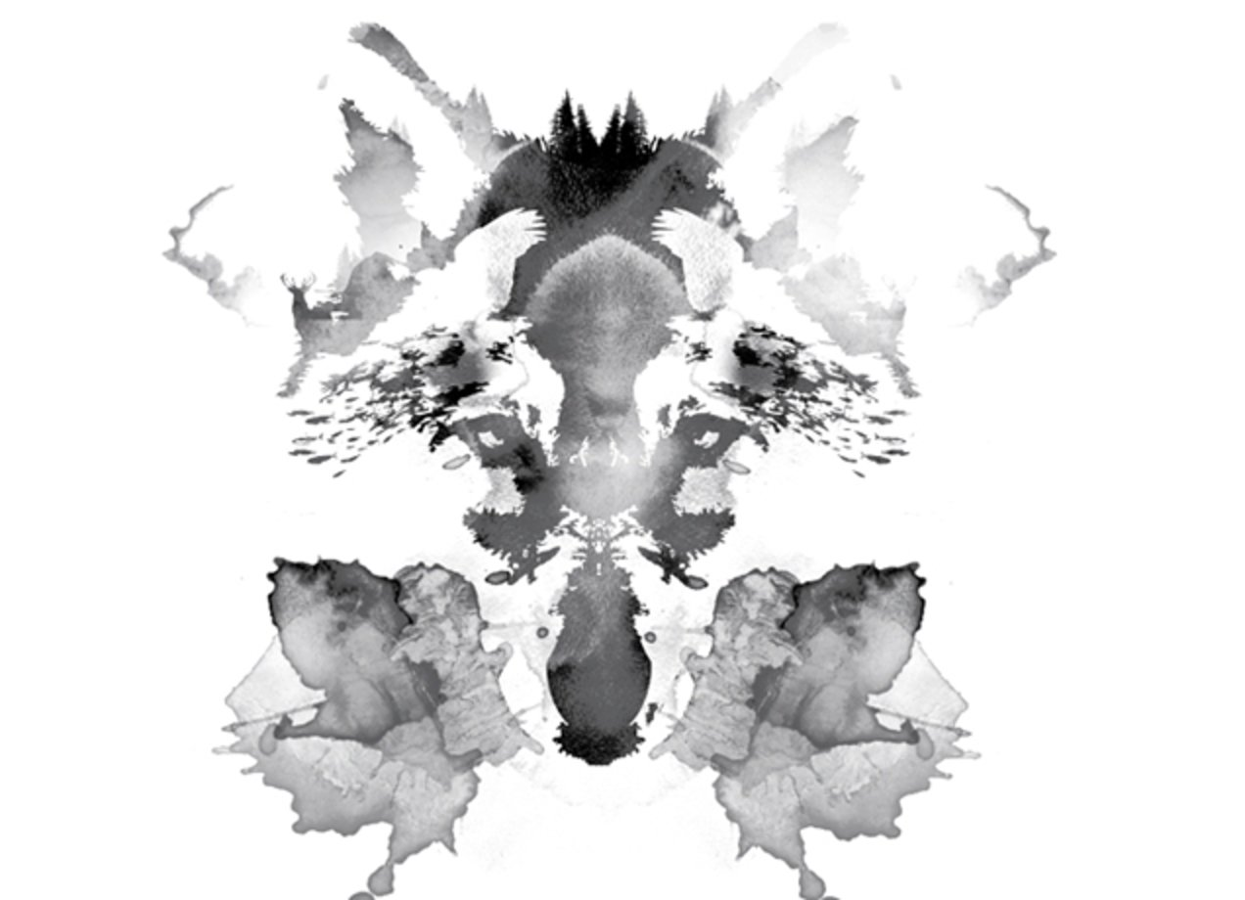

Slide 6
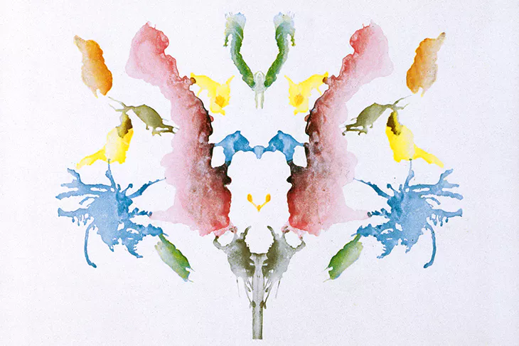

Slide 7
Rorschach Test
Hermann Rorschach (1960s)
Showed abstract images and recorded the results
Looked at HOW people responded
Similar mental diseases had similar answers
Used by psychologists to diagnose mental illness
Often misused these days

Slide 8
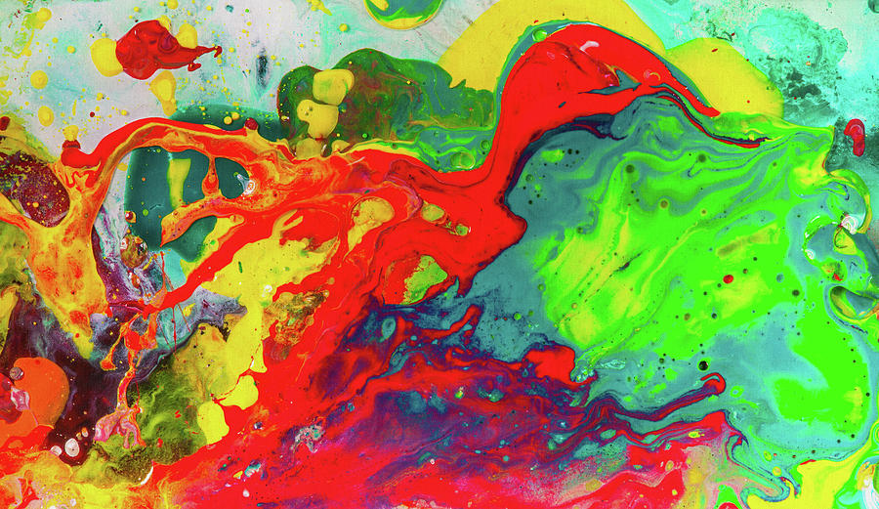

Slide 9
Art Critic
Look around the class
Find a picture with meaning to you
Write about the picture:
What do you see?
How do you feel?
What was the artist thinking?

