Slide 1
Some Games

Slide 2
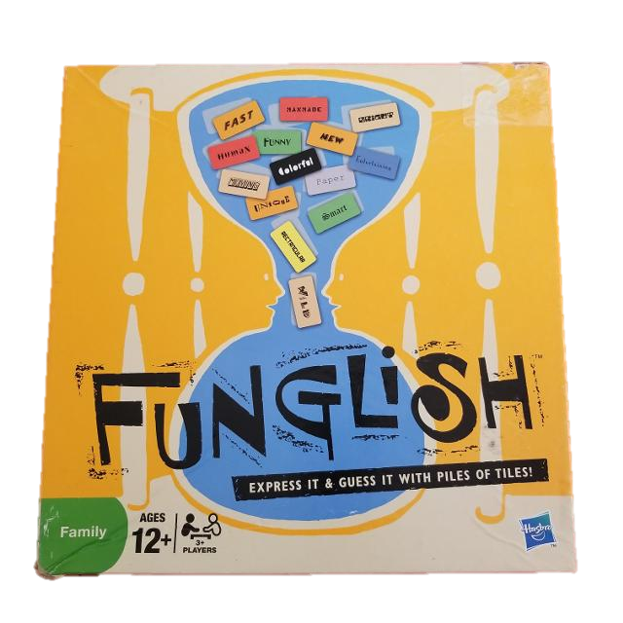
Funglish

Slide 3
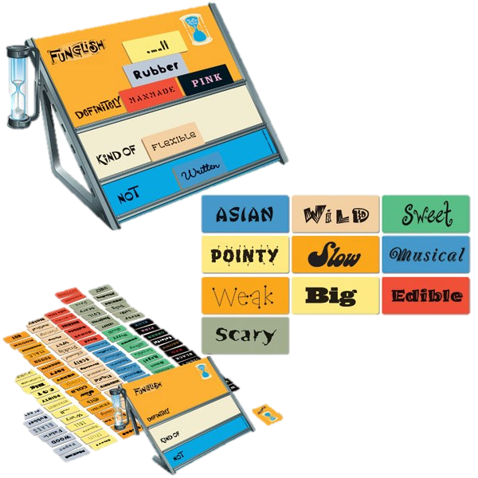
Funglish
Find adjectives
Add them to the board
In the correct place
Your team will guess your word
No Speaking
No Gestures

Slide 4
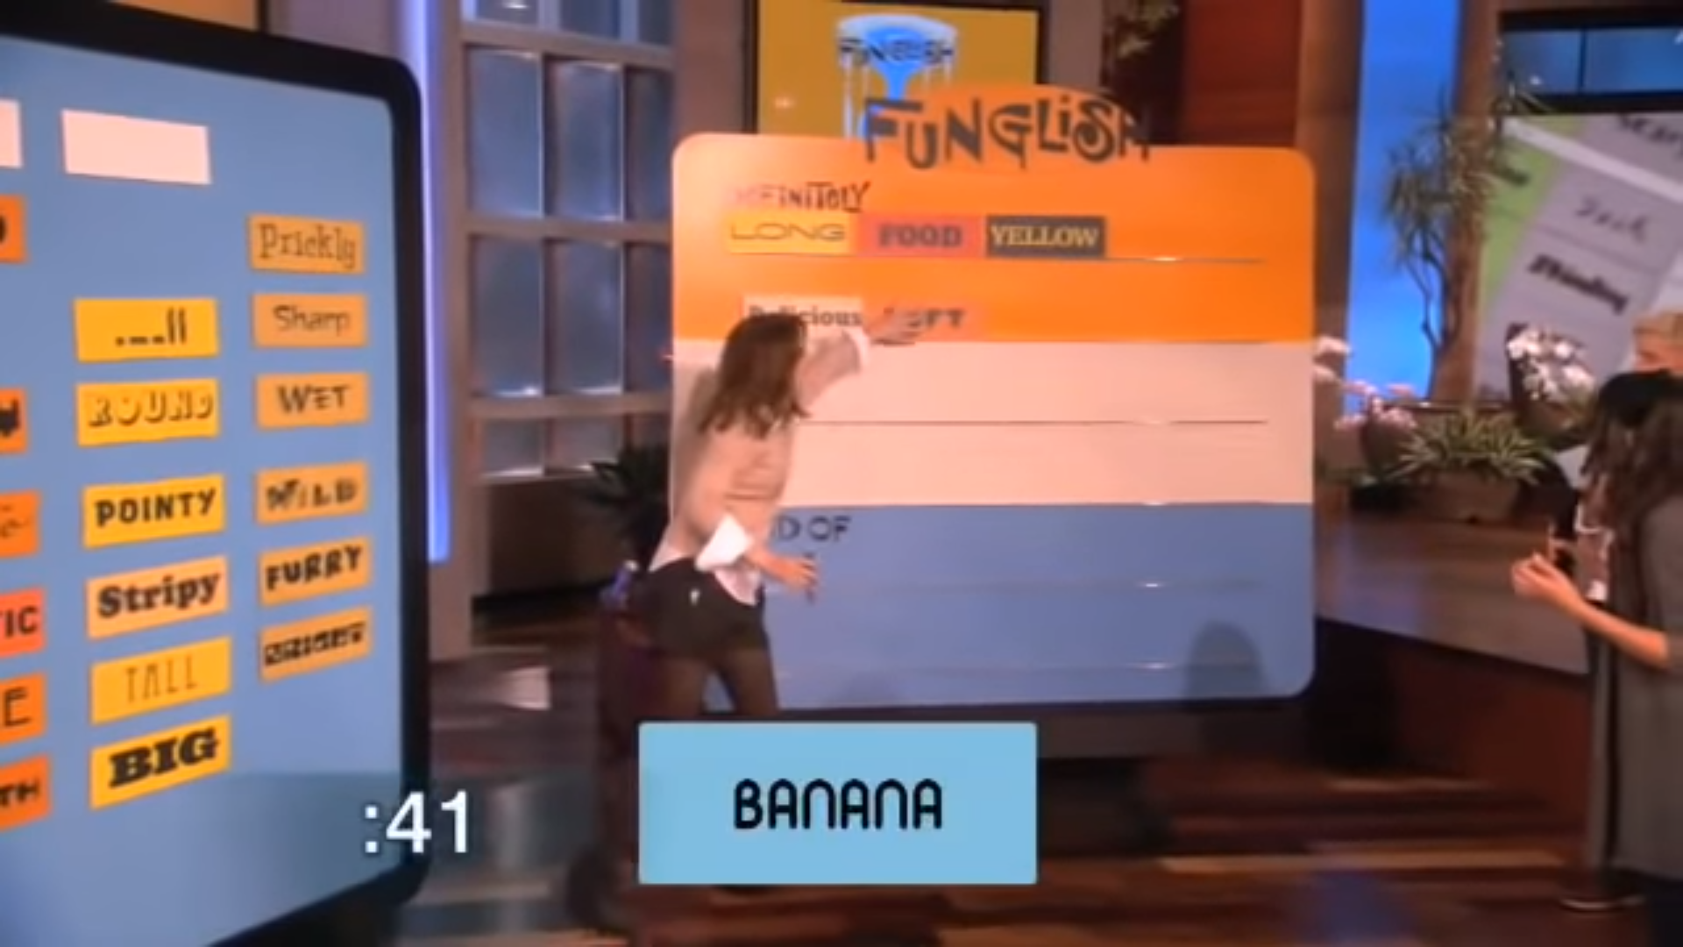

Slide 5
https://www.youtube.com/watch?v=s7_XRcCKqP4

Slide 6
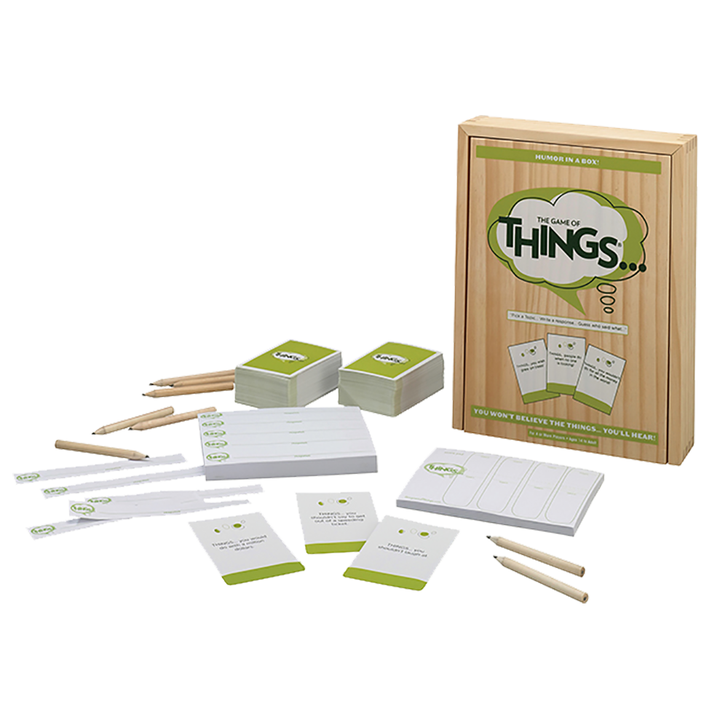
Game of Things

Slide 7
Game of Things
One person is the reader
Read the question
Secretly write your response
Collect the answers
Reader reads the answers
Everyone guesses who wrote it

Slide 9
https://www.youtube.com/watch?v=bTqXOtThjHg

Slide 10
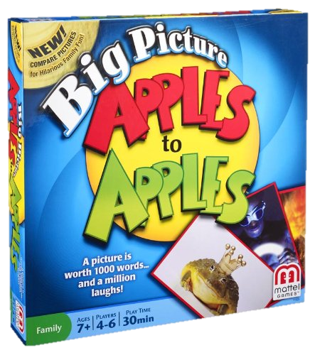
Apples to Apples

Slide 11
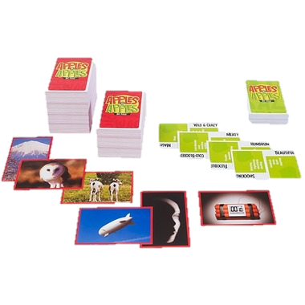
Apples to Apples
One person is the judge
Take a (green) adjective
Other players secretly give a card to the judge
The judge shows the cards
Choose one winner

Slide 12
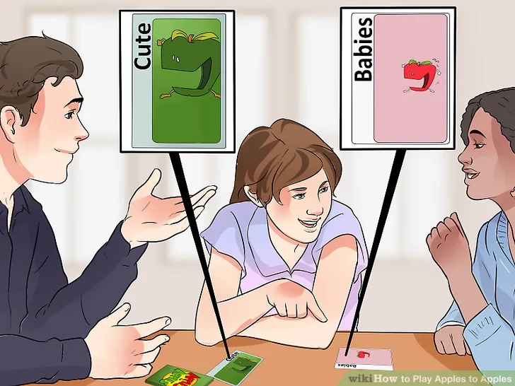

Slide 13
https://www.youtube.com/watch?v=0ScphJ-H9ic

Slide 14
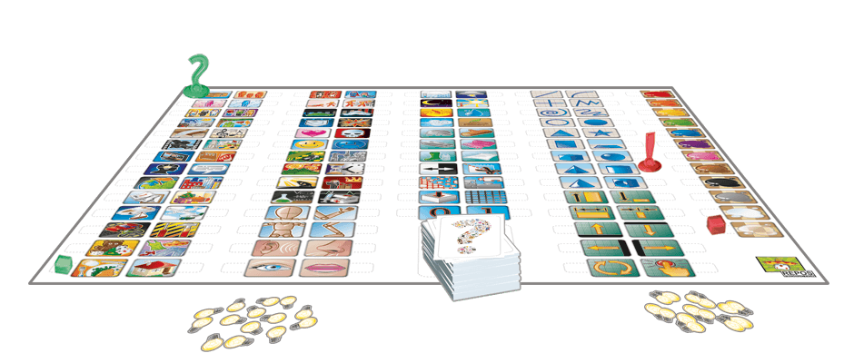
Concept

Slide 15
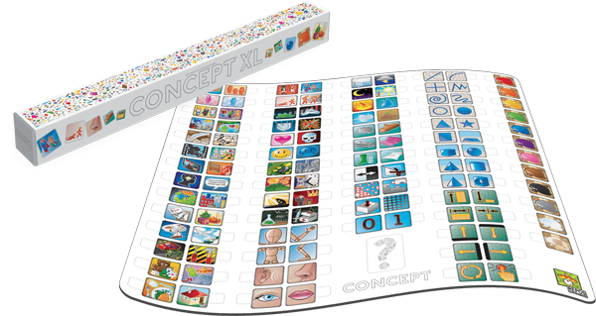
Concept
One judge
Use the main clue marker
Add sub clues connected to the main clue
The other players guess the answer

Slide 16
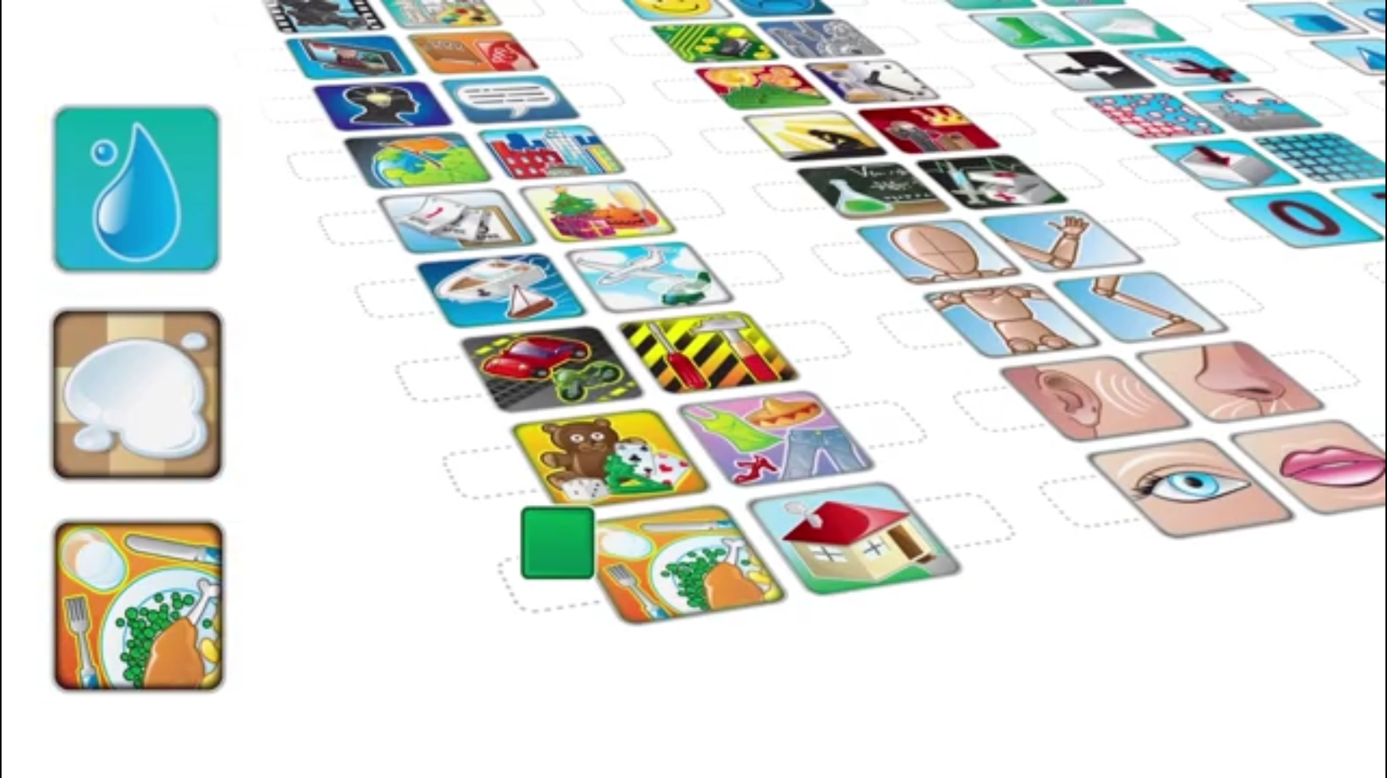
Liquid
White
Food

Slide 17
Concept Game
http://concept-the-game.com/index.php?lang=en

