Slide 1
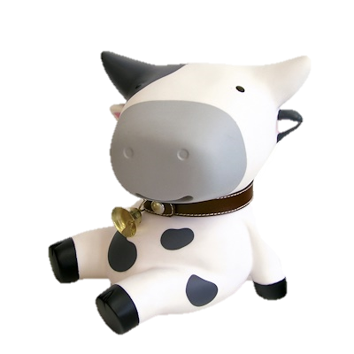
Superlatives

Slide 2
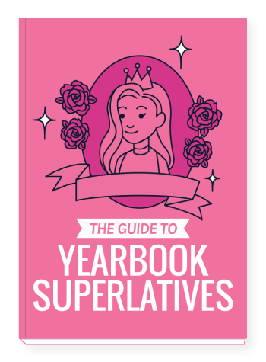
SENIOR SUPERLATIVES
Choose superlatives to describe other students
teachers

Slide 3
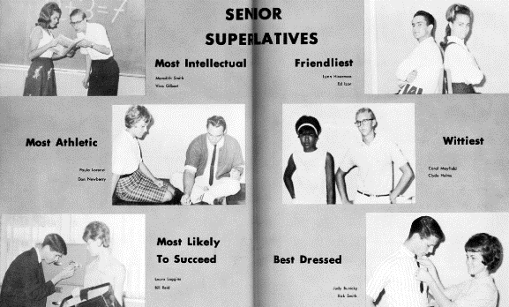

Slide 4
FUNNY or SERIOUS?

Slide 5
SENIOR SUPERLATIVES
Vote on superlatives
Write a certificate (using cursive writing)

Slide 6
Nerio Son
Brenton Jennings
Jessamine Price
Gillian Witter
David Stewart
Troy Lambrecht
Cassandra Taylor
Jonathan Pharis
Surrette Matthee

