Slide 1
“We talk, even if no one listens, because we never know when someone will.”
- Caitlyn Paige

Slide 2
TIM
TIMOTHY JACK SCHILSTRA

Slide 3
Where am I from?

Slide 4
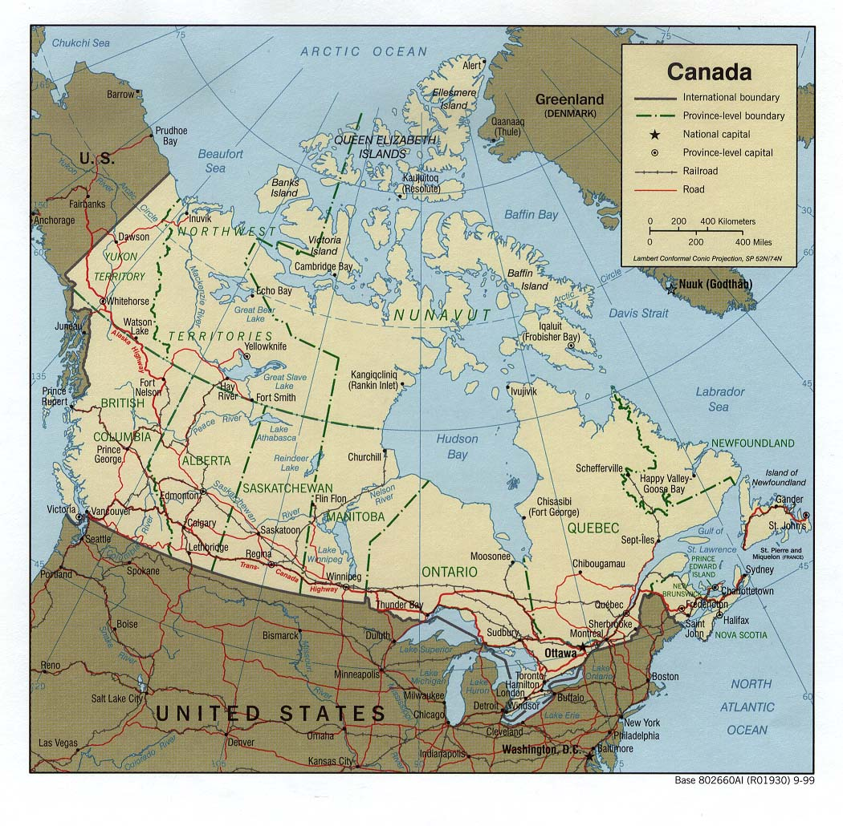

Slide 5
How many are there in my family?

Slide 6
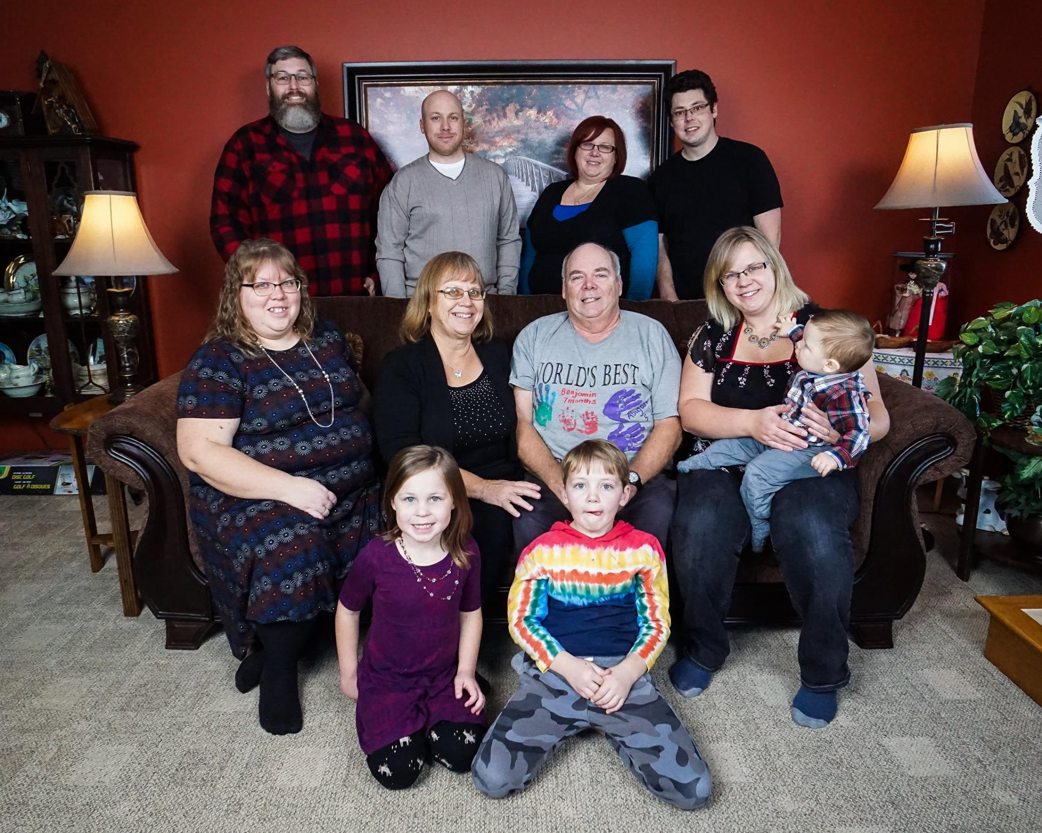
My Family

Slide 7
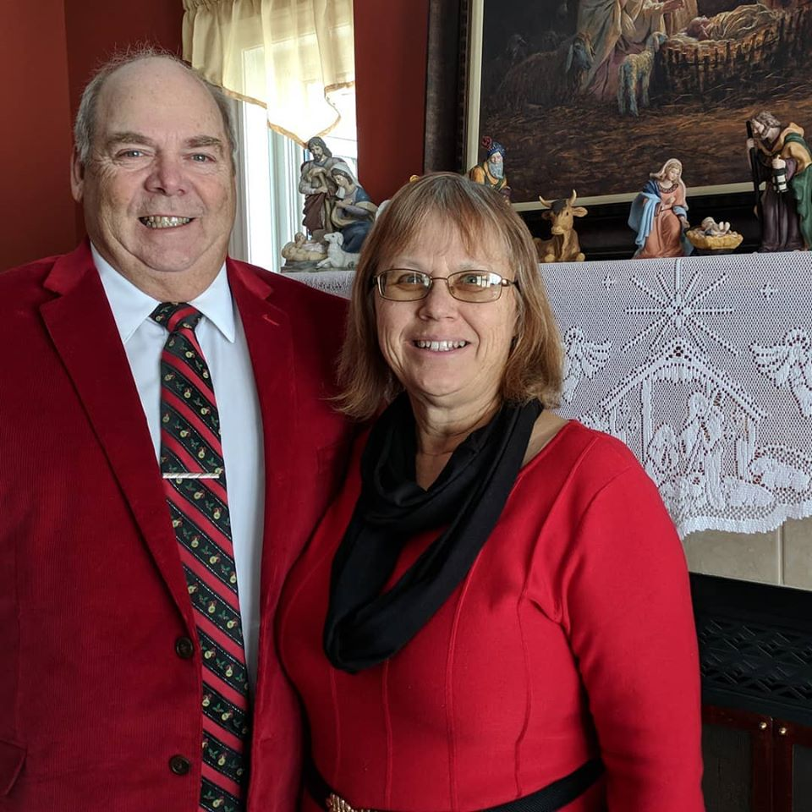
Mother and Father

Slide 8
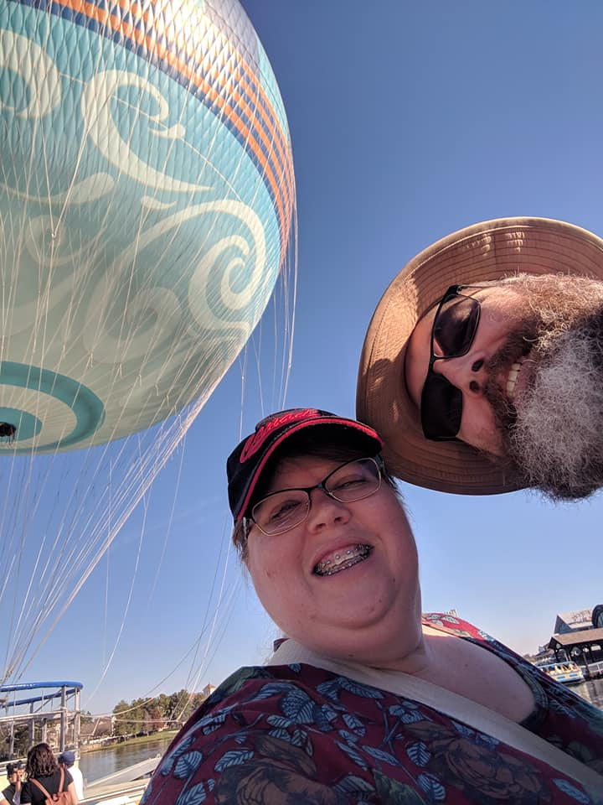
Debbie and Dave

Slide 9
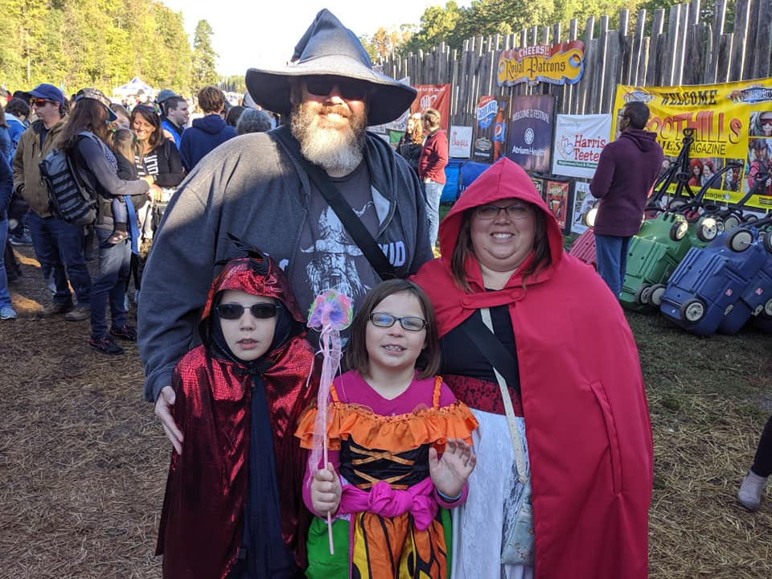
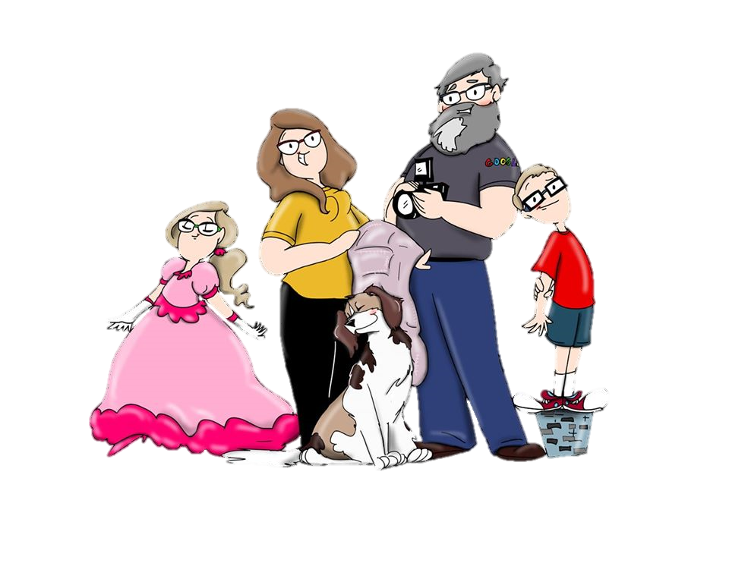
Zeke and Abigail

Slide 10
Amanda

Slide 11
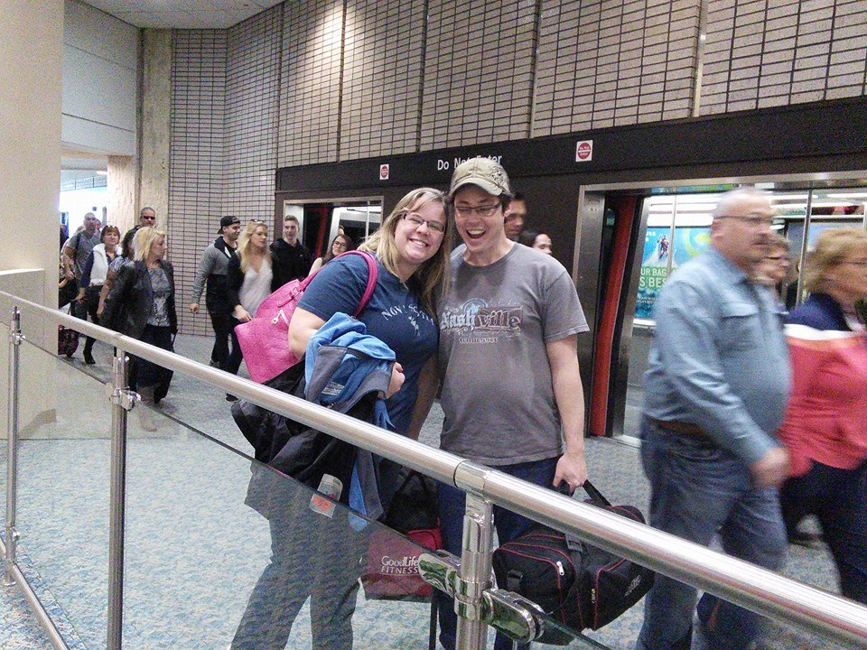
Melissa and Bob

Slide 12
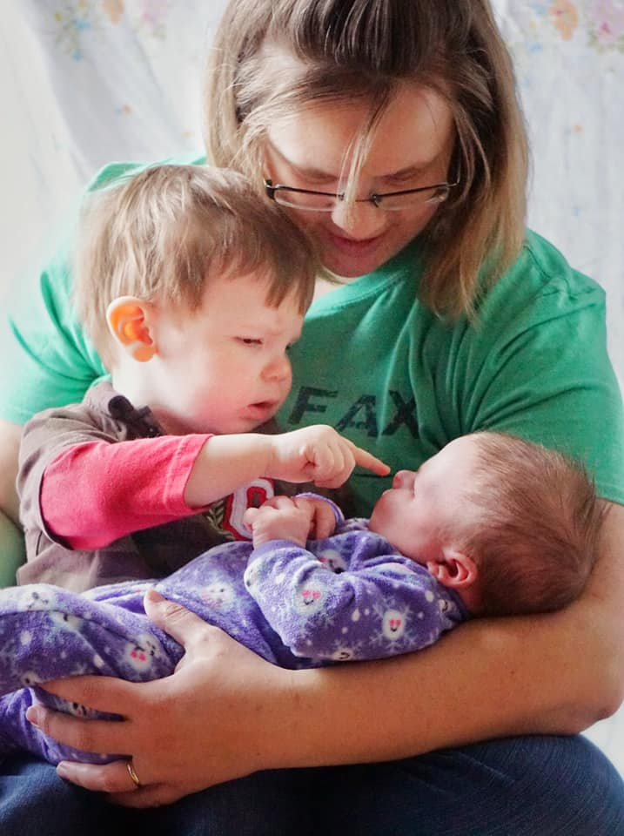
Benjamin Lydia

Slide 13
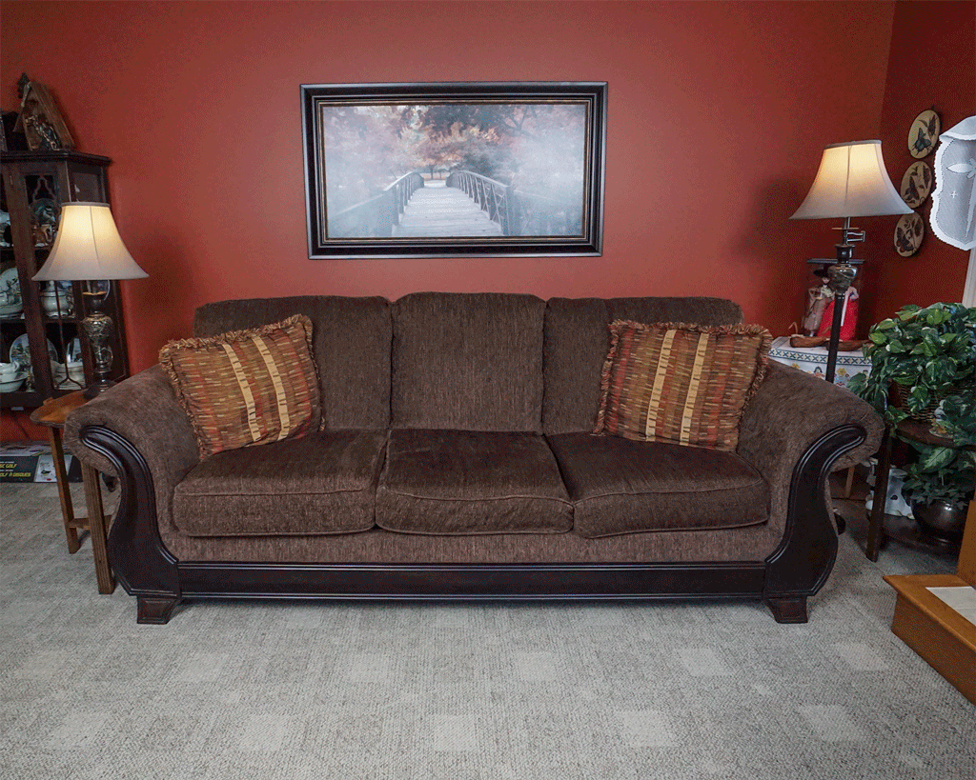

Slide 14
How long have I lived in Korea?

Slide 15
Mr.S in Korea
2009

Slide 16
Yuseong Bio-Science and Technology High School

Slide 17
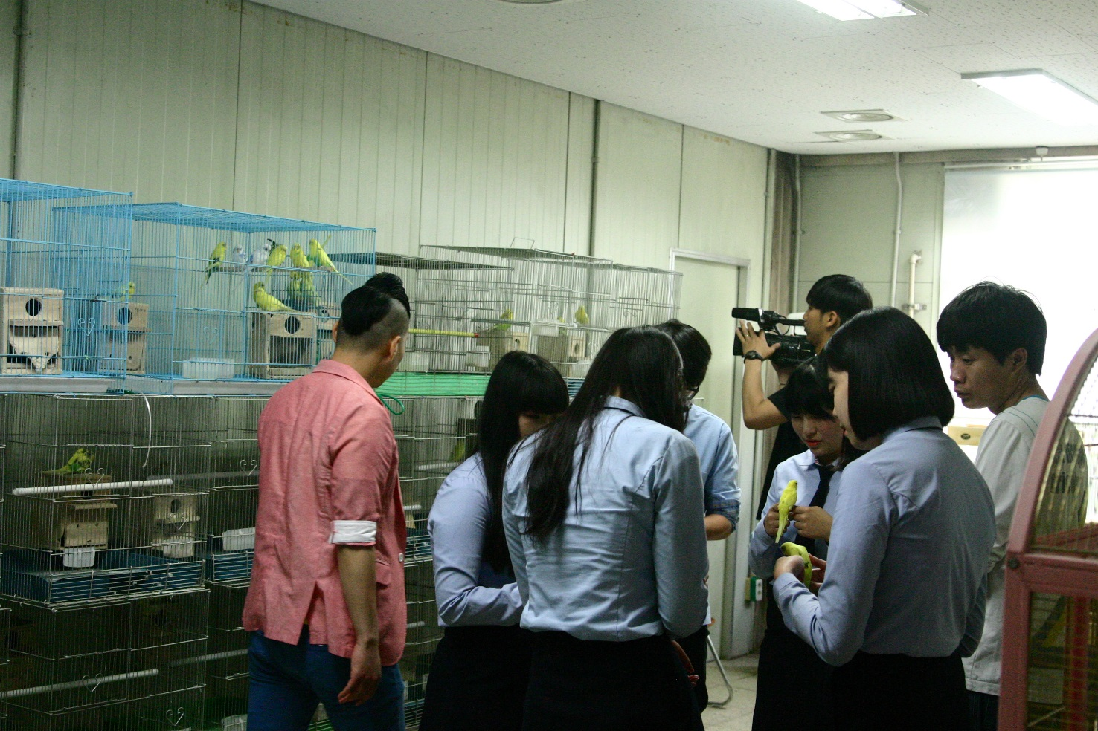
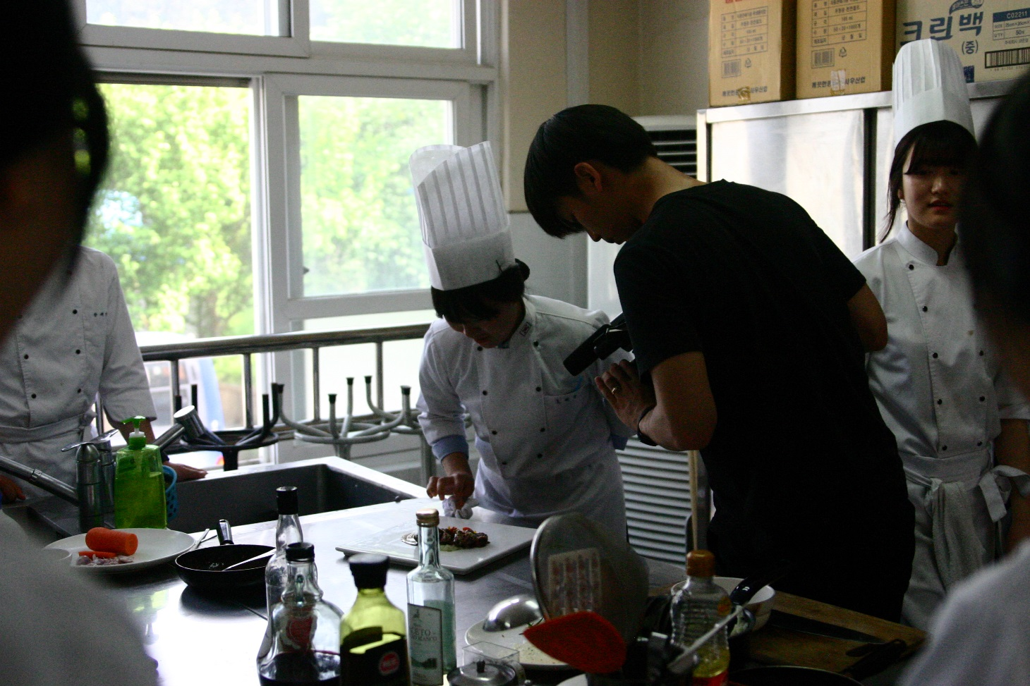
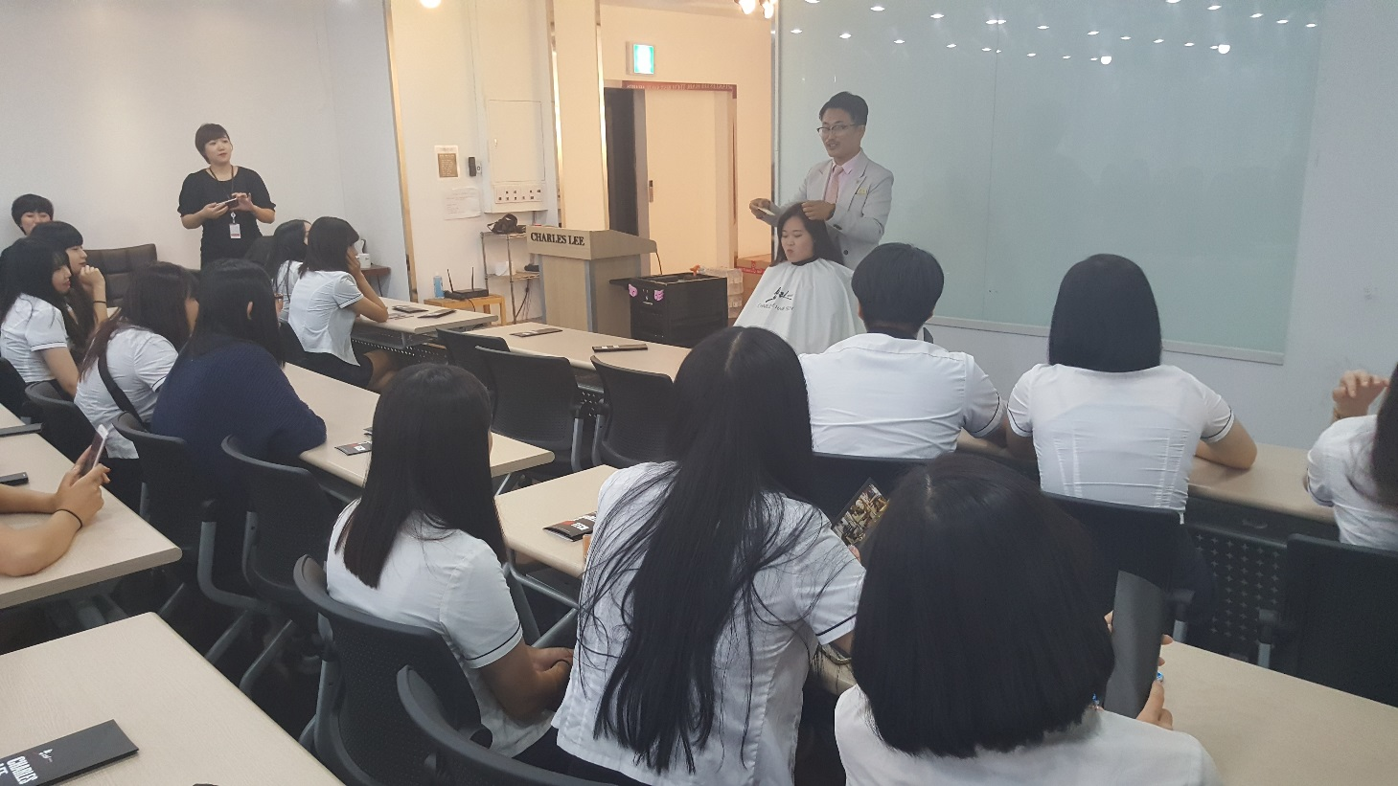

Slide 18
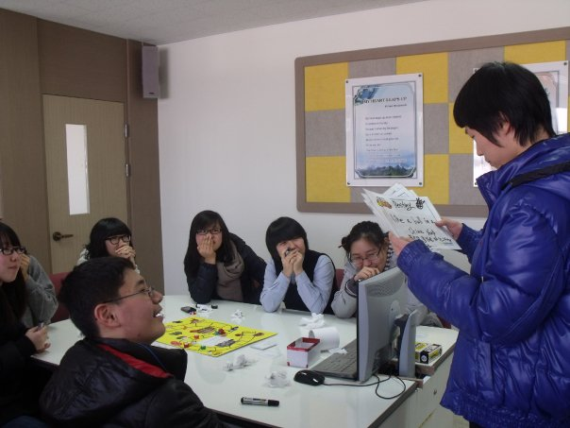
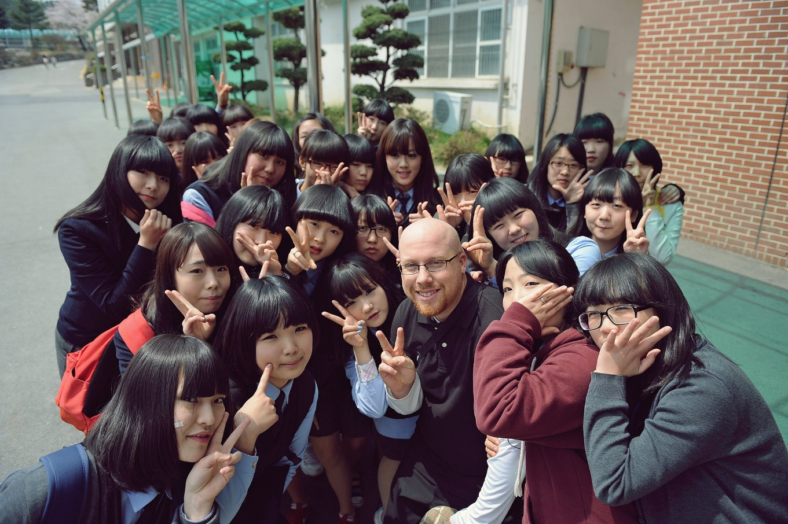

Slide 19
Eoeun Elementary School

Slide 20
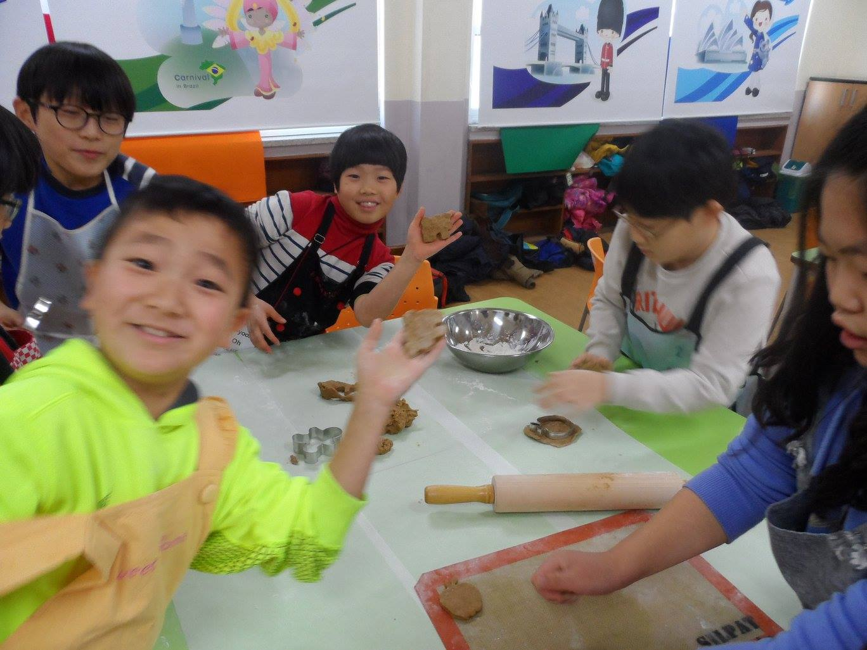

Slide 21
Shinhan High School

Slide 22
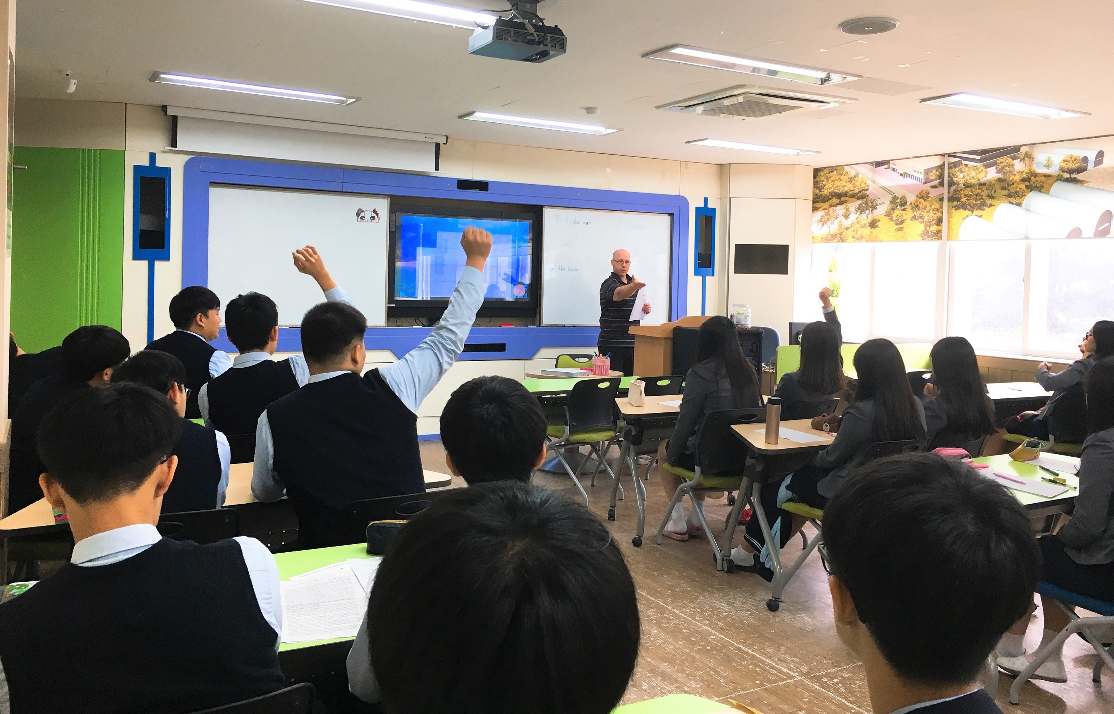
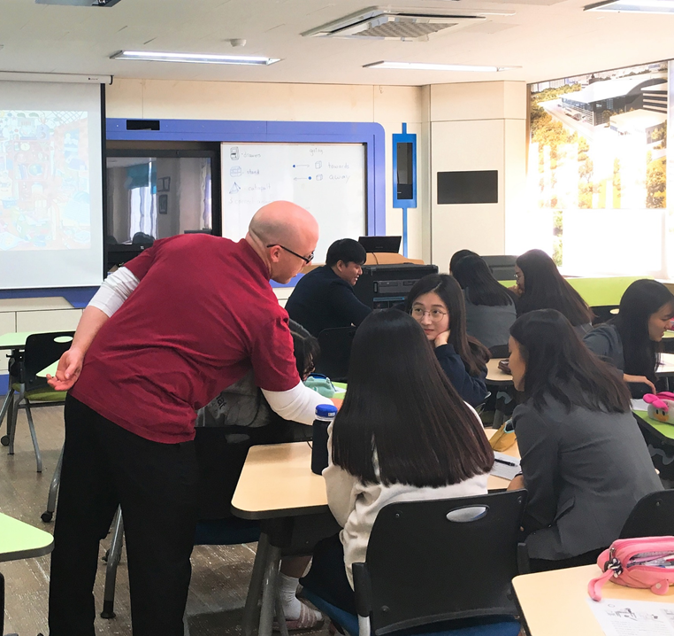

Slide 23
What was my major?

Slide 24
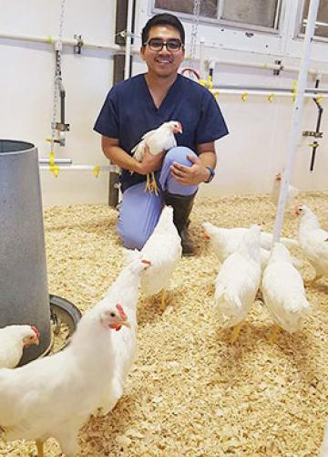

Slide 25
What is my favorite Korean Food?

Slide 26
What is my favorite Korean Food?

Slide 27
What is my favorite hobby?

Slide 28
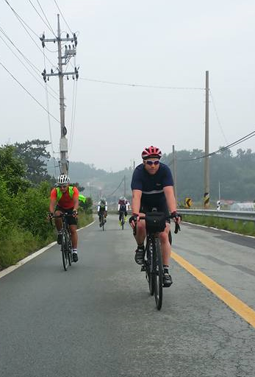
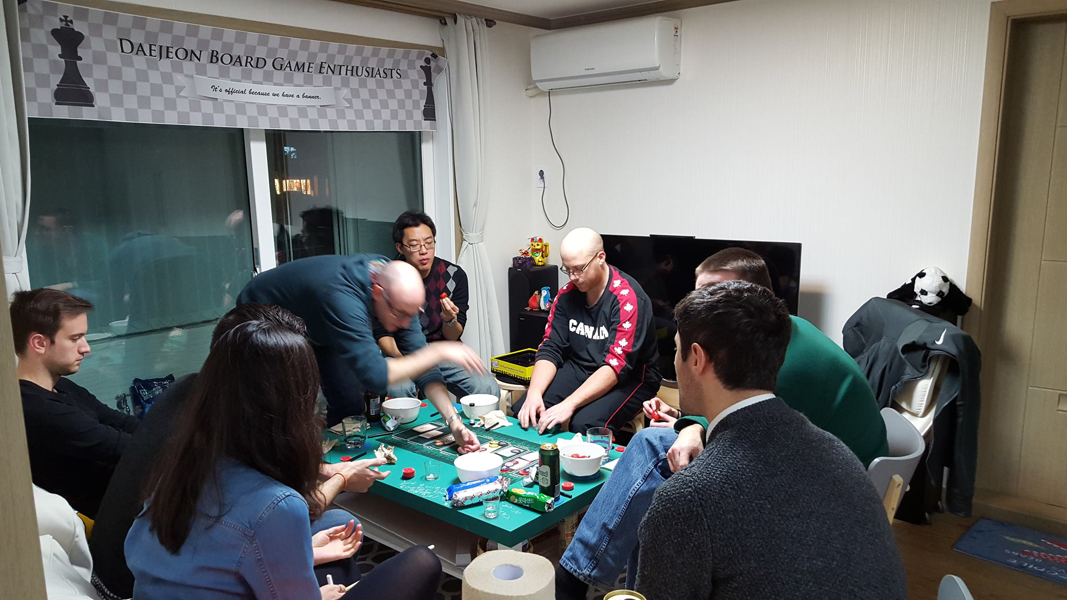
My Hobbies
Cycling
Playing board games

Slide 29
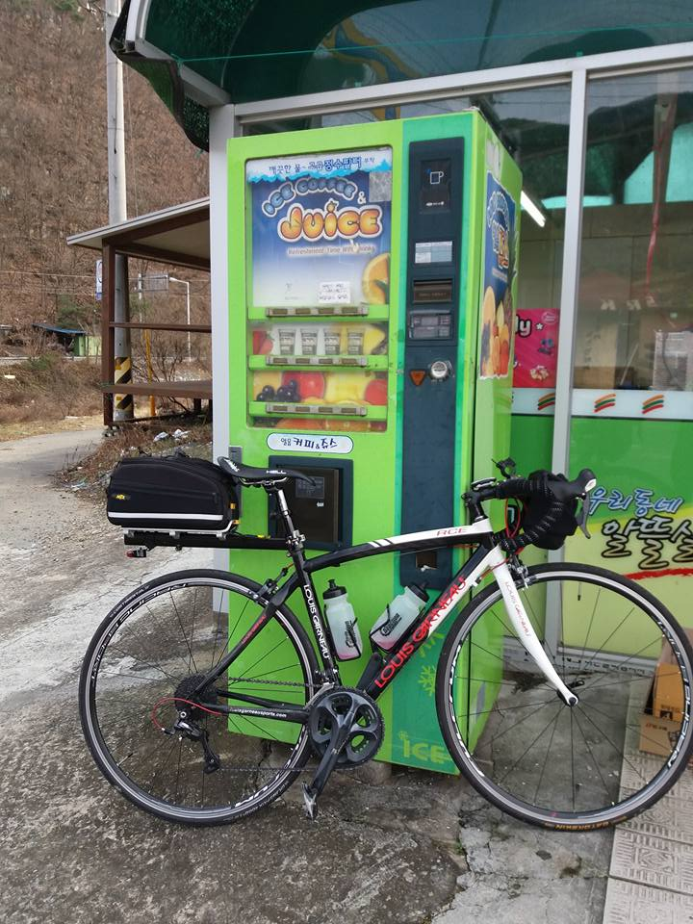
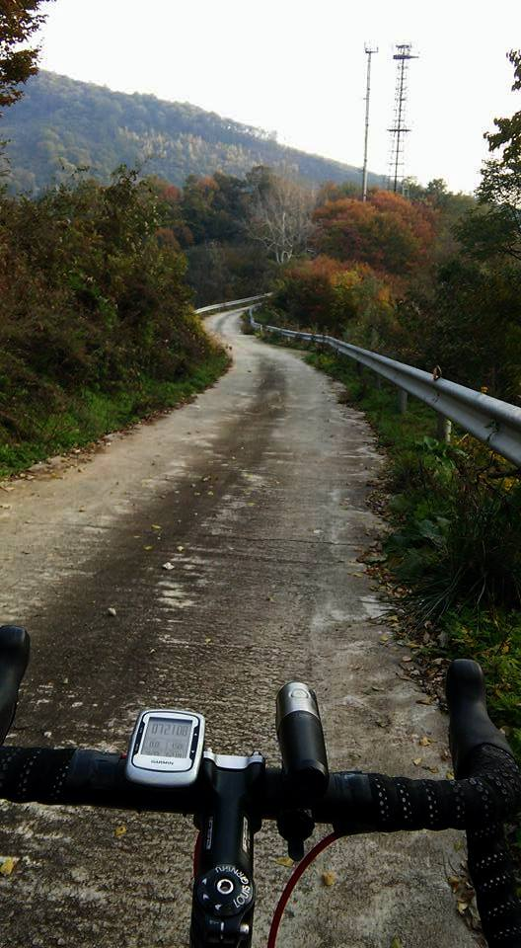

Slide 30
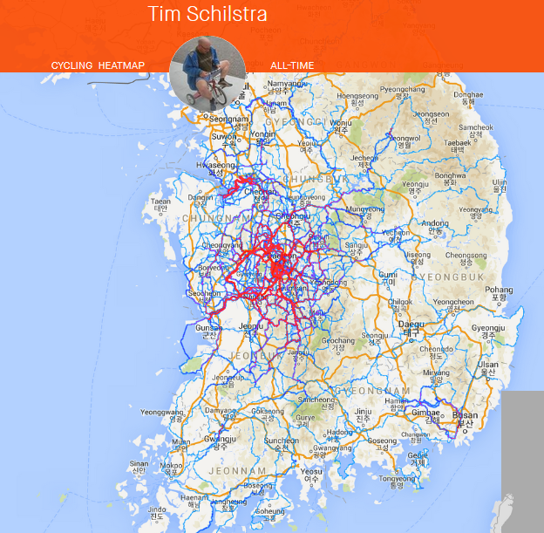

Slide 31
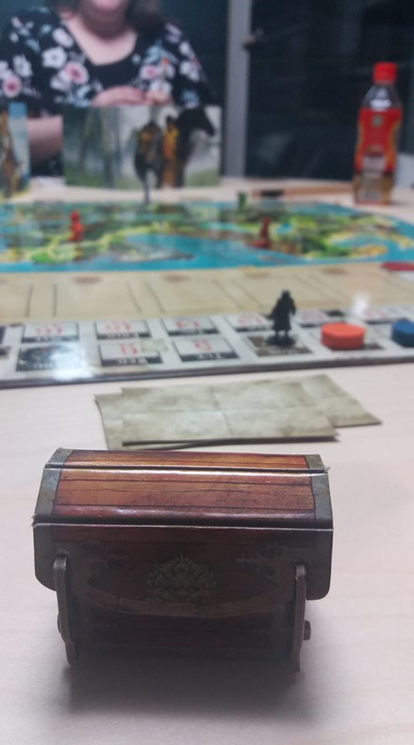
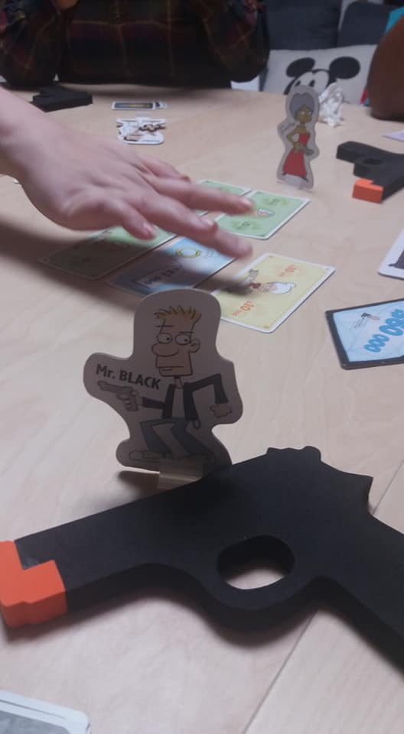
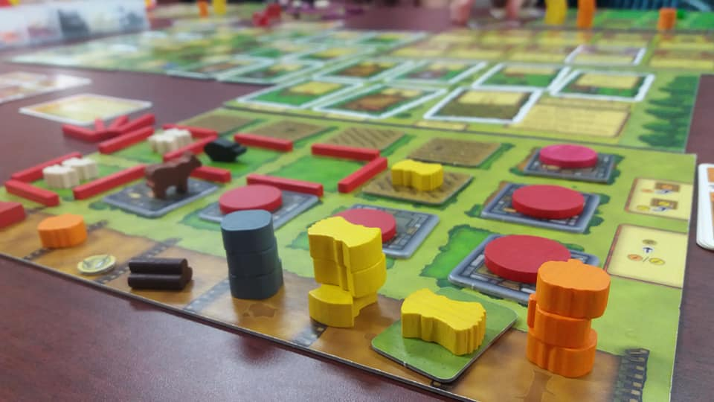
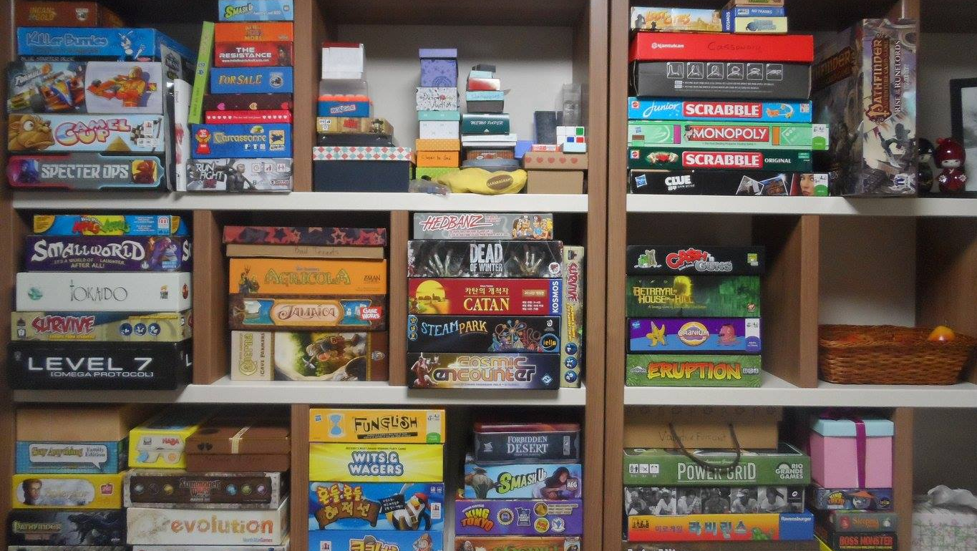
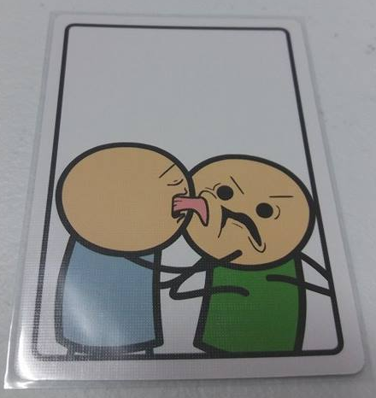

Slide 32
What is my favorite animal?

Slide 33
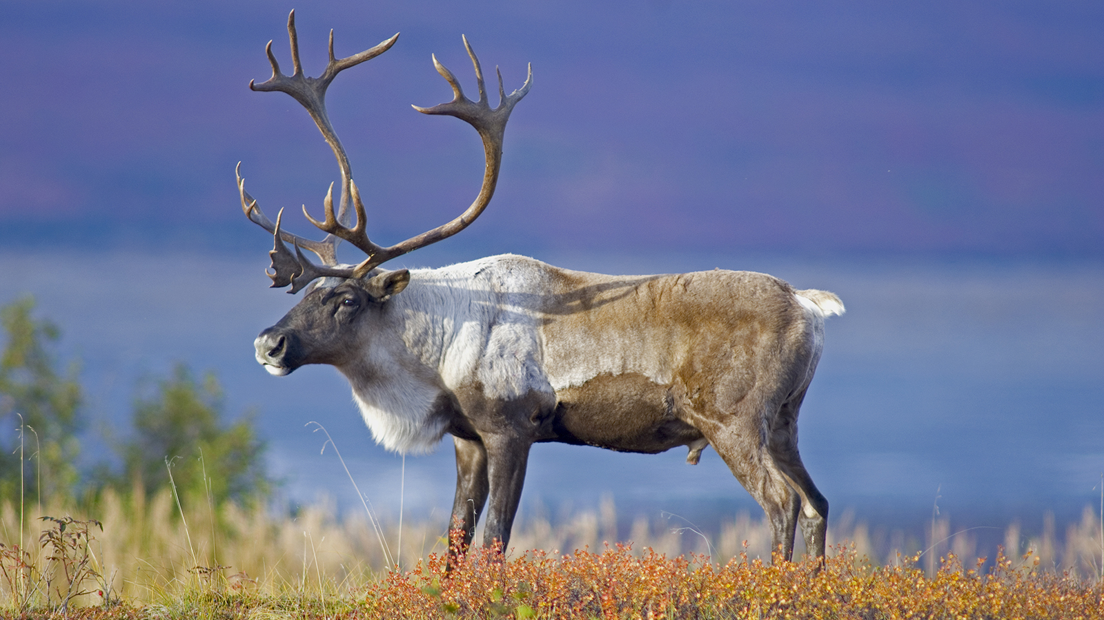
What is my favorite animal?

Slide 34
What is the strangest place I have been?

Slide 36
GOALS
LISTENING II

Slide 37
PERSONAL SKILLS
ACTIVE LISTENING

Slide 38
STUDENT SKILLS
ACTIVITIES AND TEXTBOOK

Slide 39
MOTIVATION
CLASSROOM MANAGEMENT

Slide 40
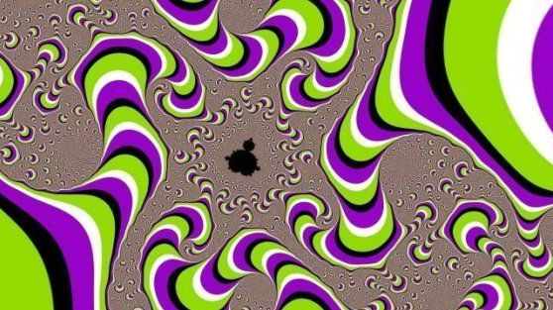
Audio Illusions

Slide 41
How old are your ears?
8,000 hz
Everyone can hear.
10,000 hz
Normal hearing.
12,000 hz
Under 50 years old
15,000 hz
Under 40 years old
18,000 hz
Under 20 years old
https://www.youtube.com/watch?v=VxcbppCX6Rk

Slide 42
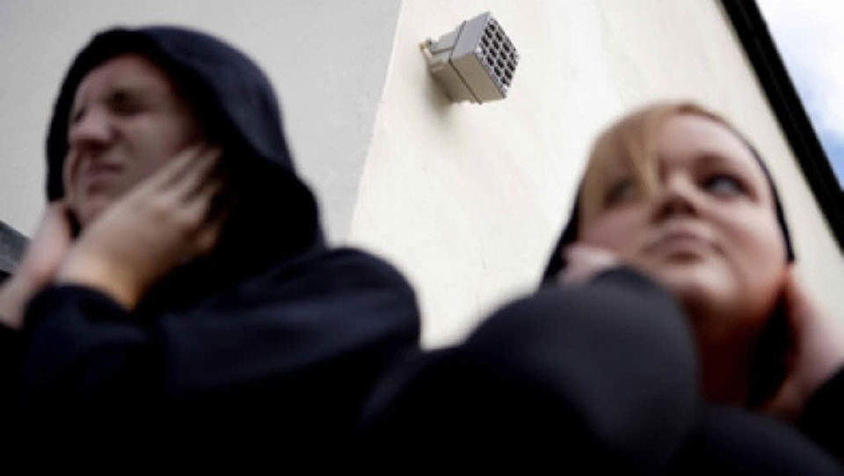

Slide 43
Does the tone go up or down?

Slide 44
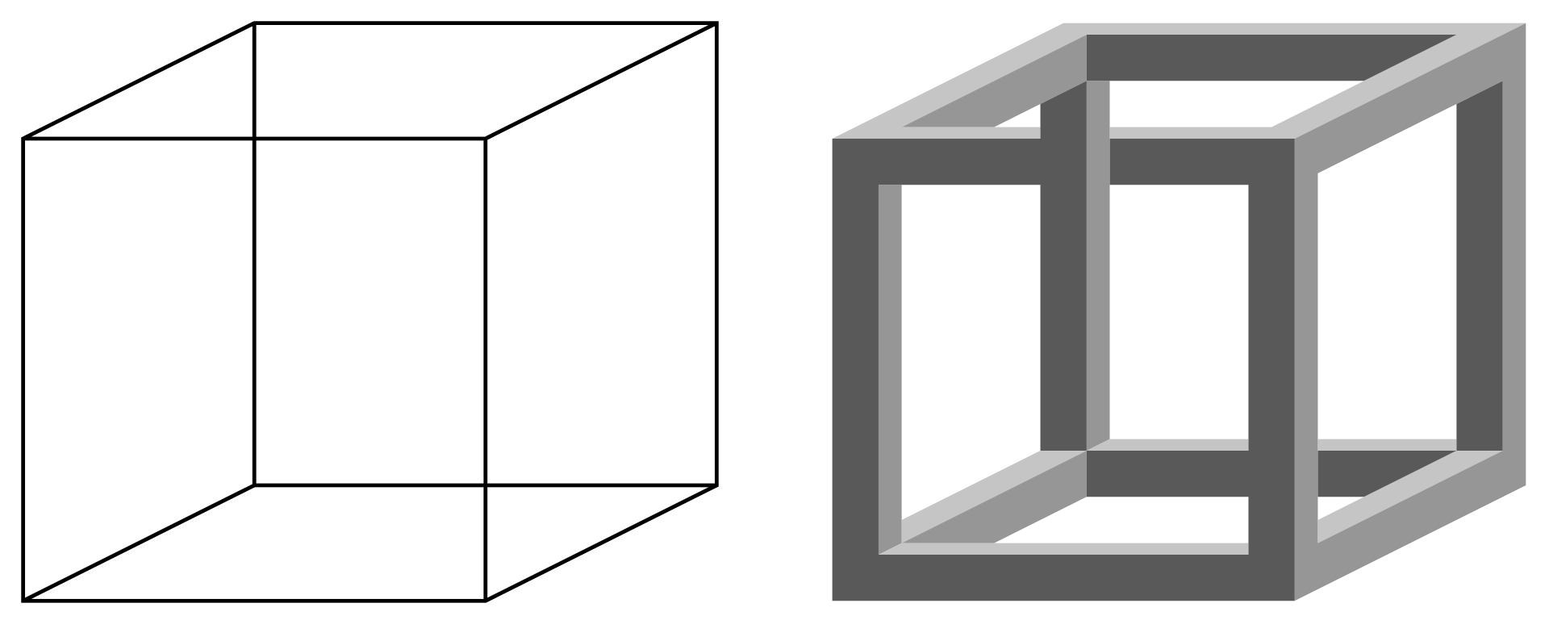
Tritone Paradox
Different between people
Ascending and Descending

Slide 46
What is happening?

Slide 47
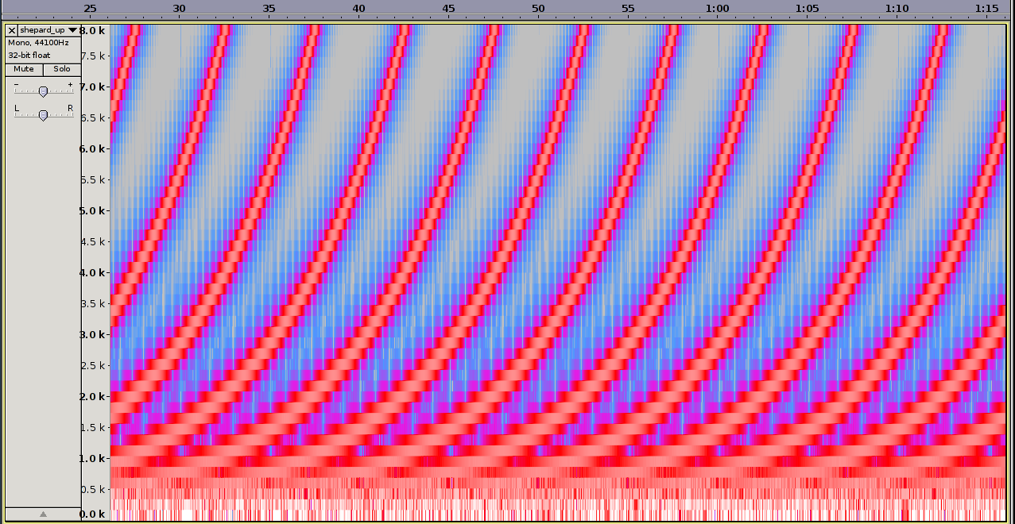
Shepard Tone
Continuously goes up or down
But the notes stay the same

Slide 48
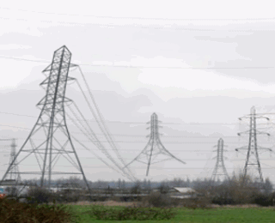
Can you hear it?

Slide 49
What is she saying?

Slide 50
What is she saying?

Slide 51
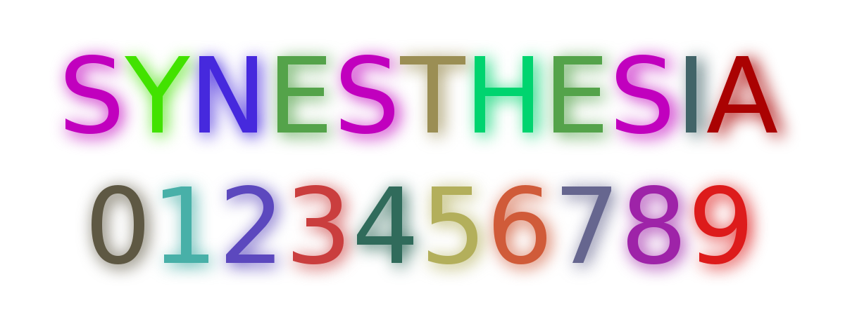
Synesthsia
Two senses get crossed in your brain
https://www.youtube.com/watch?v=yKR2pGwavqE

Slide 52
What is she saying?

Slide 53
Phantom Word Illusion
https://www.youtube.com/watch?v=kbzL9PxtFf0

Slide 54
What is he saying?
A
B
C

Slide 55
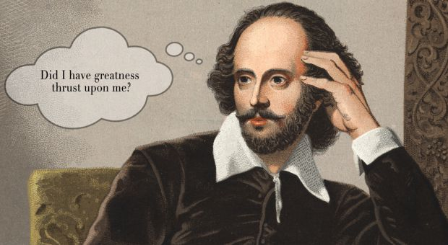
Phonemic Restoration Effect
To _e or n__ to _e.
Your brain fills in the gaps
https://www.youtube.com/watch?v=ZyvyGMkzNQc

Slide 56
Do you hear…
Laurel
Yanny

Slide 57
https://www.youtube.com/watch?v=w40XcUP5KrI

Slide 58
https://www.youtube.com/watch?v=w40XcUP5KrI

Slide 59
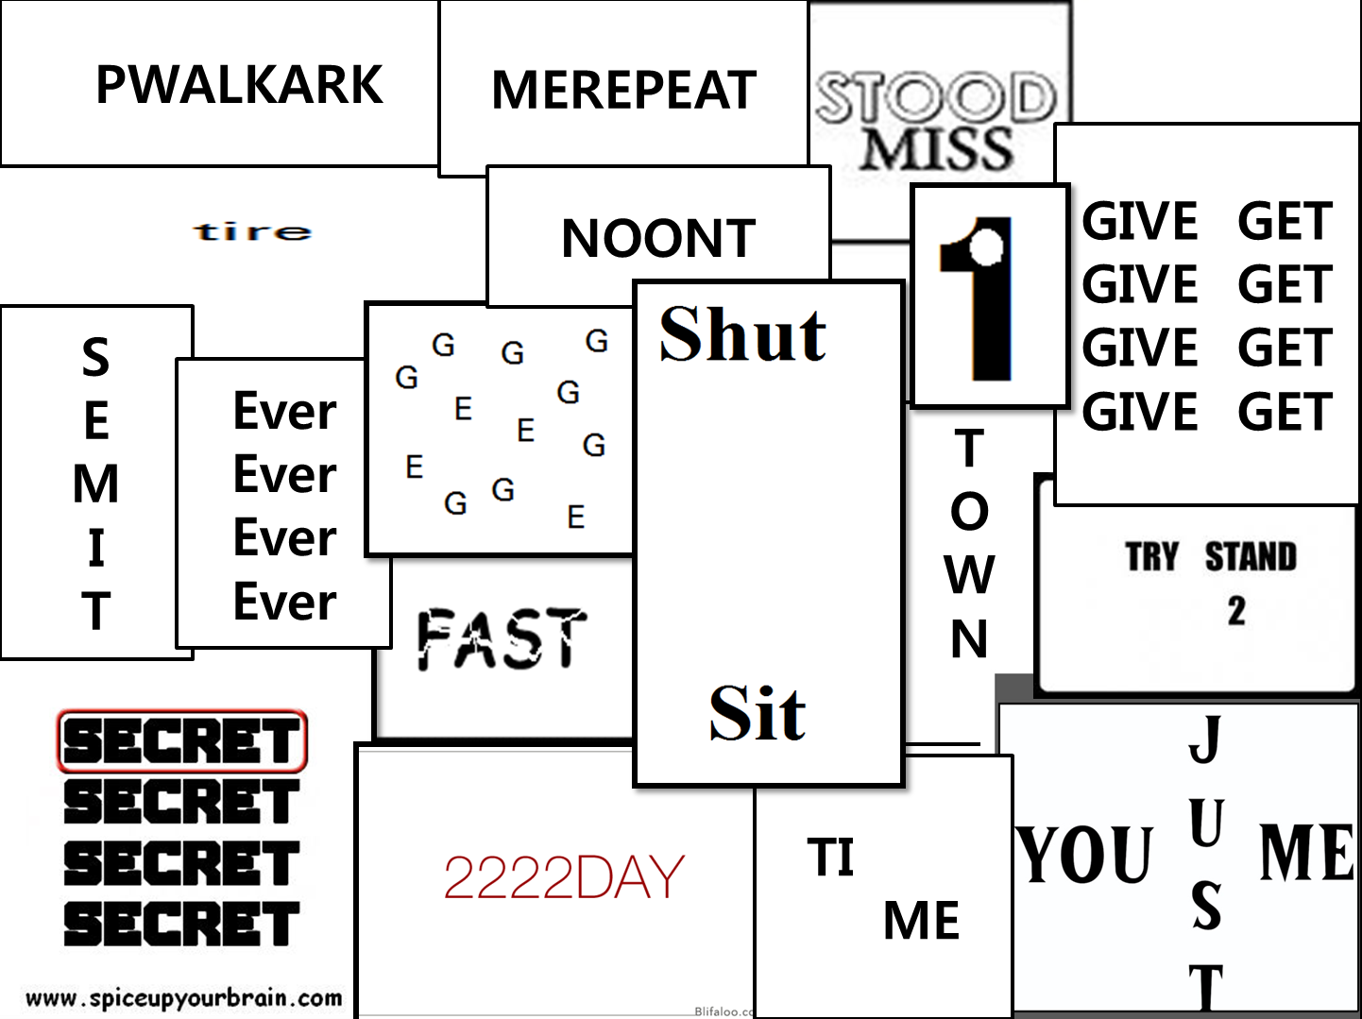
REBUS Puzzles
Repeat after me.
Walk in the park.
Forgive and forget
Try to understand.
Shut up and sit down.
Hole in one.
Downtown
Half time / Break time
Forever
Times up
Flat tire
Breakfast
Misunderstood
Scrambled eggs
Afternoon tea
Tuesday
Top secret
Just between you and me

