Slide 1
“No one is listening until you fart.”
- Anonymous

Slide 2
RISK
VS
SURVIVAL
REWARD

Slide 3
COIN
FLIP

Slide 4
RISK REWARD
You lose: $10
You win: $10
https://www.youtube.com/watch?v=vBX-KulgJ1o

Slide 5
RISK REWARD
You lose: $10
You win: $12
https://www.youtube.com/watch?v=vBX-KulgJ1o

Slide 6
RISK REWARD
You lose: $10
You win: $15
https://www.youtube.com/watch?v=vBX-KulgJ1o

Slide 7
RISK REWARD
You lose: $10
You win: $20
https://www.youtube.com/watch?v=vBX-KulgJ1o

Slide 8
You
VS
SURVIVAL
Wild

Slide 9
YOUR MISSION: Search for wreckage Find the anti-venom

Slide 10
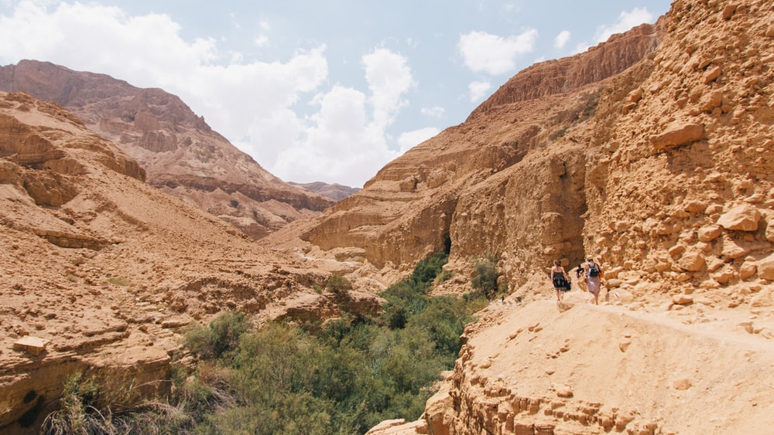
Terrain : Scorching valleys

Slide 11
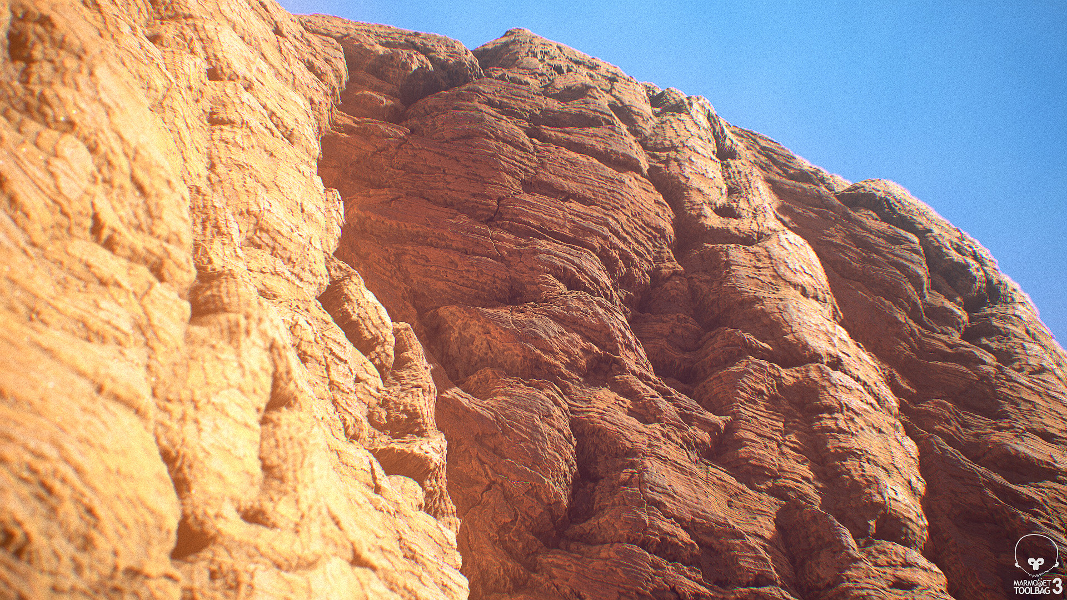
Terrain : Sandstone Cliffs

Slide 12
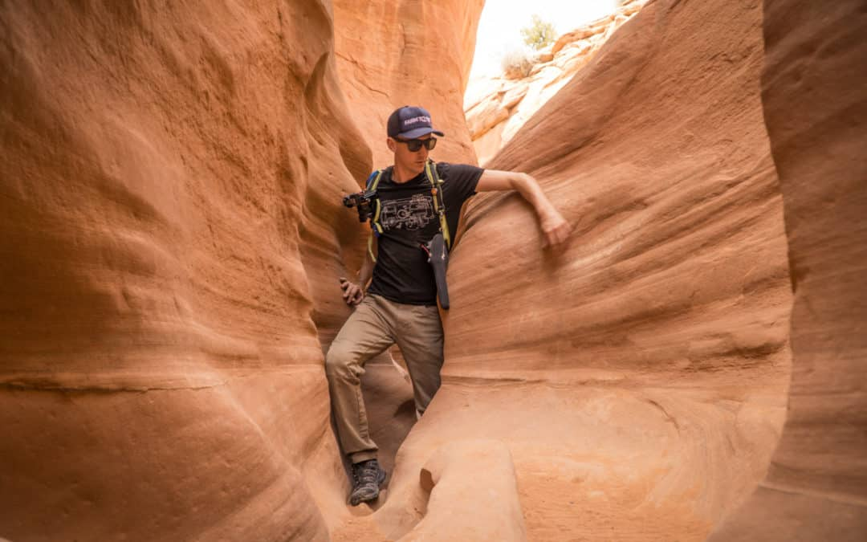
Terrain : Slot Canyons

Slide 13
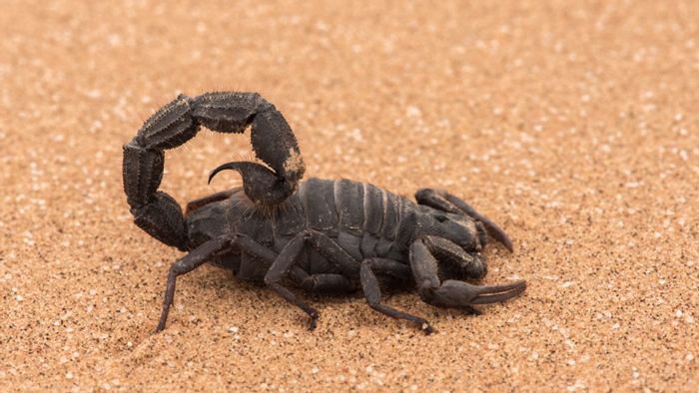
What are some dangers in the desert?
Deadly creatures
Precarious Terrain
Dehydration

Slide 14
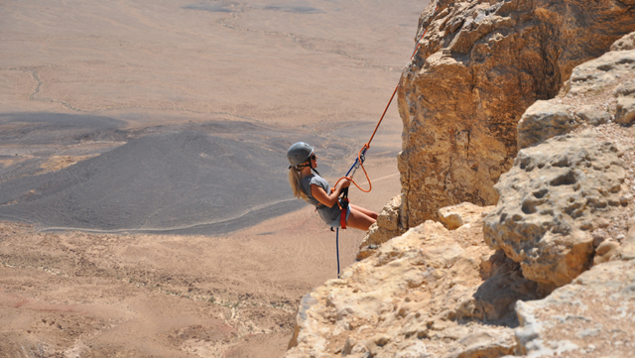
Rappel

Slide 15
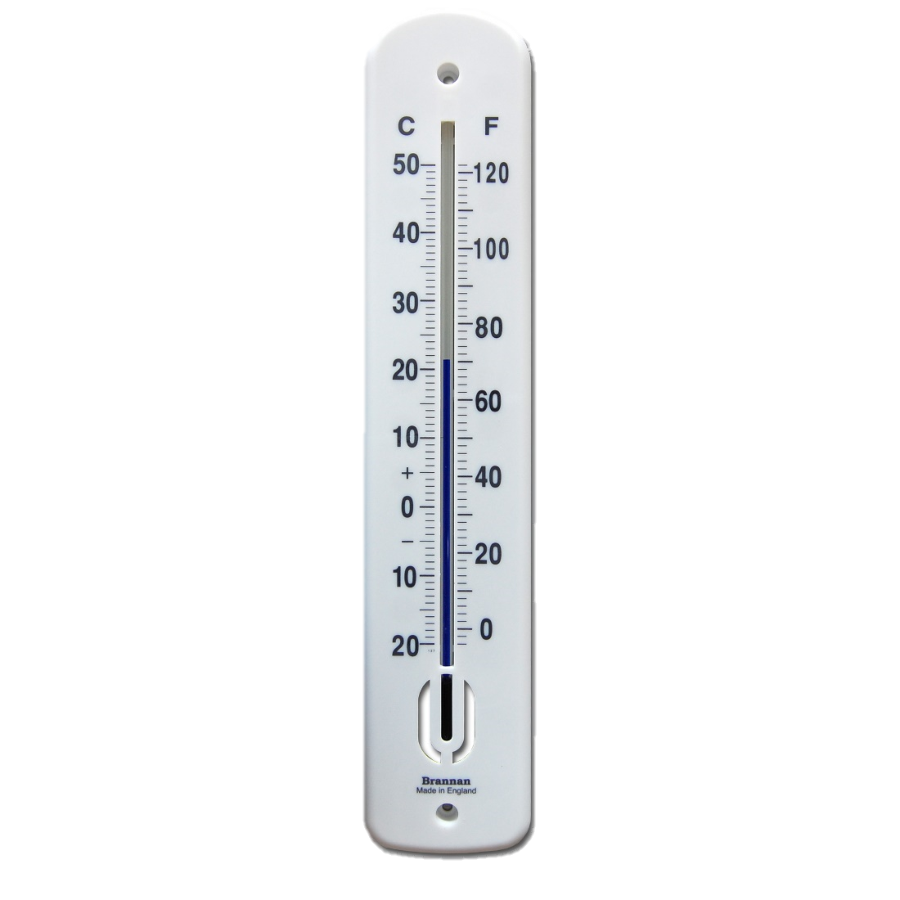
Kilometers :
Miles
Meters :
Feet
Celsius :
Fahrenheit

Slide 16
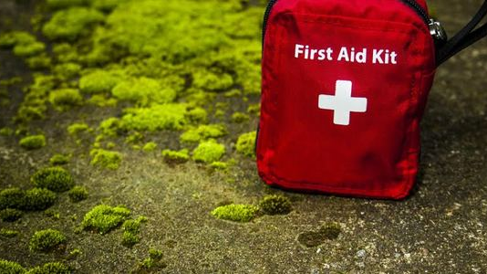
What is the “precious cargo”?
Anti-Venom

Slide 17
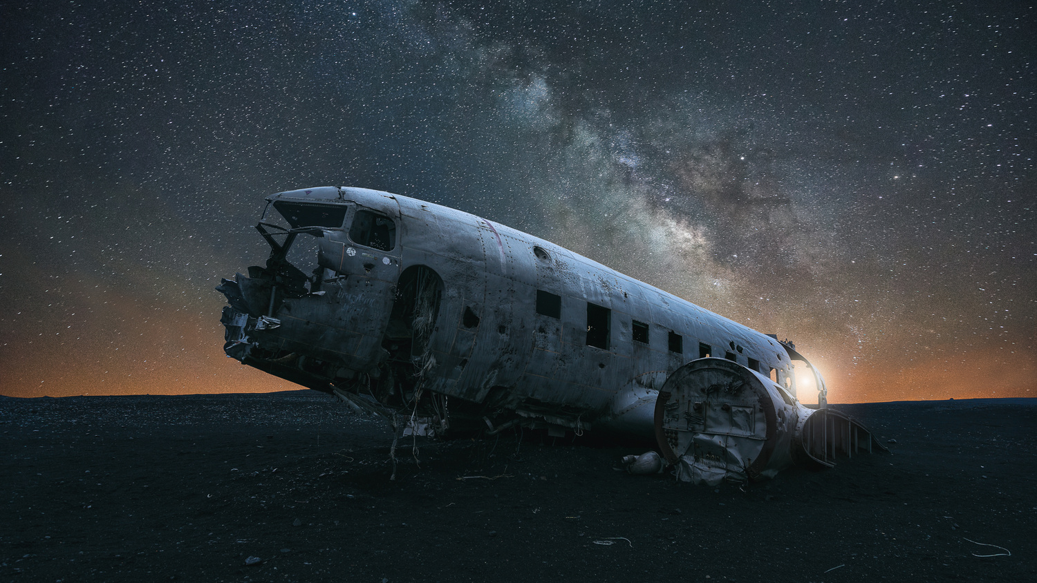
What is our goal?
Find the wreckage
Find the anti-venom
Survive

Slide 18
Voting:
O X

