Slide 1
“Wisdom is the reward you get for a lifetime of listening when you’d have preferred to talk.”
- Doug Larson

Slide 2
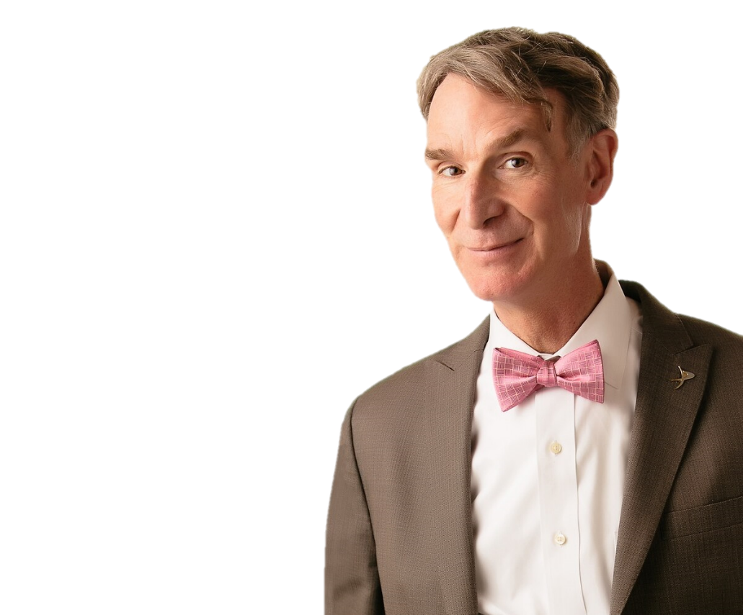
Everyone
What do you know about?

Slide 3
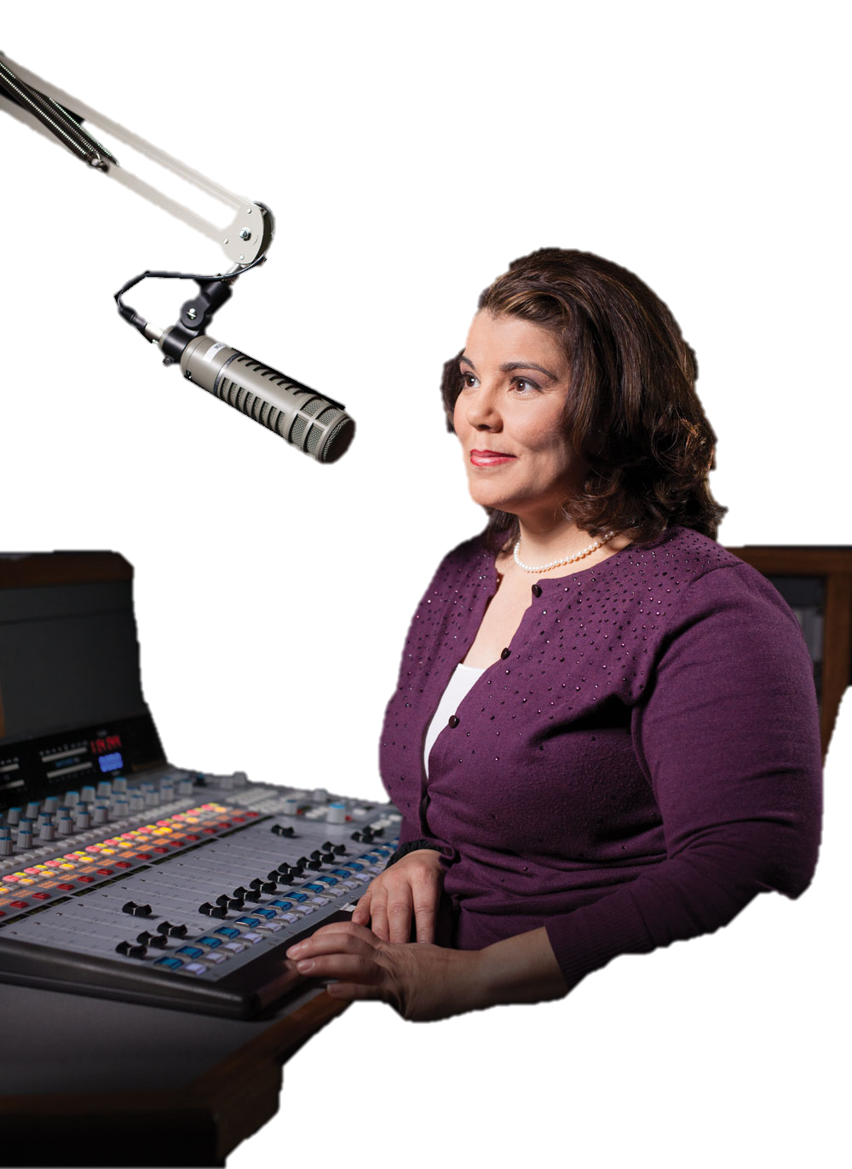
10 Ways to Have a Better Conversation
https://www.ted.com/talks/celeste_headlee_10_ways_to_have_a_better_conversation/transcript?language=en#t-198355
Celeste Headlee

Slide 4
1. Don’t multi-task

Slide 5
Don’t multi-task
Multiple – many
Tasks – actions
No phone
Don’t think about something else

Slide 6
2. Don’t pontificate

Slide 7
Don’t pontificate
Talk about your own opinion
Boring
No one cares

Slide 8
3. Use open-ended questions

Slide 9
Use open ended questions
Not just “yes” / “no”
Start with 5Ws
“Were you angry?”
“How did that feel?”

Slide 10
4. Go with the flow

Slide 11
Go with the flow
Follow the conversation (like water)
Don’t try to control the conversation
If stories / questions come to you… let them go.
Don’t ask questions to be clever
Ask follow up questions

Slide 12
5. If you don’t know, say that you don’t know.

Slide 13
If you don’t know, say that you don’t know.
Honesty
Don’t pretend to be an expert

Slide 14
6. Don’t equate your experience with theirs.

Slide 15
Don’t equate your experiences with theirs.
It’s not about you
Your experiences are never the same as someone else’s

Slide 16
7. Try not to repeat yourself.

Slide 17
Try not to repeat yourself.
Try not to repeat yourself
Condescending
Boring

Slide 18
8. Stay out of the weeds.

Slide 19
Stay out of the weeds.
Don’t talk about specifics
People care about what your like, what you have in common

Slide 20
9. Listen.

Slide 21
Listen
This is the most important one
Really listen
We’d rather talk
Average person talks at 225 words/minute
Average person listens at 500 words/minute

Slide 22
10. Be brief

Slide 23
“A good conversation is like a miniskirt; short enough to retain interest, but long enough to cover the subject.”

Slide 24
Active Listening Interviews

