Slide 1
“Be a good listener. Your ears will never get you in trouble.”
- Frank Tyger

Slide 2
MONSIEUR MANGETOUT
“MR. EAT-ALL”
ROADS BECOMING UNSAFE FOR SENIOR CITIZENS IN S.KOREA
SHIP WASHES UP ON SHORE AND REVEALS INCREDIBLE MYSTERY
HOW RELEASING 1,500,000 BALLOONS WENT HORRIBLY WRONG
HOW THIS GUY BECAME A WORLD CHAMPION WHISTLER
DRIVING A RACECAR IN THE CITY

Slide 3
SHIP WASHES UP ON SHORE AND REVEALS INCREDIBLE MYSTERY

Slide 4
Ship Washes Up on Shore and Reveals Incredible Mystery
Design a boat to cross the ocean.

Slide 5
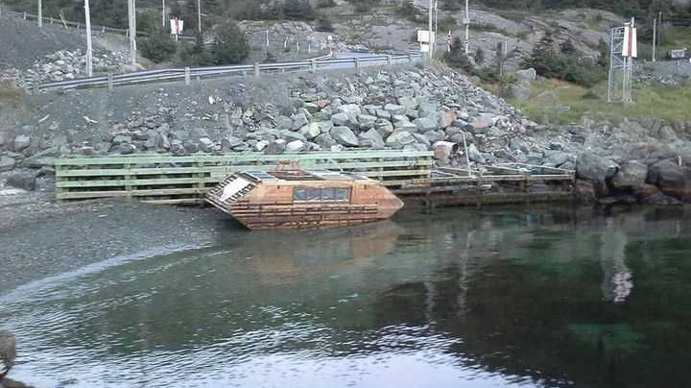

Slide 6
Where does the story take place?

Slide 7
When they saw the ship coming, what did they do?

Slide 8
What was the mystery?

Slide 9
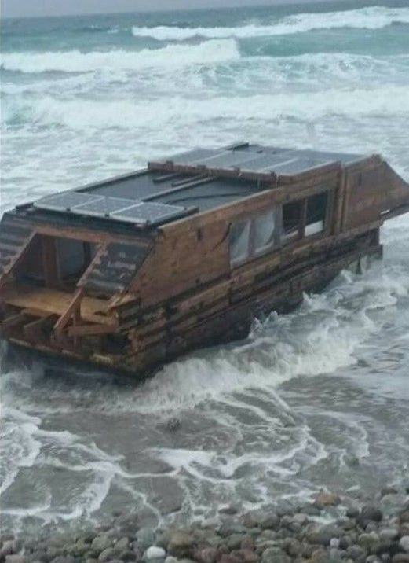
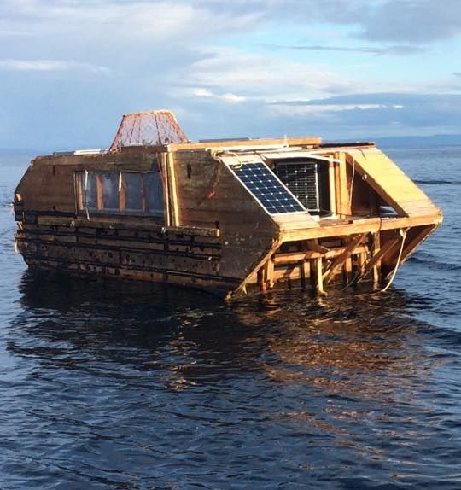

Slide 10
What would you do if you saw an empty ship like this?

Slide 11
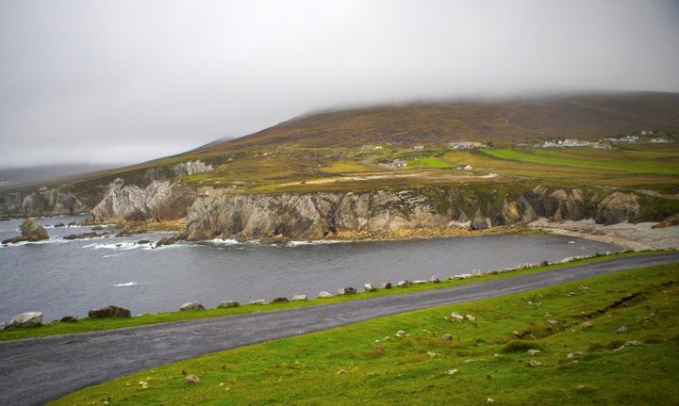

Slide 12
What strange items do you think have washed ashore in Mayo?

Slide 14
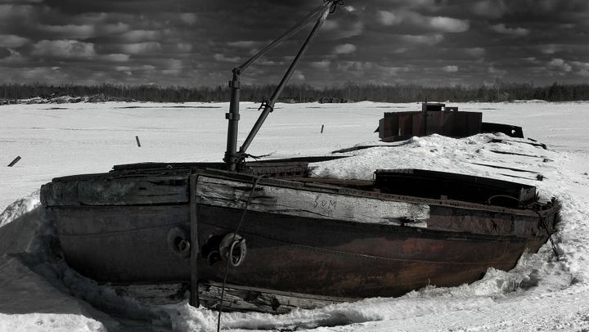

Slide 15
What was the surprise?

Slide 16
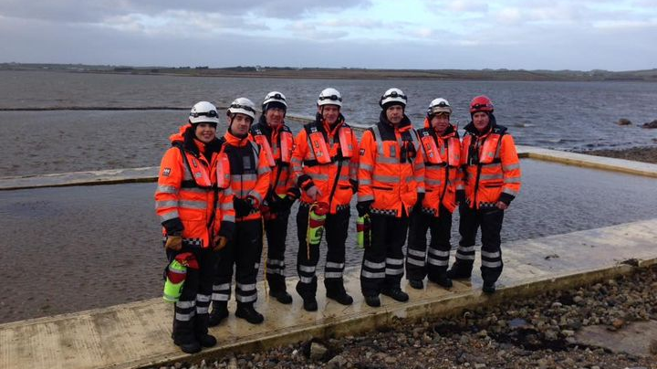

Slide 18
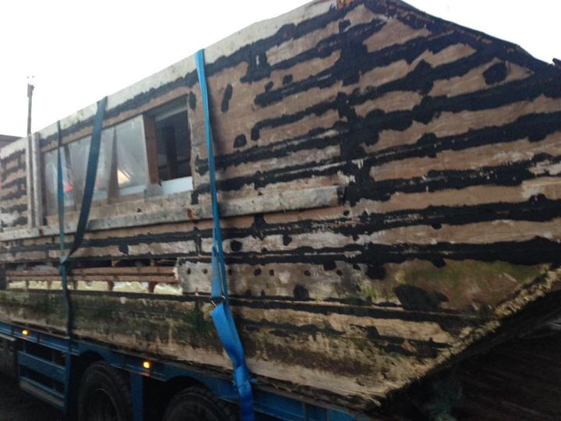

Slide 19
Who do you think made it? Why?

Slide 20
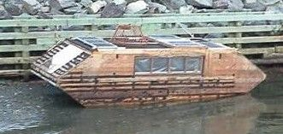

Slide 21
Where do you think it came from?

Slide 22
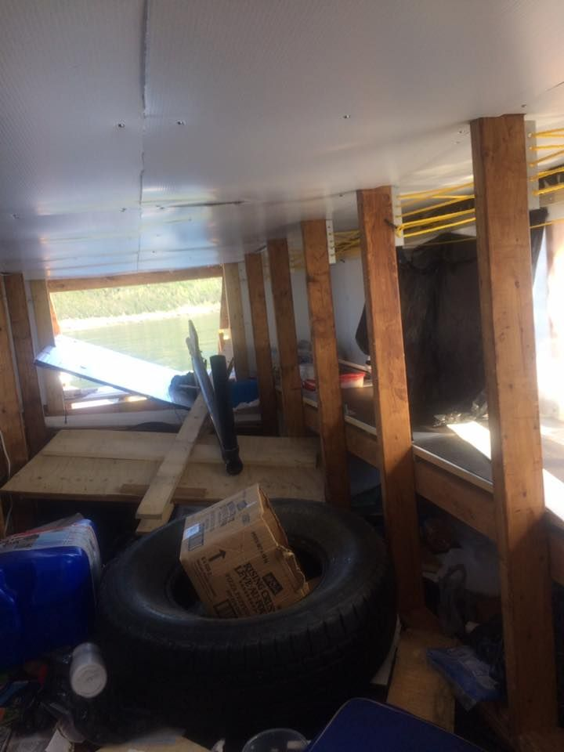
If you were homeless, would you live here?

Slide 23
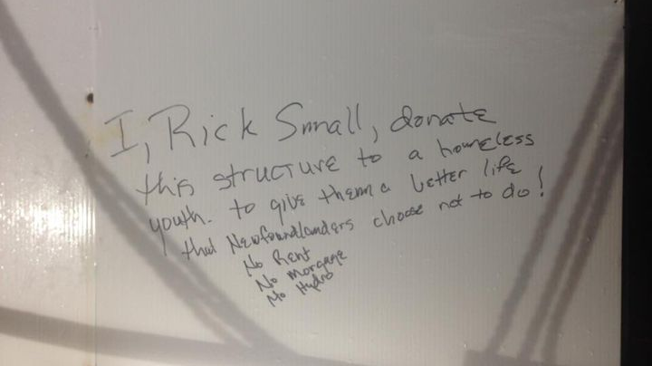

Slide 24
Newfoundlanders are people from Newfoundland.
But where is Newfoundland?

Slide 25
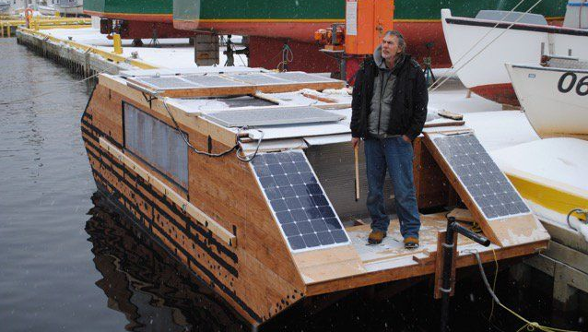

Slide 26
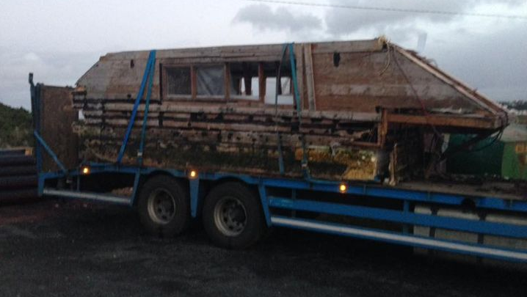

Slide 27
Rick Small originally wanted to sail across the ocean.
Would you tell him to do it?

Slide 28
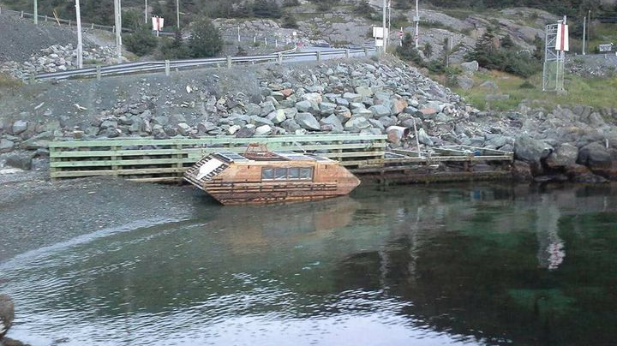

Slide 29
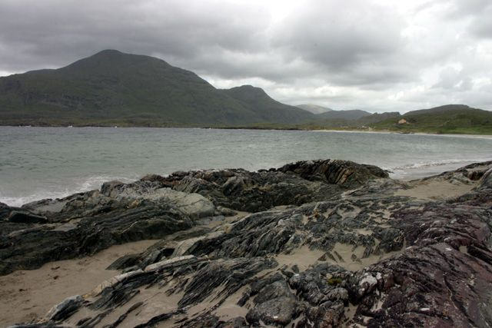

Slide 33
What should they do with the boat?

Slide 34
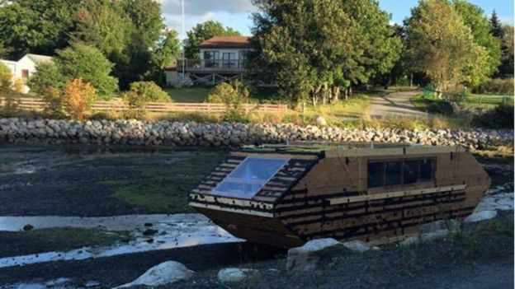

Slide 35
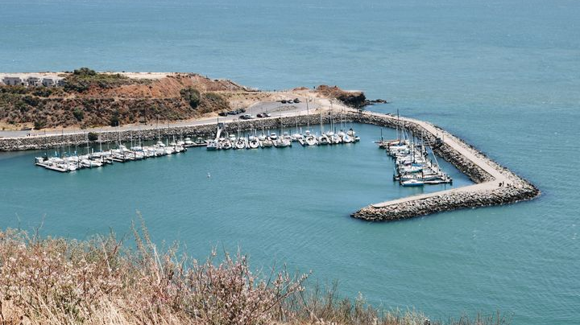

Slide 36
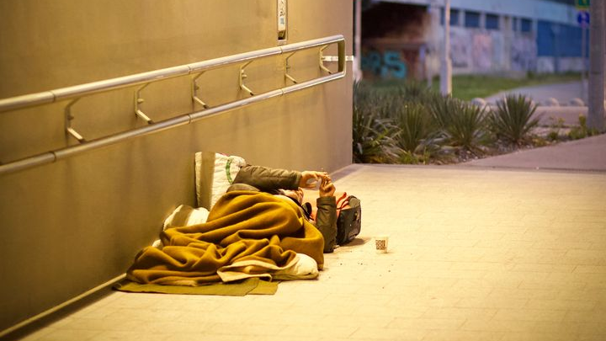

Slide 37
What do you think about making home like this for homeless people?

Slide 40
What do you think happened to Rick Smalls?

Slide 41
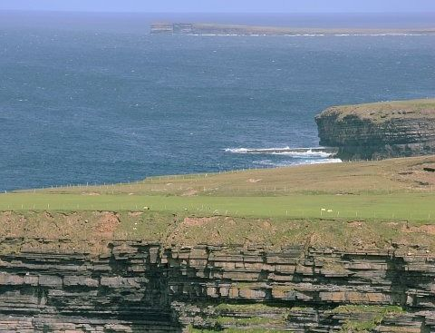

Slide 42
What “crazy invention” would Rick make next?
Design it with your group.

Slide 43
Ship Washes up on Shore and Reveals Incredible Mystery
https://playjunkie.com/post-16775160/?dai=65s9IKYfRrz4Gb5hAUWwS8&fbclid=IwAR05LFsqTSHNAd19KpoEDMqvCq6d9KJnMyMOzChj80h2CFfzUZpnUd6HqQw

Slide 46
DRIVING A RACECAR IN THE CITY

Slide 47
Driving a Racecar in the City
Would you drive a racecar in the city?
Why? Why not?

Slide 48
What are some differences between a racecar and your car?

Slide 49
What are some problems you might have?

Slide 50
Driving a Racecar in the City
https://www.youtube.com/watch?v=Y4d1ozlN_Z8&fbclid=IwAR2j-X2s87_nuoWNz37D5TUb6IUMwPlkLDNZbUCvDCiwjxJfWJRrhYBQgR0

Slide 51
What is one thing you need in your car?

Slide 52
Describe the perfect car for a road trip.

Slide 55
HOW RELEASING 1,500,000 BALLOONS WENT HORRIBLY WRONG

Slide 56
How Releasing 1,500,000 Balloons Went Horribly Wrong
What might happen if you release that many balloons?

Slide 57
How Releasing 1,500,000 Balloons Went Horribly Wrong
https://www.youtube.com/watch?v=FOnqEwbxdk4&list=PL9i6nLIBlfKvunIYrc60Hsw0vNQsANk5n&index=3&t=0s

Slide 58
What went wrong?

Slide 59
Why did they do it?

Slide 60
Why did they need to release the balloons early?

Slide 61
Do you think this record will be broken?

Slide 62
What strange record would you like to set?

Slide 65
GUY MAKES CRAZY FURBY ORGAN, ACCIDENTLY OPENS GATES TO HELL

Slide 66
GUY MAKES CRAZY FURBY ORGAN, ACCIDENTLY OPENS GATES TO HELL
What was your favorite toy as a child?

Slide 67
How Releasing 1,500,000 Balloons Went Horribly Wrong
https://twistedsifter.com/videos/guy-makes-crazy-furby-organ-accidentally-opens-gates-to-hell/?fbclid=IwAR0LjnIIGFV465q6CU1wIvfJVlt8Ih6vGouztGbNWLSVfnq4aW5spv--hfw

Slide 68
What do you think about the furby organ?

Slide 69
What are some other strange things you could make music from?

Slide 70
https://www.youtube.com/watch?v=tZ7aYQtIldg

Slide 73
MONSIEUR MANGETOUT “MR. EAT-ALL”

Slide 74
MONSIEUR MANGETOUT “MR. EAT-ALL”
Michel Lotito was a French entertainer famous for his inhuman ability to consume indigestible objects.

Slide 75
What is the strangest thing you have eaten?

Slide 76
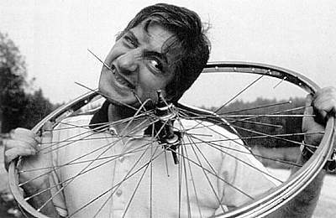

Slide 77
He is famous for eating things like bicycles. How would you eat a bicycle?

Slide 78
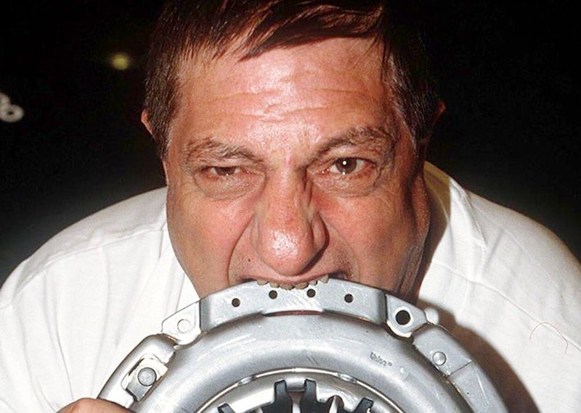

Slide 79
How many kg of material do you think he ate per day?

Slide 80
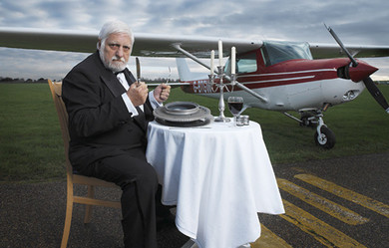

Slide 81
What are some things that he ate?

Slide 82
How long do you think it took for him to eat an airplane (Cessna 150)

Slide 84
There were two types of food that he did not like. What do you think they were?

Slide 86
Why wouldn’t he eat bananas?

Slide 87
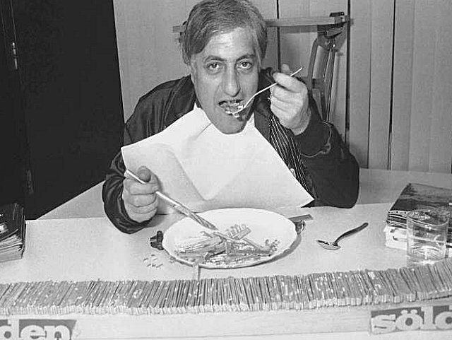

Slide 89
Monsieur Mangetout “Mr. Eat-all”
http://nothingnormalhere.com/tag/mr-eat-it-all/?fbclid=IwAR04kIMxisCftu7352lldQOpR4rADmXFqOuEUgAW8GSJHV1xQLwqHYDZiN4

Slide 92
ROADS BECOMING UNSAFE FOR SENIOR CITIZENS IN S. KOREA

Slide 93
ROAD’S BECOMING UNSAFE FOR SENIOR CITIZENS IN S.KOREA
Why do you think the roads in Korea are becoming ‘unsafe’?

Slide 94
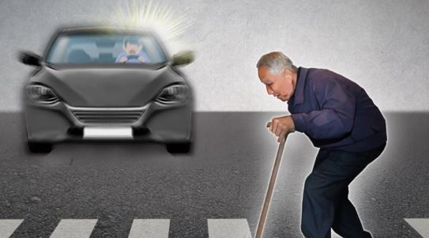

Slide 95
Have you ever jaywalked?
What precautions do you take?

Slide 96
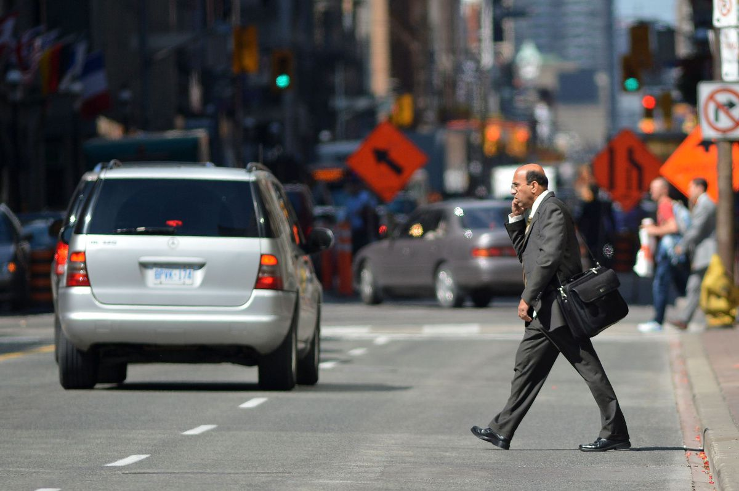

Slide 97
Find a solution to this problem.

Slide 98
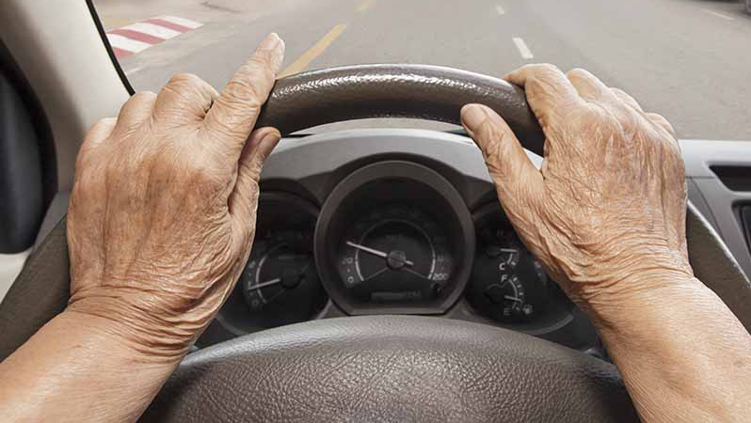

Slide 99
Monsieur Mangetout “Mr. Eat-all”
http://www.koreaherald.com/view.php?ud=20191118000797&fbclid=IwAR3-1ccmoebRsmk7G1-9gB7ciShrcMb5a0_8RQf5Hhwn-ZqQBc2jtMrGsWg

Slide 102
HOW THIS GUY BECAME WORLD CHAMPION WHISTLER

Slide 103
How This Guy Became A World Champion Whistler
Can you whistle?

Slide 104
What makes him good at whistling?

Slide 105
Can you use whistling as an instrument?

Slide 106
Can you think of other uses for whistling?

Slide 107
HOW THIS GUY BECAME A WORLD CHAMPION WHISTLER
https://www.youtube.com/watch?v=8XVRpotGsO0&fbclid=IwAR3wK226vZL3oS3d4UkiQdT-T7hNbU92icVcJ53RTTXBFzMVWdP6wFS_0do

Slide 108
What food is good for whistling?

Slide 109
What makes him good at whistling?

