Slide 1
YouTube

Slide 2
When did YouTube launch?
February 14, 2005

Slide 3
The first video?
Me at the zoo…
https://www.youtube.com/watch?v=jNQXAC9IVRw

Slide 4
The most liked video?
Despacito – Luis Fonsi
https://www.youtube.com/watch?v=kJQP7kiw5Fk

Slide 5
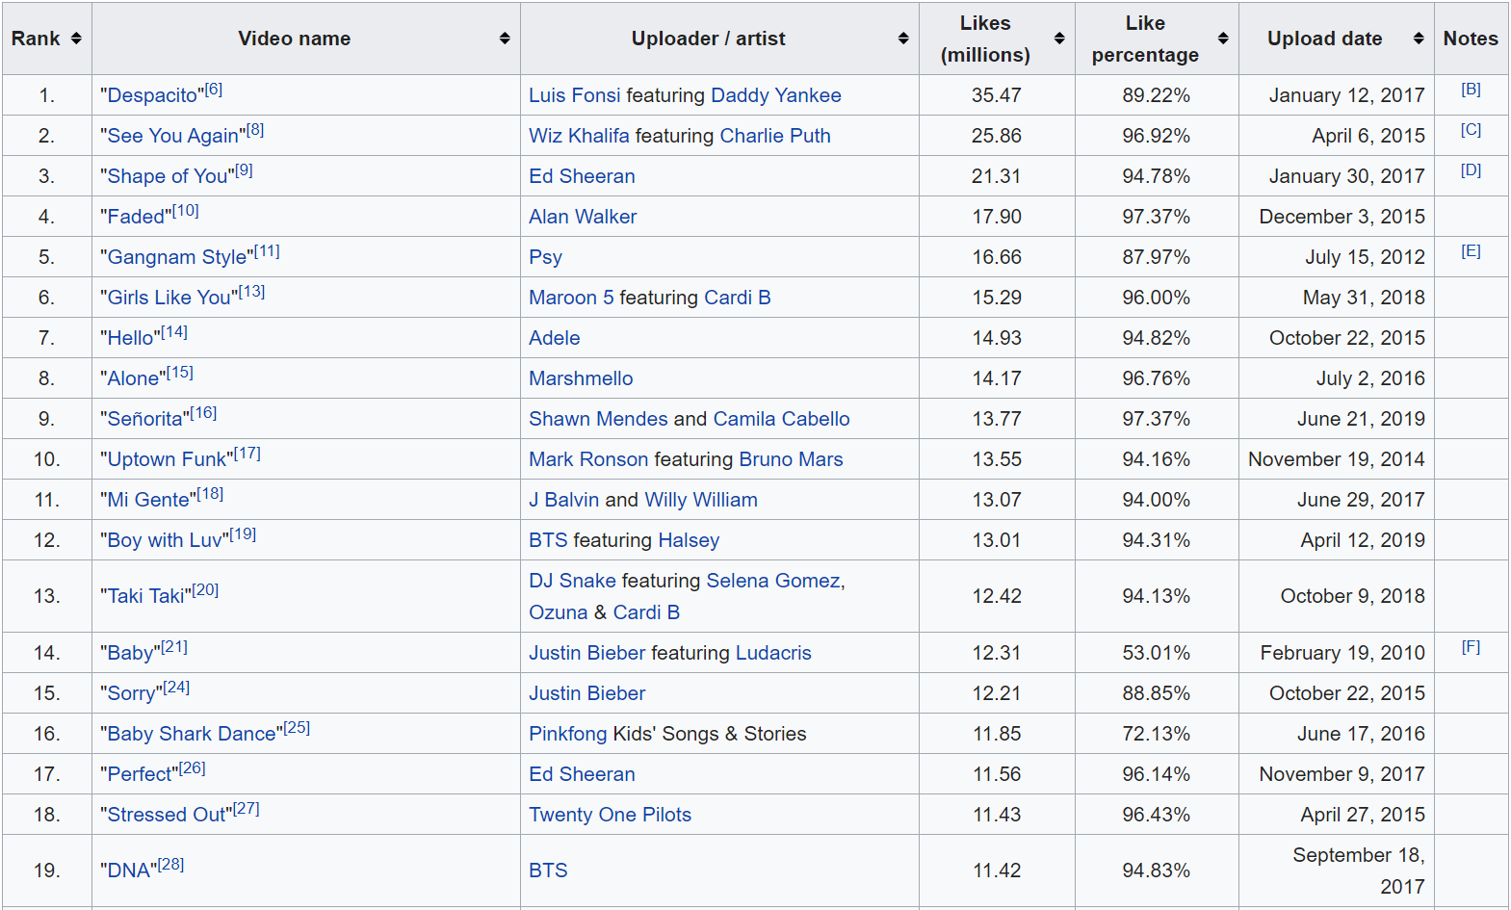

Slide 6
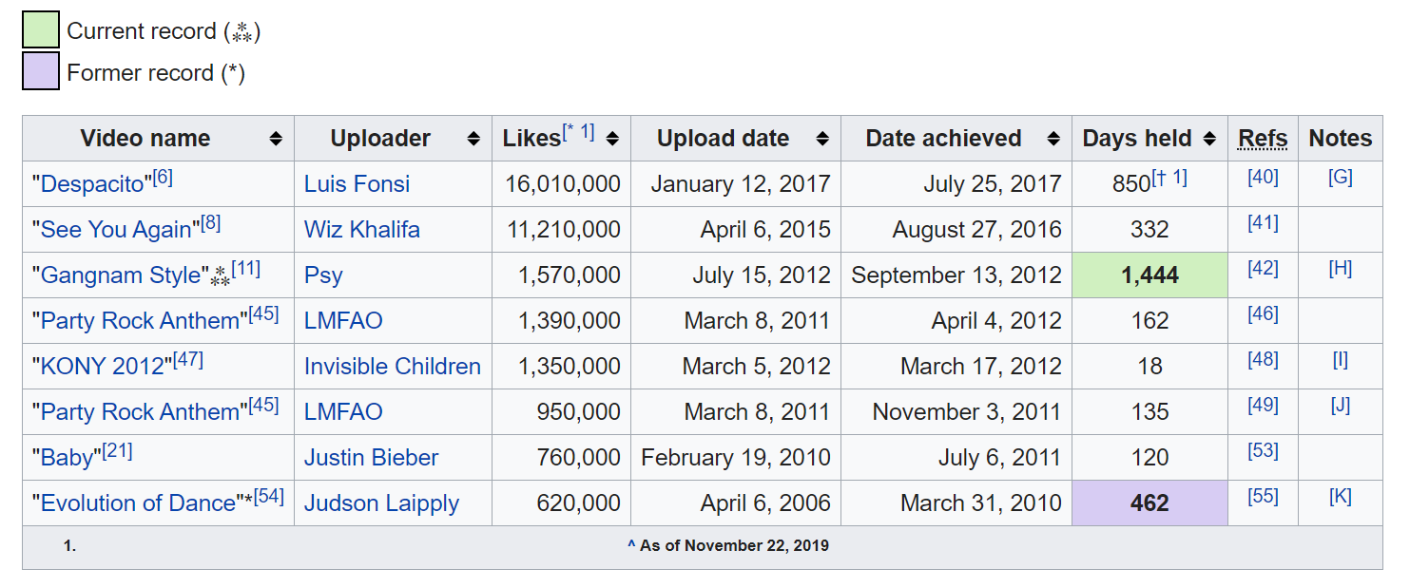

Slide 7
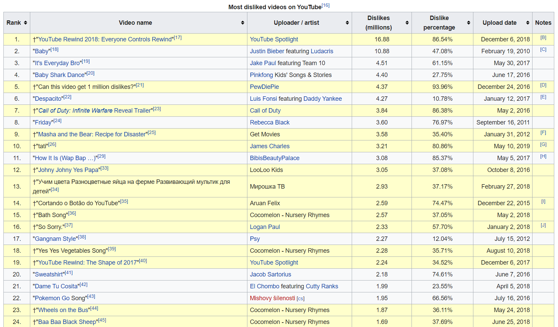

Slide 8
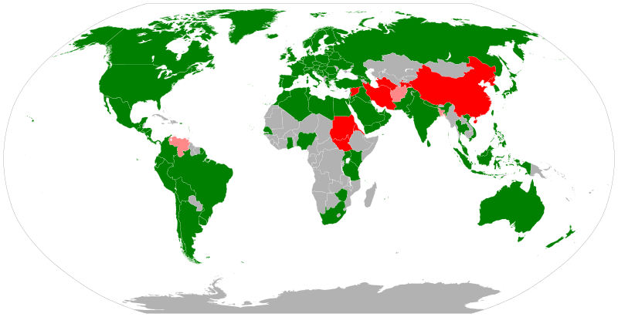
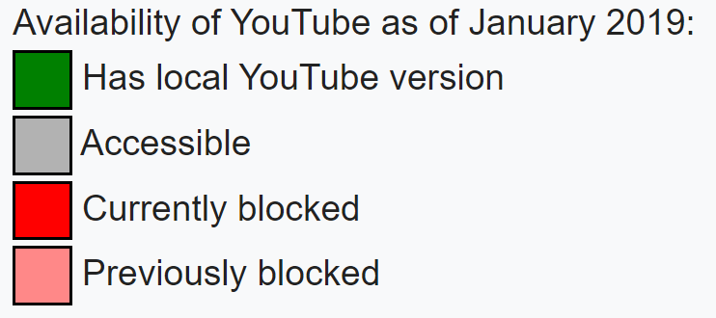

Slide 9
The Total Number of YouTube users
1,325,000,000

Slide 10
Hours of Video uploaded to YouTube every minute
300 hours

Slide 11
Number of videos viewed on Youtube every day
4,950,000,000

Slide 12
Most Viewed Videos
(not music)

Slide 13
YouTube Kids
https://www.youtube.com/kids/

Slide 14
TED Talks
https://www.ted.com/talks/celeste_headlee_10_ways_to_have_a_better_conversation

Slide 15
YouGlish
https://youglish.com/

Slide 16
Interesting Stories
FactFiend – With Karl Smallwood
Omeleto
National Geographic
#Mind Warehouse
MinuteEarth
CrashCourse
INSIDER
WIRED
LEMMiNO
Zefrank
Simple History
Dory Story
Mr.Beast

Slide 17
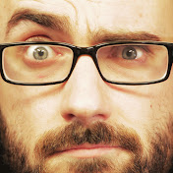
Science
Vsauce (Vsauce2)
ASAP Science
Veritasium
SciShow
Joe Scott
Astrum
Adam Savage's Tested
RED SIDE
The Slow Mo Guys
King of Random
Kurzgesagt
Minutephsycis

Slide 18
Informative
BRIGHT SIDE
Today I Found Out
SmarterEveryDay
It’s Ok to be Smart
Knowing Better
RealLifeLore
LegalEagle
Tom Scott

Slide 19
News
Vice
CNN
BBC News
Vox
ABC News
The Young Turks

Slide 20
Art + Entertainment
Epicurious
Post-Modern Jukebox
Now You See It
Nerdwritter
Screen Junkies
Extra Credits
Sam Johnson
Jenna Marbles
Simone Giertz

Slide 21
For Kids
Art for Kids Hub
People are Awesome
Dude Perfect
Brave Wilderness
Epic Meal Time
Simon’s Cat
Mark Rober
Stated Clearly (Stated Casually)
Will it blend?
FailArmy
VOA Learning English

Slide 22
Studying?
Rachel’s English
Learn English with EnglishClass101.com
Real English With Real Teachers
BBC Learn English
Speak English with Mr Duncan
Eat Sleep Dream English
Interactive English
TED-Ed
Britlish

