Slide 1
Google Cardboard

Slide 2
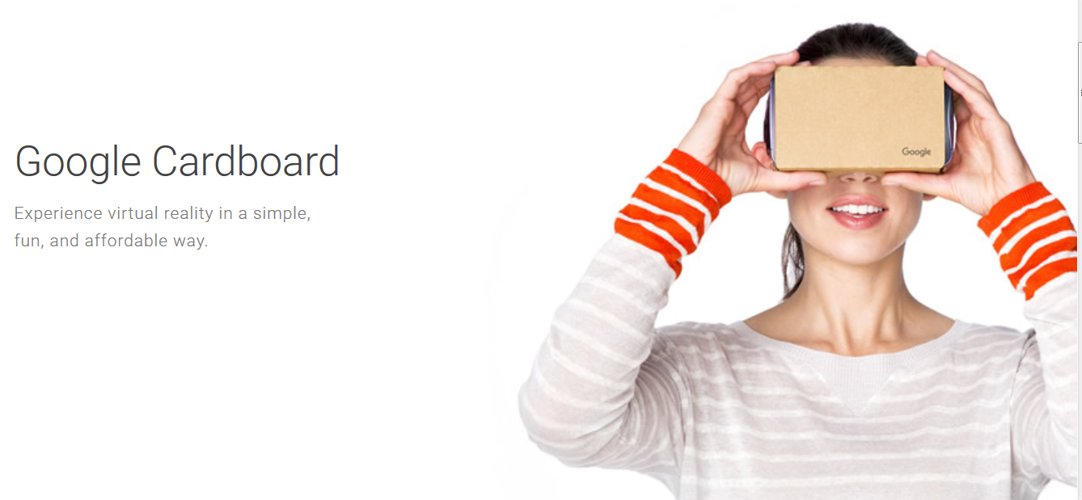

Slide 3
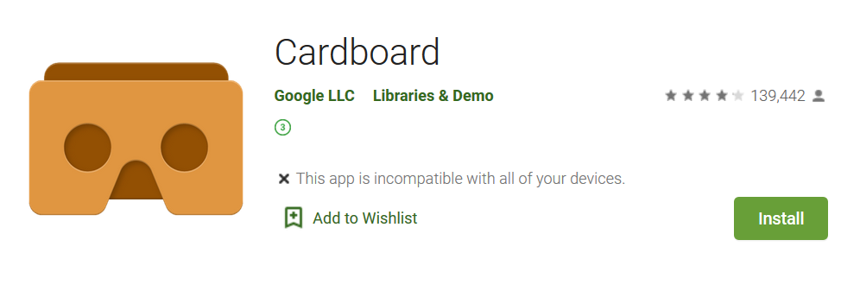

Slide 4
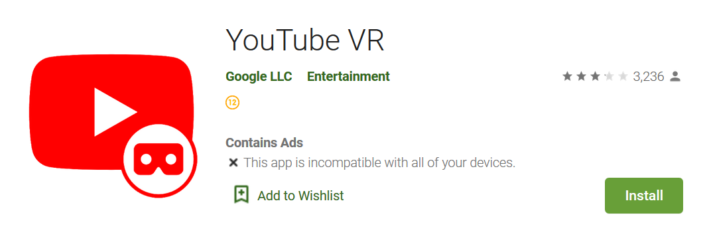

Slide 7
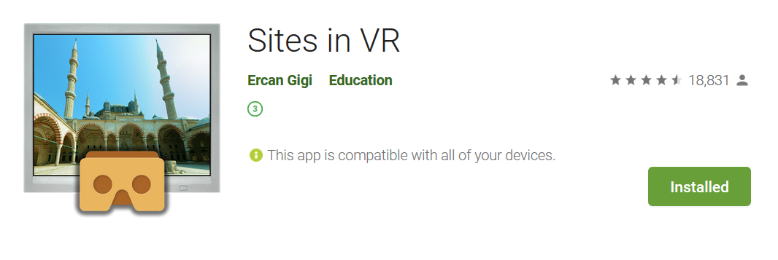

Slide 8
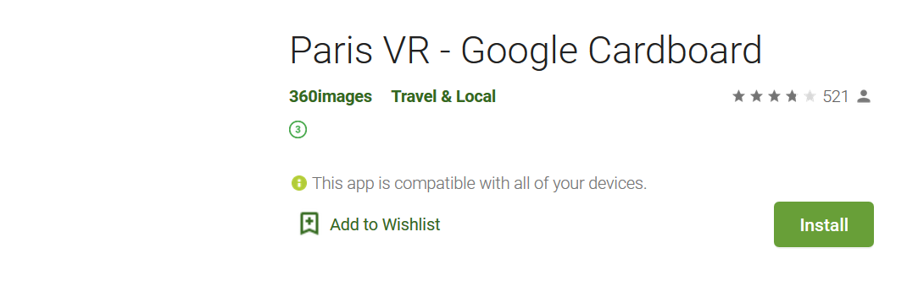

Slide 9
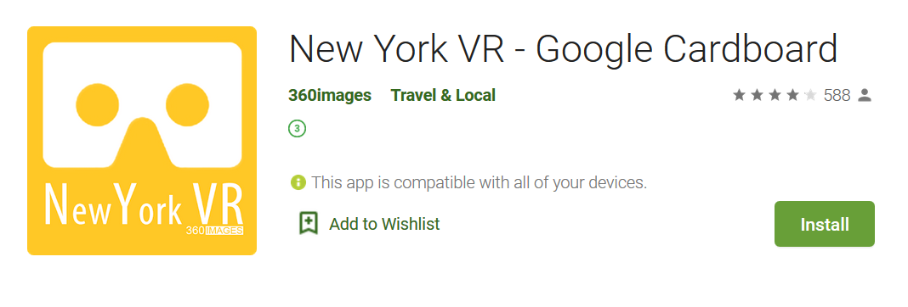

Slide 10
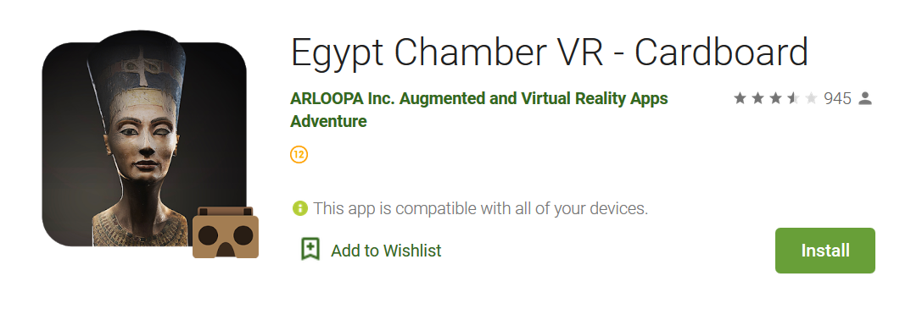

Slide 11
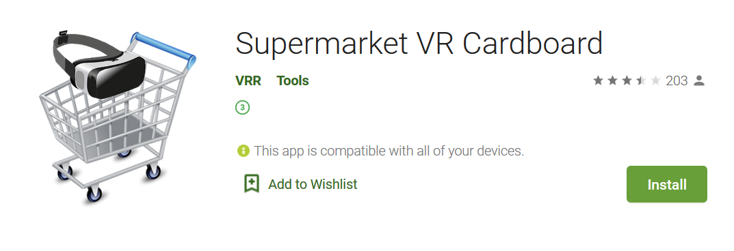

Slide 13
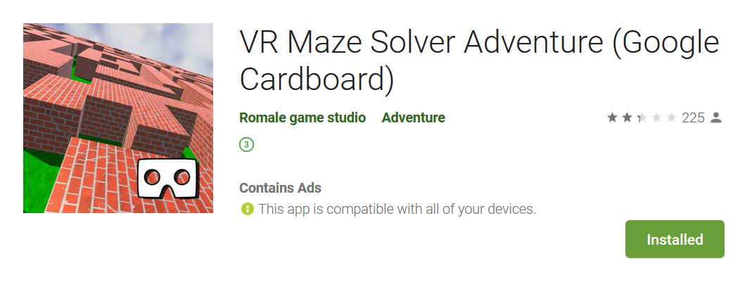

Slide 14
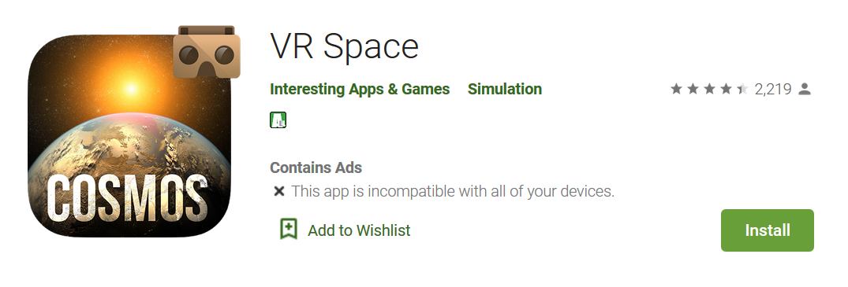

Slide 15
Google Cardboard
Google cardboard app
YouTube VR
FD VR Theater
Expeditions
Sites on VR
Paris VR
New York VR
Egypt Chamber VR
Supermarket VR
VR Noir
VR Maze Solver Adventure
VR Space

Slide 16
Apartment Tours
Describe the apartment to your team.
“Refinery29 Influencer 360”

Slide 17
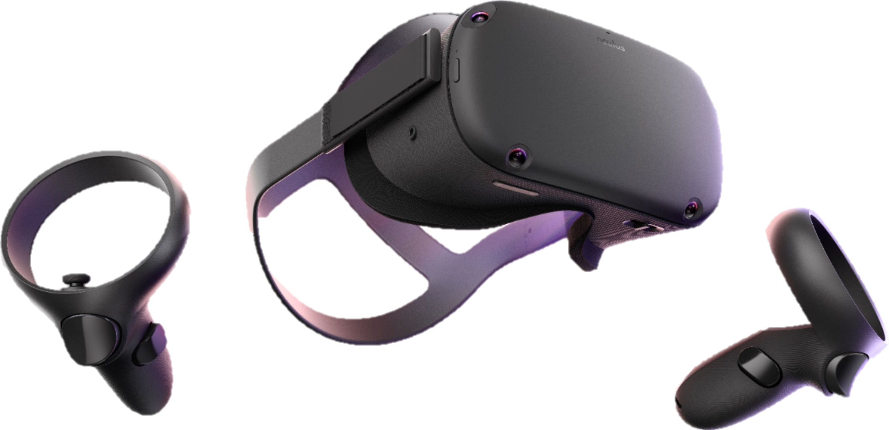
More VR

Slide 18
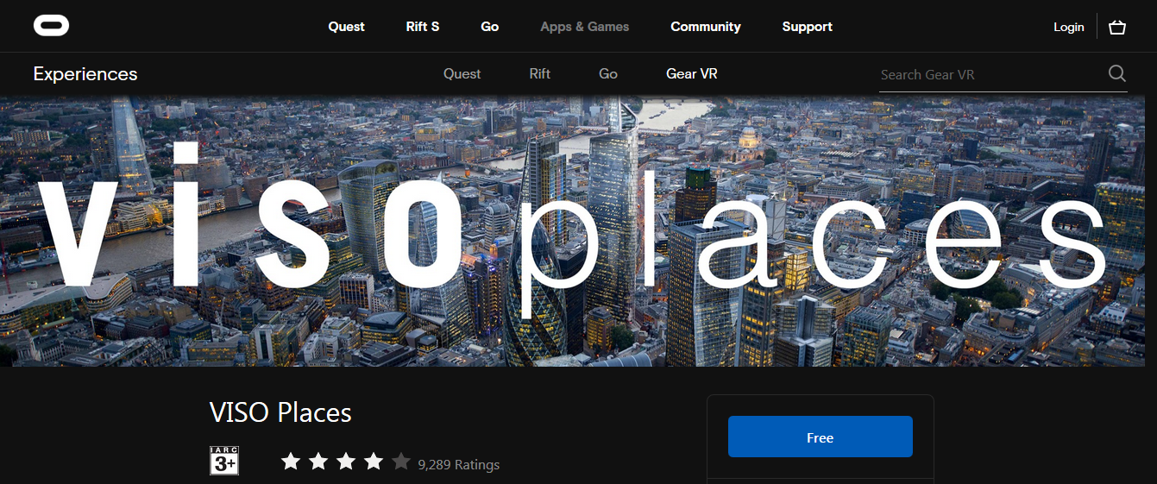

Slide 19
https://www.youtube.com/watch?v=BYunaBkn9Ng

