Slide 1
Smartphones
Listening with apps

Slide 2
Improve English:
Word Games
Duolingo
Busuu
LingQ
Memrise
Babbel

Slide 3
Rosetta Stone
LearnEnglish
Grammar
LingoDeer
Beelinguapp
ELSA Speak
Speak English
Conversation

Slide 4
Spaceteam ESL
http://spaceteamesl.ca/

Slide 6
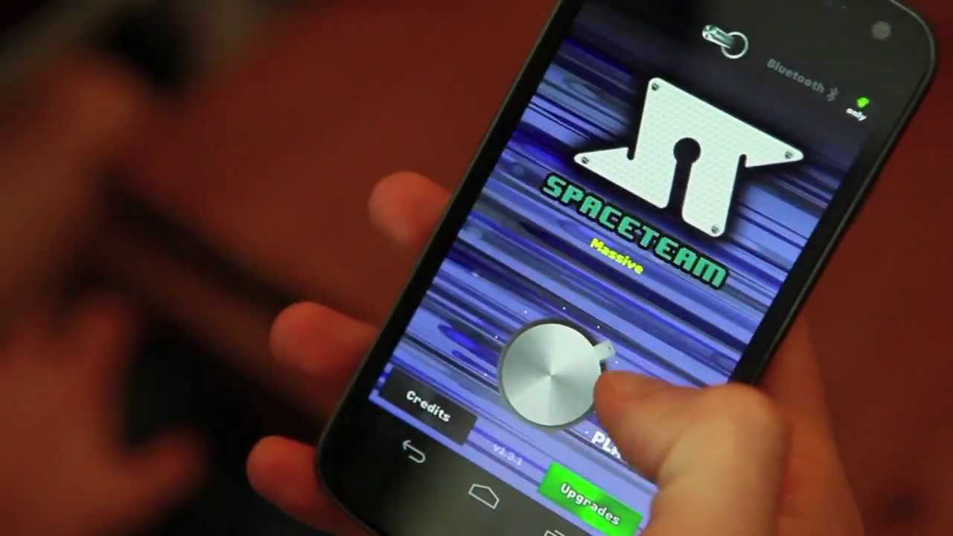

Slide 8
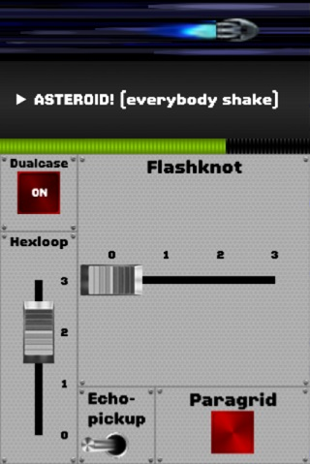

Slide 9
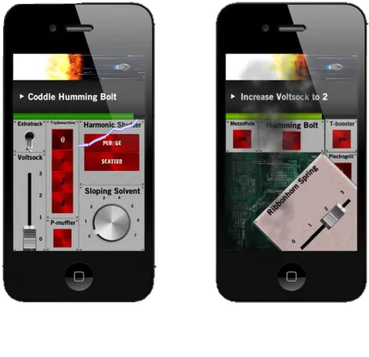

Slide 11
Spyfall

Slide 13
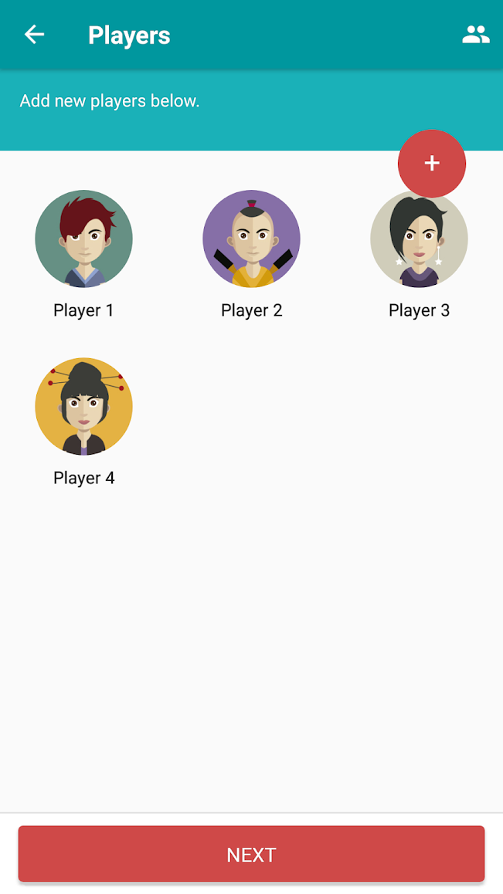

Slide 14
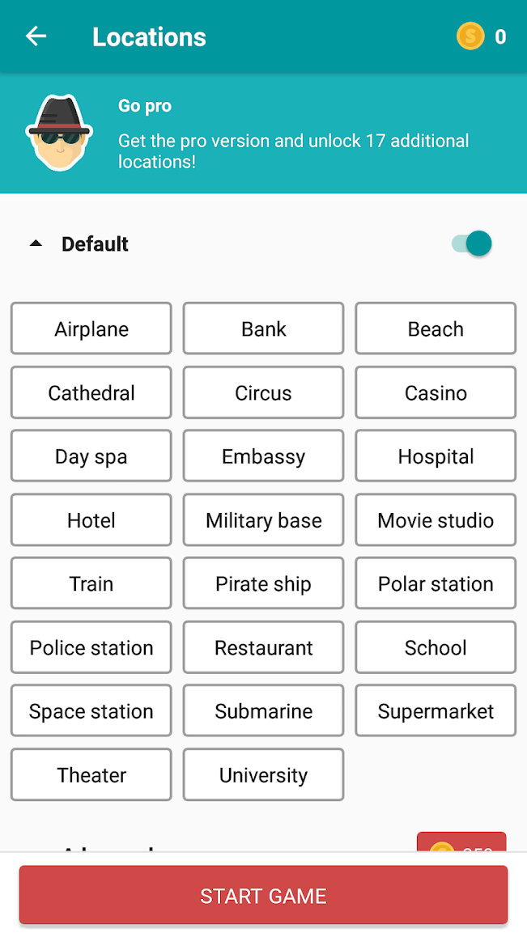

Slide 15
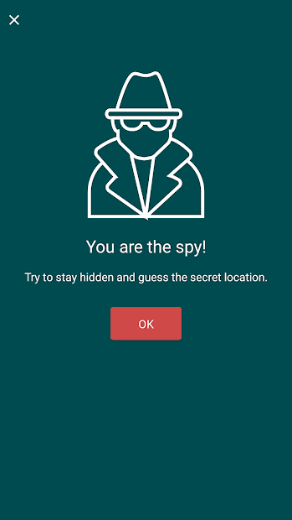

Slide 16
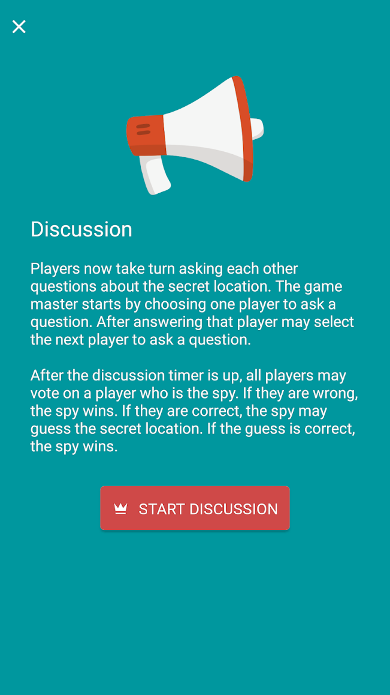

Slide 17
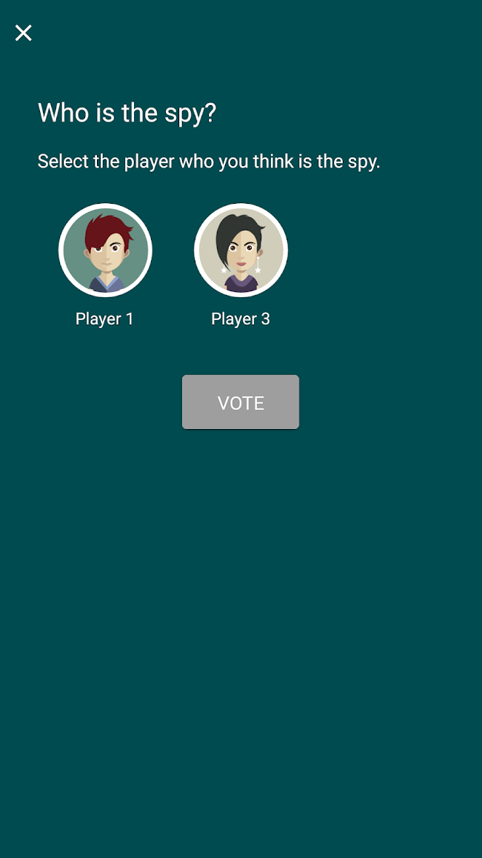

Slide 18
Mafia Online

Slide 19
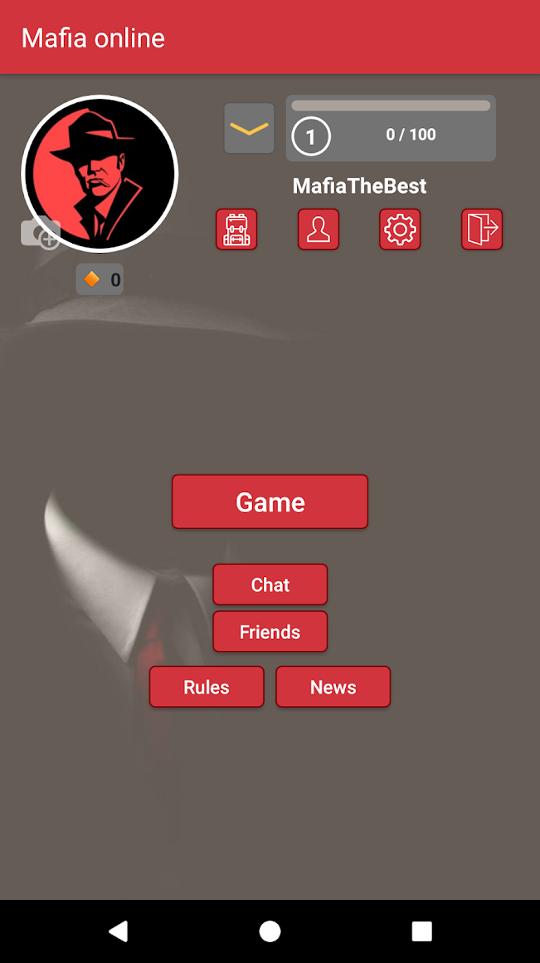

Slide 20
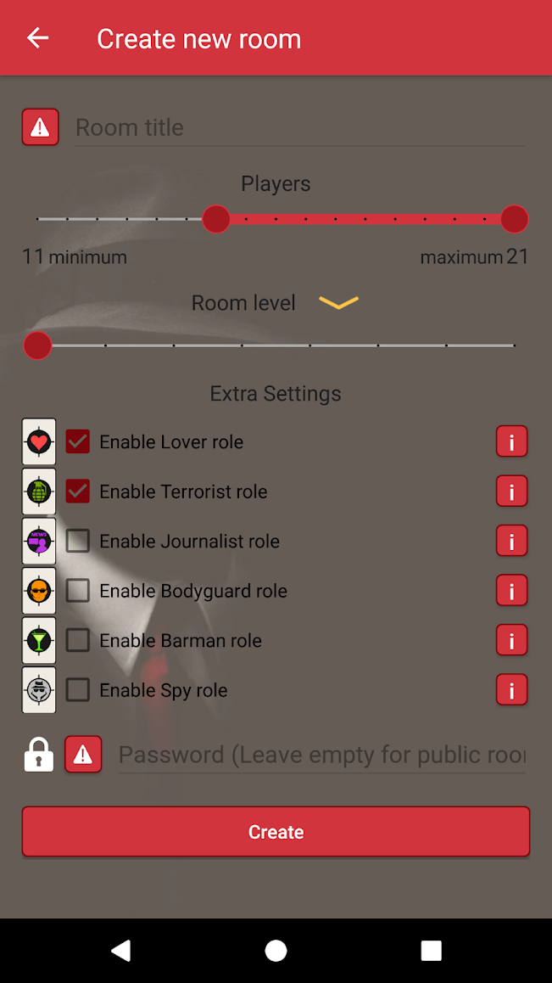

Slide 21
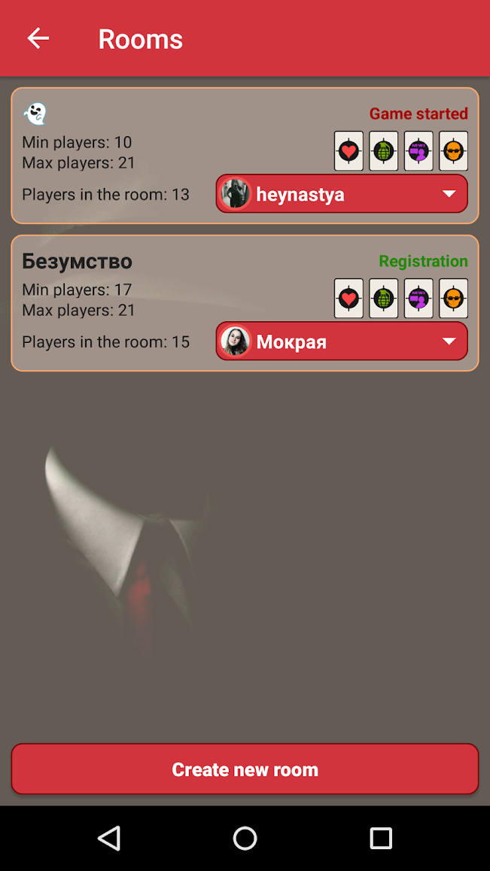

Slide 22
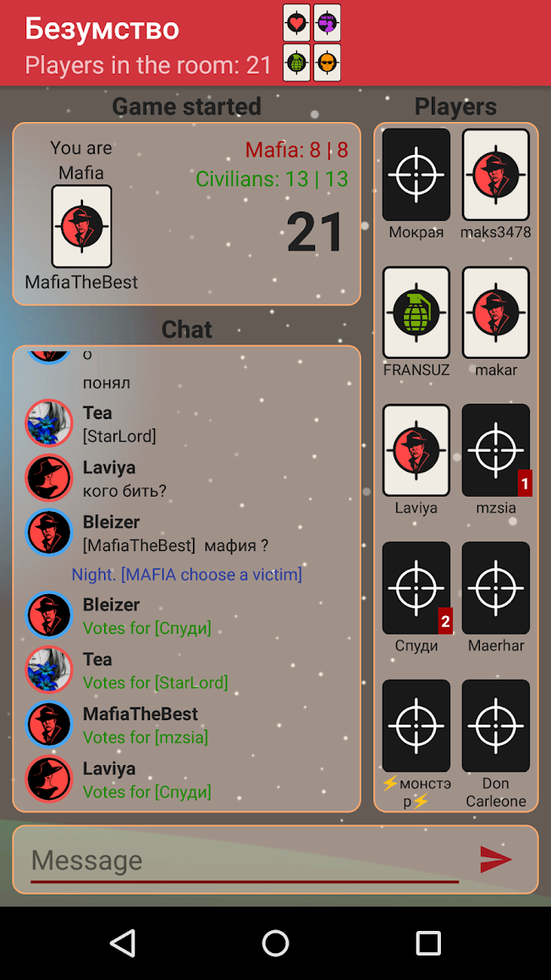

Slide 23
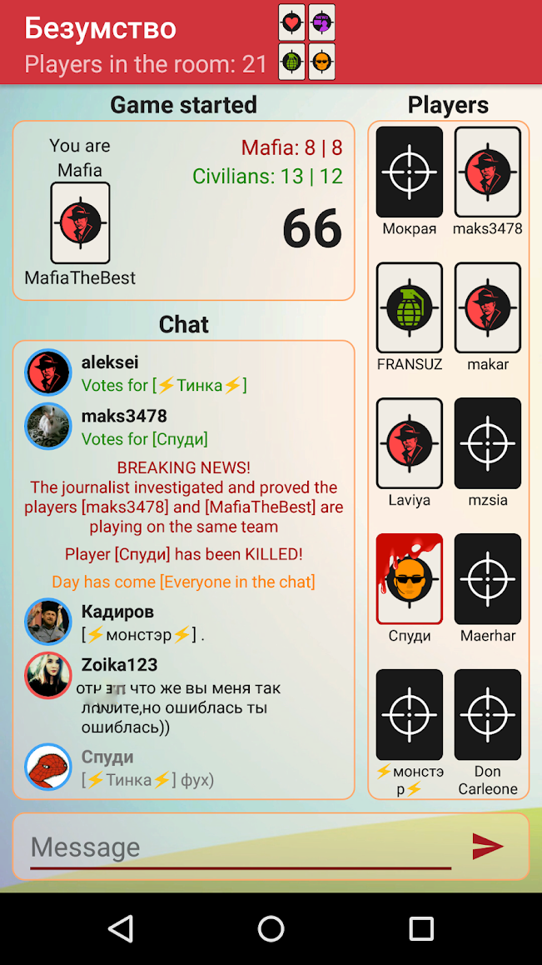

Slide 24
Heads Up!

Slide 25
Draw It

Slide 26
Coup

Slide 27
Battle Text

Slide 28
Guess Up

Slide 29
Scattegories

Slide 30
Taboo

Slide 31
Would You Rather?

Slide 32
Hangman Free

Slide 33
Match-UP Learn English

Slide 34
Scrabble

Slide 35
Boggle with Friends

Slide 36
2 Pictures 1 Word

Slide 37
Charades

Slide 38
Word Search Online

Slide 39
Just Riddles

Slide 40
Wheel of Fortune

Slide 41
Epic!

Slide 42
Draw a Stickman EPIC

Slide 43
…and many
hidden objects apps

