Slide 1
“If speaking is silver, then listening is gold.”
- Turkish Proverb

Slide 2
Three Blind Mice

Slide 3
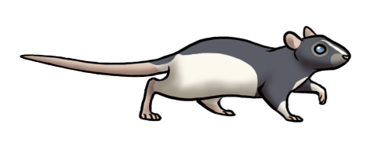
Three blind mice. Three blind mice.
See how they run. See how they run.
They all ran after the farmer's wife,
Who cut off their tails with a carving knife,
Did you ever see such a sight in your life,
As three blind mice?

Slide 4
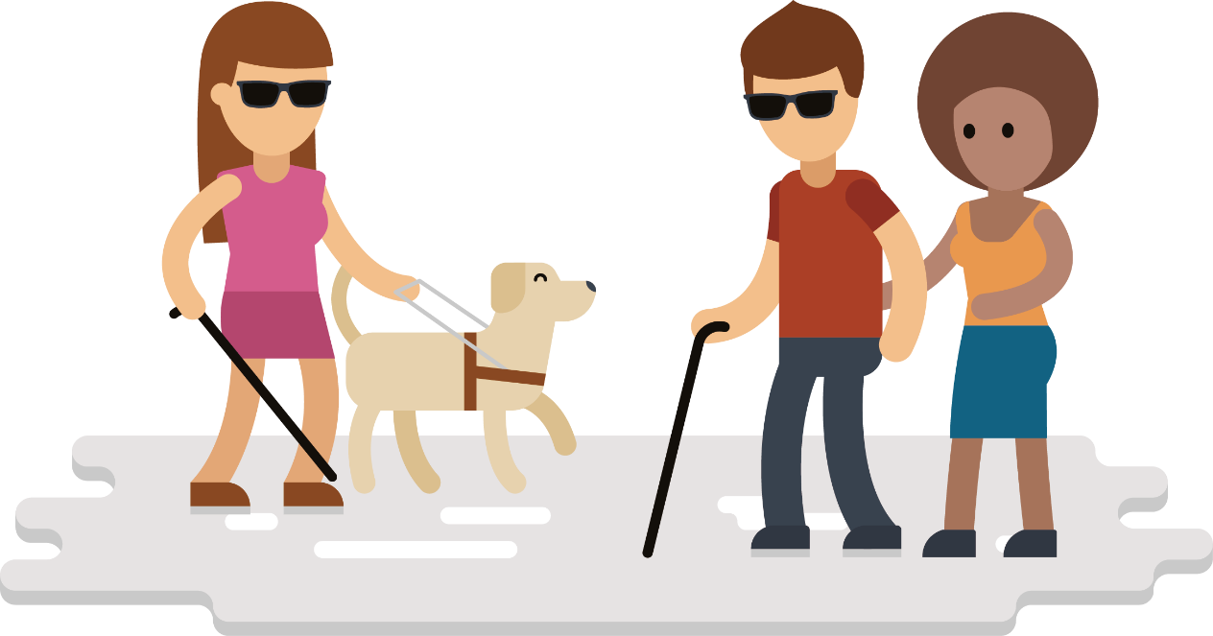
Visually Impaired
Humans are visual creatures
90% of information
How do blind people “see”?
Obstacles for blind people?

Slide 5
Visually Impaired
Rely on other senses
ORCAM - New camera glasses use audio to describe the world
https://www.youtube.com/watch?v=Khjes55OQKM
https://www.orcam.com/en/

Slide 6
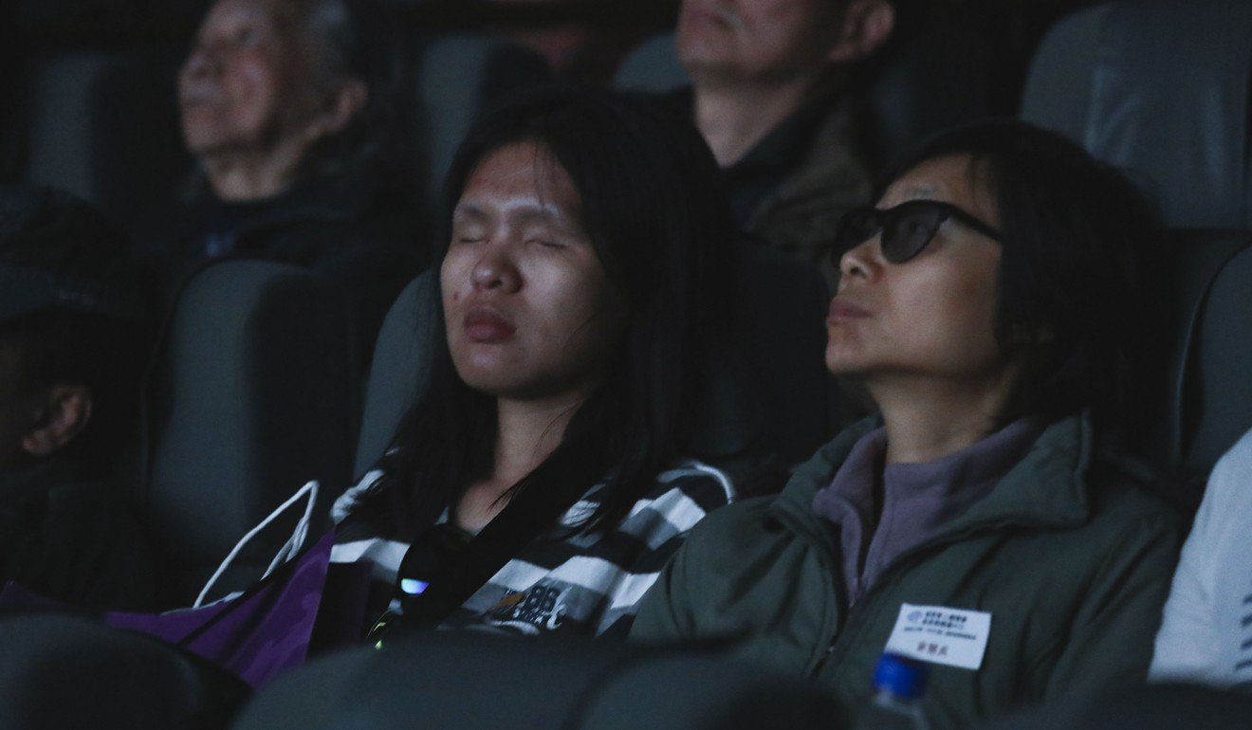
Visually Impaired
How can they watch a movie?
https://www.scmp.com/culture/film-tv/article/2128644/hong-kong-audio-describers-bring-films-life-blind-and-visually

Slide 7
Audio Descriptions
Example

Slide 8
Audio Descriptions
What movie is it from?
What happened during the Scene?
anything you remember
What are they trying to get?

Slide 9
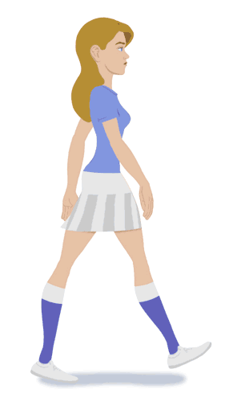
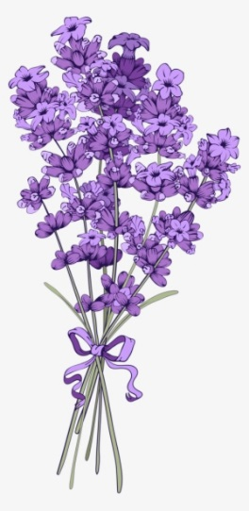
Audio Descriptions
A carrot-nosed snowman shuffles up to a purple flower peeping out of deep snow.

Slide 10
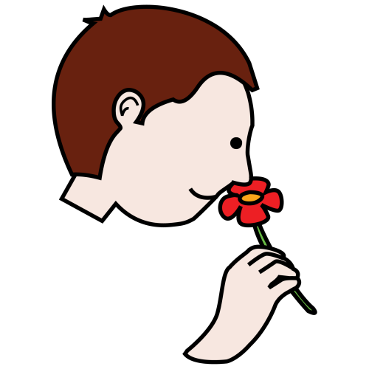
He takes a deep sniff.

Slide 11
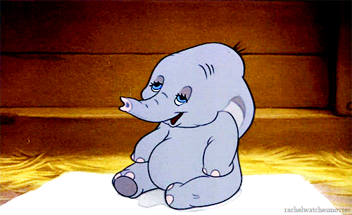
Achoo!

Slide 12
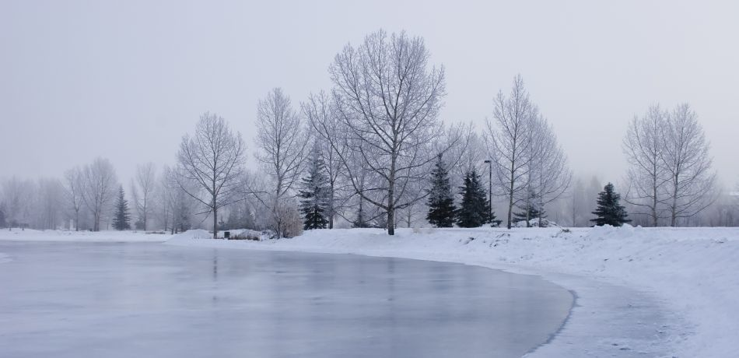
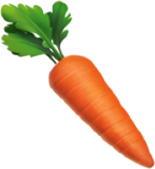
His nose lands on a frozen pond.

Slide 13
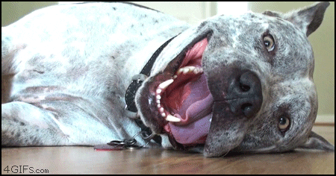
A reindeer look up and pants like a dog.

Slide 14
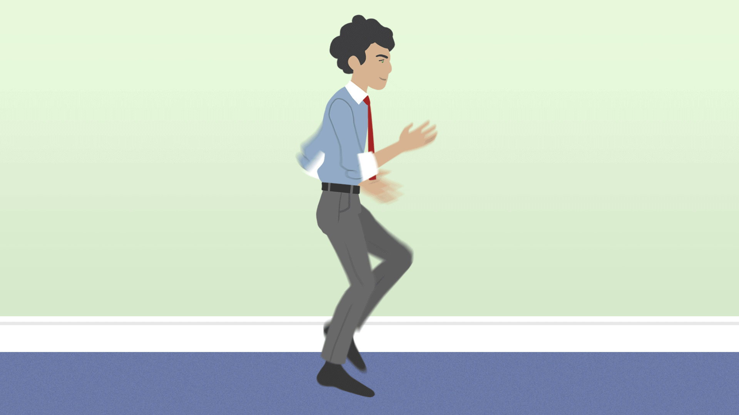
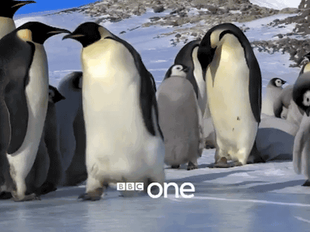
Seeing the reindeer slip on the ice, the snowman smiles and moves towards him. Actually, he is running on the spot.

Slide 15
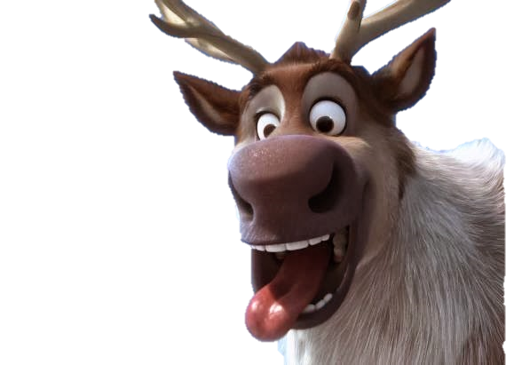
The reindeer falls on his chin.

Slide 16
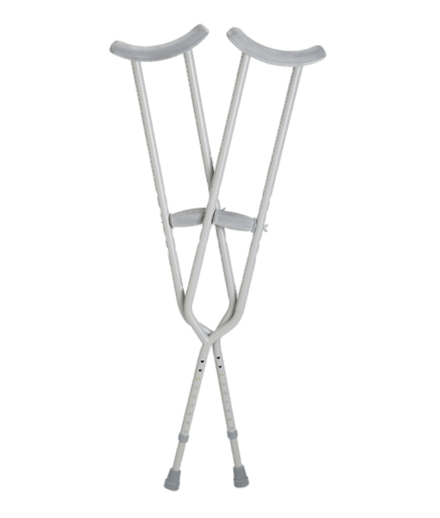
The snowman uses his arm as a crutch.

Slide 17
The reindeer paddles his front legs.

Slide 18
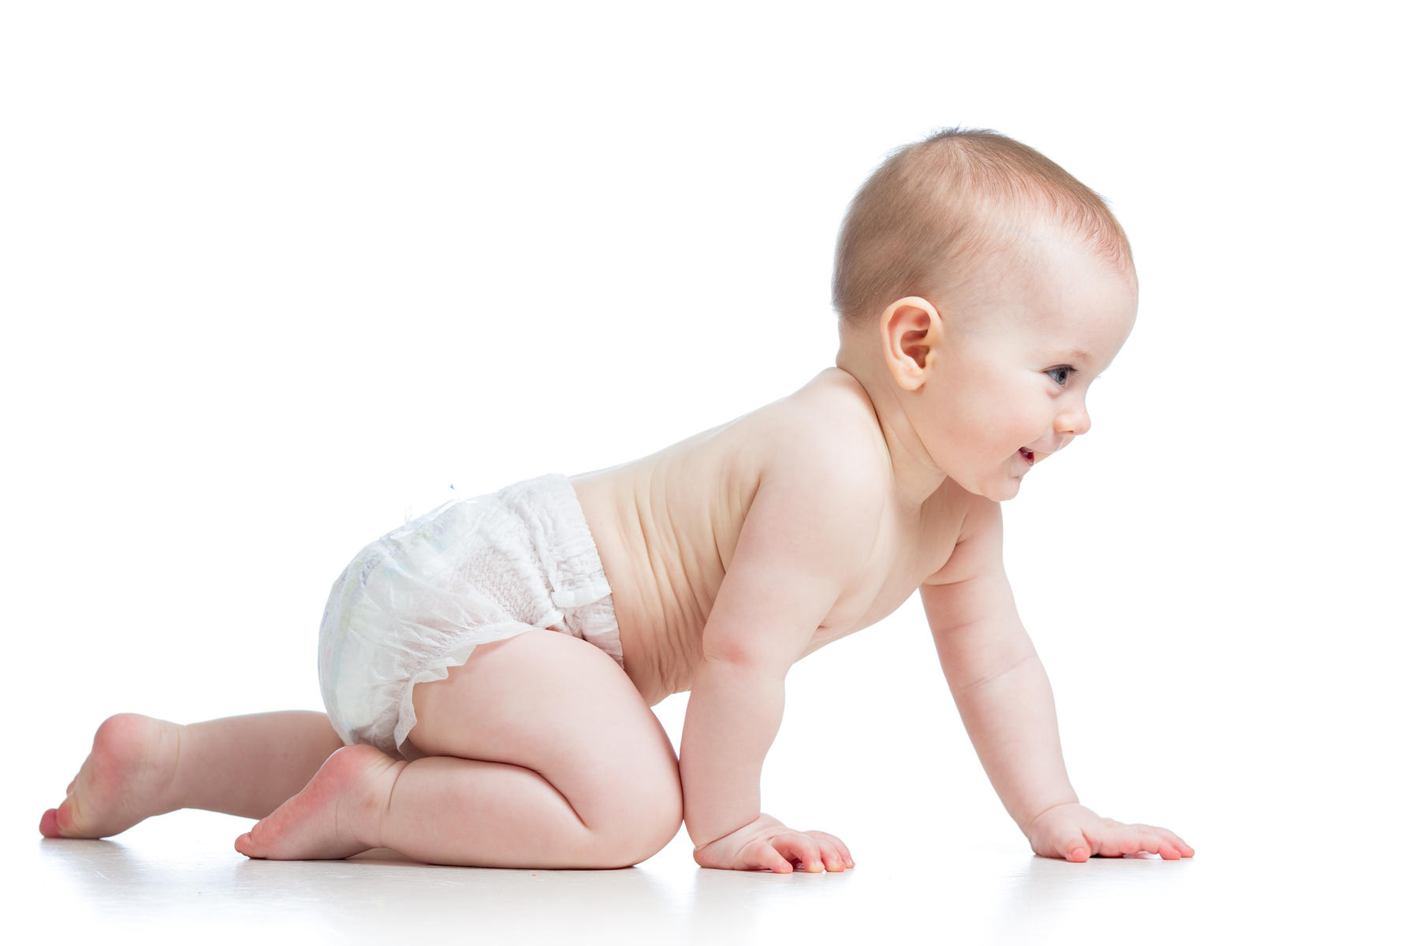
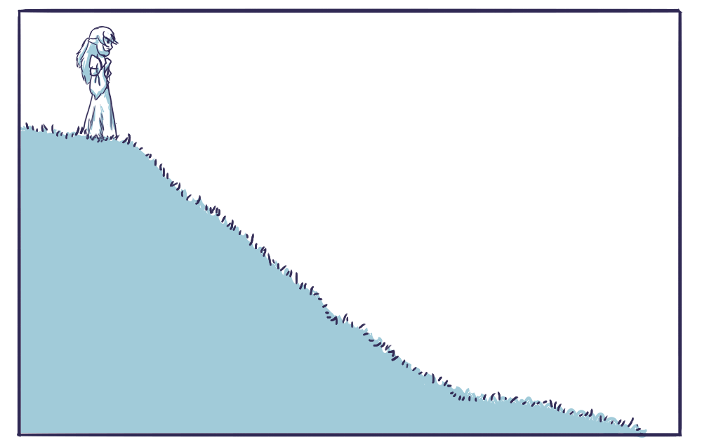
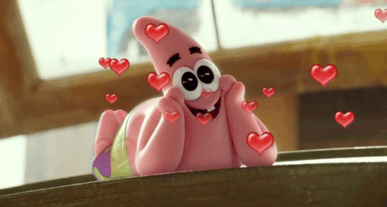
Head over heels first, snowman crawls along the ice.

Slide 19
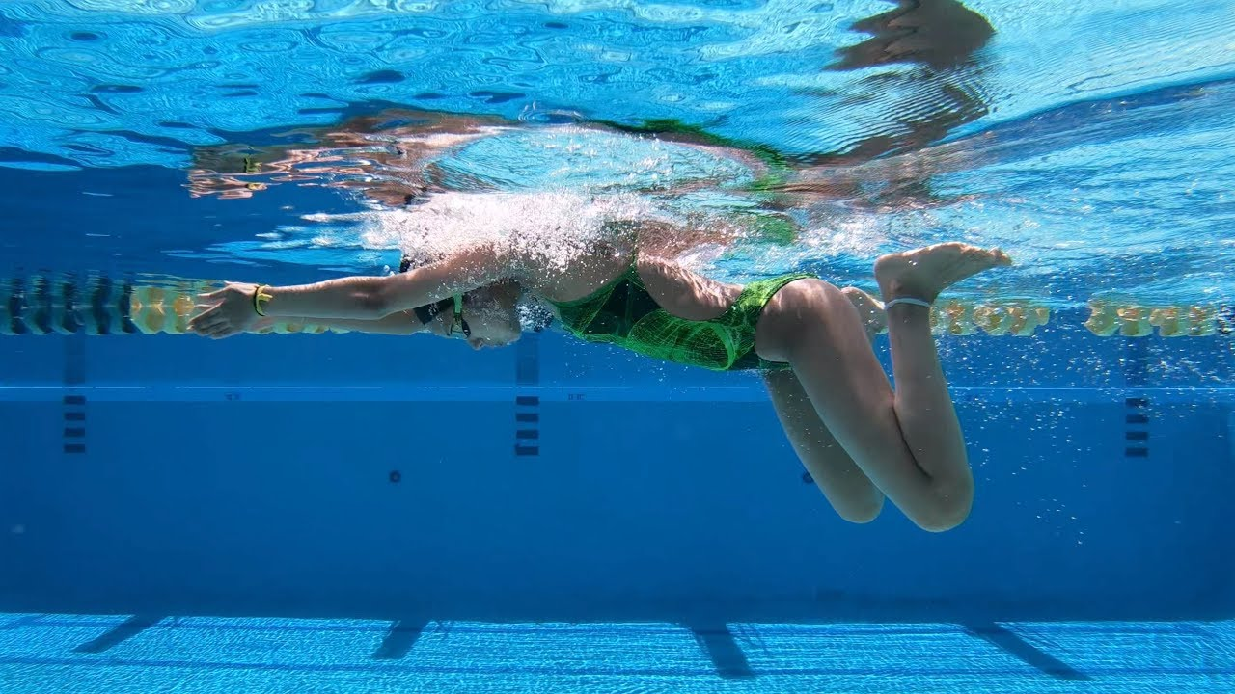
The reindeer does the breaststroke.

Slide 20
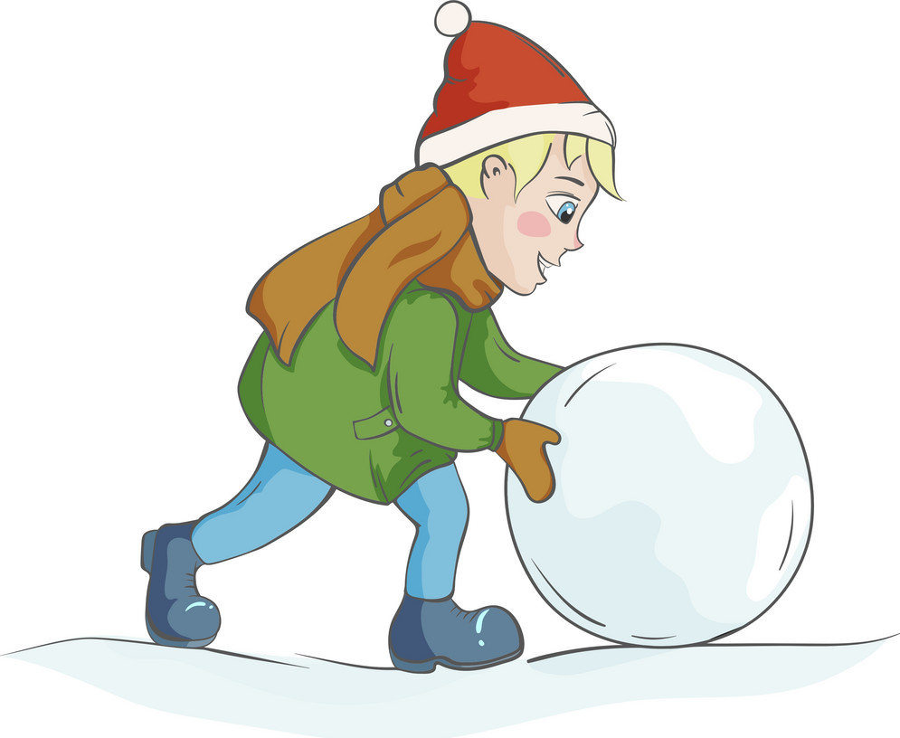
The snowman rolls his body, but flips onto his back.

Slide 21
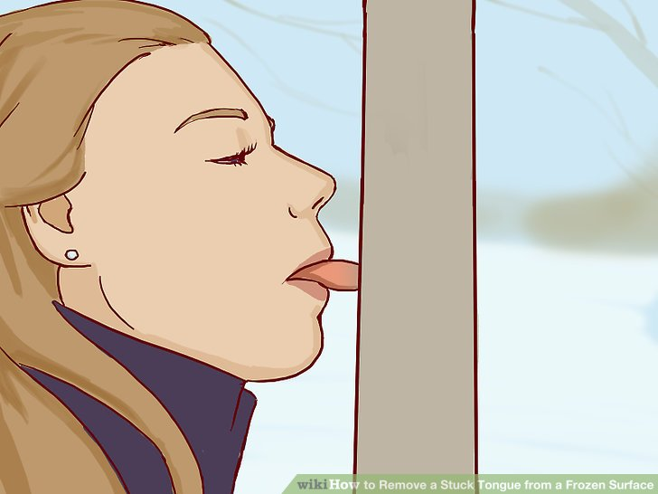
The reindeer’s tongue sticks to the ice.

Slide 22
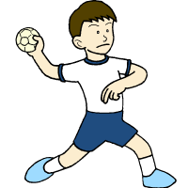
The snowman hurls his head.

Slide 23
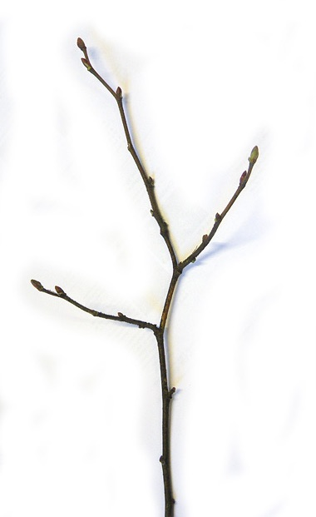
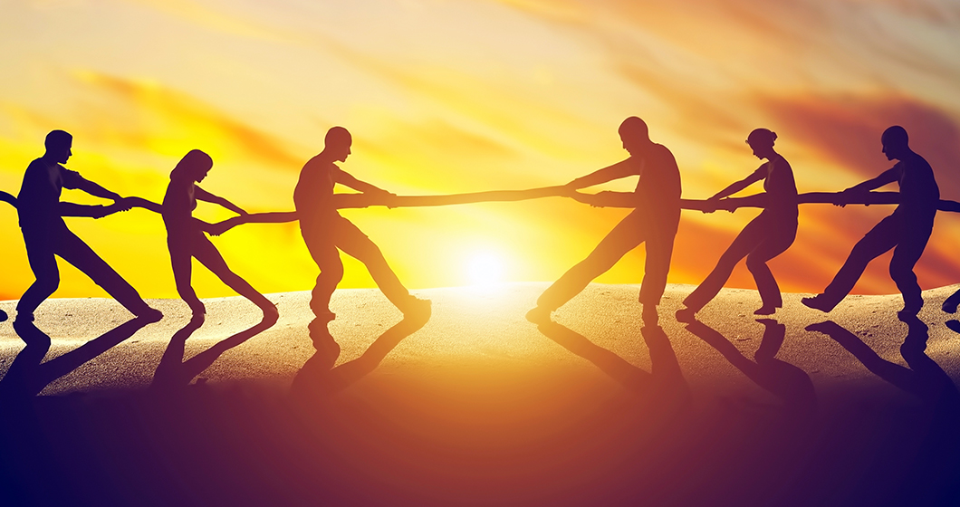
Twig arm and reindeer lips tug at the carrot.

Slide 24
The carrot flies off and lands in soft snow.

Slide 25
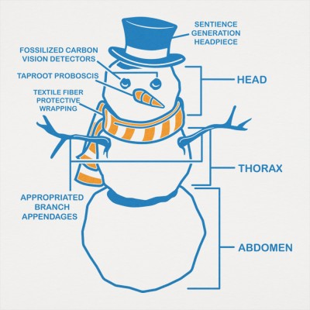
The reindeer goes after it with snowman and his body parts hanging on his tail.

Slide 26
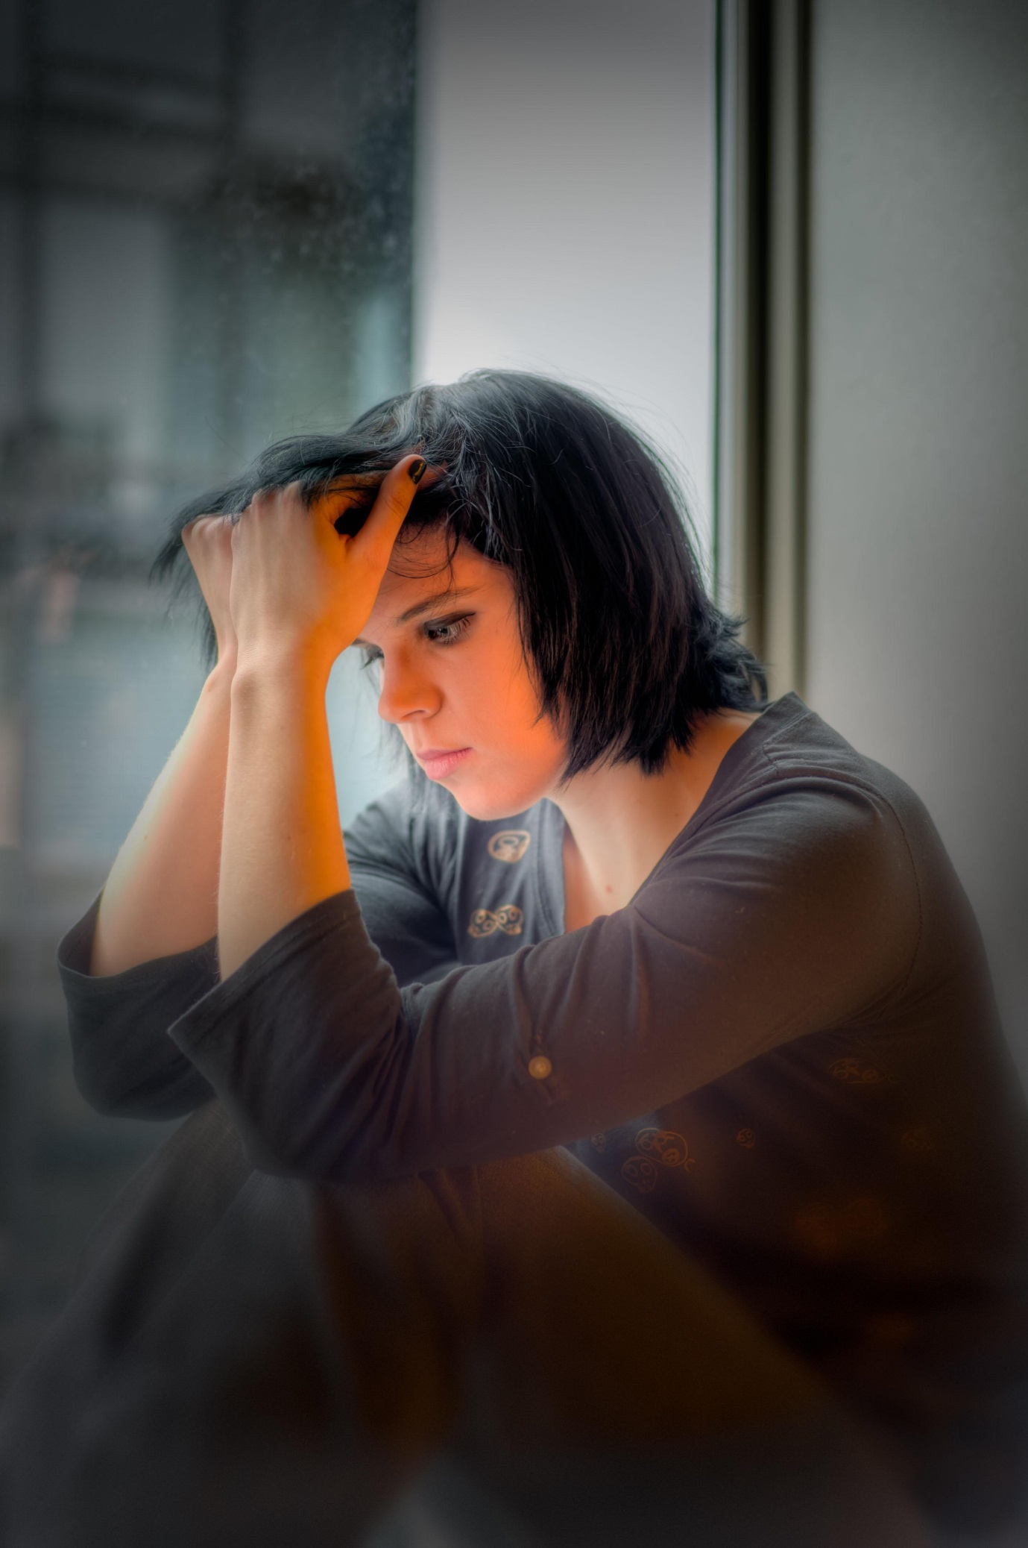
The snowman puts himself back together again and glumly contemplates his noseless state.

Slide 27
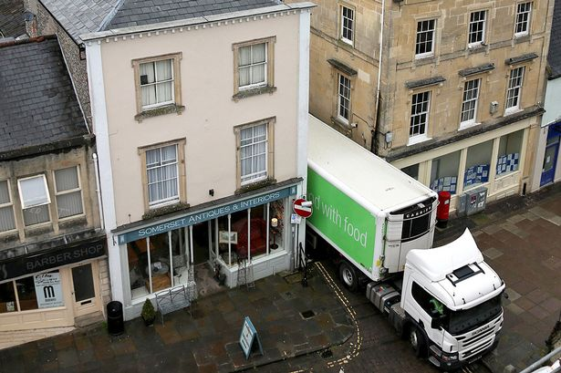
The reindeer jams the carrot back in place and pants like a proud puppy.

Slide 28
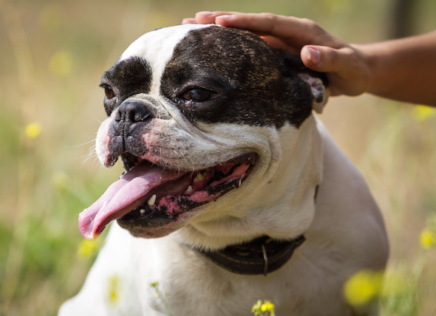
The snowman pats him with a stick then arm.

Slide 29
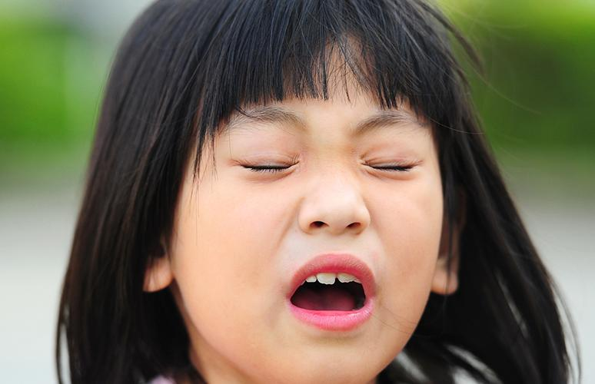
He goes to sneeze.

Slide 30
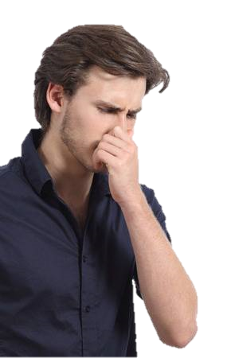
He grabs his nose with two hands.

Slide 31
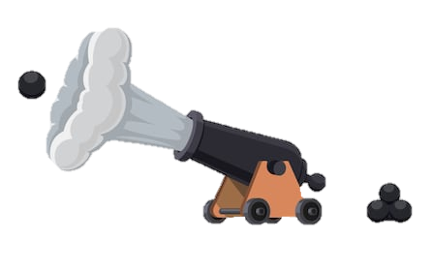
His head shoots off.

Slide 32
https://www.youtube.com/watch?v=O7j4_aP8dWA

Slide 33
Visual Gap Fill Activities
One person has information that they must communicate to the others

Slide 34
Close your eyes
I will describe a picture.

Slide 35
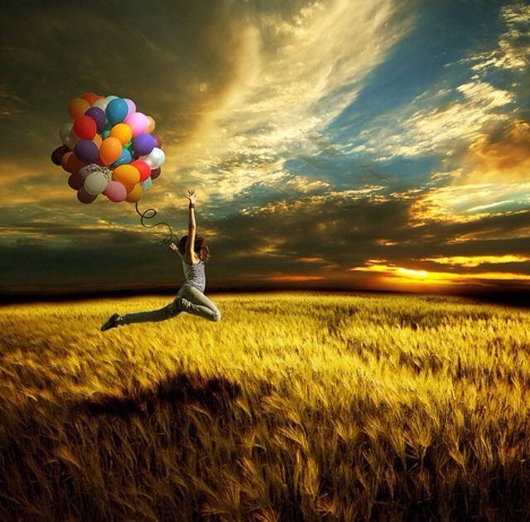
Visual Gap Fill
Tell me about the scene.
Details
ANSWER

Slide 36
Three Blind Mice
Everyone will get a picture
The other (mice) will close their eyes
Describe the picture
Mice will describe it back to the leader
How accurate is it?

Slide 37
What is it Game
Turn off the TV
Only one student can see the answer
Ask questions
Can only answer “yes” or “no”
Be careful of reflections

Slide 38
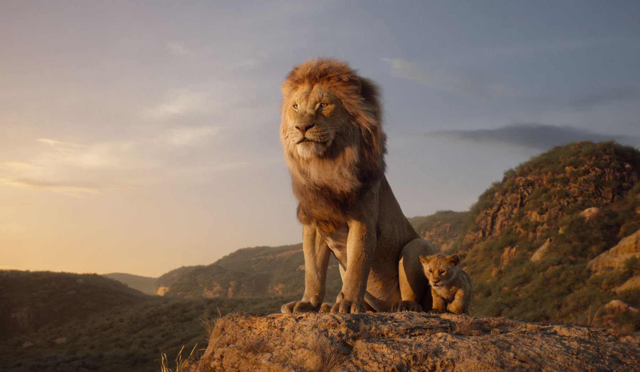

Slide 39
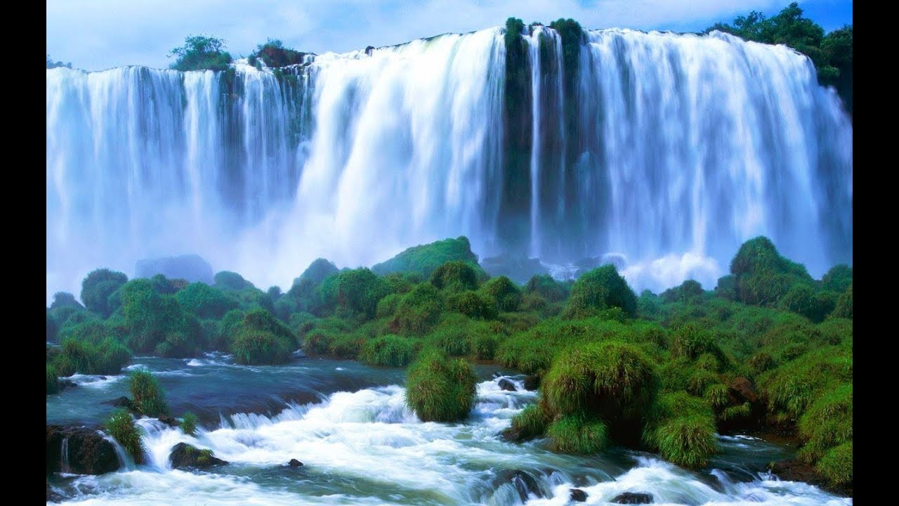

Slide 40
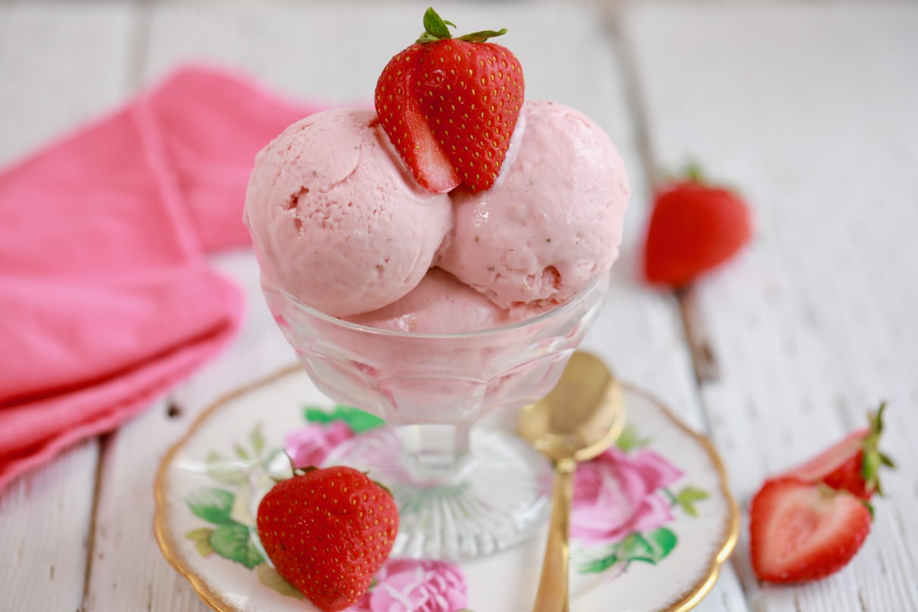

Slide 41
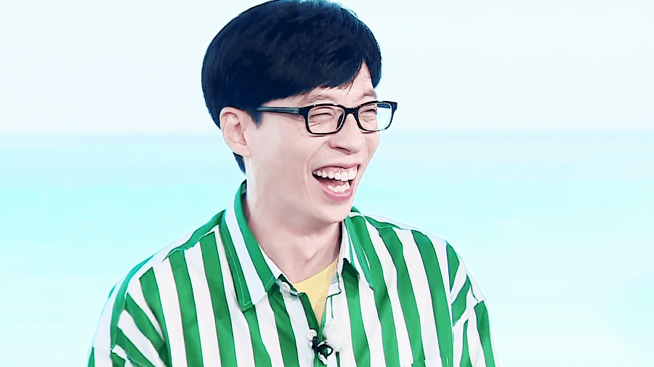

Slide 42
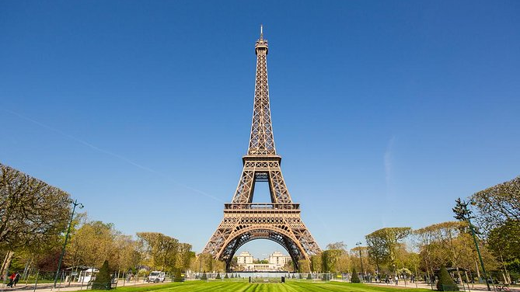

Slide 43
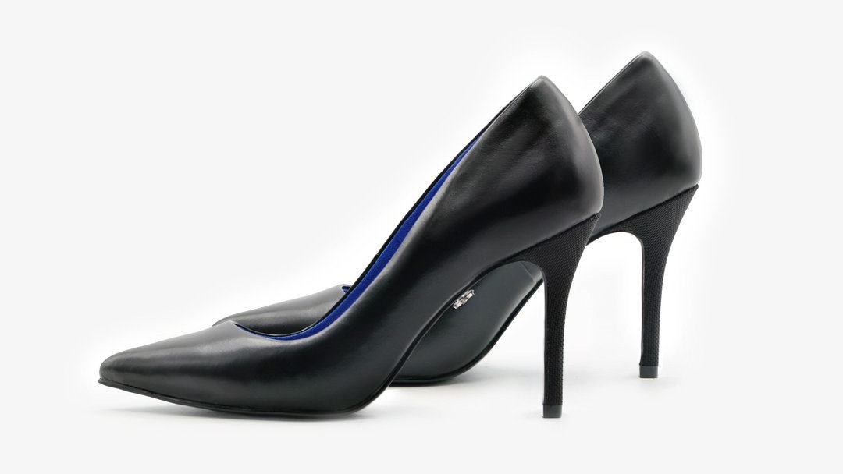

Slide 44
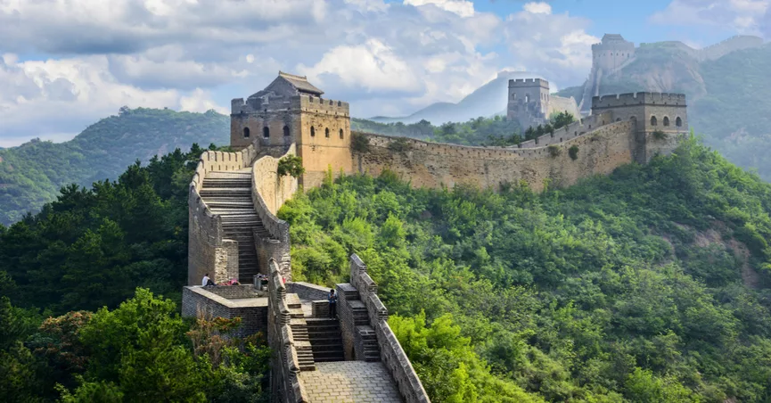

Slide 45
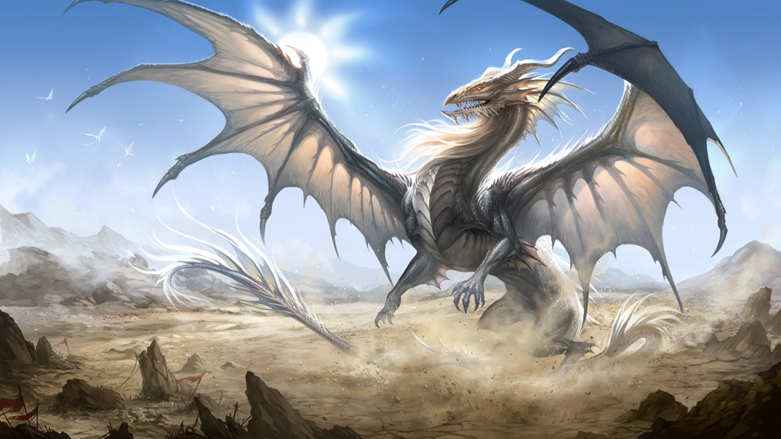

Slide 46
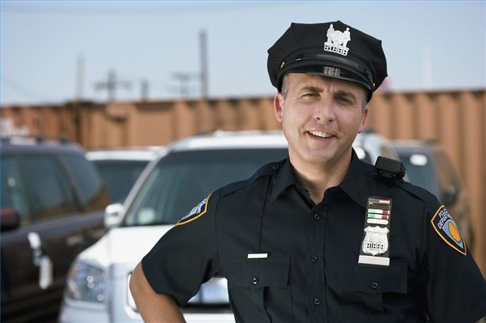

Slide 47
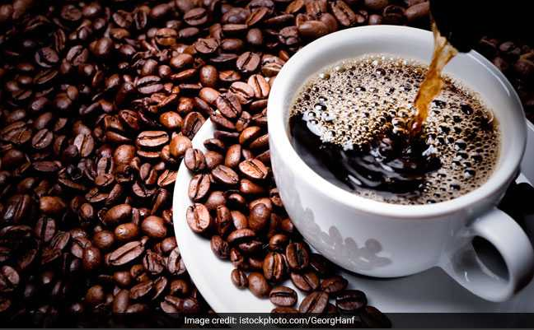

Slide 48
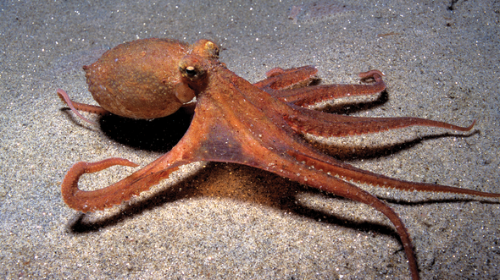

Slide 49
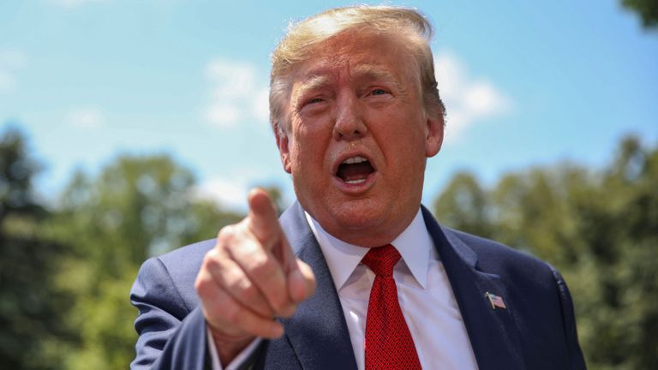

Slide 50
