Slide 2
What is the best job?

Slide 3
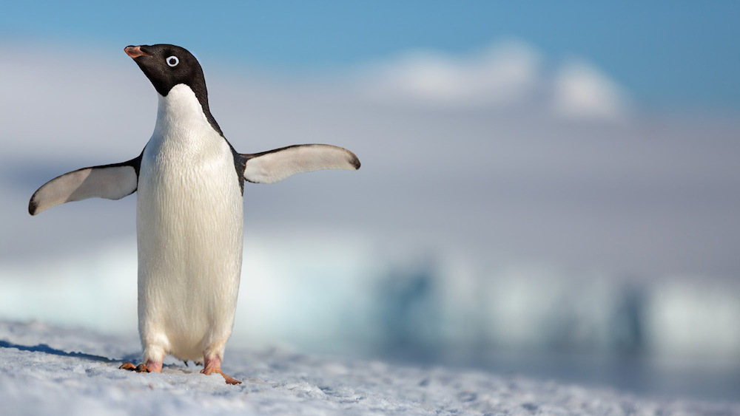
Do you think it would be fun to work with penguins?

Slide 4
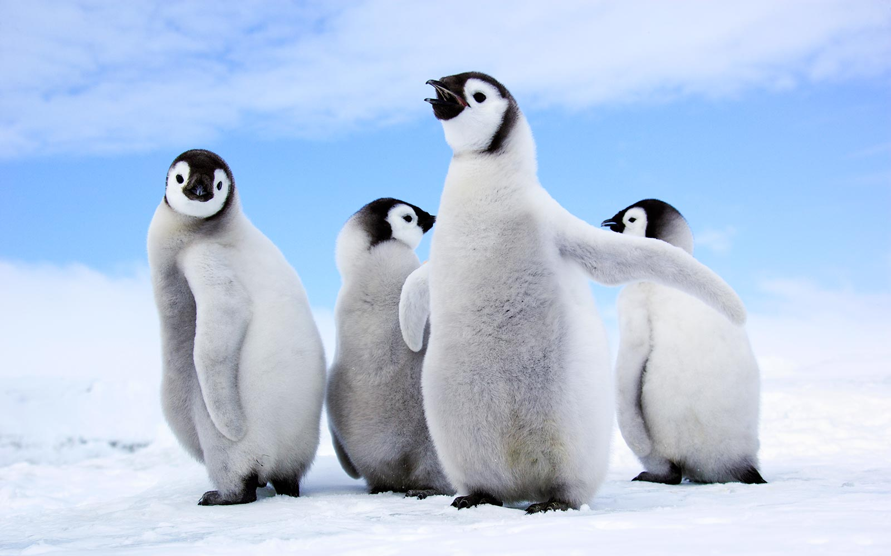
Would you like to work with penguins?

Slide 5
https://kids.nationalgeographic.com/videos/best-job-ever/#/1288264259894

Slide 6
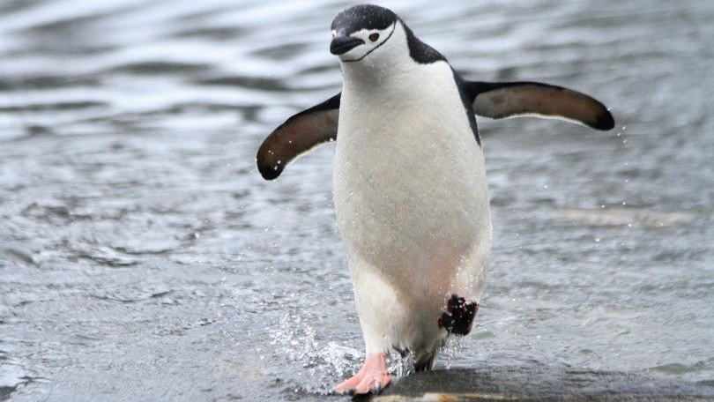
What kind of penguins are they?

Slide 7
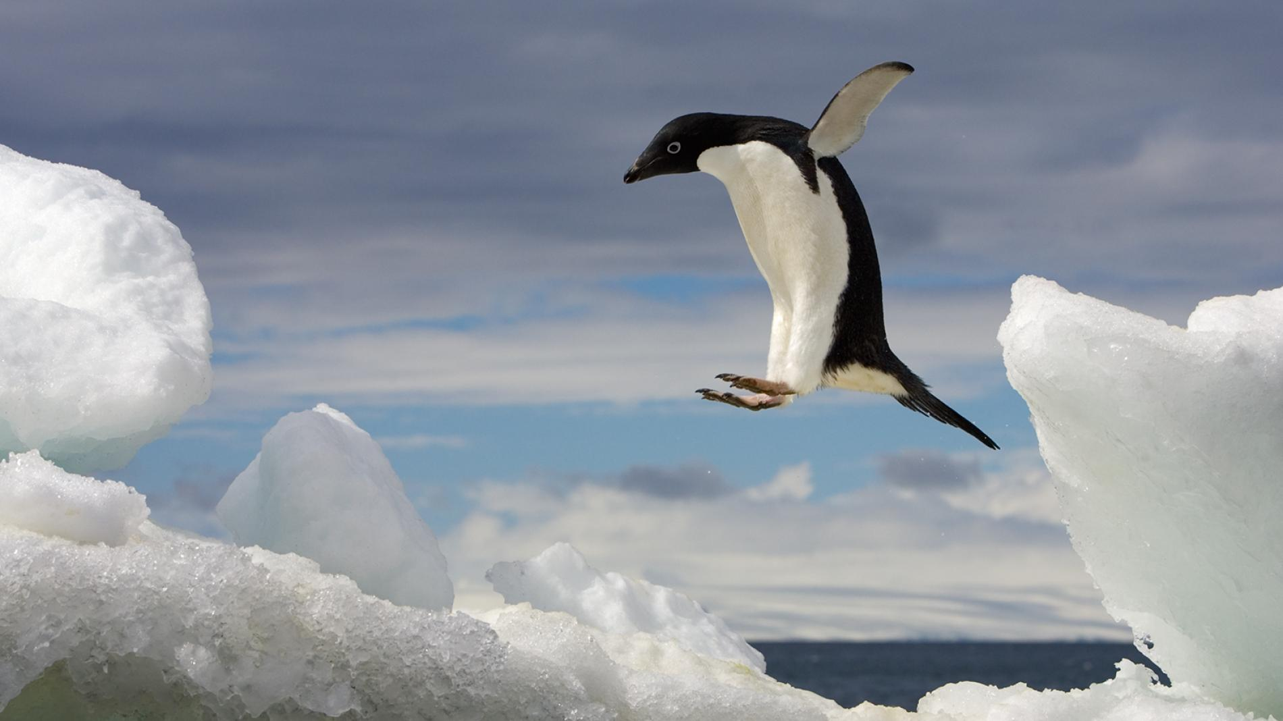
What are some bad things about working with penguins?

Slide 8
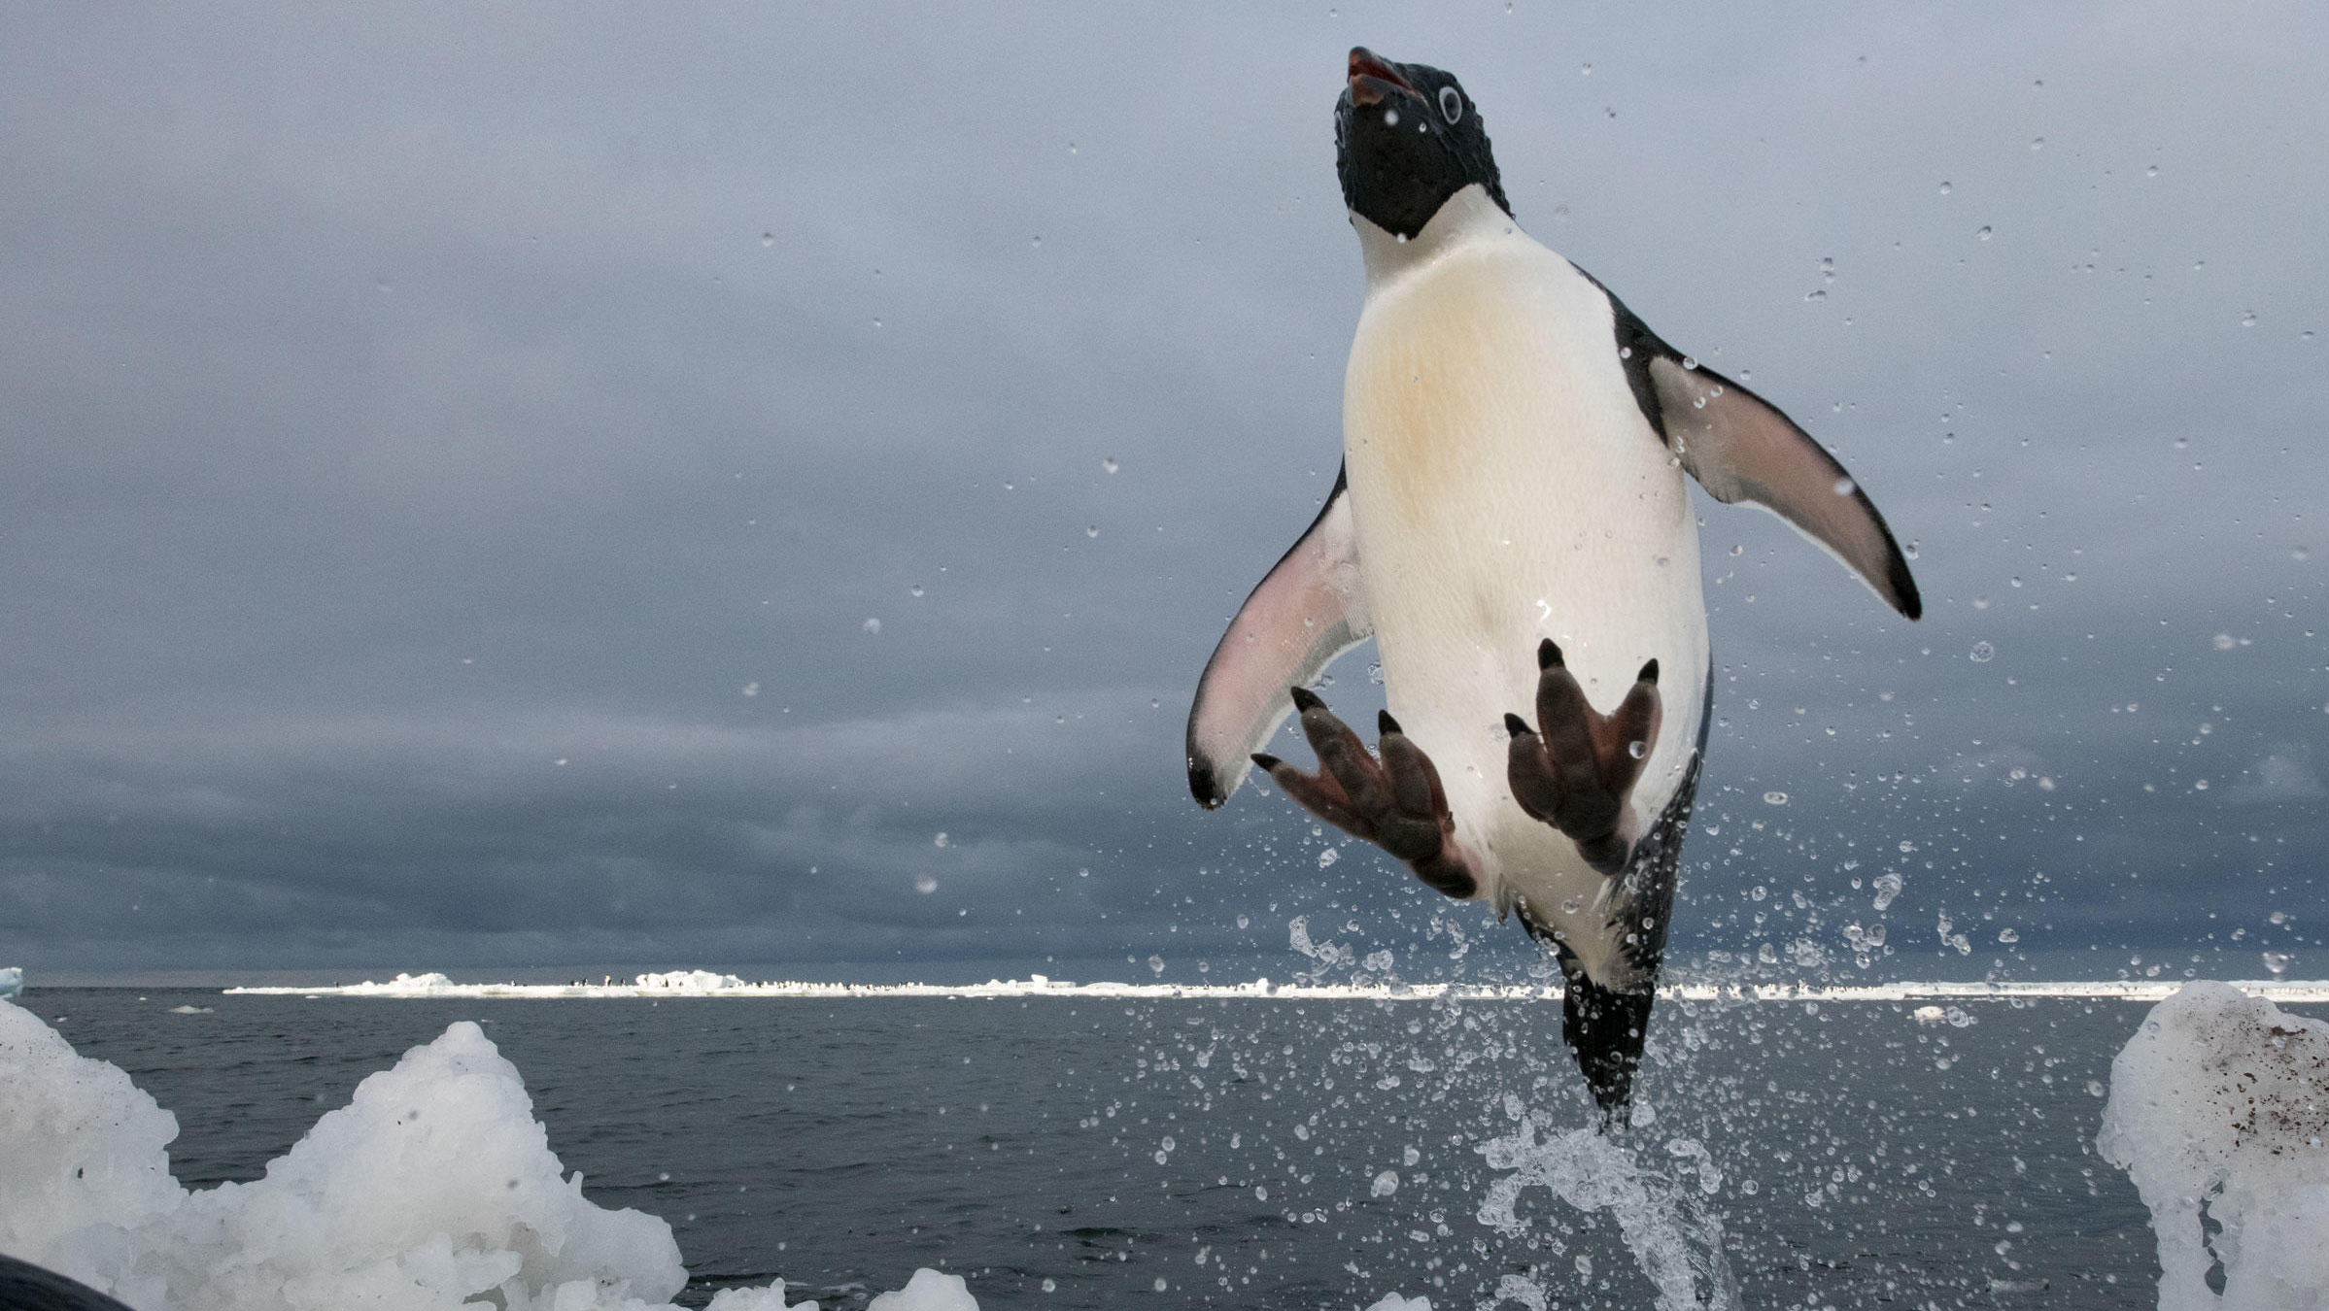
What do penguins do when you get near?

Slide 9
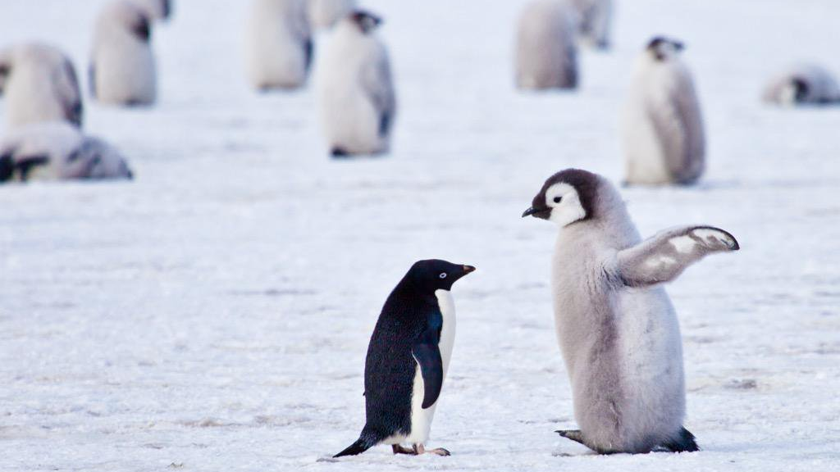
Are penguins nice to each other?

Slide 10
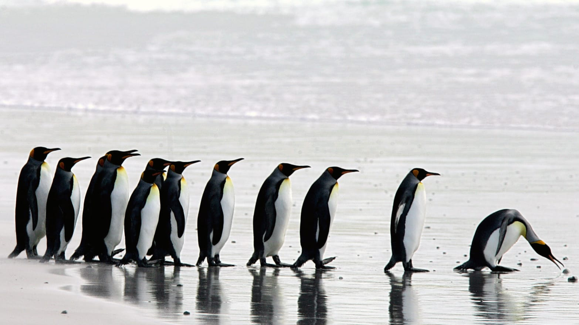
What does cantankerous mean?

Slide 11
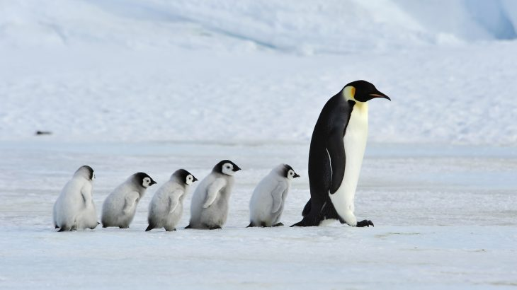
Why do they hurt each other?

Slide 12
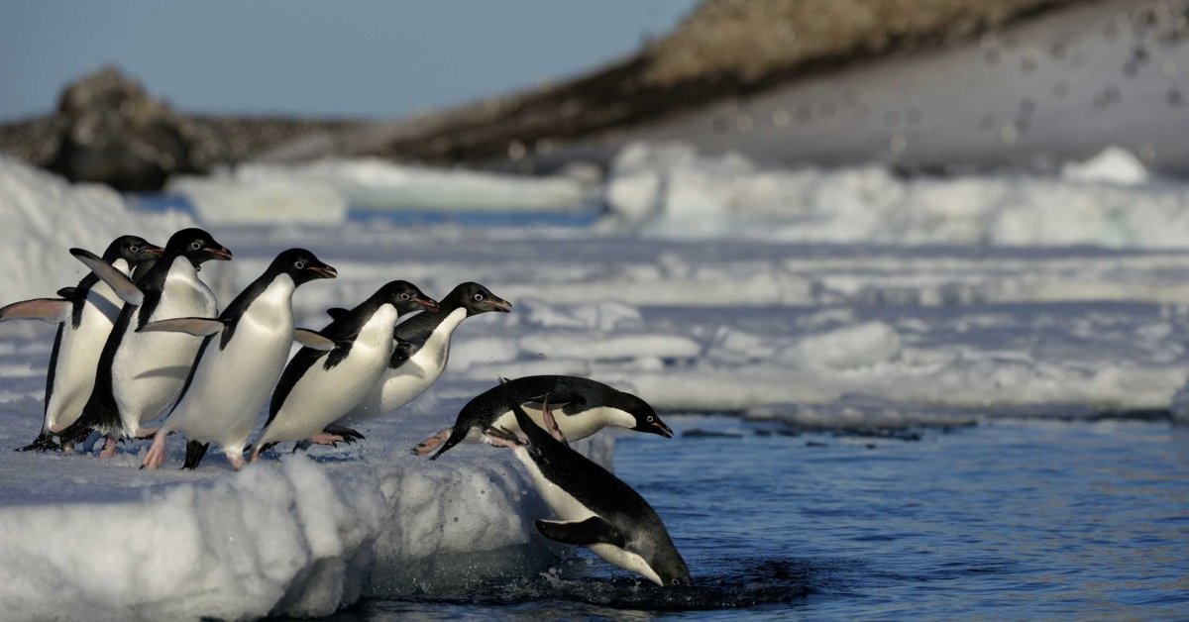
What is his job?

Slide 13
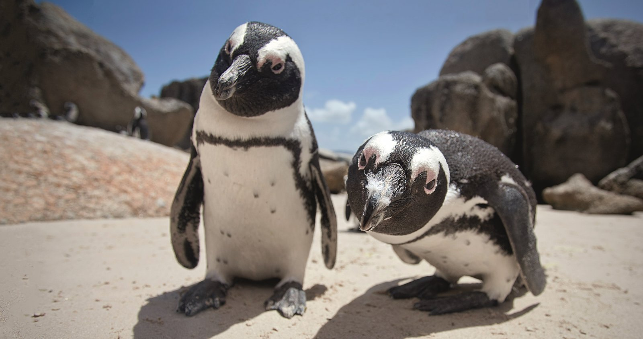
Where do the penguins go?

Slide 14
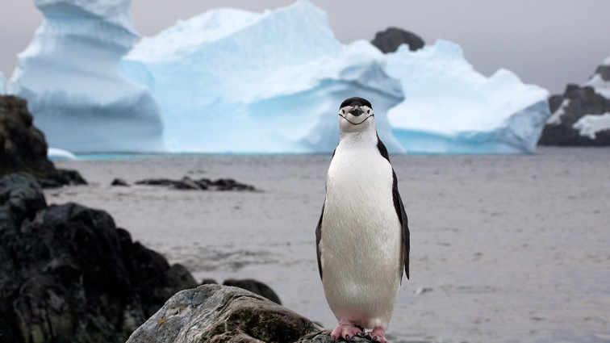
Does he like his job?

Slide 15
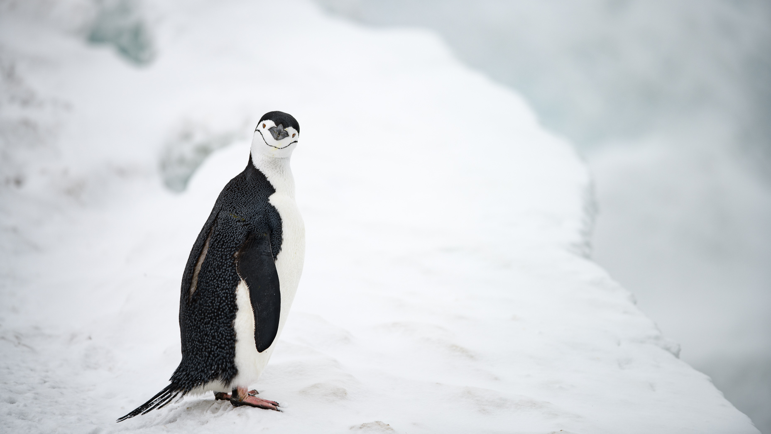
Do you want his job?

Slide 16
C
omprehension
C
heck
Q
uestions

Slide 17
Listening CCQ Tips
Do you understand?

Slide 18
Listening CCQ Tips
New hands

Slide 19
Listening CCQ Tips
Focus on what is right

Slide 20
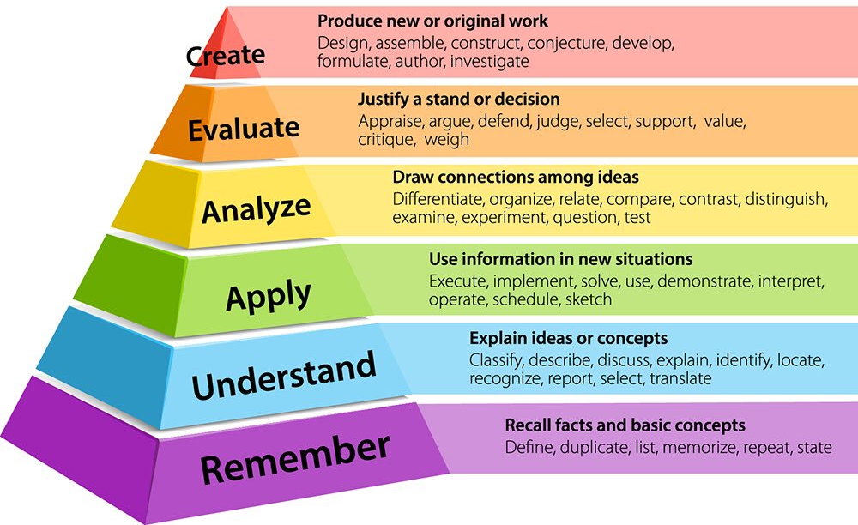
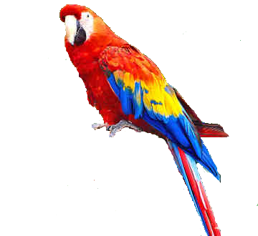
Listening CCQ Tips

Slide 21
Listening CCQ Tips
Meaning

Slide 22
Listening CCQ Tips
Interpretation
(What do you think)

Slide 23
Listening CCQ Tips
Personalize

Slide 24
Listening CCQ Tips
Answer students questions.

Slide 25
Listening CCQ Tips
Games / Activities

Slide 26
https://kids.nationalgeographic.com/

