Slide 1
Internet Sites

Slide 2
Feed the Head
http://vectorpark.com/head/

Slide 3
https://quickdraw.withgoogle.com/

Slide 4
https://idiottest.net/

Slide 5
https://www.seussville.com/

Slide 6
https://pbskids.org/

Slide 7
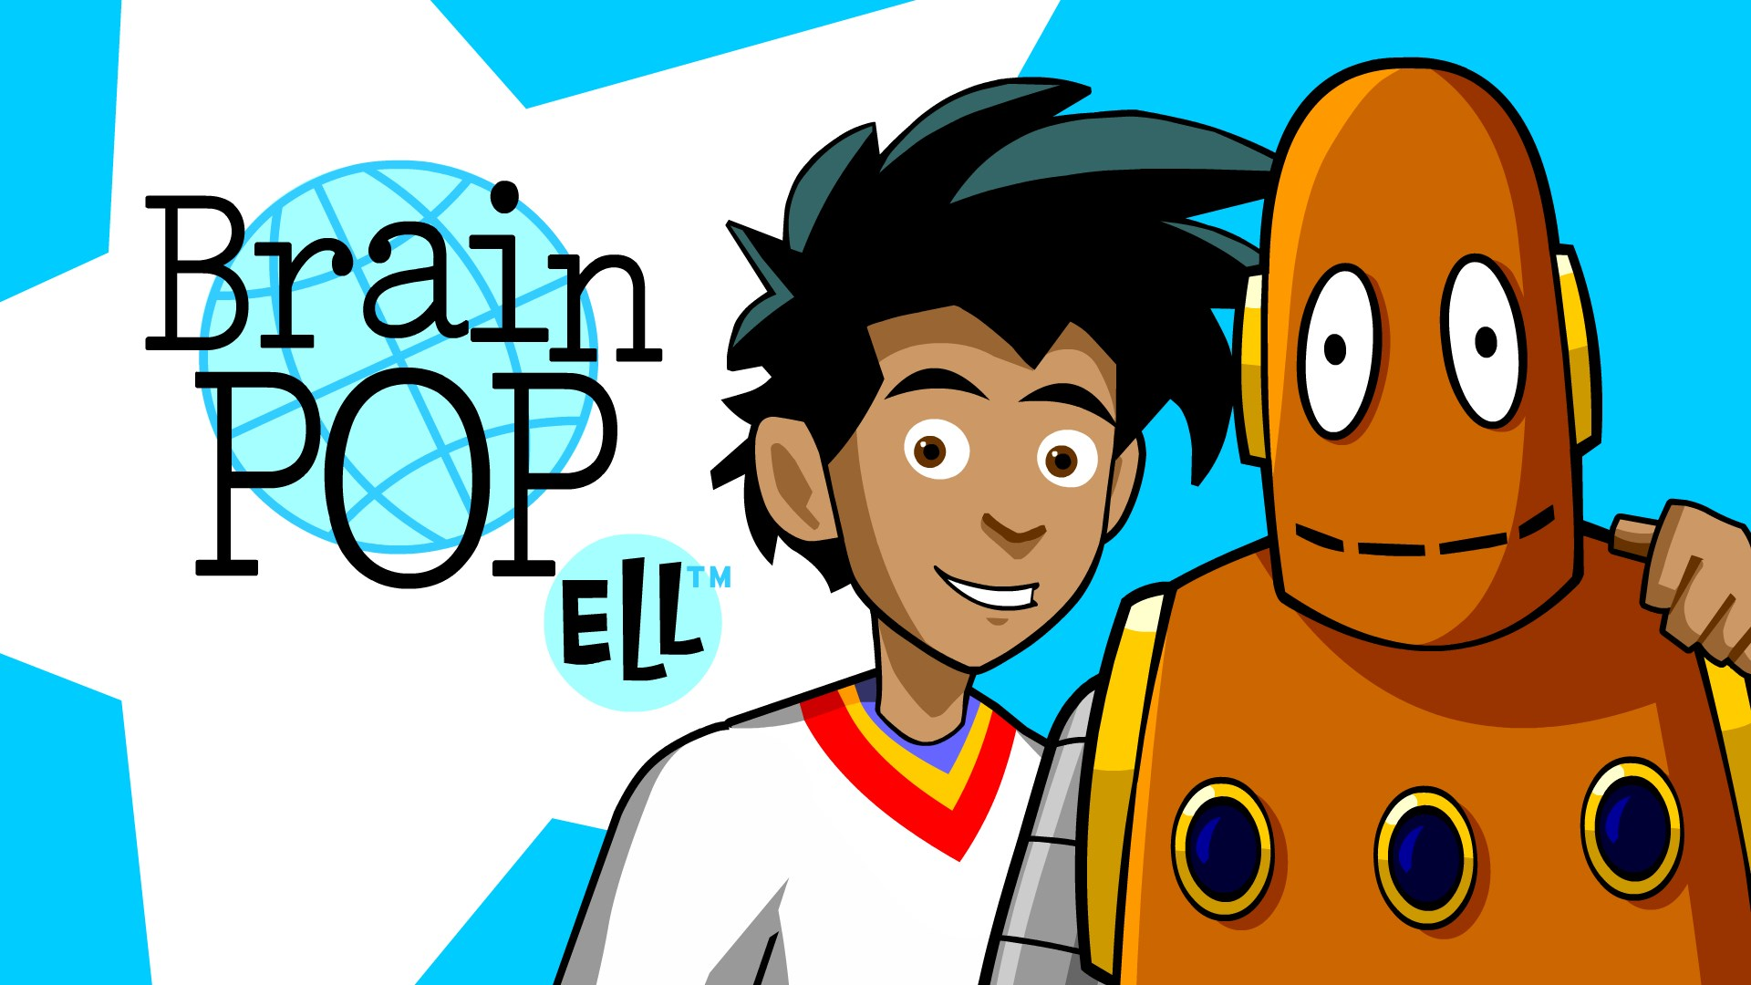
https://www.brainpop.com/

Slide 8
https://www.babytv.com/

Slide 9
*
http://www.agnitus.com/

Slide 10
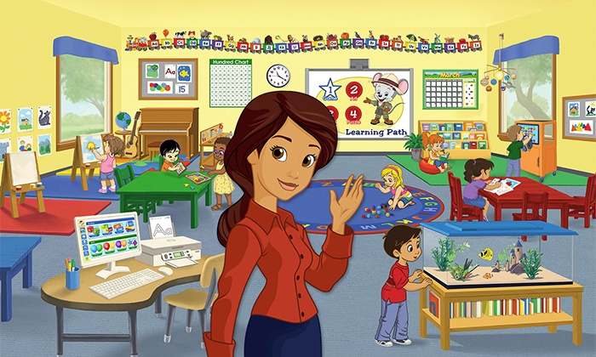
ABC Mouse *
https://www.abcmouse.com/

Slide 11
https://www.funbrain.com/

Slide 12
Spatulatta
http://spatulatta.com/

Slide 13
Itch.io

Slide 14
Draw Your Own Adventure
https://dashingashes.itch.io/draw-your-own-adventure

Slide 15
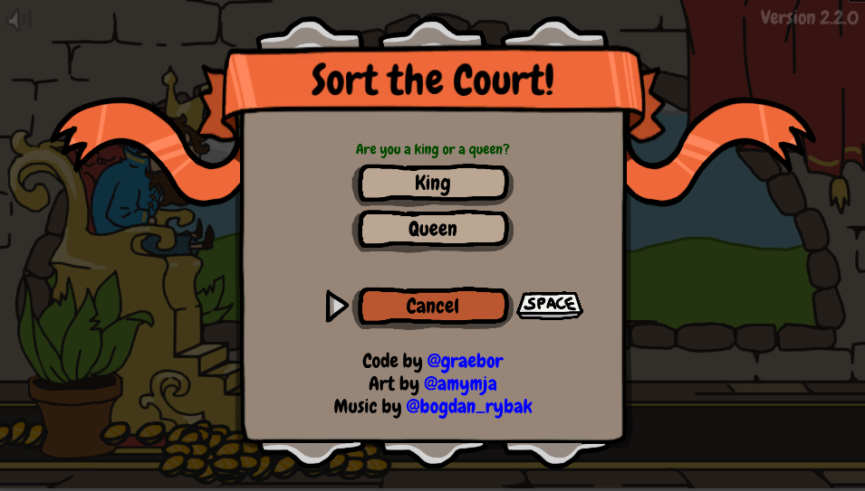
Sort the Court
https://graebor.itch.io/sort-the-court

Slide 16
https://oddbird.itch.io/impeached

Slide 17
Other Games:

Slide 18
https://store.steampowered.com/

Slide 19
https://www.newgrounds.com/

Slide 20
https://www.kongregate.com/

Slide 21
https://www.humblebundle.com/

Slide 22
https://kids.nationalgeographic.com/

Slide 23
ESL Toybox
www.esltoybox.com

