Slide 1
Pizza
Artist

Slide 2
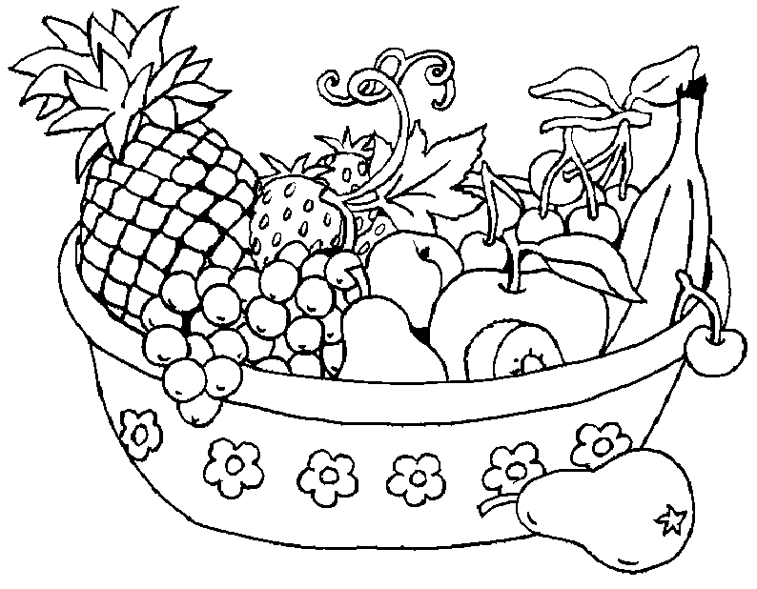
Score

Slide 3
Color Bingo

Slide 4
