Slide 1
Silent Phase
https://www.eslbase.com/teaching/silent-period-second-language-acquisition

Slide 2
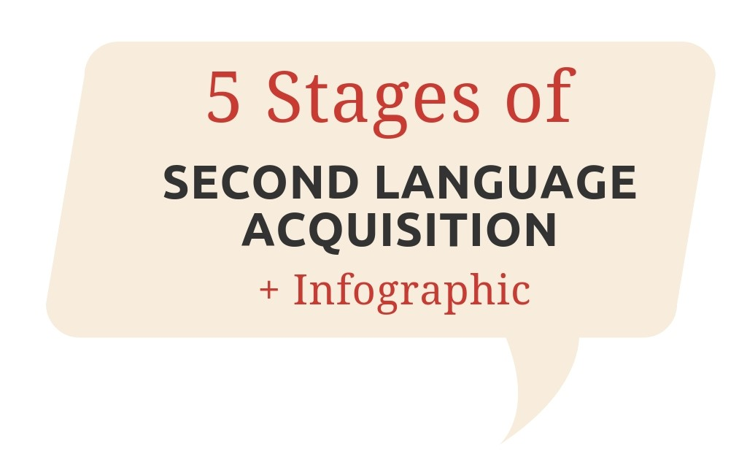
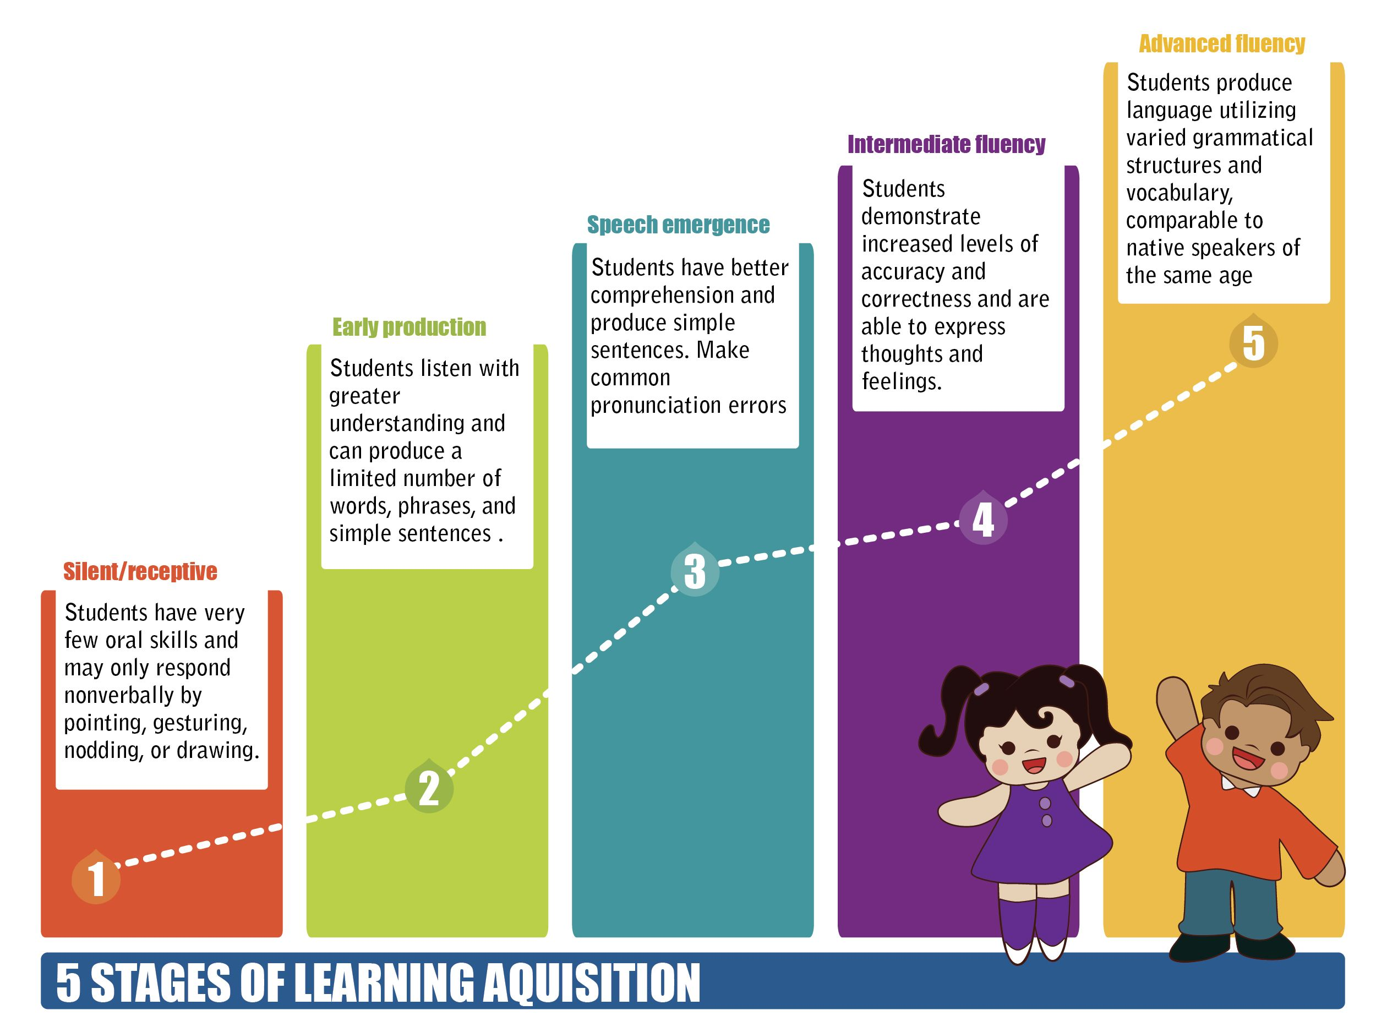

Slide 3
Why?

Slide 4
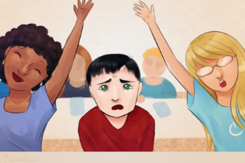
Silent phase is not shyness.

Slide 5
Silent phase is not incomprehension.

Slide 6
500 words

Slide 7
During Silent Phase

Slide 8
Exposure to Language

Slide 9
Gaining Meaning

Slide 10
Curious

Slide 11
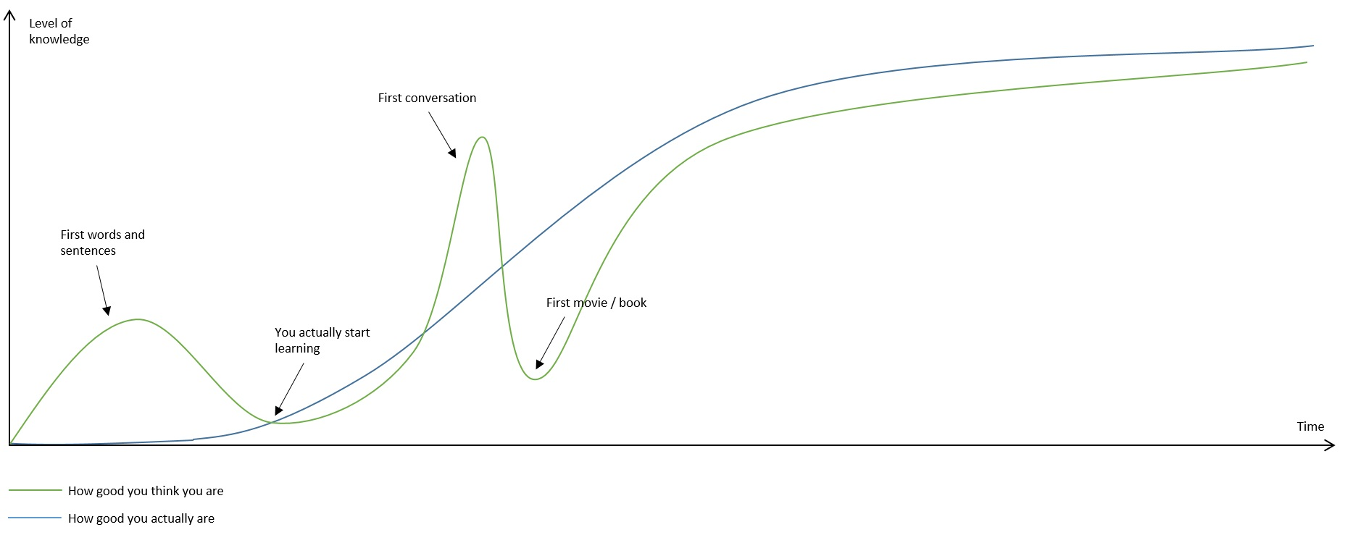
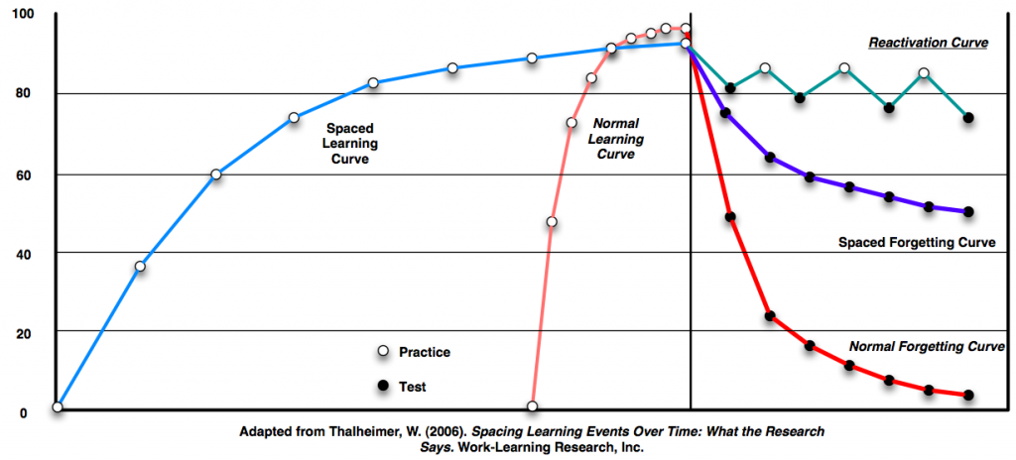
Rapid Learning Rate

Slide 12
Forcing Students Out of Silent Phase

Slide 13
De-motivated
Bad relationship with language
Language is forced
Frustration

Slide 14
Silent Phase Advice
https://choiceliteracy.com/article/understanding-the-silent-period-with-english-language-learners/?fbclid=IwAR00Bo54bE3KTOUGw9l4uoutV0QxQDbi6MHLy029-CJvbQfKfvayVtbNMjM

Slide 15
Visual Aids
Vocabulary
Comprehensible Input
Relaxed Atmosphere
TPR
Listening + Reading

Slide 16
We ask questions that allow the child to respond with nods of “yes” or “no”
Is this your mother?
Is it a duck?
Do you like chocolate?

Slide 17
We accept as response facial expressions like smiles.
Eye contact
Flipping pages along with reading
Physically helping draw a letter

Slide 18
We share a word or two in the child’s language.
Students appreciate the effort
Connection

Slide 19
We ask the child to teach us words in their language.

Slide 20
Many children draw pictures of their family, and we ask for details.
Point and ask
First words in Silent Phase are often related to family.

Slide 21
We watch the child on the playground.
Early words can present themselves in play.

Slide 22
We ask children to mime the action of what they are trying to convey using their bodies to communicate.
Non-verbal cues

Slide 23
We ask the child to draw a picture of what they are trying to tell us.
Communication without speaking

Slide 24
Receptive
Productive

Slide 25
Pointing (Identification) Games

Slide 26
Shows understanding w/o speaking

Slide 27
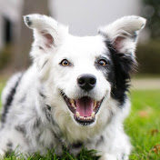
Chaser
https://www.youtube.com/results?search_query=chaser+the+border+collie

Slide 29
How many?

Slide 30
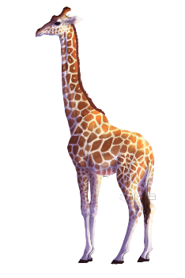
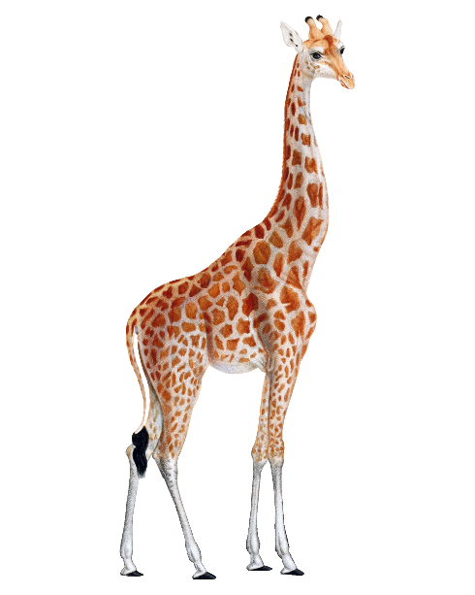
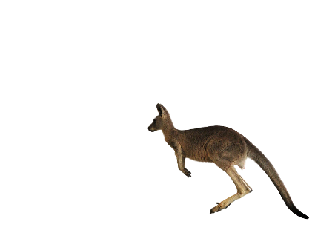
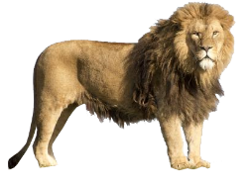
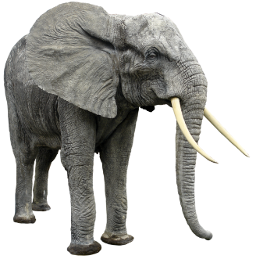
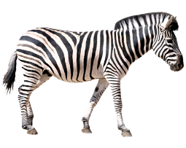
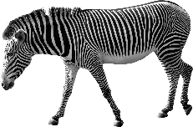
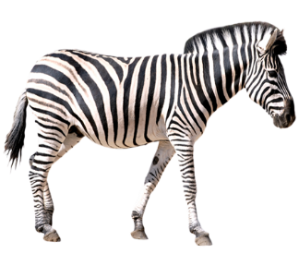
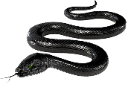
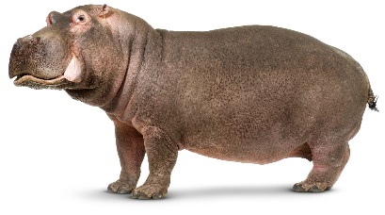
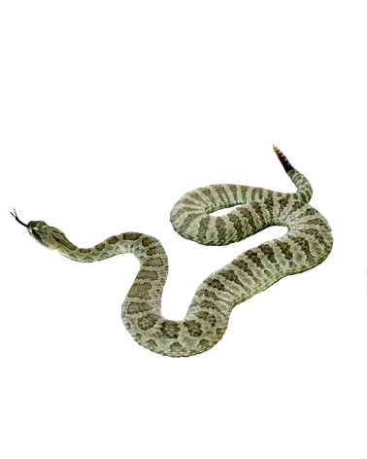
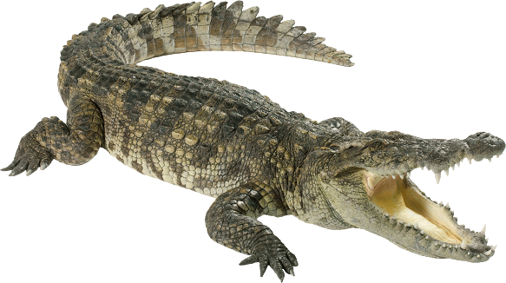
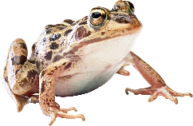

Slide 31
Find the Action

Slide 32
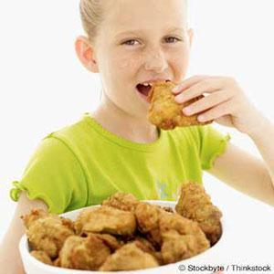
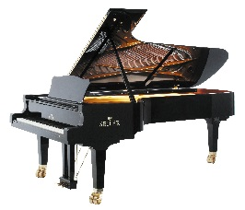
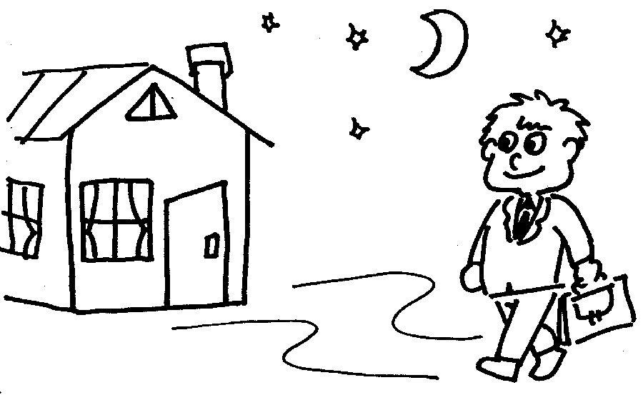
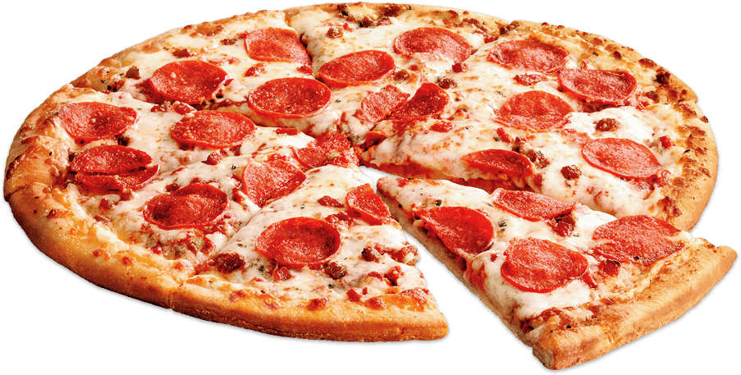
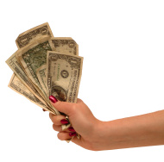
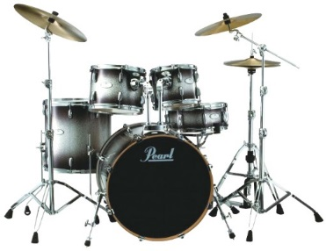
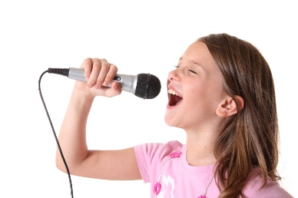
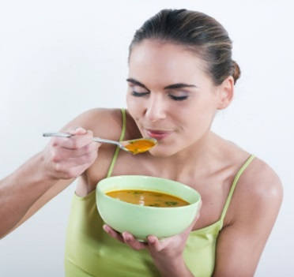
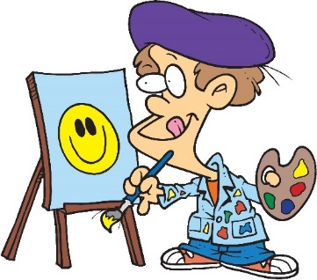
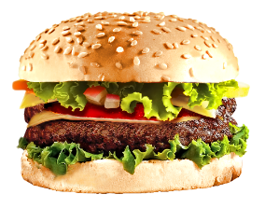
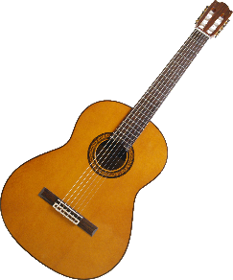
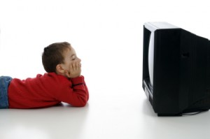
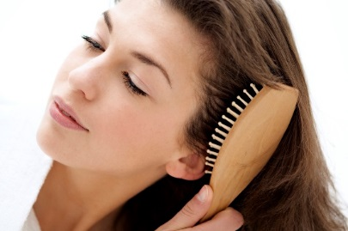
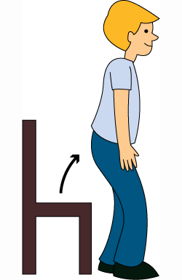
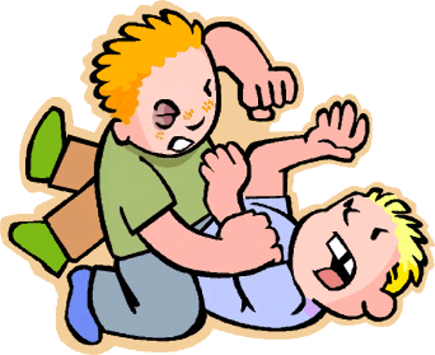
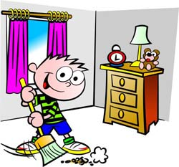

Slide 33
Fruit Basket

Slide 34
Color
Have the students color in their fruit basket using unique colors

Slide 35
Play
Choose a color and a fruit at random.
Script:
What is it?
It’s a ________.
What color is it?
It’s _________. It’s a _________ __________.

Slide 36
Score

Slide 38
Simon Says

Slide 39
Coloring Bingo

Slide 40
Color Bingo

Slide 43
Early Language Emergence

Slide 44
Make a List of Early Words

Slide 45
Early Language Emergence:
Yes / No (understanding)
Is it ________?
It is… It’s not…

Slide 46
Eye Spy

Slide 47
What’s This?

Slide 48
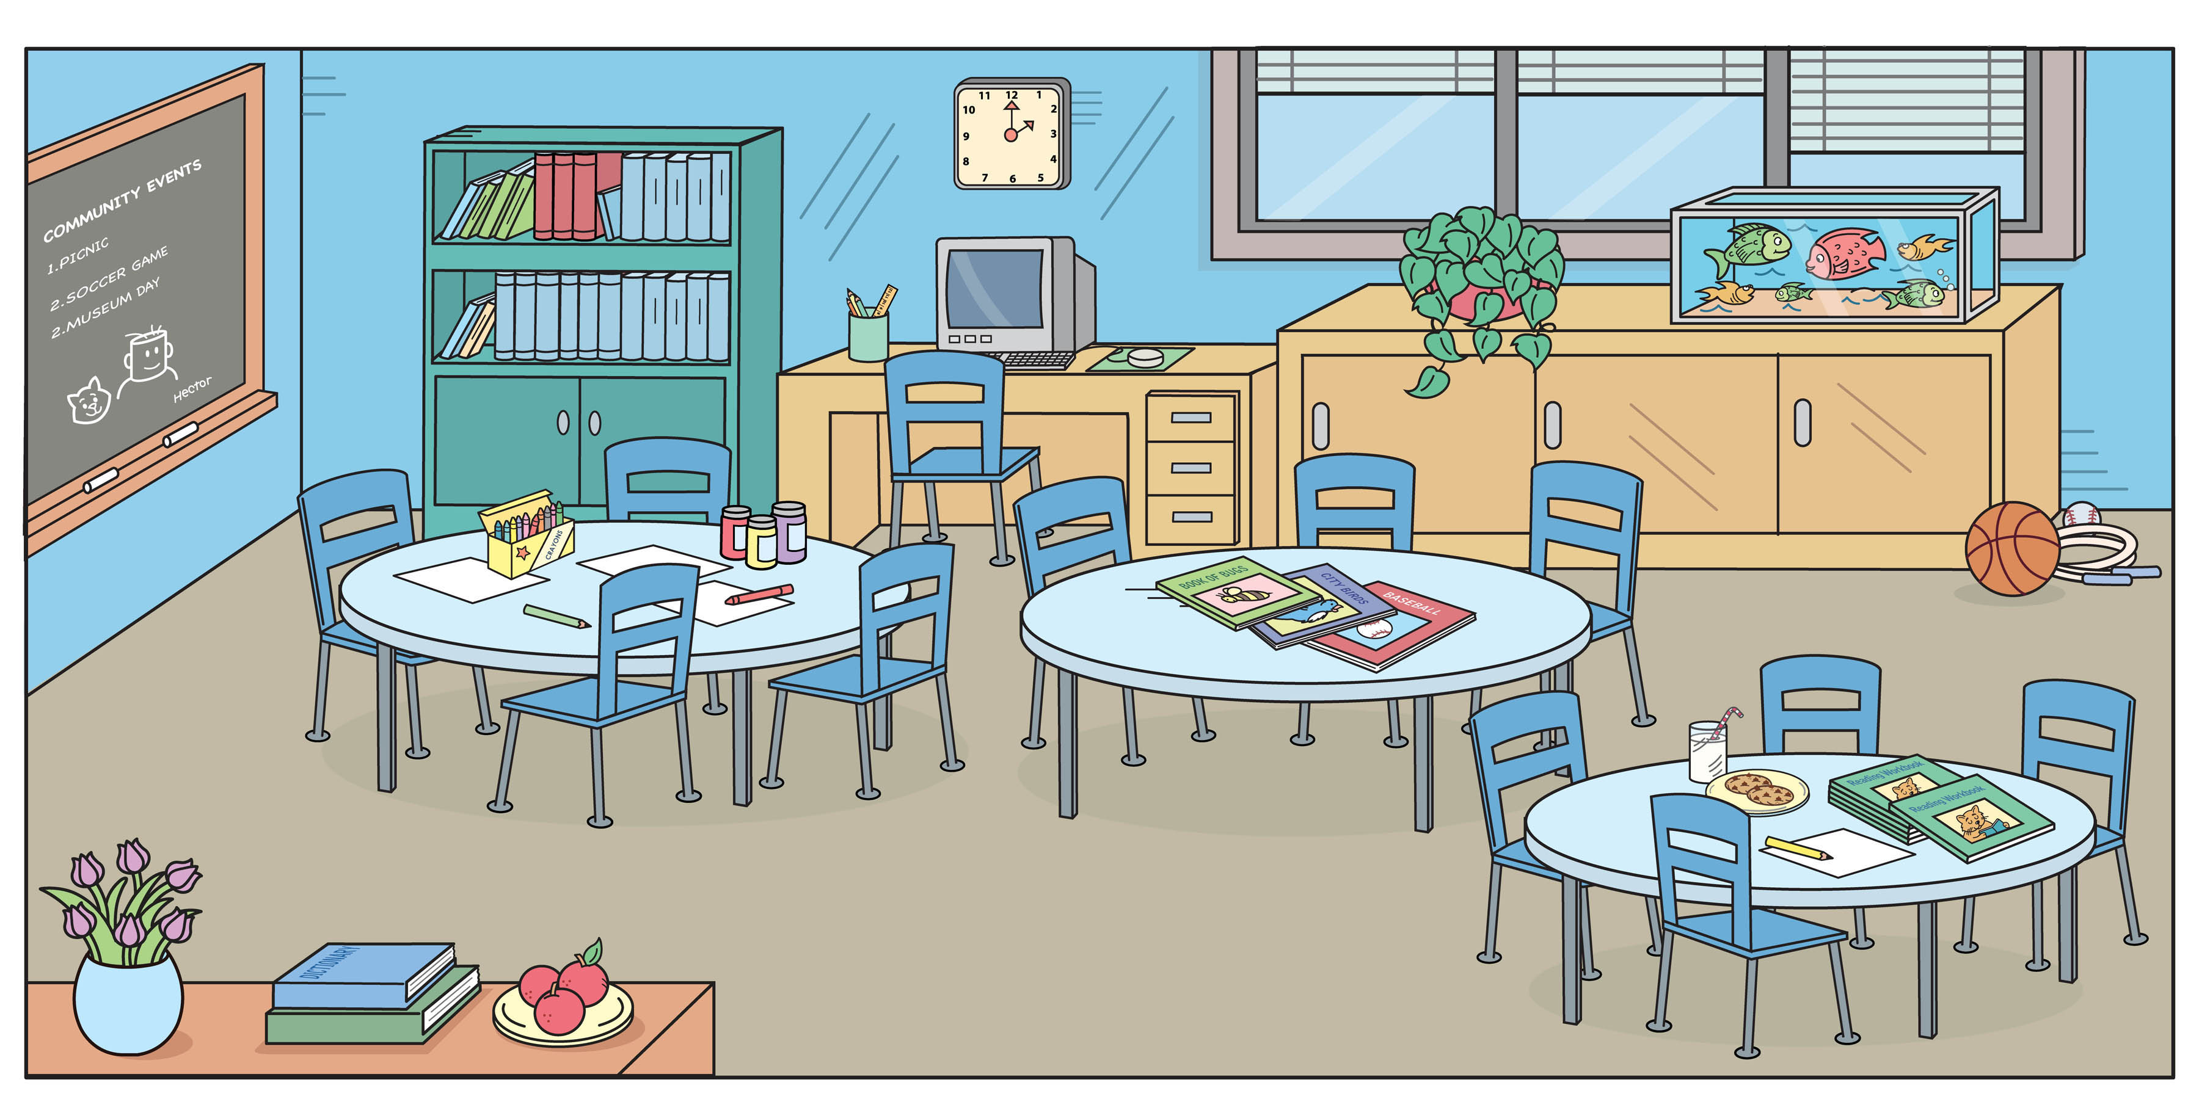
Player 1
Player 2

Slide 49
How to Play:
One student asks, “What’s this?” and points to an item.
The other student will answer, “It’s a ________.” (The first student can check if it is true.)
True = 1 point
False = 0 points
Then switch the roles.

Slide 50
Revealing Games
PPT

Slide 51
Pizza Artist
PPT

Slide 52
Choose a Song

