Slide 1
“He listened like a cactus drinks the rain.”
- Laini Taylor

Slide 2
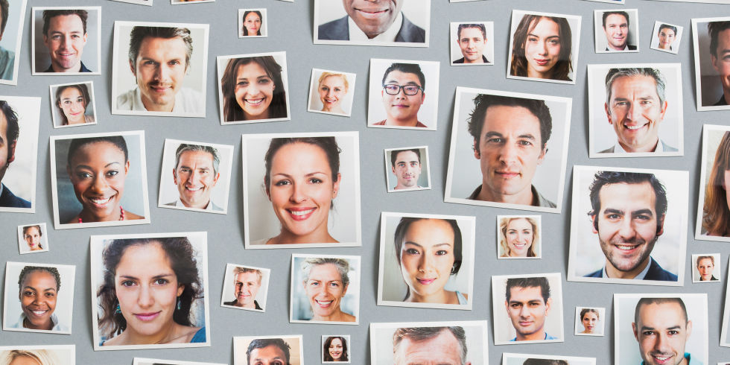
Face Blindness

Slide 3
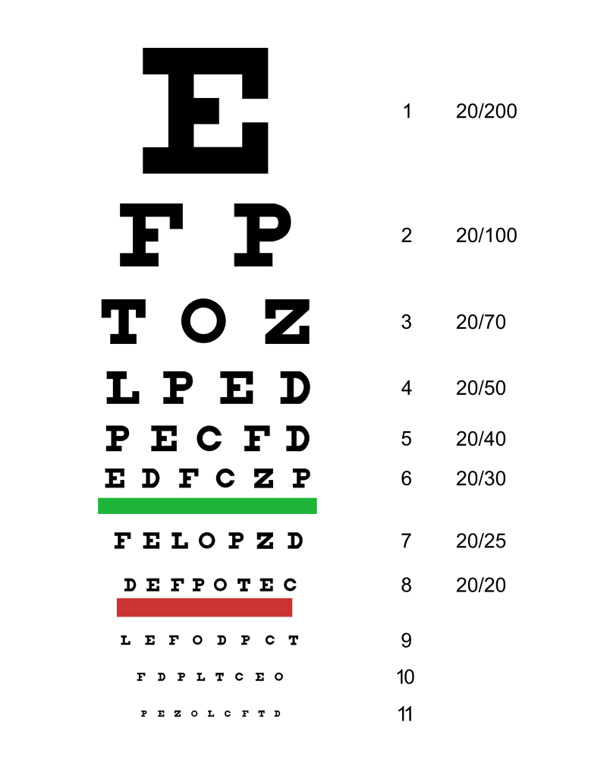
Eyesight

Slide 4
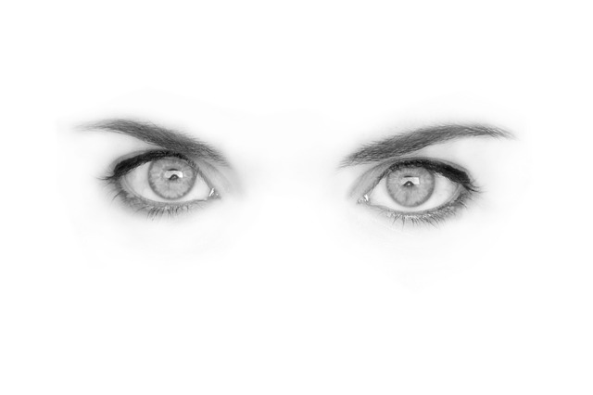
Eyesight
Perhaps 90% of the information we receive is from vision.
What would life be like without eyesight?

Slide 5
Blindness
36 million people are legally blind.
Other senses are increased.

Slide 6
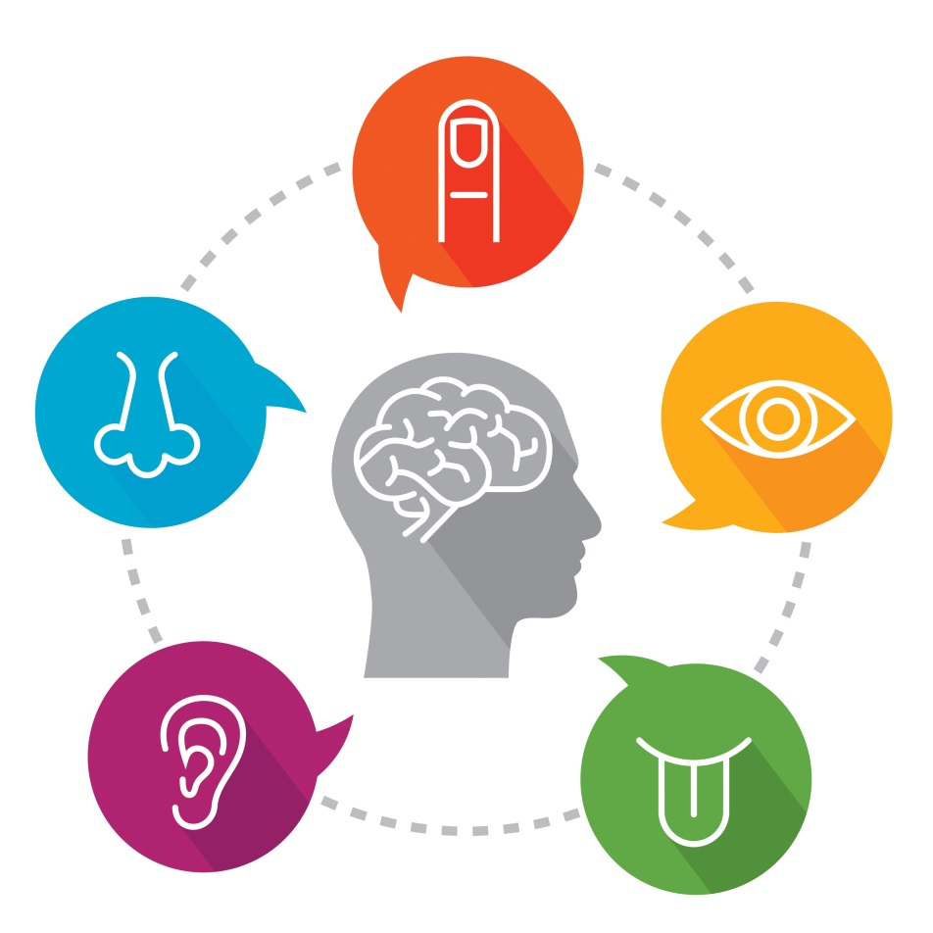
5 Main Senses:
Touch
Smell
Sight
Hearing
Taste

Slide 7
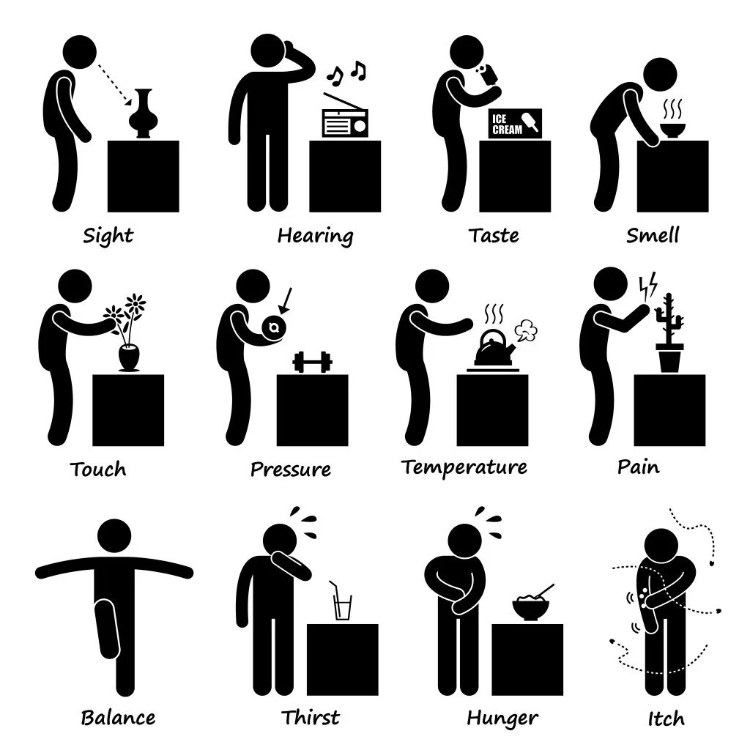
Other Senses

Slide 8
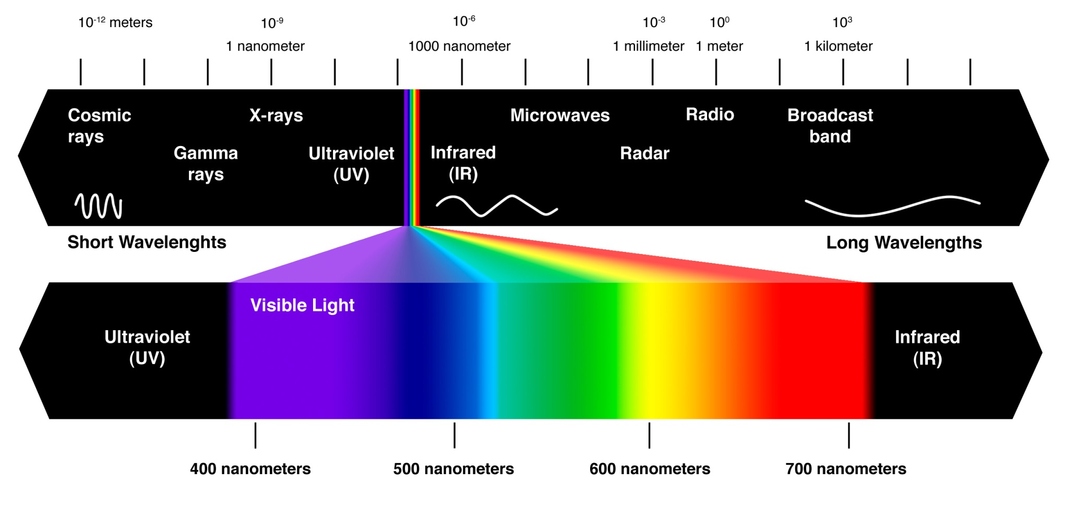
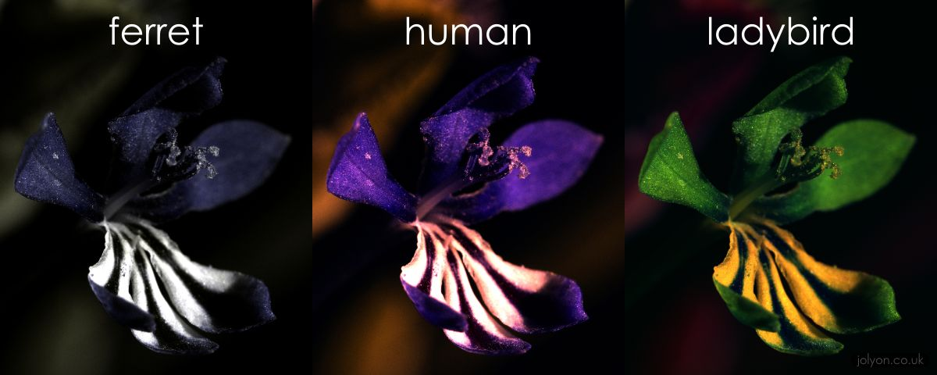
Ultraviolet / Infrared

Slide 9
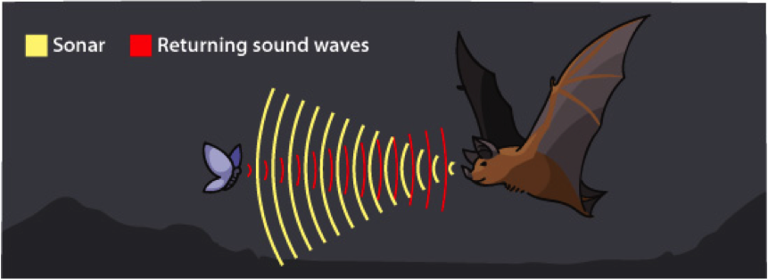
Echolocation
https://www.youtube.com/watch?v=A8lztr1tu4o (humans)

Slide 10
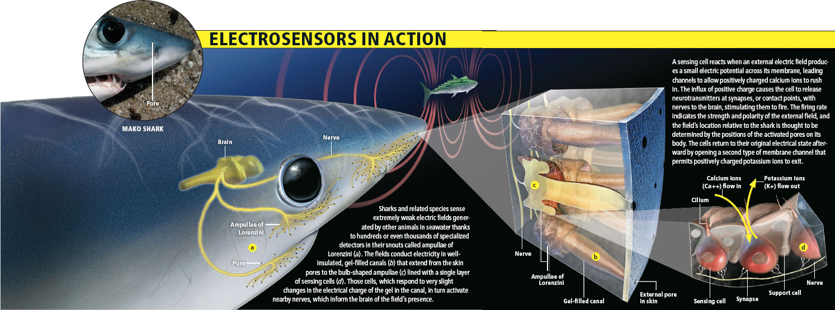
Electric Sense

Slide 11
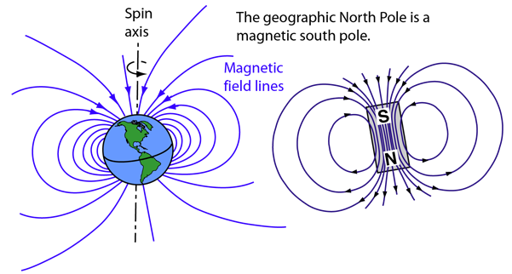
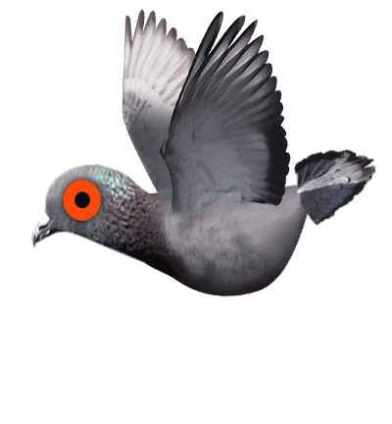
Magnetic Sense

Slide 12
Face blindness
Prosopagnosia, or face blindness is the inability to recognize familiar faces.
You may not be able to recognize your own face.

Slide 13
Face blindness
Face blindness makes it difficult for people to recognize the faces of others they have met before. In extreme cases, a person with face blindness may not even recognize family members. Furthermore, sufferers can’t easily imagine people’s appearance in their minds. Focusing on non-facial clues, such as hairstyles and voices, help them to recognize others. One problem often experienced by these people is the inability to distinguish one actor from another in movies, making it difficult to follow the plot. Face blindness often follows brain damage such as a stroke. Some cases, however, seem to be genetic.

Slide 14
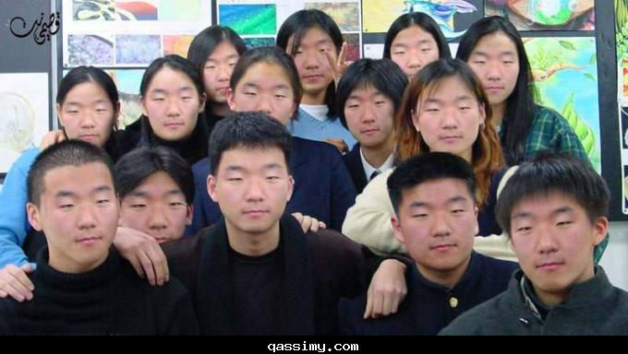
How does face blindness affect sufferers?
It is difficult to recognize faces of people they met before.

Slide 15
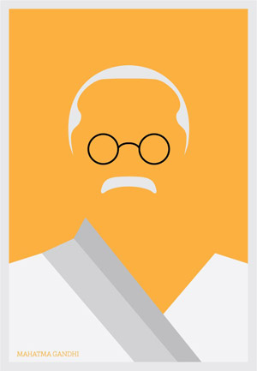
How can sufferers recognize people?
Hairstyles and voices

Slide 16
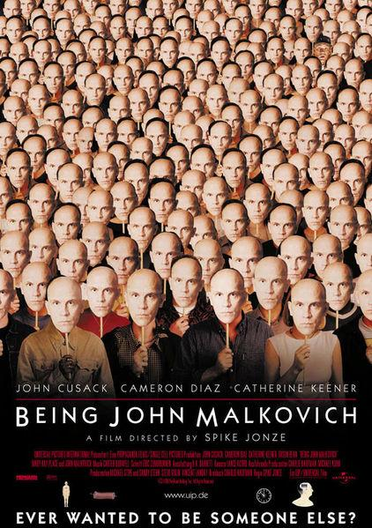
Why do sufferers have a difficult time following the plot of movies?
Can’t distinguish actors

Slide 17
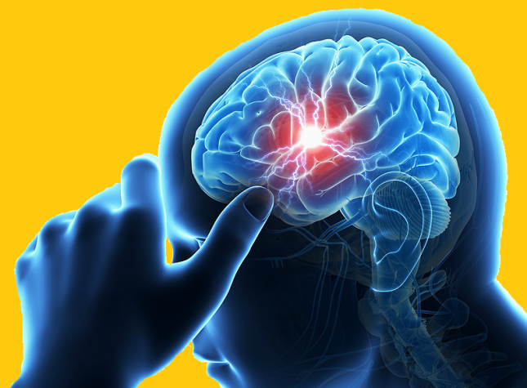
What is a common way to get face blindness?
Brain damage (stroke)

Slide 18
Can you spot the mistake?
Face blindness makes it difficult for people to recognize the faces of others they have met before. In extreme cases, a person with face blindness may not even recognize family members. Furthermore, sufferers can’t easily imagine people’s appearance in their minds. Focusing on non-facial clues, such as hairstyles and voices, help them to recognize others. One problem often experienced by these people is the inability to distinguish one actor from another in movies, making it difficult to follow the plot. Face blindness often follows brain damage such as a stroke. Some cases, however, seem to be genetic.

Slide 19
Can you spot the mistake?
Face blindness makes it difficult for people to recognize the faces of others they have met before. In extreme cases, a person with face blindness may not even recognize family members. Furthermore, sufferers can’t easily imagine people’s appearance in their minds. Focusing on non-facial clues, such as hairstyles and voices, help them to recognize others. One problem often experienced by these people is the inability to distinguish one actor from another in movies, making it difficult to follow the plot. Face blindness often follows brain damage such as a stroke. Some cases, however, seem to be genetic.
helps

Slide 20
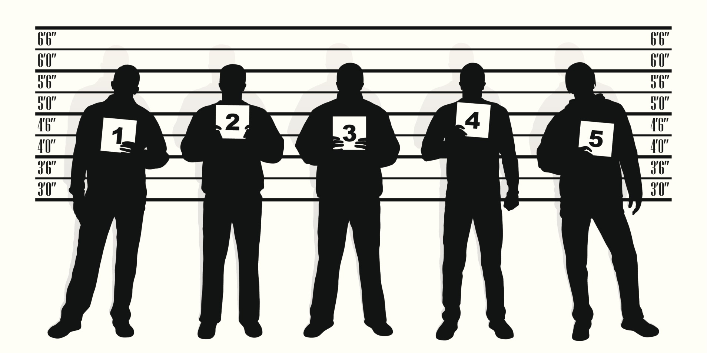
Police Lineup
https://www.youtube.com/watch?v=RWO2UQ4MW7U

Slide 22
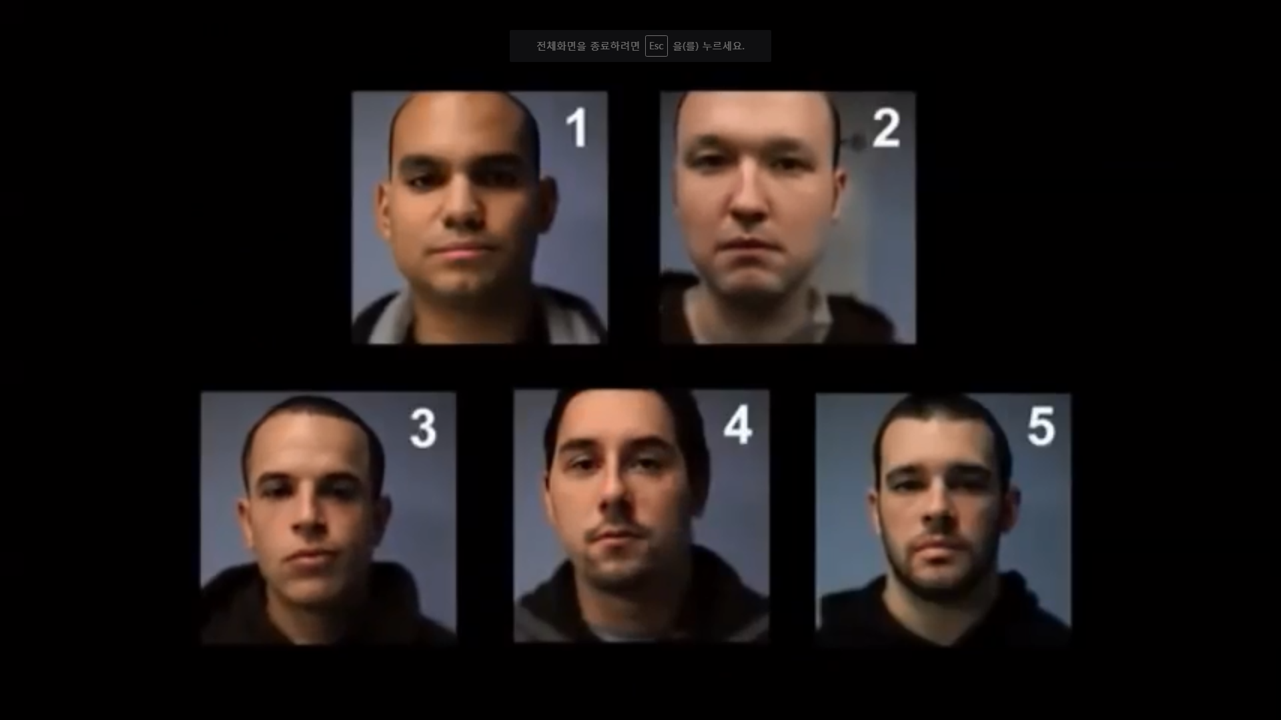

Slide 23
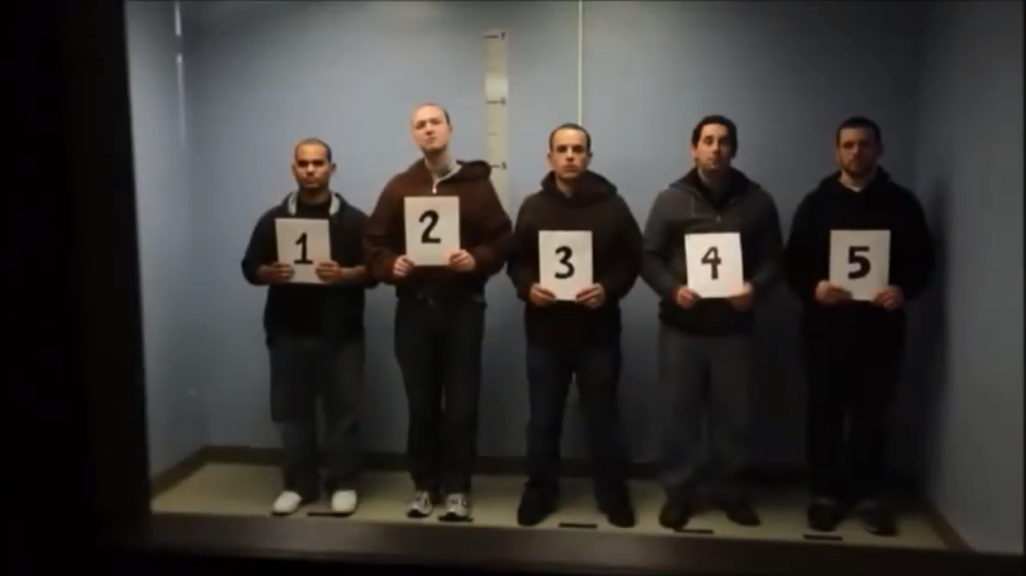
Who committed the crime?

Slide 24
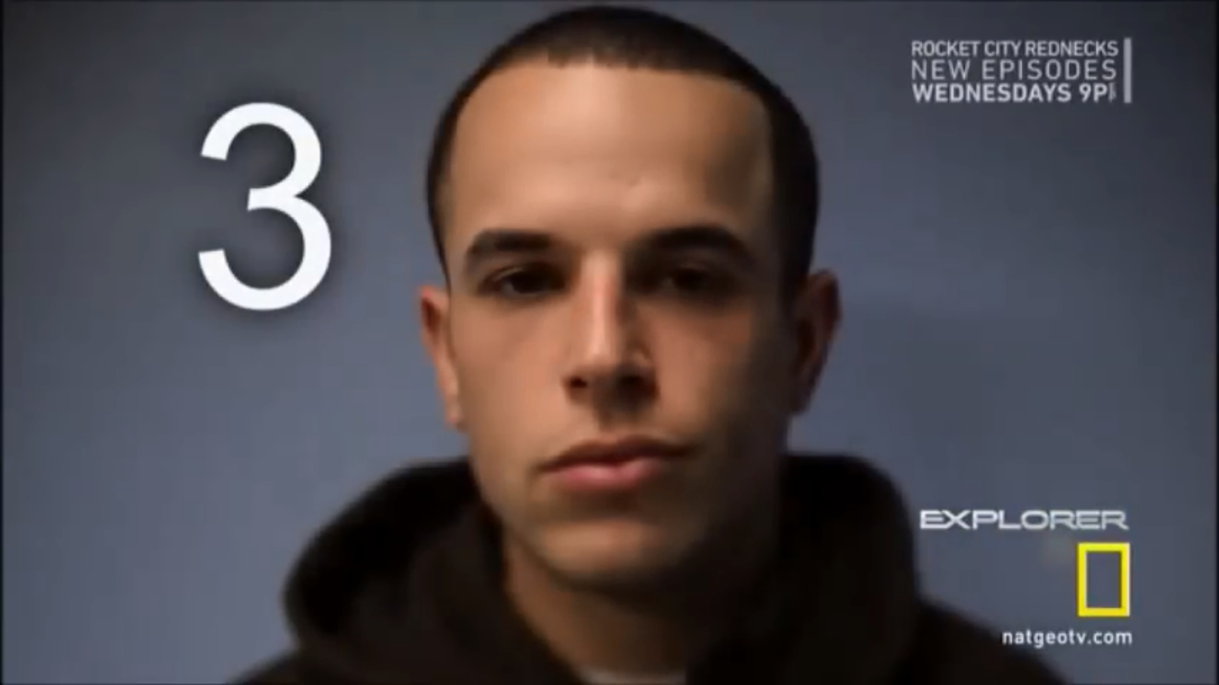
Reveal answer

Slide 25
Police Sketch Game
Describe the people.

Slide 26
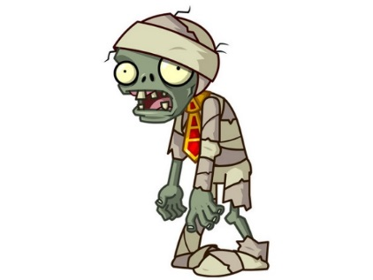
Rules:
Students work in pairs
One student will be the artist
Their back is to the TV
The other student is facing the TV and can see the picture.
For added complexity, allow students to see the picture for a limited time before describing the character. Click to the next screen, so they have to use their memory.
The artist must draw the what the other student describes

Slide 27
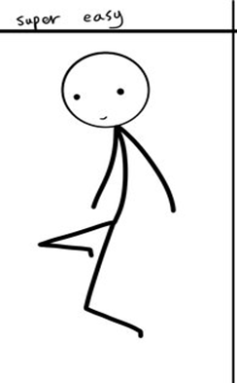
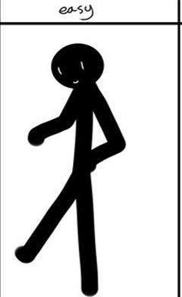
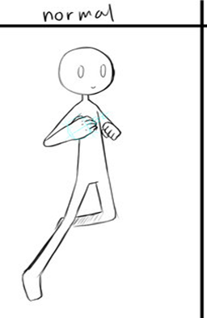
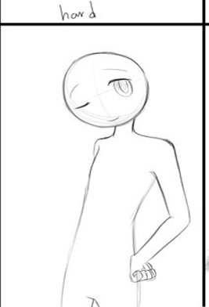
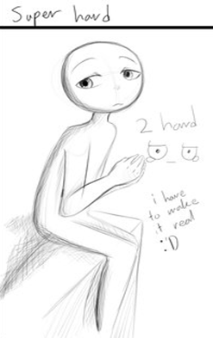
Choose a character:

Slide 28
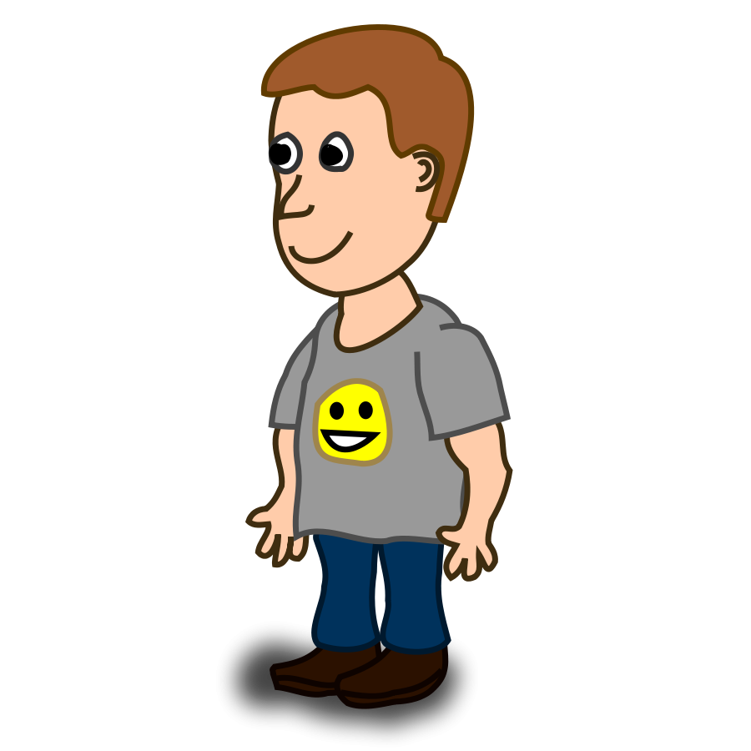

Slide 29
Draw!!!

Slide 30
Reveal Answer
Choose a new character

Slide 31
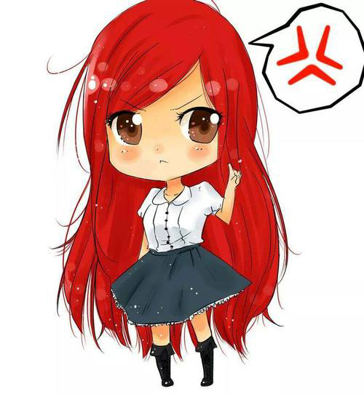

Slide 32
Draw!!!

Slide 33
Reveal Answer
Choose a new character

Slide 34
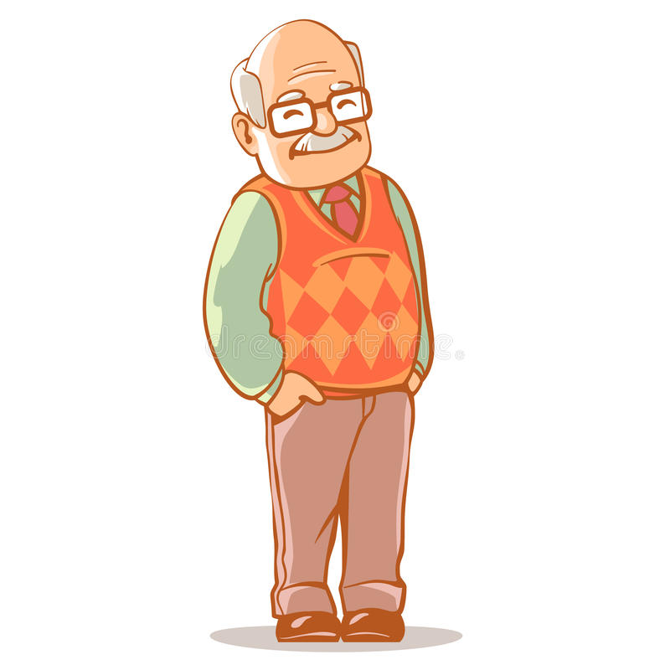

Slide 35
Draw!!!

Slide 36
Reveal Answer
Choose a new character

Slide 37
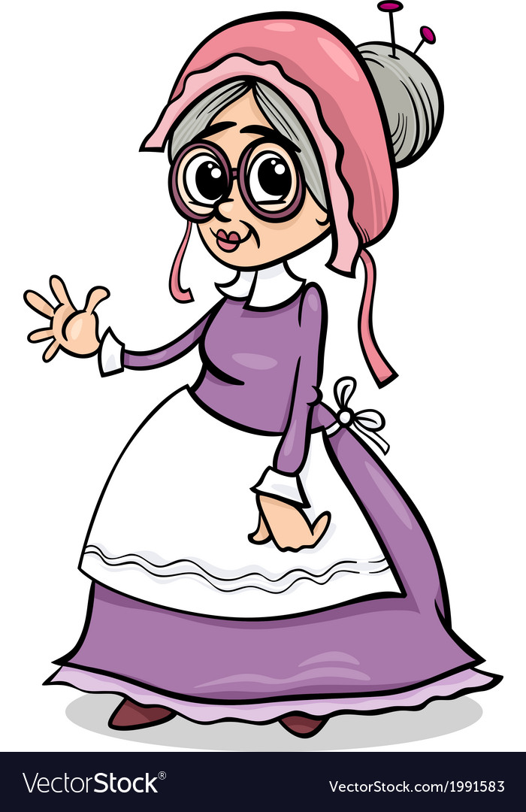

Slide 38
Draw!!!

Slide 39
Reveal Answer
Choose a new character

Slide 41
Draw!!!

Slide 42
Reveal Answer
Choose a new character

Slide 44
Draw!!!

Slide 45
Reveal Answer
Choose a new character

Slide 47
Draw!!!

Slide 48
Reveal Answer
Choose a new character

Slide 49
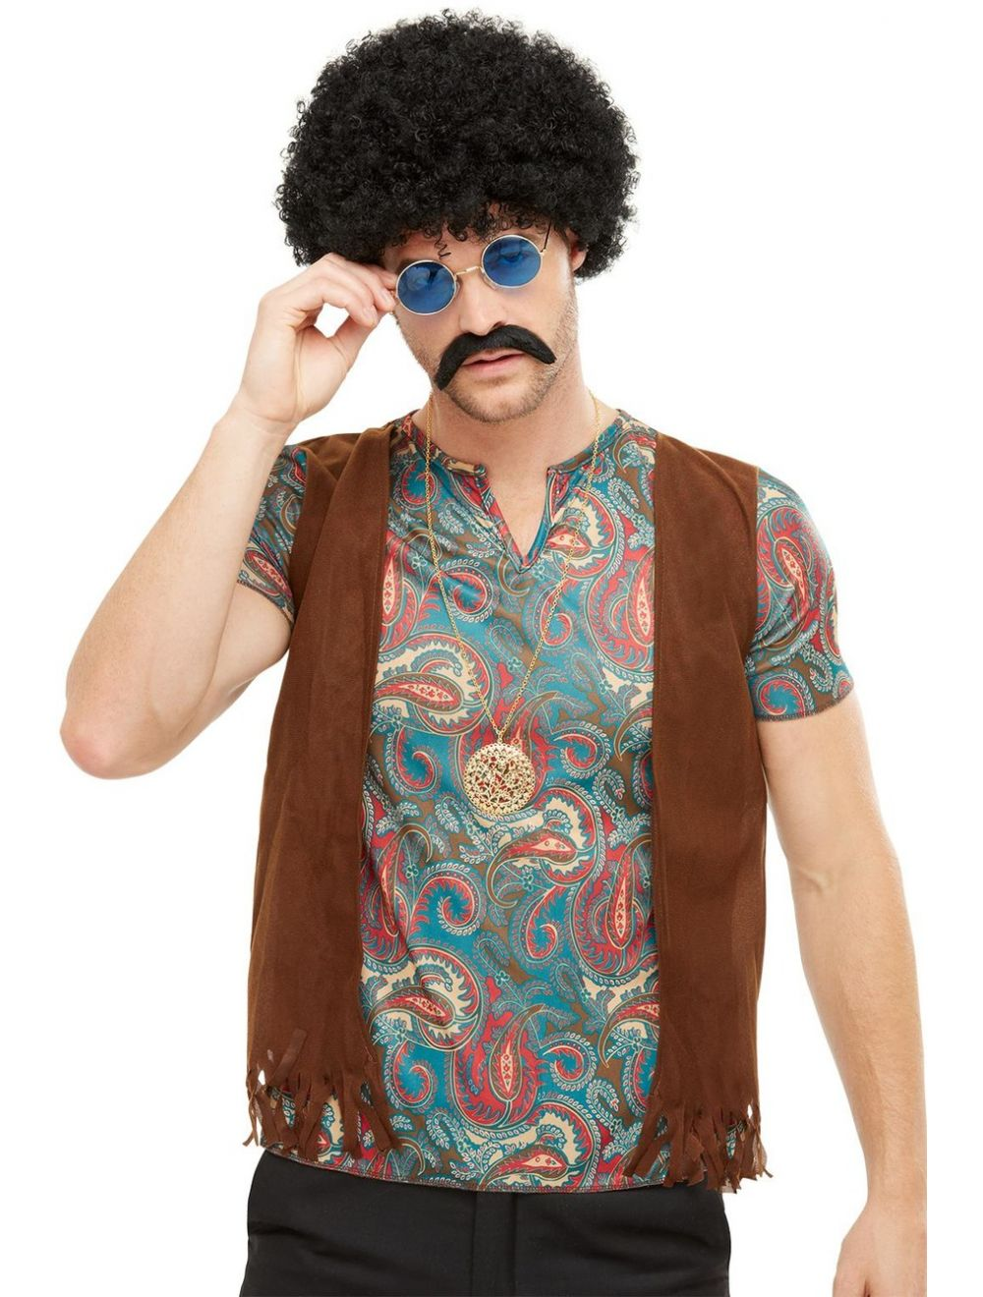

Slide 50
Draw!!!

Slide 51
Reveal Answer
Choose a new character

Slide 53
Draw!!!

Slide 54
Reveal Answer
Choose a new character

Slide 56
Draw!!!

Slide 57
Reveal Answer
Choose a new character

