Slide 1
“Be quiet and still; then listen, listen, listen.”
- Helen S. Rosenau

Slide 2
Eye Witness

Slide 3
https://www.youtube.com/watch?v=Ahg6qcgoay4

Slide 4
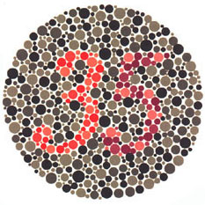
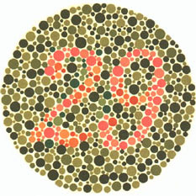

Slide 5
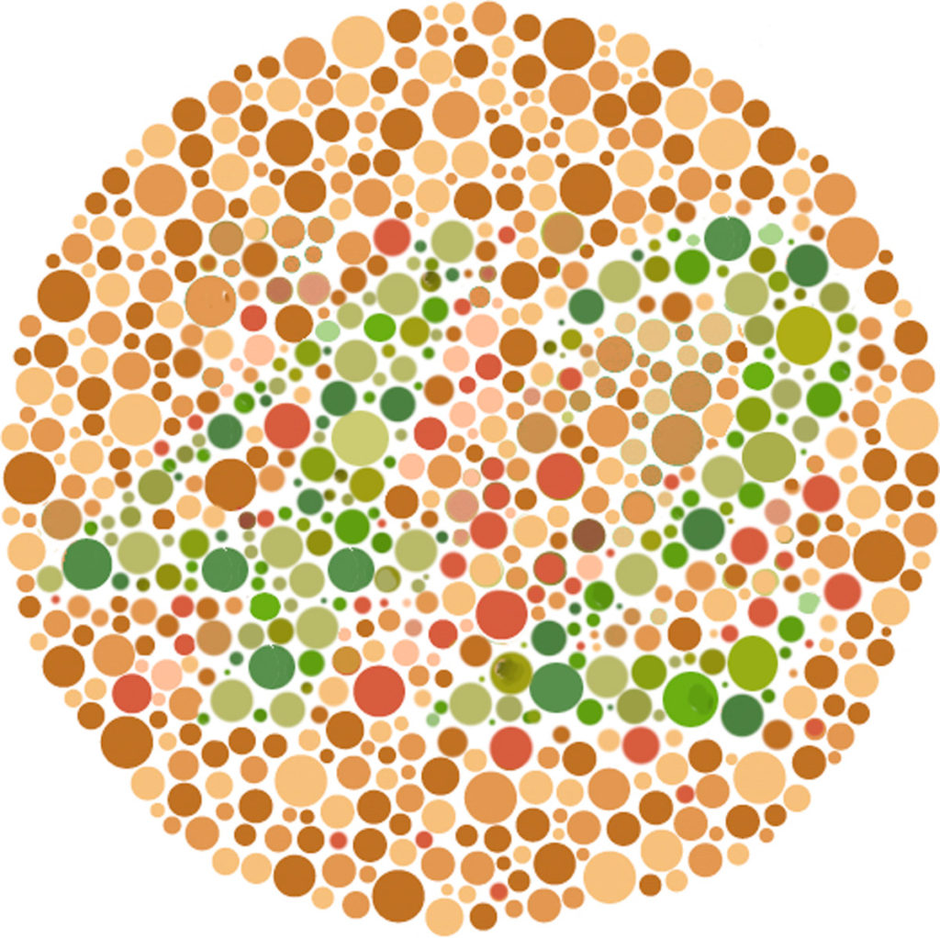

Slide 6
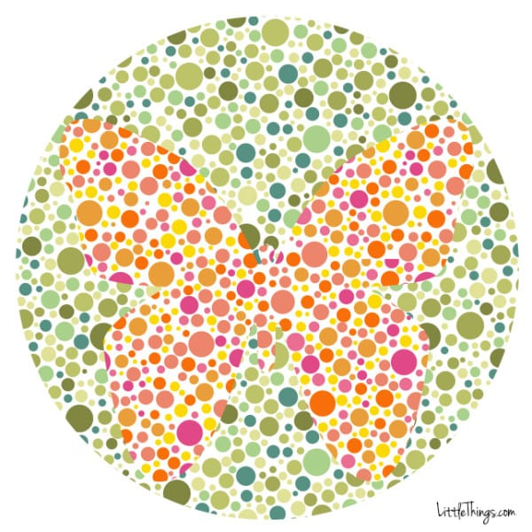
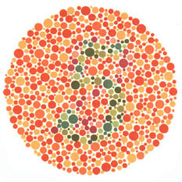

Slide 7
Color Blindness
The inability to see certain colors well.

Slide 8
Color Blindness Simulator
http://www.color-blindness.com/coblis-color-blindness-simulator/?fbclid=IwAR2_fv6TJgHa23c1kNBX3Bws9QmC9aRWl8togrKOSBaep0XrWYe_IKVakn8

Slide 9
Imagine a red star

Slide 10
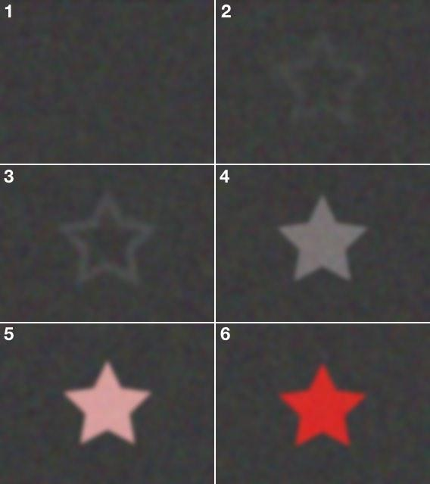

Slide 11
Aphantasia
The inability to picture an object in your head.
(mind’s eye / imagination)

Slide 12
