Slide 1
“Your secrets are safe with me.
I wasn’t listening anyways.”
- Anonymous

Slide 2
LISTENING
BETTER

Slide 3
Listen to…
5 Ways to Listen Better:
Use a highlighter:
Yellow = something I don’t understand
Blue = something important
https://www.youtube.com/watch?v=cSohjlYQI2A&t=30s

Slide 4
Blue Highlighter
How many?
https://www.youtube.com/watch?v=cSohjlYQI2A&t=30s

Slide 5
Yellow Highlighter
How many?
https://www.youtube.com/watch?v=cSohjlYQI2A&t=30s

Slide 6
5 Listening
Exercises
https://www.youtube.com/watch?v=cSohjlYQI2A&t=30s

Slide 7
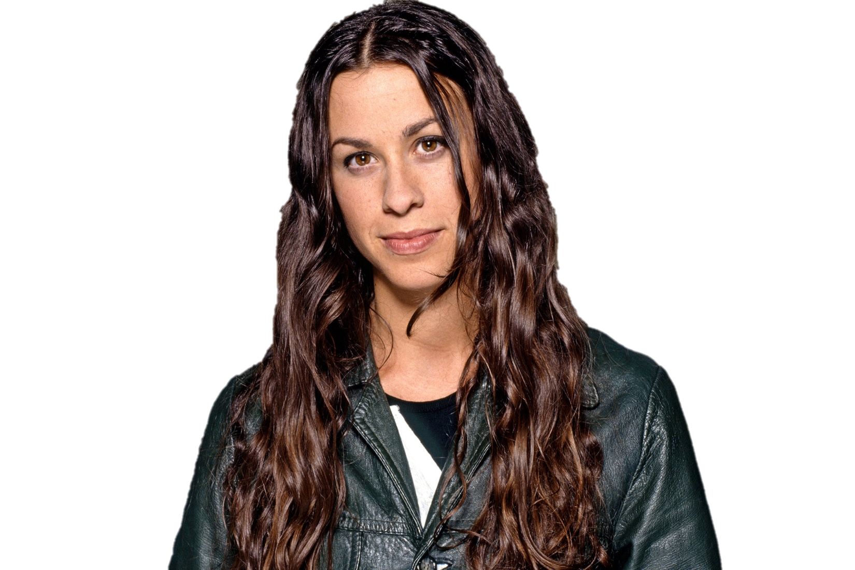
Silence
3 minutes each day
Why are you so petrified of silence?
Here, can you handle this?
…
Did you think about your bills, your ex, your deadlines of when you think you’re gonna die? Or did you long for the next distraction?

Slide 8
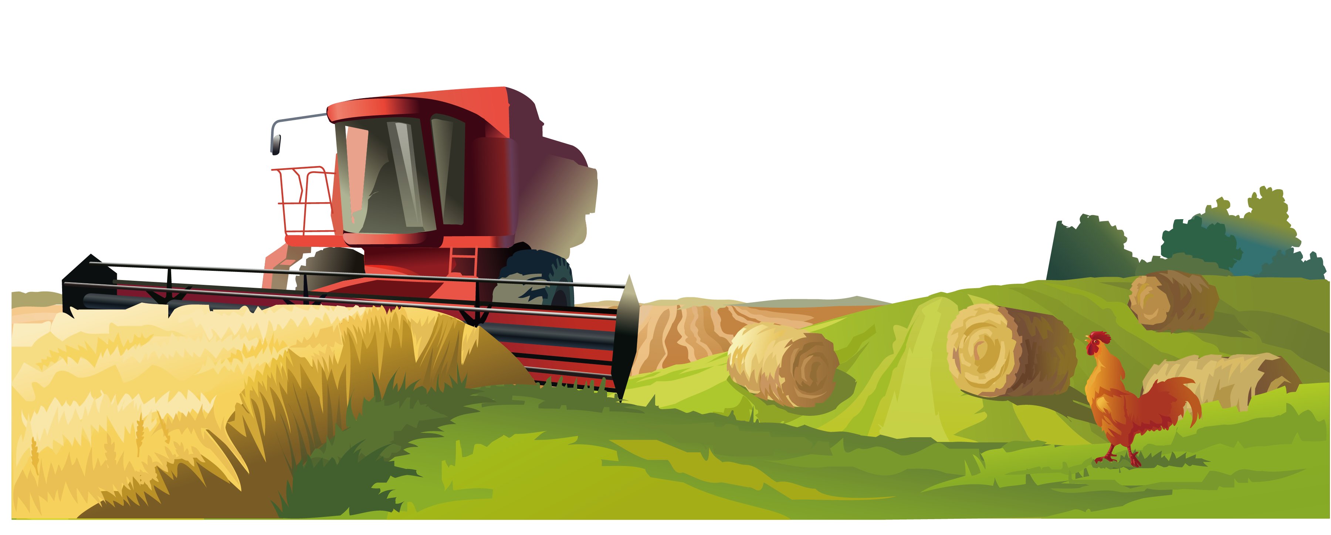
The Mixer
How many different channels can you hear?

Slide 9
Savoring
Enjoy the mundane sounds.

Slide 10
Listening Positions
Sounds have different meanings for each person
Your values, attitudes, and beliefs
Critical Listening
Active Listening
Passive Listening

Slide 11
RASA
Sanskrit word for “Juice” or “Essence”
Receive – pay attention
Appreciate – making small noises (hmm, ok)
Summarize – “so…”
Ask – after they finish talking

Slide 12
Losing our listening
Listening is making meaning from sounds (process of extraction)
Techniques
Pattern recognition
Filters
In time and space (sonority)
Lose listening because:
Recording
Noisy world
Headphones
Impatient
Simple Exercises:
Silence
The mixer
Savoring
Listening position
RASA – receive / appreciate / summarize / ask
Teach listening in schools
Key Points

Slide 13
Key Points
You can understand without knowing the details.
If students don’t understand the key points, they wont understand the message.
Summarize the main idea in one sentence.

Slide 14
Key Points
Topic
What is being said about this person or thing (topic).
Repeated information

Slide 15
The Main Idea
Identify the main point of the news story.

Slide 19
The Key Points
What are their main points?

