Slide 1
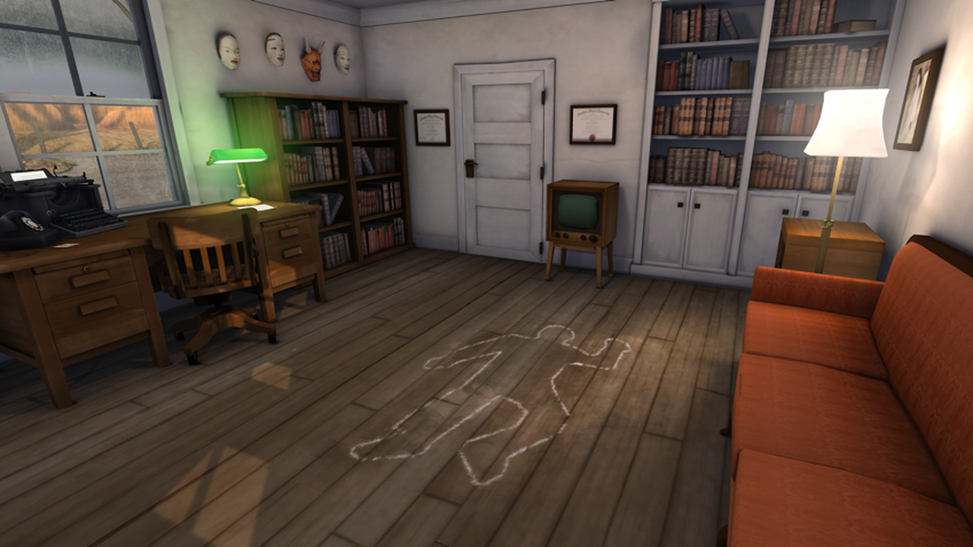
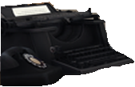
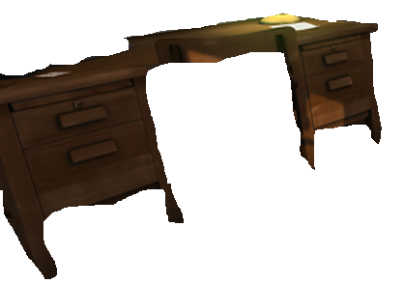
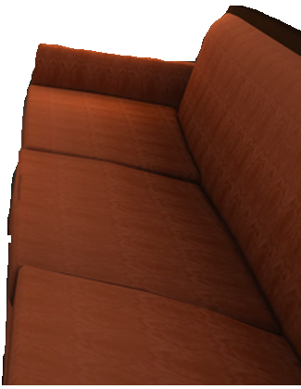
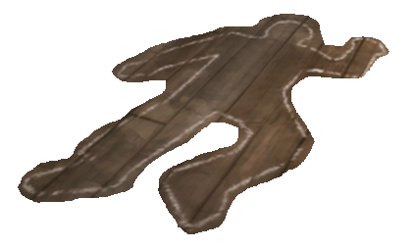
Police Lineup

Slide 2
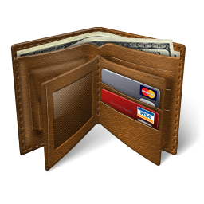
Body Outline
There is DNA from the victim and the suspect
The victim has fingers.
DNA
There are fibers from a red scarf.
Fingerprints
The victim was stabbed.
There was a lot of blood.
The victim’s name is Josh.
He is wearing blue jeans, a red shirt and a black hat.
Fibers
Examine

Slide 3
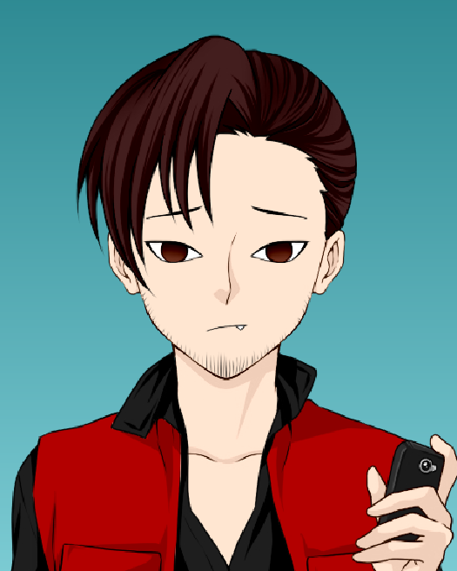
There is a picture of the victim:
There is some money.
There are no fingerprints.
Look inside:
(click 3 times)

Slide 4
Painting
There is no DNA on the painting.
There are fingerprints from the victim.
DNA
Fingerprints
There are no fibers.
Fibers
Examine
It looks like a gift.
There is nothing special about this painting.

Slide 5
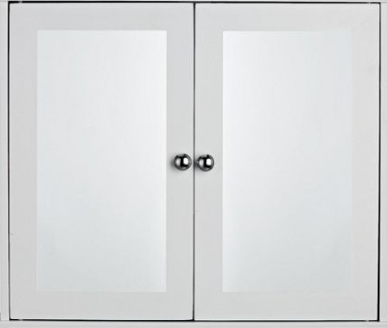
Drawers
There is no DNA on the doors.
There are fingerprints from the suspect.
DNA
Fingerprints
There are no fibers.
Fibers
Examine
It looks like someone was looking for something.

Slide 6
The DNA belongs to the victim.
Lamp
There are fingerprints from the victim.
DNA
Fingerprints
There are no fibers.
Fibers
Examine
The light turns on and off.

Slide 7
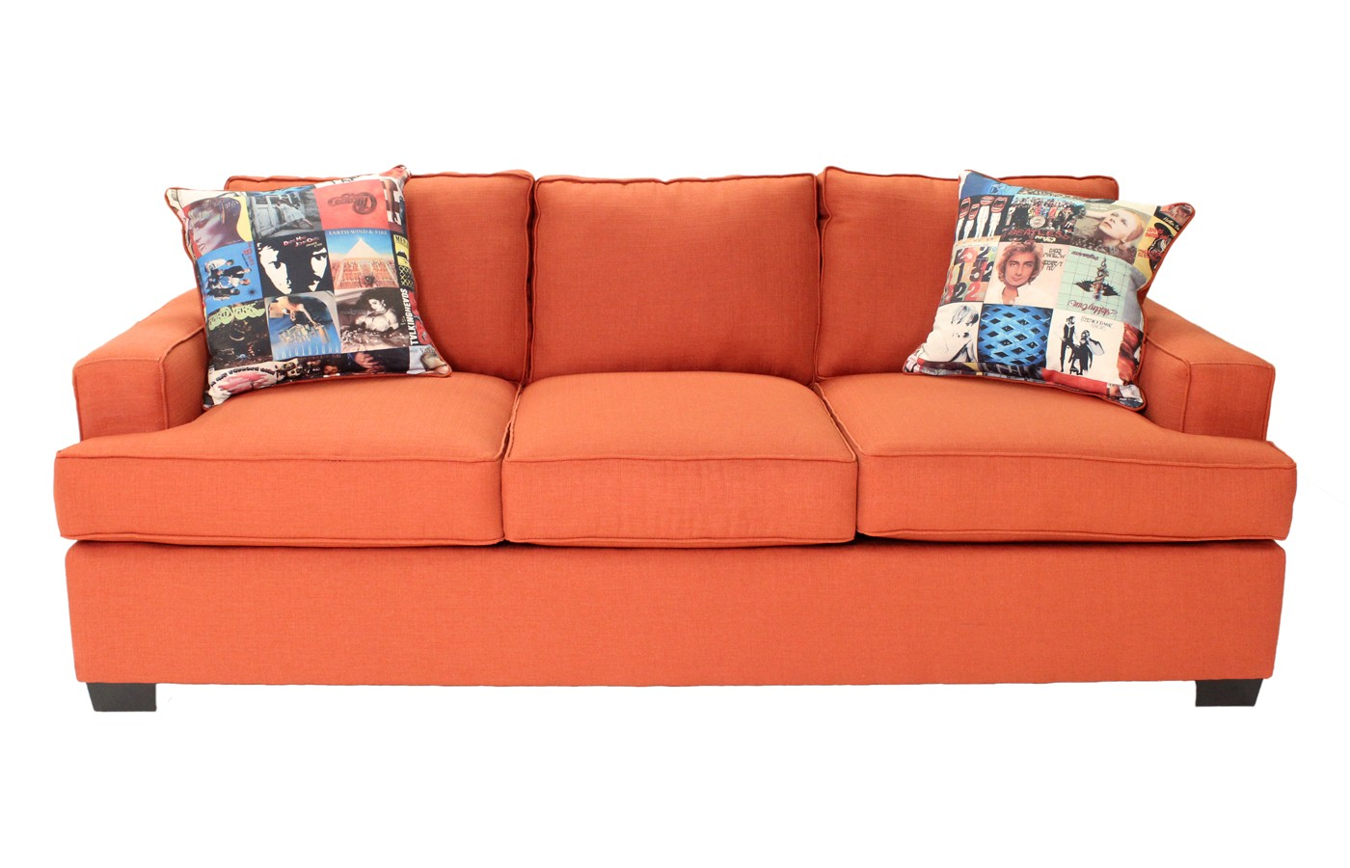
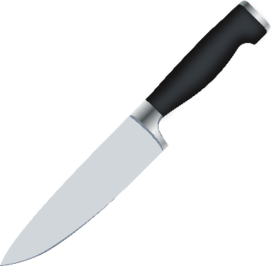
There is DNA from the Victim and the suspect.
You find some blonde hair.
Sofa
There are fingerprints from the victim.
DNA
Fingerprints
There are fibers from a black shirt.
Fibers
Examine
You found some money and a knife under the cushions.

Slide 8
There are fingerprints and DNA from the suspect.
DNA and fingerprints
Examine
The name, “Molly” is written on the handle.

Slide 9
There is no DNA on the books.
Bookshelf 2
There are fingerprints from the victim.
DNA
Fingerprints
There are no fibers.
Fibers
Examine
The are books about sports and there is a lot of money.

Slide 10
There is no DNA on the books.
Bookshelf 3
There are fingerprints from the suspect.
DNA
Fingerprints
There are no fibers.
Fibers
Examine
There are books about betting.

Slide 11
There is no DNA on the books.
Bookshelf 4
There are fingerprints from the victim and the suspect.
DNA
Fingerprints
There are no fibers.
Fibers
Examine
There is a bank book.
The victim was very poor.

Slide 12
There is no DNA on the books.
Bookshelf 5
There are fingerprints from the suspect.
DNA
Fingerprints
There are fibers from a red scarf.
Fibers
Examine
There is a book missing.

Slide 13
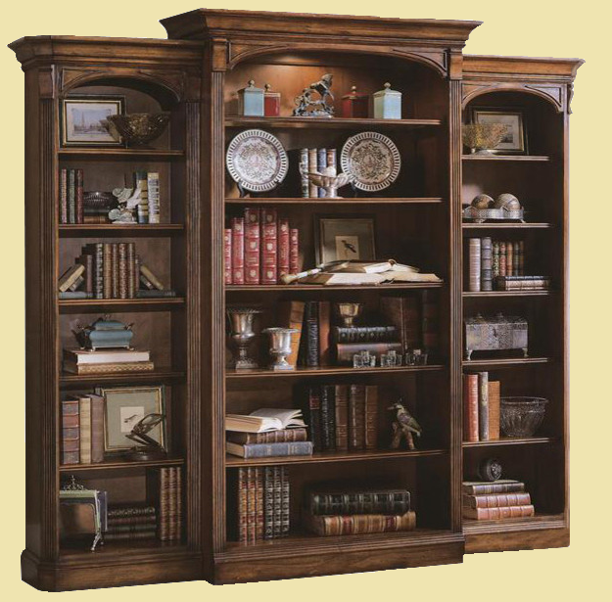
There is DNA from the suspect.
Bookshelf 1
There are fingerprints from the suspect.
DNA
Fingerprints
There are fibers from a black shirt.
Fibers
Examine
There are a lot of books.
You also find a letter:

Slide 14
You broke my heart.
Now I am going to kill you.
From,
Molly

Slide 15
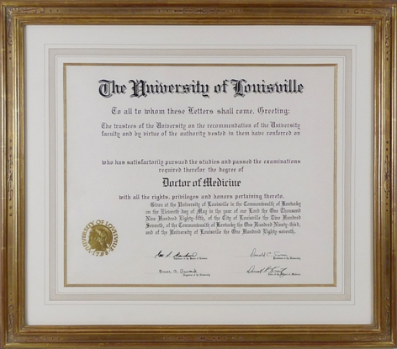
Diploma
There is no DNA on the diploma.
There are fingerprints from the victim.
DNA
Fingerprints
There are no fibers.
Fibers
Examine
The diploma says the victim finished university.
The victim studied math.

Slide 16
Certificate
There is no DNA on the certificate.
There are no fingerprints.
DNA
Fingerprints
There are no fibers.
Fibers
Examine
It is a certificate for winning a math contest.
Behind the certificate, you find a lot of money.

Slide 17
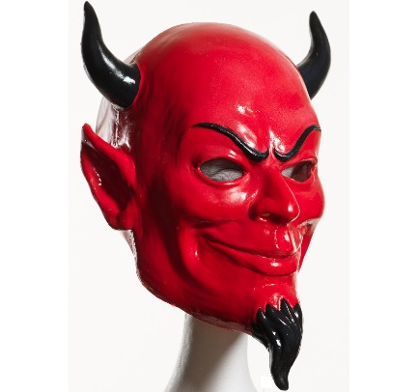
Masks
There is no DNA on the masks.
You find some blonde hair
There are fingerprints from the victim.
DNA
Fingerprints
There are no fibers.
Fibers
Examine
The devil mask looks new:

Slide 18
Devil Mask
There is no DNA on the mask.
There are fingerprints from the suspect.
DNA
Fingerprints
There are no fibers.
Fibers
Examine
On the back of the mask, it says, “I love you more than your wife”

Slide 19
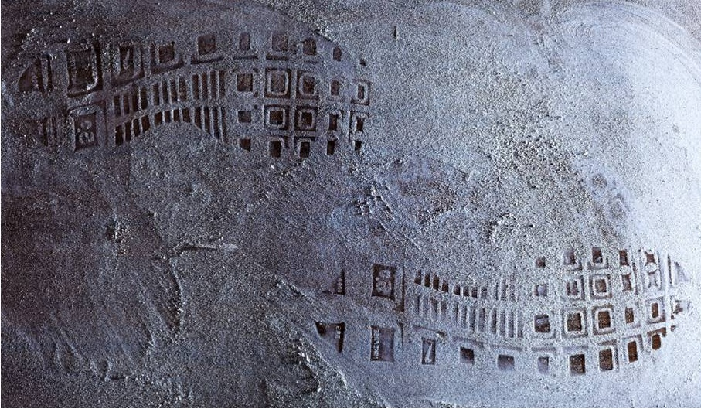
Footprints
There is DNA from the victim and the suspect.
There are no fingerprints.
DNA
Fingerprints
There are fibers from a black shirt.
Fibers
Examine
The footprints are from high heels.

Slide 20
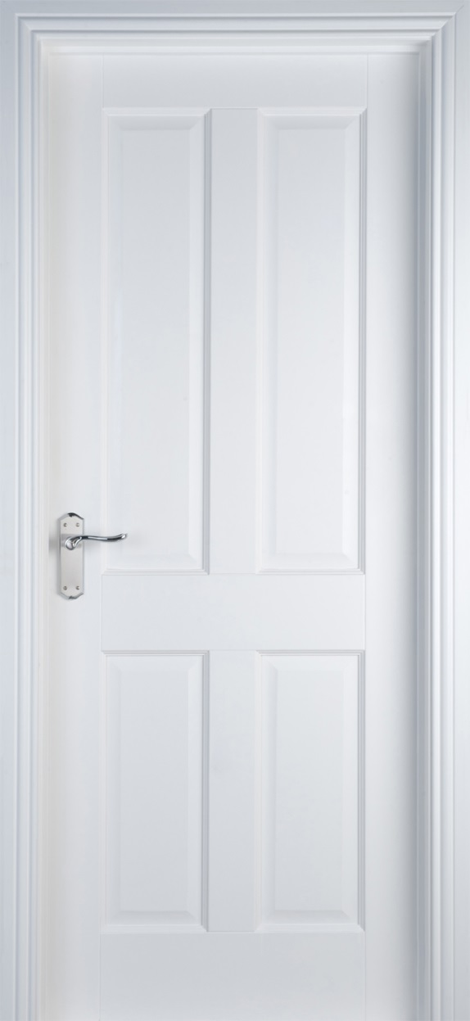
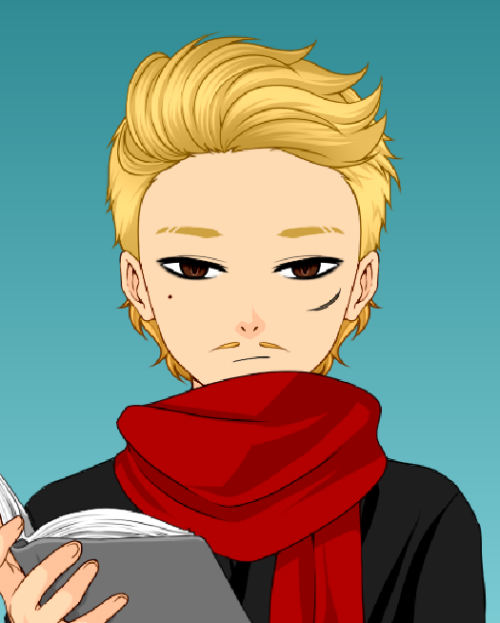
Door
Talk to the Witness: *Ask Mr. S questions*
He knows about the characters

Slide 21
TV
There is DNA from the suspect.
There are no fingerprints.
DNA
Fingerprints
There are no fibers.
Fibers
Examine
It is just a TV.
There is nothing special about this TV.

Slide 22
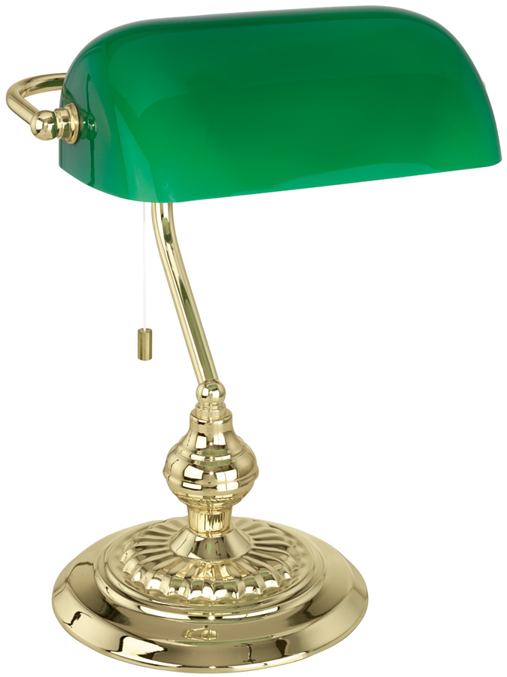
There is no DNA on the desk.
Desk Lamp and Note
There are fingerprints from the victim and suspect.
DNA
There are fibers from a red scarf.
Fingerprints
On the desk, you find a note.
Fibers
Examine

Slide 23
I never want to see you again.
I hate you.
From,
Sarah

Slide 24
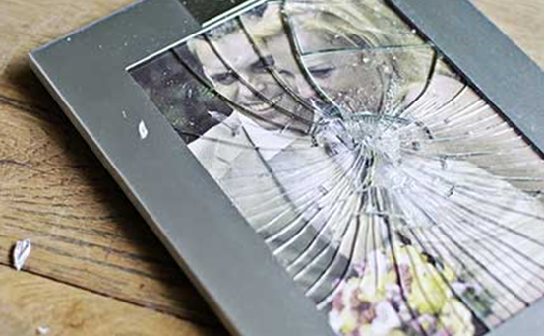
There is no DNA on the desk.
Desk
There are fingerprints from the victim and the suspect.
DNA
Fingerprints
There black fibers from a shirt.
Fibers
Examine
On the desk, there is a broken picture.

Slide 25
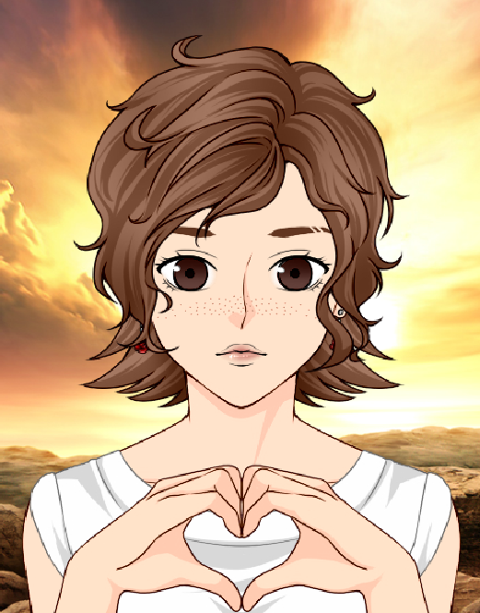
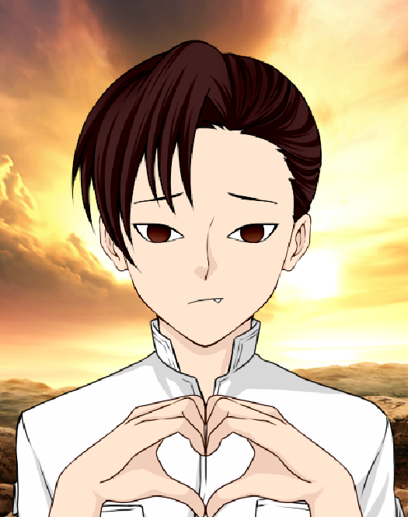
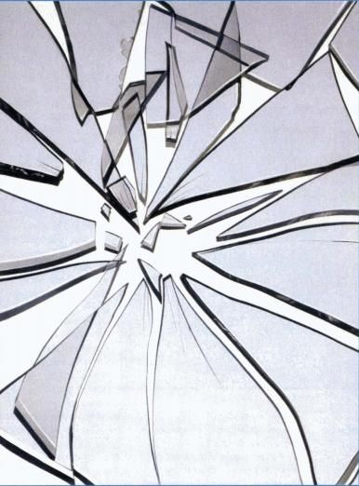
Josh and Molly Forever

Slide 26
There is no DNA on the wine.
Wine
There are fingerprints from the victim.
DNA
Fingerprints
There are no fibers.
Fibers
Examine
Someone drank a lot of wine last night.

Slide 27
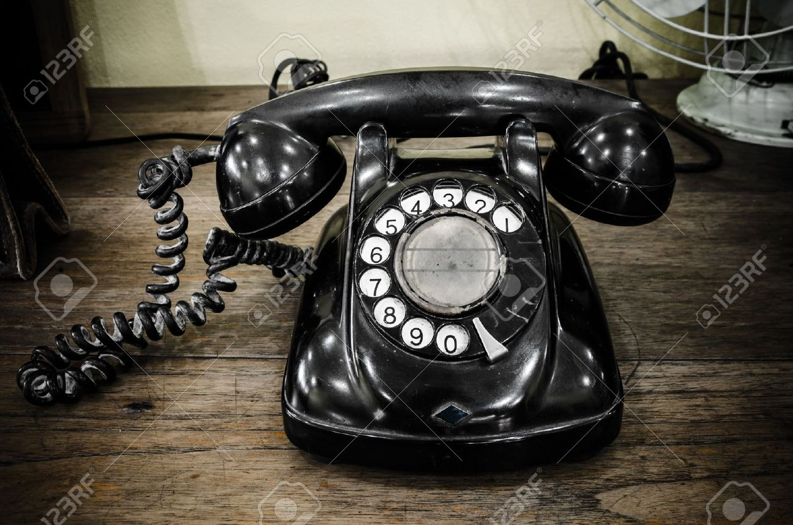
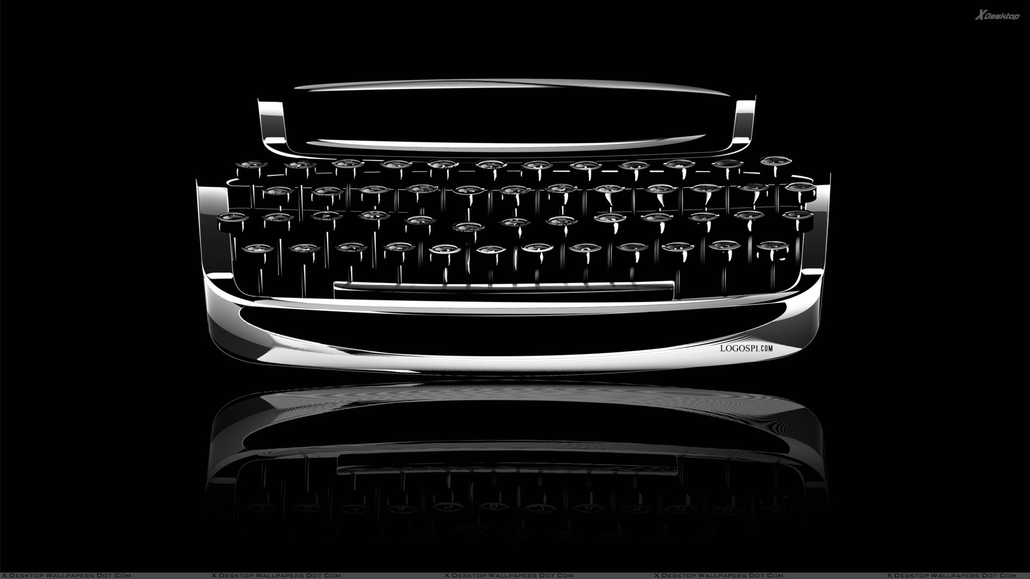
There is DNA from the victim on the phone.
You also find some blonde hair.
Typewriter and Phone
There are fingerprints on the typewriter are from the suspect.
DNA
Fingerprints
There are no fibers.
Fibers
Examine
It looks like the victim tried to call police.
It also looks like someone typed a note.

Slide 28
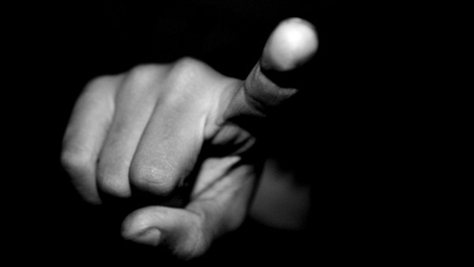
Oh no!
You are WRONG!
The DNA and fingerprints don’t match this suspect.
Try Again?

Slide 29
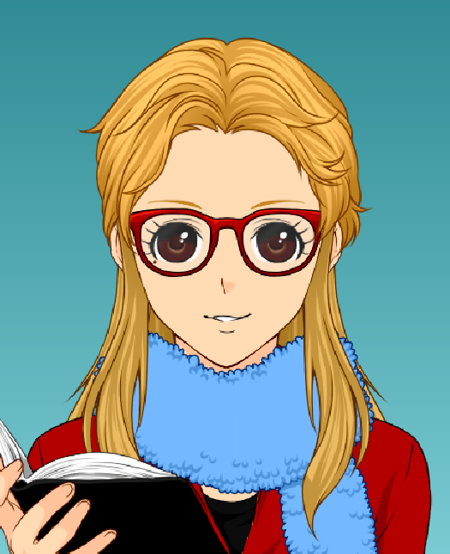
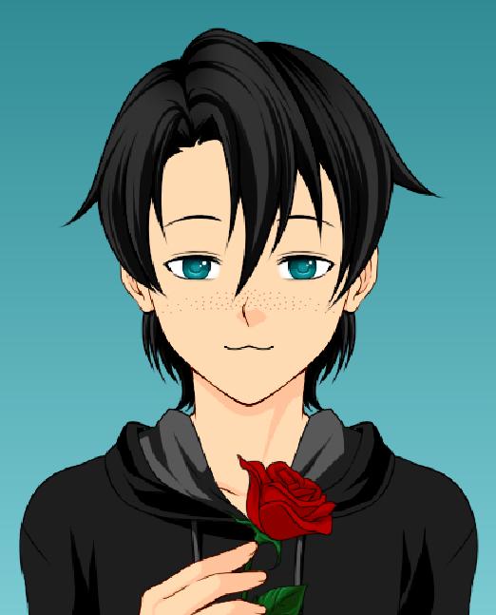
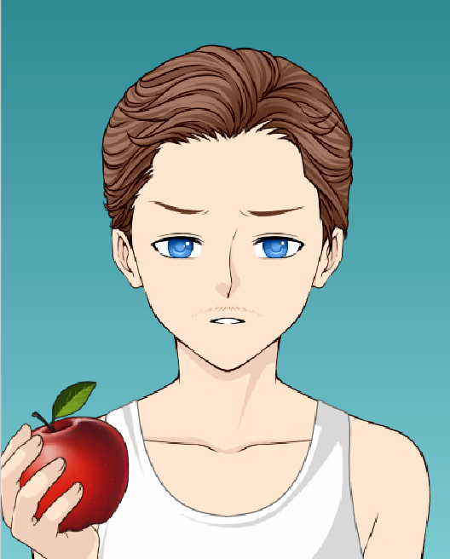
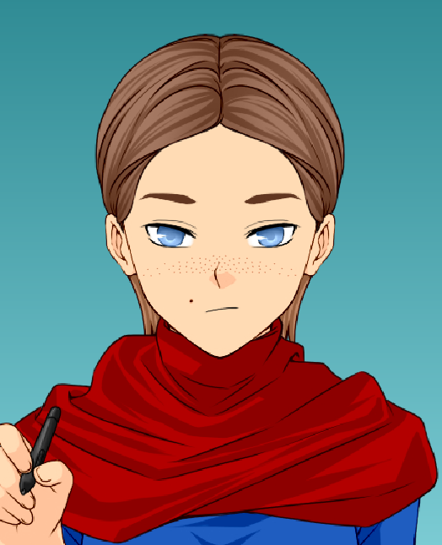
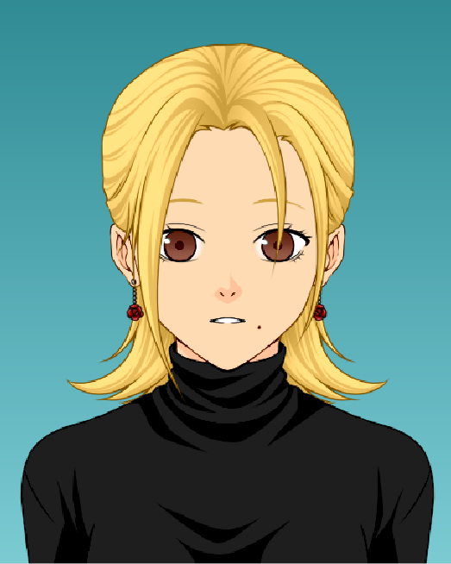
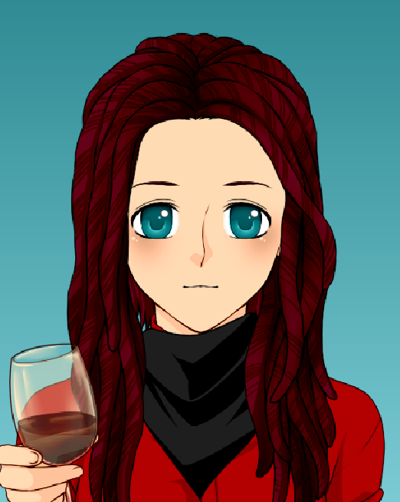
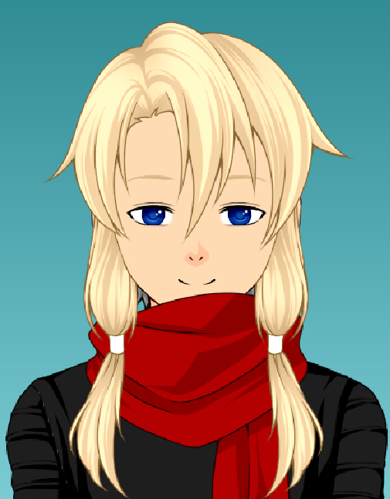
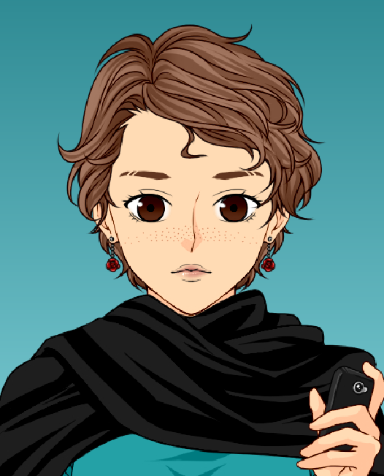
Who did it?

Slide 30
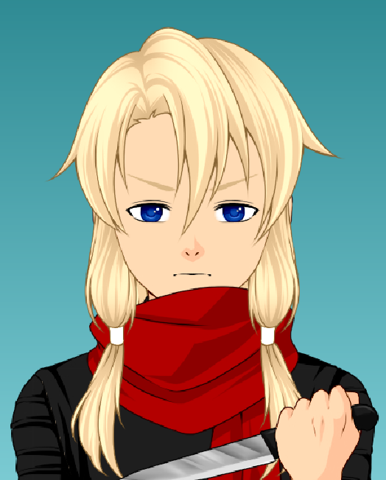
You figured it out!!
It was Molly, the victim’s girlfriend. She was angry that the victim was going to make up with his wife. She said she would rather kill him than lose him.
The suspect had blonde hair, a red scarf, and a black shirt.
The DNA and fingerprints match Molly.
GOOD JOB!

