Slide 1
“Part of being successful is about asking questions and listening to the answers.”
- Anne Burrell

Slide 2
Detective Games

Slide 3
Vacation Liar

Slide 4
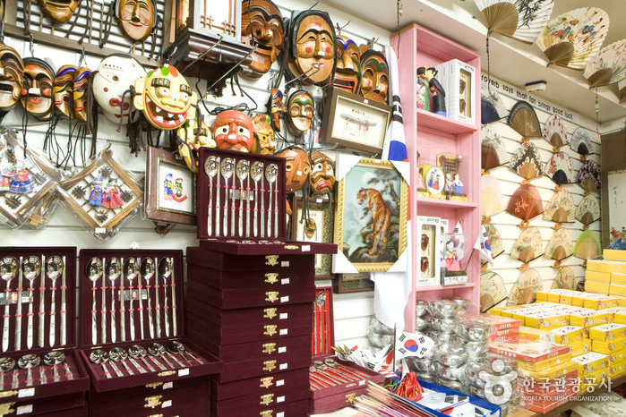
What is a souvenir?
It’s something you can buy on vacation

Slide 5
5 Ws
Who
Where
When
Why
What

Slide 6
did you go with?
did you buy?
did you go?
did you go there?

Slide 7
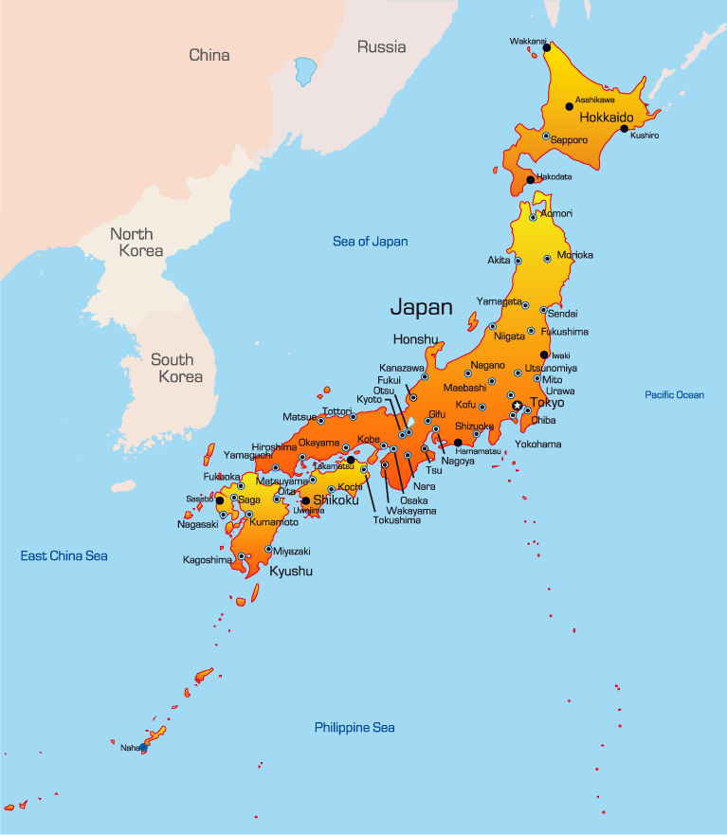
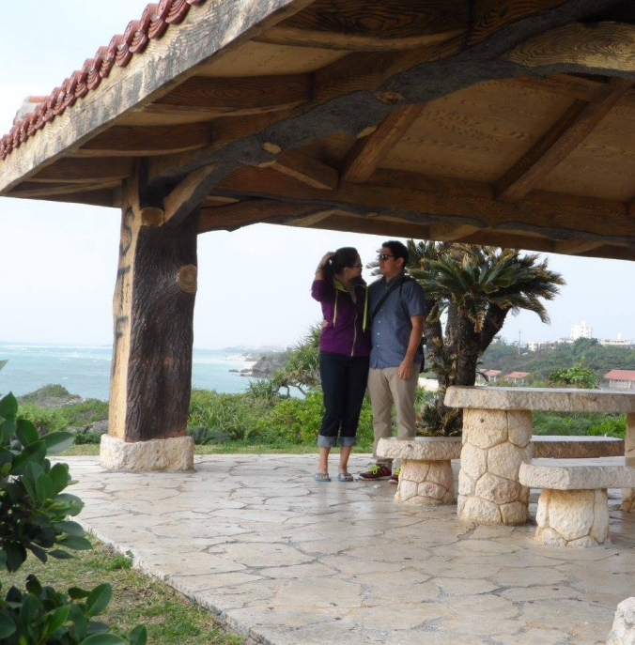
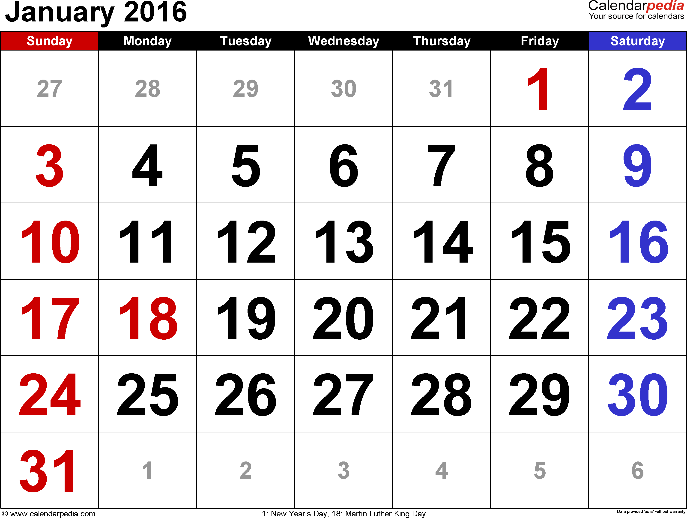
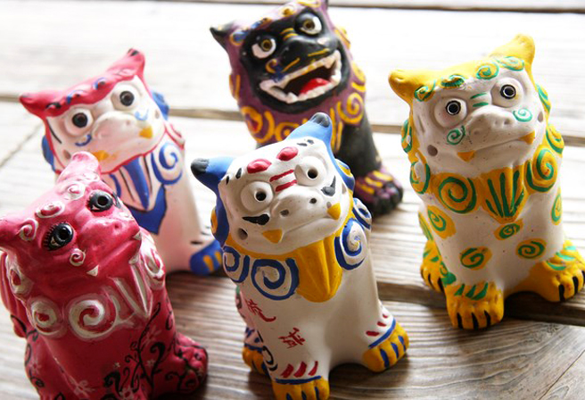
Mr.S’ Souvenir
What did you buy?
Where did you go?
When did you go there?
Who did you go with?

Slide 8
Vacation Liar!
Choose 6 students to be the suspects.
Each student has a souvenir.
Students can ask questions like:
What did you buy?
Where did you get it?
When did you go there?
Who did you go with?
One story will not be true. You must guess which one!

Slide 9
Round 1

Slide 10
Vacation Liar!
What did you buy?
Where did you go?
When did you go there?
Who did you go with?

Slide 11
Who is the liar?

Slide 12
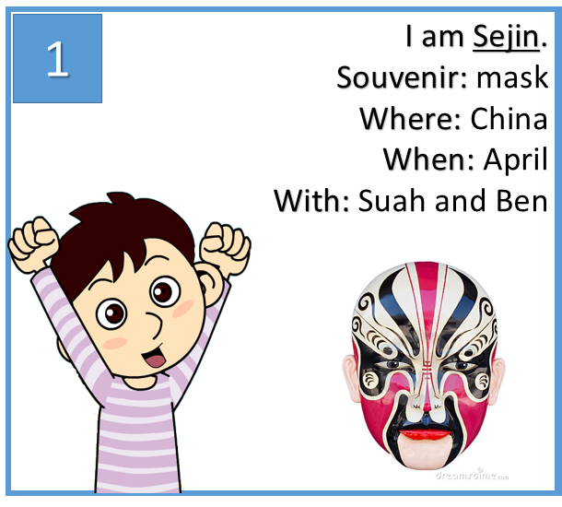

Slide 13
Round 2

Slide 14
Vacation Liar!
What did you buy?
Where did you go?
When did you go there?
Who did you go with?

Slide 15
Who is the liar?

Slide 17
Round 3

Slide 18
Vacation Liar!
What did you buy?
Where did you go?
When did you go there?
Who did you go with?

Slide 19
Who is the liar?

Slide 21
Round 4

Slide 22
Vacation Liar!
What did you buy?
Where did you go?
When did you go there?
Who did you go with?

Slide 23
Who is the liar?

Slide 25
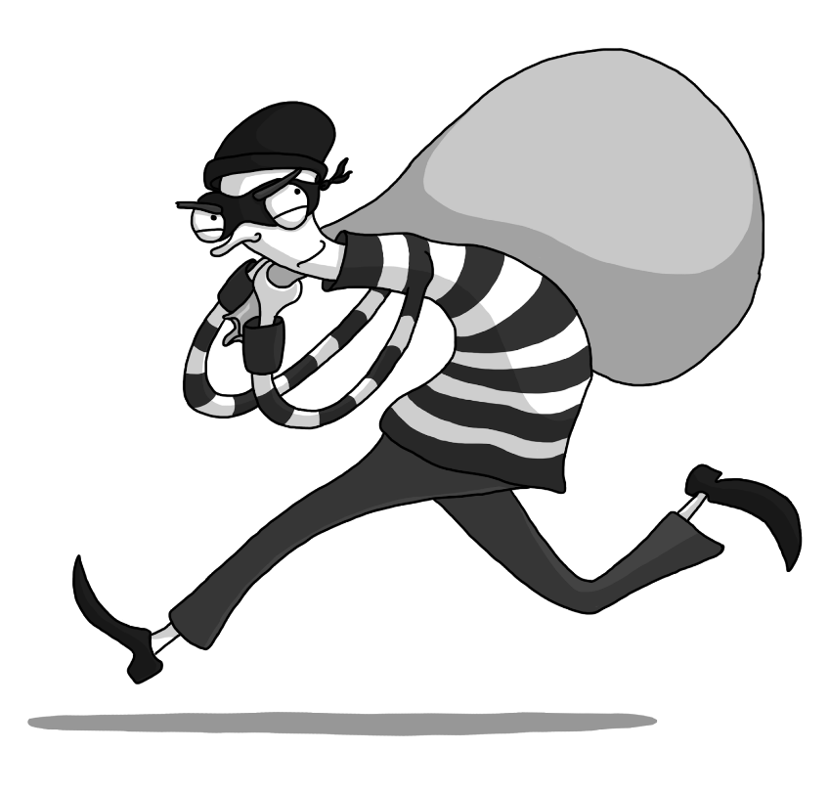
Jewelry Thief

Slide 26
Robbery
We need 4 suspects
You will receive information about your character.
If the other students ask questions, you should answer.
If the answer is not on the paper, you can make up the answer, or just say, “I don’t know.”
The rest of the students are police officers.

Slide 27
Who Robbed Mrs. Red?
 | Mrs. Red | Mr. Red | Mr. Green | Mrs. Yellow | Mrs. Blue
TIME | what / who | what / who | what / who | what / who | what / who
5:00
6:00
7:00
8:00
9:00
10:00
11:00
12:00
1:00

Slide 28
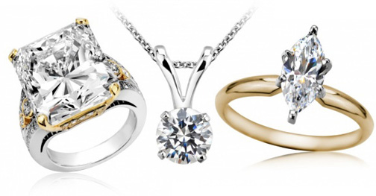
Robbery
 | Mrs. Red
TIME | what / who
5:00
6:00
7:00
8:00
9:00
10:00
11:00
12:00
1:00
Last night Mrs. Red’s jewelry was stolen.
She was at work until 7:00pm
She went to the restaurant for dinner at 7:00pm.
She ate dinner with Mrs. Yellow
She got home at 9:00pm
She watched TV with Mr. Red from 9:00pm to 10:00pm.
She went for a walk with Mr. Red at 10:00pm
She went to bed at 11:00pm
Mrs. Red noticed the jewelry was missing when she woke up. She called the police.
The jewelry was there when she left the house to go to the restaurant.

Slide 29
Mr. Red
I am married to Mrs. Red.
I love Mrs. Red.
I am poor and I want money.
The jewelry is expensive.
5:00 | Exercise with Mrs. Blue
6:00
7:00 | Dinner with Mr. Green
8:00 | And Mrs. Blue
9:00
10:00 | Watch TV with Mrs. Red
11:00 | Walked with Mrs. Red
12:00
1:00 | Sleeping
2:00
3:00 - 7:00

Slide 30
Mr. Green
I am friends with Mr. Red.
I don’t like Mrs. Red.
She is always angry and mean.
I don’t know where she keeps her jewelry.
I know her jewelry is expensive.
I am friends with everybody.
5:00 | Exercised with
6:00 | Mrs. Yellow
7:00 | Dinner with Mr. Red
8:00 | And Mrs. Blue
9:00 | Watched a movie with
10:00 | Mrs. Yellow and Mrs. Blue
11:00 | Walked with Mrs. Yellow
12:00 | Ate Ice cream
1:00
2:00 | Sleeping
3:00 - 7:00

Slide 31
Mrs. Yellow
I am friends with Mrs. Red.
I ate dinner with Mrs. Red.
Sometimes Mrs. Red lets me borrow her jewelry.
I am rich. I don’t need to steal jewelry.
5:00 | Exercised with
6:00 | Mr. Green
7:00 | Dinner with Mrs. Red
8:00
9:00 | Watched a movie with
10:00 | Mrs. Blue and Mr. Green.
11:00 | Walked with Mr. Green
12:00
1:00 | Sleeping
2:00
3:00 - 7:00

Slide 32
Mrs. Blue
I am Mrs. Red’s friend.
I know everything about her.
Mrs. Red doesn’t play with me anymore.
Mrs. Red plays with Mrs. Yellow and not me.
I am poor.
5:00 | Exercised with Mr. Red
6:00
7:00 | Dinner with Mr. Red
8:00 | And Mr. Green
9:00 | Watched a movie with
10:00 | Mrs. Yellow and Mr. Green
11:00 | Walked with Mr. Red
12:00
1:00 | Sleeping
2:00
3:00 - 7:00

Slide 33
CSI: COEILI

Slide 35
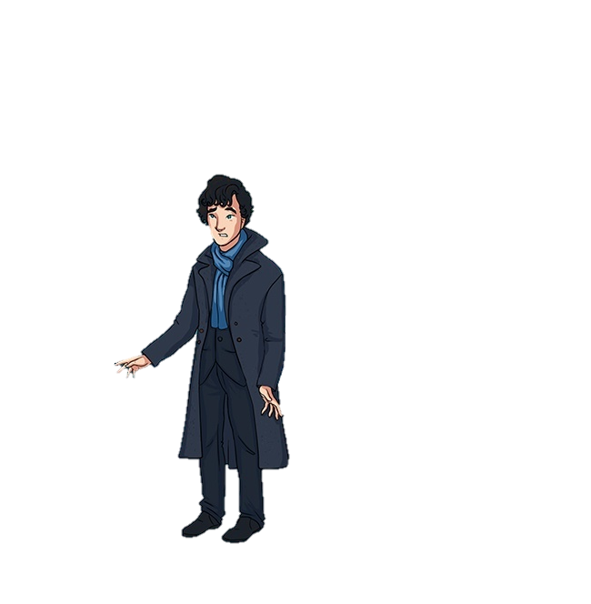
QR Detective

Slide 36
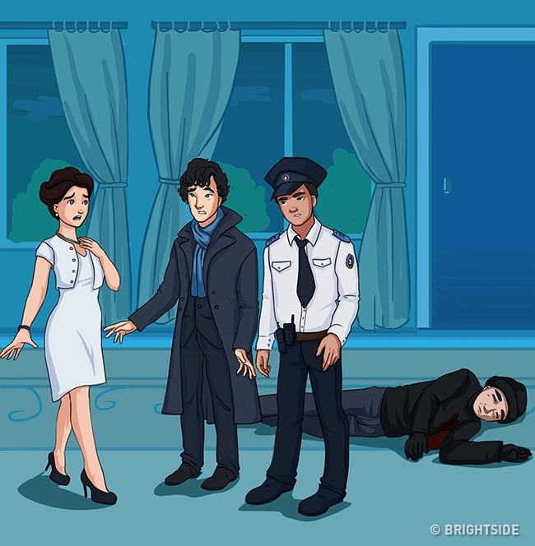

Slide 37
Detective’s tragedy
One morning, the detective had an argument with his wife and went away without his cell phone and keys. In the evening, when he returned home, he found his colleague, his scared wife, and a murdered man. Stevens’s wife told her story:
"I was sitting in the living room when I heard the doorbell. I thought it was my husband and opened the door. But a criminal pushed me, and so I stabbed him with a knife."
The detective ordered the policeman to arrest his wife because she had planned to kill him.
How did the detective figure it out?

Slide 39
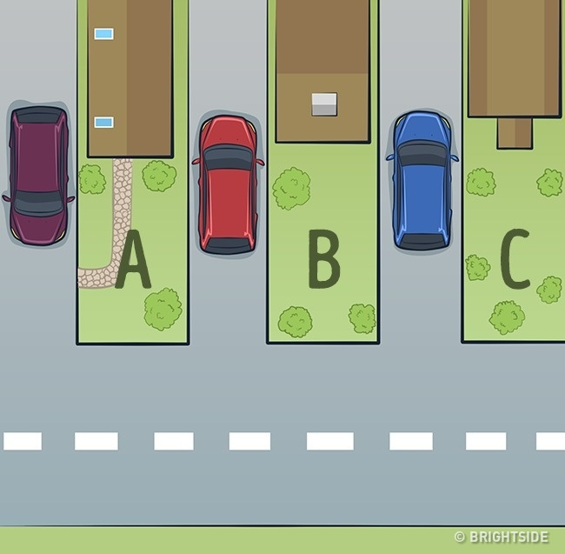

Slide 40
Escape
The detective once had to find an escaped prisoner. He knew that the criminal was hiding in one of these houses. But he had to know the exact address so as not to frighten away the criminal. First, he took a photo of the houses with the help of a drone.
When he looked at the photo, he realized where the criminal was.
Where was that fugitive, and how was he found?

Slide 42
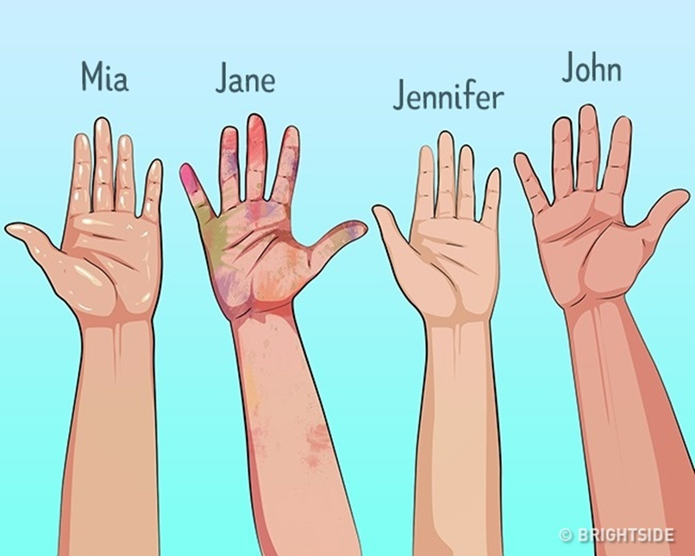

Slide 43
Friendly murder
Mary and Ben lived with their 4 friends. One day, Ben came home and found Mary dead on a sofa. He called the police.
The detective arrived and realized that Mary had been killed not so long ago. He interrogated all 4 friends.
Mia was in the kitchen and said she’d come home 2 hours ago and gone to the kitchen.
John was reading a book in the garden. He said he hadn’t left the place that day.
Jennifer said she had been swimming in a swimming pool for 3 hours.
Jane was painting in her room.
The detective asked everyone to show him their hands and found out who lied to him. That person was the murderer. How did Stevens discover the criminal?

Slide 45
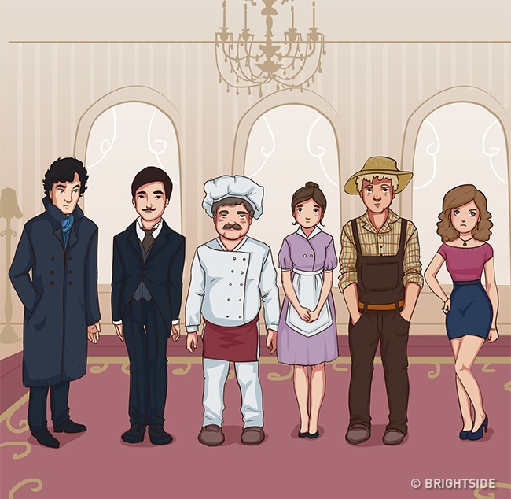

Slide 46
The murder of an aristocrat
George Smith was murdered on Sunday evening. There were 5 other people in his house: Mr. Smith’s wife, his personal cook, a butler, a housemaid, and a gardener. They all told Detective Stevens what they were doing that evening:
Mrs. Smith was reading a book near a fireplace.
The cook was making breakfast.
The butler was giving instructions to workers in the living room.
The housemaid was washing the dishes.
The gardener was watering plants in the greenhouse.
Right after all the conversations, the detective arrested the murderer. Who was the killer, and how did Stevens find the criminal?

Slide 47
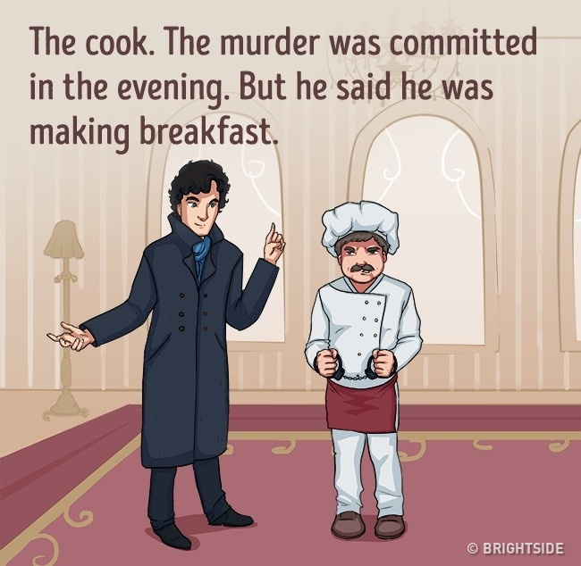

Slide 48
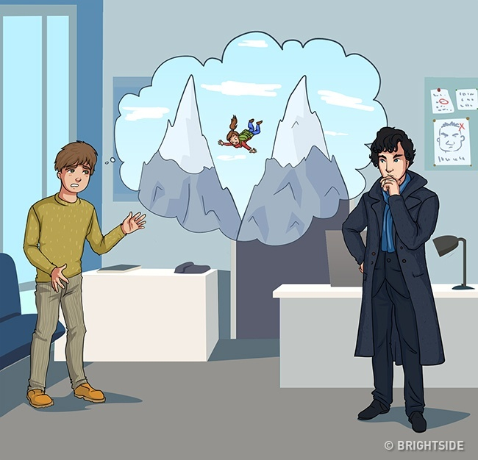

Slide 49
Romantic journey
Mr. and Mrs. Clyde went on a trip to the mountains. But 2 days later, Mr. Clyde returned home alone. He went to the police and said that Mrs. Clyde had fallen to her death.
The next day, Detective Stevens visited Mr. Clyde and arrested him for his wife’s murder. Clyde confessed his guilt and asked the detective how he’d found out he was the murderer. Stevens said he’d simply called a travel agent and asked for some information.
What did the travel agent say to the detective?

Slide 50
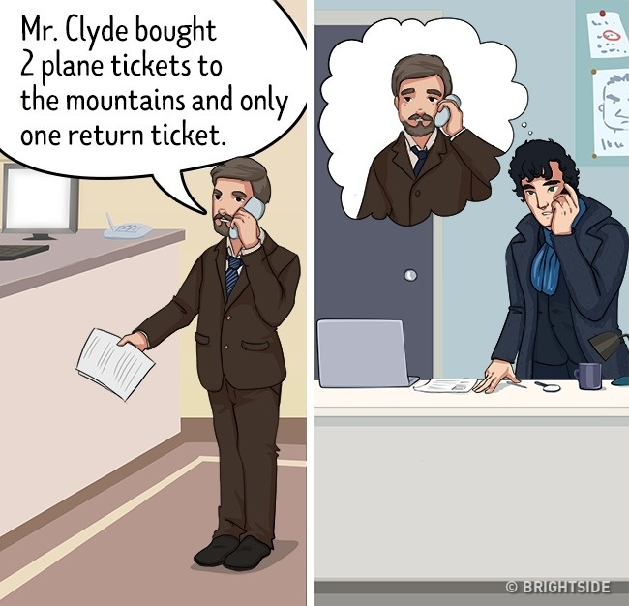

Slide 51
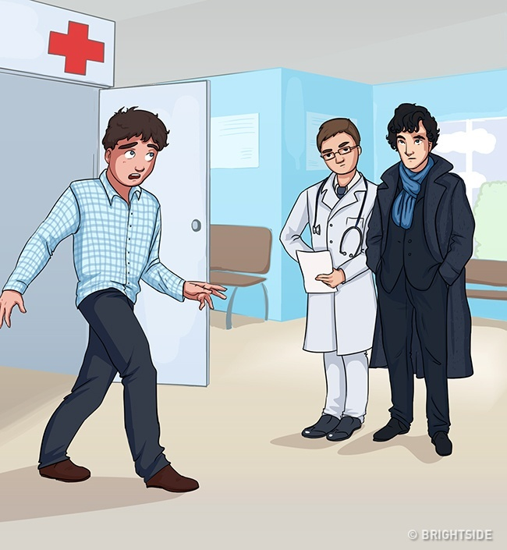

Slide 52
Silly murderer
The detective was speaking to a doctor in a waiting room when a dismayed man rushed in and screamed, "Someone shot my wife!"
The detective asked the man to tell him everything. The man, Mr. Clark, said that he was at work when his housekeeper called him and said that something terrible had happened to his wife and that she was in the intensive care unit. He hung up immediately and went to the hospital.
When Mr. Clark finished his story, the detective arrested him on an attempted murder charge. Why did he do this?

Slide 53
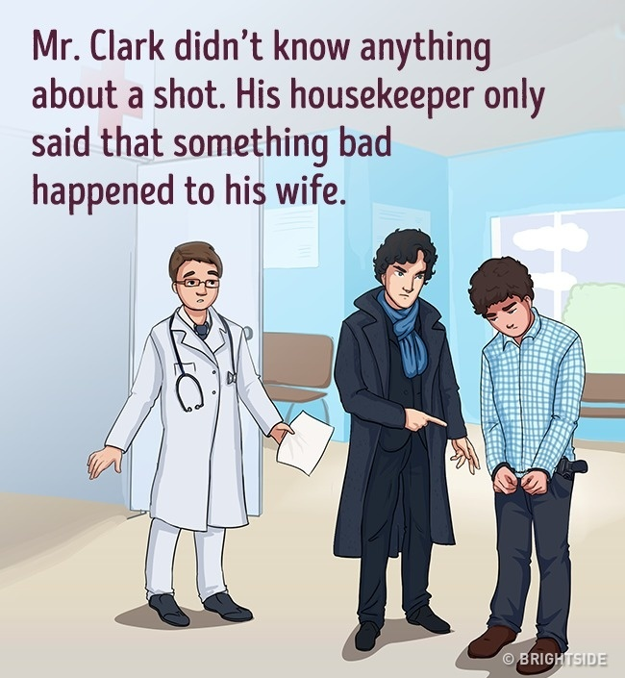

Slide 55
Blood ties
A millionaire was shot in the forehead at home. The detective spoke to the millionaire’s 3 sons, Jack, John, and James, who were at home.
Jack said that night John, their father, and he had been at an official reception. They arrived home and entered the living room: his father came in, and then John and Jack. When their father came up to the stairs, James entered the living room and shot their father.
John confirmed Jack’s information.
James said he had visited his friends that night. When he arrived home, his father was already dead.
The detective understood everything immediately. Who was the killer, and how did Stevens resolve that case?

Slide 56
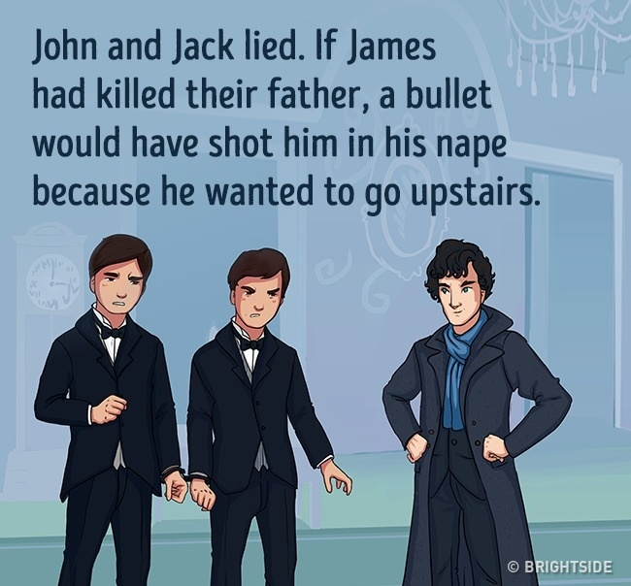

Slide 57
Answer the riddle

Slide 58
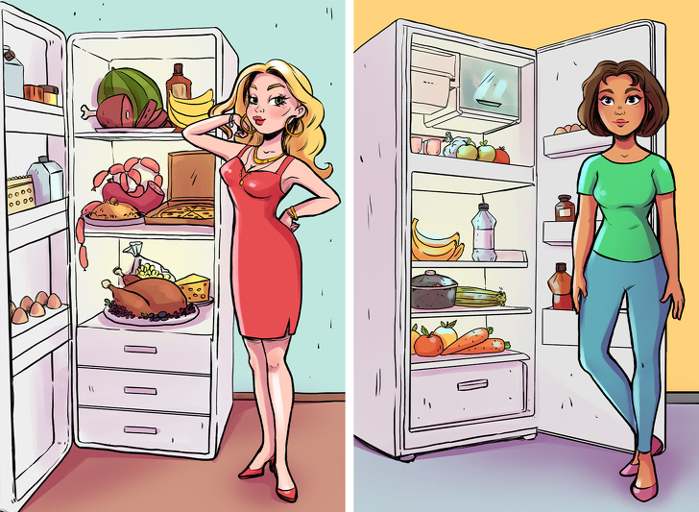
Who is poor?
Both of these women are single but one of them lived in poverty for many years and just robbed a bank to pay her debt. Can you guess which one?

Slide 59
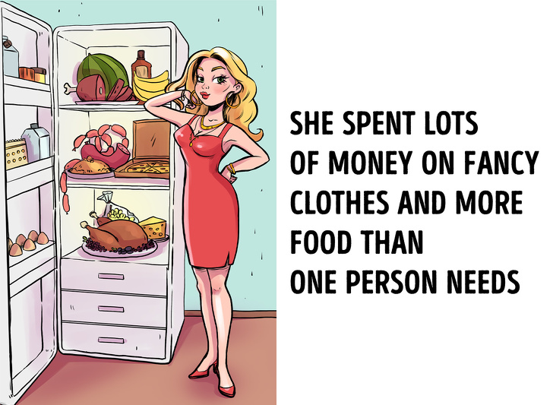

Slide 60
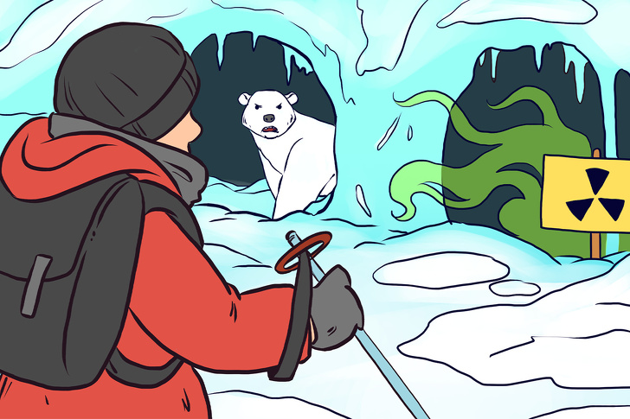
Which way should he choose?
A man was exploring the South Pole when a strong storm began. He managed to find 2 caves where he could take shelter, but he noticed a hungry polar bear in one cave and the other one is filled with radioactive waste. Which cave should he choose?

Slide 62
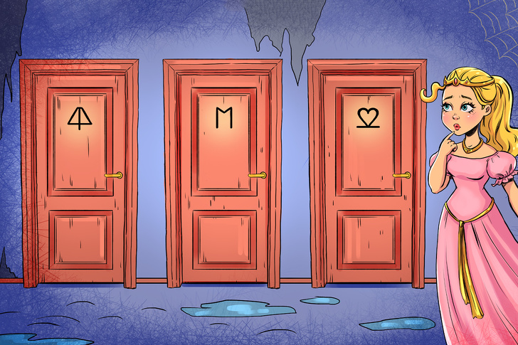
Where is the exit?
A princess got locked in a tower. She found out that she could escape through the fourth door. But there are only 3 doors. How can she find door number 4?

Slide 64
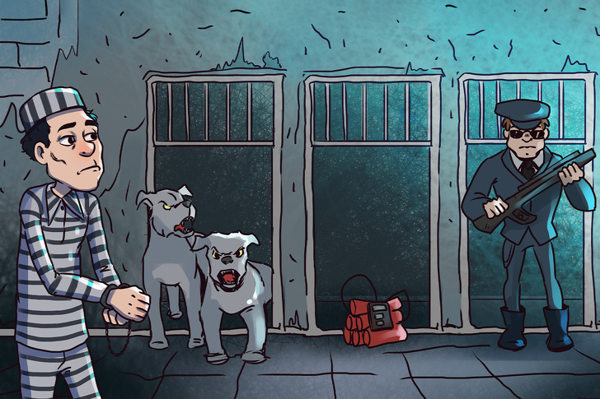
Which exit should he choose?
A man got captured, but there are 3 possible ways for him to escape. One exit has angry dogs. The second has a bomb with a 5-minute timer and it’s already on. The third has an armed guard. Which should he choose?

Slide 65
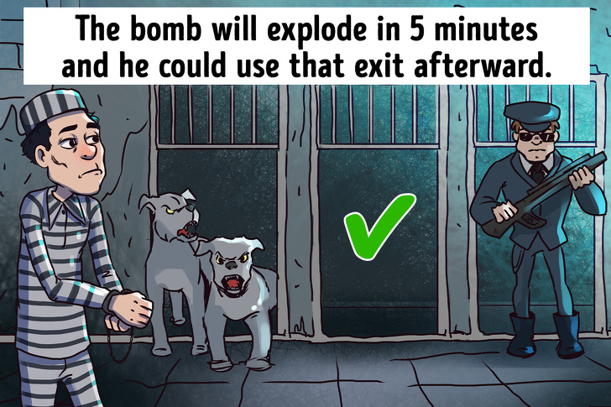

Slide 66
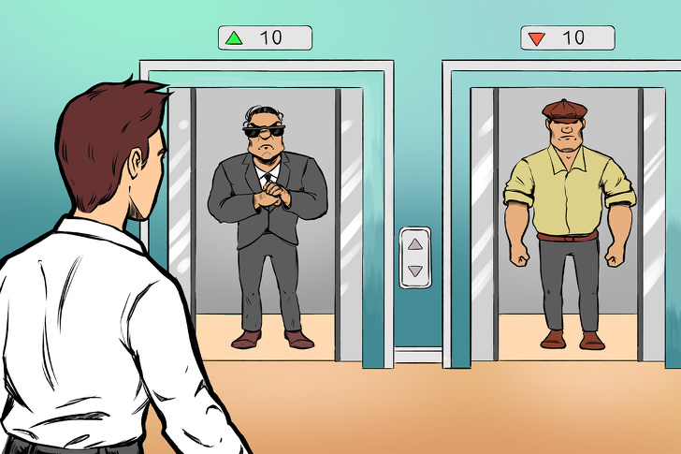
Which elevator is safer?
Tom received a message saying that a serial killer has just been spotted entering his building and he decided to try to get out. While he was waiting, 2 elevators arrived at Tom’s floor at the same time and in both of them there was a guy who looked very suspicious. Which elevator should he take?

Slide 67
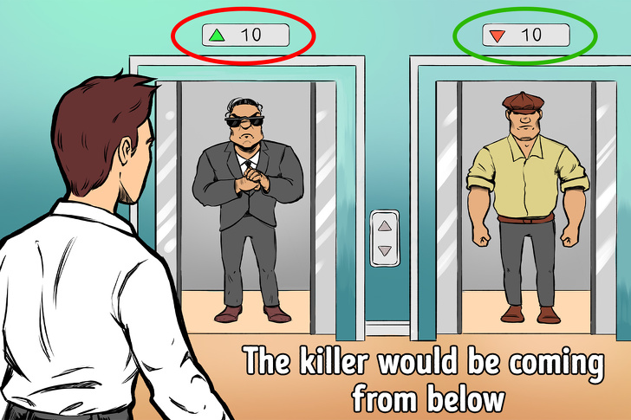

Slide 68
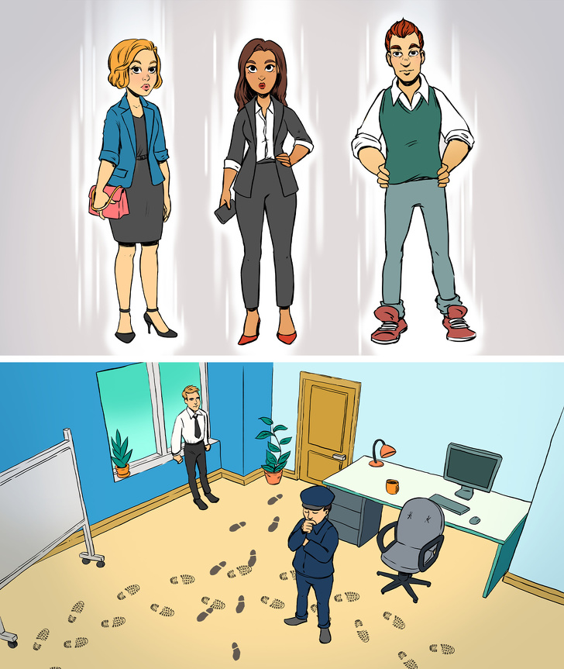
Who is the liar?
A businessman arrived at his office and found that some very important documents had disappeared from his desk. Police suspected 3 people and each of them said that they hadn’t even been to the office. Who is lying?

Slide 69
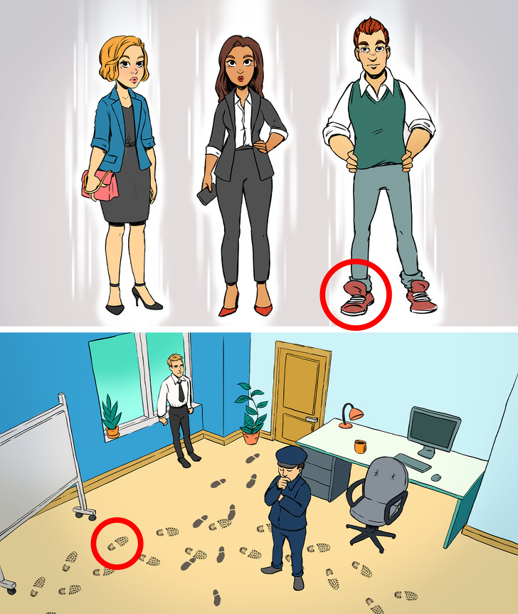

Slide 70
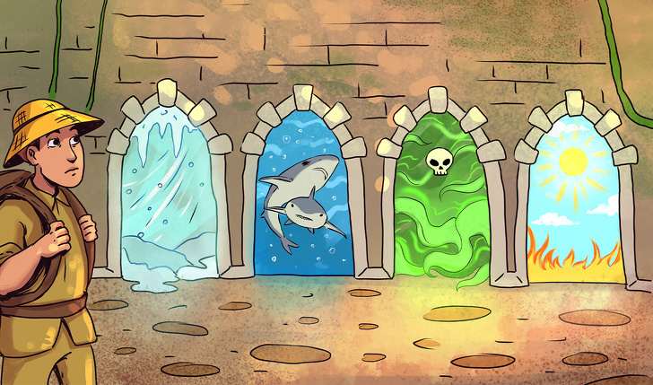
How could he escape?
A man got kidnapped and locked in a house. The house had 4 doors and he could escape through one of them. There is an extremely cold temperature behind the first door that would freeze him to death. There are very hungry sharks behind the second door. The room behind the third is filled with poisonous gas. The fourth has such a strong sun that it burns everything. How can he escape?

Slide 71
