Slide 1
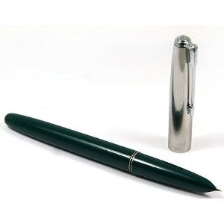
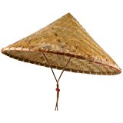
I am Ben.
Souvenir: pen
Where: China
When: April
With: Suah and Sejin
I am Tanya.
Souvenir: hat
Where: Vietnam
When: April
With: Ben and Bona
1
1

Slide 2
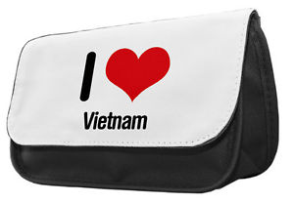
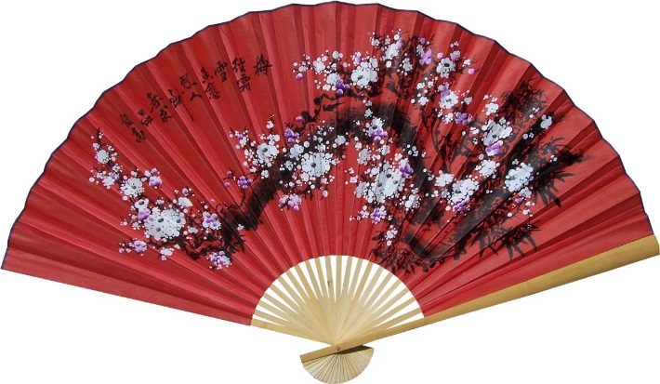
I am Bona.
Souvenir: pencil case
Where: Vietnam
When: May
With: Junho
I am Suah.
Souvenir: fan
Where: China
When: April
With: Ben and Sejin
1
1

Slide 3
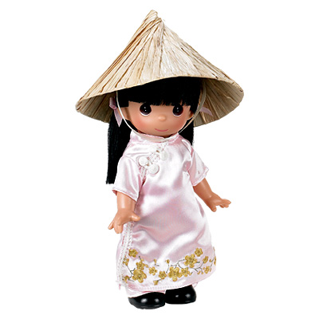
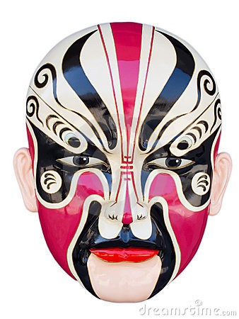
I am Sejin.
Souvenir: mask
Where: China
When: April
With: Suah and Ben
I am Juho.
Souvenir: doll
Where: Vietnam
When: May
With: Bona
1
1

Slide 4
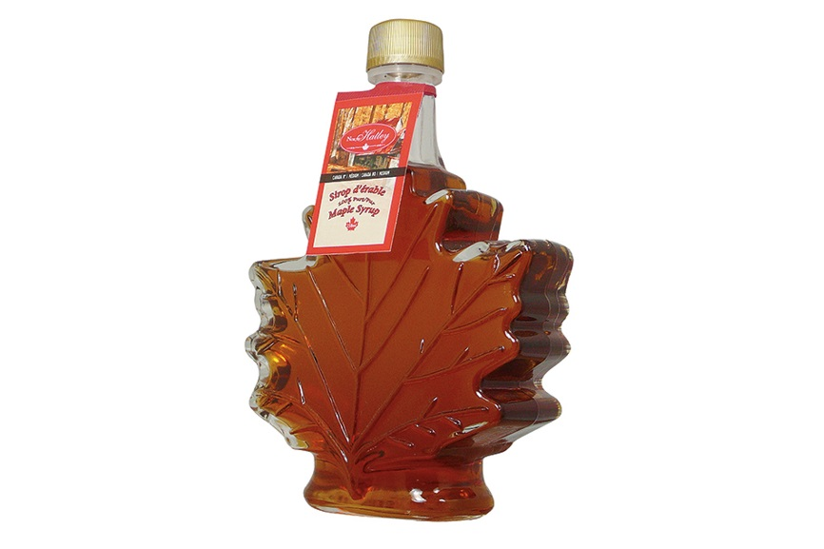
I am Ben.
Souvenir: maple syrup
Where: Canada
When: September
With: Tanya and Bona
I am Tanya.
Souvenir: flag
Where: Canada
When: September
With: Ben and Bona
2
2

Slide 5
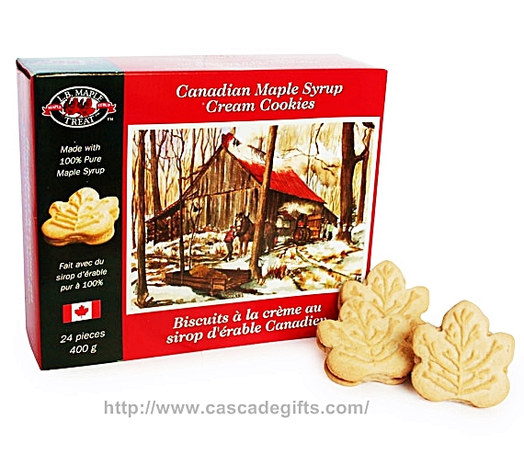
I am Bona.
Souvenir: cookies
Where: Canada
When: September
With: Tanya and Ben
I am Suah.
Souvenir: pin
Where: Canada
When: September
With: Sejin and Juho
2
2

Slide 6
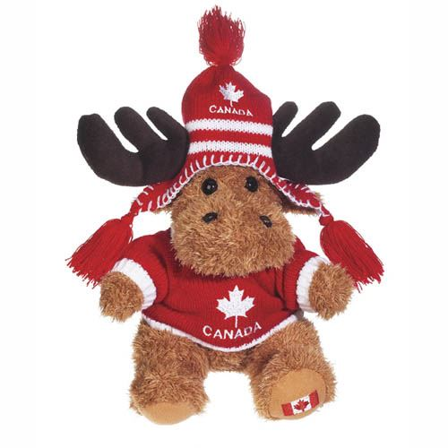
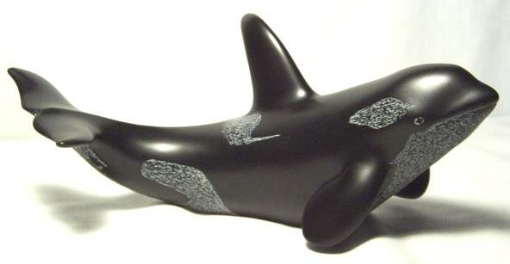
I am Sejin.
Souvenir: whale figurine
Where: Canada
When: March
With: Juho and Suah
I am Juho.
Souvenir: teddy bear
Where: Canada
When: March
With: Sejin and Suah
2
2

Slide 7
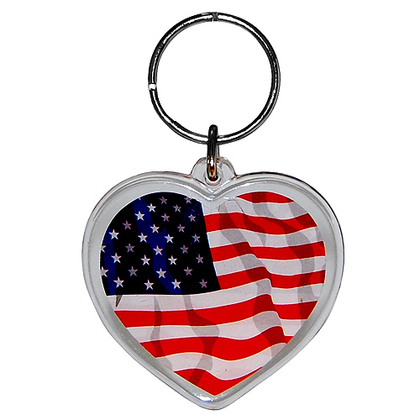
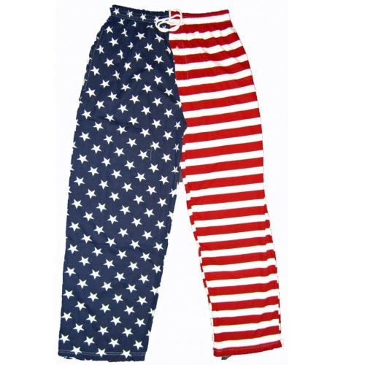
I am Ben.
Souvenir: keychain
Where: USA
When: February
With: Tanya and Bona
I am Tanya.
Souvenir: pants
Where: USA
When: February
With: Ben and Bona
3
3

Slide 8
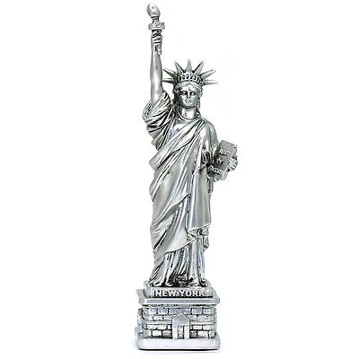
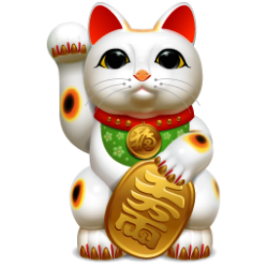
I am Bona.
Souvenir: statue
Where: USA
When: February
With: Ben and Tanya
I am Suah.
Souvenir: Lucky Cat
Where: Japan
When: January
With: Sejin and Juho
3
3

Slide 9
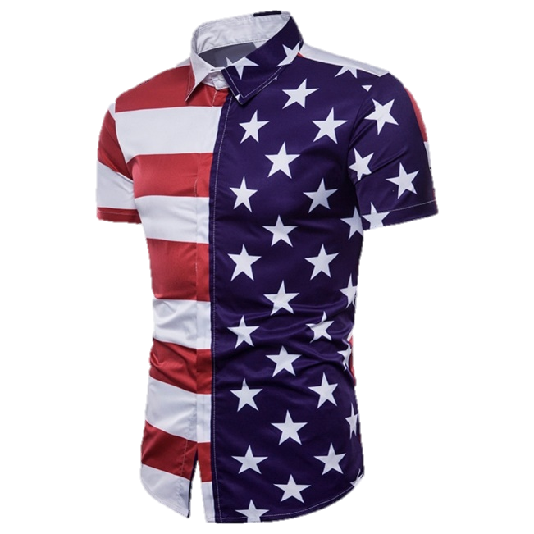
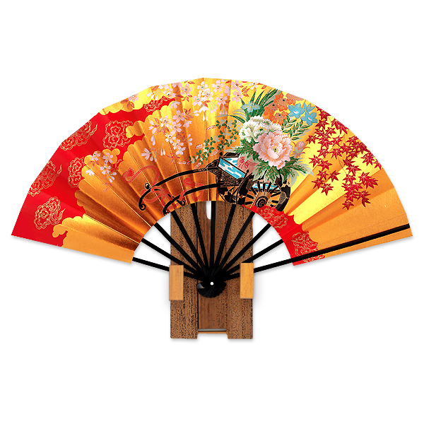
I am Sejin.
Souvenir: tshirt
Where: America
When: February
With: Juho and Suah
I am Juho.
Souvenir: fan
Where: Japan
When: January
With: Sejin and Suah
3
3

Slide 10
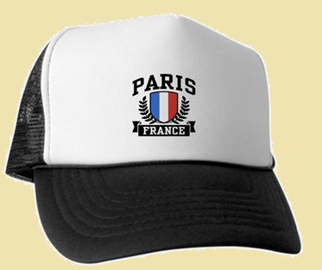
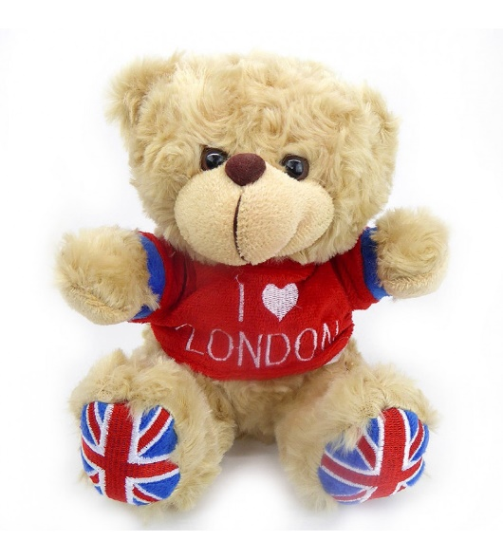
I am Ben.
Souvenir: hat
Where: France
When: June
With: Suah
I am Tanya.
Souvenir: teddy bear
Where: England
When: October
With: Suah and Sejin
4
4

Slide 11
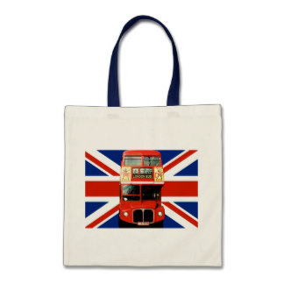
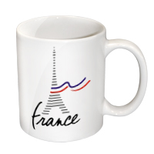
I am Bona.
Souvenir: cup
Where: France
When: June
With: Junho
I am Suah.
Souvenir: bag
Where: England
When: October
With: Tanya and Sejin
4
4

Slide 12
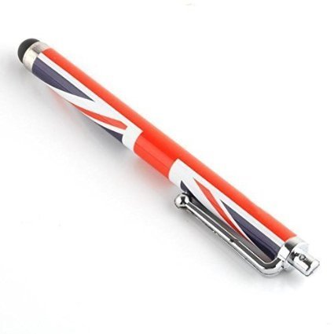
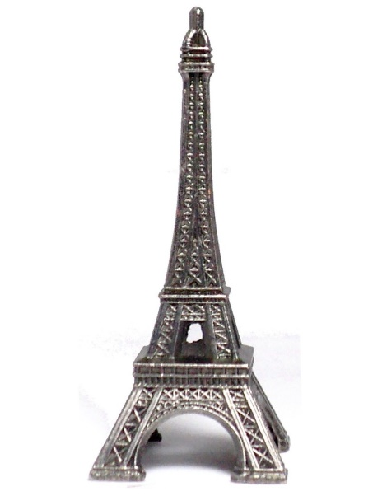
I am Sejin.
Souvenir: pen
Where: England
When: October
With: Suah and Tanya
I am Juho.
Souvenir: statue
Where: France
When: June
With: Bona
4
4

