Slide 1
“We have two ears and only one tongue in order that we may hear more and speak less.”
- Diogenes Laertius

Slide 2
3D Escape Room
https://podcasts.google.com/?feed=aHR0cDovL2ZlZWRzLm1lZ2FwaG9uZS5mbS8zZGVzY2FwZQ%3D%3D

Slide 3
Escape Room
What is it?
What do you do there?
How can you escape?

Slide 4
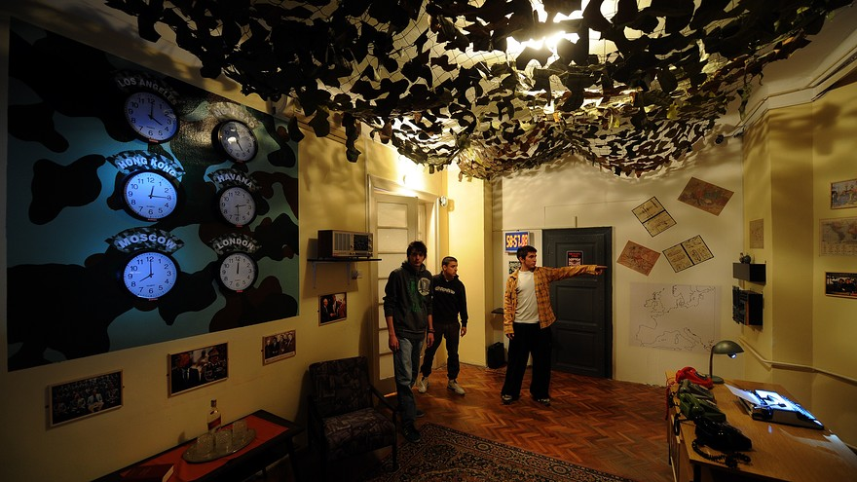

Slide 5
Escape Room
The clues will help solve the next clue
There is usually a timer

Slide 6
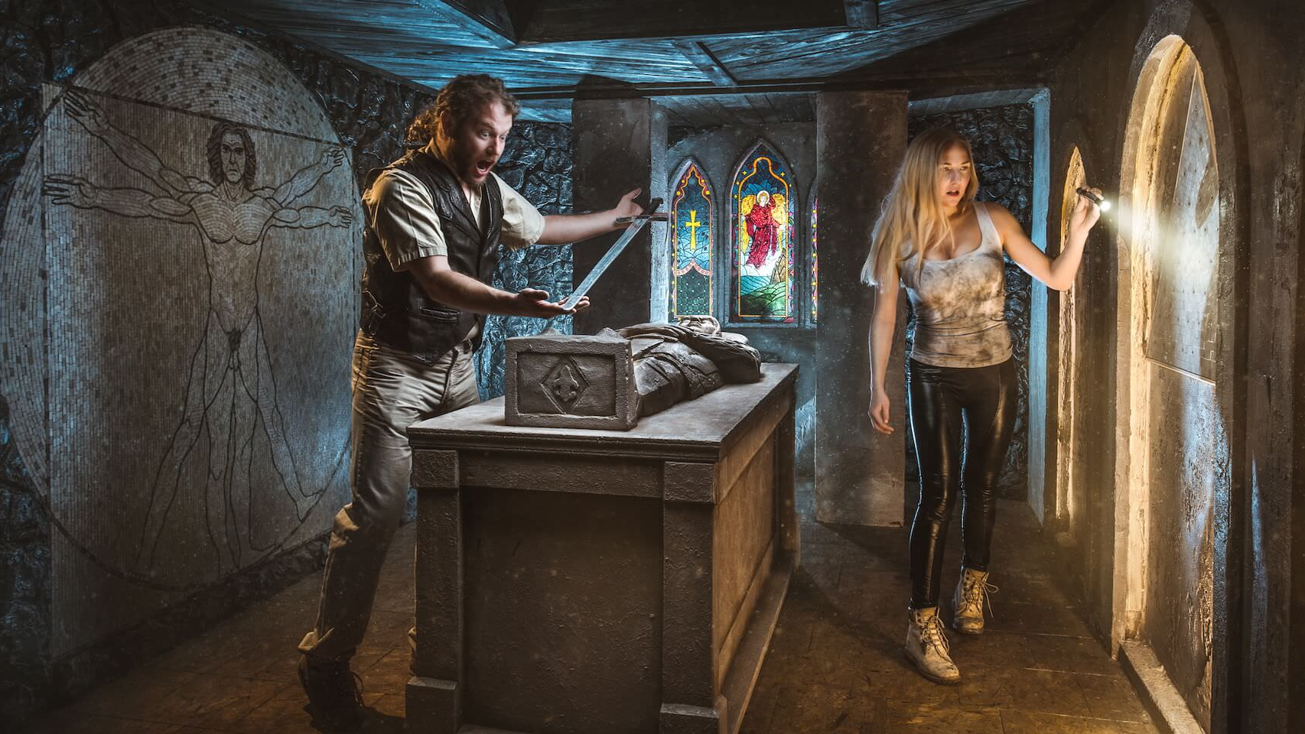

Slide 7
12.15.15.11
21.14.4.5.18
20.8.5
20.1.2.12.5

Slide 9
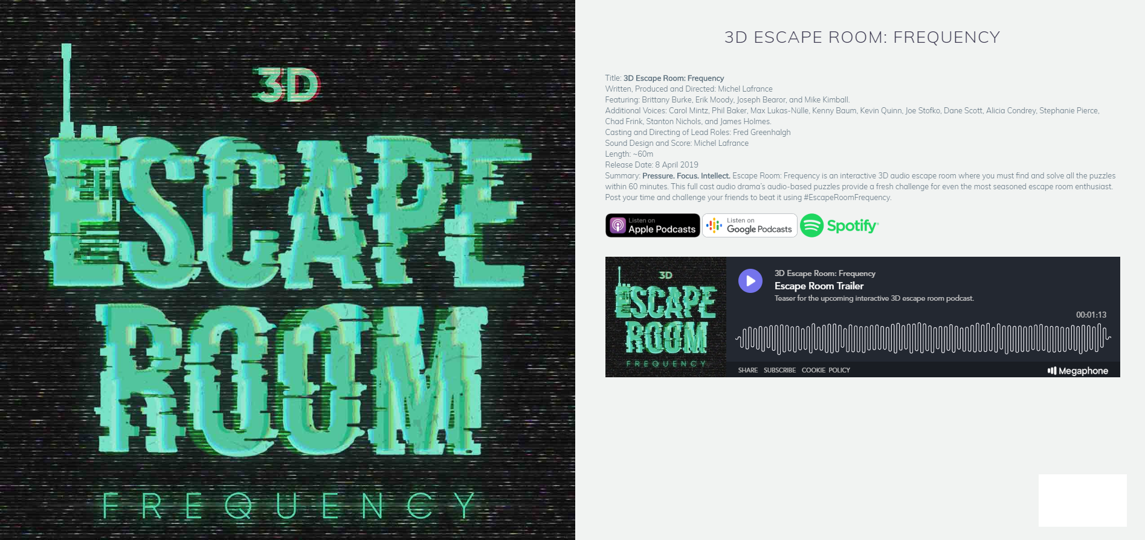
https://podcasts.google.com/?feed=aHR0cDovL2ZlZWRzLm1lZ2FwaG9uZS5mbS8zZGVzY2FwZQ%3D%3D

