Slide 1
“A good listener is a witness, not a judge of your experience.”
- Michael P Nichols

Slide 2
Listening to Body Language

Slide 3
EQ
https://greatergood.berkeley.edu/quizzes/ei_quiz/take_quiz

Slide 4
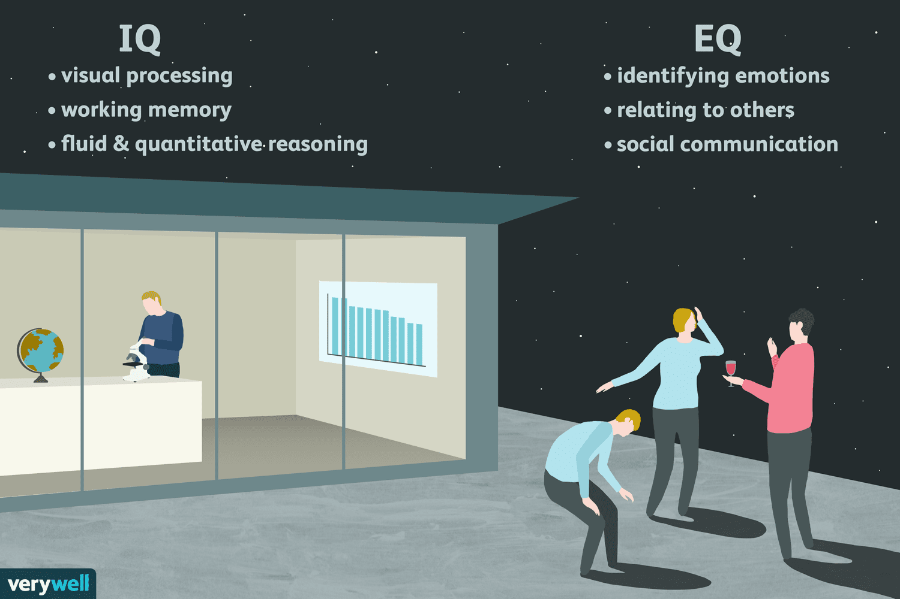

Slide 5
Faces

Slide 6
Faces
Find someone who…
looks angry

Slide 7
Faces
Find someone who…
looks sad

Slide 8
Faces
Find someone who…
recently fell in love.

Slide 9
Faces
Find someone who…
you can trust

Slide 10
Faces
Find someone who…
will go to jail

Slide 11
Faces
Find someone who…
has a secret.

Slide 12
Faces
Find someone who…
you want to know better.

Slide 13
Faces
Find someone who…
has had an interesting life.

Slide 14
Faces
Find someone who…
has the most friends.

Slide 15
Faces
Find someone who…
just farted.

Slide 16
Faces
Find someone who…
could be a k-pop idol

Slide 17
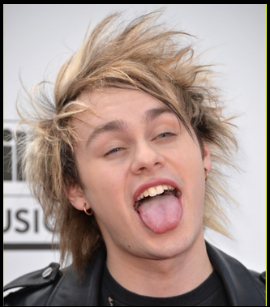
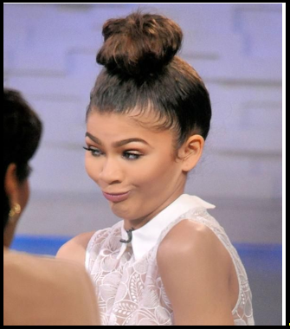
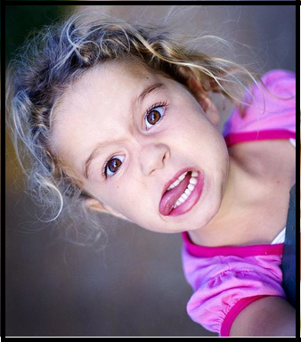
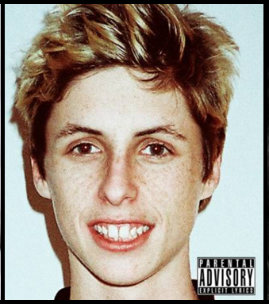
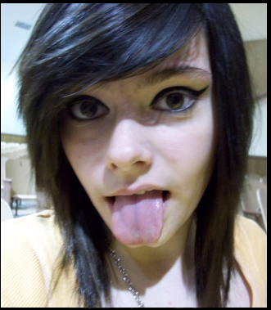
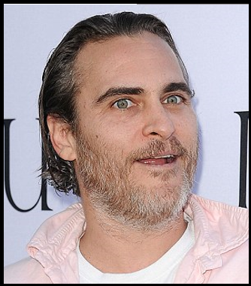
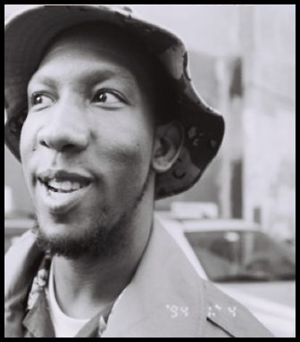
How to Play:
Put all the cards in the middle.

Slide 18
How to Play:
Choose a leader

Slide 19
How to Play:
The leader describes a face.
She has blonde hair.
She has big eyes.
She is wearing glasses.

Slide 20
How to Play:
The other students can choose one card.
(You can’t change it)

Slide 21
How to Play:
After everyone has a card, the leader tells the answer.

Slide 22
How to Play:
The winner becomes the new leader.

Slide 23
Body Language

Slide 24
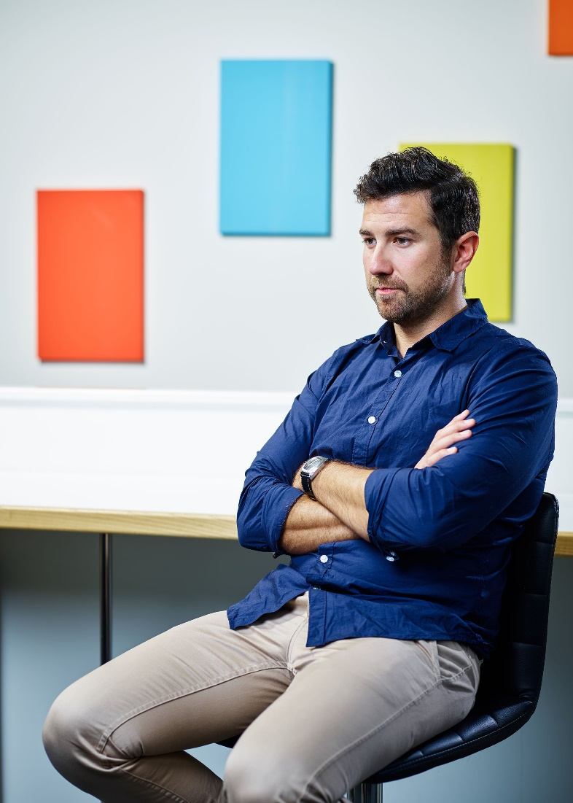
Body Posture
Compare

Slide 25
Body Posture
Is he listening?

Slide 26
Body Posture
What is he communicating?

Slide 27
Body Posture
What is he communicating?

Slide 28
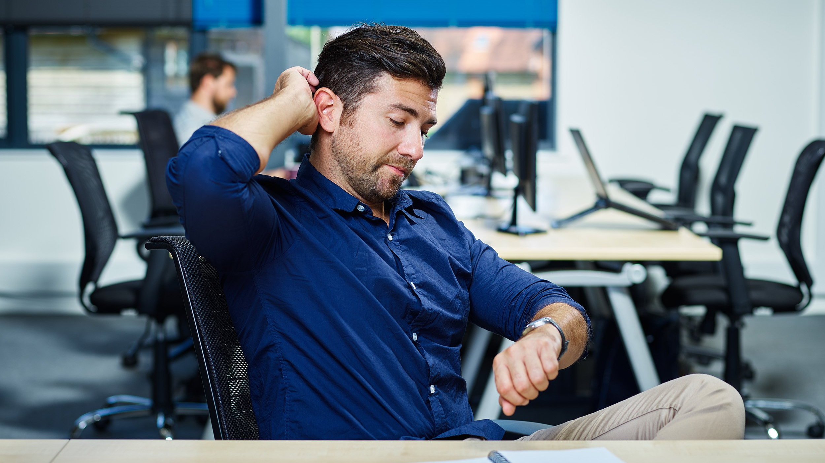
Body Posture
What is he communicating?

Slide 29
Body Posture
What is he communicating?

Slide 30
Body Posture
What is he communicating?

Slide 31
Body Posture
Good examples

Slide 35
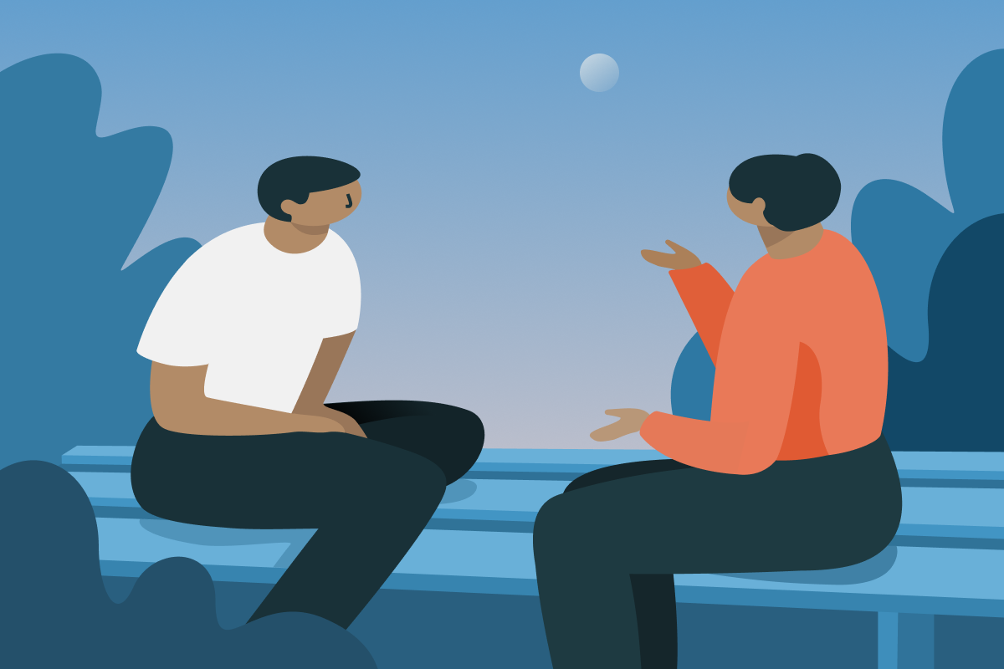
Body Posture
How can we show that we are listening?

Slide 36
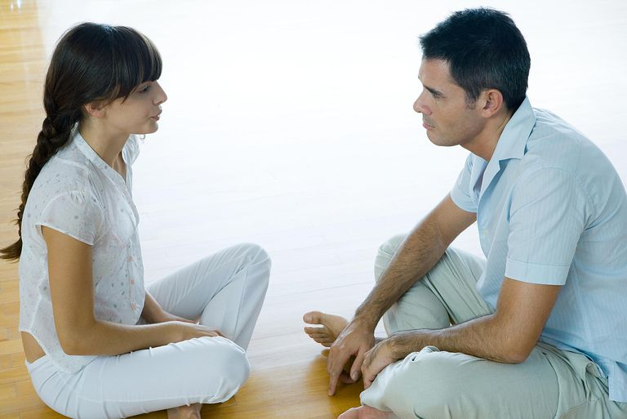

Slide 38
Mirroring Technique

Slide 39
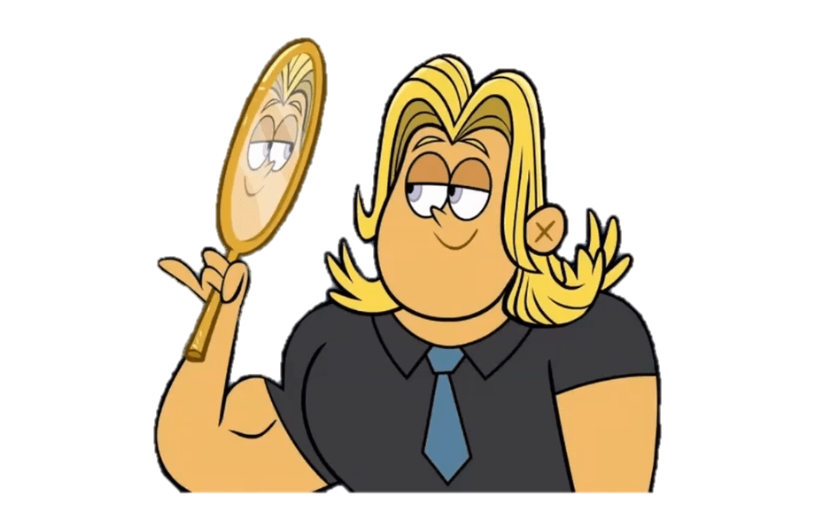
Mirroring
Reflect their emotions.
Copy their facial expressions.

Slide 40
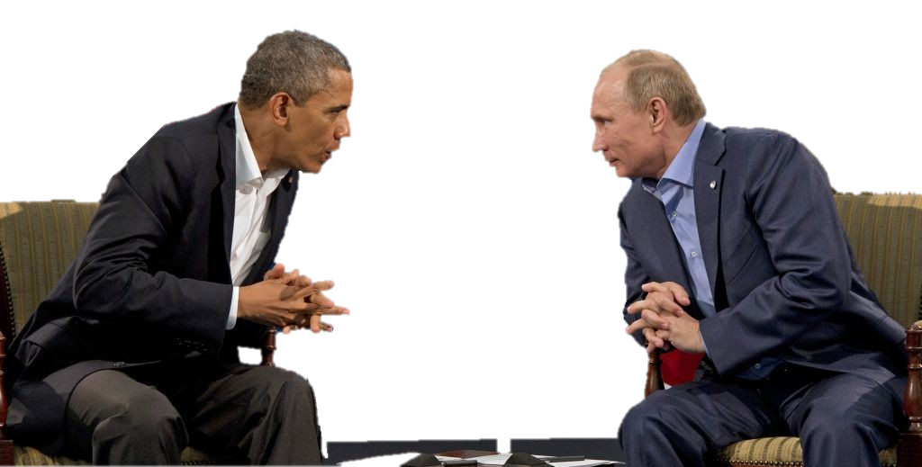
Mirroring
In conversation
Shows you are listening
Shows empathy
Feel comfortable

Slide 41
Mirroring
With a partner
One tells a story
One listens using mirroring

Slide 42
Oprah

Slide 43
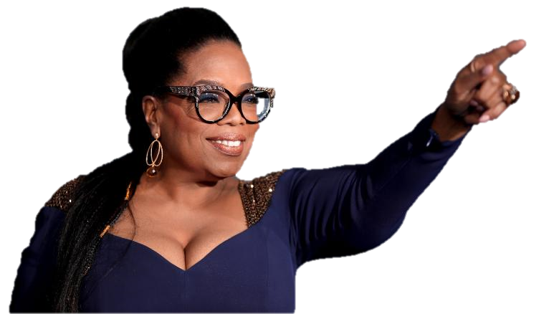
James Corden Cries
How does Oprah use body language?
https://www.youtube.com/watch?v=_GZlUextcAA

Slide 44
Bonus Oprah
https://www.youtube.com/watch?v=v-ps2nfkAiA

