Slide 1
“In order to be effective, be responsive. In order to be responsive, listen.”
- Sharon Weil

Slide 2
Goals of Active Listening:
Speaker feels comfortable.
Speaker believes you are really listening.
For deeper conversations.

Slide 3
Body Language:
What is mirroring?
Listening posture?

Slide 4
Verbal
Response

Slide 5
Affirmation responses
Silence
Labeling feelings
Repeat
Summarizing
Open-ended Questions

Slide 6
Affirmation Responses (minimal encouragers, background cues)
“I agree”
Oh…
Ok.
Sure.
Yes.
Yeah?
I see.
Interesting
Right
Uh huh.
Go on.
응…
Oh, really?

Slide 7
Silence (effective pauses)
The word ‘listen’ contains the same letters as the word ‘silent’.
- Alfred Brendel

Slide 8
Labeling Feelings
You must feel…
You must be….
It sounds like you are…
You’re feeling ______ about that.

Slide 9
Label the Feeling
One person reads the card.
Everyone tries to label the feeling.

Slide 10
Repeating the Last Words
Use the last words to ask a question.

Slide 11
Repeating the Last Words
“I haven’t been feeling well lately. I have a cold. My boss is angry at me. And my dog ran away.”
“Your dog ran away?”

Slide 12
Repeating the Last Words
“Last week I had dinner with my parents. We went to an expensive restaurant to celebrate my birthday. I had so much fun.”
“You had a lot of fun?”

Slide 13
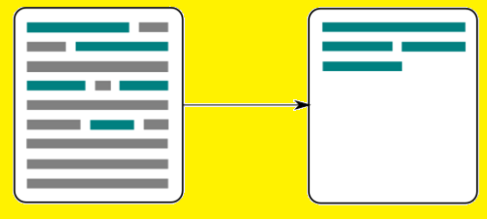
Summarizing
Repeat what they have said.
Include the main points.

Slide 14
Summarize
“I haven’t been feeling well lately. I have a cold. My boss is angry at me. And my dog ran away.”
“So, you haven’t been feeling well, your boss is angry and your dog ran away?”

Slide 15
Summarize:
“Last week I had dinner with my parents. We went to an expensive restaurant to celebrate my birthday. I had so much fun.”
“Oh, you had dinner at an expensive restaurant for your birthday and it was fun?”

Slide 16
Open-ended Questions
Avoid “Yes / No” questions.

Slide 17
Open-ended Questions
Did it make you feel angry?
“Yes.”

Slide 18
Open-ended Questions
How did that make you feel?
“It made me feel angry because…”

Slide 19
Open-ended Questions
What color was it?
“Orange.”

Slide 20
Open-ended Questions
Can you describe it to me?
“It was orange, large and delicious.”

Slide 21
Open-ended Questions
What do you think about that?
Do you think it was right?
Why did you do that?
What did you hope would happen?
Why?

Slide 22
Conversation

Slide 23
Conversation Goal:
Listener = keep the speaker talking
Speaker = tell a story from your childhood.

