Slide 1
Good Teachers Great Teachers
https://www.youtube.com/watch?v=vrU6YJle6Q4

Slide 2
Who was your best teacher? What made them great?
Discuss

Slide 3
Qualities of a Great Teacher:
They set high expectations for all students.
A great teacher respects students.
They have clear, written-out objectives.
A great teacher has his own love of learning
They are prepared and organized.
They engage students and get them to look at issues in a variety of ways.
A great teacher is a skilled leader.
A great teacher can “shift-gears”
They form strong relationships with their students and show that they care about them as people.
A great teacher collaborates with colleagues on an ongoing basis.
They are masters of their subject matter.
A great teacher maintains professionalism in all areas
They communicate frequently with parents.
GreatSchools Staff, 2018
Orlando, 2013

Slide 4
What makes good teachers great?
Terronez, 2017
26,000 responses
8 schools
(LA, Texas, Abroad)
https://www.youtube.com/watch?v=vrU6YJle6Q4

Slide 5
Terronez, 2017
What makes good teachers great?
“A great teacher eats apples.”
“A great teacher isn’t a teacher.”
“A great teacher understands that students have a life outside of school.”
“A great teacher is chill.”
“A great teacher loves to teach.”
“A great teacher thinks like a kid but acts like an adult.”
“A great teacher notices when there is a struggle.”
“A great teacher sings.”
“A great teacher loves to learn.”

Slide 7
“A great teacher eats apples.”
Accept gifts
Symbol of relationship

Slide 8
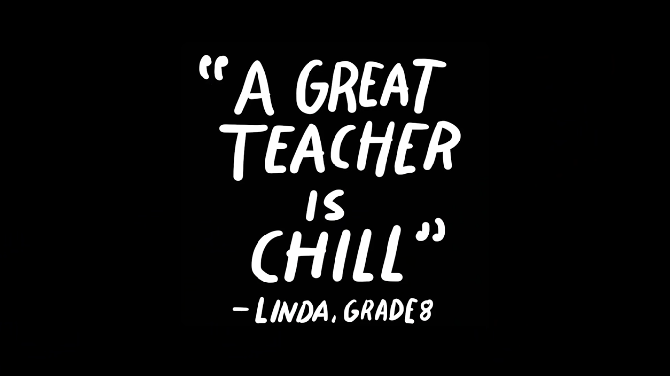

Slide 9
“A great teacher is chill.”
Not serious
Calm
Relaxed
State of mind

Slide 10
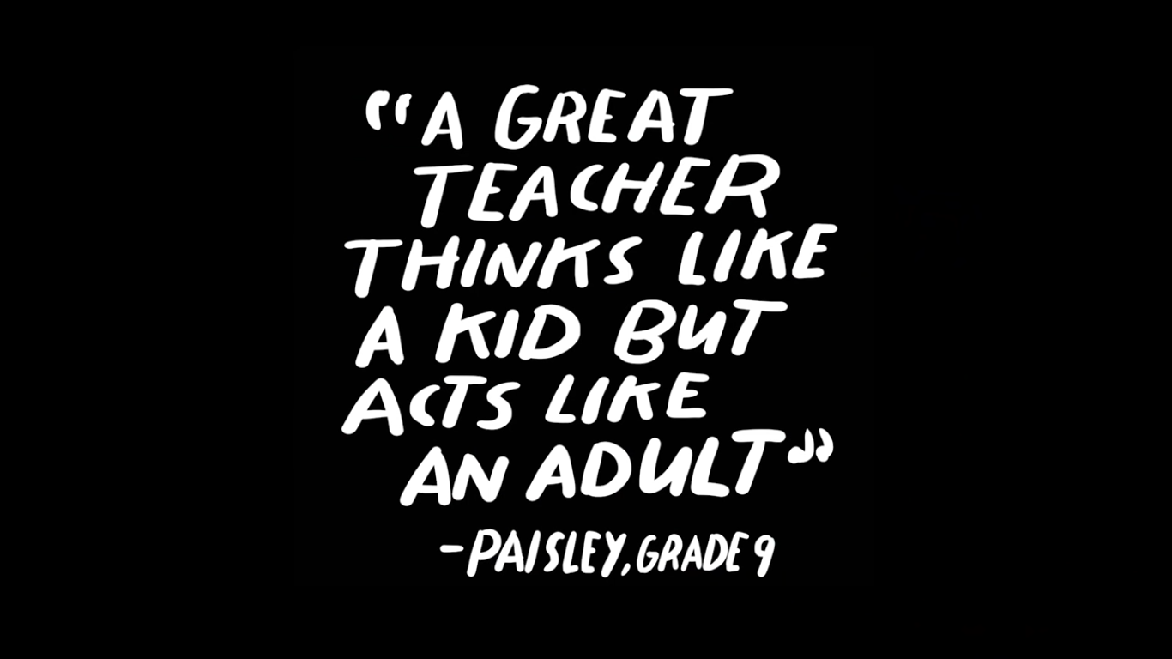

Slide 11
“A great teacher thinks like a kid but acts like an adult.”
Understands the students
Acts responsibly
Calm, protective environment

Slide 12
“A great teacher loves to teach.”
Enthusiasm
Some just want a paycheck

Slide 13
“A great teacher loves to learn.”
Model of good learning habits
Admit they are wrong
Autonomy

Slide 14
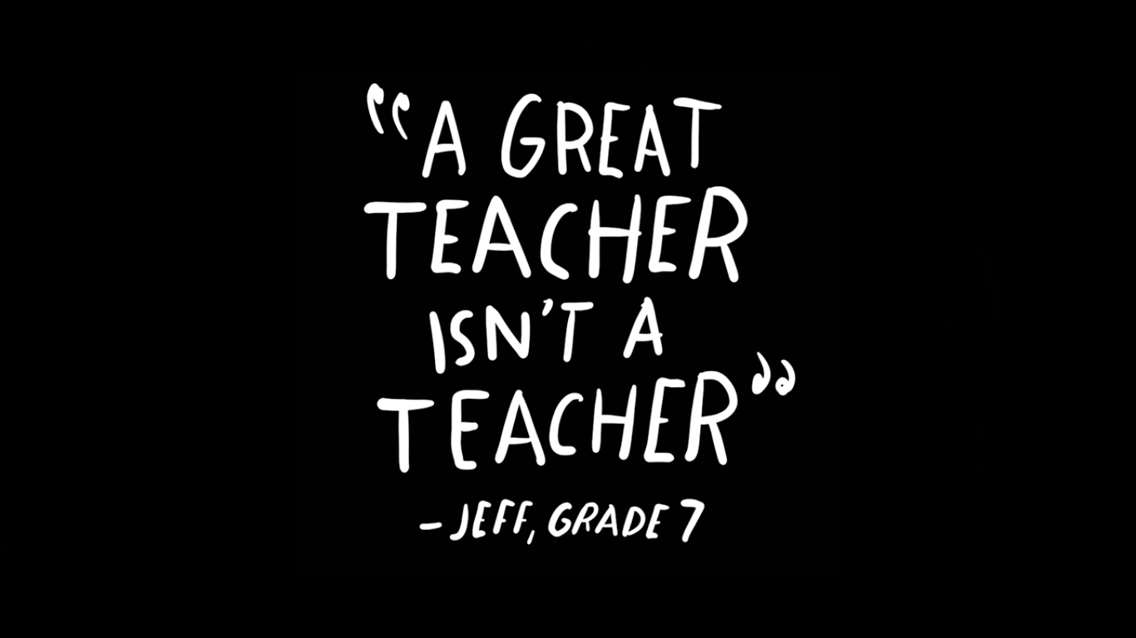

Slide 15
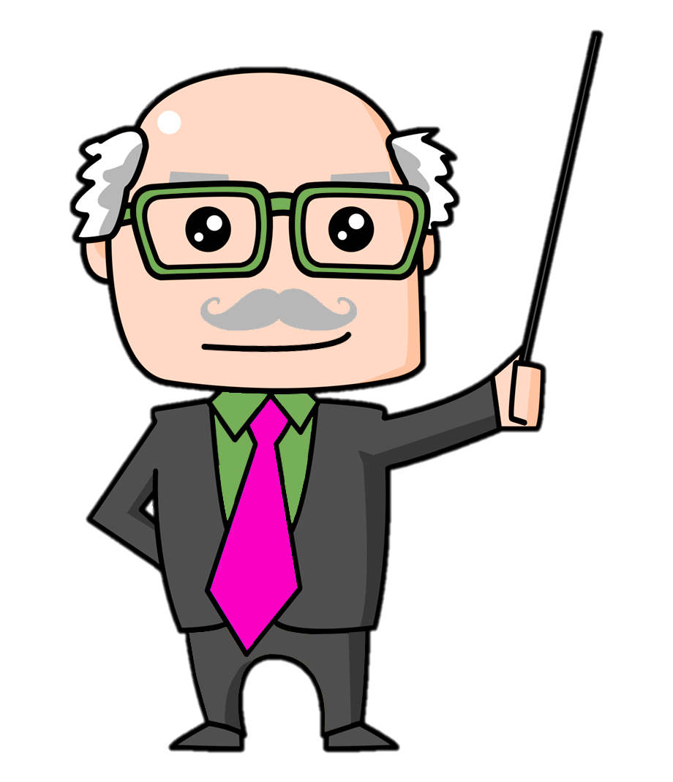
“A great teacher isn’t a teacher.”
Beyond the classroom.
Riding a bike example

Slide 16
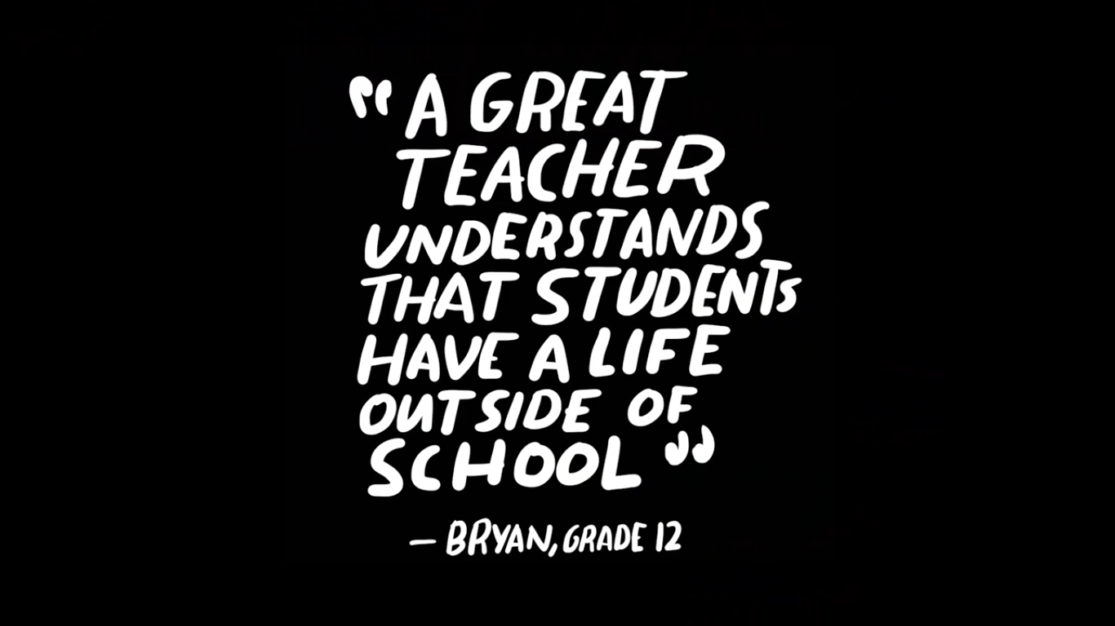

Slide 17
“A great teacher understands that students have a life outside of school.”
Issues we are unaware of
Shows you care

Slide 19
“A great teacher notices when there is a struggle.”
Personal attention
Fix the struggle
One student vs Whole class
Material / Teaching style

Slide 21
“A great teacher sings.”
Take risks
Be silly and humble
Safe to be wrong

Slide 22
What do students think?
Guess

Slide 23
UNESCO
What do students want from teachers?
The teacher is enthusiastic
The teacher has a good relationship with us
They encourage us to think for ourselves
They enjoy our progress and success
They create a safe and supportive environment
1
2
3
4
5

Slide 24
What do students think?
https://www.youtube.com/watch?v=cI5EM8WBSSQ

Slide 26
Brainstorm
What are students interested in?
Describe the perfect student?
What behaviors do you want to change in your classroom?

