Slide 1
Student Centered Classrooms

Slide 2
Teacher Centered vs Student Centered

Slide 3
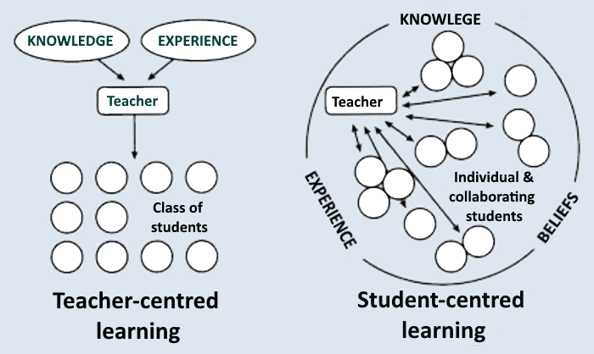

Slide 5
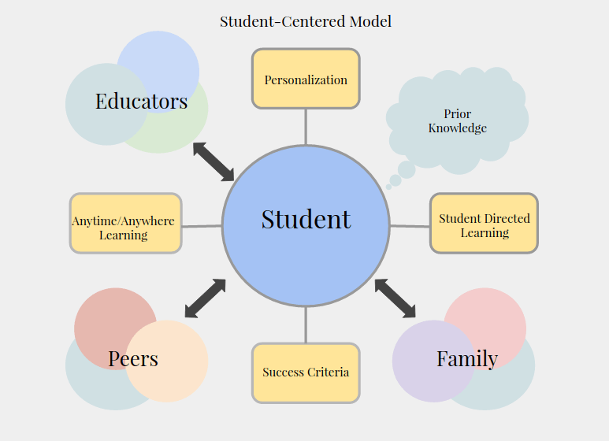
Ownership
Competency Based

Slide 6
21st Century Skils
https://www.youtube.com/watch?v=UCFg9bcW7Bk

Slide 8
4+ Cs
- Critical Thinking
- Creativity
- Collaboration
- Communication
- Choice
- Caring

Slide 9
Critical Thinking

Slide 10
Creativity

Slide 11
Collaboration

Slide 12
Choice

Slide 13
Caring

Slide 14
Biology Class
https://www.youtube.com/watch?v=UCFg9bcW7Bk

Slide 16
What happens in a student centered classroom?

Slide 17
What is not required?
- test
- computer tutorial (lecture)

Slide 18
of Activities
- computer tutorial
- website activities
- heaphones / answers to a video
- lab activities
- science fair projects
- educational games
- hands on simulations
- reflection sheets
- arts and entertainment

Slide 19
Arts and Entertainment
- song
- skit
- video
- model that they built
- poetry
- non-traditional

Slide 20
Your Objective:
Choose one of the sustainable development goals
Make a presentation to teach the rest of the class about that goal.

Slide 21
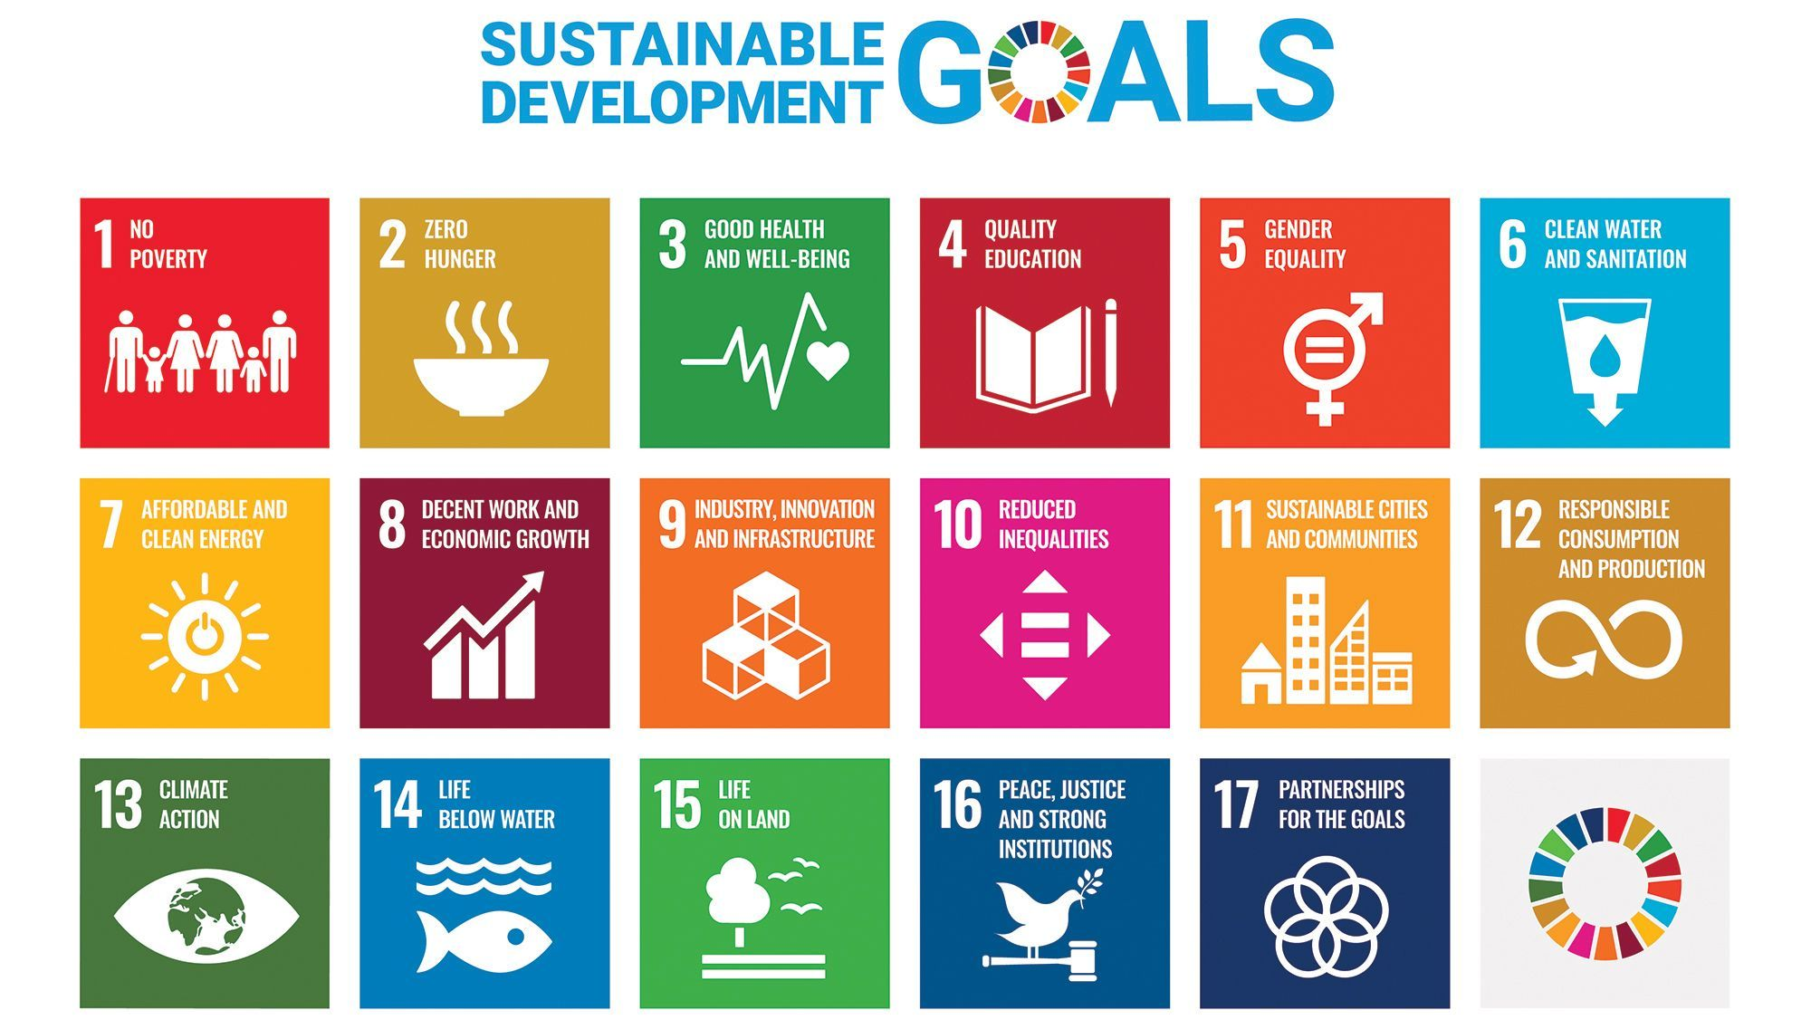

Slide 22
reallivesworld.com

