Slide 1
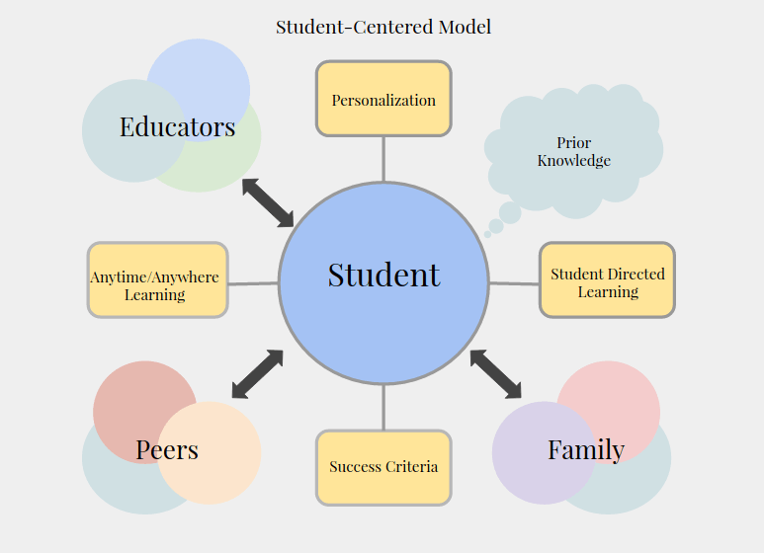

Slide 2
Teacher Centered vs Student Centered
Student Centered vs Teacher Centered

