Slide 1
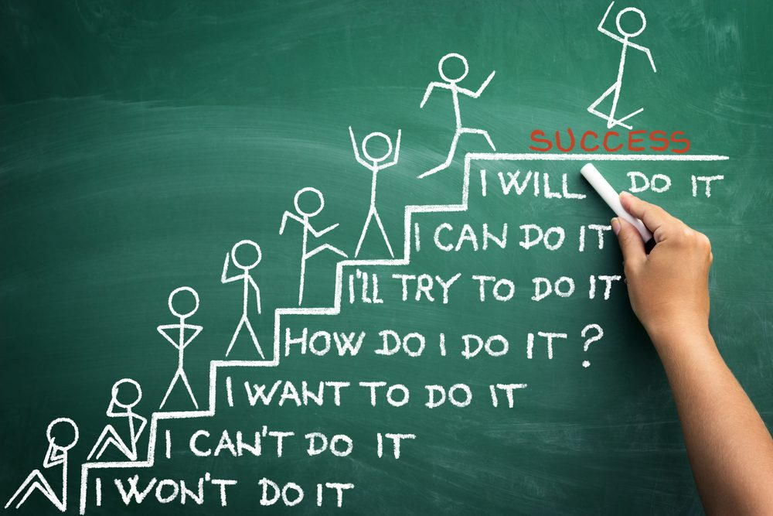

Slide 2
Behavioral Learning
https://www.verywellmind.com/

Slide 3
Discussion - Classroom management techniques - Success / Failure ~ Why?

Slide 4
Early Discipline

Slide 5
Discussion - What motivated you as a student? - What motivates you as an adult?

Slide 7
Classical Conditioning

Slide 8
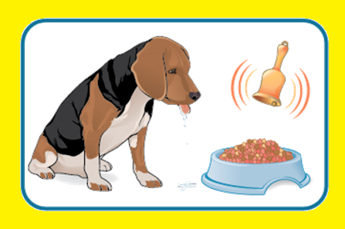
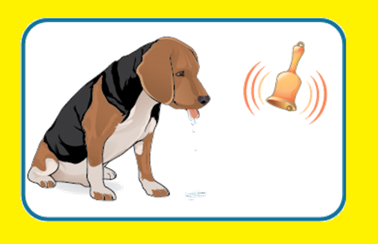
Pavlov
Before
During
After

Slide 9
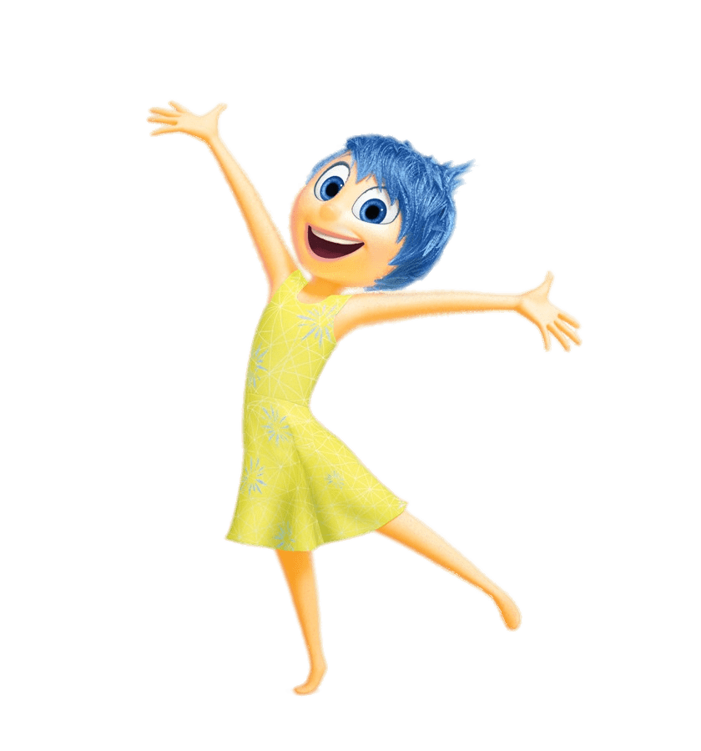
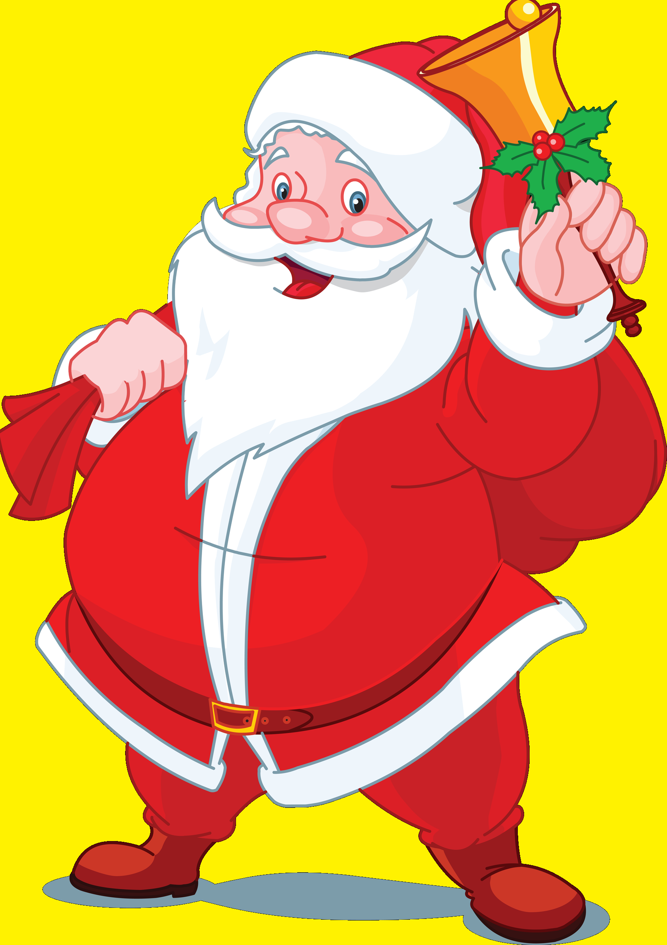
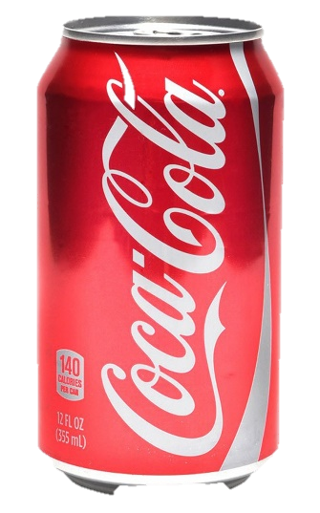
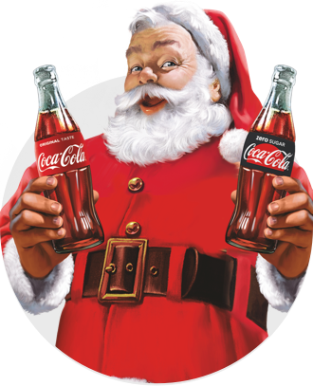
Before
During
After

Slide 10
Classical Conditioning in the Classroom
Before:
Clap 3 times (Students don’t respond)
Tell students to be quiet (Students are quiet)
During:
Clap 3 times, then instruct students to be quiet. (Students are quiet)
After:
Clap 3 times (Students are quiet)

Slide 11
Classical Conditioning in the Classroom
Before:
Count to 20 (Students don’t clean up)
Say, “Clean up.” (Students clean up)
During:
Say, “Clean up.” then count to 20 (Students clean up)
After:
Count to 20 (Students clean up)

Slide 12
Observational Learning

Slide 13
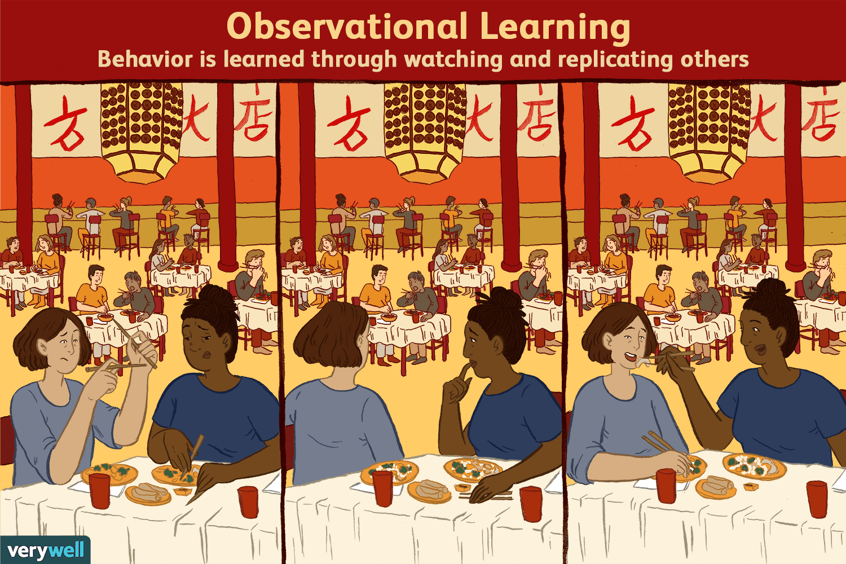

Slide 14
Observational Learning in the Classroom
Students notice that the teacher favors students who raise their hands. They also raise their hands
The teacher demonstrates a technique. The students try to replicate it.
Silly walking

Slide 15
Operant Conditioning

Slide 16
B.F. Skinner

Slide 17
Pleasant
Unpleasant
Positive Reinforcement
Positive Punishment
Add
Reward
Spanking
Increases behavior
Decreases behavior
Negative Punishment
Negative Reinforcement
Subtract
Decreases behavior
Escape
Time Out
Increases behavior

Slide 18
Operant Conditioning in the Classroom
Pleasant
Unpleasant
Positive Reinforcement
Positive Punishment
Add
Negative Punishment
Negative Reinforcement
Subtract

Slide 19
Corporal Punishment
Pleasant
Unpleasant
Positive Reinforcement
Positive Punishment
Add
Negative Punishment
Negative Reinforcement
Subtract

Slide 20
Giving a candy for answering a question.
Pleasant
Unpleasant
Positive Reinforcement
Positive Punishment
Add
Negative Punishment
Negative Reinforcement
Subtract

Slide 21
Taking away break time for bad behavior.
Pleasant
Unpleasant
Positive Reinforcement
Positive Punishment
Add
Negative Punishment
Negative Reinforcement
Subtract

Slide 22
Students get free time if they finish their work early.
Pleasant
Unpleasant
Positive Reinforcement
Positive Punishment
Add
Negative Punishment
Negative Reinforcement
Subtract

Slide 23
Play a loud noise until students are quiet.
Pleasant
Unpleasant
Positive Reinforcement
Positive Punishment
Add
Negative Punishment
Negative Reinforcement
Subtract

Slide 24
Students must write lines if they disobey the class rules.
Pleasant
Unpleasant
Positive Reinforcement
Positive Punishment
Add
Negative Punishment
Negative Reinforcement
Subtract

Slide 25
Parents pester the student until they finish their homework.
Pleasant
Unpleasant
Positive Reinforcement
Positive Punishment
Add
Negative Punishment
Negative Reinforcement
Subtract

Slide 26
Students receive stickers for good behavior. They can use these to ‘buy’ things later.
Pleasant
Unpleasant
Positive Reinforcement
Positive Punishment
Add
Negative Punishment
Negative Reinforcement
Subtract

Slide 27
Which one is the most motivating?
Positive Reinforcement
Positive Punishment
Negative Punishment
Negative Reinforcement

Slide 28
Discussion - Think of some examples

