Slide 1
Broccoli Ice Cream
https://www.youtube.com/watch?v=frN3nvhIHUk

Slide 2
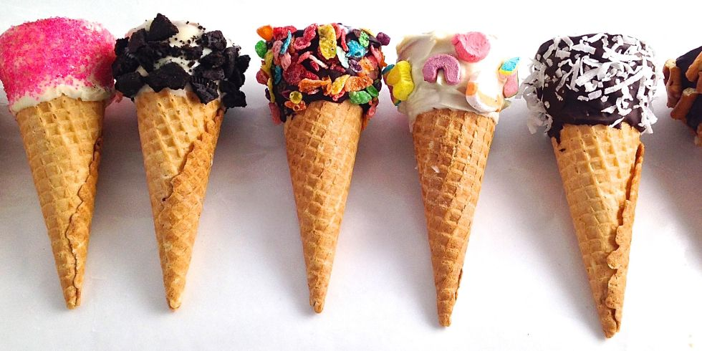
Do you like ice cream?

Slide 3
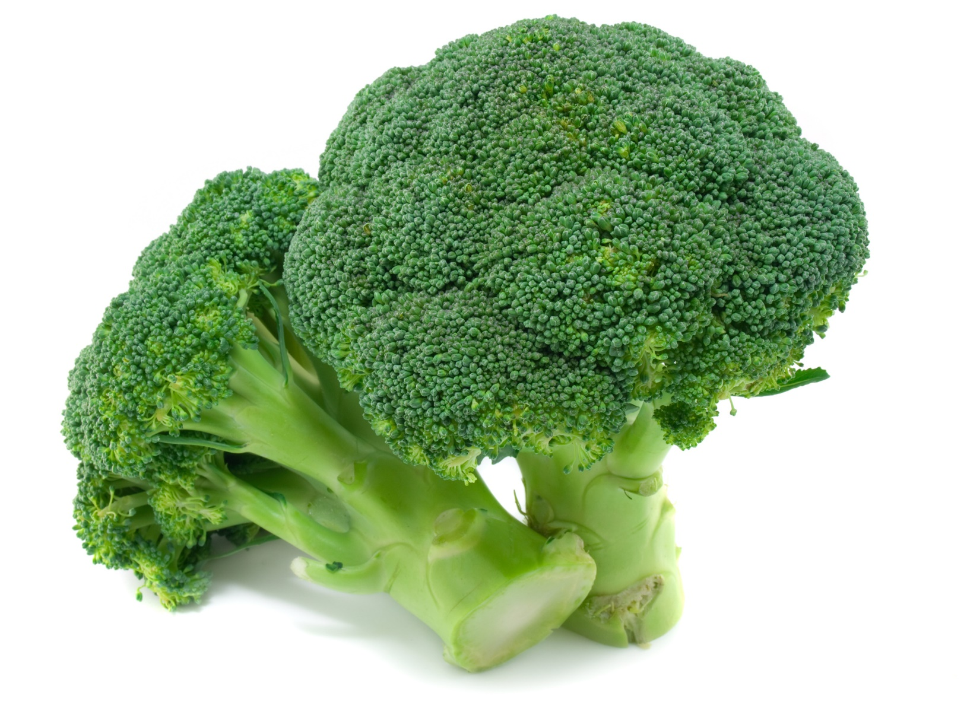
Do you like broccoli?

Slide 4
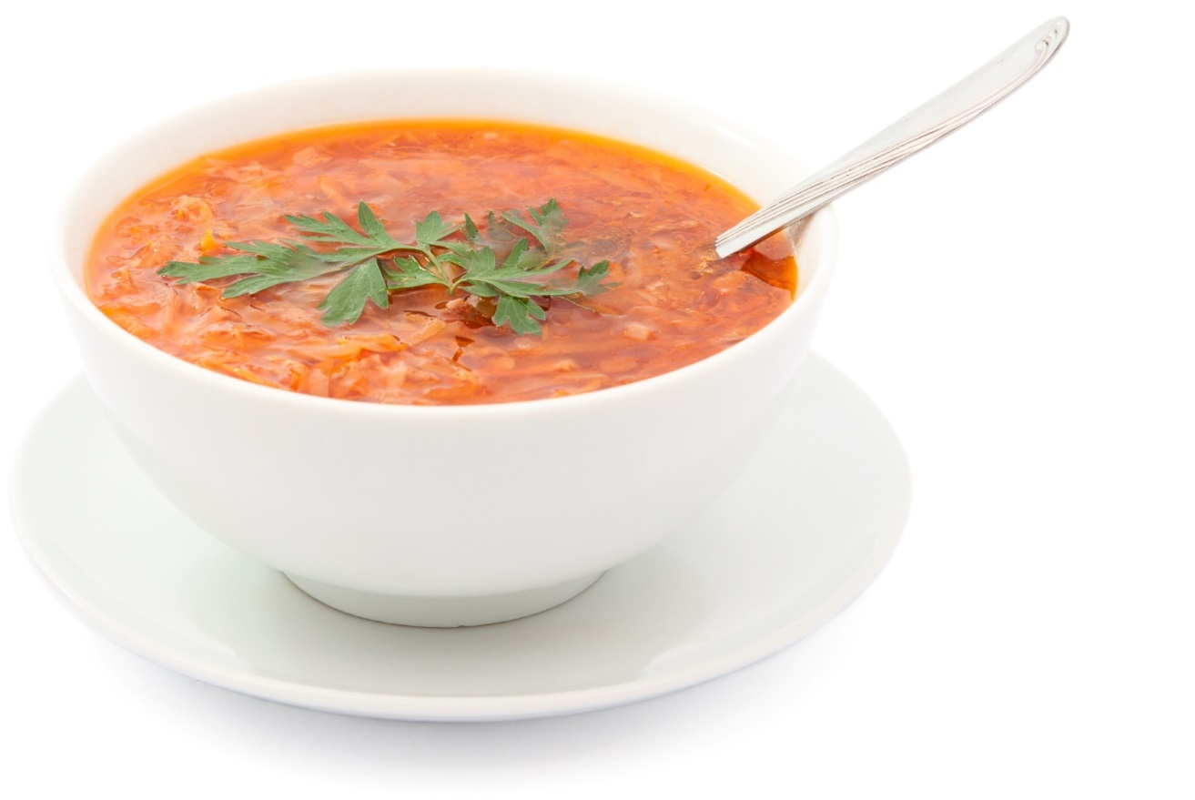
Do you like soup?

Slide 5
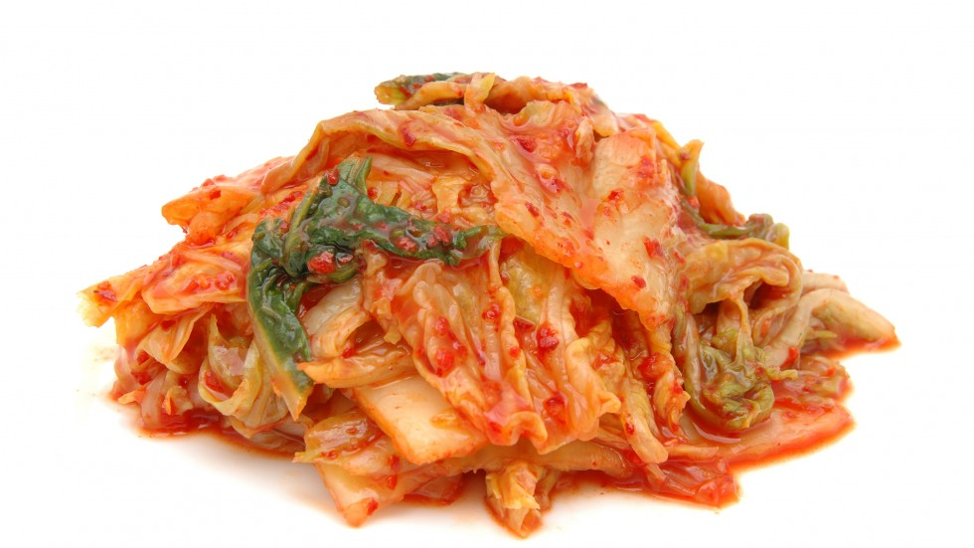
Do you like kimchi?

Slide 6
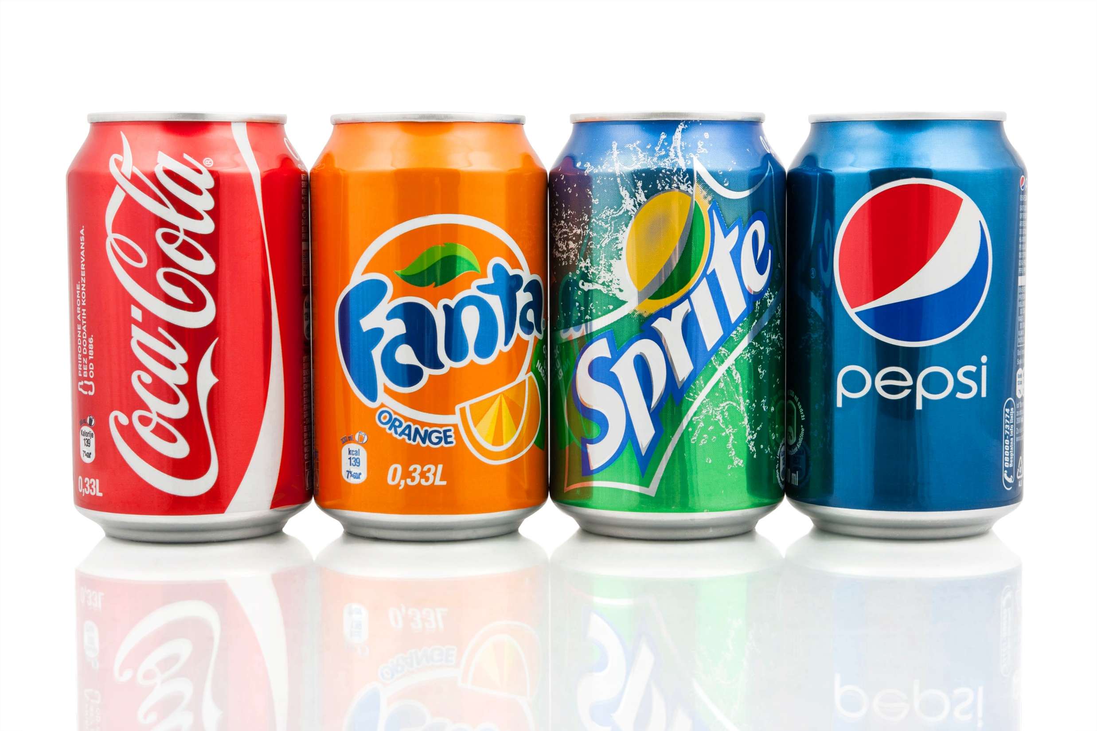
Do you like soda?

Slide 7
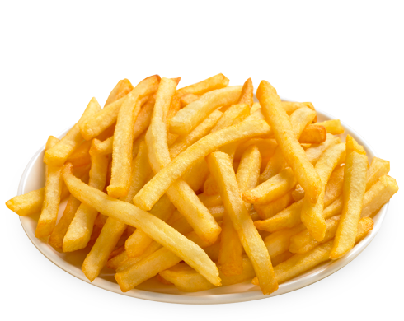
Do you like fries?

Slide 8
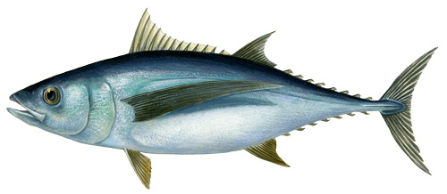

Do you like tuna?

Slide 9


Do you like gum?

Slide 10
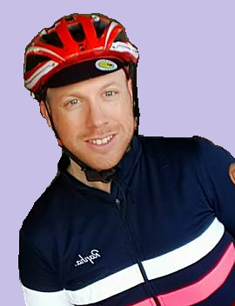
Ask Mr.S a question:
Do you like ___________?

Slide 11

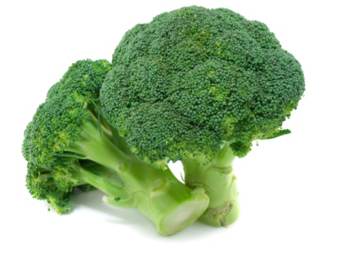
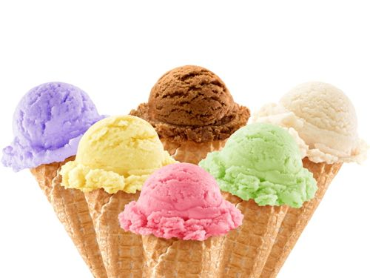
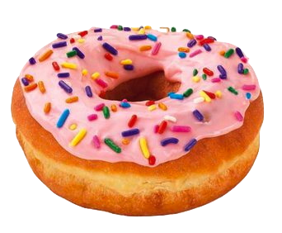

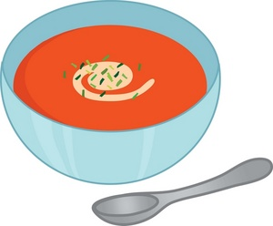
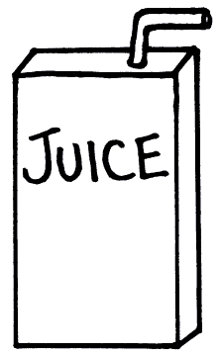


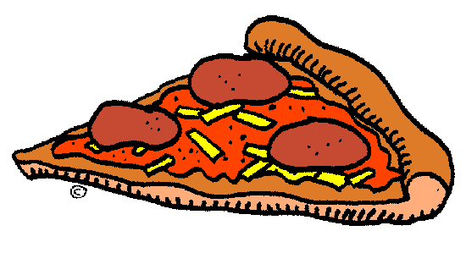


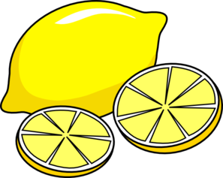



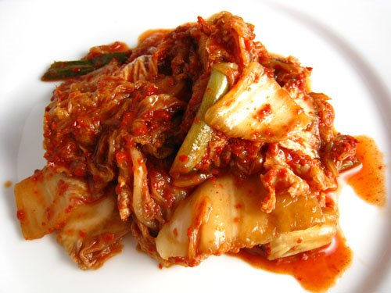




Broccoli
Ice Cream
Donut
Pop Corn
Soup
Juice
Soda
Pizza
Banana
Candy
Cake
Lemon
Chocolate
Chicken
Apple
Cheese
Kimchi
Tuna
Fries
Gum

Slide 12
Yes, I do.
Yes, I do.
Do you like chicken?
No, I don’t.
Do you like
chicken cake?
Do you like cake?

Slide 13
How to Play
First play the video clip
Cut out the above foods
Place cards (foods) facedown
One student will pick up a card and ask,
“Do you like______?”
The other student will answer
“Yes, I do.”
“No, I don’t”
Repeat the last two instructions again
Finally, the first student will put the two foods
together to create a new question.

