Slide 1
Music
Santa Tell Me + Lose Yourself

Slide 2
Do You Like Broccoli?
https://www.youtube.com/watch?v=frN3nvhIHUk&list=PL9i6nLIBlfKsXM30Qsn1fWf-jAZEHurYT&index=8&t=0s

Slide 3
Yes, I do.
Yes, I do.
Do you like chicken?
No, I don’t.
Do you like chicken cake?
Do you like cake?

Slide 4
Santa Tell Me
https://www.youtube.com/watch?v=nlR0MkrRklg

Slide 5
What is the mood?

Slide 6
Who is she singing to?

Slide 7
Santa Tell Me
Santa tell me if you're really there Don't make me fall in love again If he won't be here next year Santa tell me if he really cares 'Cause I can’t give it all away if he won't be here next year

Slide 8
Who is she singing about?

Slide 9
Santa Tell Me
Santa tell me if you're really there Don't make me fall in love again If he won't be here next year Santa tell me if he really cares 'Cause I can’t give it all away if he won't be here next year

Slide 10
What does she want to know about “him”?

Slide 11
Santa Tell Me
Santa tell me if you're really there Don't make me fall in love again If he won't be here next year Santa tell me if he really cares 'Cause I can’t give it all away if he won't be here next year

Slide 12
Santa Tell Me
Santa tell me if you're really there Don't make me fall in love again If he won't be here next year Santa tell me if he really cares 'Cause I can’t give it all away if he won't be here next year

Slide 13
Santa Tell Me
Feeling Christmas all around And I'm trying to play it cool But it's hard to focus when I see you walking around the room Let it snow, it's blasting now But I won't get in the mood I'm avoiding every mistletoe until I know It's true love that he thinks of So next Christmas I'm not all alone, boy

Slide 14
Santa Tell Me
Santa, tell me if you're really there Don't make me fall in love again if he won't be here Next year Santa, tell me if he really cares 'Cause I can't give it all away if he won't be here Next year

Slide 15
Santa Tell Me
I've been down this road before Fell in love on Christmas night But on New Year's Day I woke up and he wasn't by my side Now I need someone to hold Be my fire in the cold But it's hard to tell if this is just a fling Or if it's true love that he thinks of So next Christmas I'm not all alone, babe

Slide 16
Santa Tell Me
Santa, tell me if you're really there Don't make me fall in love again if he won't be here Next year Santa, tell me if he really cares 'Cause I can't give it all away if he won't be here Next year

Slide 17
Santa Tell Me
Oh, I wanna have him beside me like oh-oh-oh On the 25th by the fire place, oh-oh-oh But I don't want no broken heart This year I've got to be smart
Oh, baby If you want me, if you want me

Slide 18
Santa Tell Me
Santa, tell me if you're really there Don't make me fall in love again if he won't be here Next year Santa, tell me if he really cares 'Cause I can't give it all away if he won't be here Next year

Slide 19
Lose Yourself
https://www.youtube.com/watch?v=_Yhyp-_hX2s

Slide 20
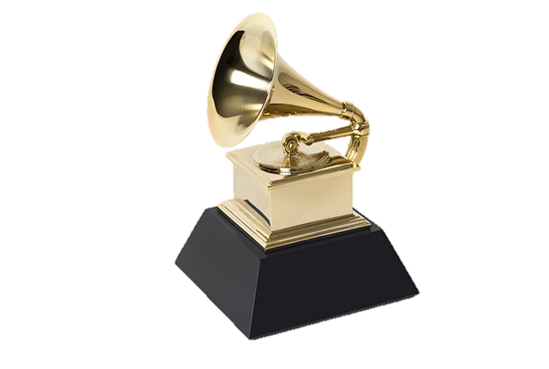

Slide 21
Abbreviations
Yo His palms are sweaty, knees weak, arms are heavy There's vomit on his sweater already, mom's spaghetti He's nervous, but on the surface he looks calm and ready To drop bombs, but he keeps on forgettin' What he wrote down, the whole crowd goes so loud He opens his mouth, but the words won't come out He's chokin', how, everybody's jokin' now The clocks run out, times up, over, blaow!
forgetting
choking
joking

Slide 22
Abbreviations
Snap back to reality, oh there goes gravity Oh, there goes Rabbit, he choked He's so mad, but he won't give up that easy? No He won't have it, he knows his whole back city's ropes It don't matter, he's dope, he knows that, but he's broke He's so stacked that he knows, when he goes back to his mobile home, that's when its Back to the lab again yo, this whole rhapsody He better go capture this moment and hope it don't pass him

Slide 23
Abbreviations
The souls escaping, through this hole that its gaping This world is mine for the taking Make me king, as we move toward a, new world order A normal life is borin', but super stardom's close to post mortem It only grows harder, only grows hotter He blows us all over these hoes is all on him Coast to coast shows, he's known as the globetrotter Lonely roads, God only knows, he's grown farther from home, he's no father He goes home and barely knows his own daughter But hold your nose 'cause here goes the cold water His hoes don't want him no mo, he's cold product They moved on to the next schmo who flows, he nose dove and sold nada So the soap opera is told and unfolds, I suppose it's old partna, but the beat goes on Da da dumb da dumb da da
boring
because
no more
partner

Slide 24
Abbreviations
No more games, I'm a change what you call rage Tear this motherfuckin' roof off like two dogs caged I was playin' in the beginnin', the mood all changed I been chewed up and spit out and booed off stage But I kept rhymin' and stepwritin' the next cipher Best believe somebody's payin' the pied piper All the pain inside amplified by the Fact that I can't get by with my nine to Five and I can't provide the right type of Life for my family 'cause man, these God damn food stamps don't buy diapers And its no movie, there's no Mekhi Phifer
@$&@^($#@*
mother fucking
playing
beginning
rhyming
step writing
paying
because

Slide 25
Abbreviations
This is my life and these times are so hard And it's getting even harder tryin' to feed and water my seed, plus See dishonor caught up between bein' a father and a prima-donna Baby mama drama screamin' on and too much For me to want to say in one spot, another jam or not Has gotten me to the point, I'm like a snail I've got To formulate a plot ‘fore I end up in jail or shot Success is my only motherfuckin' option, failures not Mom, I love you, but this trail has got to go, I cannot grow old in Salem's lot So here I go is my shot Feet fail me not 'cause maybe the only opportunity that I got
trying
being
screaming
before
mother fucking
because

Slide 26
Lose Yourself Elsa Clement
https://www.youtube.com/watch?v=082NwylIO6c

Slide 27
Lose Yourself
You better lose yourself in the music, the moment You own it, you better never let it go You only get one shot, do not miss your chance to blow This opportunity comes once in a lifetime you better

Slide 28
Lose Yourself

Slide 29
Own it

Slide 30
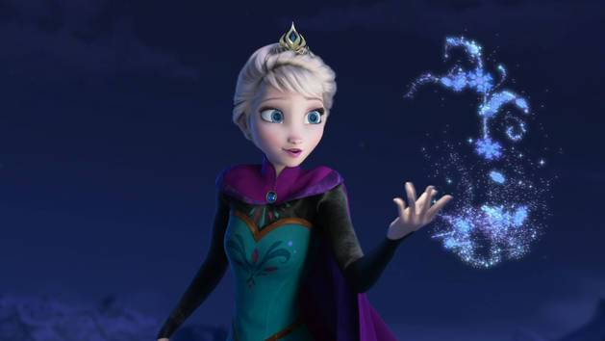
Let it go

Slide 31
One Shot

Slide 32
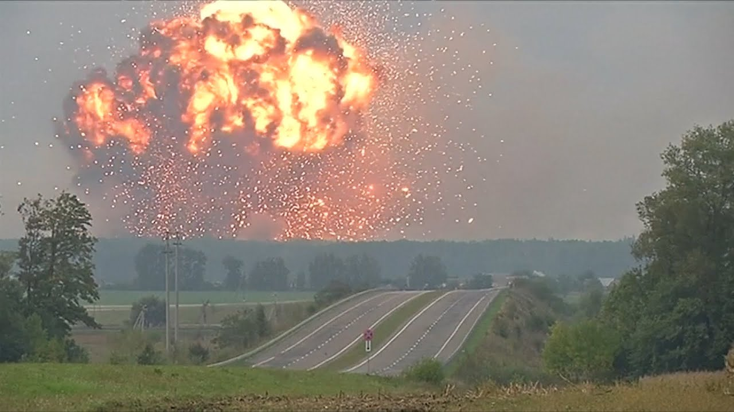
Chance to blow (up)

Slide 33
Once in a lifetime

Slide 34
Lose Yourself Vincent Vinel
https://www.youtube.com/watch?v=Y9oZZzLr3BU

Slide 35
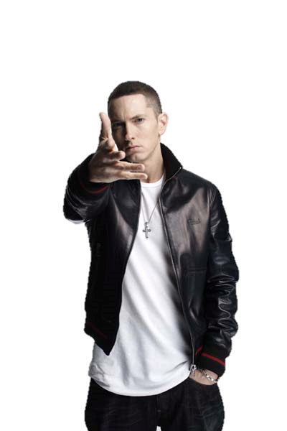
Lose Yourself
Look If you had One shot Or one opportunity To seize everything you ever wanted In one moment Would you capture it Or just let it slip?

Slide 36
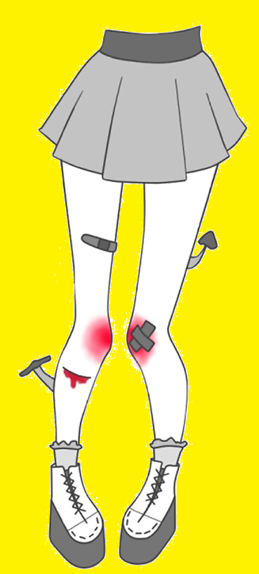
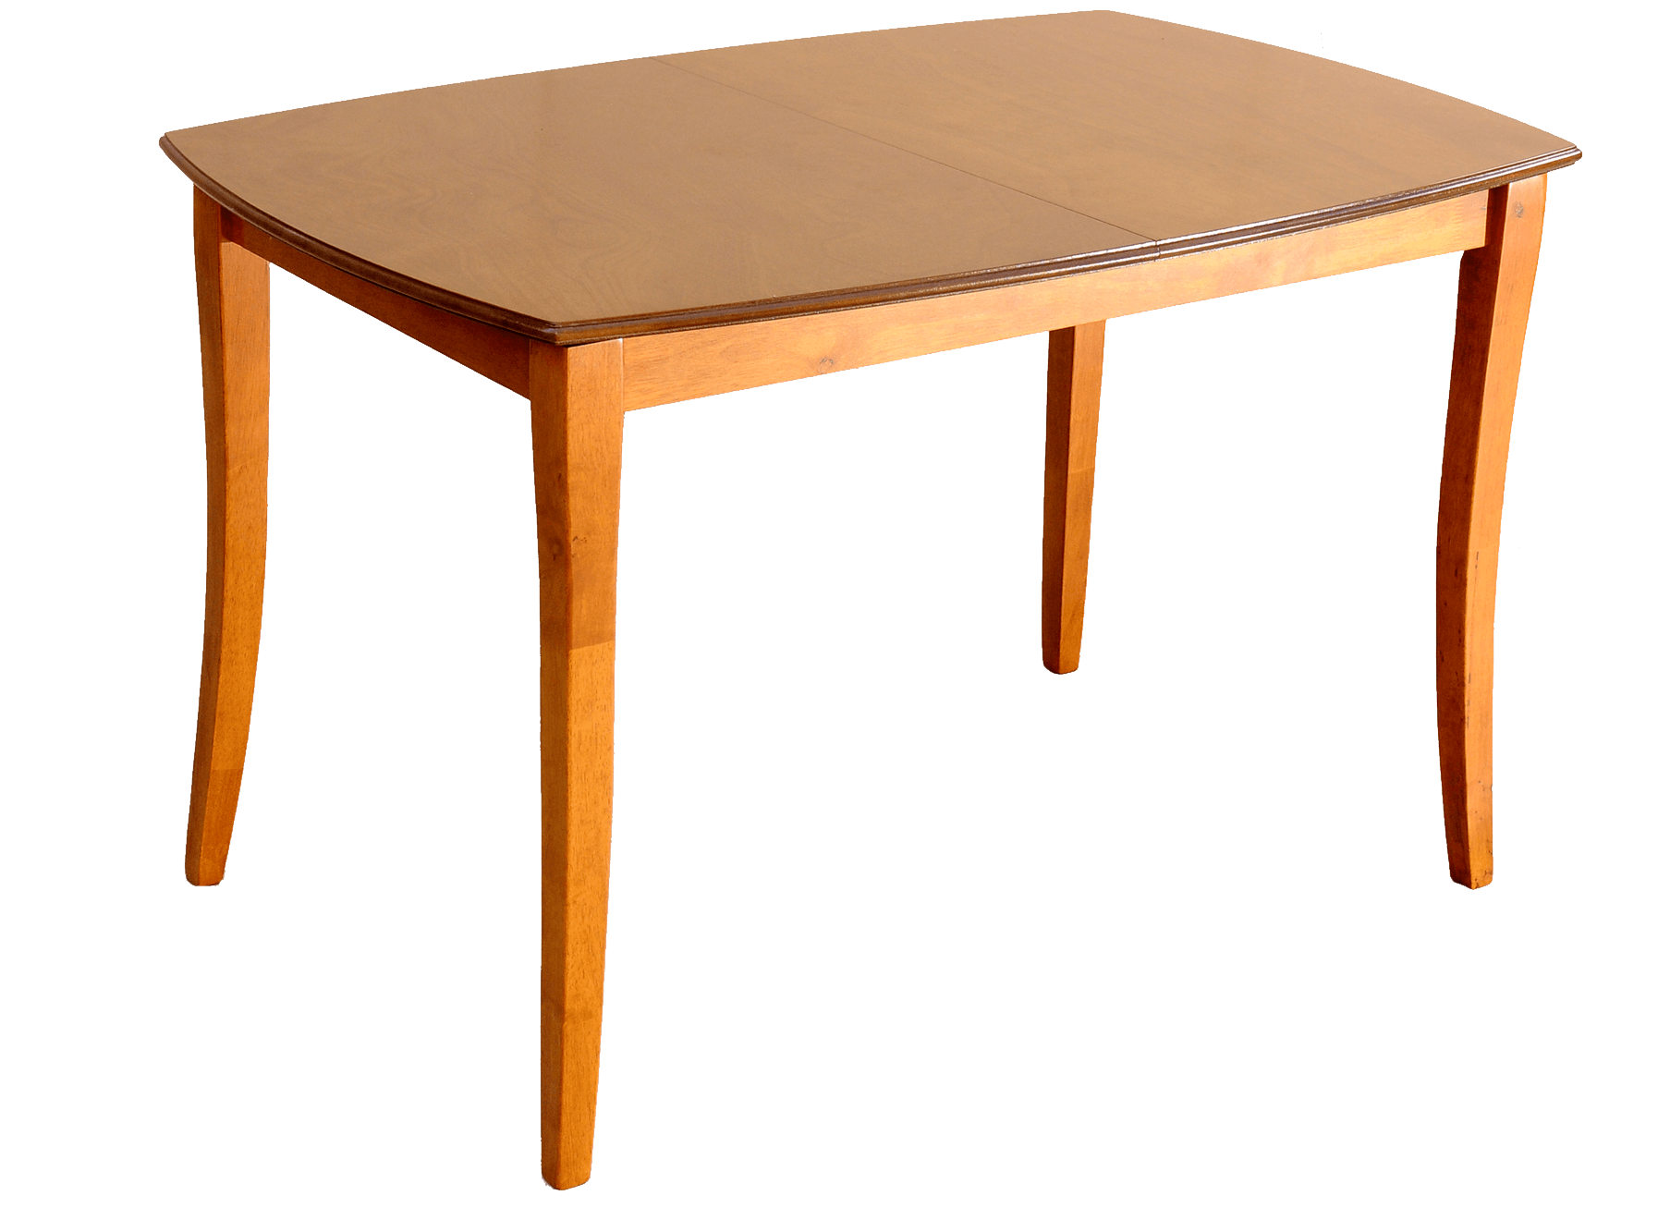
Lose Yourself
Yo His palms are sweaty, knees weak, arms are heavy There's vomit on his sweater already, mom's spaghetti He's nervous, but on the surface he looks calm and ready To drop bombs, but he keeps on forgettin' What he wrote down, the whole crowd goes so loud He opens his mouth, but the words won't come out He's chokin', how, everybody's jokin' now The clocks run out, times up, over, blaow!

Slide 37
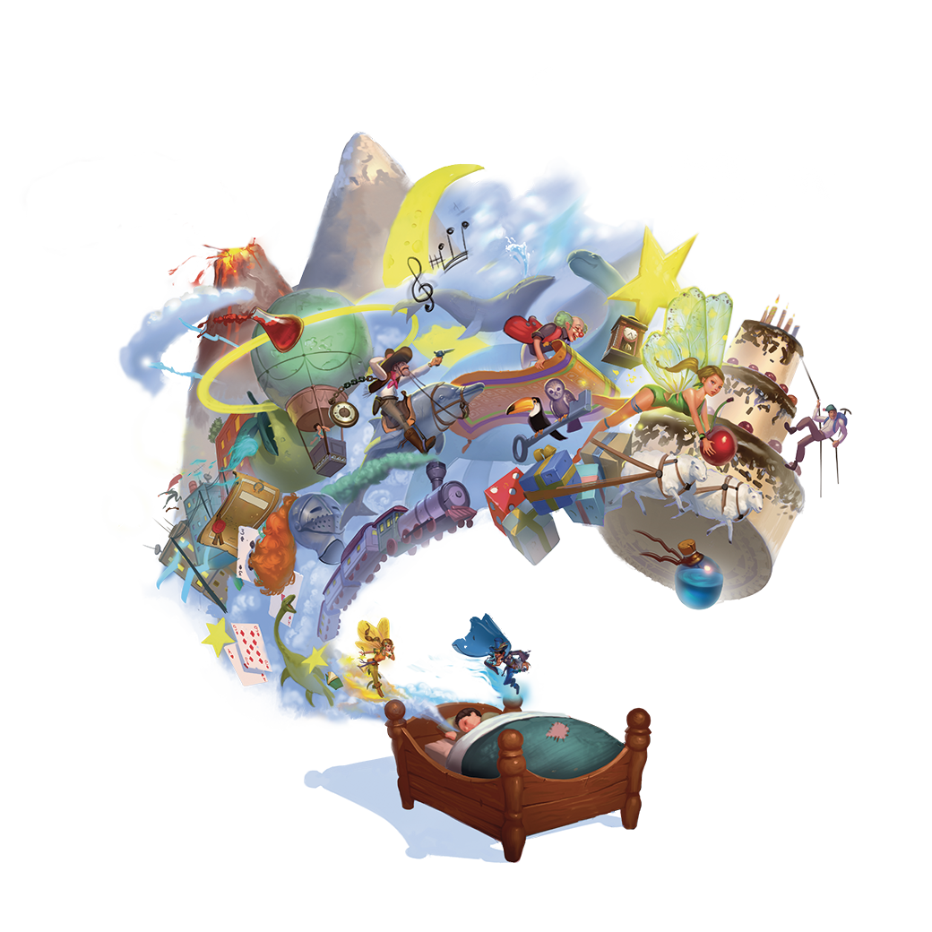
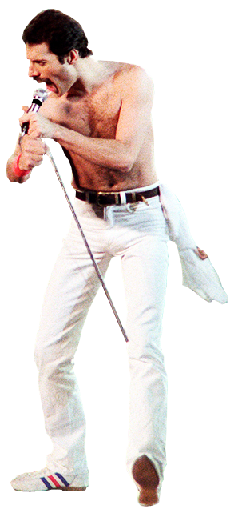
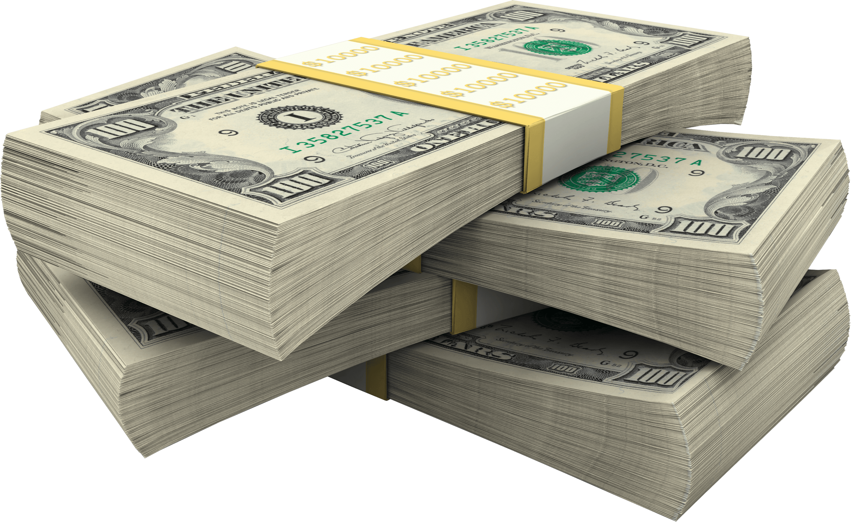
Lose Yourself
Snap back to reality, oh there goes gravity Oh, there goes Rabbit, he choked He's so mad, but he won't give up that easy? No He won't have it, he knows his whole back city's ropes It don't matter, he's dope, he knows that, but he's broke He's so stacked that he knows, when he goes back to his mobile home, that's when its Back to the lab again yo, this whole rhapsody He better go capture this moment and hope it don't pass him

Slide 38
Lose Yourself
You better lose yourself in the music, the moment You own it, you better never let it go You only get one shot, do not miss your chance to blow This opportunity comes once in a lifetime you better

Slide 39
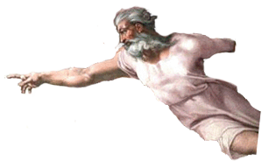
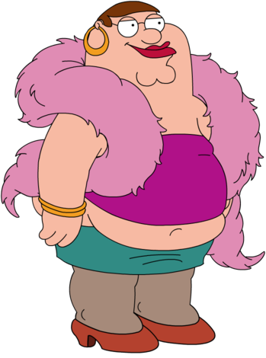
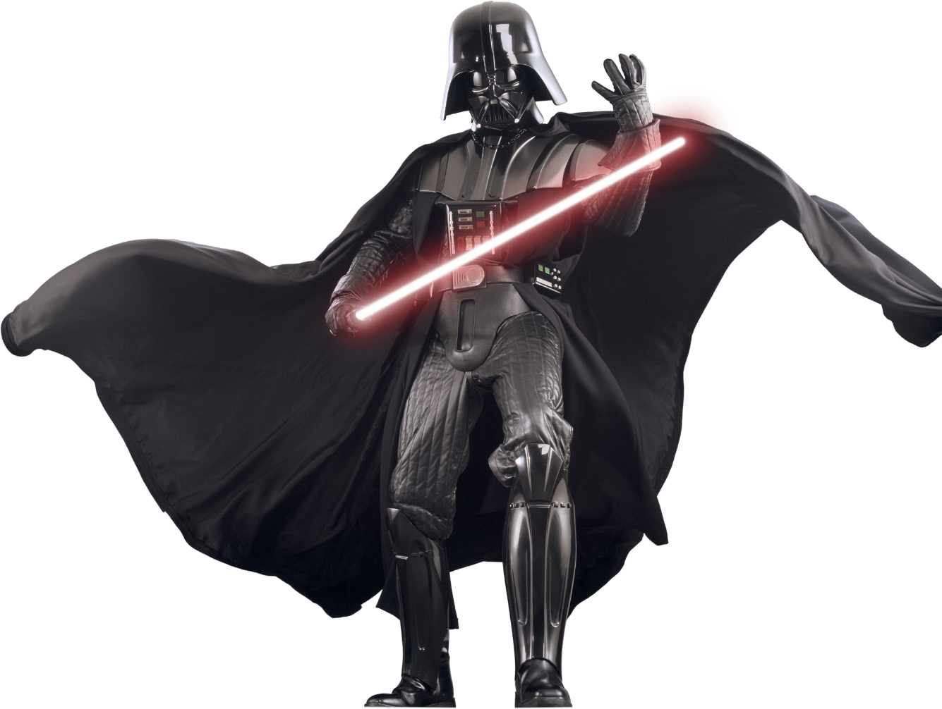
Lose Yourself
The souls escaping, through this hole that its gaping This world is mine for the taking Make me king, as we move toward a, new world order A normal life is borin', but super stardom's close to post mortem It only grows harder, only grows hotter He blows us all over these hoes is all on him Coast to coast shows, he's known as the globetrotter Lonely roads, God only knows, he's grown farther from home, he's no father He goes home and barely knows his own daughter But hold your nose 'cause here goes the cold water His hoes don't want him no mo, he's cold product They moved on to the next schmo who flows, he nose dove and sold nada So the soap opera is told and unfolds, I suppose it's old partna, but the beat goes on Da da dumb da dumb da da

Slide 40
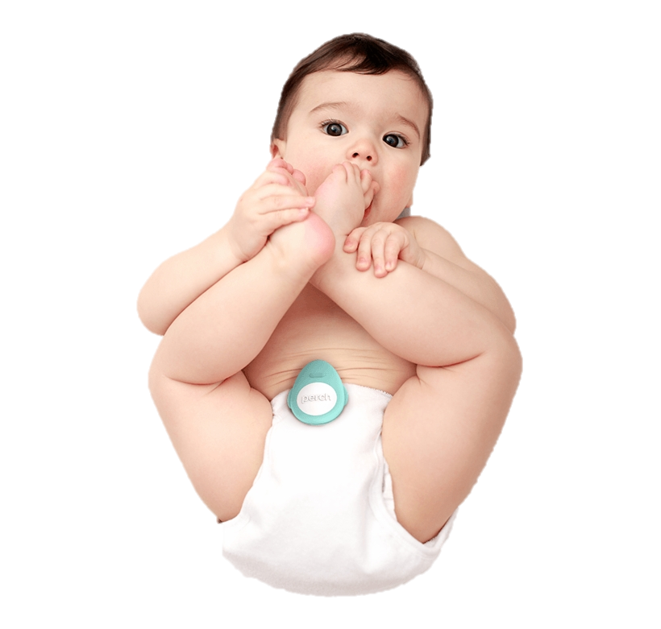
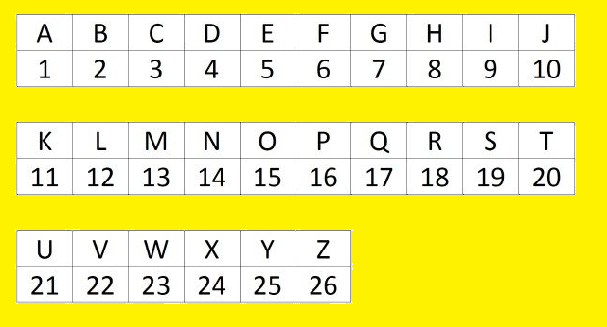
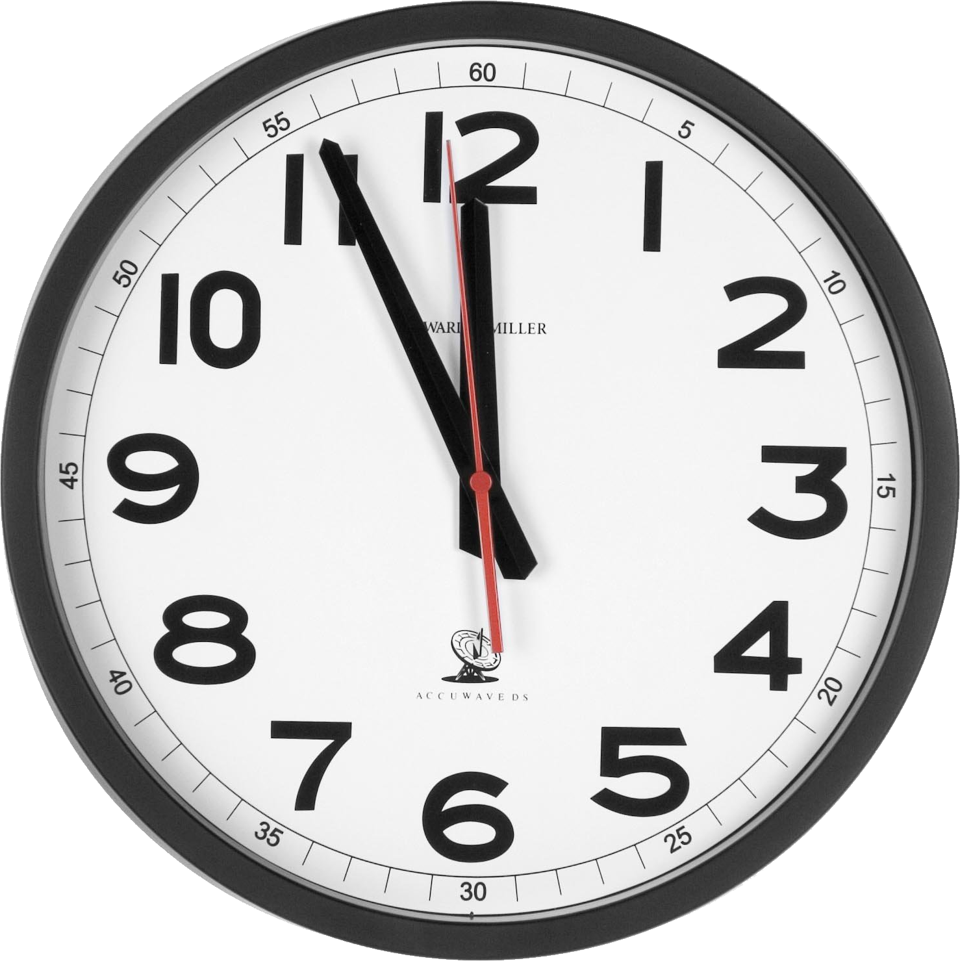
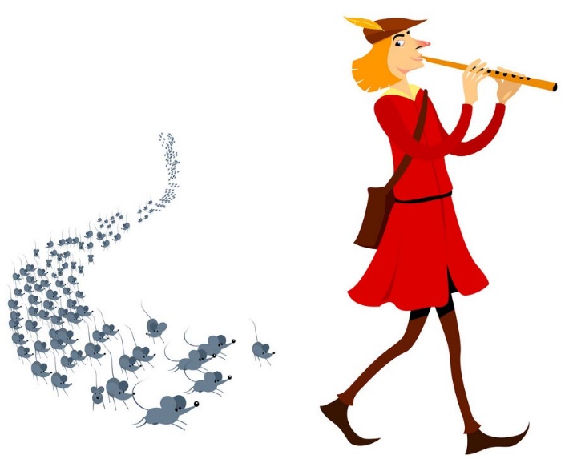
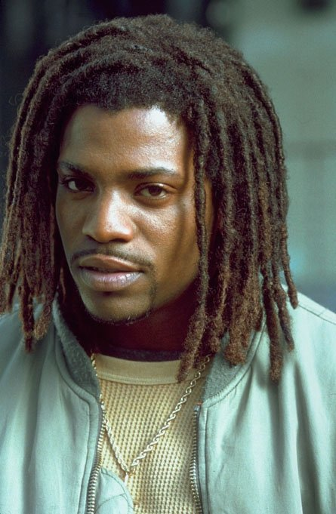
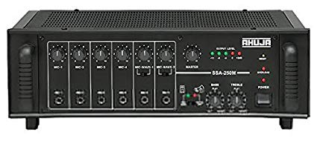
Lose Yourself
No more games, I'm a change what you call rage Tear this motherfuckin' roof off like two dogs caged I was playin' in the beginnin', the mood all changed I been chewed up and spit out and booed off stage But I kept rhymin' and stepwritin' the next cipher Best believe somebody's payin' the pied piper All the pain inside amplified by the Fact that I can't get by with my nine to Five and I can't provide the right type of Life for my family 'cause man, these God damn food stamps don't buy diapers And its no movie, there's no Mekhi Phifer

Slide 41
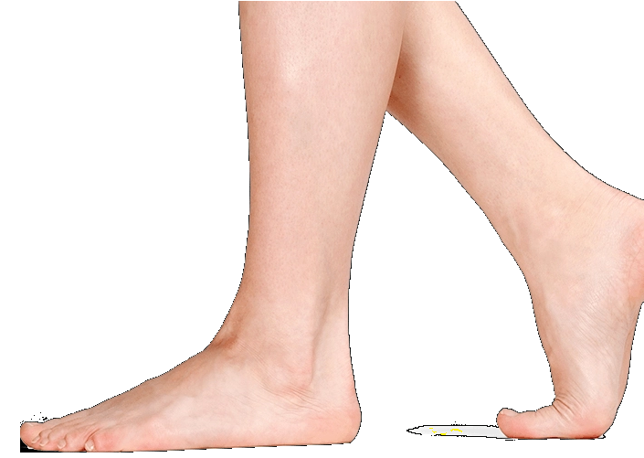
Lose Yourself
This is my life and these times are so hard And it's getting even harder tryin' to feed and water my seed, plus See dishonor caught up between bein' a father and a prima-donna Baby mama drama screamin' on and too much For me to want to say in one spot, another jam or not Has gotten me to the point, I'm like a snail I've got To formulate a plot ‘fore I end up in jail or shot Success is my only motherfuckin' option, failures not Mom, I love you, but this trail has got to go, I cannot grow old in Salem's lot So here I go is my shot Feet fail me not 'cause maybe the only opportunity that I got

Slide 42
Lose Yourself Robyn Adele Anderson
https://www.youtube.com/watch?v=NeB9TSu08KU

Slide 43
Lose Yourself In depth analysis:
https://genius.com/11369

Slide 44
Just Dance
https://www.youtube.com/watch?v=33_qubchCFs

